Slide 1

20ECE109 ANALOG COMMUNICATION
Unit FOUR

Slide 2
ANALOG PULSE MODULATION SCHEMES
(contents are as per the syllabus)

Slide 3
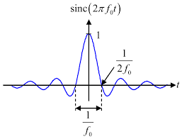
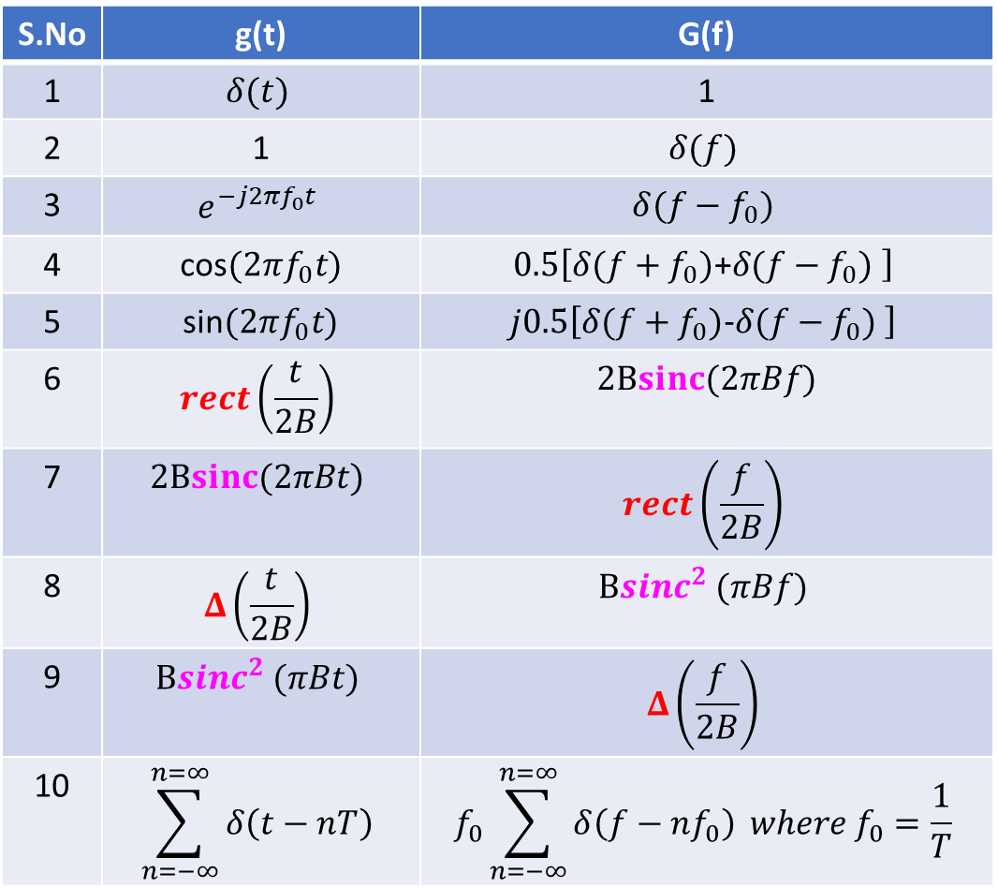
RECALL Some of the important Fourier Transform Pairs
1
S.No | g(t) | G(f)
1 | $$δ(t)$$ | 1
2 | 1 | $$δ(f)$$
3 | $$e^{−j2πf_{0}t}$$ | $$δ(f−f_{0})$$
4 | cos$(2πf_{0}t)$ | $$0.5\left[δ(f+f_{0})\text{+}δ(f−f_{0}) \right]$$
5 | sin$(2πf_{0}t)$ | $$j0.5\left[δ(f+f_{0})\text{−}δ(f−f_{0}) \right]$$
6 | $$rect\left(\frac{t}{2B}\right)$$ | $$2Bsinc(2πBf)$$
7 | $$2Bsinc(2πBt)$$ | $$rect\left(\frac{f}{2B}\right)$$
8 | $$Δ\left(\frac{t}{2B}\right)$$ | $$B{sinc}^{2} (πBf)$$
9 | $$B{sinc}^{2} (πBt)$$ | $$Δ\left(\frac{f}{2B}\right)$$
10 | $$\sum_{n=−∞}^{n=∞}{δ\left(t−nT\right)}$$ | $$f_{0}\sum_{n=−∞}^{n=∞}{δ\left(f−nf_{0}\right)} where f_{0}=\frac{1}{T}$$
-B B
1
-B B

Slide 4
SAMPLING THEORM
Sampling
A-D Conversion
Transmission (in suitable form)
D-A Conversion
Signal Reconstruction
The block diagram above shows some of the signal processing in any digital communication
The sampler converts continuous-time signal x(t) into discrete-time signal x(n)
The A-D converter produces corresponding binary data stream
The binary data may be further processed /stored/modulated and transmitted
The D-A converter converts the binary data stream into discrete-time pulses
Finally, the reconstruction (interpolation) filter reproduces the message back.
As such, sampling becomes the essential part of any communication (/signal processing) hardware.
We will discuss the sampling process (in the next slide)

Slide 5
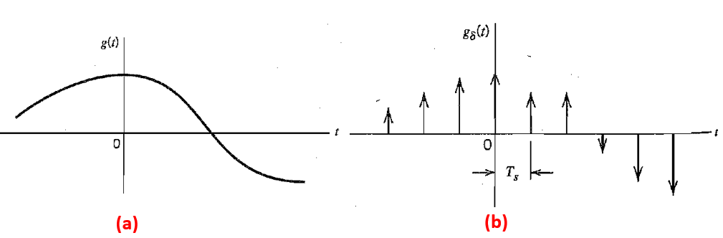
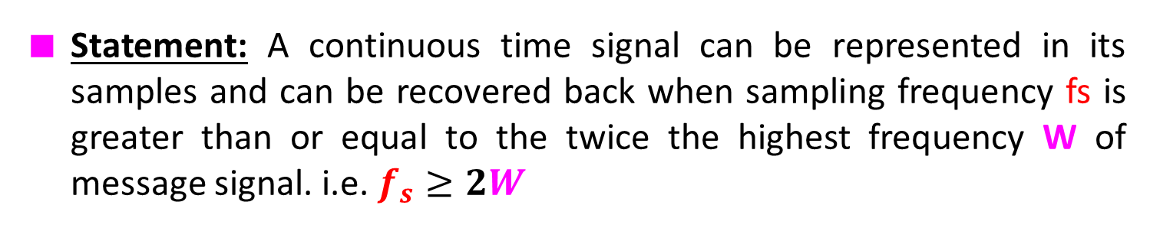
SAMPLING THEORM
Statement: A continuous time signal can be represented in its samples and can be recovered back when sampling frequency fs is greater than or equal to the twice the highest frequency W of message signal. i.e. $f_{s}≥2W$
FIGURE 1: Sampling process (a) analog signal (b) instantaneously sampled version of analog signal

Slide 6
Consider an arbitrary signal g(t) of finite energy, which is specified for all time t. A segment of the signal g(t) is shown in Fig. (1a).
Suppose that we sample the signal g(t) instantaneously and at a uniform rate, once every T_{s} seconds. Consequently, we obtain an infinite sequence of samples spaced T_{s} seconds apart and denoted by g_{δ}(t) as shown in Fig. (1b).
Mathematically,
We refer to g_{δ}(t) as the instantaneously (ideal) sampled signal. The term δ(t-nT_{s}) represents a delta function positioned at time t=nT_{s}
And we refer to T_{s} as the sampling period or sampling interval and to its reciprocal f_{s} =1/T_{s} as the sampling rate. This ideal form of sampling is called instantaneous sampling.
→(1)

Slide 7
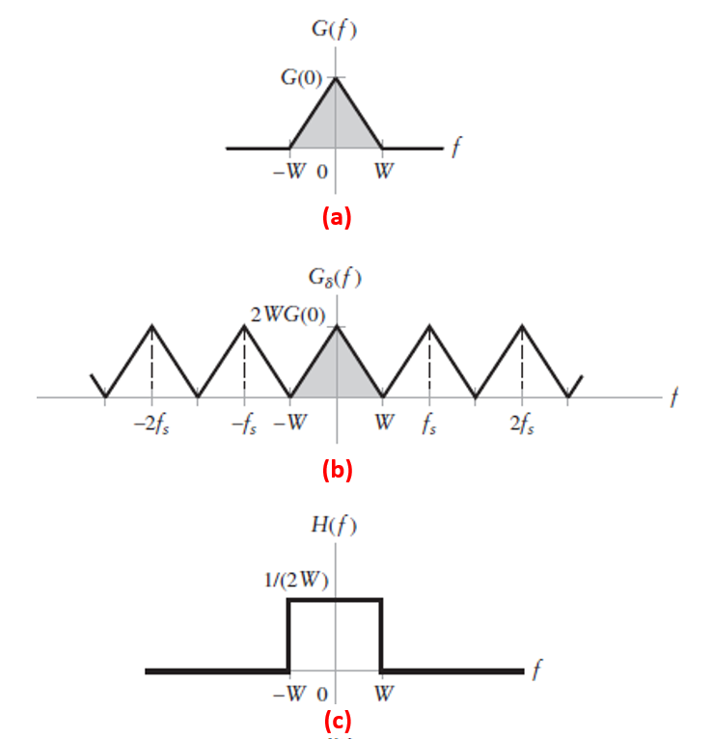
FIGURE 2: (a) Spectrum of a strictly band-limited signal g(t) (b) Spectrum of instantaneously sampled version of g(t) for a sampling period T_{S}=1/2w (c) Frequency response of ideal low-pass filter aimed at recovering the original message signal g(t) from its uniformly sampled version.

Slide 8
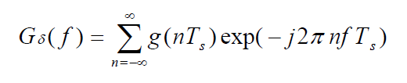

Uniform sampling at the time domain results in a periodic spectrum with a period equal to the sampling rate. The Fourier transform of the sampled signal g_{δ}(t)
Suppose, however, that the signal g(t) is strictly band-limited, with no frequency components higher than W hertz. That is, the Fourier transform G(f) of the signal g(t) has the property that G(f) is zero for |f|>W as illustrated in Fig (2a).
Suppose we choose the sampling period T_{s}=1/2W, then the corresponding spectrum of the sampled signal becomes as shown in Fig (2b). And the Fourier transform of g_{δ}(t) given in Eqn.(2) becomes
→(2)
→(3)

Slide 9
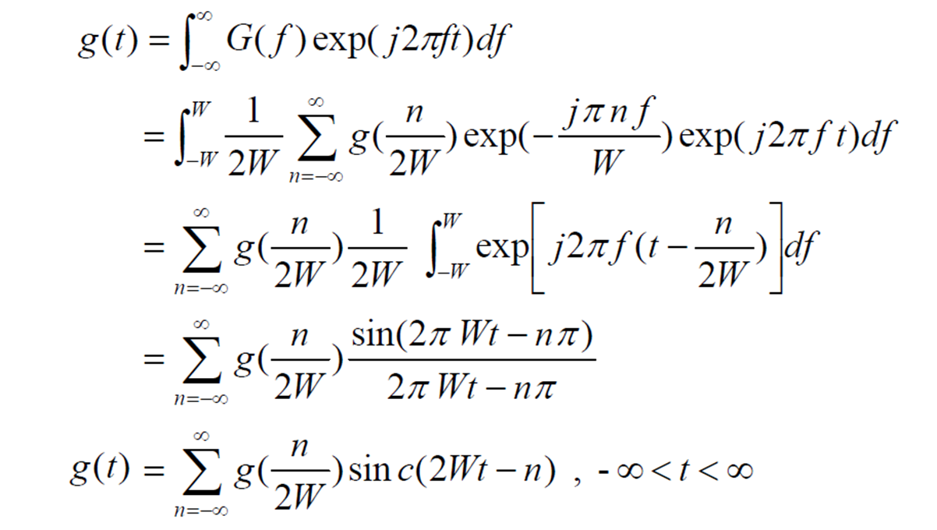
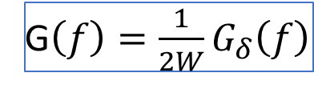
Signal Reconstruction:
Equation (3) shows that g(t) can be uniquely determined from g(n/2W). In other words, g(n/2W) contains all the information about g(t).
From the spectrum in Figure 2(a) and 2(b), we can understand that
Intuitively, let us take the inverse Fourier Transform of eqn. (4), and look for its meaningful insights.
G$\left(f\right)=\frac{1}{2W}G_{δ}\left(f\right)$
→(4)
→(5)

Slide 10
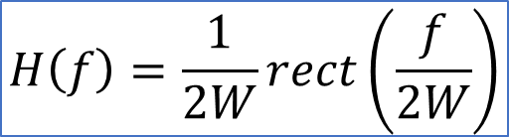
In Equation (5) the presence of sinc reveals that original signal can be reconstructed by passing g_{δ}(t) through an ideal low pass filter as shown in Fig (2c), whose transfer function given as
Therefore ,from Eqns. (5) and (6), the sampling theorem becomes:
The sampling rate of 2W samples per second for a signal bandwidth of W hertz is called the Nyquist rate; its reciprocal 1/2W (measured in seconds) is called the Nyquist interval.
$$H\left(f\right)=\frac{1}{2W}rect\left(\frac{f}{2W}\right)$$
→(6)
A band-limited signal of finite energy that has no frequency components higher than W hertz is completely recovered from knowledge of its samples taken at the rate of 2W samples per second

Slide 11
Aliasing Effect (in Sampled signal):
Sampling theorem (discussed as above) is applicable only if the information signal is bandlimited to W.
1. So what if the information signal is not bandlimited?
Real time information sources (for example audio signal generated from the microphone and/or video signal from the camera) are not strightly bandlimited.
Therefore, if the information is not bandlimited then the spectrum of the sampled signals will get overlapped as shown in Fig(3b). The spectrum overlapping is called as “Aliasing effect” and this overlapping will cause distortion in the reconstructed signal.
2. And what if the information is bandlimited but we sample exactly at fs=2W?
If we sample exactly at fs=2W, there is no aliasing in the spectrum, but we need “ideal filter” ( i.e filter with sharp cut-off frequency with zero Hertz transition band).
Ideal filtering is not viable and we use filters like Butterworth and Chebyshev as shown in Fig (3c) with non-zero transition band.

Slide 12
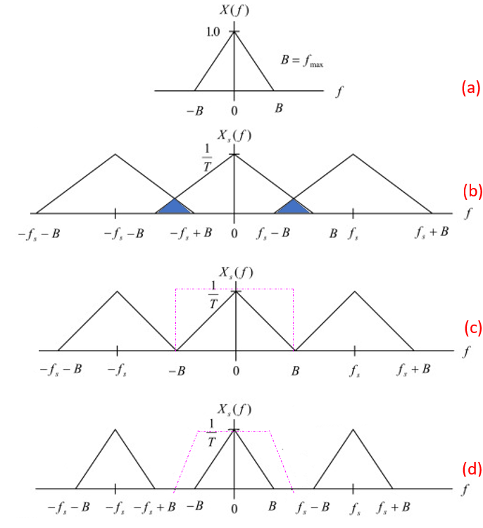
Message signal
Aliasing effect
Undersampled and/or
band unlimited
Ideal Filter
fs=2W
(Nyquist sampled)
Practical filter
Fs>2W (Oversampled)

Slide 13
How do we eliminate Aliasing Effect?
To avoid Alaising (overlapping) of sampled spectrum, we need to bandlimit the message signal by passing it through a low pass filter of cut-off frequency fs/2; and this LPF is called as “anti-aliasing” filter.
And considering the transition band characteristics of the practical filters, we need to keep the sampling frequency larger than twice the message bandwidth (i.e., fs>2W).
So it would be appropriate if we RECALL the sampling theorem once again here. Understand the theorem in conjunction with our discussion on “aliasing effect” and “anti-aliasing filer”.
A band-limited signal of finite energy that has no frequency components higher than W hertz can be completely recovered from knowledge of its samples, if the signal is sampled at a rate equal to or more than 2W samples per second (i.e., fs>= 2W)

Slide 14
Types of Sampling
In the earlier slides, we discussed about sampling process and signal reconstruction detail.
We used unit delta signal to sample the message and such sampling is called as “ideal sampling”.
Ideal sampling results in the samples whose width τ approaches zero. Due to this, the power content in the instantaneously sampled pulse is negligible. Thus, this method is not suitable for transmission purpose.
Practically, there are two basic techniques used to perform the sampling function:
Natural sampling , and
Flat-top sampling.

Slide 15
1. Natural Sampling
As the name implies, in natural sampling, the tops of the sample pulses retain their natural shape during the sample interval, as shown in FIGURE 1
There are two points to note in natural sampling
The first point is that: With natural sampling, the frequency spectrum of the sampled output is different from that of an ideal sample. The amplitude of the frequency components produced from narrow, finite-width sample pulses decreases for the higher harmonics in a (sin x)/x manner. This requires the use of frequency equalizers (compensation filters) before recovery by a low-pass filter.
And the second point is that: The sample tops takes the shape of the amplitude of the analog signal which means that if there is noise above that signal, then it will appear at the sample tops and till the end of reconstruction filter output.
As such, natural sampling is less attractive , such as in PCM

Slide 16
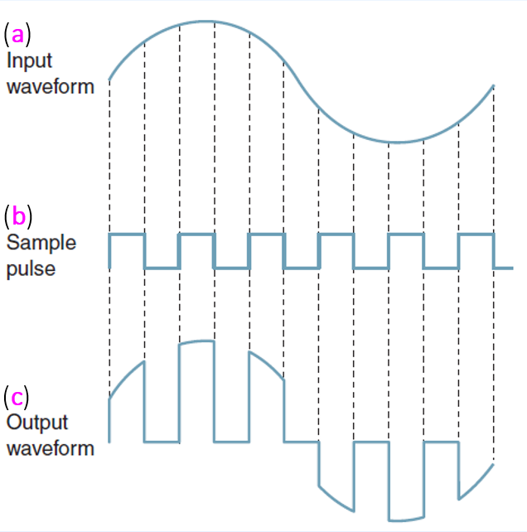
FIGURE 1 Natural sampling: (a) input analog signal; (b) sample pulse; (c) sampled output

Slide 17
1. Flat Top Sampling
As the name implies, in this methods of sampling the tops of the sample pulses retained constant as shown in FIGURE 2
With flat-top sampling, the input voltage is sampled with a narrow pulse and then held relatively constant until the next sample is taken.
The most common method used for sampling voice signals in PCM systems is flattop sampling, which is accomplished in a sample-and-hold circuit as shown in FIGURE 3.
The purpose of a sample-and-hold circuit is to periodically sample the continually changing analog input voltage and convert those samples to a series of constant-amplitude PAM voltage levels.

Slide 18
Flat top sampling process alters the frequency spectrum and introduces an error called aperture error, which is when the amplitude of the sampled signal changes during the sample pulse time.
This prevents the receiver recovery circuit (such as PCM) from exactly reproducing the original analog signal voltage.
The magnitude of error depends on how much the analog signal voltage changes while the sample is being taken and the width (duration) of the sample pulse.
Flat-top sampling, however, introduces less aperture distortion than natural sampling and can operate with a slower analog-to-digital converter.

Slide 19
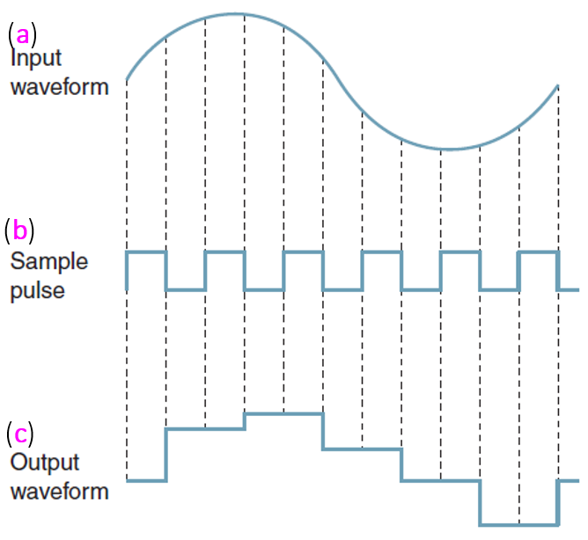
FIGURE 2: Flat-Top sampling: (a) input analog signal; (b) sample pulse; (c) sampled output

Slide 20
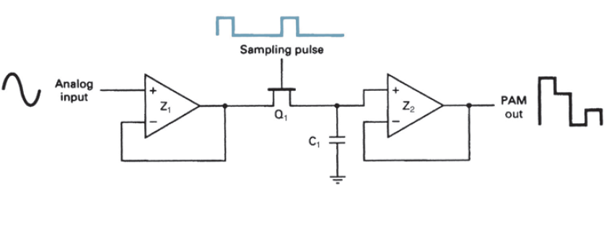
FIGURE 3: Sample-and-Hold circuit used for Flat-Top sampling

Slide 21
Pulse Modulation
Sampling converts the continuous time signal into discrete time
Pulse modulation consists essentially of sampling analog information signals and then converting those samples into discrete pulses and transporting the pulses from a source to a destination over a physical transmission medium.
The four predominant methods of pulse modulation include:
Pulse amplitude modulation (PAM),
Pulse width modulation (PWM),
Pulse position modulation (PPM),and
Pulse Code Modulation (PCM)
PWM is sometimes called pulse duration modulation (PDM) or pulse length modulation (PLM), as the width (active portion of the duty cycle) of a constant amplitude pulse is varied proportional to the amplitude of the analog signal at the time the signal is sampled.

Slide 22
PWM is shown in FIGURE 1(c). As the Figure shows, the amplitude of sample 1 is lower than the amplitude of sample 2. Thus, pulse 1 is narrower than pulse 2. The maximum analog signal amplitude produces the widest pulse, and the minimum analog signal amplitude produces the narrowest pulse. Note, however, that all pulses have the same amplitude.
With PPM, the position of a constant-width pulse within a prescribed time slot is varied according to the amplitude of the sample of the analog signal. PPM is shown in FIGURE 1(d).
As the FIGURE shows, the higher the amplitude of the sample, the farther to the right the pulse is positioned within the prescribed time slot. The highest amplitude sample produces a pulse to the far right, and the lowest amplitude sample produces a pulse to the far left.

Slide 23
With PAM, the amplitude of a constant width, constant-position pulse is varied according to the amplitude of the sample of the analog signal. PAM is shown in FIGURE 1(e), where it can be seen that the amplitude of a pulse coincides with the amplitude of the analog signal. PAM waveforms resemble the original analog signal more than the waveforms for PWM or PPM.
With PCM, the analog signal is sampled and then converted to a serial n-bit binary code for transmission. Each code has the same number of bits and requires the same length of time for transmission. PCM is shown in FIGURE 1(f). PAM is used as an intermediate form of modulation with PSK, QAM, and PCM, although it is seldom used by itself.
PWM and PPM are used in special-purpose communications systems mainly for the military but are seldom used for commercial digital transmission systems. PCM is by far the most prevalent form of pulse modulation and, consequently, will be discussed in more detail in later part of this unit FOUR.

Slide 24
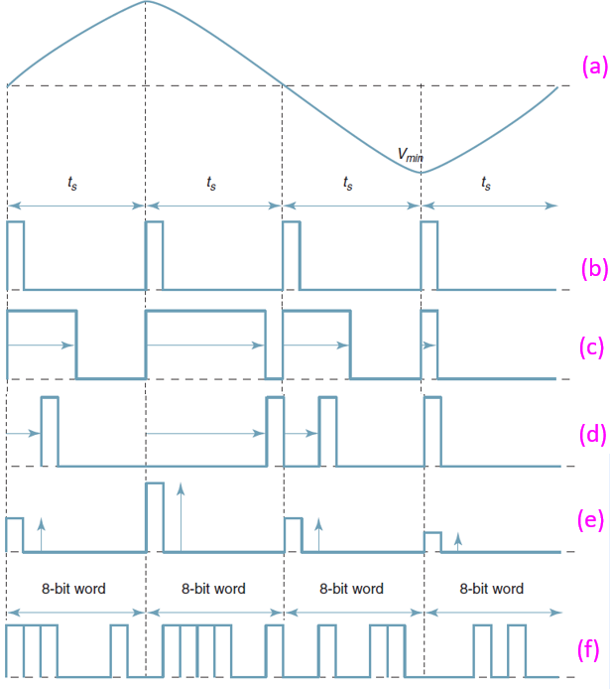
FIGURE 1 Pulse modulation: (a) analog signal; (b) sample pulse; (c) PWM; (d) PPM;
(e) PAM; (f) PCM

Slide 25
Pulse Amplitude Modulation and Demodulation
RECALL that in analog modulation systems, some parameter of a sinusoidal carrier is varied according to the instantaneous value of the modulating signal.
In Pulse modulation methods, the carrier is no longer a continuous signal but consists of a pulse train. And some parameter of which is varied according to the instantaneous value of the modulating signal.
So in Pulse Amplitude Modulation, the “amplitude” of the pulse train is varied according to the instantaneous value of the modulating signal.
Let us discuss how to generate and detect the PAM (from the next slide)

Slide 26
PAM Generation
The circuit of Figure 1(a) is used to generate pulse amplitude modulation (PAM) with natural sampling.
The FET is the switch used as a sampling gate. When the FET is ON, the analog voltage is shorted to ground; when OFF the FET is essentially open, so that the analog signal sample appears at the output.
OPAMP 1 is a noninverting amplifier that isolates the analog input channel from the switching function
OPAMP 2 is a high input-capable of driving low-impedance loads.
NOTE that resistor R is used to limit the output current of OPAMP 1 when the FET is “on” and provides a voltage division with rd of the FET. (rd, the drain-to-source resistance, is low but not zero)

Slide 27
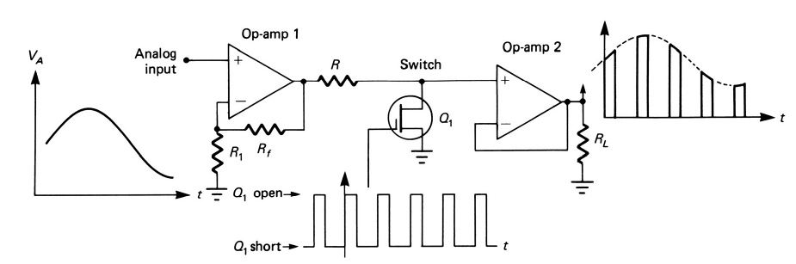
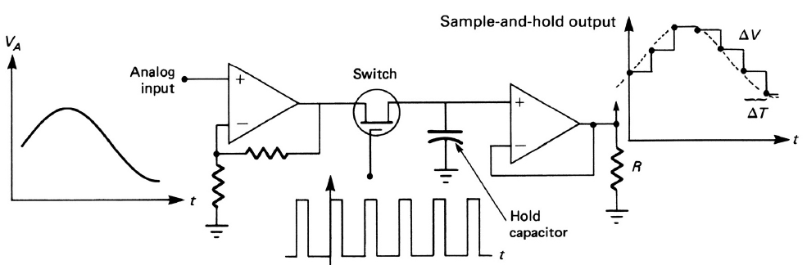
FIGURE 1(a) : PAM Generation with natural sampling.
FIGURE 1(b) : PAM Generation with Flat-top sampling.

Slide 28
The circuit of Figure 1(b) is used to generate pulse amplitude modulation (PAM) with Flat-top sampling.
As seen in Figure, the instantaneous amplitude of the analog signal is held as a constant charge on a capacitor for the duration of the sampling period Ts.
This technique is useful for holding the sample constant while other processing is taking place, but it alters the frequency spectrum and introduces an error, called aperture error, resulting in an inability to recover exactly the original analog signal.

Slide 29
PAM Detection
Reconstruction Filter (LPF)
FIGURE 1(c) : PAM detection for natural sampling.
Reconstruction Filter (LPF)
Equalizer
FIGURE 1(d) : PAM detection for flat-top sampling.

Slide 30
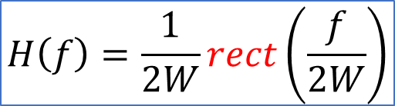

The block diagram of Figure 1(c) is used to detect PAM signal with natural sampling.
Whereby, the PAM is passed through a reconstruction filter which will produce the message signal from the PAM
The reconstruction filter is a low pass filter with transfer function
(or)
where W is the bandwidth of the message
The block diagram of Figure 1(d) is used to detect PAM signal with flat-top sampling.
Whereby, the reconstruction filter is followed by an equalizer to compensate the “aperture error”
$$H\left(f\right)=\frac{1}{2W}rect\left(\frac{f}{2W}\right)$$
$$h\left(t\right)=sinc\left(2πWt\right)$$

Slide 31
Advantage of PAM:
It has simple process for modulation and demodulation
Transmitter and receiver circuits are simple and easy to construct
Disadvantage of PAM:
Wide bandwidth required for PAM
Since the amplitude of the PAM pulses varies, any noise picked up by the PAM cannot be removed easily. Thus, PAM has high interference due to noises.
Also since the amplitude of the PAM pulses varies, the peak power required by the transmitter is high.

Slide 32
Pulse Width Modulation and Demodulation
RECALL that in analog modulation systems, some parameter of a sinusoidal carrier is varied according to the instantaneous value of the modulating signal.
In Pulse modulation methods, the carrier is no longer a continuous signal but consists of a pulse train. And some parameter of which is varied according to the instantaneous value of the modulating signal.
So in Pulse Width Modulation, the “Width” of the pulse train is varied according to the instantaneous value of the modulating signal.
Let us discuss how to generate and detect the PWM (from the next slide)

Slide 33
PWM Generation
The circuit of Figure 1(a) is used to generate pulse width modulation (PWM) signal.
This circuit is simply a high-gain comparator that is switched ON and OFF by the sawtooth waveform derived from a very stable-frequency oscillator.
Notice that the output will go to +Vcc the instant the analog signal exceeds the sawtooth voltage.
And the output will go to -Vcc the instant the analog signal is less than the sawtooth voltage.
As a results, the circuit will produce PWM output as shown in the output waveform
Note 1: With this circuit the average value of both inputs should be nearly the same. This is easily achieved with equal value resistors (at the inverting and non-inverting terminal) to ground
Note 2: And +V and –V values should not exceed Vcc.

Slide 34
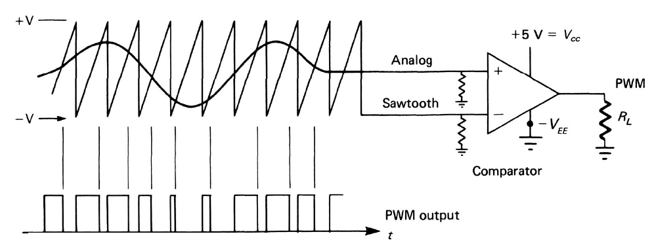
FIGURE 1(a) : PWM Generation

Slide 35
PWM Detection
The concept of PWM detection is shown in Figure 1(b) whereby we need to convert PWM into PAM signal and then use LPF to recover the message signal.
And the corresponding circuit diagram is shown in Figure 1(c).
The transistor T1 works as an inverter. Hence during the time interval A-B, when the PWM signal is high, the input to the transistor T2 is low. Therefore, during this time interval, the transistor T2 is cut-off and the capacitor C gets charged through an R-C combination
During the time interval B–C when the PWM signal is low, the input to the transistor T2 is high, and it gets saturated. The capacitor C then discharges very rapidly through T2. Therefore, collector voltage of T2 during the interval B-C is then low. Thus the waveform at the collector of T2 is more or less a saw-tooth waveform whose envelope is the modulating signal.
The OPAMP which is designed as 2nd order LPF will reproduce the message signal.

Slide 36
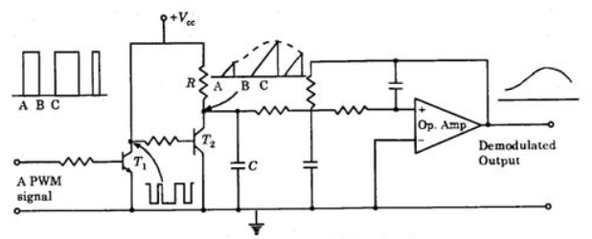
PWM to PAM Converter
Reconstruction Filter (LPF)
FIGURE 1(b) : Concept of PWM detection
FIGURE 1(c) : Circuit of PWM Detection

Slide 37
Advantage of PWM:
As the amplitude is held constant, any noise pick-ups can easily be removed (clipped!). Therefore, noise in PWM is less than PAM
PWM does not require synchronization between transmitter and receiver
Disadvantage of PWM:
Large bandwidth is required compared with PAM
Since width of the pulse is varying, the transmitter must be able to handle the large power corresponding to large width of the pulse.

Slide 38
Pulse Position Modulation and Demodulation
RECALL that in analog modulation systems, some parameter of a sinusoidal carrier is varied according to the instantaneous value of the modulating signal.
In Pulse modulation methods, the carrier is no longer a continuous signal but consists of a pulse train. And some parameter of which is varied according to the instantaneous value of the modulating signal.
So in Pulse Position Modulation, the “position” of the pulse train (from the reference) is varied according to the instantaneous value of the modulating signal.
Let us discuss how to generate and detect the PPM (from the next slide)

Slide 39
PWM Generation
The circuit of Figure 1(a) is used to generate pulse position modulation (PPM) signal.
Firstly, a PWM signal corresponding to the message is produced using a high gain comparator and sawtooth waveform.
Secondly, the PWM signals are passed through an invering-OPAMP based differentiator which produces negative and positive spike signals (corresponding to rising and falling edge of the PWM)
Then the negative spikes are bypassd to ground using the diode.
And finally, the positive spikes are used to trigger a monostable multivibrator which in turn produce the PPM signal.
(Here it is assumed that you (the learners) are familiar with the basics of OPAMP applications and Multivibrators)

Slide 40
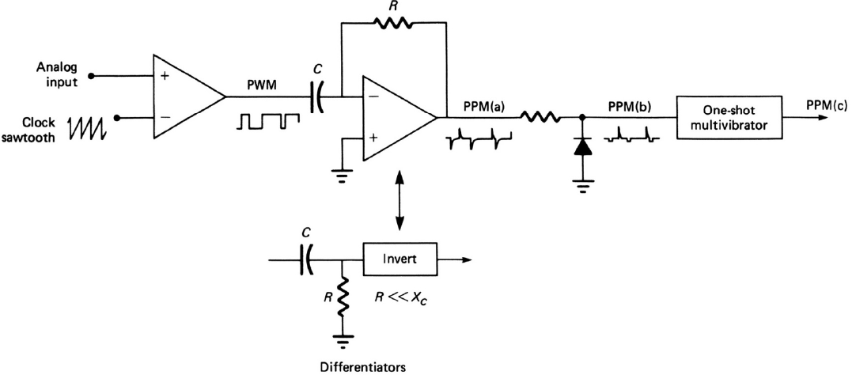
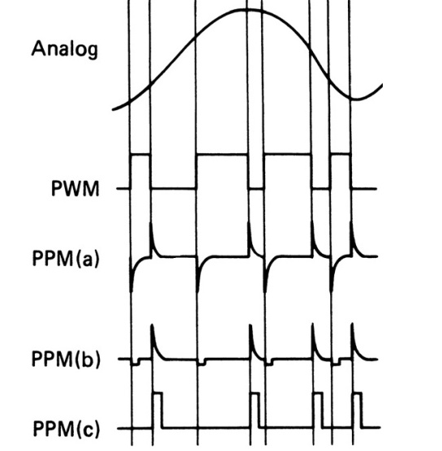
FIGURE 1(a) : PPM Generation

Slide 41
PPM Detection
The concept of PPM detection is shown in Figure 1(b) whereby we need to convert PPM into PAM signal and then use LPF to recover the message signal.
And the corresponding circuit diagram is shown in Figure 1(c). It utilizes the fact that the gaps between PPM pulse contains the information about the message signal
During the gap interval A-B between pulses, the PPM signal is low, which makes the transistor to OFF and hence the capacitor C gets charged through an R-C combination
During the pulse interval B–C, the PWM signal is high, which makes the transistor to ON and hence the capacitor C gets discharged through the transistor (to the ground)
Thus, the waveform at the collector of the transistor is more or less a saw-tooth waveform whose envelope is the modulating signal.
The OPAMP which is designed as 2nd order LPF will reproduce the message signal.

Slide 42
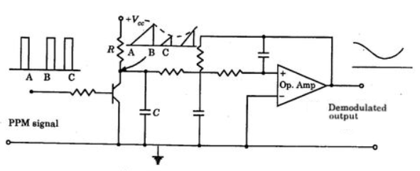
PPM to PAM Converter
Reconstruction Filter (LPF)
FIGURE 1(b) : Concept of PPM detection
FIGURE 1(c) : Circuit of PPM Detection

Slide 43
Advantage of PPM:
Like PWM, as the amplitude is held constant, any noise pick-ups can easily be removed (clipped!). Therefore, noise in PPM is less than PAM
Since pulse width of PPM is constant, transmitter power for each pulse is same.
Disadvantage of PPM:
Large bandwidth is required compared with PAM
PPM requires perfect synchronization between transmitter and receiver

Slide 44
Pulse Code Modulation
PCM is one of the important application of pulse modulation.
We know that in Pulse Modulation methods, the carrier is no longer a continuous signal but consists of a pulse train. And some parameter of which is varied according to the instantaneous value of the modulating signal.
So in Pulse Code Modulation, firstly, the signal is sampled to produce PAM, and then the PAM signal is encoded to produce binary waveform.
NOTE: You will learn in detail about PCM in the next semester in Digital Communication subject. As such, here we just discuss only the concept of PCM system as a continuation of pulse modulation.

Slide 45
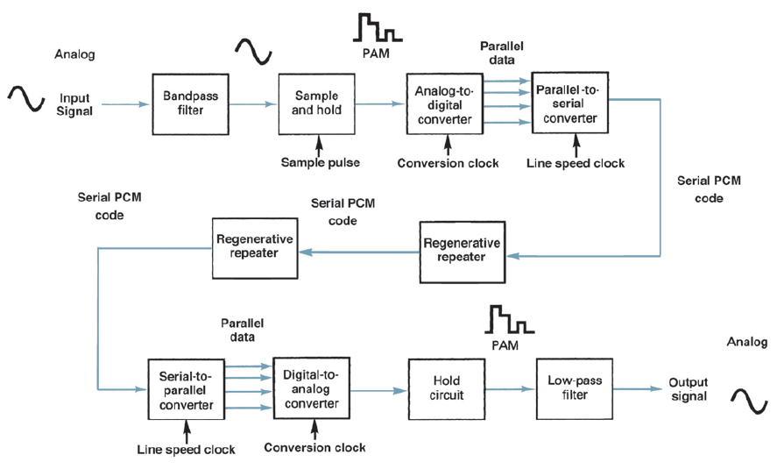
Figure: Block diagram PCM system.

Slide 46
Figure above shows a simplified block diagram of single-channel, simplex (one-way only) PCM system.
In the Transmitter:
The bandpass filter limits the frequency of the analog input signal to the standard voice-band frequency range of 300 Hz to 3000 Hz.
The sample-and-hold circuit periodically samples the analog input signal and converts those samples to a multilevel PAM signal.
The analog-to-digital converter (ADC) converts the PAM samples to parallel PCM codes.
The parallel-to-serial converter converts the parallel PCM codes into serial binary data and then outputted onto the transmission line as serial digital pulses.

Slide 47
In the Channel
The transmission line repeaters are placed at prescribed distances to regenerate the digital pulses.
In the Receiver
Serial-to-parallel converter converts serial pulses received from the transmission line to parallel PCM codes.
The digital-to-analog converter (DAC) converts the parallel PCM codes to multilevel PAM signals.
The hold circuit and lowpass filter that converts the PAM signals back to its original analog form

Slide 48
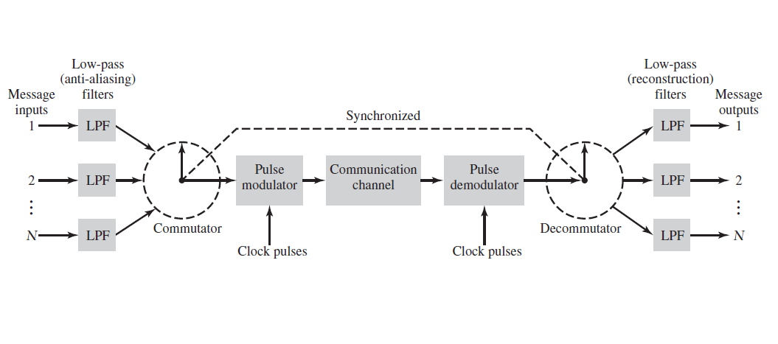
PAM-TDM
Figure: Block diagram PAM-TDM system.

Slide 49
An important feature of the sampling process is a conservation of time.
That is, the transmission of the message samples engages the communication channel for only a fraction of the sampling interval on a periodic basis, and this give way to send more independent message sources on a time-shared basis.
The concept of TDM is illustrated by the block diagram shown in Figure above.
At the transmitter end:
Each input message signal is first restricted in bandwidth by a low-pass anti-aliasing filter to remove the frequencies that are nonessential to an adequate signal representation.
The low-pass filter outputs are then applied to a commutator, which is usually implemented using electronic switching circuitry.

Slide 50
The function of the commutator is twofold:
It takes a narrow sample of each of the N input messages at a rate that is slightly higher than 2W, where W is the cutoff frequency of the anti-aliasing filter, and
It sequentially interleave these N samples inside the sampling interval. Indeed, this is the essence of the time-division multiplexing operation.
Following the commutation process, the multiplexed signal is applied to a pulse modulator which transform the pulse suitable for transmission.
At the receiving end:
The received signal is applied to a pulse demodulator, which performs the reverse operation of the pulse modulator.
The narrow samples produced at the pulse demodulator output are distributed to the appropriate low-pass reconstruction filters by means of a decommutator.

Slide 51
NOTE that:
The use of time-division multiplexing introduces a bandwidth expansion factor N, because the scheme must squeeze N samples derived from N independent message sources into a time slot equal to one sampling interval.
The commutator at the transmitter and the decommutator at the receiver need synchronization for a satisfactory operation of the system.

Slide 52
Question 1:
A signal g(t) = sinc²(5πt) is uniformly sampled at a rate of (i) 5 Hz; (ii) 10 Hz; (iii) 20 Hz.
Sketch the spectrum of the signal g(t)
For each sampling, sketch the spectrum of the sampled signal.
For each sampling, explain whether you can recover the signal g(t) from the sampled signal.

Slide 53
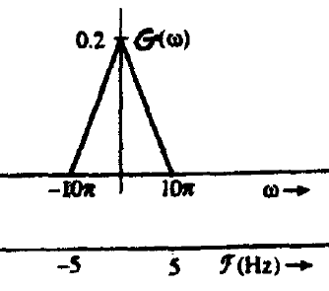



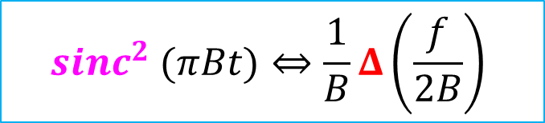
(a)
The given signal
has the bandwidth B=5Hz
Therefore, the Nyquist rate, 2B =10Hz
We know that
And/or equivalently
Therefore, for g(t)
And the spectrum of g(t)
$$g\left(t\right)={sinc}^{2}\left(5πt\right)$$
$$B{sinc}^{2} (πBt)⇔Δ\left(\frac{f}{2B}\right)$$
$${sinc}^{2} (πBt)⇔\frac{1}{B}Δ\left(\frac{f}{2B}\right)$$
$${sinc}^{2} (5πt)⇔\frac{1}{5}Δ\left(\frac{f}{10}\right)$$

Slide 54
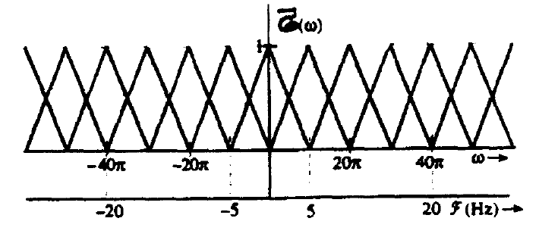
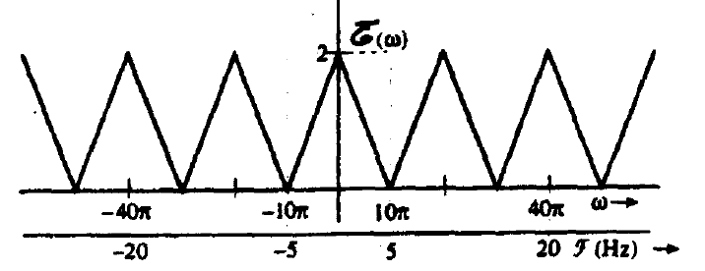
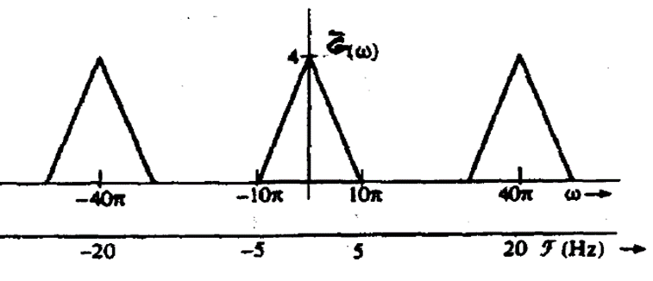
(b)
The spectrum of sampled signal when Fs=5Hz is shown on the right; which is under sampled and aliasing occurs
The spectrum of sampled signal when Fs=10Hz is shown on the right; which is Nyquist sampled case
The spectrum of sampled signal when Fs=15Hz is shown on the right; which is over sampled case

Slide 55
(c)
Case 1: Fs=5Hz
Here we can NOT recover the signal faithfully, because of spectrum overlap
Case 2: Fs=10Hz
Here we can NOT recover the signal faithfully, because, even though there is no spectrum overlap, we need ideal low pass filter
Case 3: Fs=15z
Here we CAN recover the signal faithfully, because, there is no spectrum overlap and practical low pass filter can be used

Slide 56
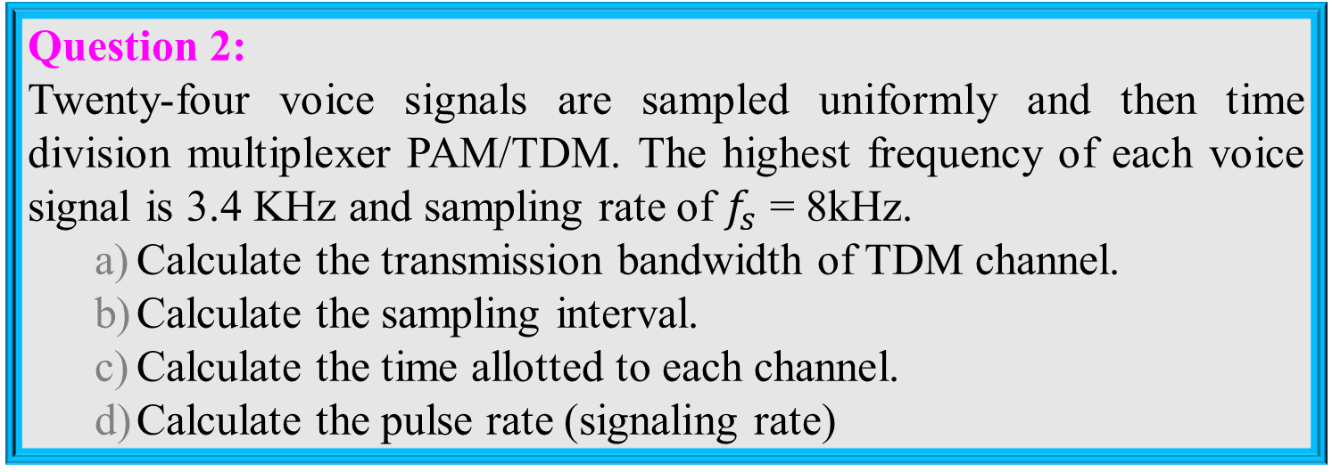
Question 2:
Twenty-four voice signals are sampled uniformly and then time division multiplexer PAM/TDM. The highest frequency of each voice signal is 3.4 KHz and sampling rate of $f_{s}$ = 8kHz.
Calculate the transmission bandwidth of TDM channel.
Calculate the sampling interval.
Calculate the time allotted to each channel.
Calculate the pulse rate (signaling rate)

Slide 57
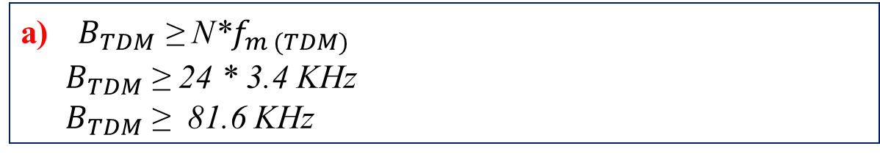
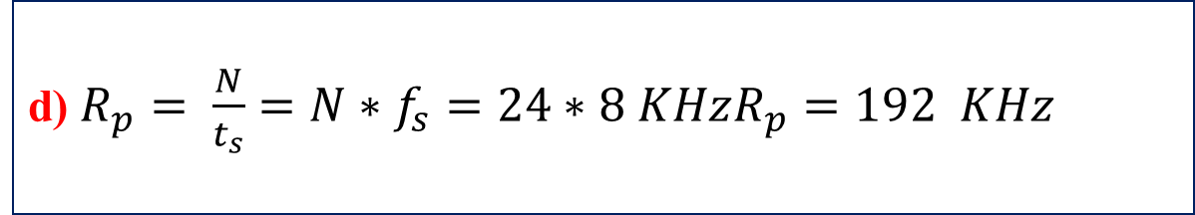
a)${ B}_{TDM}$ ≥ N*$f_{m (TDM)}$
${ B}_{TDM}$ ≥ 24 * 3.4 KHz
${ B}_{TDM}$ ≥ 81.6 KHz
b) $t_{s}$= $\frac{1}{f_{s}}=\frac{1}{8 K}=125$ µs
c) $t_{ch}$ = $\frac{t_{s}}{N}=\frac{125µ}{24}=5.2 \text{µ}\text{s}$
d) $R_{p}= \frac{N}{t_{s}}=N∗f_{s}=24∗8 KHzR_{p}=192 KHz$

Slide 58
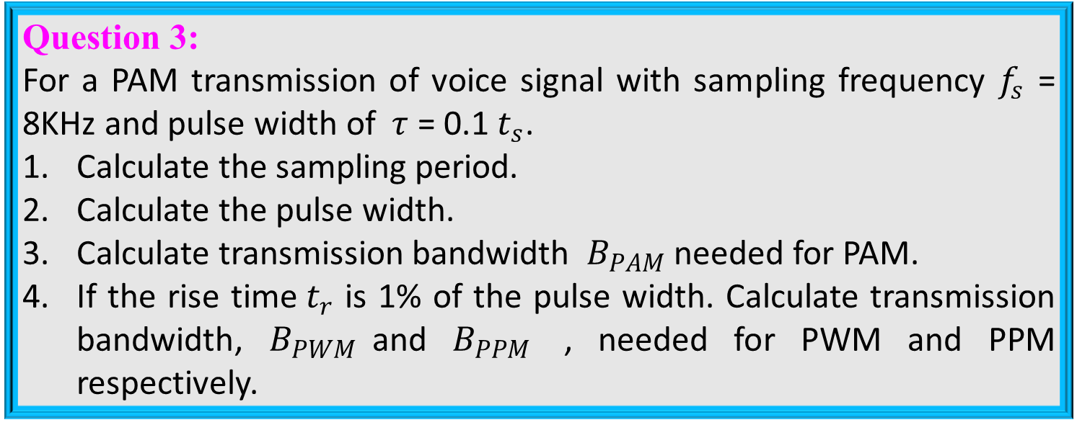
Question 3:
For a PAM transmission of voice signal with sampling frequency $f_{s}$ = 8KHz and pulse width of$τ$ = 0.1 $t_{s}$.
Calculate the sampling period.
Calculate the pulse width.
Calculate transmission bandwidth $B_{PAM}$ needed for PAM.
If the rise time${ t}_{r}$ is 1% of the pulse width. Calculate transmission bandwidth, $B_{PWM}$and $B_{PPM}$ , needed for PWM and PPM respectively.

Slide 59
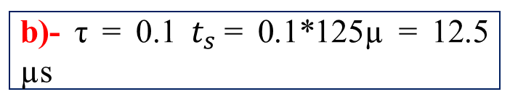
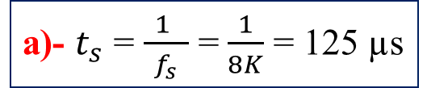
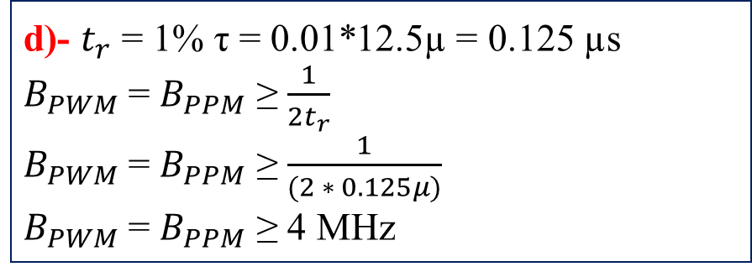
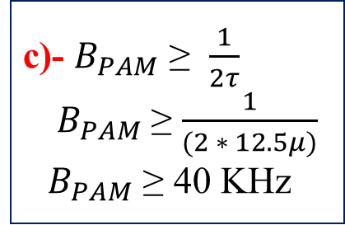
a)- $t_{s}$ = $\frac{ 1 }{f_{s}}$ = $\frac{1}{8K}$ = 125 µs
b)- τ = 0.1 $t_{s}$= 0.1*125µ = 12.5 µs
c)- $B_{PAM}$ ≥ $\frac{1}{2τ}$
${ B}_{PAM}$ ≥ $\frac{1}{(2 ∗ 12.5μ)}$
${ B}_{PAM}$ ≥ 40 KHz
d)- $t_{r}$ = 1% τ = 0.01*12.5µ = 0.125 µs
$B_{PWM}$= $B_{PPM}$ ≥ $\frac{1}{2t_{r}}$
$B_{PWM}$= $B_{PPM}$ ≥ $\frac{1}{(2 ∗ 0.125μ)}$
$B_{PWM}$= $B_{PPM}$ ≥ 4 MHz

Slide 60
Question 4:
Explain the sampling of analog signals with suitable sketches and mathematical expressions.
Explain about aliasing effect and anti-aliasing filter
Refer to the previous slides
Question 5:
Explain about natural sampling and flat-top sampling with suitable circuits and waveform sketches.
Refer to the previous slides
Question 6:
With suitable diagram and sketches, explain the modulation and demodulation of PAM signal
Refer to the previous slides
Question 7:
With suitable diagram and sketches, explain the modulation and demodulation of PWM signal

Slide 61
Question 8:
With suitable diagram and sketches, explain the modulation and demodulation of PPM signal
Refer to the previous slides
Question 9:
With suitable block diagram explain the principle of pulse code modulation and demodulation
Refer to the previous slides
Question 10:
With suitable diagram and sketches, explain the working of PAM-TDM system
Refer to the previous slides

Slide 62



