Slide 1


Analog Communication Systems
BECE304L
Module-1
Lecture 1&2:

Slide 2
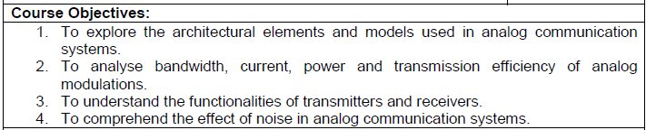
Objectives

Slide 3
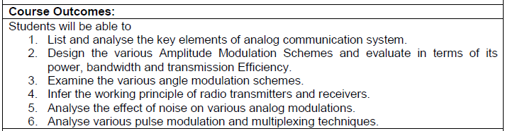
Course Outcomes

Slide 4
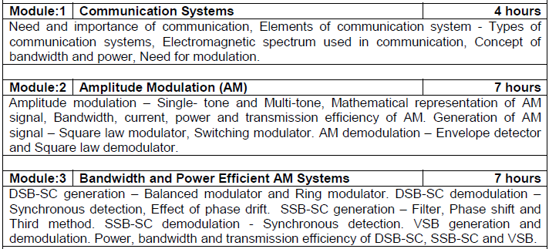
Course- modules

Slide 5
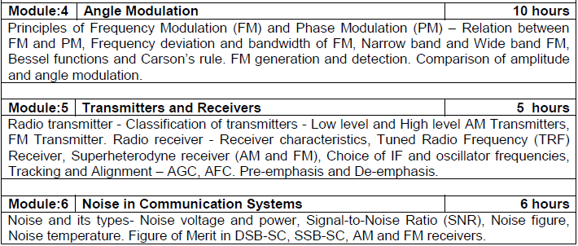
Course-modules

Slide 6
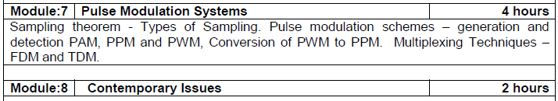
Course-modules

Slide 7
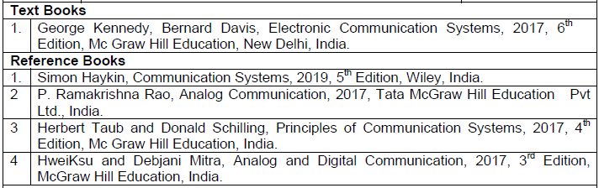
Books to follow

Slide 8
introduction
Significance of Human Communication
Communication Systems
Types of Electronic Communication
Modulation and Multiplexing
The Electromagnetic Spectrum
Bandwidth
A Survey of Communication Applications
Careers in the Communication Industry

Slide 9
Significance of Human Communication
Communication is the process of exchanging information.
Main barriers are language and distance.
Contemporary society’s emphasis is now the accumulation, packaging, and exchange of information.

Slide 10
Significance of Human Communication
Methods of communication:
Face to face
Signals
Written word (letters)
Electrical innovations:
Telegraph
Telephone
Radio
Television
Internet (computer)

Slide 11
Communication Systems
Basic components:
Transmitter
Channel or medium
Receiver
Noise degrades or interferes with transmitted information.

Slide 12
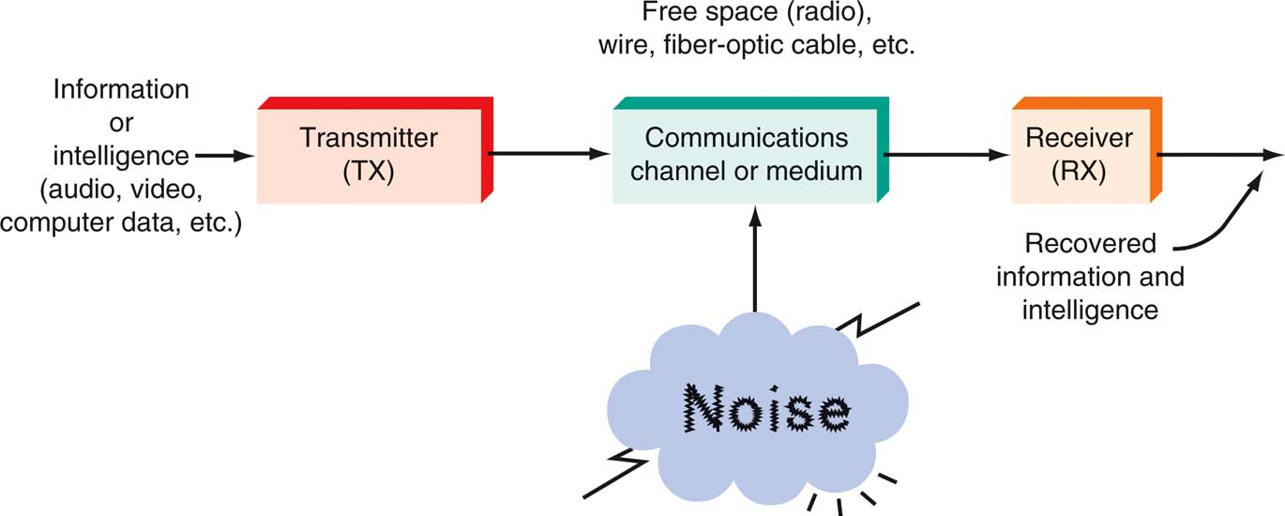
Communication Systems
A general model of all communication systems.

Slide 13
Communication Systems
Transmitter
The transmitter is a collection of electronic components and circuits that converts the electrical signal into a signal suitable for transmission over a given medium.
Transmitters are made up of oscillators, amplifiers, tuned circuits and filters, modulators, frequency mixers, frequency synthesizers, and other circuits.

Slide 14
Communication Systems
Communication Channel
The communication channel is the medium by which the electronic signal is sent from one place to another.
Types of media include
Electrical conductors
Optical media
Free space
System-specific media (e.g., water is the medium for sonar).

Slide 15
Communication Systems
Receivers
A receiver is a collection of electronic components and circuits that accepts the transmitted message from the channel and converts it back into a form understandable by humans.
Receivers contain amplifiers, oscillators, mixers, tuned circuits and filters, and a demodulator or detector that recovers the original intelligence signal from the modulated carrier.

Slide 16
Communication Systems
Transceivers
A transceiver is an electronic unit that incorporates circuits that both send and receive signals.
Examples are:
Telephones
Fax machines
Handheld CB radios
Cell phones
Computer modems

Slide 17
Communication Systems
Attenuation
Signal attenuation, or degradation, exists in all media of wireless transmission. It is proportional to the square of the distance between the transmitter and receiver.

Slide 18
Communication Systems
Noise
Noise is random, undesirable electronic energy that enters the communication system via the communicating medium and interferes with the transmitted message.

Slide 19
Types of Electronic Communication
Electronic communications are classified according to whether they are
One-way (simplex) or two-way (full duplex or half duplex) transmissions
Analog or digital signals.

Slide 20
Types of Electronic Communication
Simplex
The simplest method of electronic communication is referred to as simplex.
This type of communication is one-way. Examples are:
Radio
TV broadcasting
Beeper (personal receiver)

Slide 21
Types of Electronic Communication
Full Duplex
Most electronic communication is two-way and is referred to as duplex.
When people can talk and listen simultaneously, it is called full duplex. The telephone is an example of this type of communication.

Slide 22
Types of Electronic Communication
Half Duplex
The form of two-way communication in which only one party transmits at a time is known as half duplex. Examples are:
Police, military, etc. radio transmissions
Citizen band (CB)
Family radio
Amateur radio

Slide 23
Types of Electronic Communication
Analog Signals
An analog signal is a smoothly and continuously varying voltage or current. Examples are:
Sine wave
Voice
Video (TV)

Slide 24
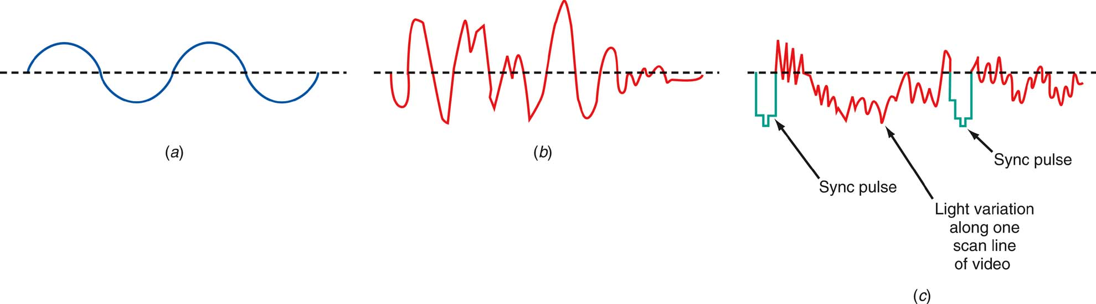
Types of Electronic Communication
Analog signals (a) Sine wave “tone.” (b) Voice. (c) Video (TV) signal.

Slide 25
Types of Electronic Communication
Digital Signals
Digital signals change in steps or in discrete increments.
Most digital signals use binary or two-state codes. Examples are:
Telegraph (Morse code)
Continuous wave (CW) code
Serial binary code (used in computers)

Slide 26
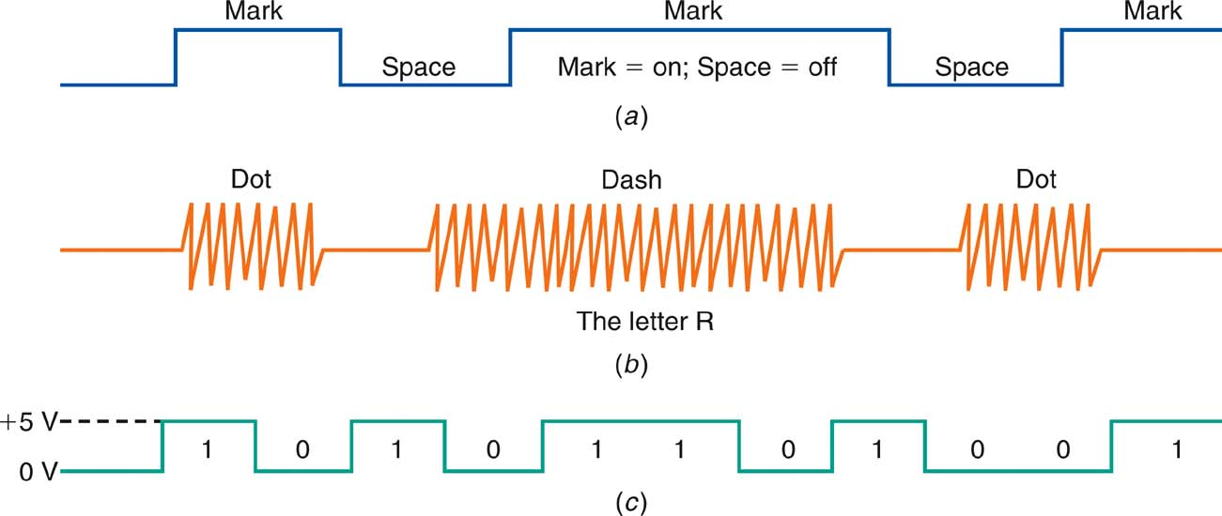
Types of Electronic Communication
Digital signals (a) Telegraph (Morse code). (b) Continuous-wave (CW) code. (c) Serial binary code.

Slide 27
Types of Electronic Communication
Digital Signals
Many transmissions are of signals that originate in digital form but must be converted to analog form to match the transmission medium.
Digital data over the telephone network.
Analog signals.
They are first digitized with an analog-to-digital (A/D) converter.
The data can then be transmitted and processed by computers and other digital circuits.

Slide 28
Modulation and Multiplexing
Modulation and multiplexing are electronic techniques for transmitting information efficiently from one place to another.
Modulation makes the information signal more compatible with the medium.
Multiplexing allows more than one signal to be transmitted concurrently over a single medium.

Slide 29
Modulation and Multiplexing
Baseband Transmission
Baseband information can be sent directly and unmodified over the medium or can be used to modulate a carrier for transmission over the medium.
In telephone or intercom systems, the voice is placed on the wires and transmitted.
In some computer networks, the digital signals are applied directly to coaxial or twisted-pair cables for transmission.

Slide 30
Modulation and Multiplexing
Broadband Transmission
A carrier is a high frequency signal that is modulated by audio, video, or data.
A radio-frequency (RF) wave is an electromagnetic signal that is able to travel long distances through space.

Slide 31
Modulation and Multiplexing
Broadband Transmission
A broadband transmission takes place when a carrier signal is modulated, amplified, and sent to the antenna for transmission.
The two most common methods of modulation are:
Amplitude Modulation (AM)
Frequency Modulation (FM)
Another method is called phase modulation (PM), in which the phase angle of the sine wave is varied.

Slide 32
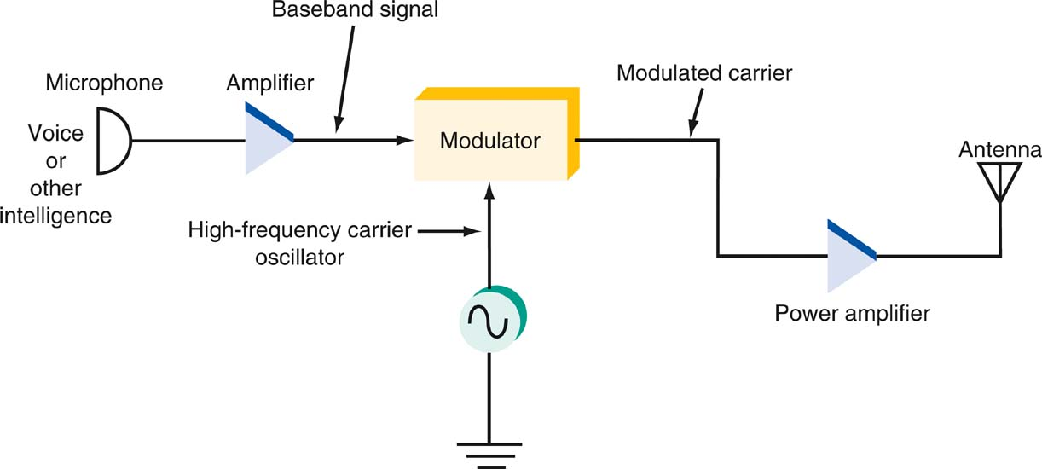
Modulation and Multiplexing
Modulation at the transmitter.

Slide 33
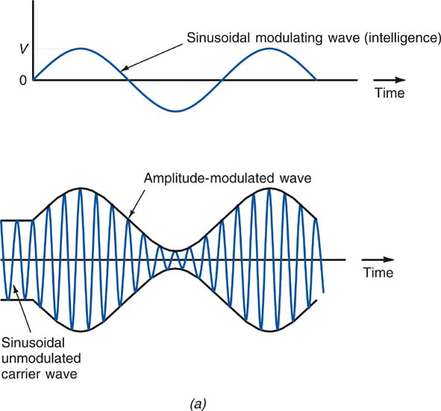
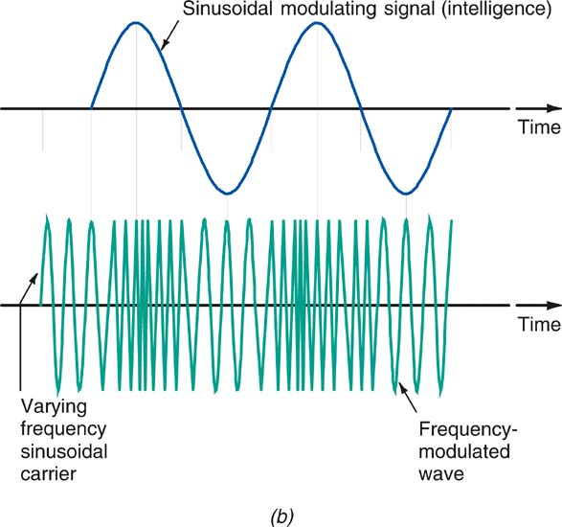
1-4: Modulation and Multiplexing
Types of modulation. (a) Amplitude modulation. (b) Frequency modulation.

Slide 34
Modulation and Multiplexing
Broadband Transmission
Frequency-shift keying (FSK) takes place when data is converted to frequency-varying tones.
Devices called modems (modulator-demodulator) translate the data from digital to analog and back again.
Demodulation or detection takes place in the receiver when the original baseband (e.g. audio) signal is extracted.

Slide 35
Modulation and Multiplexing
Multiplexing
Multiplexing is the process of allowing two or more signals to share the same medium or channel.
The three basic types of multiplexing are:
Frequency division
Time division
Code division

Slide 36
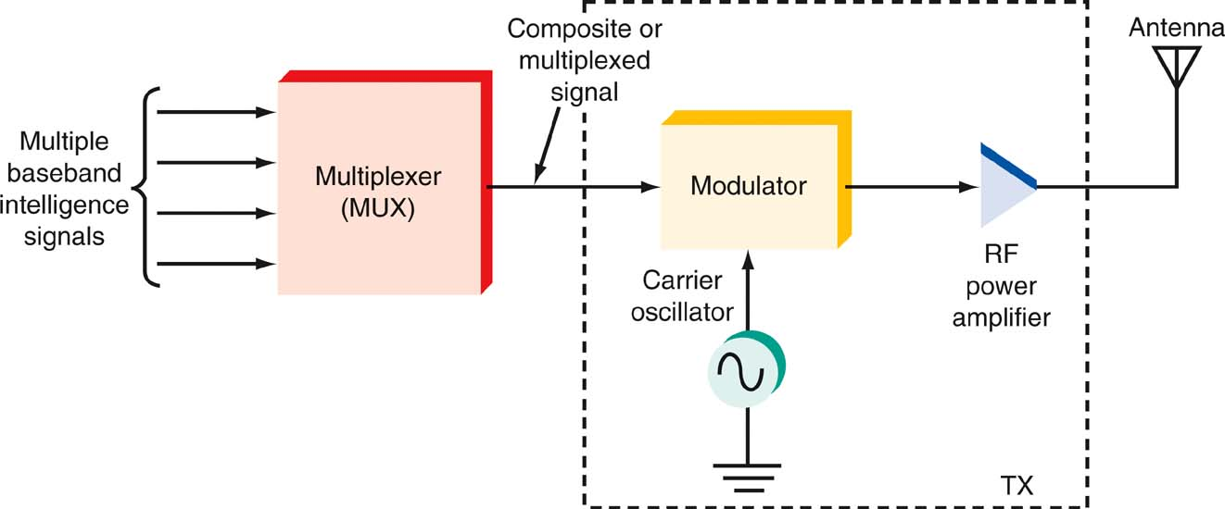
Modulation and Multiplexing
Multiplexing at the transmitter.

