Slide 1

Analog Communication Systems
BECE 304L
Module-1
Lecture: 3 & 4

Slide 2

Course- modules

Slide 3
The Electromagnetic Spectrum
The range of electromagnetic signals encompassing all frequencies is referred to as the electromagnetic spectrum.

Slide 4
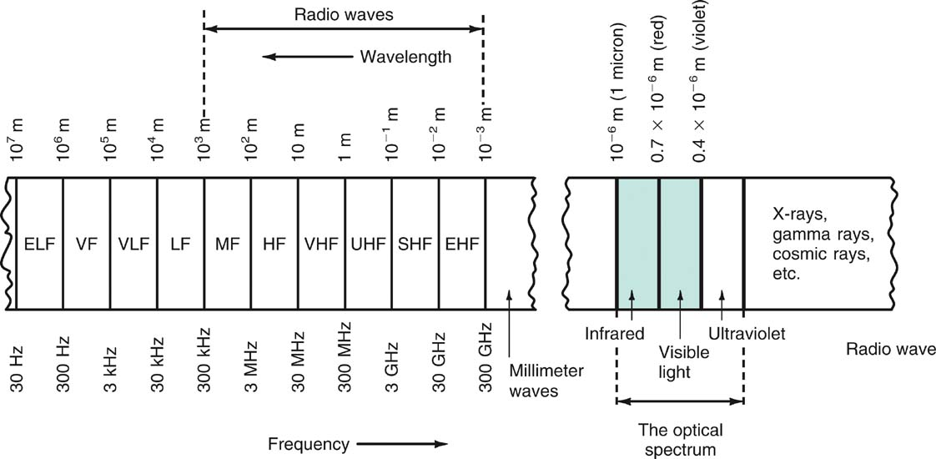
The Electromagnetic Spectrum
Figure 1-13: The electromagnetic spectrum.

Slide 5
The Electromagnetic Spectrum
Frequency and Wavelength: Frequency
A signal is located on the frequency spectrum according to its frequency and wavelength.
Frequency is the number of cycles of a repetitive wave that occur in a given period of time.
A cycle consists of two voltage polarity reversals, current reversals, or electromagnetic field oscillations.
Frequency is measured in cycles per second (cps).
The unit of frequency is the hertz (Hz).

Slide 6
The Electromagnetic Spectrum
Frequency and Wavelength: Wavelength
Wavelength is the distance occupied by one cycle of a wave and is usually expressed in meters.
Wavelength is also the distance traveled by an electromagnetic wave during the time of one cycle.
The wavelength of a signal is represented by the Greek letter lambda (λ).

Slide 7
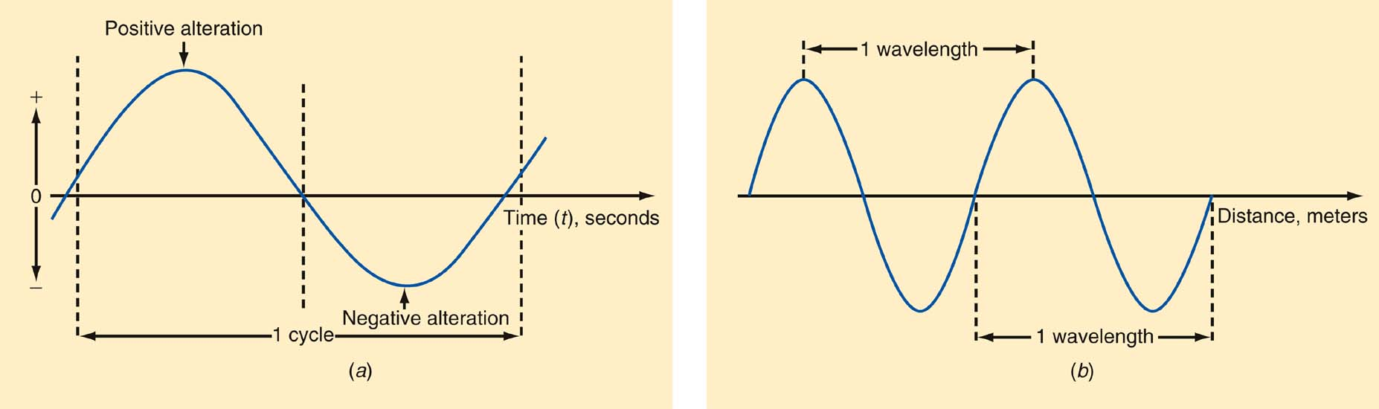
The Electromagnetic Spectrum
Frequency and wavelength. (a) One cycle. (b) One wavelength.

Slide 8
The Electromagnetic Spectrum
Frequency and Wavelength: Wavelength
Wavelength (λ) = speed of light ÷ frequency
Speed of light = 3 × 10⁸ meters/second
Therefore:
λ = 3 × 10⁸ / f
Example:
What is the wavelength if the frequency is 4MHz?
λ = 3 × 10⁸ / 4 MHz
= 75 meters (m)

Slide 9
The Electromagnetic Spectrum
Frequency Ranges from 30 Hz to 300 GHz
The electromagnetic spectrum is divided into segments:
Extremely Low Frequencies (ELF) | 30–300 Hz.
Voice Frequencies (VF) | 300–3000 Hz.
Very Low Frequencies (VLF) | include the higher end of the human hearing range up to about 20 kHz.
Low Frequencies (LF) | 30–300 kHz.
Medium Frequencies (MF) | 300–3000 kHz AM radio 535–1605 kHz.

Slide 10
The Electromagnetic Spectrum
Frequency Ranges from 30 Hz to 300 GHz
High Frequencies (HF) (short waves; VOA, BBC broadcasts; government and military two-way communication; amateur radio, CB. | 3–30 MHz
Very High Frequencies (VHF) FM radio broadcasting (88–108 MHz), television channels 2–13. | 30–300 MHz
Ultra High Frequencies (UHF) TV channels 14–67, cellular phones, military communication. | 300–3000 MHz

Slide 11
The Electromagnetic Spectrum
Frequency Ranges from 30 Hz to 300 GHz
Microwaves and Super High Frequencies (SHF) Satellite communication, radar, wireless LANs, microwave ovens | 1–30 GHz
Extremely High Frequencies (EHF) Satellite communication, computer data, radar | 30–300 GHz

Slide 12
The Electromagnetic Spectrum
Optical Spectrum
The optical spectrum exists directly above the millimeter wave region.
Three types of light waves are:
Infrared
Visible spectrum
Ultraviolet

Slide 13
The Electromagnetic Spectrum
Optical Spectrum: Infrared
Infrared radiation is produced by any physical equipment that generates heat, including our bodies.
Infrared is used:
In astronomy, to detect stars and other physical bodies in the universe,
For guidance in weapons systems, where the heat radiated from airplanes or missiles can be detected and used to guide missiles to targets.

Slide 14
The Electromagnetic Spectrum
In most new TV remote-control units, where special coded signals are transmitted by an infrared LED to the TV receiver to change channels, set the volume, and perform other functions.
In some of the newer wireless LANs and all fiber-optic communication.

Slide 15
The Electromagnetic Spectrum
Optical Spectrum: The Visible Spectrum
Just above the infrared region is the visible spectrum we refer to as light.
Red is low-frequency or long-wavelength light
Violet is high-frequency or short-wavelength light.
Light waves’ very high frequency enables them to handle a tremendous amount of information (the bandwidth of the baseband signals can be very wide).

Slide 16
The Electromagnetic Spectrum
Optical Spectrum: Ultraviolet
Ultraviolet is not used for communication
Its primary use is medical.

Slide 17
Bandwidth
Bandwidth (BW) is that portion of the electromagnetic spectrum occupied by a signal.
Channel bandwidth refers to the range of frequencies required to transmit the desired information.

Slide 18
Bandwidth
More Room at the Top
Today, virtually the entire frequency spectrum between approximately 30 kHz and 300 MHz has been spoken for.
There is tremendous competition for these frequencies, between companies, individuals, and government services in individual carriers and between the different nations of the world.
The electromagnetic spectrum is one of our most precious natural resources.

Slide 19
Bandwidth
More Room at the Top
Communication engineering is devoted to making the best use of that finite spectrum.
Great effort goes into developing communication techniques that minimize the bandwidth required to transmit given information and thus conserve spectrum space.
This provides more room for additional communication channels and gives other services or users an opportunity to take advantage of it.

Slide 20
Bandwidth
Spectrum Management and Standards
Spectrum management is provided by agencies set up by the United States and other countries to control spectrum use.
The Federal Communications Commission (FCC) and the National Telecommunications and Information Administration (NTIA) are two agencies that deal in spectrum management.
Standards are specifications and guidelines necessary to ensure compatibility between transmitting and receiving equipment.

Slide 21
Need for modulation
Practically speaking, modulation is required for;
High range transmission
Quality of transmission
To avoid the overlapping of signals.

Slide 22
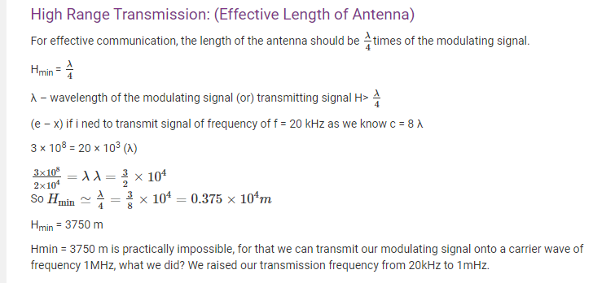
Need for modulation

Slide 23
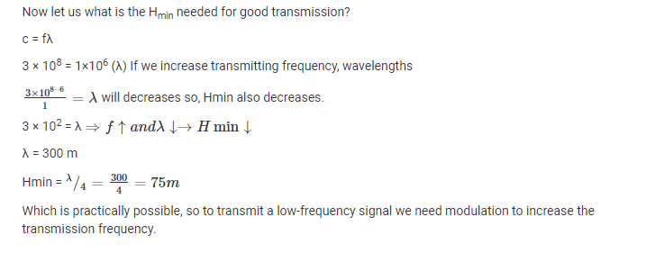
Need for modulation

Slide 24

Need for modulation

Slide 25
A Survey of Communications Applications
Simplex
AM and FM broadcasting
Digital radio
TV broadcasting
Digital television (DTV)
Cable television
Facsimile
Wireless remote control
Paging services
Navigation and direction-finding services
Telemetry
Radio astronomy
Surveillance
Music services
Internet radio and video

Slide 26
1-8: Jobs and Careers in the Communication Industry
The electronics industry is roughly divided into four major specializations:
Communications (largest in terms of people employed and the dollar value of equipment purchased)
Computers (second largest).
Industrial controls.
Instrumentation.

Slide 27
Careers in the Communication Industry
Types of Jobs
Engineers design communication equipment and systems.
Technicians install, troubleshoot, repair, calibrate, and maintain equipment.
Engineering Technicians assist in equipment design, testing, and assembly.

Slide 28
A Survey of Communications Applications
Family Radio service
The Internet
Wide-area networks (WANs)
Metropolitan-area networks (MANs)
Local area networks (LANs)
Duplex
Telephones
Two-way radio
Radar
Sonar
Amateur radio
Citizens radio

Slide 29
Careers in the Communication Industry
Types of Jobs
Technical sales representatives determine customer needs and related specifications, write proposals and sell equipment.
Technical writers generate technical documentation for equipment and systems.
Trainers develop programs, generate training and presentation materials, and conduct classroom training.

Slide 30
Careers in the Communication Industry
Major Employers
The communication electronics industry is made up of the following segments:
Manufacturers
Resellers
Service Organizations
End users

Slide 31
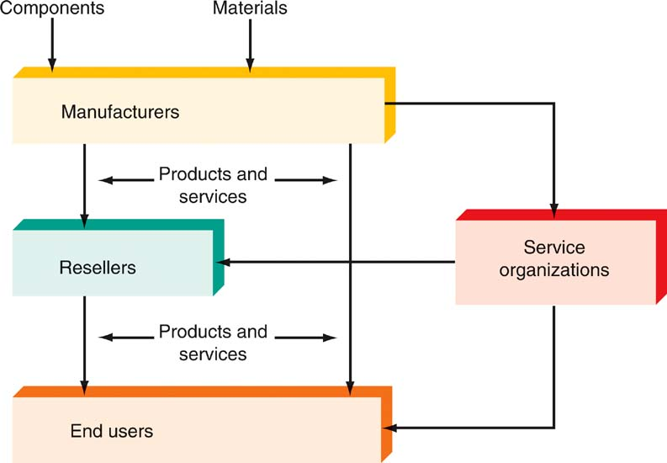
Careers in the Communication Industry
Structure of the communication electronics industry.

