Slide 1

Analog Communication Systems
BECE 304L
Module 2

Slide 2

Course- module-2

Slide 3
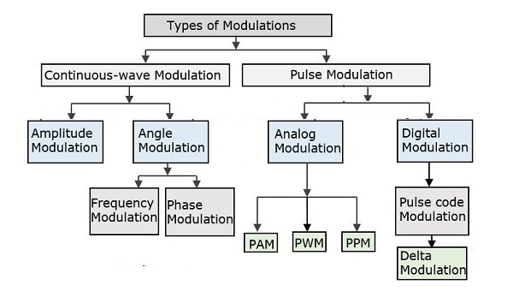
Modulation types

Slide 4
Continuous Wave modulation
Continuous Wave modulation Types:
Amplitude Modulation (AM):Process of changing the amplitude of the carrier signal in accordance with instantaneous amplitude of the modulating signal.
Frequency Modulation (FM): Process of changing the frequency of the carrier signal in accordance with instantaneous amplitude of the modulating signal.
Phase Modulation (PM):Process of changing the phase of the carrier signal in accordance with instantaneous amplitude of the modulating signal.

Slide 5
AM Modulation/Demodulation
Source
Sink
Channel
Modulator
Demodulator
Baseband Signal
with frequency
fm
(Modulating Signal)
Bandpass Signal
with frequency
fc
(Modulated Signal)
Original Signal
with frequency
fm
fc >> fm
Voice: 300-3400Hz GSM Cell phone: 900/1800MHz

Slide 6
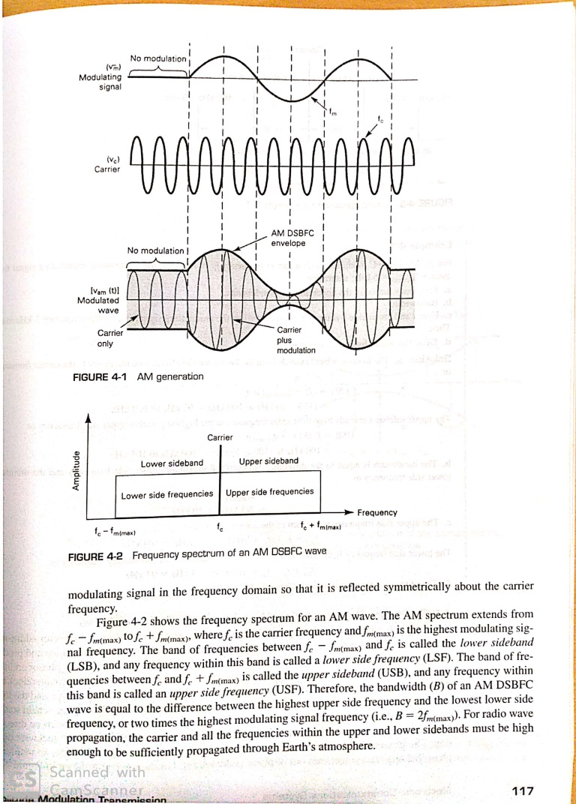
Amplitude Modulation
The amplitude of high-carrier signal is varied according to the instantaneous amplitude of the modulating message signal.

Slide 7
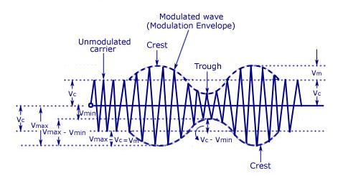
Amplitude Modulated Carrier Wave

Slide 8
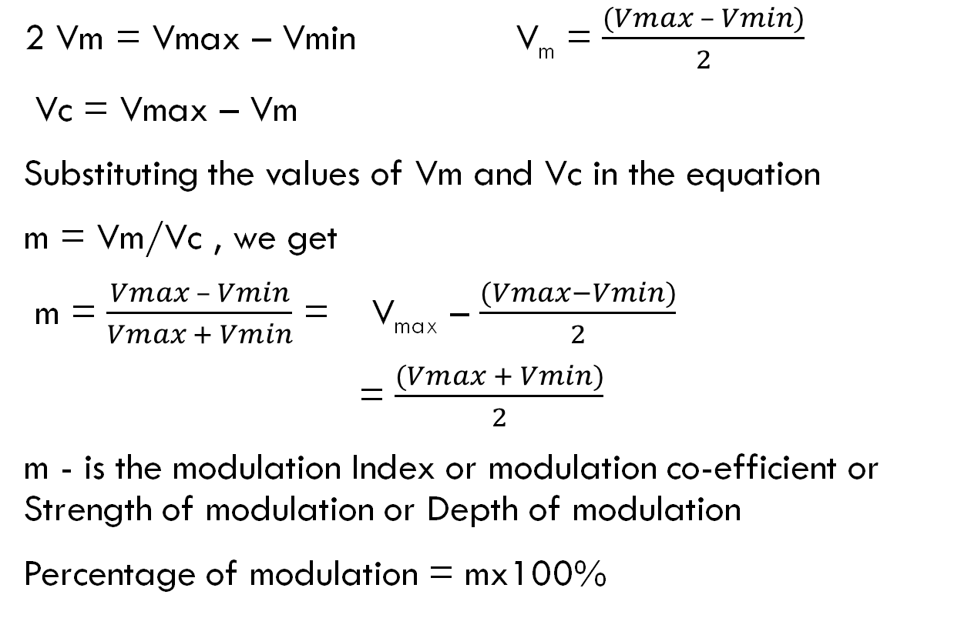
Amplitude Modulation Modulation index
2 Vm = Vmax – Vmin V_{m} = $\frac{(Vmax – Vmin)}{2}$
Vc = Vmax – Vm
Substituting the values of Vm and Vc in the equation
m = Vm/Vc , we get
m = $\frac{Vmax – Vmin}{Vmax + Vmin}$ = V_{max} – $\frac{(Vmax−Vmin)}{2}$
= $\frac{(Vmax + Vmin)}{2}$
m - is the modulation Index or modulation co-efficient or Strength of modulation or Depth of modulation
Percentage of modulation = mx100%

Slide 9
Implication of modulation index
The value of m ‘ lies between 0 and 1.
The value of m determines the strength and the quality of the transmitted signal.
In an AM wave, the signal is contained in the variations of the carrier amplitude.
The audio signal transmitted will be weak if the carrier wave is only modulated to a very small degree.
But if the value of m exceeds unity, the transmitter output produces erroneous distortion.

Slide 10
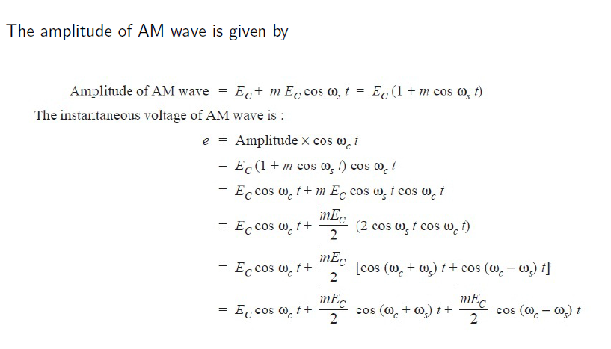
AM Signal Math Expression

Slide 11
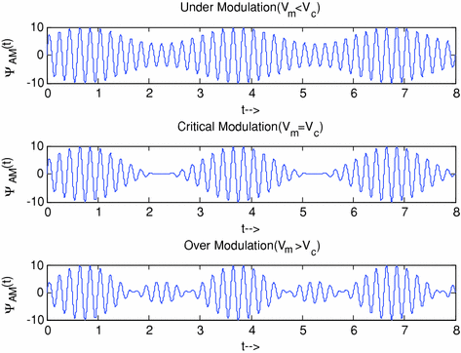
Implication of modulation index

Slide 12
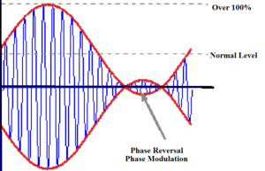
Over modulation effects
Leads to serious distortion

Slide 13
Frequency Spectrum of am

Slide 14
AM Modulation – Example
The information signal is usually not a single frequency but a range of frequencies (band). For example, frequencies from 20Hz to 15KHz. If we use a carrier of 1.4MHz, what will be the AM spectrum?
In frequency domain the AM waveform are the lower-side frequency/band (f_{c} - f_{m}), the carrier frequency f_{c}, the upper-side frequency/band (f_{c} + f_{m}). Bandwidth: 2x(25K-20)Hz.
1.4 MHz
frequency
fc
1,400,020Hz to 1,415,000Hz
1,385,000Hz to 1,399,980Hz

Slide 15
Amplitude Modulation
The AM signal is generated using a multiplier.
All info is carried in the amplitude of the carrier, AM carrier signal has time-varying envelope.
In frequency domain the AM waveform are the lower-side frequency/band (f_{c} - f_{m}), the carrier frequency f_{c}, the upper-side frequency/band (f_{c} + f_{m}).

Slide 16
Power Relations -AM wave
A modulated wave has more power than had by the carrier wave before modulating. The total power components in amplitude modulation can be written as:
Ptotal = Pcarrier + PLSB + PUSB
Considering additional resistance like antenna resistance R.

Slide 17
Power Relations -AM wave
Pcarrier = [(Ec/√2)/R]² = V_{C}²/2R
Each side band has a value of m/2 Vc and r.m.s value of mVc/2√2.
Hence power in LSB and USBcan be written as
PLSB = PUSB = (mVc/2√2)²/R = m2/4*V_{C}²/2R = m²/4 Pcarrier
Ptotal = V_{C}²/2R + [m²/4*V_{C}²/2R] + [m²/4*V_{C}²/2R]
= V_{C}²/2R (1 + m²/2)
= Pcarrier (1 + m²/2)

Slide 18
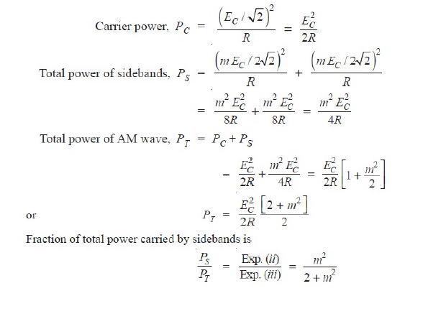
Power Relations -AM wave

