Slide 1

Analog Communication Systems
BECE 304L
Module-2

Slide 2

Course- module-2

Slide 3
Am demodulation

Slide 4
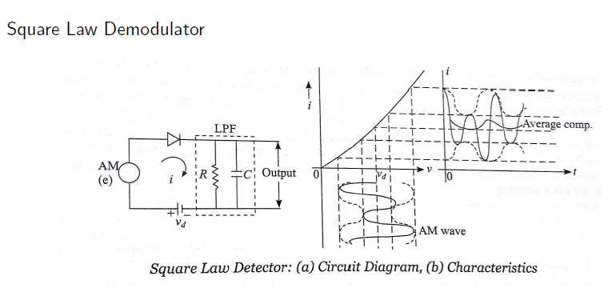
Am detection- square law demodulation

Slide 6
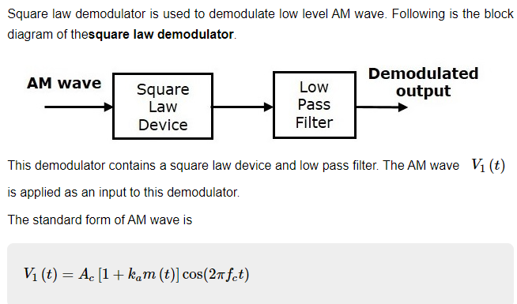
Am detection- square law demodulation

Slide 7
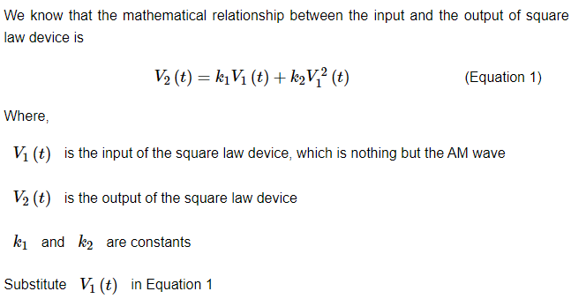
Am detection- square law demodulation

Slide 8
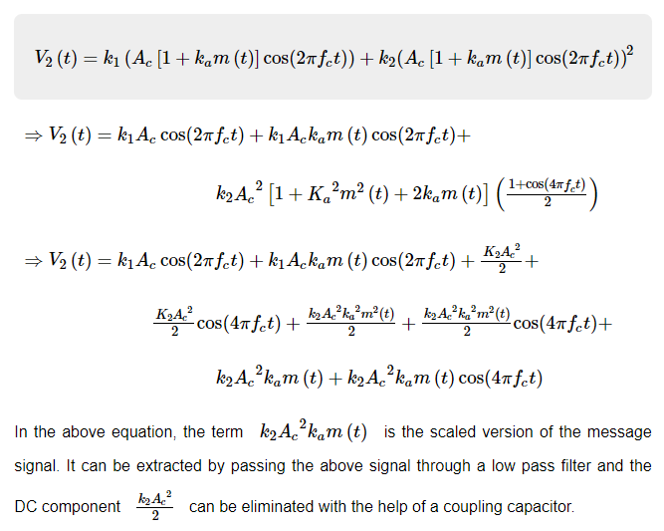
Am detection- square law demodulation

Slide 9
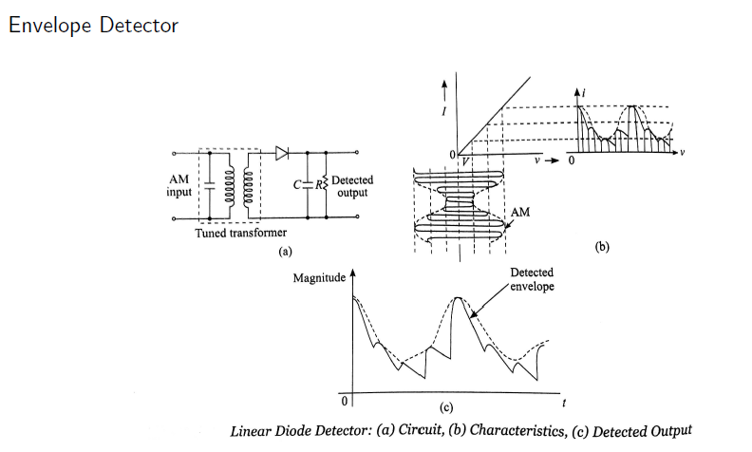
Am detection- Envelope detector

Slide 10
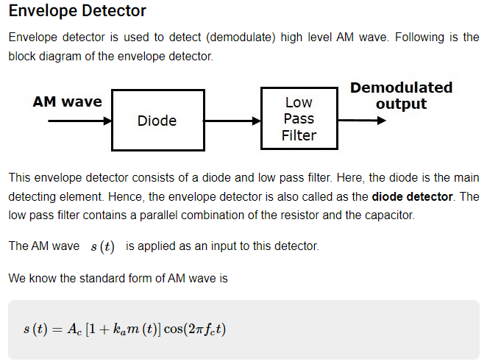
Am detection- Envelope detector

Slide 11
Am detection- Envelope detector
In the positive half cycle of AM wave, the diode conducts and the capacitor charges to the peak value of AM wave.
When the value of AM wave is less than this value, the diode will be reverse biased.
Thus, the capacitor will discharge through resistor R till the next positive half cycle of AM wave.
When the value of AM wave is greater than the capacitor voltage, the diode conducts and the process will be repeated.
We should select the component values in such a way that the capacitor charges very quickly and discharges very slowly.
As a result, we will get the capacitor voltage waveform same as that of the envelope of AM wave, which is almost similar to the modulating signal.

Slide 12
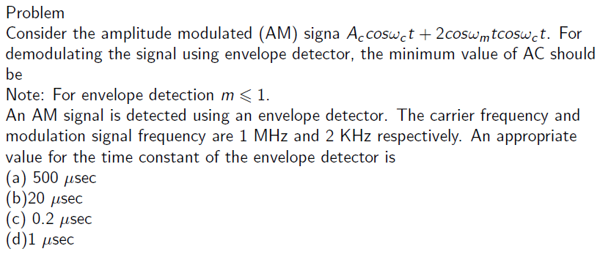
numericals

Slide 13
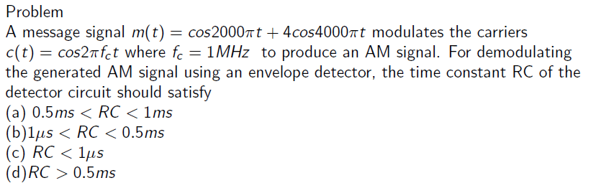
numericals

