Slide 1

Analog Communication Systems
BECE 304L
Module-3

Slide 2
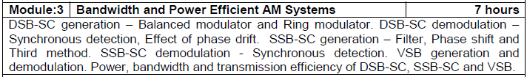
Course- module-3

Slide 3
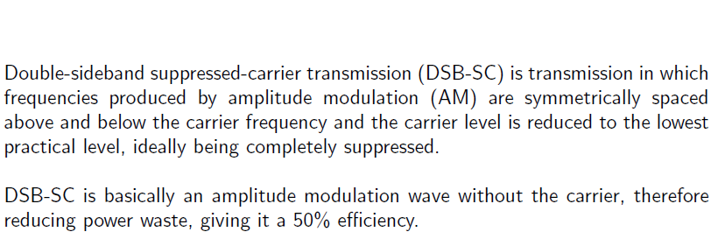
Double sideband suppressed carrier (dsb-sc)

Slide 4
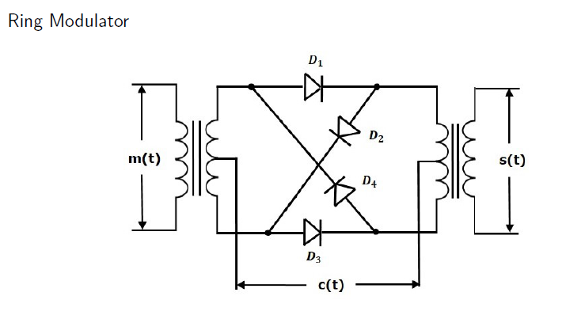
Ring modulator

Slide 5
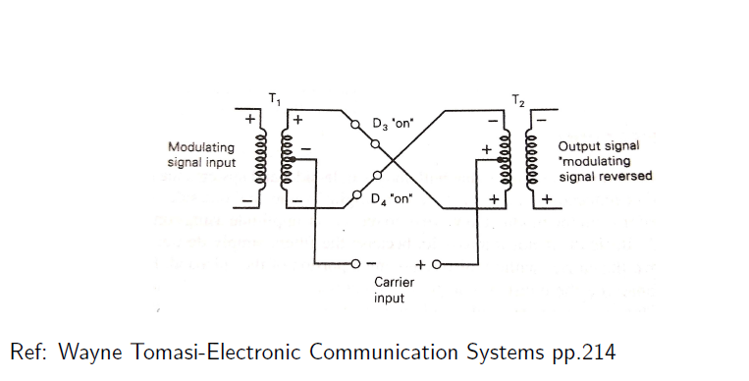
Ring modulator

Slide 6
Ring modulator
During the positive half-cycle, D1 and D2 are forward biased and on, and D3 and D4 are reverse biased and act as open circuits. The carrier current is then equally divided at the center tap of the input transformer’s secondary and flows in opposite directions through the upper and lower halves of the winding.
The currents in the upper and lower parts each produce a magnetic field that is both equal and opposite with each other therefore, the magnetic fields produced cancel out and the carrier is suppressed.

Slide 7
Ring modulator
Figure illustrates the negative half-cycle operation of the diode ring modulator. Diodes D1 and D2 are reversed biased and off while D3 and D4 are forward biased and on. Again, the same thing happens to the carrier current. It splits equally in the primary of the output transformer and both current produce magnetic fields equal and opposite with one another.
The two currents merge in the secondary of the input transformer and the magnetic fields are canceled out, and the carrier is suppressed. The modulating signal passes through the input transformer and undergoes a 180° phase reversal before reaching the output transformer.

Slide 8
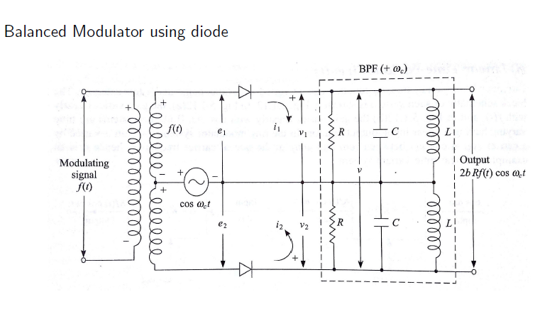
Balanced modulator

Slide 9
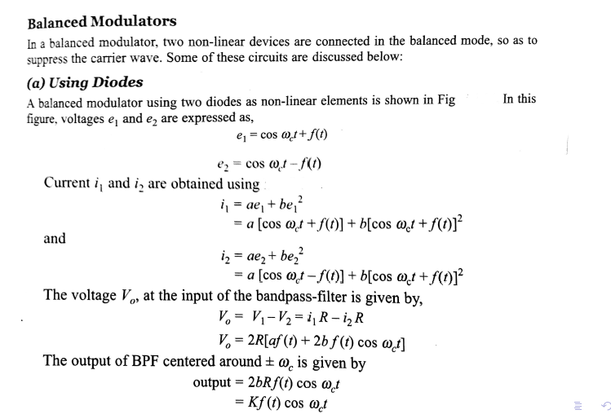
Balanced modulator

Slide 10
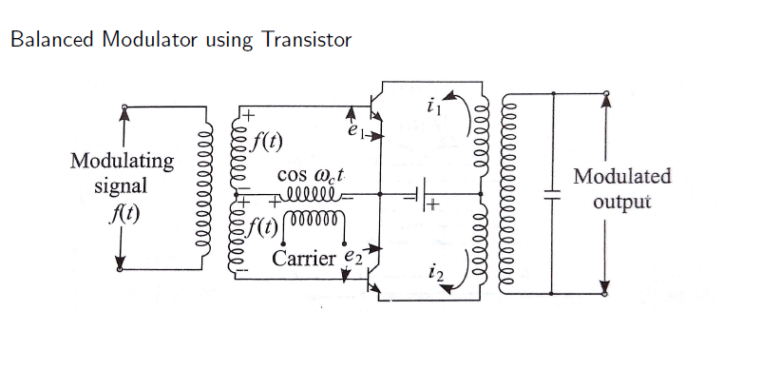
Balanced modulator

Slide 11
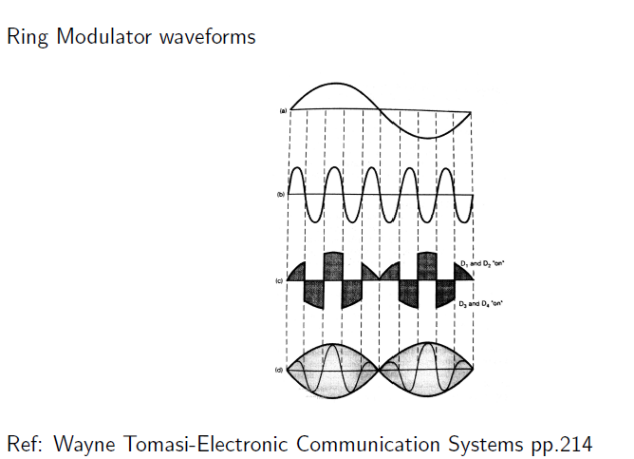
Ring modulator

Slide 12
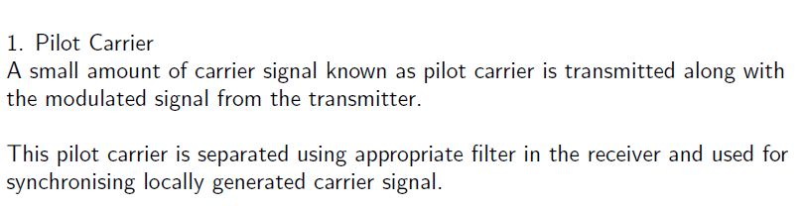
Synchronising techniques

Slide 13
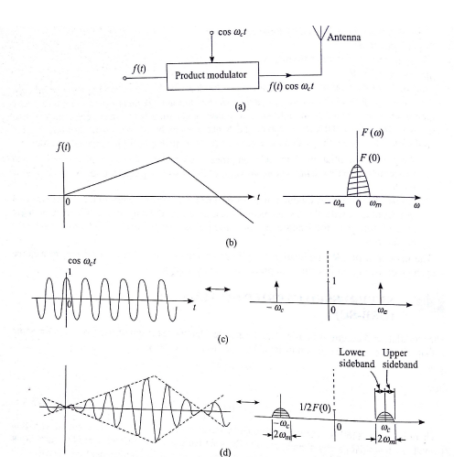
Double sideband suppressed carrier (dsb-sc)

Slide 14
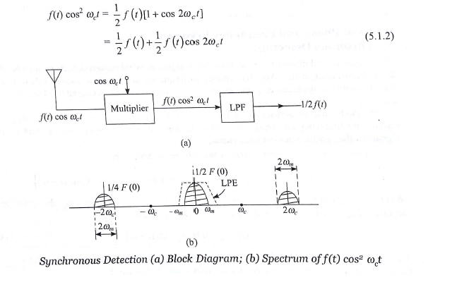
Double sideband suppressed carrier (dsb-sc)

Slide 15
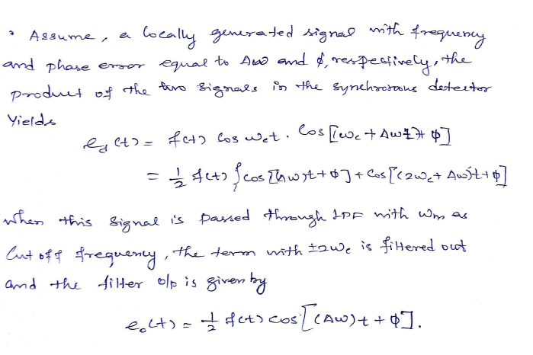
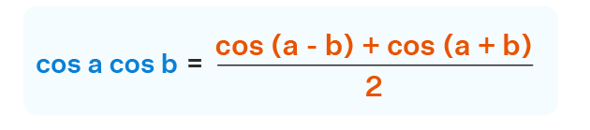
Phase and frequency errors in synchronous detection

Slide 16
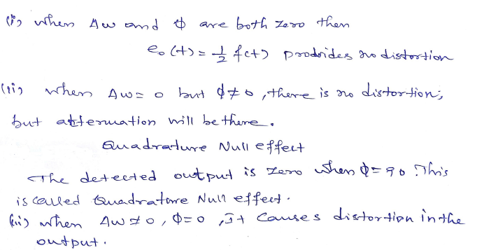
Quadrature null effect

Slide 17
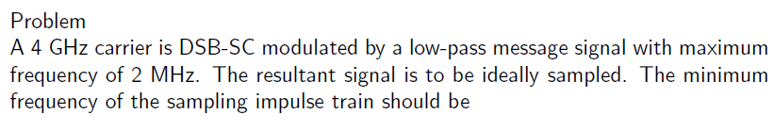
Numerical- dsb-sc

Slide 18
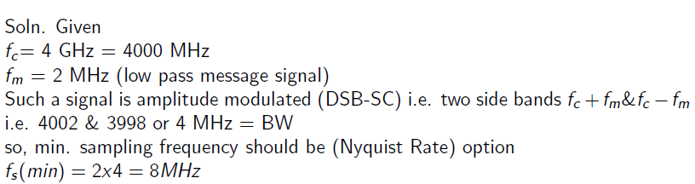
Numerical- dsb-sc

Slide 20
Single side band suppressed carrier (ssb-sc)
In radio communications, single-sideband modulation (SSB) or single-sideband suppressed-carrier modulation (SSB-SC) is a refinement of amplitude modulation which uses transmitter power and bandwidth more efficiently.
Amplitude modulation produces an output signal that has twice the bandwidth of the original baseband signal. Single-sideband modulation avoids this bandwidth doubling, and the power wasted on a carrier, at the cost of increased device complexity and more difficult tuning at the receiver.

Slide 21
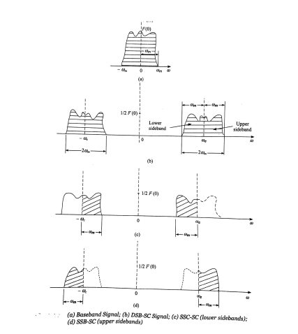
Single side band suppressed carrier (ssb-sc)

Slide 22
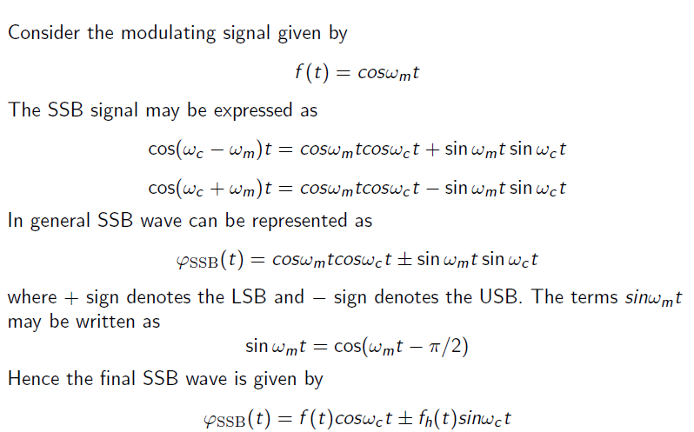
Single side band suppressed carrier (ssb-sc)

Slide 23
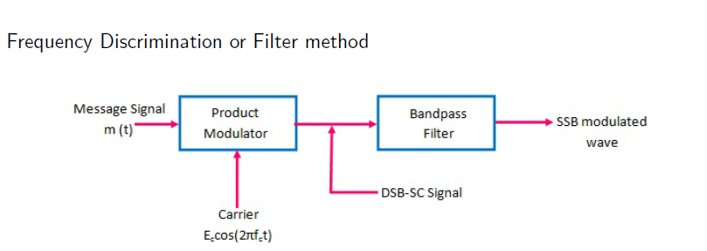
ssb-sc- generation

Slide 24
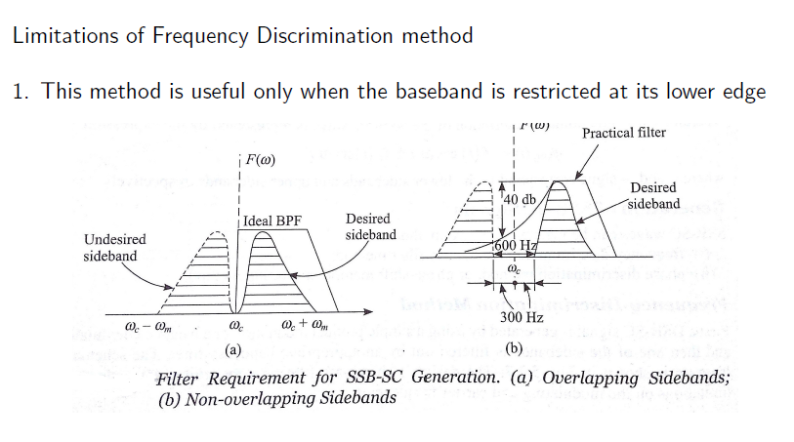
ssb-sc- generation

Slide 25
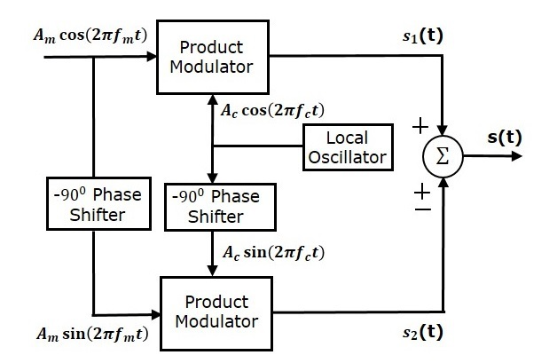
Phase discrimination method
ssb-sc- generation

Slide 26
ssb-sc- generation
This block diagram consists of two product modulators, two −90 degrees degrees phase shifters,
one local oscillator and one summer block. The product modulator produces an output, which is the product of two inputs.
The −90 degrees phase shifter produces an output, which has a phase lag of −90 degrees with respect to the input.

Slide 27
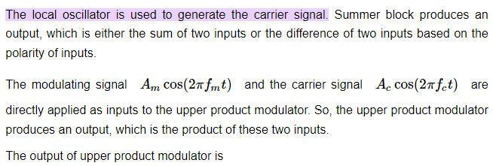
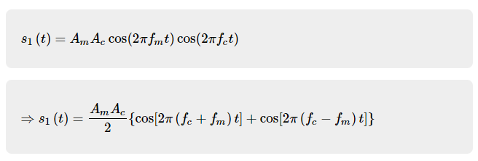
ssb-sc- generation

Slide 28
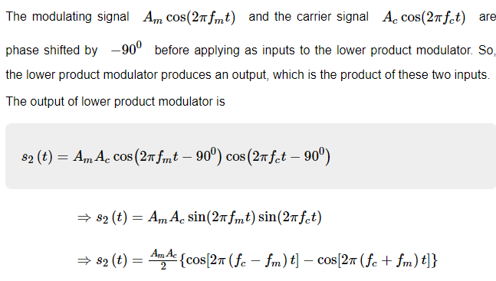
ssb-sc- generation

Slide 29
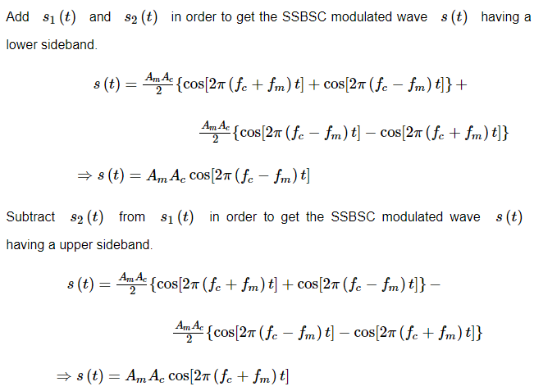
ssb-sc- generation

Slide 30
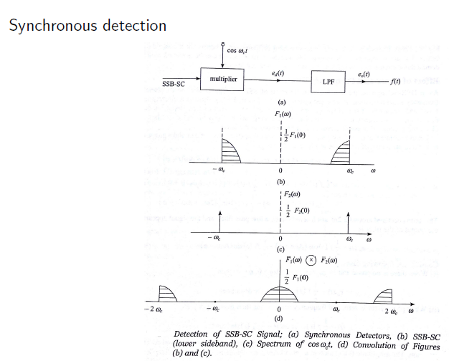
ssb-sc- detection

Slide 31
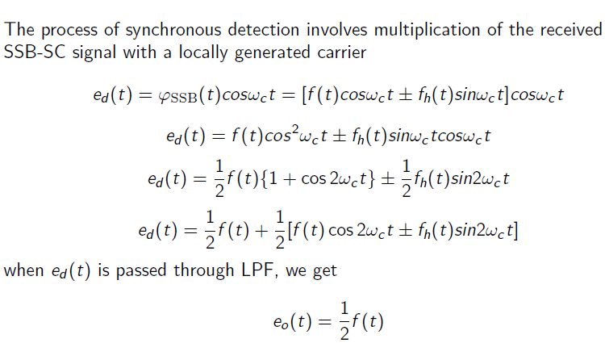
ssb-sc- detection

