Slide 1

Analog Communication Systems
BECE 304L
Module-3

Slide 2
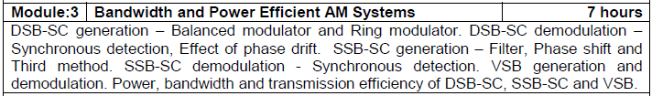
Course- module-3

Slide 3
Vestigial sideband –vsb-sc (am)
The main limitation associated with SSB is the practical difficulty in suppressing the unwanted sideband frequency components. It was observed in practice that such a process results in eliminating even some portion of the wanted sideband.
This is because, in many cases the message has information starting from zero frequency and spreads upto a maximum of fm Hz.
ln such a scenario, the first wanted and unwanted frequency components lie very close to each at the carrier frequency fc;.

Slide 4
Vestigial sideband –vsb-sc (am)
Therefore an attempt to attenuate unwanted component will in turn leads to attenuation of wanted component.
One way to compensate for this loss is to allow a vestige or trace or fraction-of unwanted sideband along with the wanted sideband.
This thought process lead to the development of yet another of AM termed as vestigial sideband suppressed carrier (VSBSC)

Slide 5
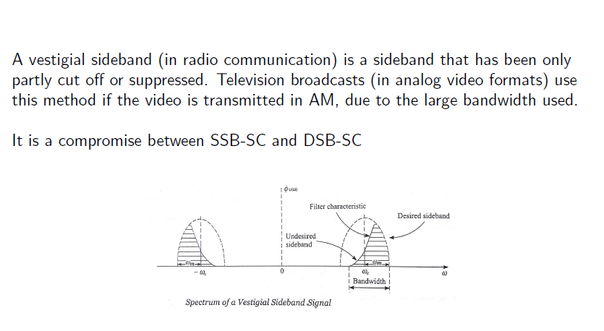
Vestigial sideband –vsb-sc(am)

Slide 6
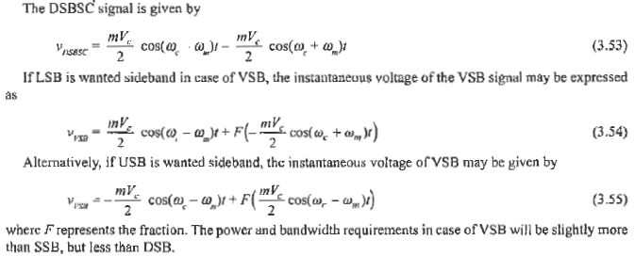
Vestigial sideband –vsb-sc (am)

Slide 7
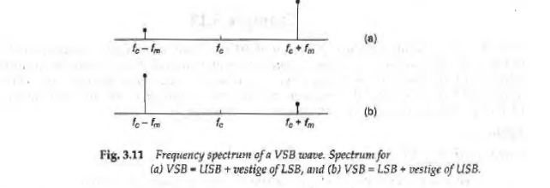
VSB-SC- FREQUENCY SPECTRUM

Slide 8
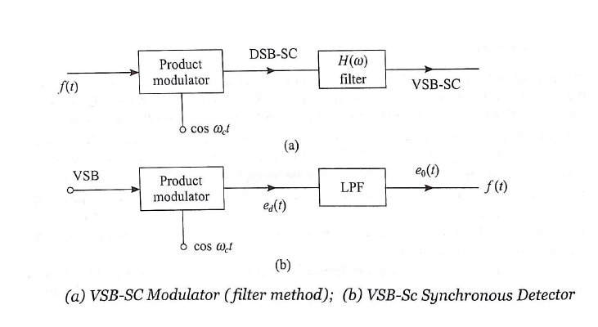
Vestigial sideband –vsb-sc (am)

Slide 9
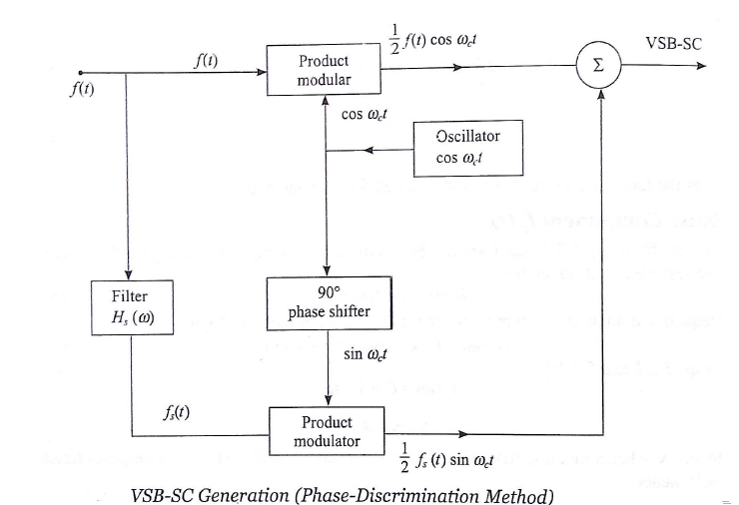
Vestigial sideband –vsb sc(am)

Slide 10
Vestigial sideband –vsb sc(am)

Slide 11
Vestigial sideband –vsb sc(am)

Slide 19
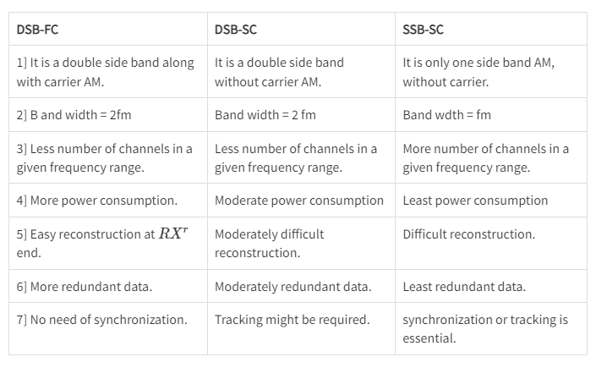
DSB-FC, DSB-SC, SSB-SC

