Slide 1

BECE304L ANALOG COMMUNICATION
Module 2

Slide 2
AMPLITUDE MODULATION SYSTEMS

Slide 3
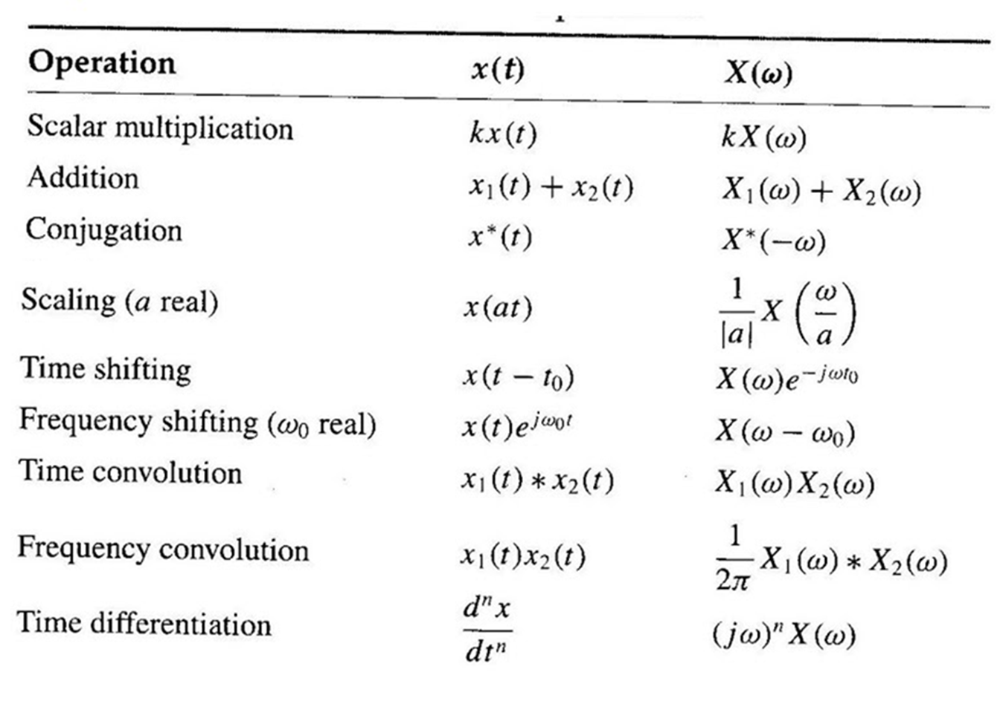
RECALL the properties Fourier Transform Pair

Slide 4
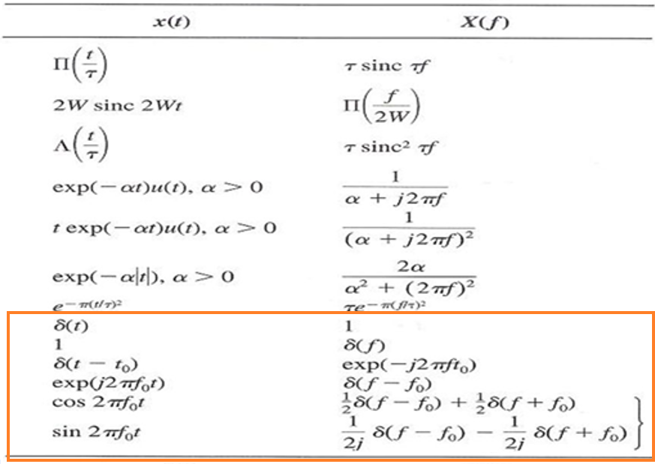
RECALL some of the important Fourier Transform Pair

Slide 5
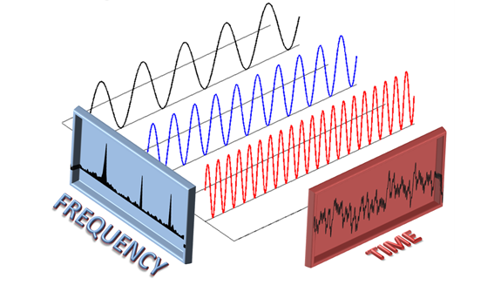

Slide 6
PART-A
Various Amplitude Modulation and Demodulation Schemes
(Contents are as per syllabus)

Slide 7
Amplitude Modulation
Baseband vs Passband Transmission
Baseband Signal:- Information bearing Signal or Message Signal.
The term Baseband refers to the band of frequencies representing the original signal obtained from the source (or Base)
Voice (0-4kHz)
TV (0-6 MHz)
A signal may be sent in its baseband format when a dedicated wired channel is available.
Otherwise, it must be converted to passband.

Slide 8
Need for Modulation
To reduce the size of the antenna
For efficient radiation, the size of the antenna should be λ/10 or more (preferably around λ/4 ), where λ is the wavelength of the signal to be radiated.
Easy to Multiplex
Several message signals can be transmitted on a given channel, by assigning to each message signal an appropriate slot in the channel.
Channel Selectivity
Each station can be assigned a suitable carrier so that the corresponding program material can be received by tuning to the station desired.
Less Fading of transmitted signal
As the energy of a signal is proportional to its frequency, fading by the atmospheric particle is less

Slide 9
What is Modulation?
So for better transmission, we need to send a high frequency signal.
But message signal is of low frequency.
If we alter the frequency of message signal, the information will be lost.
We can send a high frequency signal which reflects the characteristics of message signal.
This high frequency signal is called CARRIER SIGNAL
The message signal is called MODULATING SIGNAL or BASEBAND SIGNAL.
The resultant signal after modulation is called MODULATED SIGNAL.

Slide 10
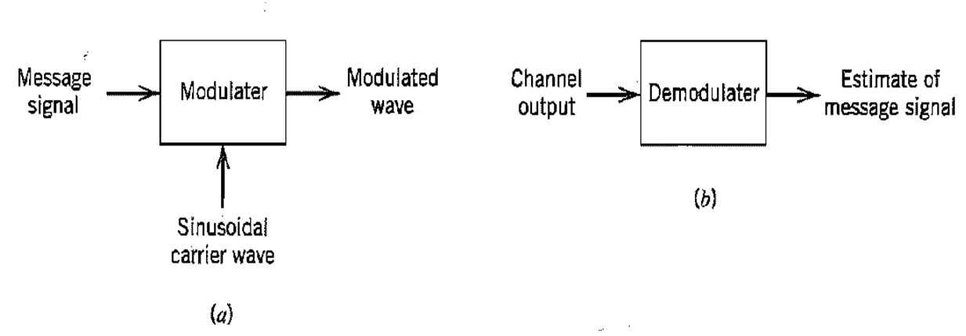
For study purpose, the commonly used carrier and message signal is SINUSOIDAL WAVE.
Transmitter Side - Modulation
Receiver Side - Demodulation
Fig: Important process components of a communication system (a) Transmitter (b) receiver

Slide 11
Definition for Modulation
Modulation is defined as the process by which some characteristic of a carrier wave is varied in accordance with the message signal.
AM – Amplitude modulation is a process in which the amplitude of the carrier signal is varied in accordance with the instantaneous amplitude of the message signal.
FM – Frequency modulation is a process in which the frequency of the carrier signal is varied in accordance with the instantaneous amplitude of the message signal
PM – Phase modulation is a process in which the phase of the carrier signal is varied in accordance with the instantaneous amplitude of the message signal.

Slide 12
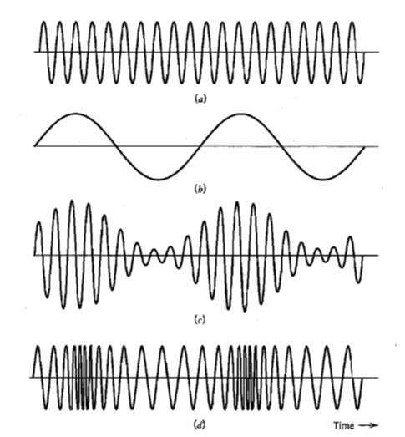
CARRIER
MESSAGE
AM
FM

Slide 13
Equation for AM
Recall that, Amplitude Modulation (AM) is defined as the process in which the amplitude of the Carrier Signal, c(t) is varied about a mean value, linearly with the Base band Signal, m(t).
Let the carrier signal be
→(1)
Let the message signal be
→(2)
During modulation, the message signal is superimposed on the carrier amplitude
Therefore, after modulation, the modulated signal is given by
→(3)

Slide 14
→(4)
is called the as modulation index
When m>1, then the envelope of s(t) gets overlapped, and the modulation is called as over-modulation, there are distortion in the modulated signal
When m=1, then the envelope of s(t) gets just touches, and the modulation is called as unity-modulation
When m<1, then the envelope of s(t) is not overlapped , and the modulation is called as under-modulation, there is no distortion
The maximum absolute value of m multiplied by 100, is called as the percentage modulation.

Slide 15
Spectrum ,BW and Power in AM
Recall the Eqn. (4), the equation of AM signal
→(4)
Expanding Eqn.,(4)
→(5)
Carrier
Lower side band
Upper side band
Thus the standard AM signal contains three frequencies: carrier, lower side band (LSB), upper side band (USB)

Slide 16
Taking Fourier Transform of Eqn,(5)
→(6)
Amplitude
Frequency

Slide 17
From the spectrum of AM wave, the bandwidth signal becomes
BW= (f_{c}+f_{m})-(f_{c}-f_{m})=2f_{m}
In practice, the AM wave is a voltage or current wave. In either case, the average power delivered to a 1-ohm resistor by s(t) is comprised of three components:
The carrier power
Lower side band power
Upper sideband power

Slide 18
The total power becomes

Slide 19
Types of Amplitude Modulation
The AM given by Eqn. (5) is called as Double Sideband Full Carrier (DSB FC) AM signal as there is a carrier, LSB and USB.
In the DSBFC AM, the carrier component contains no information and hence it is suppressed before transmission, and the resulting transmission is called as Double Sideband Suppressed Carrier (DSB SC) AM signal.
In DSB SC AM signal, both sidebands contains equal and identical information, hence one of the sideband can be removed before transmission, and the resulting transmission is called as Single Sideband (SSB) AM signal.
When AM is used for the TV video signal transmission, then one full sideband and part (vestige) of other sideband is transmitted, and the resulting transmission is called Vestigial Sideband (VSB) AM signal.

Slide 20
Types of Amplitude Modulation
Amplitude Modulation
illus
Non Linear AM
AM DSB FC
Amplitude Modulation
AM DSB SC
Linear
AM
SSB
VSB

Slide 21
Generation and Detection of Full AM
Generation of DSB FC AM (Square law method)
v₁(t)
v₂(t)
s(t)
m(t)
Square law device
BPF
+
c(t)
Let the message signal be
→(1)
Let the carrier signal be
→(2)
The output of summing network
→(3)

Slide 22
The output of square law device becomes
→(4)
→(5)
From Eqn.(5), the output of square law device consists of 2 DC terms and 6 AC terms of frequencies: ω_{c}, ω_{m}, 2ω_{c}, 2ω_{m}, (ω_{c}+ ω_{c}), (ω_{c}+ ω_{c})

Slide 23
The BPF is designed for center frequency of ω_{c} and bandwidth of 2ω_{m}, and therefore s(t) becomes
Which is a DSB FC AM wave
Carrier
Lower side band
Upper side band

Slide 24
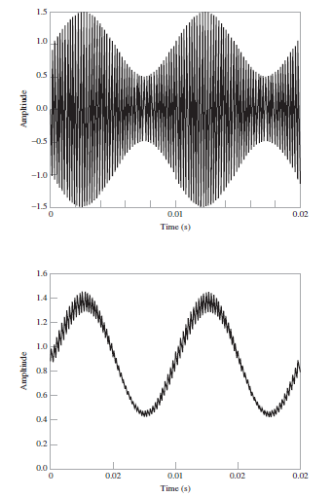
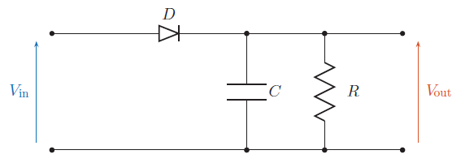
Detection of DSB FC AM (Envelope Detector)
Fig (b): Envelop detector input
Fig(a): Envelop detector
Fig(c): Envelop detector output

Slide 25
Fig. (a) shows the circuit diagram of a envelope detector.
The DSB FC AM signal consisting of both positive and negative going voltages as shown as shown in Fig (b) is applied at the input.
The diode envelope detector rectifies the waveform leaving only the positive or negative half of the waveform.
The high frequency element of this is then filtered out, typically using a capacitor which forms the low pass filter.
Thus the output of the detector is the demodulated message signal as shown in Fig (c).

Slide 26
Envelope detector advantages:
Low cost: The diode detector only requires the use of a few low cost components.
Simplicity: Using very few components, the Diode AM detector was easy to implement.
Envelope detector disadvantages:
Distortion: As the diode detector is non-linear it introduces distortion onto the detected audio signal.
Sensitivity: If silicon diodes are used, these have a turn on voltage of around 0.6 volts as a result, germanium or Schottky diodes are used which have a lower turn on voltage of around 0.2 to 0.3 volts. Even with the use of the Schottky diode, the diode envelope detector still suffers from a poor level of sensitivity

Slide 27
Module 3

Slide 28
Generation and Detection of DSB SC AM
Generation of DSB SC AM (Product Modulator)
m(t)
Product Modulator
s(t)
c(t)
Let the message signal be
→(1)
Let the carrier signal be
→(2)
The output of product modulator becomes
→(3)

Slide 29
→(4)
Lower side band
Upper side band
As can be seen from Eqn. (4), the output product modulator contains only LSB and USB and hence it is a DSB SC AM wave

Slide 30
Detection of DSB SC AM (Coherent detection/ Product detector)
v(t)
s¹(t)
Product Detector
Low Pass Filter
v_{o}(t)
c¹(t)
Local Oscillator
Let the AM signal input to the modulator be
→(1)
Let the output of local oscillator be
→(2)

Slide 31
The output of product detector becomes
→(3)
→(4)
Eqn. (4) consists of three frequency terms:2ω_{c} - ω_{m}, 2ω_{c} + ω_{m}, ω_{m}
The LPF will pass only the message frequency terms to its output.
→(5)
Which is nothing but a demodulated message

Slide 32
Generation and Detection of SSB AM
Generation of SSB AM (Filter Method)
s₁(t)
s(t)
m(t)
Product Modulator
Sideband Filer
c(t)
Let the message signal be
→(1)
Let the carrier signal be
→(2)
The output of product modulator becomes
→(3)

Slide 33
The signal s1(t) is passed through a band pass filer with cut-off frequency ‘fc’, and bandwidth ‘fm’ resulting in SSB AM wave
(or)
Drawback of Filter Method
Since a perfect cutoff at f = fc can not be achieved, so a practical sideband filter will either pass a portion of the undesired sideband or attenuate a portion of the desired sideband.

Slide 34
Generation of SSB AM (Phase Discrimination Method)
s₁(t)
s(t)
m(t)=cosω_{m}t
Product Modulator 1
+
cosω_{c}t
Oscillator
Wideband Phase shifter
-90 º Phase shifter
sinω_{c}t
Product Modulator 2
s₂(t)

Slide 35
Let the message signal be
→(1)
Let the carrier signal from the oscillator be
→(2)
The output of wideband phase shifter becomes
→(3)
The output of -90o phase shifter becomes
→(4)
The output of product modulator 1 becomes
→(5)
The output of product modulator 2 becomes
→(6)
The output of adder becomes
which is the SSB AM wave
→(7)

Slide 36
Detection of SSB AM (Coherent detection)
v(t)
s¹(t)
Product Detector
Low Pass Filter
v_{o}(t)
c¹(t)
Local Oscillator
Let the SSB signal input to the modulator be
→(1)
Let the output of local oscillator be
→(2)

Slide 37
illus
The output of product modulator becomes
→(3)
Eqn. (3) consists of two frequency terms:2ω_{c} - ω_{m}, ω_{m}
The LPF will pass only the message frequency terms to its output.
→(4)
Which is nothing but a demodulated message

Slide 38
illus
Generation of VSB AM
s₁(t)
s(t)
m(t)
Product Modulator
VSB Filer
c(t)
Let the message signal be
→(1)
Let the carrier signal be
→(2)
The output of product modulator becomes
→(3)

Slide 39
VSB is derived by filtering full AM (or DSB-SC) with a VSB filter in such a fashion that one sideband is passed almost completely while just a trace, or vestige, of the other sideband is included.
VSB filter (shown in FIGURE) should have the following characteristics:
Odd symmetry about carrier frequency
A relative response of ½ at fc

Slide 40
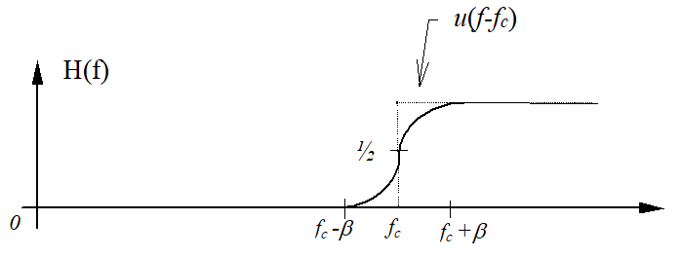
The VSB filter is thus a practical sideband filter with transition width 2β. Obviously, the transmission bandwidth is
Hence the output is a VSB AM signal

Slide 41
PART-C
Problems/Tutorials to Practice
You are advised to discuss among students (and/or with Faculty) to solve some simple tutorials related to AM , such as given in the next slide.

Slide 42
Tutorial 1: For a DSB FC AM using sinusoidal modulating wave, the percentage modulation is 20 percent. Calculate the average power in
the carrier
each side frequency
Express the powers as percentage of total power

Slide 43
Tutorial 1 (Solution)
(a)
(b)

Slide 44
(c)

Slide 45
Tutorial 2:
If sinusoidal DSB-SC modulation considered in Tutorial 1, what is the average power in the lower or upper side-frequency, expressed as a percentage of the average power in the DSB-SC modulated wave?

Slide 46
Tutorial 2 (Solution)

Slide 47
Tutorial 3: The modulating signal m(t) = 2cos4000πt + 5cos6000πt is multiplied by the carrier c (t) = 100cos2πfct , where fc =50 kHz. Determine and sketch the power-spectral density of the DSB signal

Slide 48
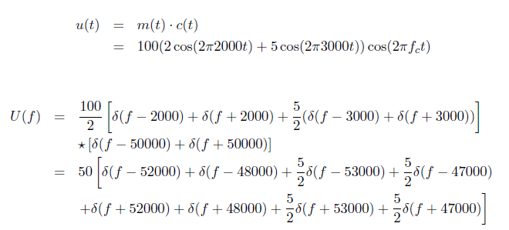
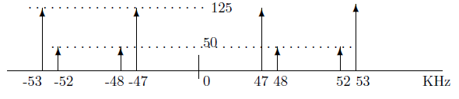
Example 4 (Solution)
Tutorial 3 : Solution

Slide 49
Tutorial 4: A message signal m(t) = cos2000πt+2cos4000πt modulates the carrier c(t) = 100cos2πfct where fc = 1 MHz to produce the DSB signal m(t)c(t).
1. Determine the expression for the upper sideband (USB) signal.
2. Determine and sketch the spectrum of the USB signal.

Slide 50
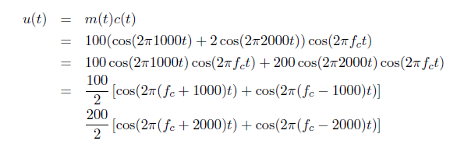


Tutorial 4 (Solution)
1.

Slide 51

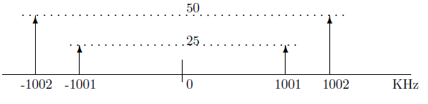
Tutorial 4 (Solution) cont…
2.

Slide 52
Tutorial: 5
The message signal m(t) = 2 cos400t + 4sin(500t + π/3 ) modulates the carrier signal c(t)= Acos(8000πt), using DSB-SC amplitude modulation.
Find the time domain and frequency domain representation of the modulated signal, and
Plot the spectrum (Fourier transform) of the modulated signal, and also
What is the power content of the modulated signal?

Slide 53
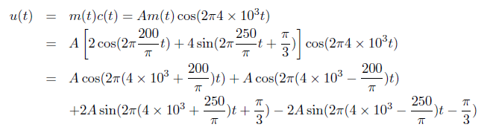
Tutorial 5 (Solution)
1.

Slide 54
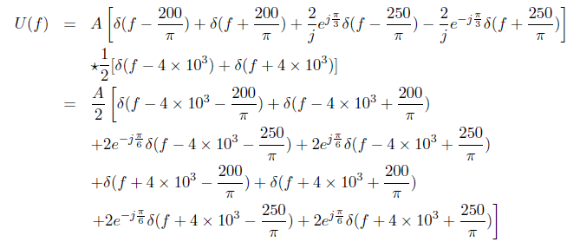
Tutorial 5 (Solution) cont….

Slide 55
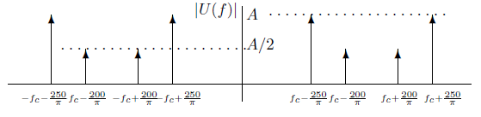
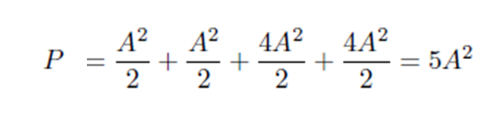
Tutorial 5 (Solution) cont….
2.
3.

Slide 56
Tutorial for student: The message signal m(t) = 2 cos400t + 4sin(500t) modulates the carrier signal c(t)= Acos(8000πt), using DSB-SC amplitude modulation.
Find the time domain and frequency domain representation of the modulated signal, and
Plot the spectrum (Fourier transform) of the modulated signal

Slide 57



