Slide 1
Orthogonal Frequency Division Modulation (OFDM)

Slide 2



Basic Concept of OFDM
Wide-band channel
Multiple narrow-band channels
Send a sample using the entire band
Send samples concurrently using multiple orthogonal sub-channels

Slide 3
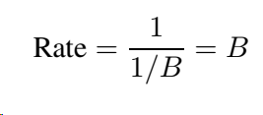
Single Carrier Systems
Bandwidth B = 2W available for communication, where W is the one-sided bandwidth (or max freq),
For a single-carrier communication system, the symbol time T is given as T = 1/B
Symbol rate is given as

Slide 4
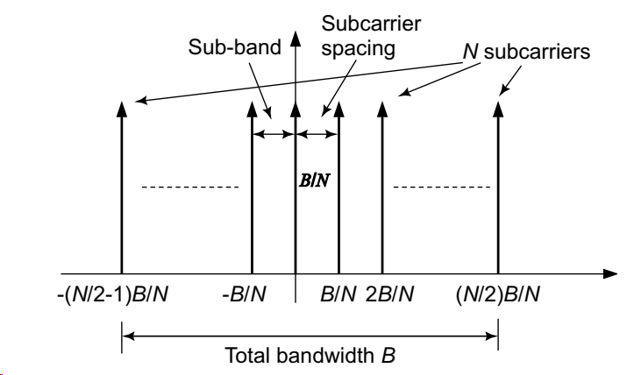

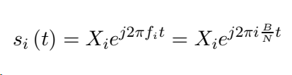
Multi Carrier Systems
Divide the total bandwidth B into N sub-bands of bandwidth B/N
Subcarriers are placed at
Consider the i^{th} subcarrier at the frequency
Let X_{i} denote the data transmitted on the i^{th} subcarrier
The signal s_{i}(t) corresponding to the i^{th} subcarrier
The N different data symbols X_{i} are modulated over the N different subcarriers with centre frequencies f_{i}
Hence, there are a total of N data streams

Slide 5
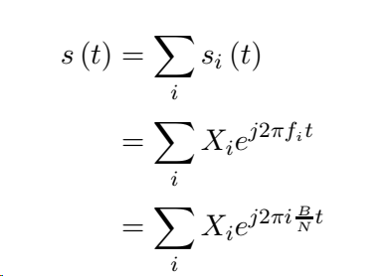
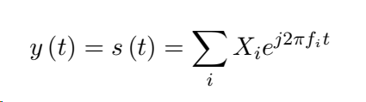
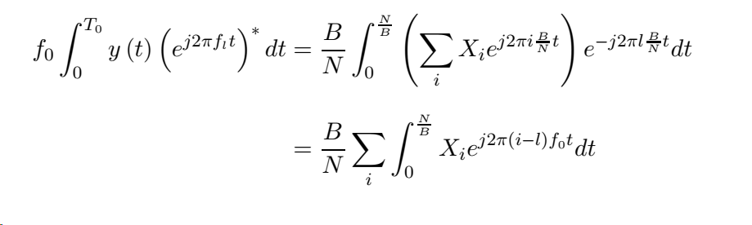
Composite Signal Transmitted and Received

Slide 6
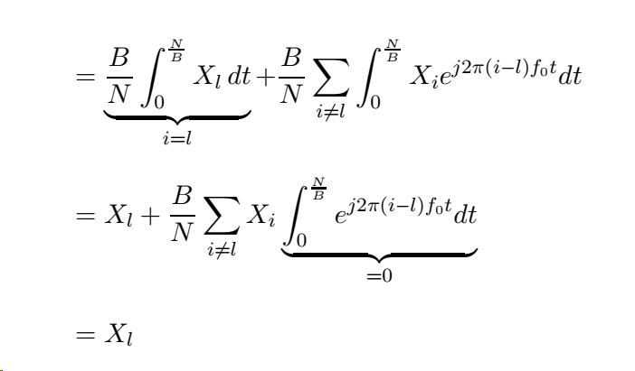
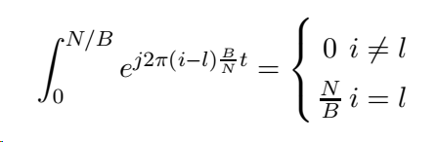
Composite Signal Received & Orthogonality

Slide 7
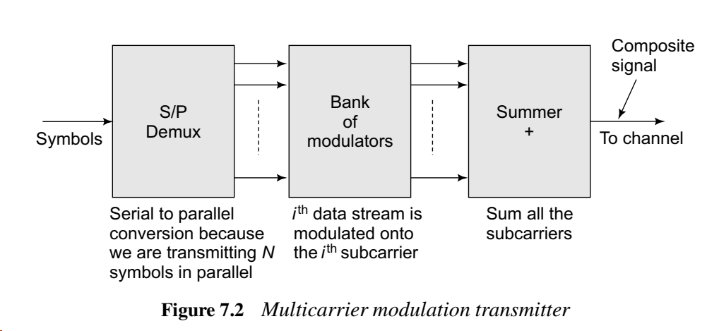
Multi-carrier modulation transmitter

Slide 8
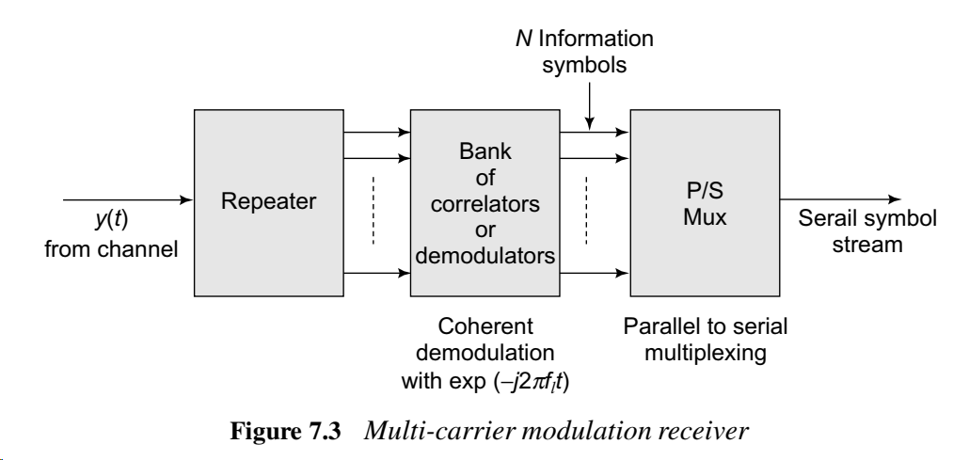

Multi-carrier modulation receiver

Slide 9
Symbol Rate of MCM system
N symbols using N subcarriers
Each with a rate B/N
Or time duration N/B
Net rate : N/(N/B)= B
Overall Symbol rate of MCM= Symbol rate of SCM
The single-carrier system transmits each symbol in time 1/B, while the MCM system transmits N symbols in parallel in time N/B

Slide 10






Why OFDM is better?
t
t
₀ 1
₁ ₀ 0
f
₀ 1
f
₀ ₁ ₁ ₀ ₀ ₀ ₁ …........
Wide-­‐band Narrow-­‐band
Multiple sub-channels (sub-carriers) carry samples sent at a lower rate
⯈ Almost same bandwidth with wide-band channel
Only some of the sub-channels are affected by interferers or multi-path effect

Slide 11
Simple Example
Consider a system with a transmission bandwidth of B = 1.024 MHz, i.e., 1024 kHz
Consider the coherence bandwidth Bc which is typically around 250 kHz, i.e., Bc ≈ 250 kHz.
Therefore, since the transmission bandwidth B >> Bc, the single-carrier system experiences frequency-selective fading and inter-symbol interference.
However, consider an OFDM system with employs N = 256 subcarriers in the same bandwidth. The bandwidth per subcarrier is Bs = 1024/ 256 = 4 kHz
B<<Bc, each channel experiences Flat fading

Slide 12














Importance of Orthogonality
Why not just use FDM (frequency division multiplexing)
⯈ Not orthogonal
Individual sub-­‐channel
Leakage interference from
adjacent sub-­‐channels
f
guard band
Guard bands protect leakage interference
f
Need guard bands between adjacent frequency bands → extra overhead and lower throughput

Slide 13
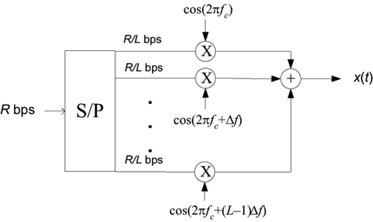
Multicarrier communications
Concept:
Divide original data stream at rate R into L lower rate (R/L) streams on different carriers to increase symbol time
Effects
High receiver complexity
separate receiver chain per carrier
Bandwidth due to sidebands
Each subcarrier experiences flat fading
J. Andrews, A. Ghosh, R. Muhamed, Fundamentals of WiMAX, Prentice Hall, 2007
B/L
B_{c}
f
B

Slide 14
OFDM- Basic Concept

Slide 15




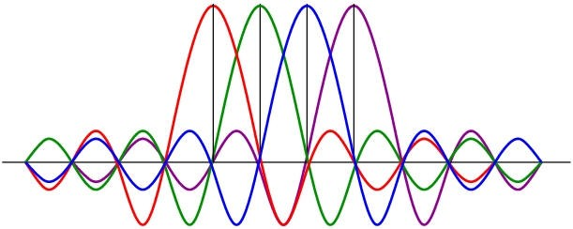
Difference between FDM and OFDM
guard band
f
Frequency division multiplexing
f
Orthogonal sub-carriers in OFDM
Don’t need guard bands

Slide 16
Spectra of OFDM signal

Slide 17
Modulation or Multiplexing?
OFDM can be viewed as either a modulation technique or a multiplexing technique.
Modulation technique
Viewed by the relation between input and output signals
Multiplex technique
Viewed by the output signal which is the linear sum of the modulated signals

Slide 18
MCM to OFDM
The employment of discrete Fourier transform to replace the banks of sinusoidal generator and the demodulation significantly reduces the implementation complexity of OFDM modems.

Slide 19
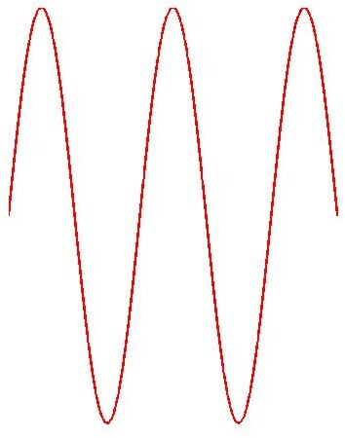
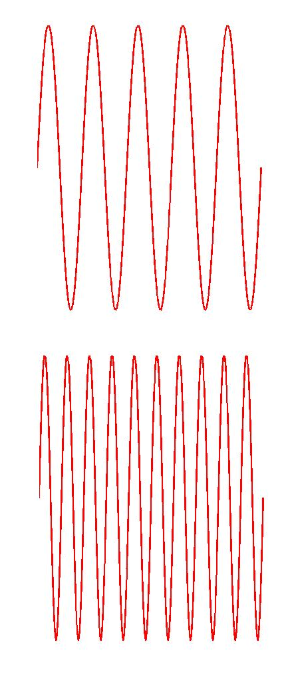


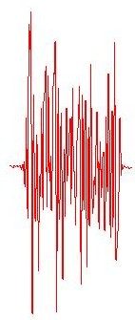
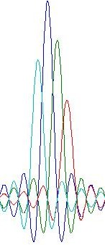



Orthogonal Frequency Division Modulation
* x[1]
IFFT
* x[2]
transmit
f
* x[3]
t
…
Data coded in frequency domain
Transformation to time domain: each frequency is a sine wave
In time, all added up
Channel frequency response
Decode each subcarrier separately
receive
FFT
Time domain signal
Frequency domain signal

Slide 20


OFDM Transmitter and Receiver -Level 1

Slide 21



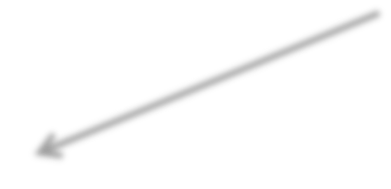
Orthogonality of Sub-carriers
IFFT
Encode: frequency-domain samples → time-domain sample
N 2−1
_{∑ X[k]e}j 2πkt N k=−N 2
x(t) =
Time-domain
Frequency-domain
_{∑ x(t)e}− j 2πkt N
1
N 2−1
X[k] =
^{N} t=N 2
FFT
Decode: time-domain samples → frequency-domain sample
N 2−1
_{∑ e}− j 2πkt N _{e}− j 2π pt N t=N 2
Orthogonality of any two bins :
= 0, ∀p ≠ k

Slide 22
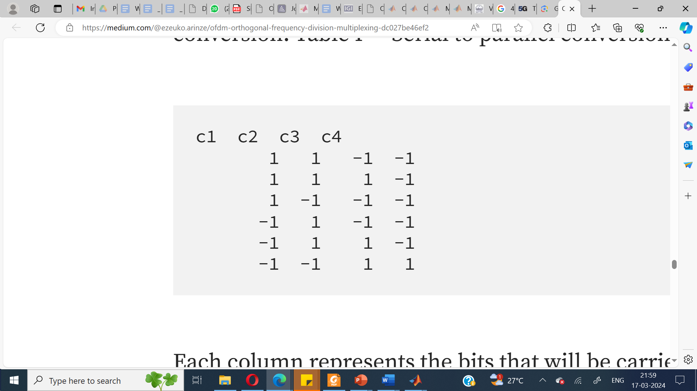

Example
Let’s consider N=4
The signal has a symbol rate of 1 and the sampling frequency is 1 sample per symbol, so each transition is a bit
First few bits are 1, 1, -1, -1, 1, 1, 1, -1, 1, -1, -1, -1, -1, 1, -1, -1, -1, 1,…
Write these bits in rows of fours
Assume C1 is 1 Hz

Slide 23
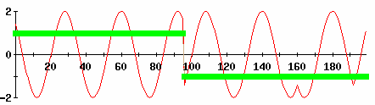
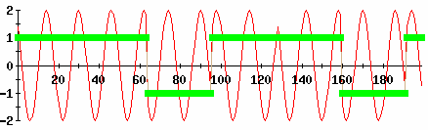
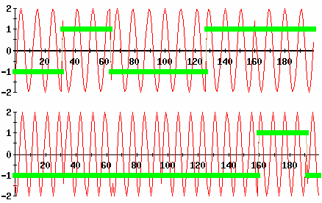

t1
t2 t3 t4 t5
t6
Carrier 1 — We need to transmit 1, 1, 1 -1, -1, -1
bin1
symbol1 | 1 | 1 | -­‐1 | -­‐1
symbol2 | 1 | 1 | 1 | -­‐1
symbol3 | 1 | -­‐1 | -­‐1 | -­‐1
symbol4 | -­‐1 | 1 | -­‐1 | -­‐1
symbol5 | -­‐1 | 1 | 1 | -­‐1
symbol6 | -­‐1 | -­‐1 | 1 | 1
bin2
bin3
bin4

Slide 24
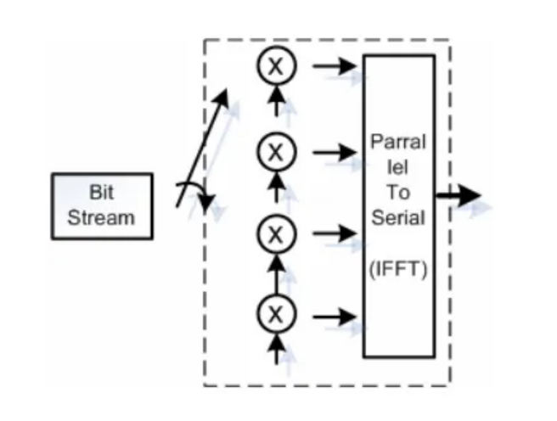
Composite Signal

Slide 25


Example
Frequency-­‐domain signal Time-­‐domain signal
c1 c2 c3 c4
IFFT
symbol1 symbol2 symbol3 symbol4
1 1 -­‐1 -­‐1
0 2 -­‐ 2i 0 2 + 2i
1 1 1 -­‐1
1 -­‐1 -­‐1 -­‐1
-­‐1 1 -­‐1 -­‐1
2
-­‐2
-­‐2
0 -­‐ 2i 2
2 2
0 -­‐ 2i -­‐2
0 + 2i
2
0 + 2i
Parallel to serial conversion, and transmit time- domain samples
0, 2 -­‐ 2i, 0, 2 + 2i, 2, 0 -­‐ 2i, 2, 0 + 2i, -­‐2, 2, 2, 2, -­‐2, 0 -­‐ 2i, -­‐2,
0 + 2i, 0, -­‐2 -­‐ 2i, 0, -­‐2 + 2i, 0, -­‐2 + 2i, 0, -­‐2 -­‐ 2i, …

Slide 26
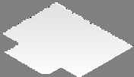









Multi-Path Effect
Faded path
α = Line of sight path gTariene
α₁ = Secondary path gain
0
τ = Secondary path delay
τ = Pathdelay
1
0
α₀
α α
Reflected multipath
1
k
α = Secondary path gain
Δ
Δ₁
k
0
τ = Secondary pathdelay
Δ
k
k
y(t) = h(0)x(t) + h(1)x(t −1) + h(2)x(t − 2) +☹
= ∑h(Δ)x(t − Δ) = h(t) ∗ x(t)
⟺
Y ( f ) = H ( f )X( f )
Δ
frequency-domain
time-domain

Slide 27
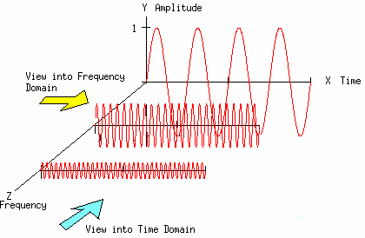
Current symbol + delayed-version symbol
→ Signals are deconstructive in only certain frequencies

Slide 28
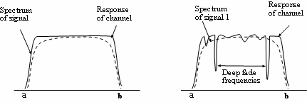
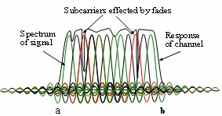
Frequency Selective Fading
Frequency selective fading: Only some sub-­‐carriers get aﬀected

Slide 29
Inter Symbol Interference (ISI)
The delayed version of a symbol overlaps with the adjacent symbol
One simple solution to avoid this is to introduce a guard-band
Guard band

Slide 30
Inter Symbol Interference
Intersymbol interference is eliminated almost completely by introducing a guard interval with zero padding in every OFDM symbol.
Guard interval with zero padding
The way to eliminate ISI

Slide 31
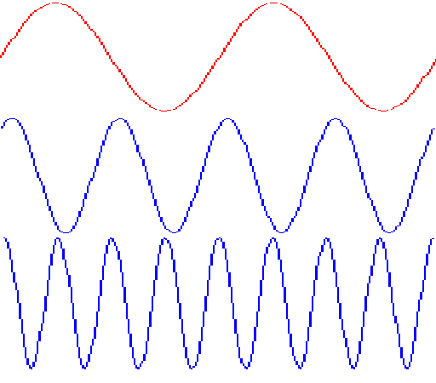
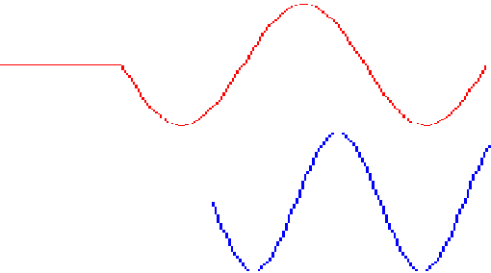
Inter Carrier Interference
Due to non integer number of cycles in the delayed cycle
The way to avoid ICI – cyclic extension(works only when delay <guard time)
Part of subcarrier #2 causing ICI on subcarrier #1
Subcarrier #1
Delayed subcarrier #2
Guard time
FFT integration time=1/carrier spacing
Guard time
FFT integration time=1/carrier spacing
OFDM symbol time
OFDM symbol time

Slide 32
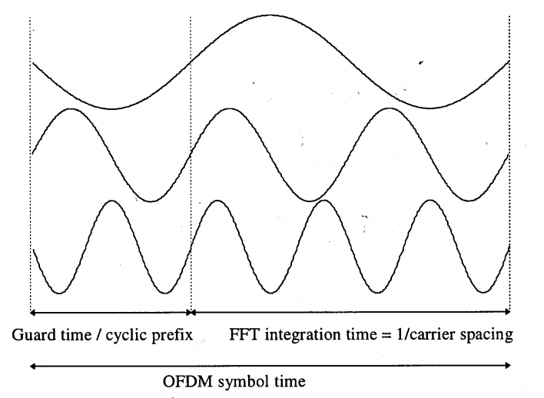
OFDM symbol with cyclic extension

Slide 33
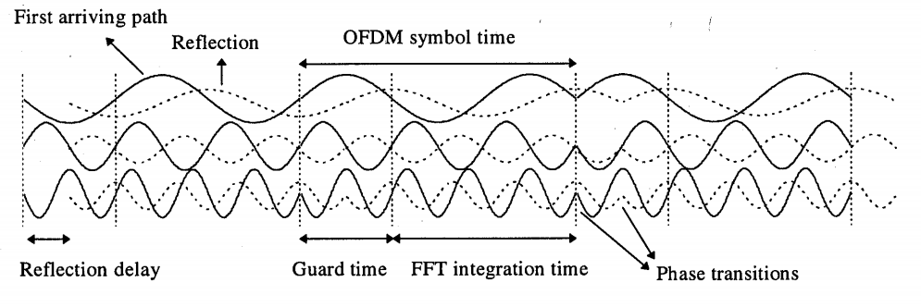
OFDM – Two –ray multipath channel

Slide 34
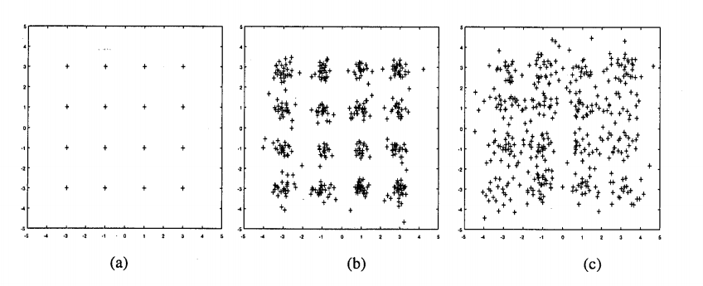
16-QAM constellation for 48 sub-carrier OFDM link
(a) delay< guard time (b) delay(3%)>guard time
(c) delay(10%)>guard time

Slide 35
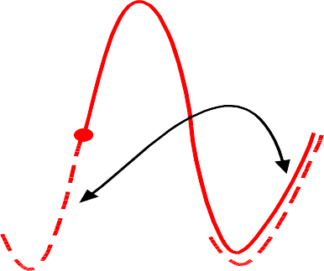
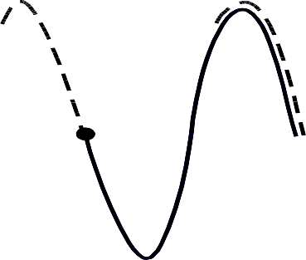
Cyclic Prefix (CP)
However, we don’t know the delay spread exactly
⯈ The hardware doesn’t allow blank space because it needs to send out signals continuously
Solution: Cyclic Prefix
⯈ Make the symbol period longer by copying the tail and glue it in the front
Symbol 2
Symbol 1 Copy this part at front
Copy this part at front
In 802.11,
CP:data = 1:4
Portion added in the front
Original symbol
Extension
Original symbol

Slide 36

Cyclic Prefix (CP)
Because of the usage of FFT, the signal is periodic
FFT( ) = exp(-­‐2jπ_{Δ}f)*FFT( )
delayed version original signal
Delay in the time domain corresponds to rotation in the frequency domain
Can still obtain the correct signal in the frequency domain by compensating this rotation

Slide 37


Cyclic Prefix (CP)
w/o multipath ^{y(t) → FFT(}
) →Y[k] = H[k]X[k]
original signal
w multipath
y(t) → FFT(
) →Y[k] = α(1+exp(-­‐2jπ_{Δ}k))*X[k]
= H’[k]X[k]
original signal + delayed-­‐version signal
Lump the phase shift in H

Slide 38
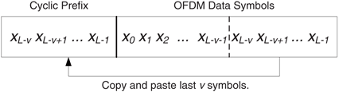

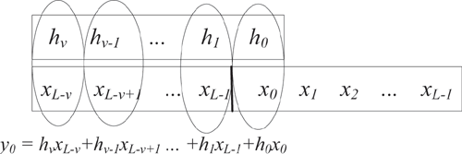
Cyclic Prefix
Adding a cyclic prefix at transmitter leads to circular convolution
Note that misaligned timing still results in a circular convolution, just time shifted
Makes for phase shifts in FFT bins
Correct that in a moment
J. Andrews, A. Ghosh, R. Muhamed, Fundamentals of WiMAX, Prentice Hall, 2007

Slide 39
OFDM Diagram-Level 2
Transmitter
Modulation
S/P
IFFT
Insert CP
P/S
D/A
channel
+
noise
P/S
FFT
remove CP
S/P
A/D
De-mod
Receiver

Slide 40
Impact of Cyclic Prefix on Data Rate

Slide 41
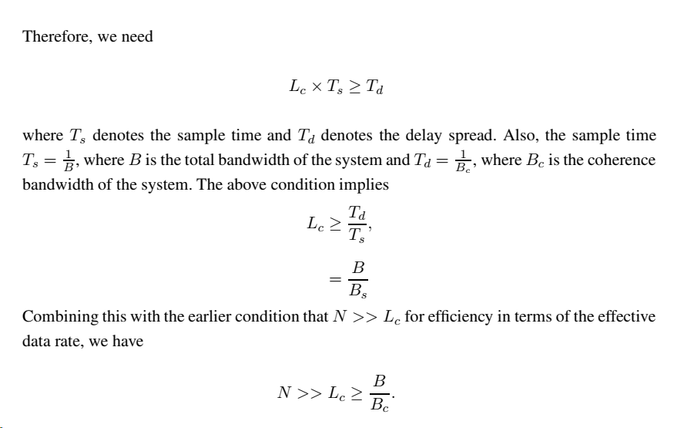


Slide 42
Interleaving
Forward Error Correction

Slide 43
Pilot Insertion
Radio channels fade both in amplitude and frequency
Channel estimator – Estimate time-varying amplitude and phase of all sub-carriers
2-D channel estimator – estimate reference values based on known pilot values
By sampling theorem, Ts< Inverse of the double-sided BW of the sampled signal
Min. subcarrier spacing and min. symbol spacing between pilots
More pilots effective SNR small for data symbols

Slide 44
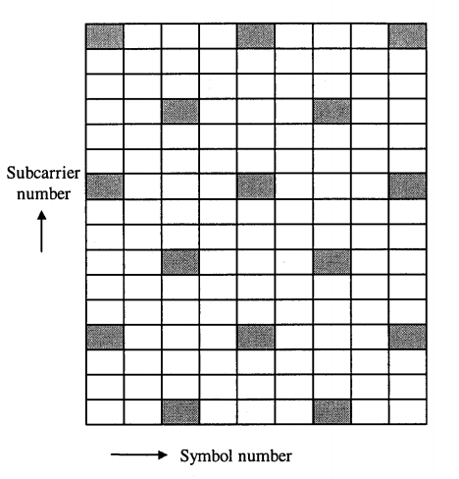
Pilots – Block of 9 OFDM symbols with 16 sub-carriers

Slide 45
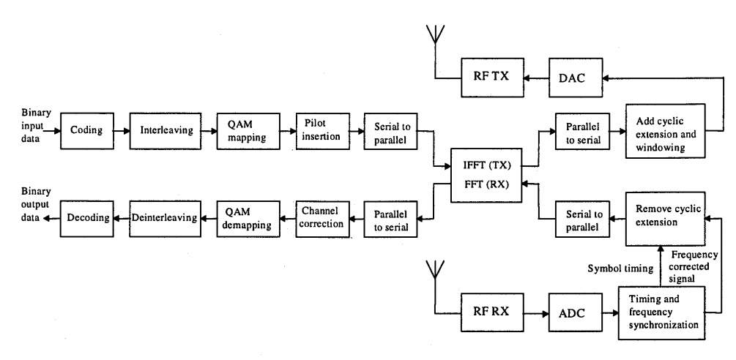

Complete OFDM Transceiver

Slide 46
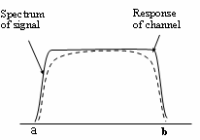
Unoccupied Subcarriers
Edge sub-carriers are more vulnerable to errors under discrete FFT
⯈ Frequency might be shifted due to noise or multi-path
Leave them unused
⯈ In 802.11, only 48 of 64 bins are occupied bins
Is it really worth to use OFDM when it costs so many overheads (CP, unoccupied bins)?

Slide 47
Synchronization
DAC (Tx)
ADC (Rx)
DAC (at Tx) and ADC (at Rx) never have exactly the sampling period
⯈ A slow shift of the symbol timing point, which rotates subcarriers
⯈ Intercarrier interference (ICI), which causes loss of the orthogonality of the subcarriers

Slide 48
Carrier Frequency Offset (CFO)
^{f}tx
DAC (Tx)
^{f}rx
ADC (Rx)
The oscillators of Tx and Rx are not typically tuned to identical frequencies
⯈ Up-convert baseband signal s_{n} to passband signal _{yn=sn*e}j2πf_{tx}nT_{s}
⯈ Down-convert passband signal y_{n} back to _{rn=sn*e}j2πf_{tx}nT_{s*e}-j2πf_{rx}nT_{s=sn*e}j2πfΔnT_{s}
⯈ Error accumulates

Slide 49
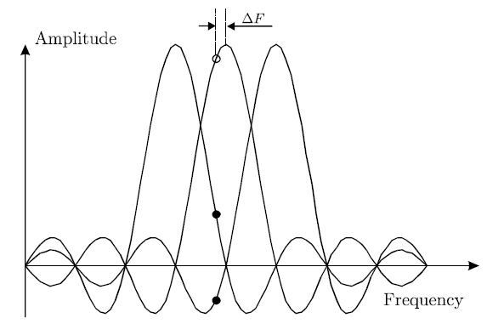
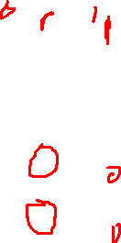
Frequency Errors
Primary sources of frequency errors
Doppler shift
Clock mismatches
Phase noise
Effects
Reduction in amplitude (missampling sinc)
Intercarrier interference
O. Edfors, M. Sandell, J. van de Beek D. Landström, F. Sjöberg, “An Introduction to Orthogonal Frequency Division Multiplexing,” Sep 98, Available online: http://epubl.luth.se/avslutade/0347-0881/96-16/esb96rc.pdf

Slide 50
OFDM Diagram
Transmitter
Modulation
S/P
IFFT
Insert CP
P/S
D/A
channel
+
noise
P/S
Phase track
FFT
remove CP
S/P
Correct CFO
A/D
De-mod
Receiver

Slide 51
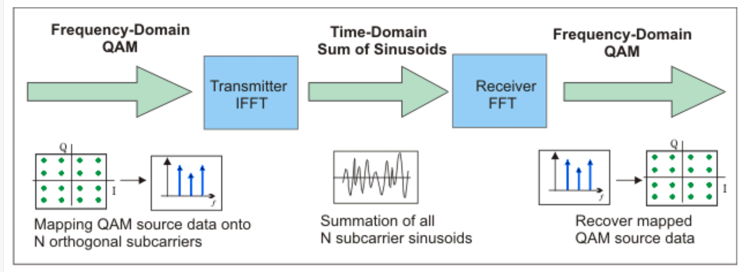
OFDM IFFT-FFT perspective

Slide 52
PAPR and its Reduction Methods
Coherent addition of N signals of same phase produces a peak which is N times the average signal.
PAPR – Peak to Average Power Ratio
Envelope Fluctuation – Superposition of sub-carriers
Causes Power Amplifiers to Saturate –leads to Non-linear Distortion, Inter-modulation and Out-of Band Radiation
Increased Complexity of ADC and DAC
Reduction is efficiency of RF amplifiers
BER high
Spectral Spreading – Adjacent Channel Interference (ACI) occurs

Slide 53

Distribution of PAPR
For a complex baseband signal
a_{n} – Modulating symbol
N – No. of sub-carriers
For Large N, real/imaginary value of x(t) –Gaussian distributed
Amplitude – Rayleigh Distribution
Power Distribution – chi-square distribution
With zero mean and two degrees of freedom

Slide 54
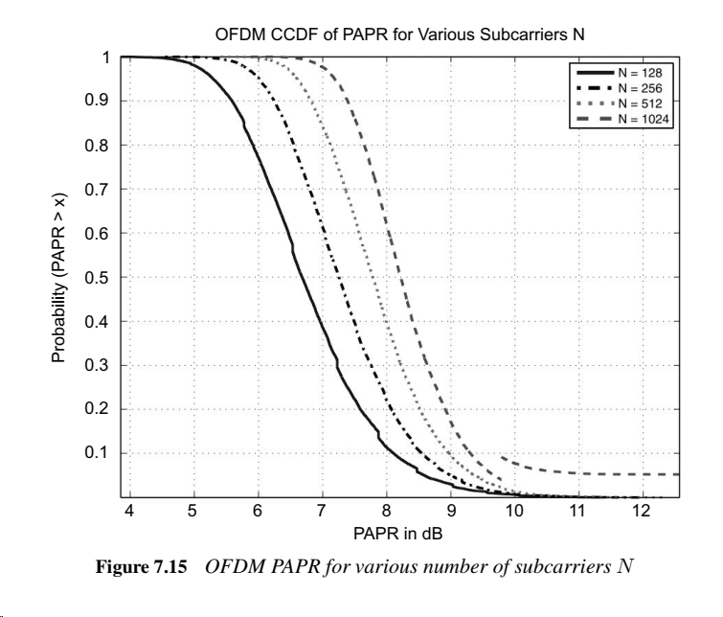
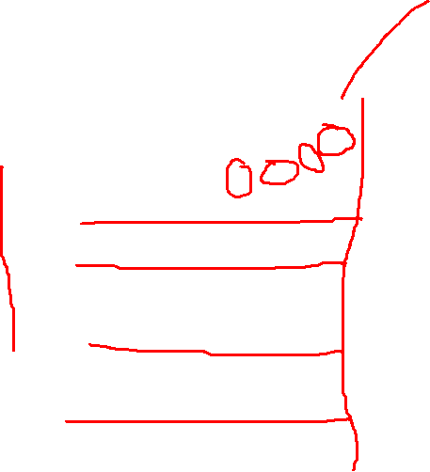

Slide 55
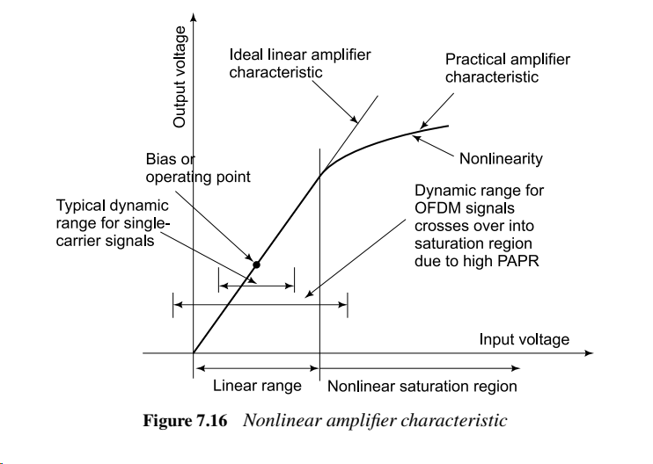
Amplifier Characteristics

Slide 56
PAPR Reduction Techniques
Distortion Techniques
Clipping
Peak Windowing
Peak Cancellation
Coding
Special FEC which exclude OFDM symbol with
large PAPR
Scrambling
Scramble OFDM to small PAPR

Slide 57

SC-FDMA
SC-FDMA, which stands for Single-Carrier Frequency Division Multiple Access, can be employed to reduce the peak-to-average power ratio in an OFDM system
Insertion of an N-point FFT block before the N-point IFFT block
It can then be seen that the FFT and the IFFT cancel the effect of each other and the net output is the exact input symbol stream, i.e., corresponding to a single-carrier system
This drastically reduces the PAPR
PAPR of a single-carrier system is 0 dB
Instead of using an N-point FFT, one can use an M-point FFT, where M < N, to reduce the PAPR, while still retaining the properties of the OFDM system

Slide 58
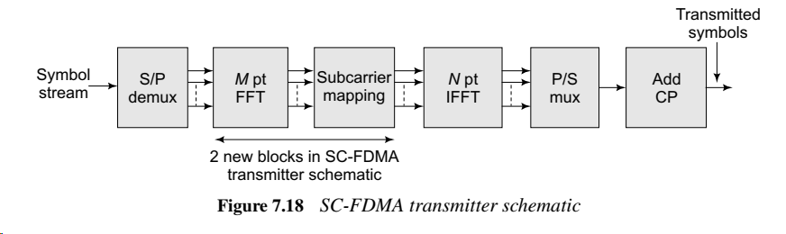
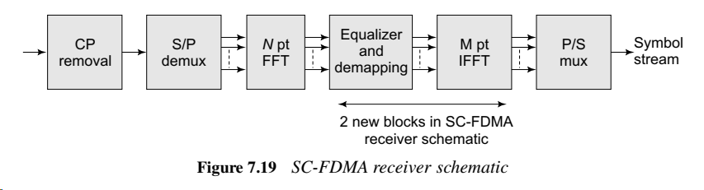

Slide 59
Solved Examples
Q1. Consider a WiMAX system that operates with a total number of subcarriers N = 256, with a bandwidth of 15.625 kHz per subcarrier.
Compute the BW of the system.
If coherence BW is 250 KHz, what kind of fading will each subcarrier experience?
Compute the raw OFDM symbol time.
If WiMAX employs a cyclic prefix that is 12.5% of the symbol time, compute the duration of the cyclic prefix, the number of samples in CP, and the loss in spectral efficiency.

Slide 60
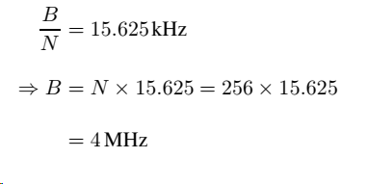


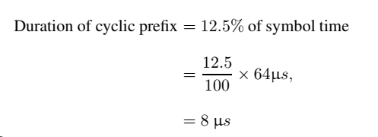

Slide 61
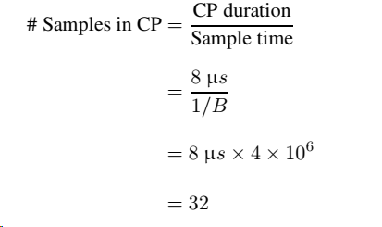



Slide 62
Q2. Consider an OFDM system with total passband bandwidth B = 5 MHz with N = 512 subcarriers. The channel has a maximum delay spread of Td = 4 μs. Answer the questions that follow.
What is the symbol time of a corresponding single-carrier system?
What is the sample time of the OFDM system and the raw symbol time without the cyclic prefix?
What is the minimum number of samples required in the cyclic prefix?
If the length of the cyclic prefix is twice the required minimum calculated above, what is the total OFDM symbol time?
What is the loss in efficiency due to the overhead of the cyclic prefix?
If the modulation employed is 16-QAM, what is the effective bit rate of the above OFDM system?
At a carrier frequency of fc = 2.4 GHz, what is the maximum possible velocity of a mobile for the system to be able to function?

Slide 63


Slide 64
IEEE 802.11ad is a WLAN standard operating at 60GHz. It has a much wider bandwidth than previous WLAN standards in lower-frequency bands. Four PHY formats are defined in IEEE 802.11ad, and one of them uses OFDM. The system uses a bandwidth of 1880MHz, with 512 subcarriers and a fixed 25% cyclic prefix. Now compute the following:
What is the sample period duration assuming sampling at the Nyquist rate?
What is the subcarrier spacing?
What is the duration of the guard interval?
What is the OFDM symbol period duration?
In the standard among the 512 subcarriers, only 336 are used as data subcarriers. Assuming we use code rate 1/2 and QPSK modulation, compute the maximum data rate of the system.

