Slide 1
MODULE 5 Diversity Techniques

Slide 2
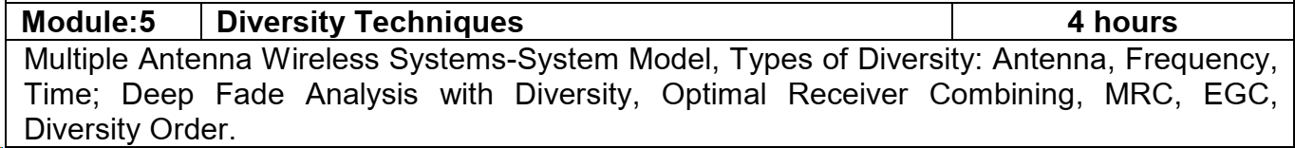

Slide 3
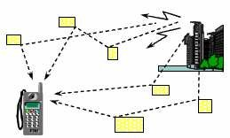
Challenges of Wireless Communication
High Data Rate, seamless and high mobility requirements
Spectral efficiency challenge (2-10 b/s/Hz)
Frequency selectivity due to large bandwidth requirements
High System Capacity
Seamless coverage and support across different networks, devices, and media forms
Reliable Communications
Harsh wireless channel
Scarce radio spectrum
Energy constraint

Slide 4
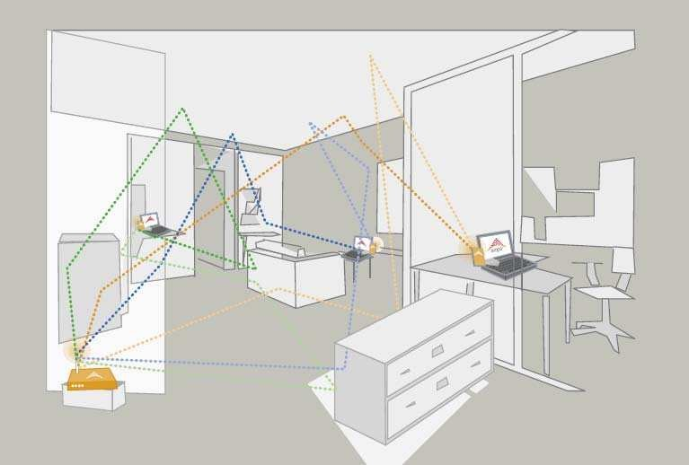
Channel Fading
Deviation or attenuation that a telecommunication signal experiences over certain propagation media
May vary with time, geographical position and/or radio frequency, and is often modeled as a random process
In wireless systems, fading may either be due to multipath propagation or due to shadowing from obstacles

Slide 5
Fading (2)
Reflectors in the environment surrounding a transmitter and receiver create multiple paths that a transmitted signal can traverse
The receiver sees the superposition of multiple copies of the transmitted signal, each traversing a different path Each signal copy will experience differences in attenuation, delay and phase shift while travelling from the source to the receiver
This can result in either constructive or destructive interference, amplifying or attenuating the signal power seen at the receiver
Strong destructive interference is frequently referred to as a deep fade and may result in temporary failure of communication due to a severe drop in the channel signal- to-noise ratio

Slide 6
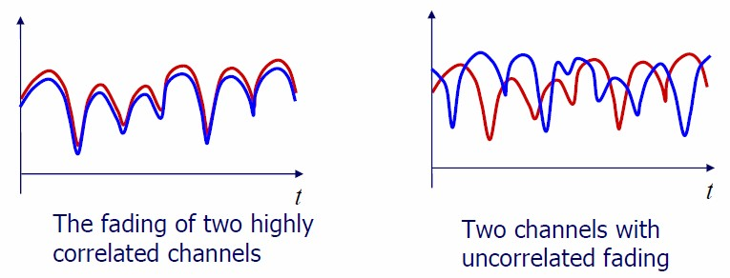
Motivation of Diversity Techniques
If a fading radio signal is received through only one channel, then in a deep fade, the signal could be lost, and there is nothing that can be done
Diversity is a way to protect against deep fades, a choice to combat fading
The key: create multiple channels or branches that have uncorrelated fading

Slide 7
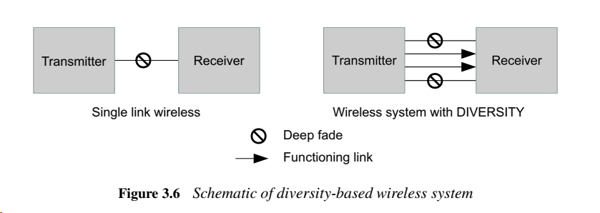
Basic Diversity Techniques
Diversity combats fading by providing the receiver with multiple uncorrelated replicas of the same information-bearing signal
There are several types of diversity methods
Time Diversity
Frequency Diversity
Multiuser Diversity
Space Diversity

Slide 8
Time Diversity (1)
Transmission in which signals representing the same information are sent over the same channel at different times
The delay between replicas > coherence time uncorrelated channels
Use coding and interleaving (it breaks the memory of the channel, not all bits of the codeword are likely to fall into a deep fade)
It consumes extra transmission time

Slide 9
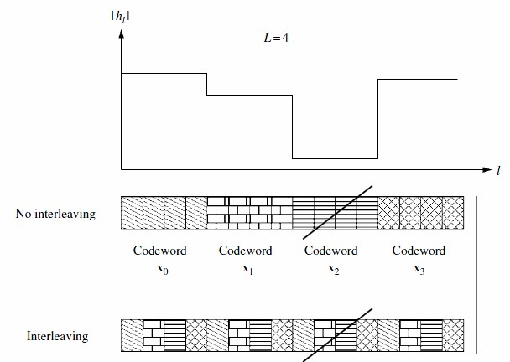
Time Diversity (2)
The codewords are transmitted over consecutive symbols (top) and interleaved (bottom)
A deep fade will wipe out the entire codeword in the former case but only one coded symbol from each codeword in the latter
In the latter case, each codeword can still be recovered from the other three unfaded symbols

Slide 10
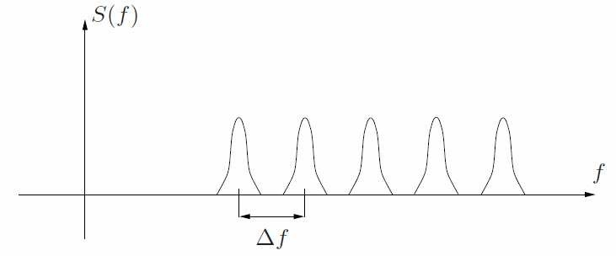
Frequency Diversity (1)
Replicas sent in bands separated by at least the coherence bandwidth uncorrelated channels
As two or more different frequencies experience different fading, at least one will have strong signal
Frequency diversity consumes extra bandwidth

Slide 11

Frequency Diversity (2)
Sending an information symbol every L symbol times
Only one symbol can be transmitted every delay spread
Once one tries to transmit symbols more frequently than the coherence bandwidth, inter- symbol interference (ISI) occurs

Slide 12
Multiuser Diversity
Opportunistic user scheduling at either the transmitter or the receiver
In a large system with users fading independently, there is likely to be a user with a very good channel at any time
Transmitter selects the best user among candidate receivers according to the qualities of each channel between the transmitter and each receiver

Slide 13
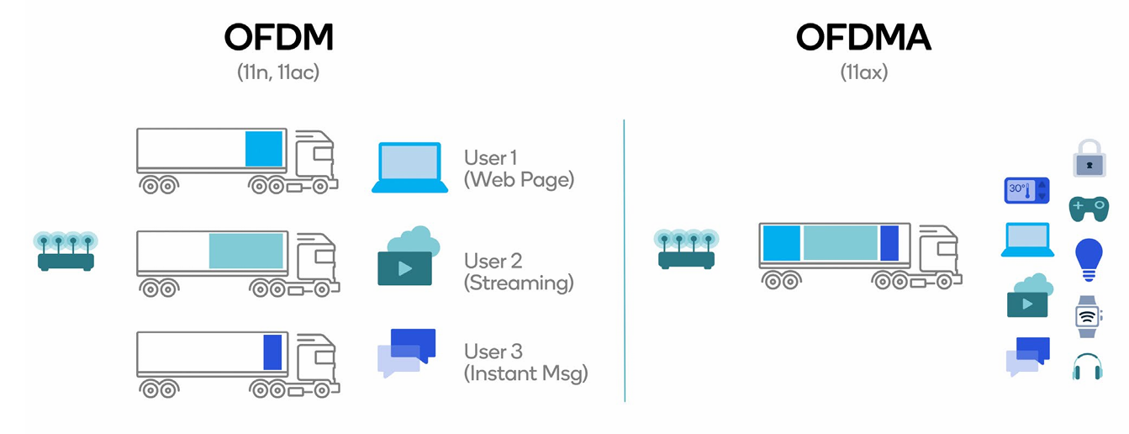
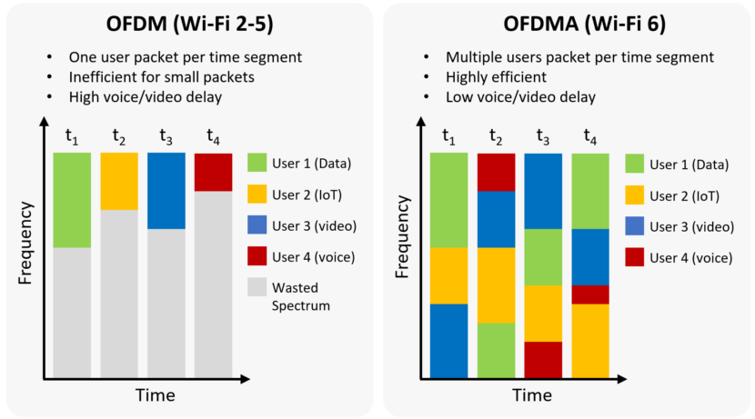
OFDMA (1)
Orthogonal Frequency Division Multiple Access (OFDMA) exploits multiuser diversity.
Multiuser version of the popular Orthogonal Frequency Division Multiplexing (OFDM) digital modulation scheme which combats ISI
Superior performance in frequency-selective fading wireless channels
Modulation and multiple access scheme used in latest wireless systems such as IEEE 802.11ax (WiFi-6)

Slide 14
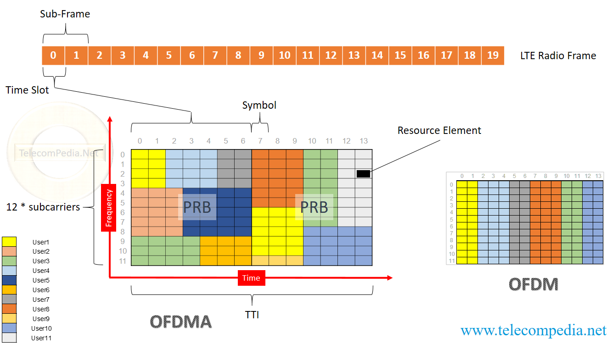
OFDMA(2)
Total bandwidth is divided into subcarriers.
Multiple access is achieved by assigning subsets of subcarriers to individual users
A subcarrier is exclusively assigned to a user at a given time
Dynamic subcarrier assignment
PRB (Physical Resource Block) consists of 12 subcarriers, 7 symbols in normal CP
Resource Element (RE) is a smallest unit in OFDMA system. It is used to carry user data, signals and control data.

Slide 15
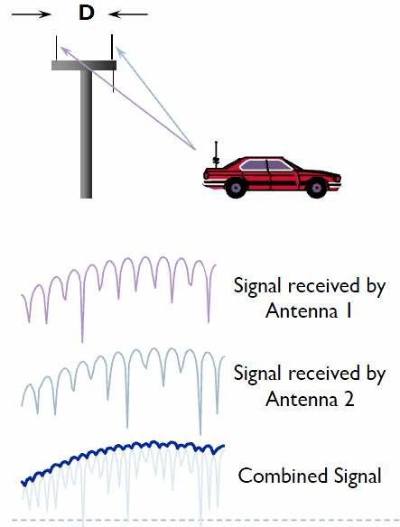
Space Diversity (1)
Two antennas separated by several wavelengths will not generally experience fades at the same time
Space Diversity can be obtained by using two receiving antennas and switching instant-by- instant to whichever is best

Slide 16
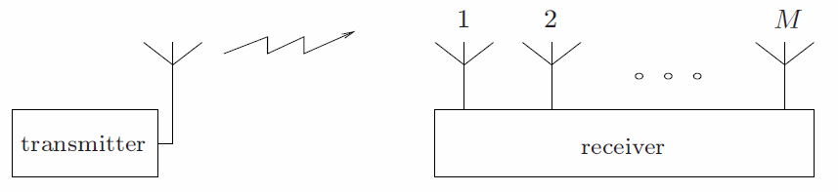
Space Diversity (2)
Several (receive) antennas (M)
Uncorrelated branches Distance between antennas ≈ λ/2, where λ is the wavelength
In GSM, λ ≈ 30 cm

Slide 17
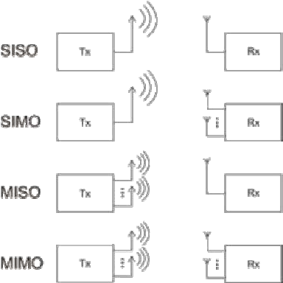
Space Diversity (3)
Single-input, single-output (SISO) channel
No spatial diversity
Single-input, multiple-output (SIMO) channel
Receive diversity
Multiple-input, single-output (MISO) channel
Transmit diversity
Multiple-input, multiple-output (MIMO) channel
Combined transmit and receive diversity

Slide 18
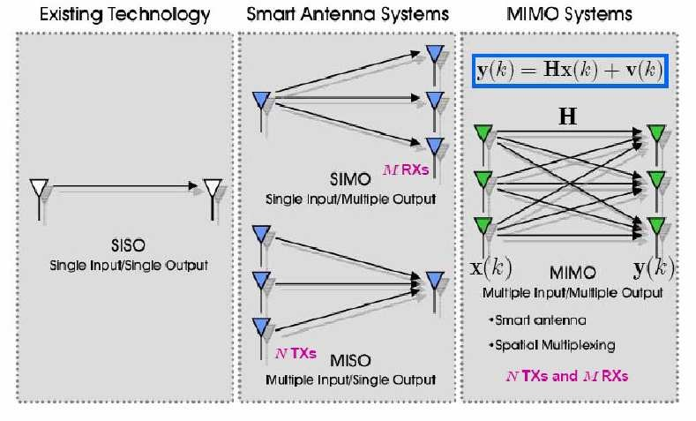
Space Diversity (5)

Slide 19
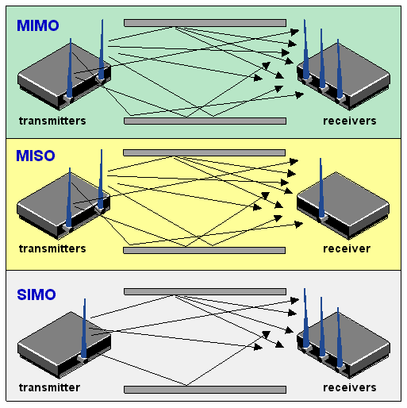
Multiple Input Multiple Output (1)
MIMO uses independent channel fading due to multipath propagation to increase capacity
No extra bandwidth required
Multiple independent samples of the same signal at the receiver give rise to diversity

Slide 20
Basic Diversity Combining Techniques
Once you have created two or more channels or branches that have uncorrelated fading, what do you do with them?
Techniques applied to combine the multiple received signals of a diversity reception device into a single improved signal
Selection Combining (SC)
Feedback or Scanning Combining (FC or SC)
Equal Gain Combining (EGC)
Maximal Ratio Combining (MRC)

Slide 21

1) Selection Diversity → simple & cheap
Rx selects branch with highest instantaneous SNR
new selection made at a time that is the reciprocal of the fading rate
this will cause the system to stay with the current signal until it is likely the signal has faded
SNR improvement :
is new avg. SNR
Γ : avg. SNR in each branch

Slide 22
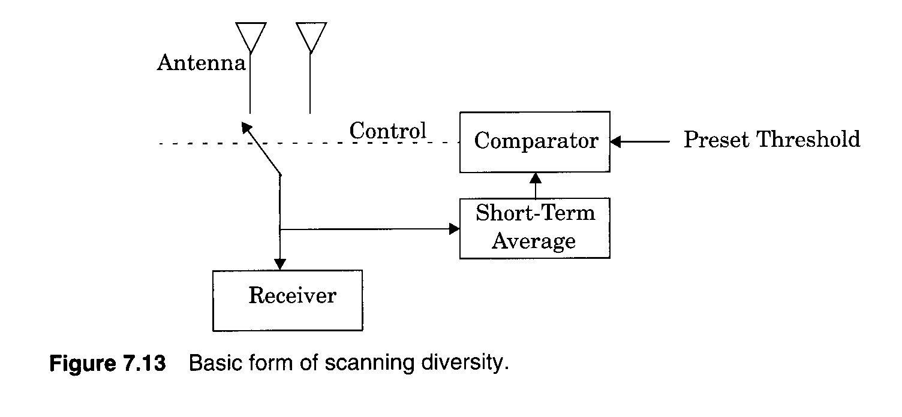
2) Scanning Diversity
scan each antenna until a signal is found that is above predetermined threshold
if signal drops below threshold → rescan
only one Rx is required (since only receiving one signal at a time),
so less costly → still need multiple antennas

Slide 23
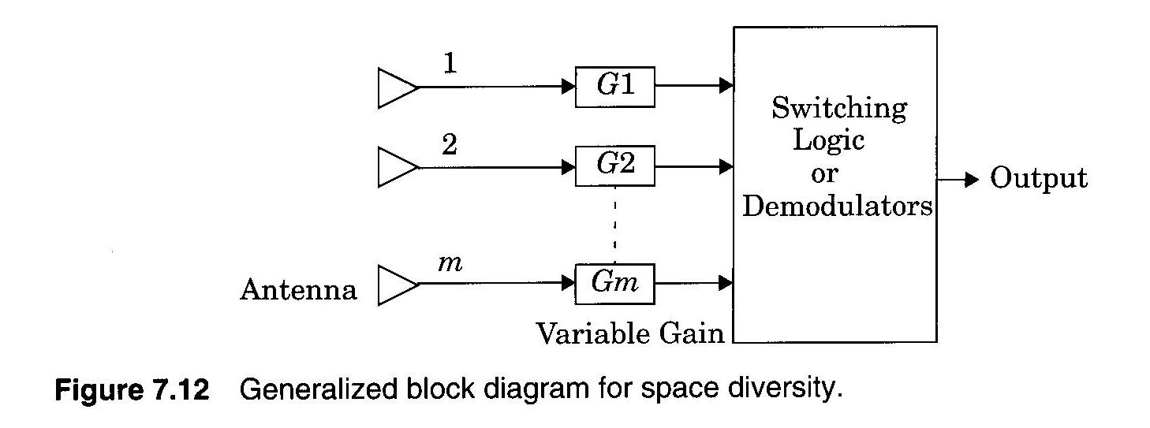
3) Equal Gain Diversity
combine multiple signals into one
G = 1, but the phase is adjusted for each received signal so that
The signal from each branch are co-phased
vectors add in-phase
better performance than selection diversity

Slide 24
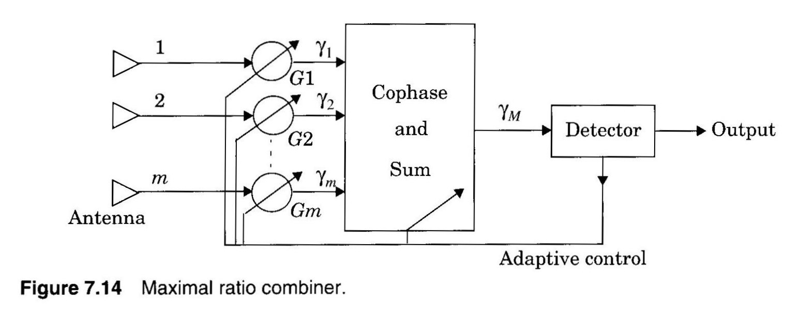
4) Maximal Ratio Diversity
signal amplitudes are weighted according to each SNR
summed in-phase
most complex of all types
a complicated mechanism, but modern DSP makes this more practical → especially in the base station Rx where battery power to perform computations is not an issue

Slide 25
Check the contents discussed in the Class
SNR of multi-antenna system
BER of multi-antenna system
Associated problems

Slide 26
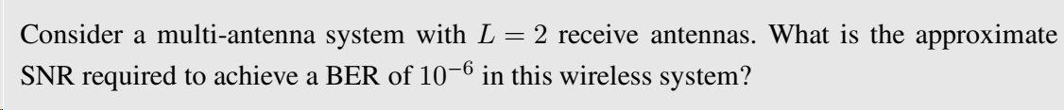
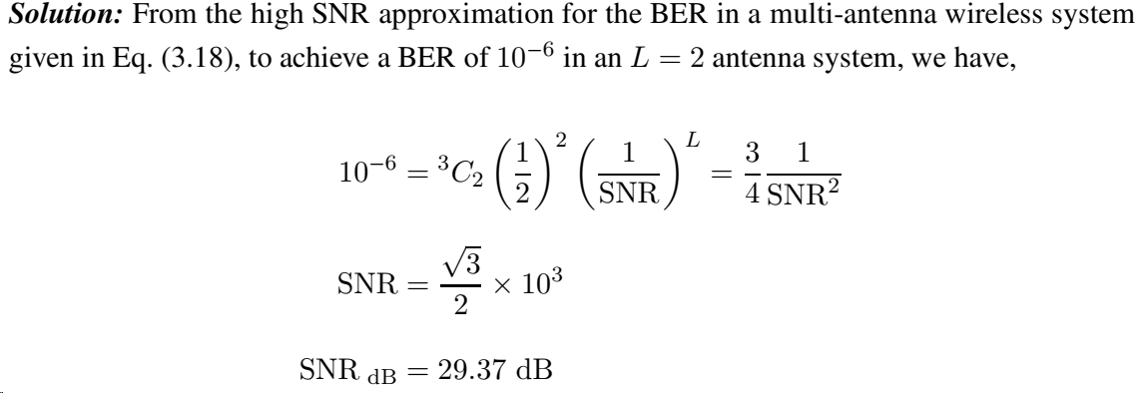
Hint: Use High SNR approximation
Corresponding SNR for a single antenna system : 57 dB, approx. 28 dB higher

Slide 27
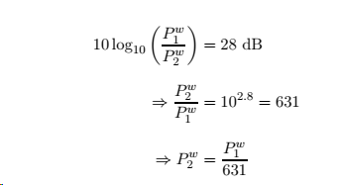
To compare the transmit power between L=1 and L=2:

Slide 28
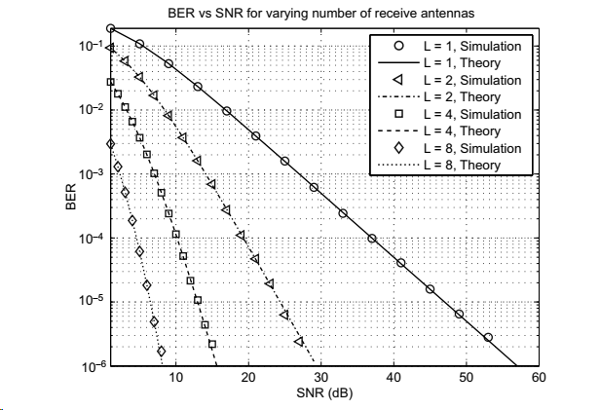
BER v/s SNR for receive diversity

Slide 29

“L” Receive Antennas, Rayleigh Fading Channel, Equal Gain Combining
P_{b}= BER
ϒ =SNR

Slide 30

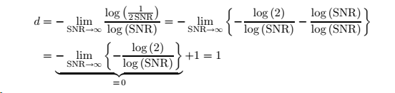
Diversity Order- Single Antenna System
The diversity order d is essentially the number of independently fading channels
For a single antenna system under High SNR:

Slide 31

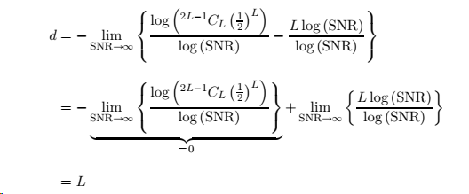
Diversity Order- L -receive Antenna System
For multiple receive antenna systems under High SNR:

Slide 32

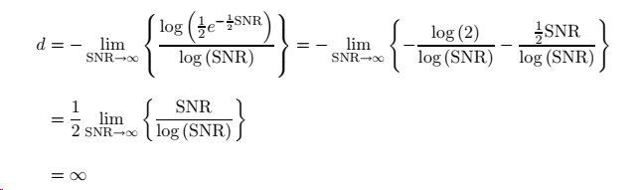
Diversity Order- Wireline AWGN Channel
BER of an AWGN Wireline communication= =

