Slide 1
MODULE 6 MIMO Technology

Slide 2
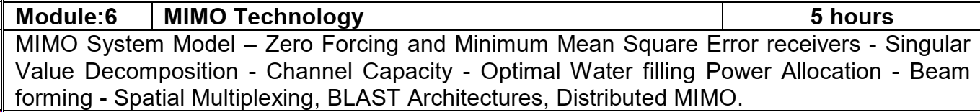

Slide 3
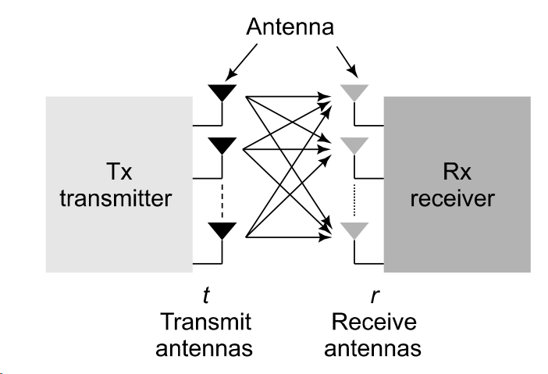
MIMO Model

Slide 4
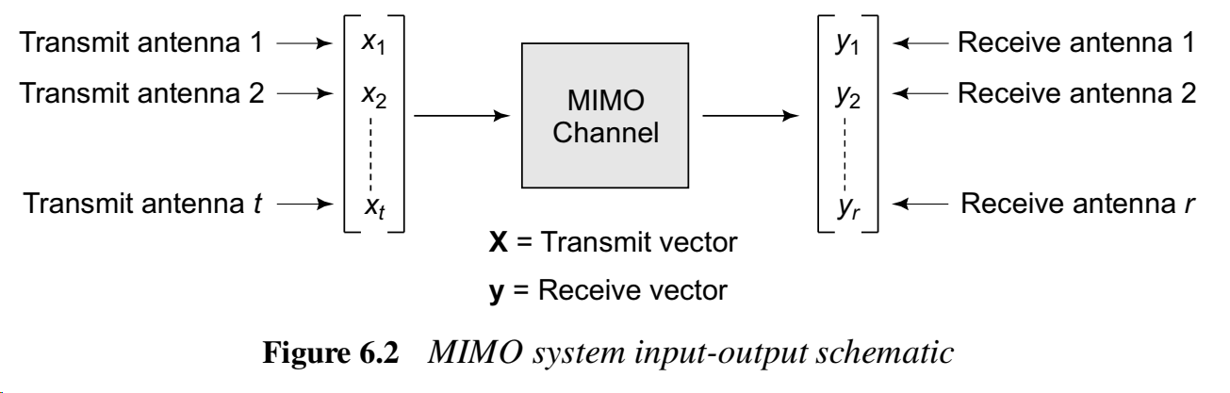
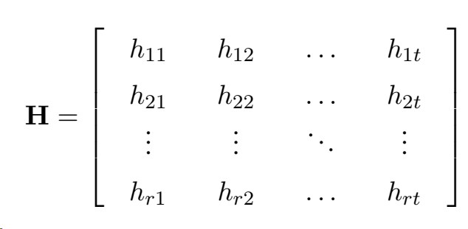
MIMO System

Slide 5
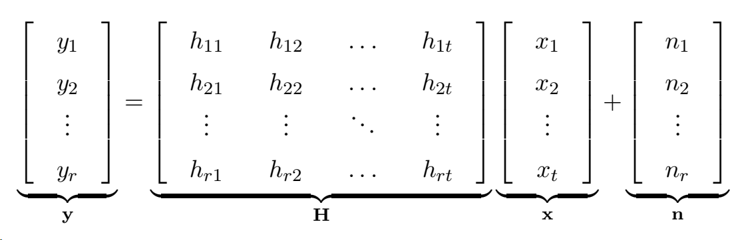



Matrix Representation

Slide 6
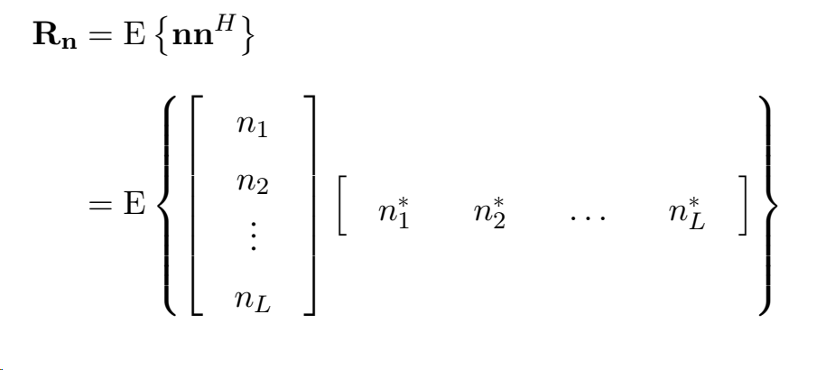
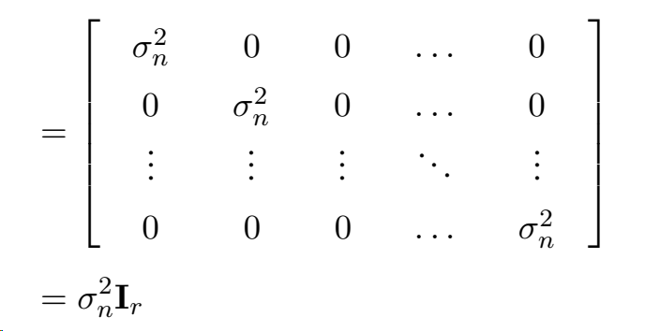
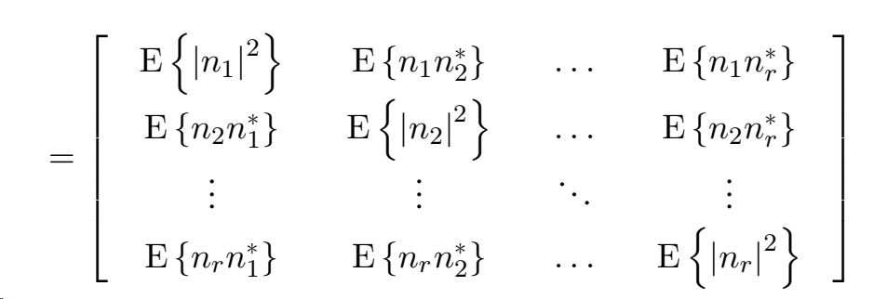
Covariance Matrix of the Noise Vector

Slide 7
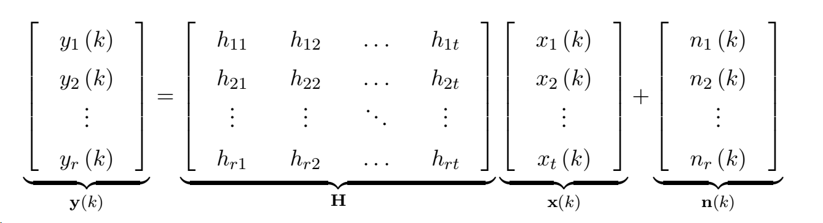
Matrix Representation

Slide 8

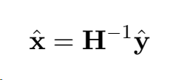
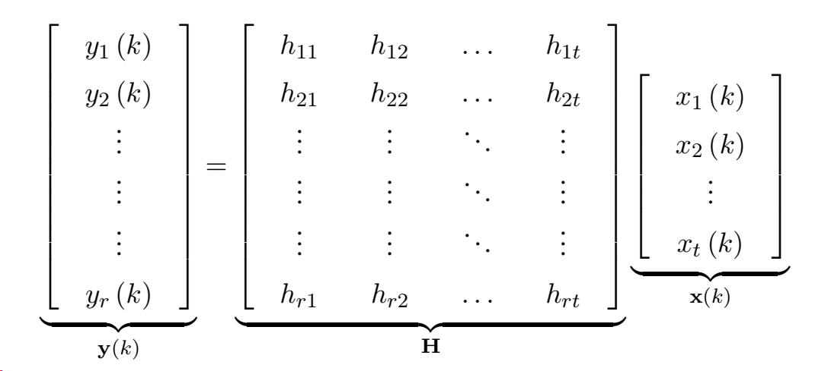
MIMO Zero-Forcing (ZF) Receiver
To recover the transmitted signal vector x from the received vector y at the MIMO receiver
where x1, x2, . . . , xt are the t unknowns and there are r equations corresponding to the r observations y1, y2, . . . , yr
If t=r, then H is a square matrix
Also if H is invertible, However, frequently, one has more receive antennas than transmit antennas, i.e., r > t. In this scenario, the system y = Hx is given as

Slide 9

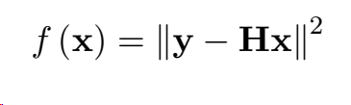
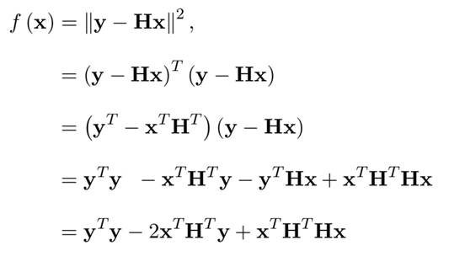

In this situation, one cannot exactly solve for x since there are more equations r than unknowns t
Hence, one can resort to choosing the vector x which minimizes the estimation error
The error function is also termed the least-squares error function and the resulting estimator is termed the least-squares estimator
Consider

Slide 10
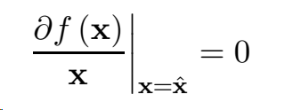

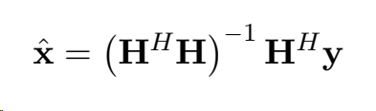
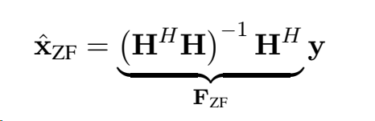
Zero Forcing Receiver
For the error to be minimized:
For the case of complex vectors/matrices x, y, H, the transpose in the above expression can be replaced by the Hermitian operator to yield

Slide 11
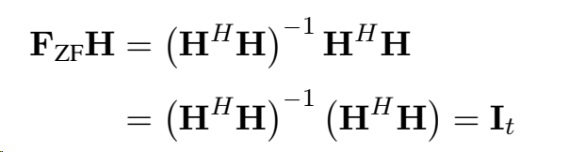


Properties of Zero Forcing Receiver Matrix
FZF acts as an inverse of the channel matrix H
However, observe that for r > t, the matrix H is rectangular and strictly speaking does NOT have a matrix inverse
Hence, this matrix FZF is termed the pseudo-inverse of H
if F_{ZF} to be the inverse of H, it must also satisfy the property that HF_{ZF} = I

Slide 12
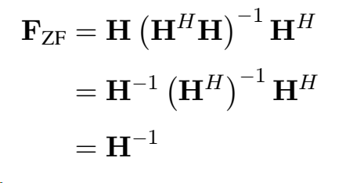

If r = t and the matrix H is invertible then the pseudo-inverse is actually the inverse

Slide 13
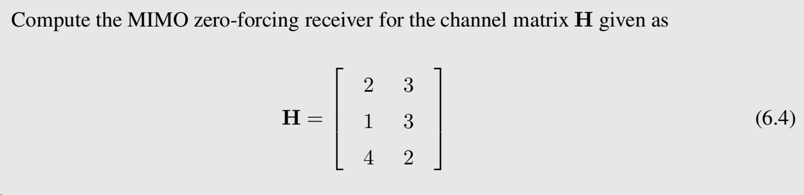
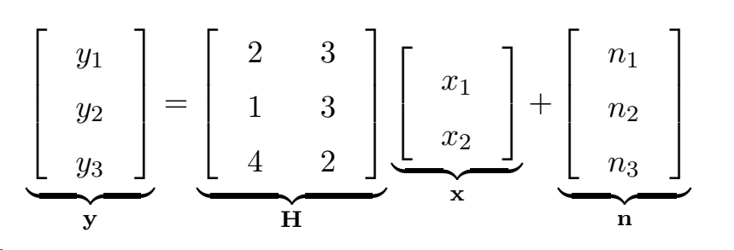
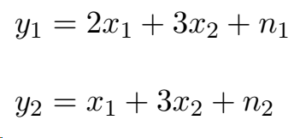

Solved Example

Slide 14
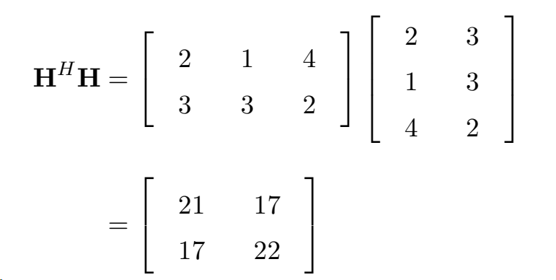

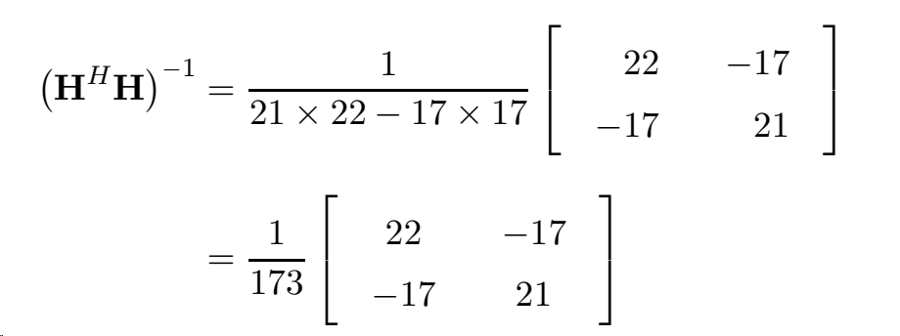

Slide 15
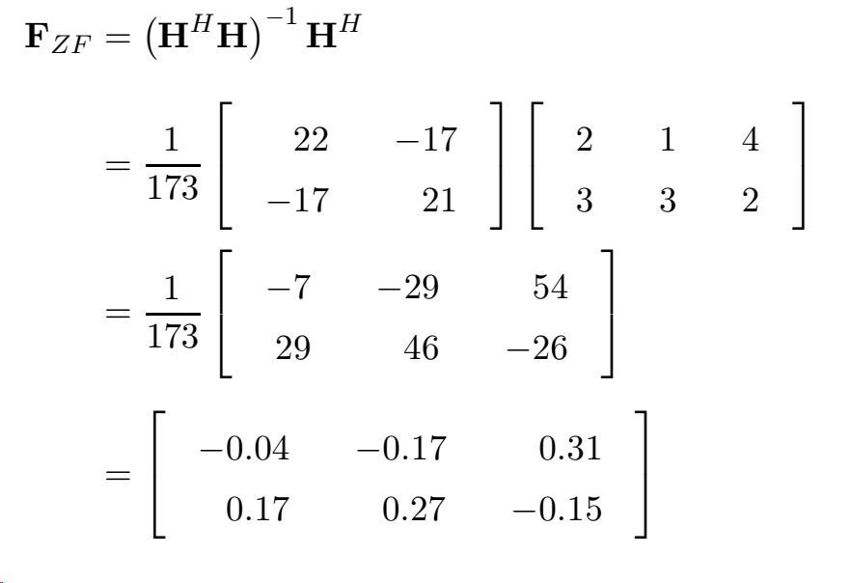

Slide 16
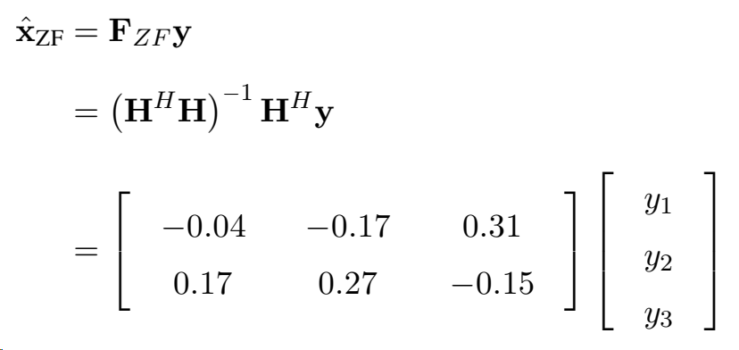
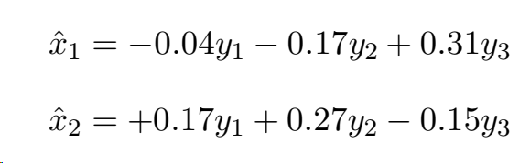
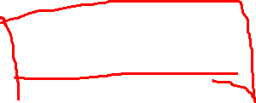

Slide 17


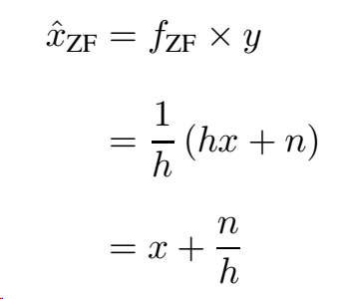
Noise Amplification in Zero Forcing Receivers
Consider a SISO System with r=t=1

Slide 18

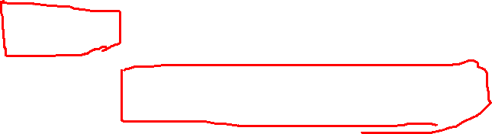
BER of MIMO system with BPSK modulation in a Rayleigh channel with ZF
Where L=r-t+1
BER @ High SNR
Example: Consider a 3x2 MIMO system with SNR= 25dB. If ZF is used, what is the BER?
Here L=r-t+1
r=3, t=2
L=3-2+1= 2

Slide 19

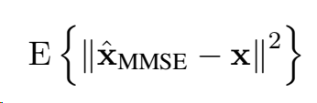
MIMO MMSE Receiver
Minimum Mean-Squared Error (MMSE) receiver
MMSE receiver is based on a Bayesian approach, meaning that the transmit vector x is assumed to be random in nature
if denotes the estimated symbol vector, the MMSE receiver minimizes the average or mean of the squared error

Slide 20


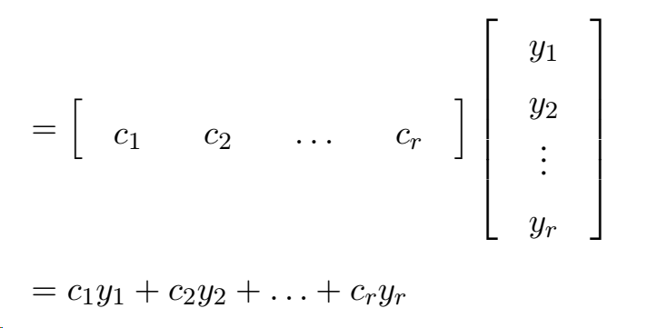
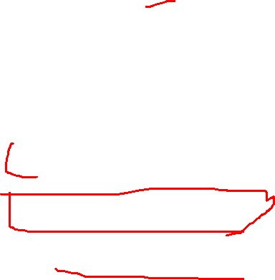
MMSE for SIMO
MMSE receiver, we consider a single-input multiple-output (SIMO) wireless system,
x is now a scalar transmitted symbol
Thus, the basic problem can be interpreted as estimating the symbol x given the vector y = [y1, y2, . . . , yr]^{T}
Let c = [c1, c2, . . . , cr]^{T,} One can now define a linear estimator of x as
linear estimator

Slide 21
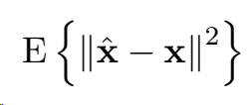
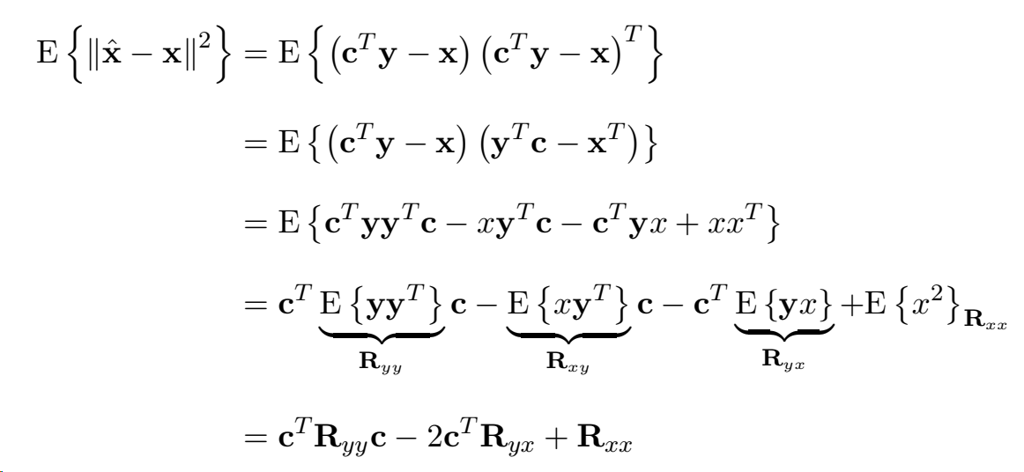

Average mean squared error

Slide 22
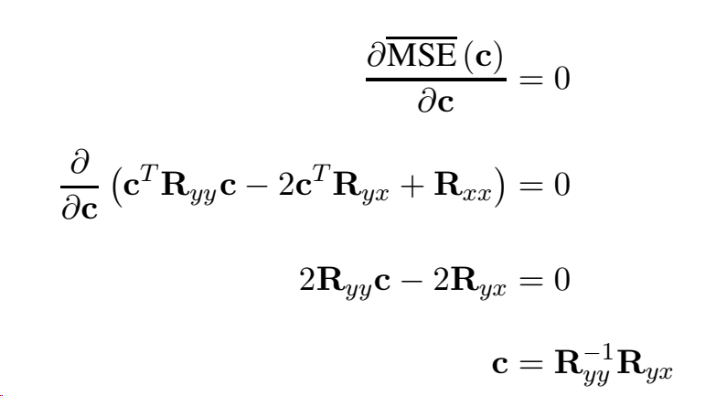

Optimal Beamformer
Optimal beamformer c which minimizes the average or mean squared error can be obtained by differentiating MSE (c) with respect to c and setting equal to zero as
optimal LMMSE beamforming vector c is given as
This is also termed in signal processing as the optimal Wiener filter

Slide 23
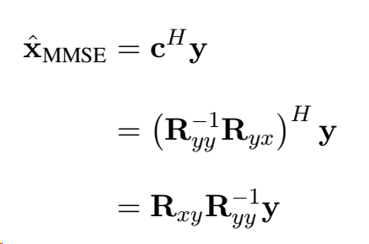
Linear MMSE for complex vector- SIMO case
In the case of complex vectors

Slide 24




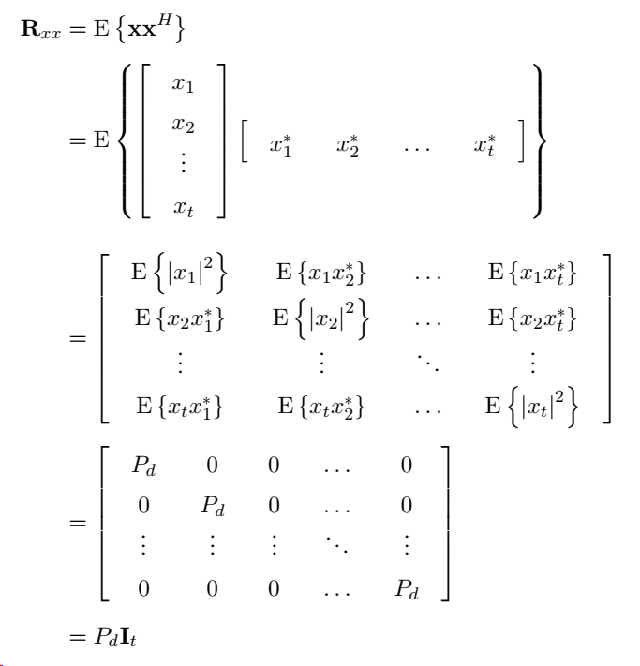

MMSE receiver for the MIMO wireless system
transmit symbols x_{i}, 1 ≤ i ≤ t be such that each is of power P_{d} =
elements on different transmit antennas being uncorrelated

Slide 25
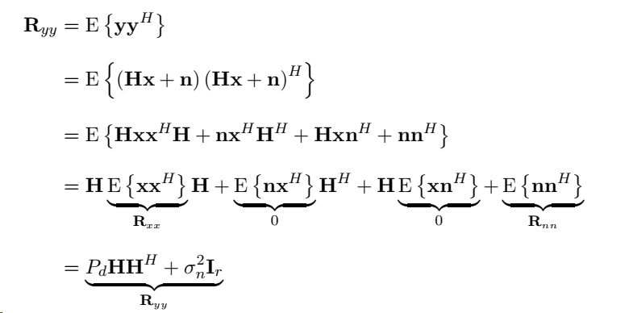
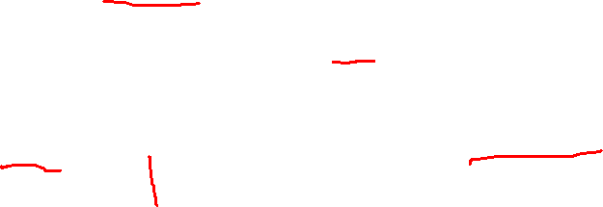
the noise at the receiver and transmit symbols are uncorrelated

Slide 26
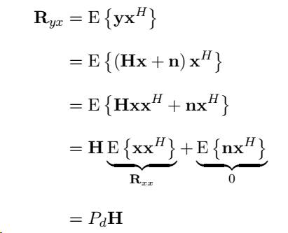

Slide 27
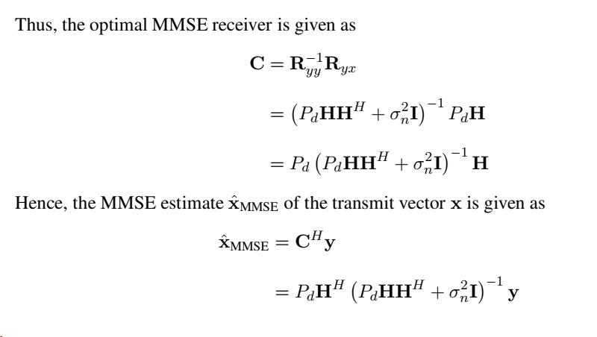

Optimal MMSE

Slide 28
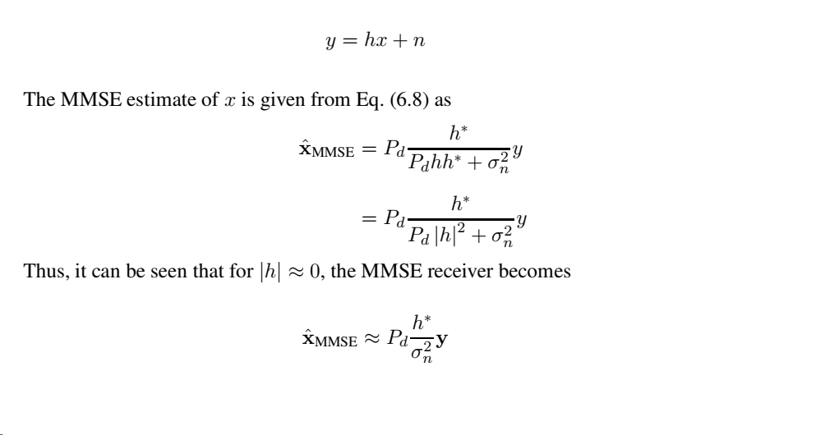
Robustness of MMSE to noise

Slide 29

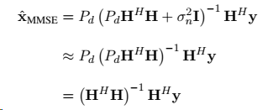
Low and High SNR Properties of the MMSE Receiver
At High SNR, MMSE mimics Zero Forcing

Slide 30



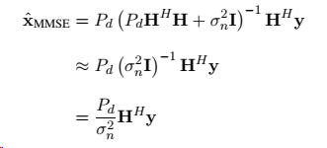
At Low SNR
Matched Filter

Slide 31
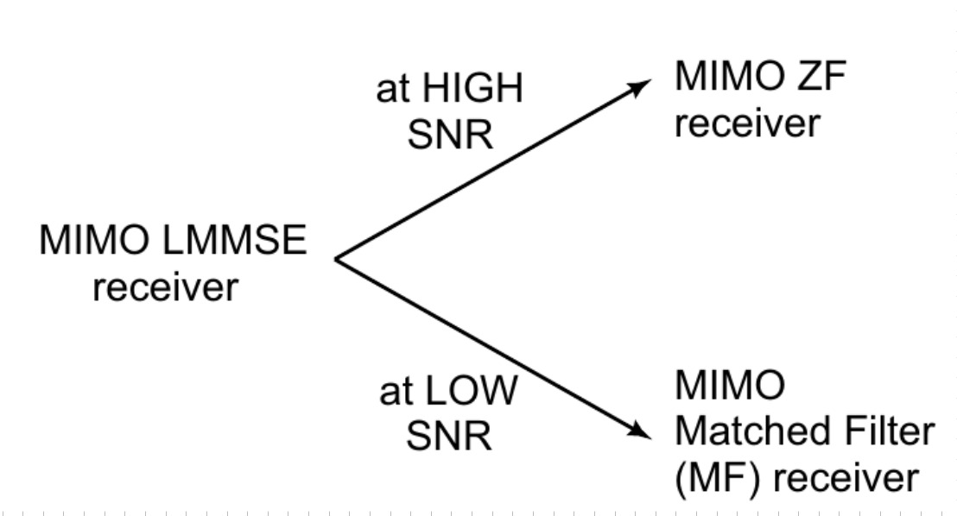

Slide 32
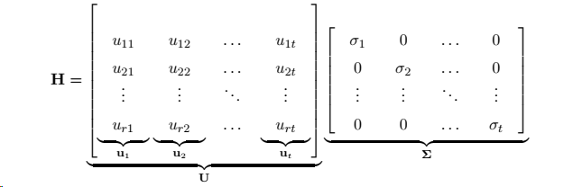
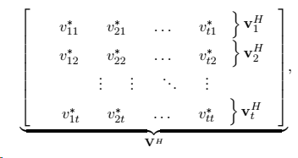
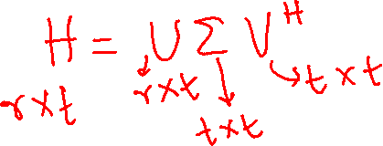
Singular Value Decomposition (SVD) of the MIMO Channel

Slide 33
Refer Notes

Slide 34


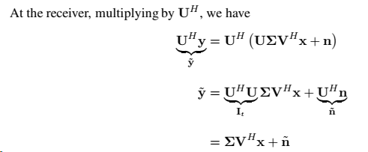



Singular Value Decomposition and MIMO Capacity
Using Transmit Precoding

Slide 35
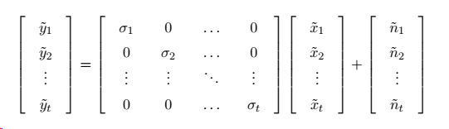


Multiplexing Logic in MIMO
The above system can in fact be written in a much simpler decoupled form as

Slide 36

Multiplexing-Diversity Tradeoff

Slide 37




Signal to Noise Ratio
Capacity of i^{th} Channel:
The MIMO system can be thought of as a collection of t parallel data pipes, with capacities
Net MIMO capacity is given as the sum of the individual capacities
The total power P at the transmitter can be allocated to the individual streams to maximize the net capacity
Thus, one can maximize the above sum capacity subject to the power constraint P1 + P2 + . . . + Pt ≤ P

Slide 38



Optimal MIMO Capacity
The optimal MIMO power allocation problem can be formulated as
employ the standard Lagrange-multiplier-based technique for the above-constrained optimization problem.
Denoting the Lagrange multiplier by λ, the Lagrangian cost function f (P , λ) for the above optimization problem can be formulated as

Slide 39



Slide 40

MIMO Water Filling

Slide 41

Asymptotic Channel Capacity

