Slide 1
MODULE 7 Next-Generation Wireless Communication

Slide 3
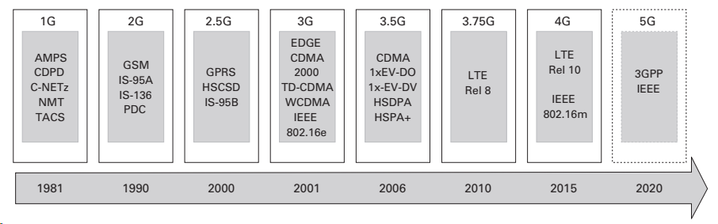
Evolution of Wireless Standards

Slide 4
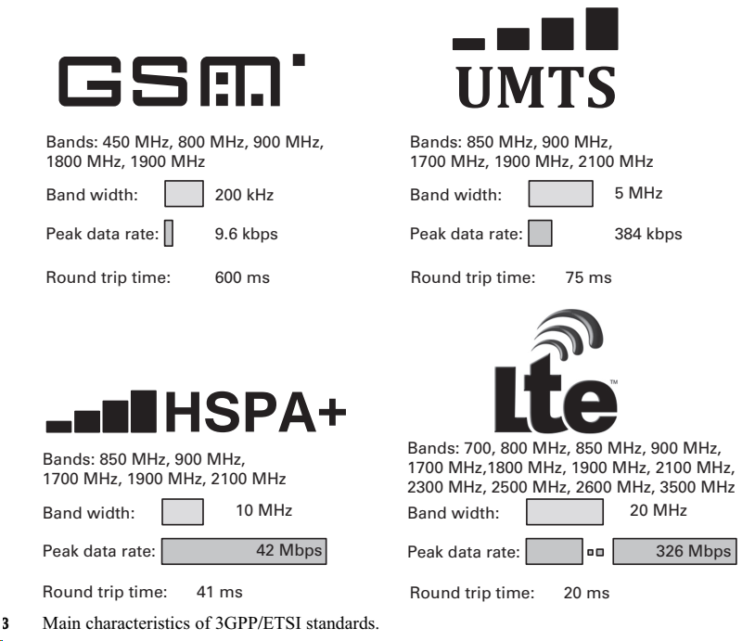

Slide 5
Major objectives of 5G
• Agriculture:
Sensors and actuators are becoming more widely used, e.g. in order to measure and communicate soil quality, rainfall, temperature and wind, to monitor how the crops are growing and livestock movements. • Automobile:
Wireless communication is interesting for a multitude of applications associated with intelligent transportation, e.g. to enable greater automation of moving vehicles, to provide Vehicle-to-Vehicle and Vehicle-to-Infrastructure communication for information, sensing and safety to prevent collisions, avoid road traffic congestion etc., as well as commercial applications such as media delivery to the vehicle. • Construction/Building:
Buildings are being constructed with sensors, actuators, integrated antennas and monitoring devices for energy efficiency, security, occupancy monitoring, asset tracking, etc. • Energy/Utilities:
The Smart Grid is affecting all parts of the value chain including exploration, generation and production, trading, monitoring, load control, fault tolerance and consumption of energy. Future systems where consumers also become producers of energy, appliances are connected and perhaps controlled by utilities, and the increase in the numbers of electric cars pose opportunities and challenges for power companies.

Slide 6
• Finance (including banking):
Financial activities, such as trading, banking and shopping are performed more and more over wireless links. Consequently, security, fraud detection and analytics are very important components of financial transactions that are improved due to the use of wireless connectivity. • Health:
Wireless communication can be used in a variety of ways ranging from the mundane to the complex; these include exercise monitoring, continuous consumer health sensing, medical alerts and health monitoring by health services, wireless connectivity within hospitals and for remote patient monitoring, remote health service delivery, remote surgery, etc. • Manufacturing:
Various engineering tasks and process control can be made more efficient, reliable and accurate with wireless communications; the use of 5G for ultrareliable operation and extreme requirements on latency is interesting for factory cell automation, while massive machine connectivity will increase in the use of wireless communications in manufacturing for robots, autonomous operation of machines, RFIDs and low-power wireless communications for asset management, etc. • Media: Video is a key driver of high bandwidth consumption, and it is expected that 5G will allow excellent user experience for viewing 3D and 4K formats on a mass scale. Today, the user experience for enjoying rich content like high-resolution video is limited to fixed networks and short-range wireless, while access to high-quality music is stressed in crowded areas where users might simultaneously consume unique content. New use cases such as Virtual Reality (VR) or Augmented Reality (AR) are also expected to become popular in mobile or nomadic situations

Slide 7
Public safety:
Police, fire, rescue, ambulance and medical emergency services covered by this category require a high degree of reliability and availability. Just as 4G is being adopted for public safety, 5G radio access will be a very important component of the tools available for security services, law enforcement and emergency personnel to use. The use of SDN and NFV can help the network play a more direct role in public safety functions, such as fighting fires and assisting in earthquake or tsunami disasters, by efficiently managing local service connectivity between responders and from hazards toward the network. The network can also support rescue missions using location services.

Slide 8
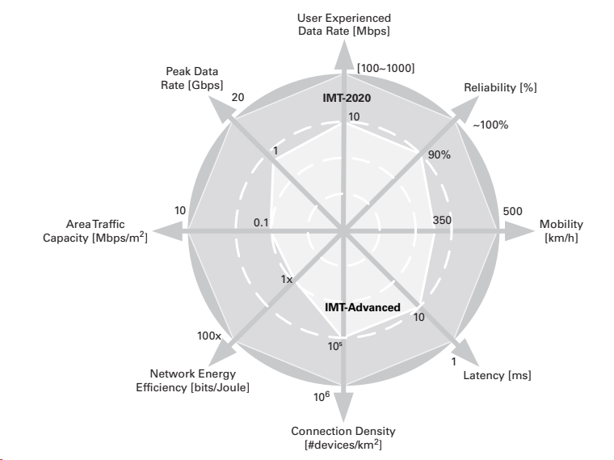
5G requirements:

Slide 9
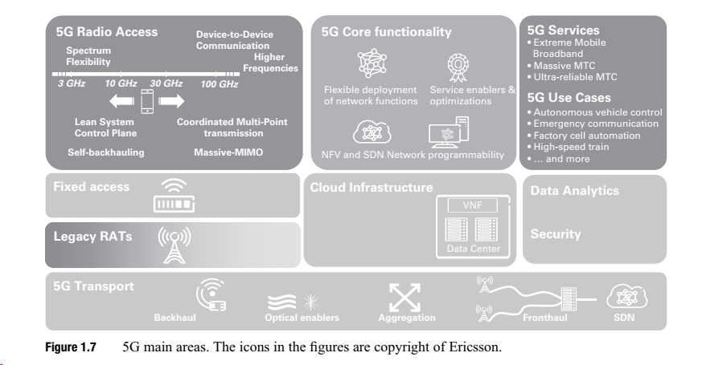

Slide 10
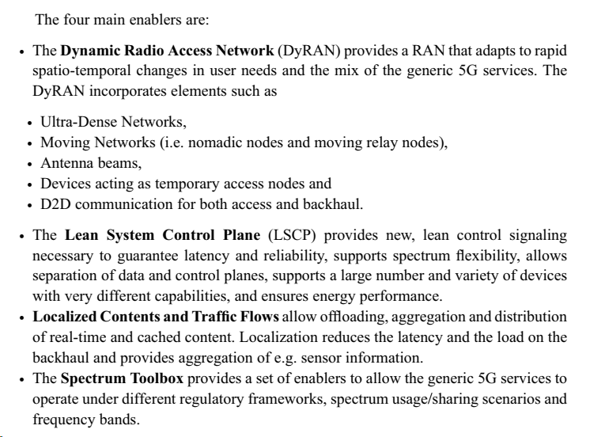
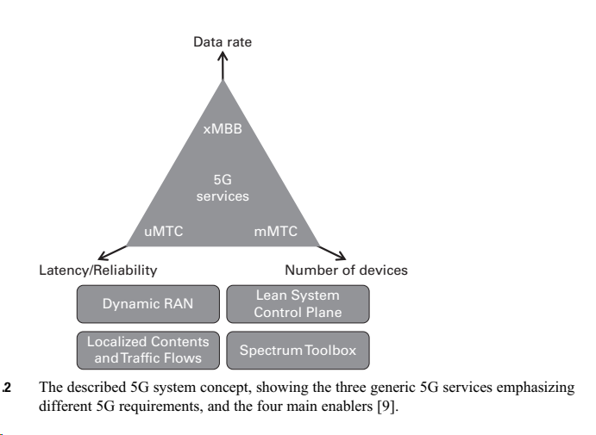
Key Enablers:

Slide 11
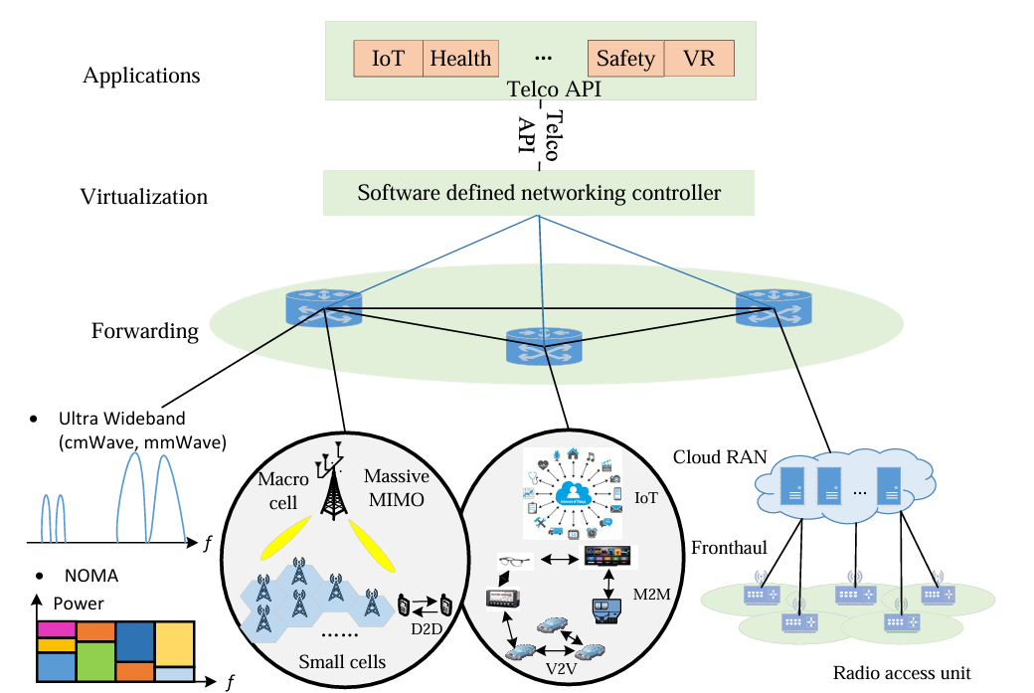
5G Architecture

Slide 12
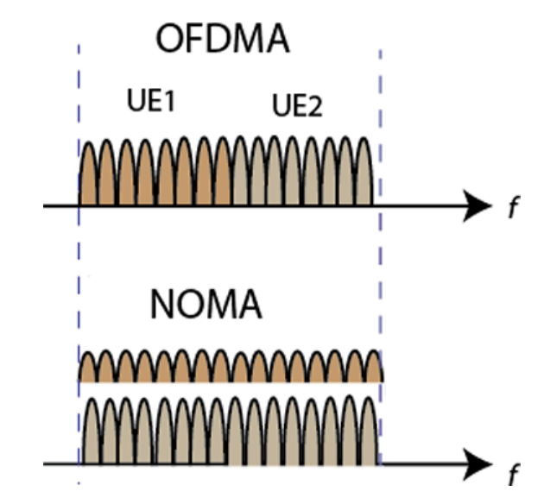
NOMA- Non-Orthogonal Multiple Access

Slide 13
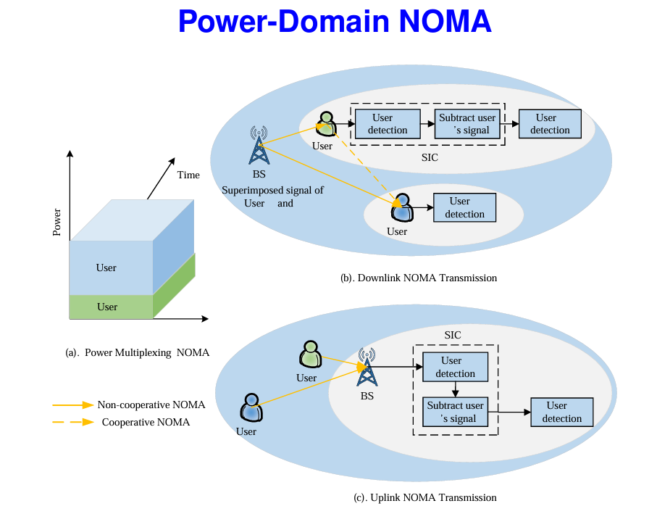

Slide 14
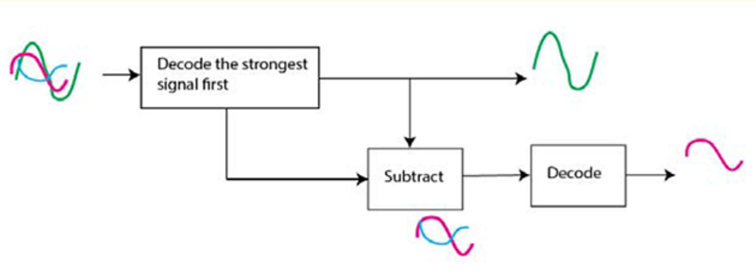
NOMA @ Receiver- Successive Interference Cancellation

Slide 15
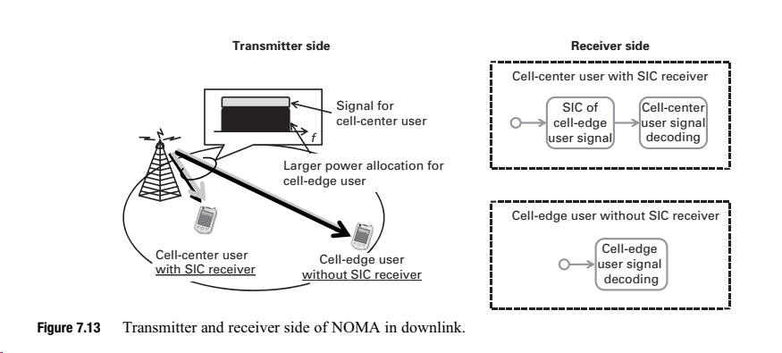

Slide 16
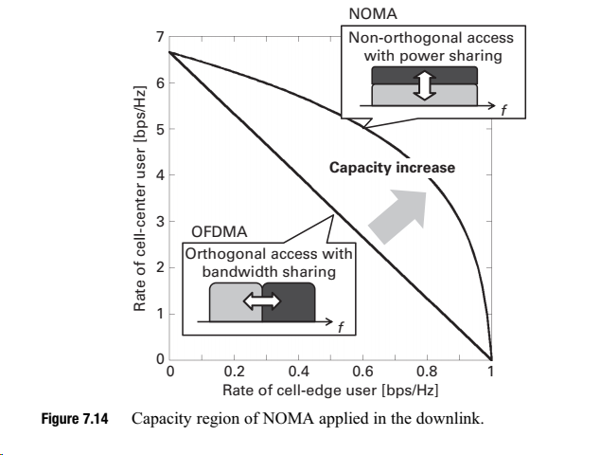

Slide 17
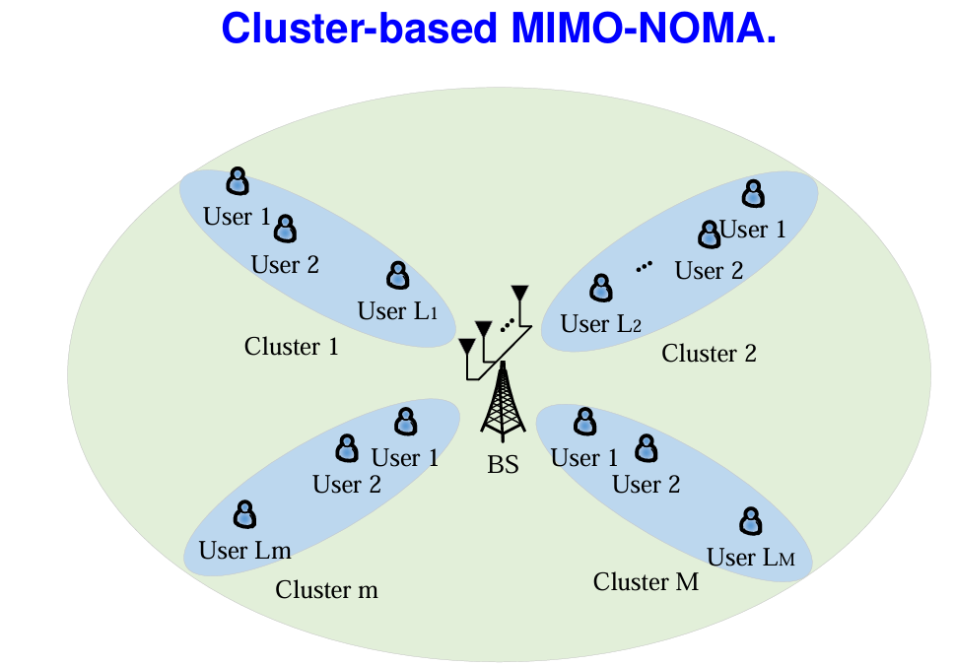

Slide 18
Device-to-device (D2D) communications
Direct Device-to-Device (D2D) communication, refers to direct communication between devices (i.e. users) without data traffic going through any infrastructure node
Advantages:
increased spectral efficiency
improved typical user data rate and capacity per area
extended coverage
reduced latency
enhanced cost and power efficiency
Reasons:
The proximity of the users employing D2D communication (proximity gain)
Increased spatial reuse of time and frequency resources (reuse gain)
From using a single link in the D2D mode rather than using both an uplink and a downlink resource when communicating via the base station in the cellular mode (hop gain)

Slide 19
Current D2D in 4G LTE:
LTE D2D can be seen as an add-on feature in a 4G LTE system
In LTE, D2D is operated synchronously,
synchronization source can be an eNode-B (in case of UEs being under network coverage)
UE (in case at least one of the UEs is not under network coverage or in case of inter-cell operation)
Either uplink (UL) spectrum (in case of Frequency Division Duplexing (FDD)) or UL subframes (in case of Time Division Duplexing (TDD)) can be used for D2D transmission
One interesting feature is the interference management among D2D links and cellular links
In practice it is assumed that D2D is running within a dedicated resource pool (i.e. certain physical resource blocks in specific subframes), where the D2D-enabled UEs will get the resource pool configuration information from the eNode-B
Compared to OFDM signaling, SC-FDMA can provide better coverage due to the lower Peak to Average Power Ratio (PAPR).

Slide 20
4G LTE D2D
The major developments of the 4G LTE D2D are:
D2D Synchronization
D2D Communication
D2D Discovery
(The D2D link is referred to as sidelink in the 3GPP Radio Access Network (RAN) Working Groups (WGs) )

Slide 21
D2D synchronization- 4G LTE
The sidelink synchronization signal (i.e. D2D synchronization signal), which is transmitted by the D2D synchronization source (either eNode-B or UE), is used for time and frequency synchronization to facilitate Synchronous D2D operation
Both eNode-B and UEs can act as synchronization sources
It is easy to understand that the eNode-B can act as a synchronization source
However, in order to facilitate inter-cell D2D operation, under certain conditions, for example at the cell edge, UEs with network coverage can transmit synchronization signals as well
In case of partial coverage where some D2D UEs are with network coverage and the rest are without network coverage, synchronization signals transmitted by UEs within network coverage can also help the out-of-coverage synchronization by aligning the out-of-coverage transmission to cellular network timing

Slide 22
D2D Communication- 4G LTE
D2D communication is based on physical layer broadcast communication, i.e. a physical layer broadcast solution is used to support broadcast, multicast and unicast services at application layer.
In order to support multicast or unicast, the targeted group ID (for multicast) or user ID (for unicast) is indicated in the higher layer message
Since by construction it is a broadcasted information, no physical layer closed control loop exists, i.e., no physical layer feedback, no link adaption, and no HARQ is supported for D2D links.
The air interface is based on the Uu interface and the UL channel structure is extended to D2D communication

Slide 23
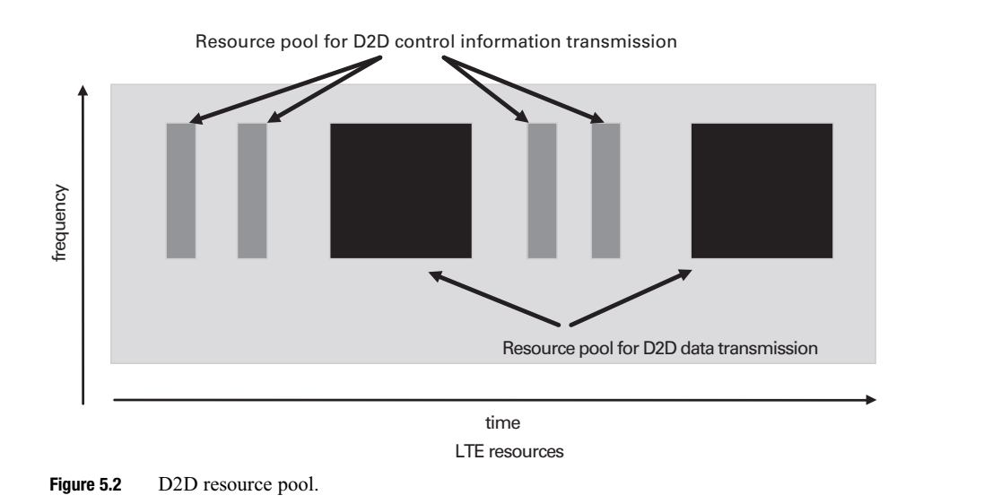
D2D Communication (Cont’d)- 4G LTE
Before the D2D data transmission, every transmitter sends out a control signal with information on the data transmission format and the occupied resource
This applies to the scenario where the network is assigning resources to the D2D transmitter and the scenario where the transmitter selects the resource by itself
At the receiving side, it is not necessary to listen to the cellular control channels in order to find out where the D2D data is located
Just based on the content of the D2D control channel, the receiving devices can find out the right location of the relevant resources
As to the resource usage for D2D communication, two different modes were specified: • Mode 1: An eNode-B or relay node schedules the exact resources used by a UE to transmit D2D data and D2D control information. Obviously, Mode 1 can be only applied to the scenarios where the transmitting UEs are within network coverage. • Mode 2: A UE by itself selects resources from the configured resource pools to transmit D2D data and D2D control information. Mode 2 can be applied no matter whether the transmitting UE has network coverage or not

Slide 24
D2D Discovery- 4G LTE
Discovery applies only to the UEs with network coverage
The concerned UEs can be in either RRC_IDLE state or RRC_CONNECTED state
Similar to the resources for D2D communication, the D2D discovery resources are arranged as resource pools as well, which are indicated by the eNode-B via SystemInformationBlockType19.
The resource pools are defined with the parameters including discoveryPeriod, discoveryOffsetIndicator and subframeBitmap
The frequency resources within a D2D subframe are given by the parameters startPRB, endPRB and numPRB. There are two ways specified for a transmitting UE to get the resources for discovery message transmission:
• Type 1: The UE selects autonomously the resource for transmission from the
discovery pools (independent of the UE RRC state)
• Type 2B: The UE transmits on resources allocated for it by the network (only
applicable to RRC_CONNECTED UEs)

Slide 25
D2D in 5G
Capacity/throughput gain: Because the involved devices are in close proximity with potentially better propagation conditions comparing to the propagation conditions toward the Base Station (BS), link throughput can be improved due to e.g. better Modulation and Coding Scheme (MCS) level. In addition, there is the possibility of sharing the same radio resources among cellular users and D2D users, which can improve the overall spectrum usage. System capacity can be improved due to offloading and local content sharing gain from D2D communication.
Latency gain: The End-to-End (E2E) latency may be reduced due to a short distance with less propagation delay, and no involvement of infrastructure network entities resulting in reduced transport delay and processing delay.

Slide 26
D2D in 5G
Availability and reliability gain: D2D can be used to extend network coverage with one-hop or multi-hop. Network coding and cooperative diversity via D2D can be used to enhance link quality as well. Furthermore, a D2D ad-hoc network can provide a fall back solution in case of a failure of the infrastructure or in case the infrastructure cannot be easily established.
Enabling new services: Full-blown D2D has great potential to enable new services and applications not only in the telecommunication area, but also in vertical industries, as for example Vehicle-to-X (V2X) communication as discussed in Chapters 2 and 4. The extension of D2D solutions for Vehicle-to-Vehicle (V2V) communication is part of LTE Release 14

Slide 27
D2D in 5G
Device discovery: Efficient network-assisted D2D discovery, which is used to determine the proximity between devices and the potential to establish a direct D2D link, is a key element in order to enable D2D communication and possible new applications.
Communication mode selection: Mode selection is another core function that controls whether two devices will communicate to each other in direct D2D mode or in regular cellular mode (i.e. via a BS). In direct D2D mode, the devices can take advantage of their proximity and may reuse cellular resources for the direct communication link. In cellular mode, the devices communicate through a common or separate serving BS by means of regular cellular links in orthogonal resources with cellular users.

Slide 28
D2D in 5G
Co-existence and interference management: Considering co-existence and related interference issues, at least two different aspects should be taken into account:
(1) co-existence among a large number of D2D links, and (2) co-existence among
D2D links and regular cellular links. Efficient schemes to handle the interference
are of importance to achieve the potential D2D benefits.
Multi-operator or inter-operator D2D operation: Inter-operator D2D is a clear
requirement resulting from e.g. V2X communication, and supporting inter-operator D2D operation is essential for the 5G D2D concept. Without multi-operator D2D support, the applicability of the future D2D solution to e.g. Cooperative Intelligent Traffic Systems will be quite limited. Considering inter-operator D2D operation, issues to be solved include, for example, spectrum usage and how to control and coordinate UEs in D2D communication across multiple operators’ networks.

Slide 29
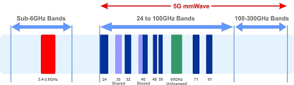
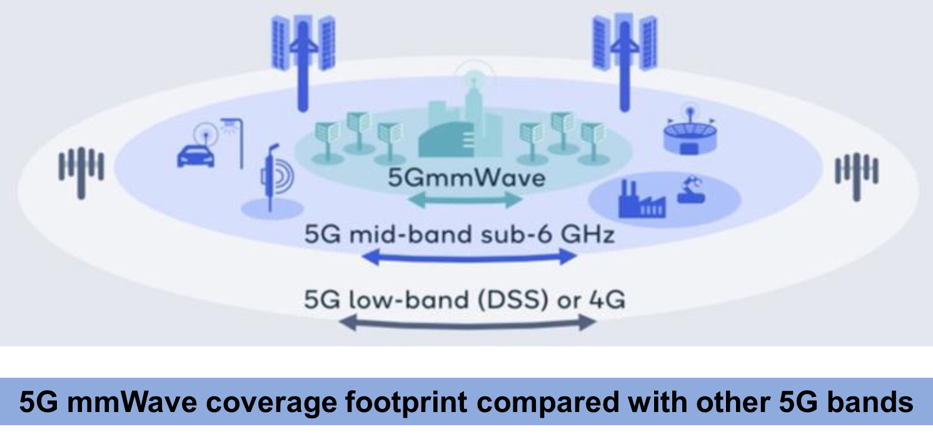
mmWave in 5G

Slide 30
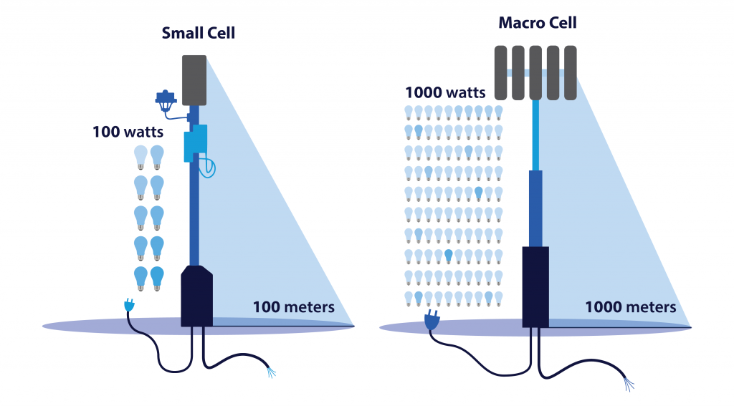
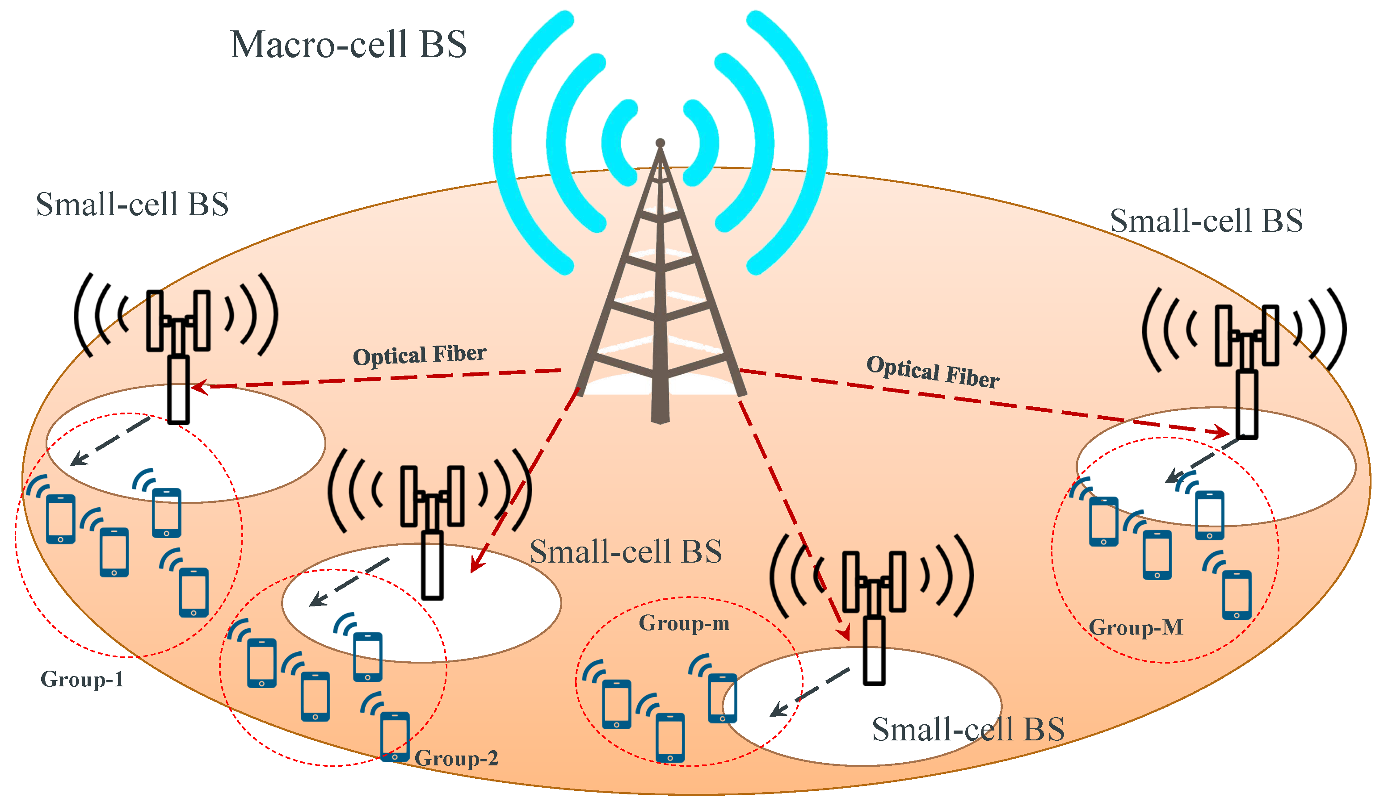
Small Cells

