Slide 1
BECE307L Wireless and Mobile Communications
Dr. Hemanth C
Associate Professor (Senior)
Vellore Institute of Technology Chennai

Slide 2
Course Objectives
1. To familiarize the concepts of wireless communication
2. To teach students the fundamentals of multipath fading and propagation models
3. To acquaint students with different generations of mobile networks
4. To describe the diversity and MIMO schemes as applied in wireless communication

Slide 3
Course Outcomes
The students will be able to:
1. Infer the wireless channel using path loss models and interpret the impact of multipath channel parameters
2. Examine the functions and services of cellular networks
3. Demonstrate the principles of multicarrier modulation
4. Select a suitable diversity technique to combat the multipath fading effects
5. Identify suitable MIMO techniques to enhance the spectrum efficiency
6. Describe the features of next-generation wireless technologies

Slide 4
Module 1: Mobile Radio Propagation: Large Scale Fading
Overview of Wireless Communication, Cellular concept – Frequency reuse – Channel assignment strategies – Handoff strategies – Interference and system capacity – Trunking and grade of service – Improving coverage and capacity in cellular system. Propagation mechanisms, Free space model, Two-way model, Outdoor and indoor propagation models, Link budget design.

Slide 5
Module 2: Mobile Radio Propagation : Small Scale Fading
Small scale multipath propagation, Parameters of multipath channels, Types of small scale fading, Rayleigh and Rician fading.

Slide 6
Module 3: Wireless Systems and Standards
AMPS, GSM, GPRS, EDGE, UMTS, LTE, LTE-A.

Slide 7
Module 4: OFDM Technology
Introduction and Challenges in Multicarrier Systems, OFDM System Model - IFFT/ FFT Transceiver Mathematical Model - Cyclic Prefix, PAPR and reduction techniques - SNR and BER performance - ICI-SC-FDMA.

Slide 8
Module 5: Diversity Techniques
Multiple Antenna Wireless Systems-System Model, Types of Diversity: Antenna, Frequency, Time; Deep Fade Analysis with Diversity, Optimal Receiver Combining, MRC, EGC, Diversity Order.

Slide 9
Module 6: MIMO Technology
MIMO System Model – Zero Forcing and Minimum Mean Square Error receivers – Singular Value Decomposition - Channel Capacity - Optimal Water filling Power Allocation – Beam forming - Spatial Multiplexing, BLAST Architectures, Distributed MIMO.

Slide 10
Module 7: Next Generation Wireless Communication
5G Wireless Technologies - NR Standard, filter bank multicarrier, Non-orthogonal multiple access, D2D, small cells, mmWave, Index Modulation - 6G Key enablers – Reconfigurable intelligent surfaces.

Slide 11
Module 8: Contemporary issues

Slide 12
Text and Reference Books:
Textbook:
Rappaport, T.S., Wireless Communications: Principles and Practice, 2018, (Reprint), Pearson Education, Noida, India.
Reference Books:
1. Andrea Goldsmith, Wireless Communications, 2020, 2nd Edition, Cambridge
University Press
2. Aditya K. Jagannatham,” Principles of Modern Wireless Communications Systems”, 2015, McGraw Hill Education
3. T L Singal, Wireless Communications, 2014, (Reprint), Tata McGraw Hill Education, 1st edition, New Delhi, India.
4. Keith Q T Zhang, Wireless Communications: Principles, Theory and Methodology, 2016, 1st edition, John Wiley & Sons, West Sussex, UK.

Slide 13
Evaluation Pattern
Assessments | Weightage
CAT1 (Module - 1 & 2) | 15%
CAT 2 (Module 3, 4 & 5) | 15%
Assignment 1 | 10%
Assignment 2 | 10%
Quiz | 10%
FAT | 40%

Slide 14
Module 1

Slide 15
Module 1: Mobile Radio Propagation: Large Scale Fading
Overview of Wireless Communication, Cellular concept – Frequency reuse – Channel assignment strategies – Handoff strategies – Interference and system capacity – Trunking and grade of service – Improving coverage and capacity in cellular system. Propagation mechanisms, Free space model, Two ray model, Outdoor and indoor propagation models, Link budget design.

Slide 16
What is Wireless Communication?
Wireless communication involves the transmission of information over a distance without the help of wires, cables, or any other forms of electrical conductors
Incorporates all forms of connecting and communicating between two or more devices using a wireless signal through wireless communication technologies and devices
Examples:
Cellular Networks
WiFi
Radio/ TV/ GPS
Satellite Communication
Remotes (TV/ Car door/ etc.)
Wireless Headset, Mouse, Keyboard etc.
Cordless Telephones

Slide 17
Advantages:
Cost Effectiveness
Flexibility
Mobility
Accessibility
Constant Connectivity

Slide 18
Cellular Concept:
Aim: To have a large power transmitter at the center to cover the entire area
Drawbacks:
Can serve only a limited number of users
Increase in the number of channels cannot increase in proportion to the users
Alternate Solution: Cellular Concept
Divide the area into smaller regions called cells
Each cell has a low-power transmitter (100w or less)
Each cell allocated a different set of frequencies
Adjacent cells on different frequencies to avoid crosstalk

Slide 19
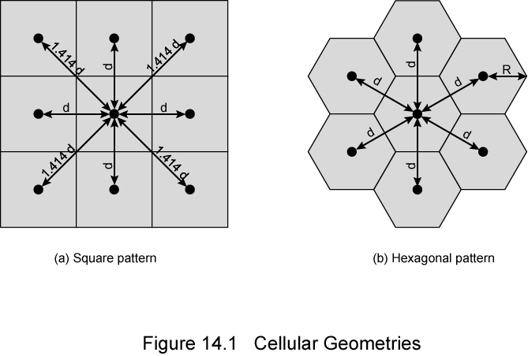
Cellular Concept:
Circle
Square
Width d cell has four neighbors at distance d and four at distance d
Better if all adjacent antennas equidistant
Simplifies choosing and switching to a new antenna

Slide 20
Cellular Concept:
Hexagon
Provides equidistant antennas
Radius defined as radius of circum-circle
Distance from center to vertex equals the length of a side
Distance between centers of cells radius R is R
Not always precise hexagons
Topographical limitations
Local signal propagation conditions
Location of antennas

Slide 21
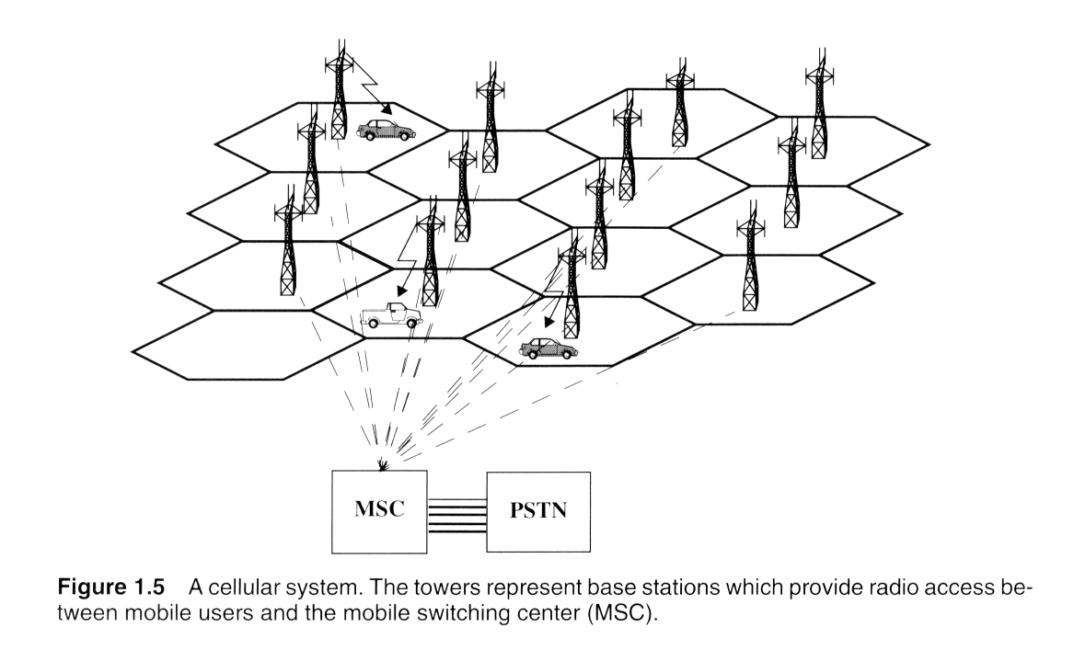
Cellular Concept:

Slide 22
Frequency Reuse:
The power of the base transceiver controlled
Allow communications within cell on given frequency
Limit escaping power to adjacent cells
Allow re-use of frequencies in nearby cells
Use same frequency for multiple conversations
10 – 50 frequencies per cell
E.g.
N cells all using same number of frequencies
K total number of frequencies used in systems
Each cell has K/N frequencies
Advanced Mobile Phone Service (AMPS) K=395, N=7 giving 57 frequencies per cell on average

Slide 23
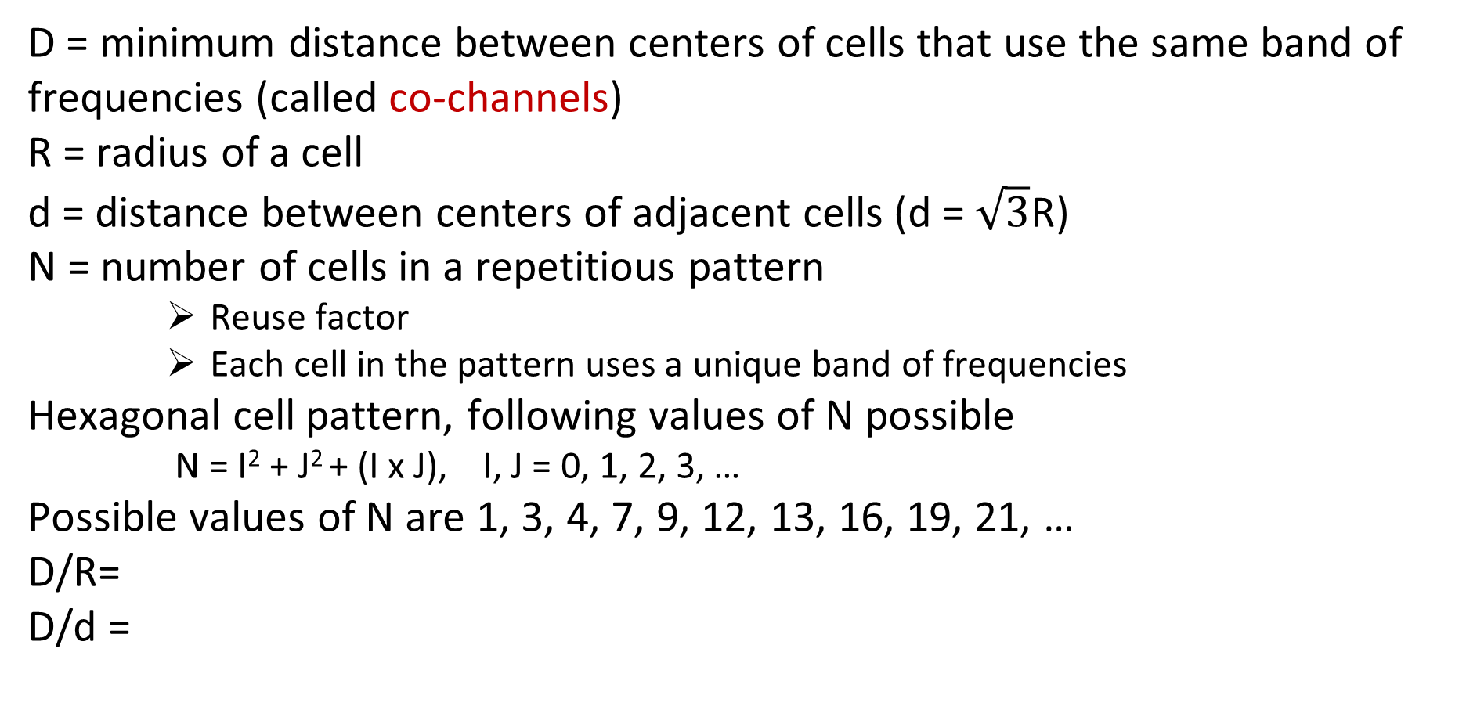
Characterizing Frequency Reuse:
D = minimum distance between centers of cells that use the same band of frequencies (called co-channels)
R = radius of a cell
d = distance between centers of adjacent cells (d = $\sqrt{3}$R)
N = number of cells in a repetitious pattern
Reuse factor
Each cell in the pattern uses a unique band of frequencies
Hexagonal cell pattern, following values of N possible
N = I² + J² + (I x J), I, J = 0, 1, 2, 3, …
Possible values of N are 1, 3, 4, 7, 9, 12, 13, 16, 19, 21, …
D/R=
D/d =

Slide 24
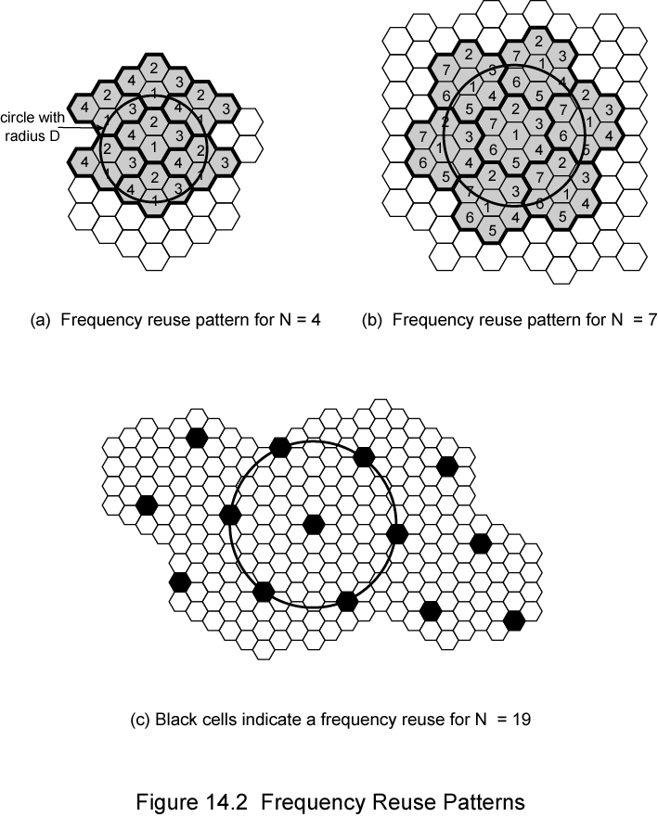
Frequency Reuse:

Slide 25
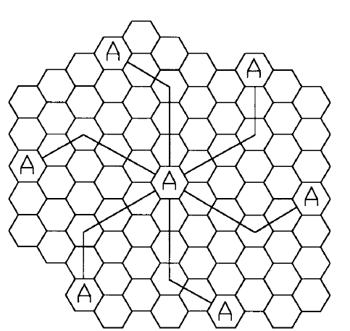
Locating Co-Channel Cells
To find the nearest co-channel neighbors of a particular cell
move i cells along any chain of hexagons and then
Turn 60 degrees counter-clockwise and move j cells.
For i = 3 and j = 2 (example, N = 19).

Slide 26
Types of Cells:
Types of base stations in cells:
Center of the cell (center-excited cells)
omnidirectional antennas are used in center-excited cells
Three of the six cell vertices (edge-excited cells)
sectored directional antennas are used in corner-excited cells.
Practical considerations usually do not allow base stations to be placed exactly as they appear in the hexagonal layout

Slide 27
Capacity Considerations:
Consider a cellular system that has a total of S duplex channels available for use
Each cell is allocated a group of k channels (k < S)
S channels are divided equally among N cells into unique and disjoint channel groups
The total number of available radio channels can be expressed as
S=kN
The N cells that collectively use the complete set of available frequencies is called a Cluster
If a cluster is replicated M times within the system, the total number of duplex channels,
C, can be used as a measure of capacity and is given by
C=MS=MkN

Slide 28
Frequency Reuse and Capacity:
The capacity of a cellular system is directly proportional to the number of times a cluster is replicated in a fixed service area
The factor N is called the cluster size and is typically equal to 1, 3, 4, 7, or 12
If the cluster size N is reduced while the cell size is kept constant, more clusters are required to cover a given area, and hence more capacity (a larger value of C) is achieved
A large cluster size indicates that the ratio between the cell radius and the distance between co-channel cells is small
A small cluster size indicates that co-channel cells are located much closer
The value for N is a function of how much interference a mobile or base station can tolerate while maintaining a sufficient quality of communications
From a design viewpoint, the smallest possible value of N is desirable in order to maximize
capacity over a given coverage area
The frequency reuse factor of a cellular system is given by 1/N, since each cell within a cluster is only assigned 1/N of the total available channels in the system

Slide 29
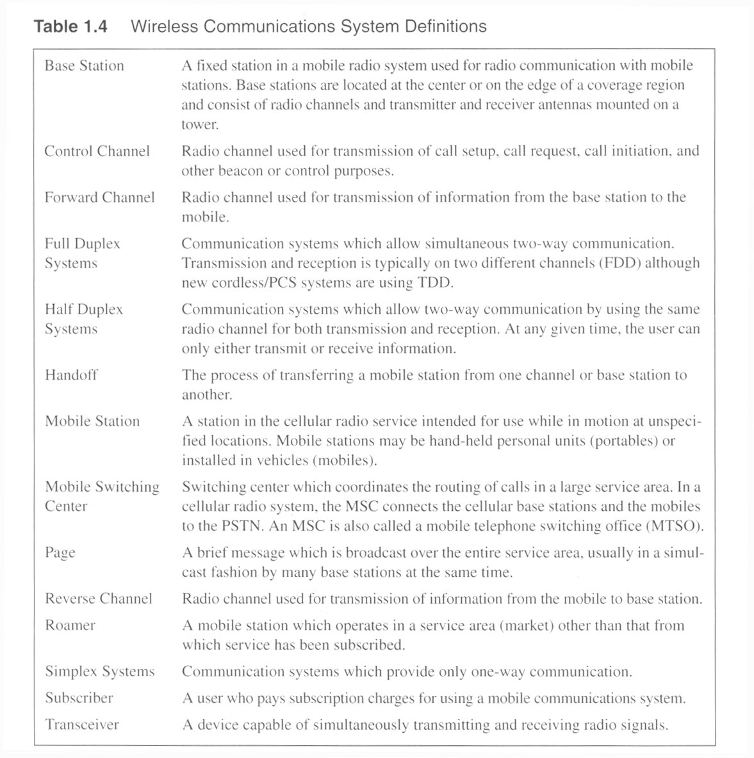

Some Terminologies

Slide 30
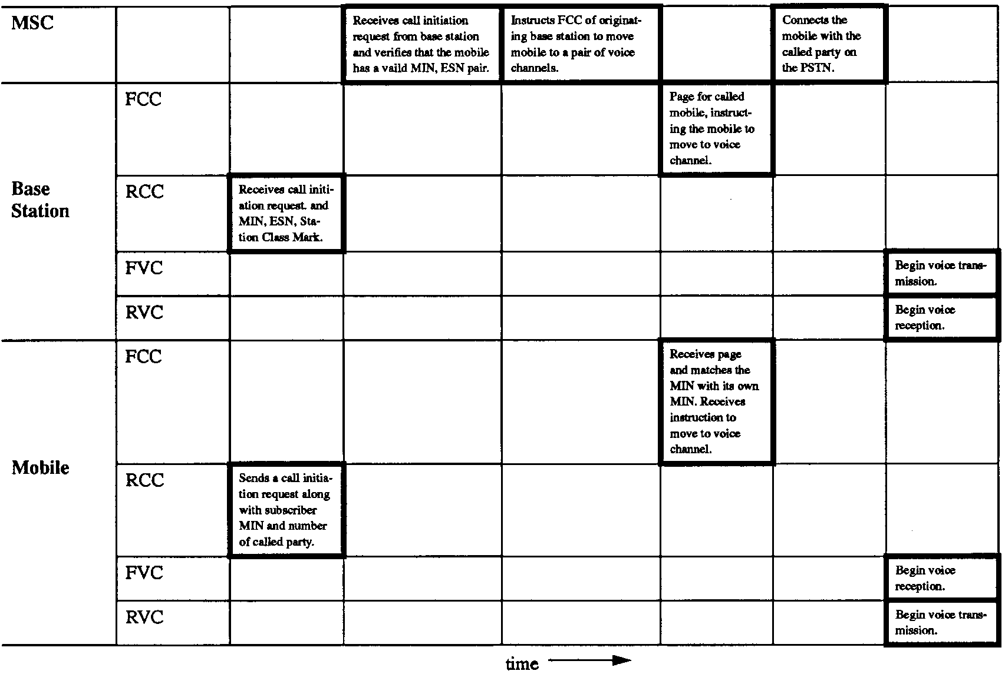
Call Process: Mobile to Mobile

Slide 31
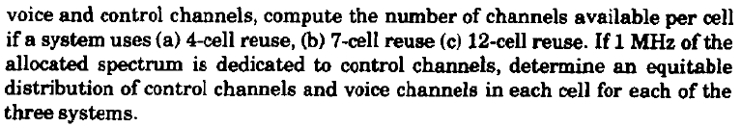
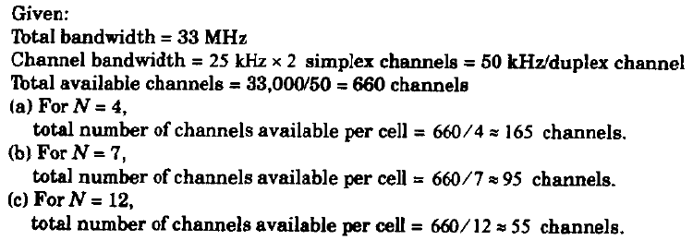
Example

Slide 32
Channel Assignment Strategies
Aim of Channel Assignment
Increase Capacity
Decrease Interference
Fixed Channel Assignment
Dynamic Channel Assignment

Slide 33
Fixed Assignment | Dynamic Assignment
Fixed number of channels or voice channels are allocated to cells | Channels are assigned dynamically depending on Channel Occupancy Traffic Distribution Radio Signal strength Indication (RSSI)
If all the channels are occupied and user make a call then the call will be blocked | If all the channels are occupied and user make a call then Base Station(BS) request more channel to the Mobile Station Center(MSC)
Allocated a predetermined set of voice channels | MSC only allocates a given frequency if that frequency is not presently in use in the cell or any other cell that falls within the minimum restricted distance of frequency reuse to avoid co-channel interference
Allocated channels remains to the cell, once the call is completed | Once the call is completed then the channel or the voice channel return to the MSC
MSC is less involved, less delay and less computation | Responsibility of MSC is more, more delay, more computational load

Slide 34
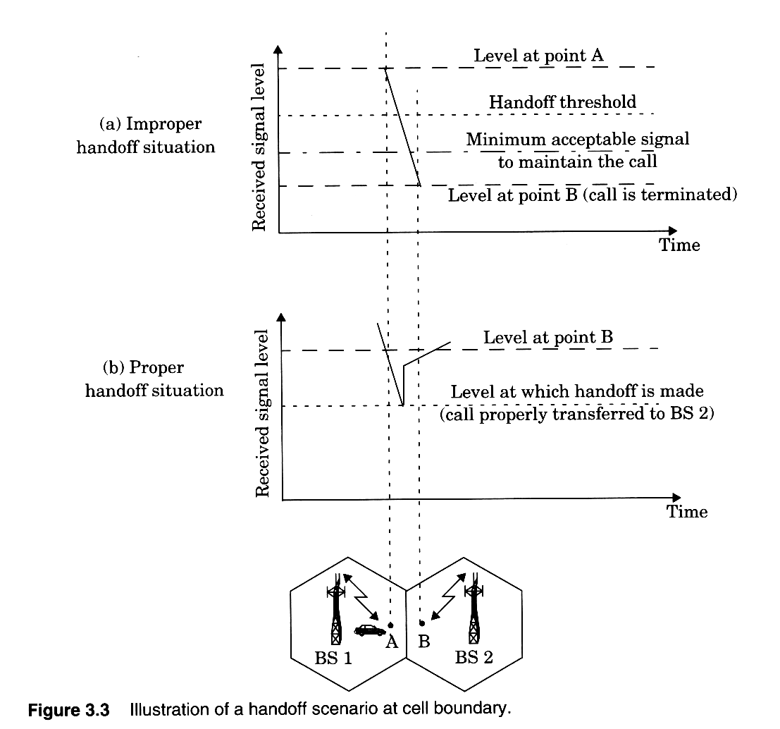
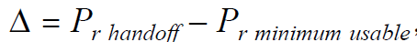

Handoffs – the basics
If Δ is too
large, unnecessary handoffs which burden the MSC may occur, and if Δ is too small, there may be insufficient time to complete a handoff before a call is lost due to weak signal conditions.

Slide 35
Handoff Decisions:
On what basis the handoff decision is made?
Based on the running average measurement and not momentarily drop
The length of time needed to decide if a handoff is necessary depends on the speed at which the vehicle is moving
If the slope of the short-term average received signal level in a given time interval is steep, the handoff should be made quickly
Dwell Time: Amount of time a user spends in a cell without Handoff
Governed by several factors, including propagation, interference, distance between the subscriber and the base station, and other time-varying effects
Handoff in 1G- Measurements made by the base station
Handoff in 2G- Mobile assisted handoff (MAHO): measures the received power from the surrounding base stations and continually reports the results of these measurements to the serving base station

Slide 36
Handoff
Intersystem Handoff:
If a mobile moves from one cellular system to a different cellular system controlled by a different MSC
a local call may become a long-distance call as the mobile moves out of its home system and becomes a roamer in a neighboring system
Prioritizing Handoff:
Handoffs more important than new calls
Requests are queued and processed
Queuing of handoffs is possible because there is a finite time interval between the time the received signal level drops below the handoff threshold and the time the call is terminated due to insufficient signal level

Slide 37
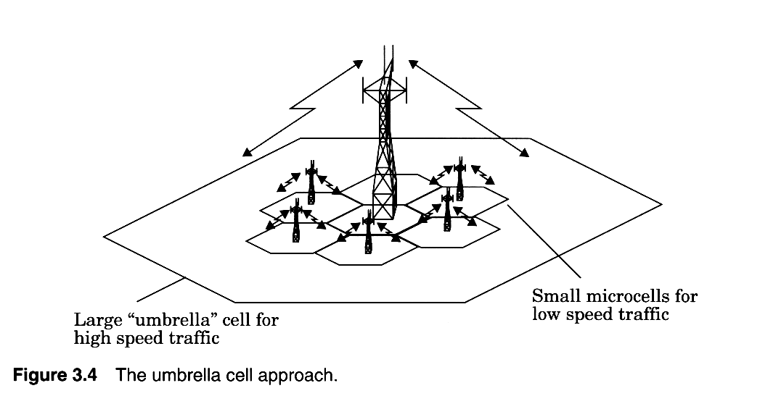
Practical Handoff Considerations:
Issue:
Fast-moving users and slow-moving users in the same cell
Umbrella cells concept:
Tall antennas (implying larger cell size) for fast-moving users and smaller cells for slow-moving users
Cell dragging:
Pedestrian users that provide a very strong signal to the base station
when there is a line-of-sight (LOS) radio path between the subscriber and the base station
Hand-off threshold and coverage parameter should be adjusted

Slide 38
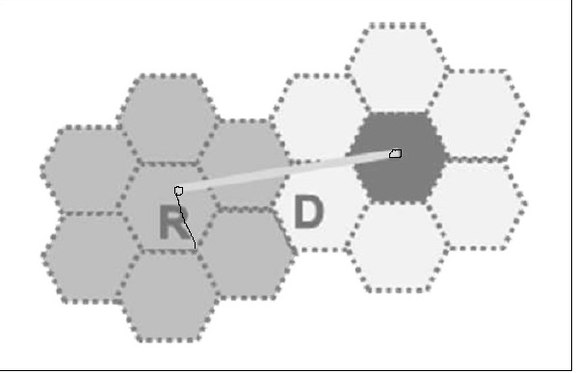

Interference:
Sources of interference:
Another mobile in the same cell
A call in progress in a neighboring cell
Other base stations operating in the same frequency band
Any noncellular system that inadvertently leaks power into the cellular band
Interference in Voice channel: Crosstalk
Interference in control channel: Missed and blocked calls due to incorrect signaling
Co-Channel interference
Adjacent channel interference

Slide 39
Adjacent Channel Interference:
Interference resulting from signals which are adjacent in frequency to the desired signal is called adjacent channel interference
Reason: Imperfect receiver filters allow nearby frequencies to leak into the passband
Technique to overcome: Non Contagious channel allocation

Slide 40
Co-Channel Interference
Interference between signals from the cells using the same
frequency is called co-channel interference
Can’t be sorted by increasing the Signal Power
Co-channel cells must be physically separated by a minimum distance to provide sufficient isolation due to propagation
When the size of each cell is approximately the same and the base stations transmit the same power, the co-channel interference ratio is independent of the transmitted power and becomes a function of the radius of the cell (R) and the distance between centers of the nearest co-channel cells (D)
By increasing the ratio of D/R, the spatial separation between co-channel cells relative to the coverage distance of a cell is increased
The parameter Q, called the co-channel reuse ratio, is related to the cluster size

Slide 41
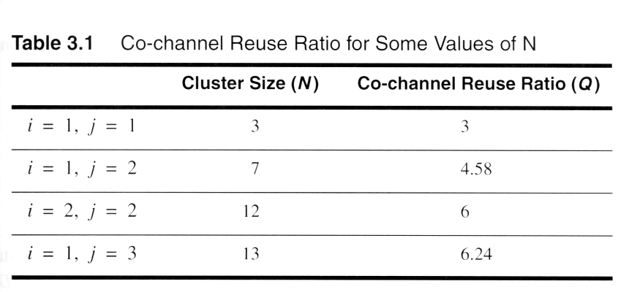
Smaller N is greater capacity, Larger Q is lesser the interference

Slide 42
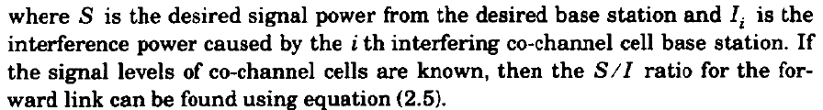
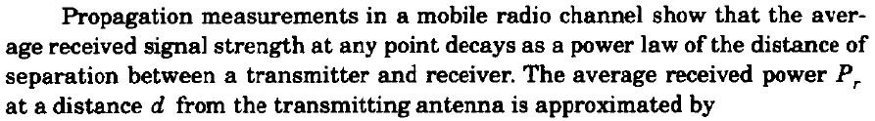



Signal to Interference ratio

Slide 43
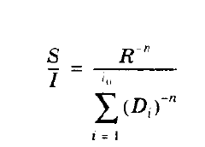

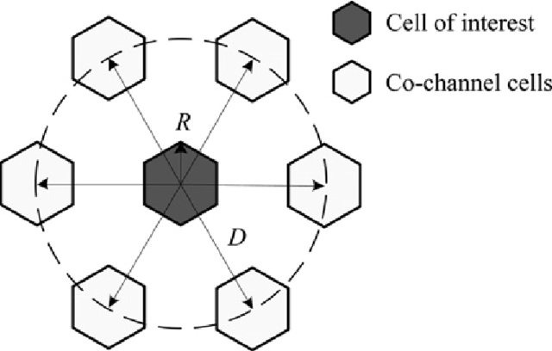
Signal to Interference Noise Ratio

Slide 44
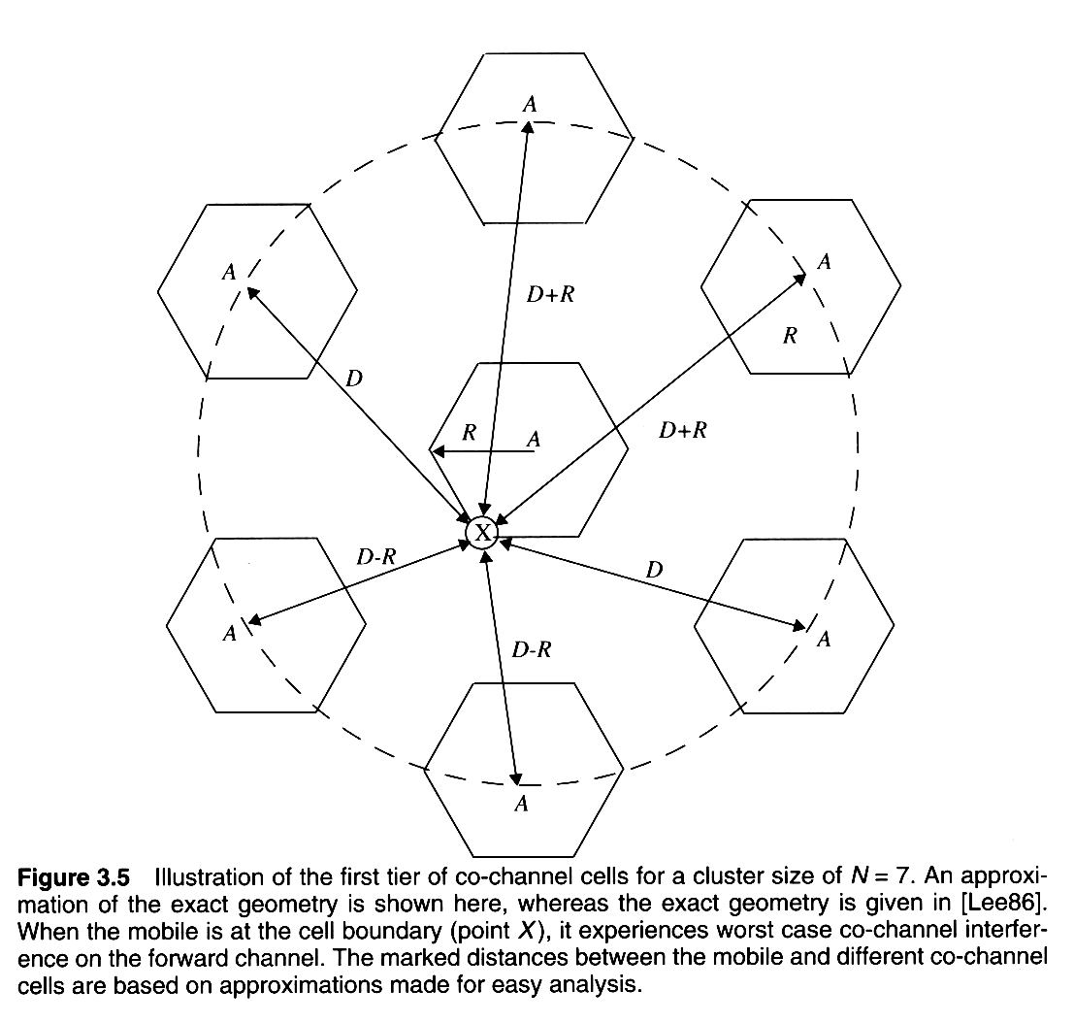
Co-channel cells for 7-cell reuse
Notes:
Fig. 2.4

Slide 45
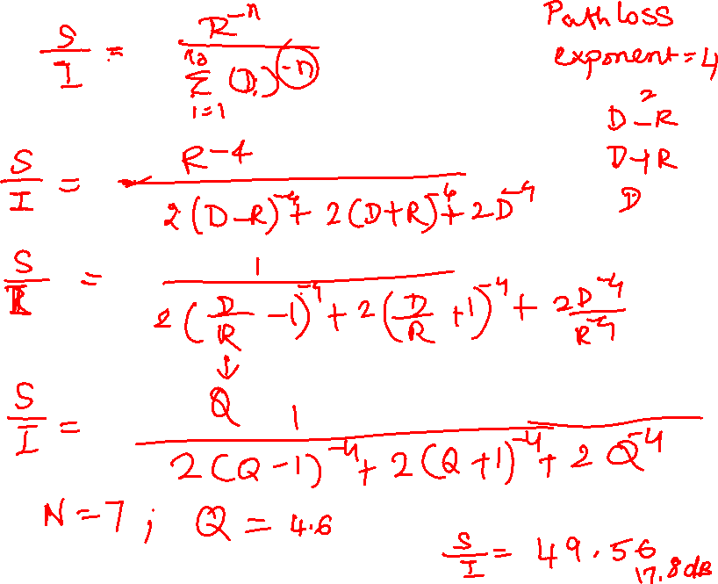

Slide 46
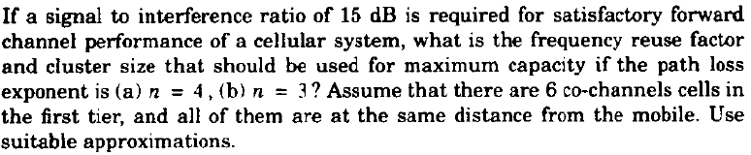
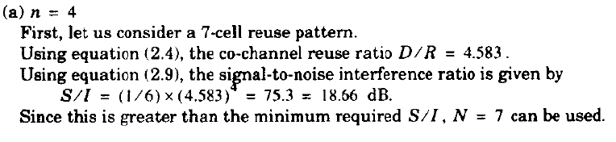
Example

Slide 47
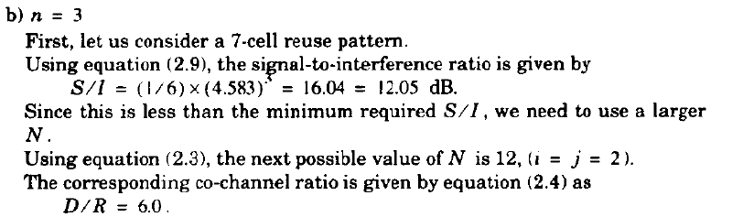


Slide 48
Improving Coverage & Capacity in Cellular System
Cell Splitting
Sectoring
Repeaters
Microcell

Slide 49
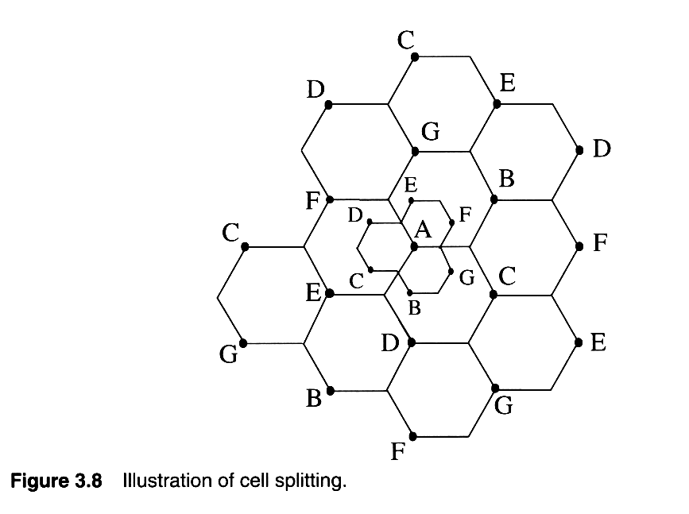
Cells are split to add channels with no new spectrum usage
Notes:
Fig. 2.10

Slide 50
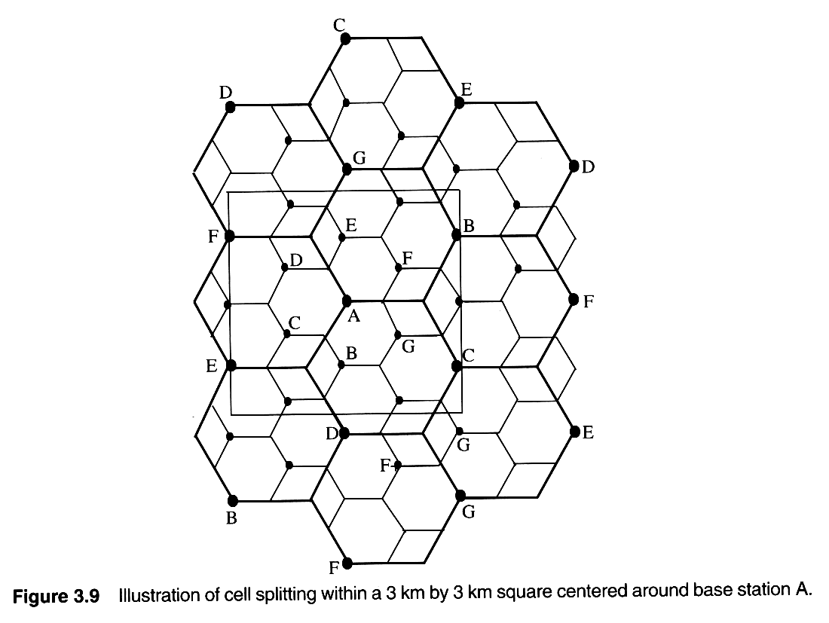
Cell Splitting increases capacity
Notes:
Fig. 2.11

Slide 51

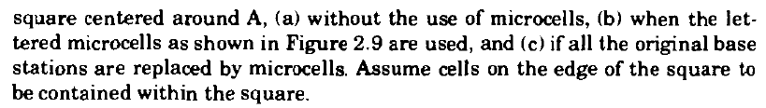

Slide 52
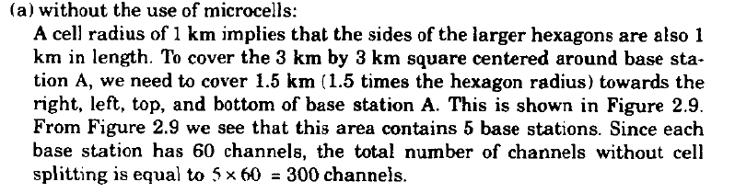
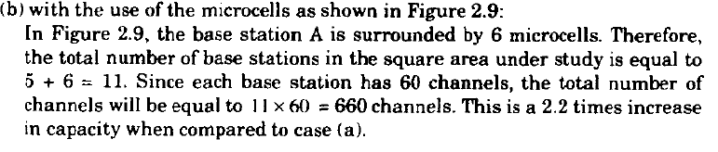

Slide 53
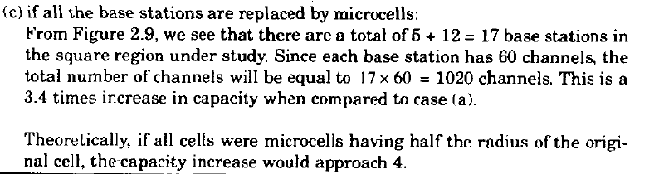

Slide 54
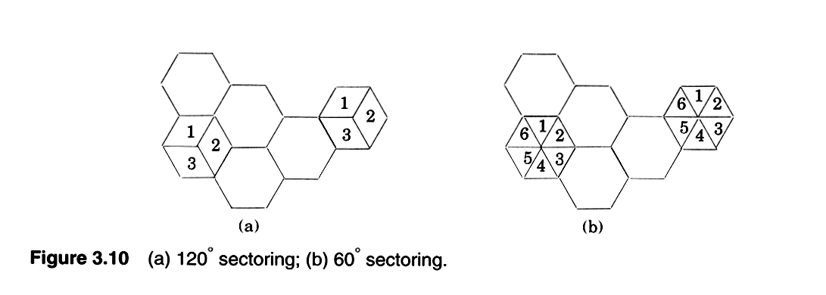
Sectoring improves S/I
Notes:
Fig. 2.12

Slide 55
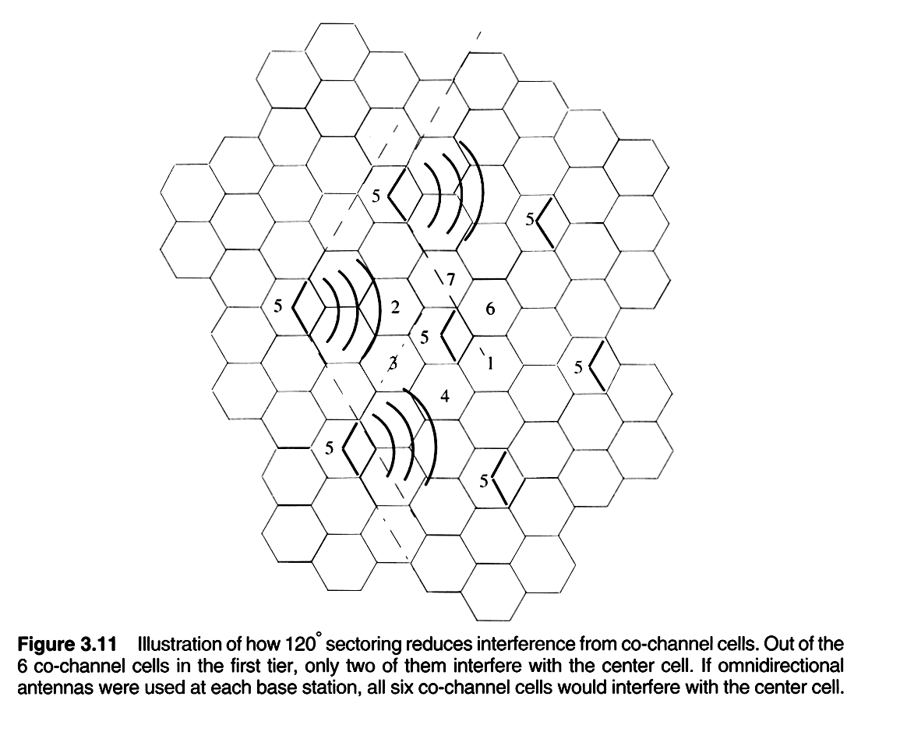
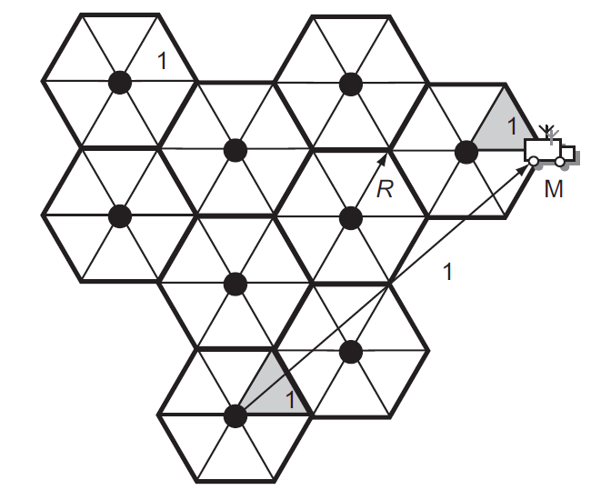
Sectoring improves S/I
Notes:
Fig. 2.13

Slide 56
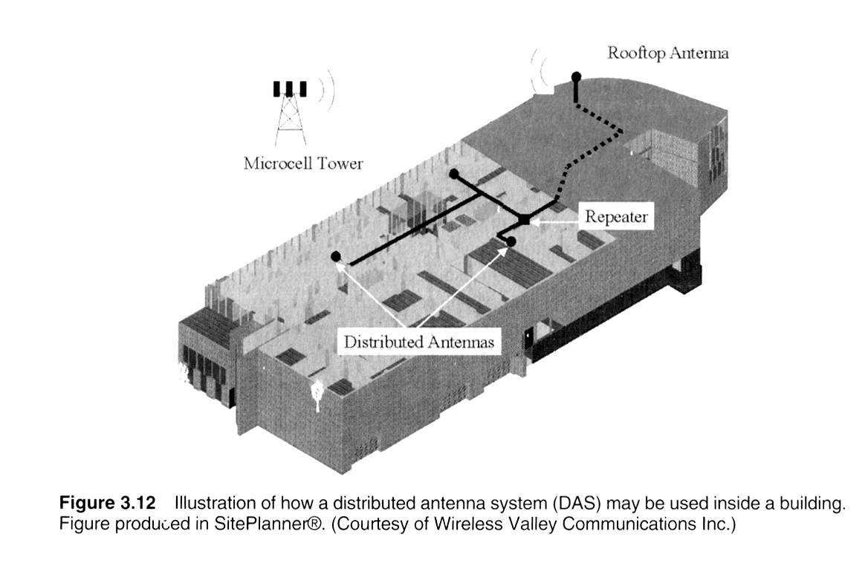
Repeaters for Range Extension

Slide 57
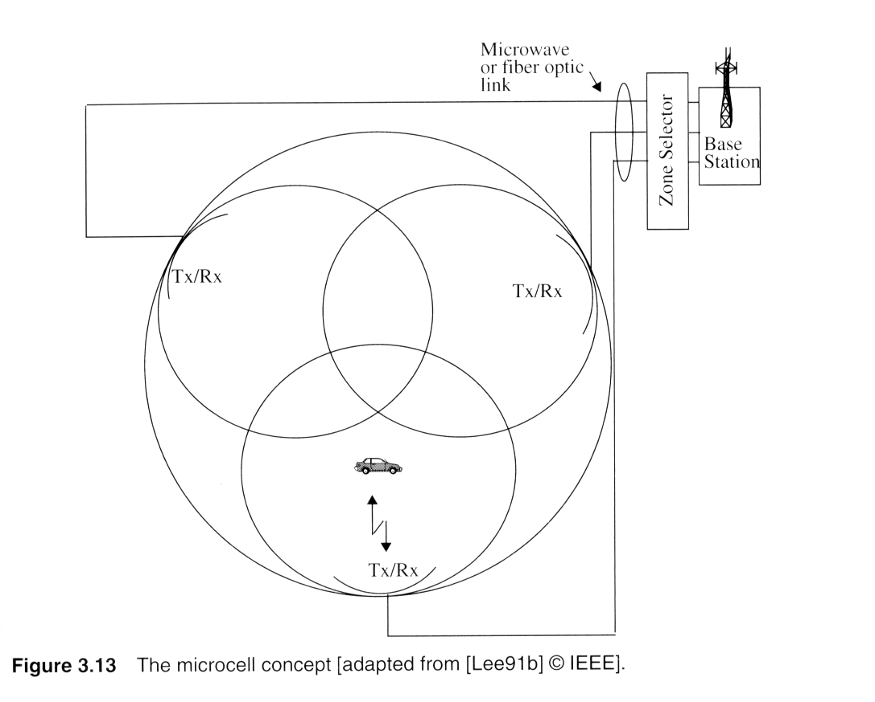
Microcell Zone concept

Slide 58
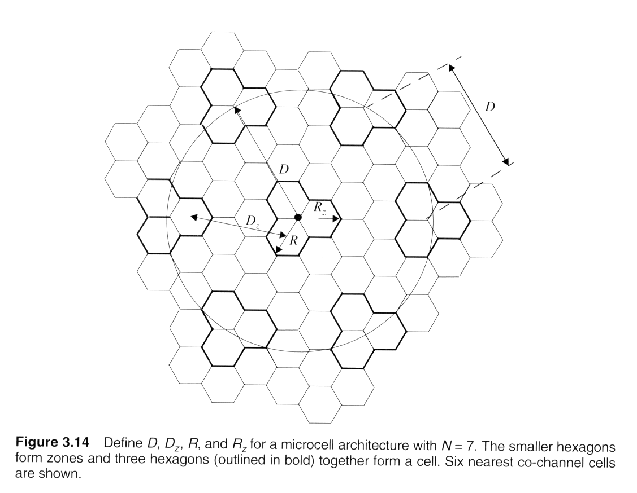
Zone Cell Concept
Notes:
Fig. 2.16

