Slide 1
BECE307L Wireless and Mobile Communications
Dr. Hemanth C
Associate Professor (Senior)
Vellore Institute of Technology Chennai

Slide 2
Module 1 b: Trunking and grade of service

Slide 3
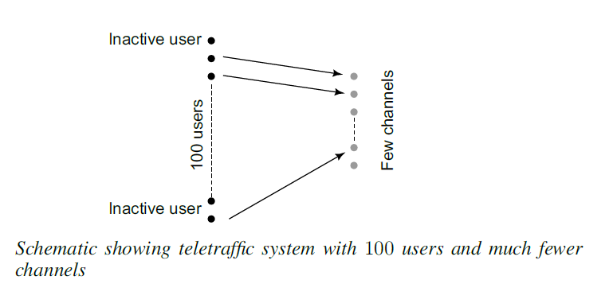
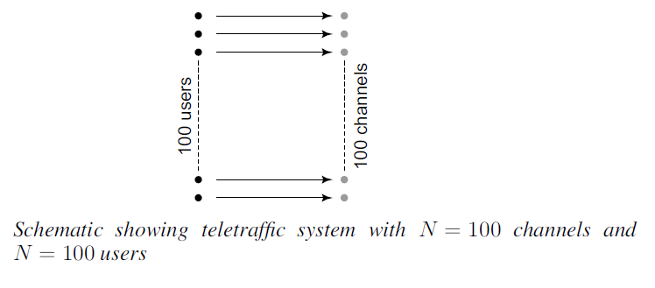
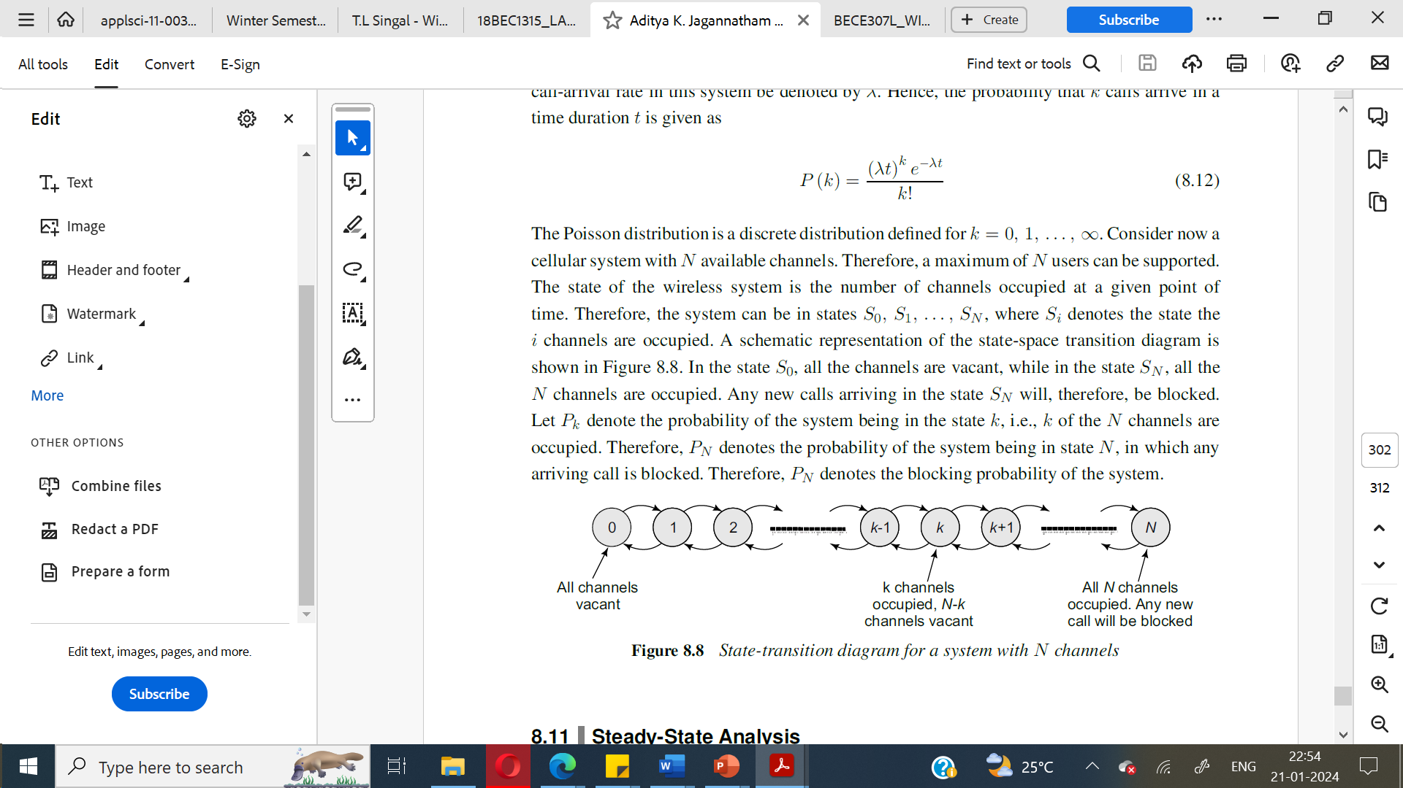
Teletraffic Theory

Slide 4
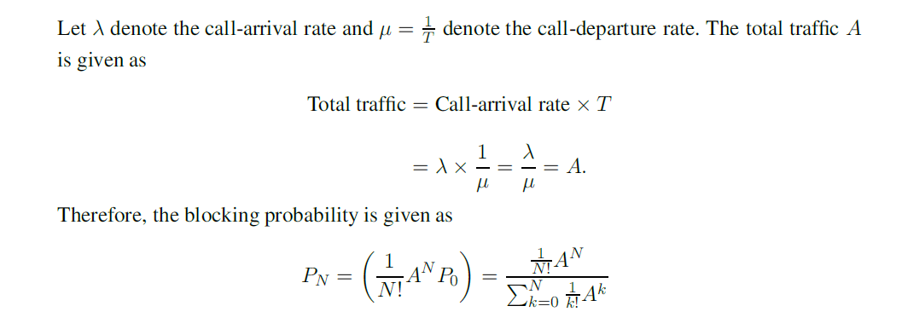
Teletraffic Theory

Slide 5
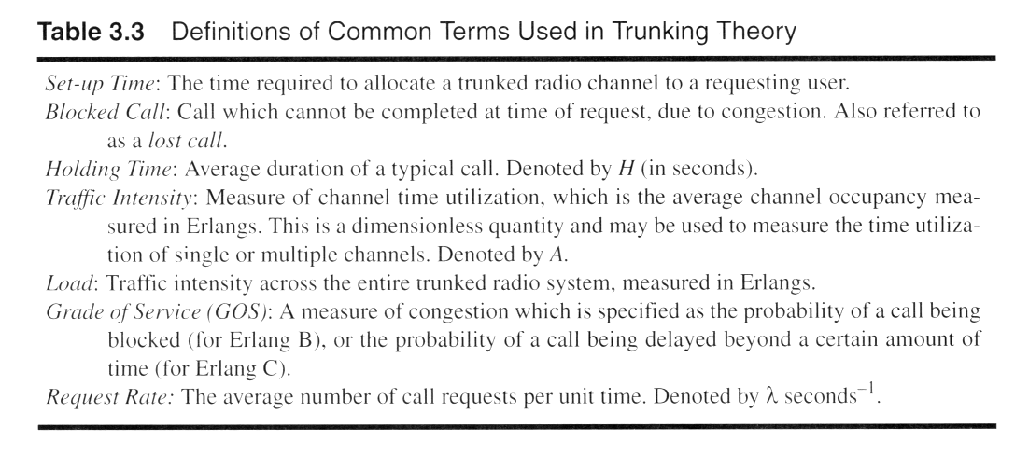
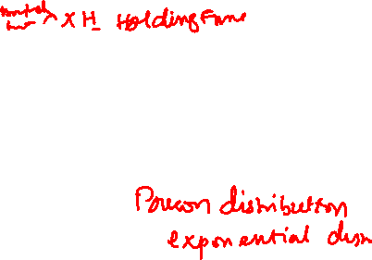
Key Definitions for Trunked Radio
Notes:
Fig. 2.6

Slide 6
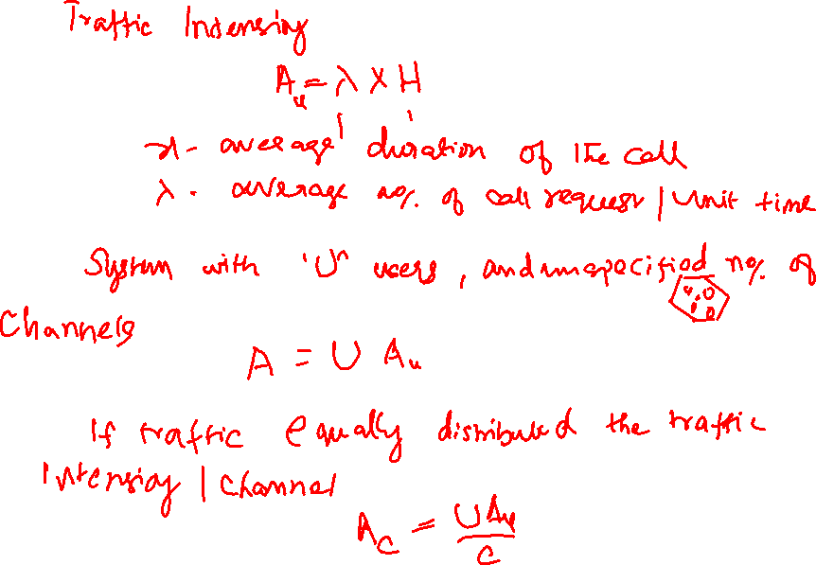

Slide 7
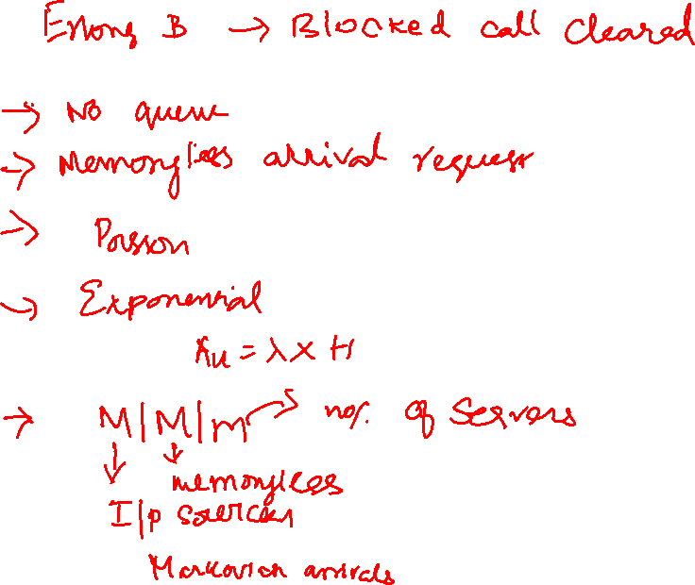

Slide 8
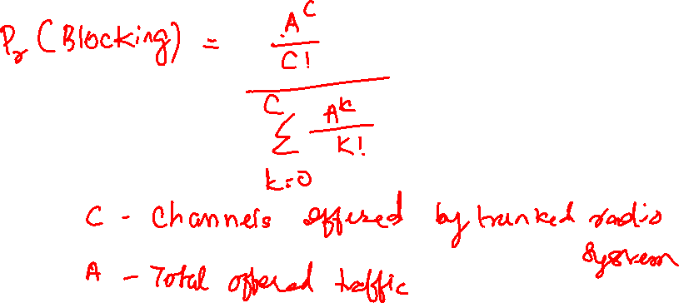

Slide 9
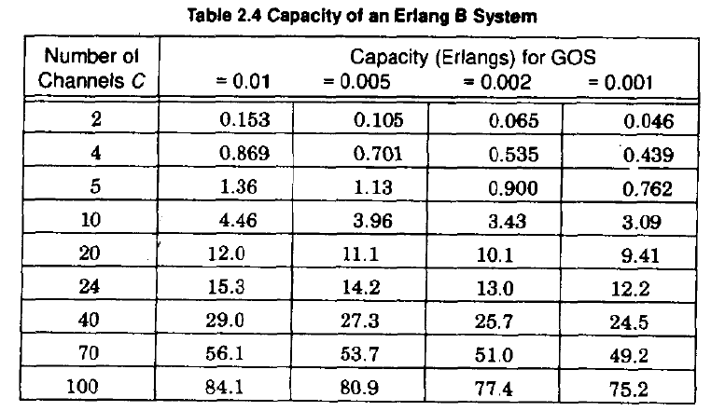
Erlang B - Capacity

Slide 10


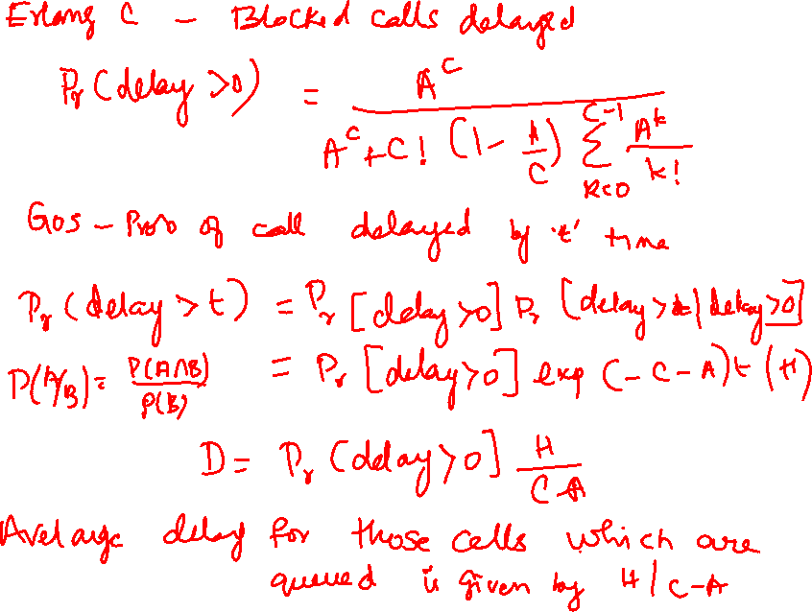

Slide 11
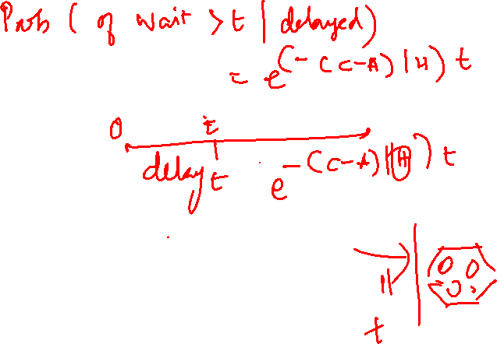

Slide 12
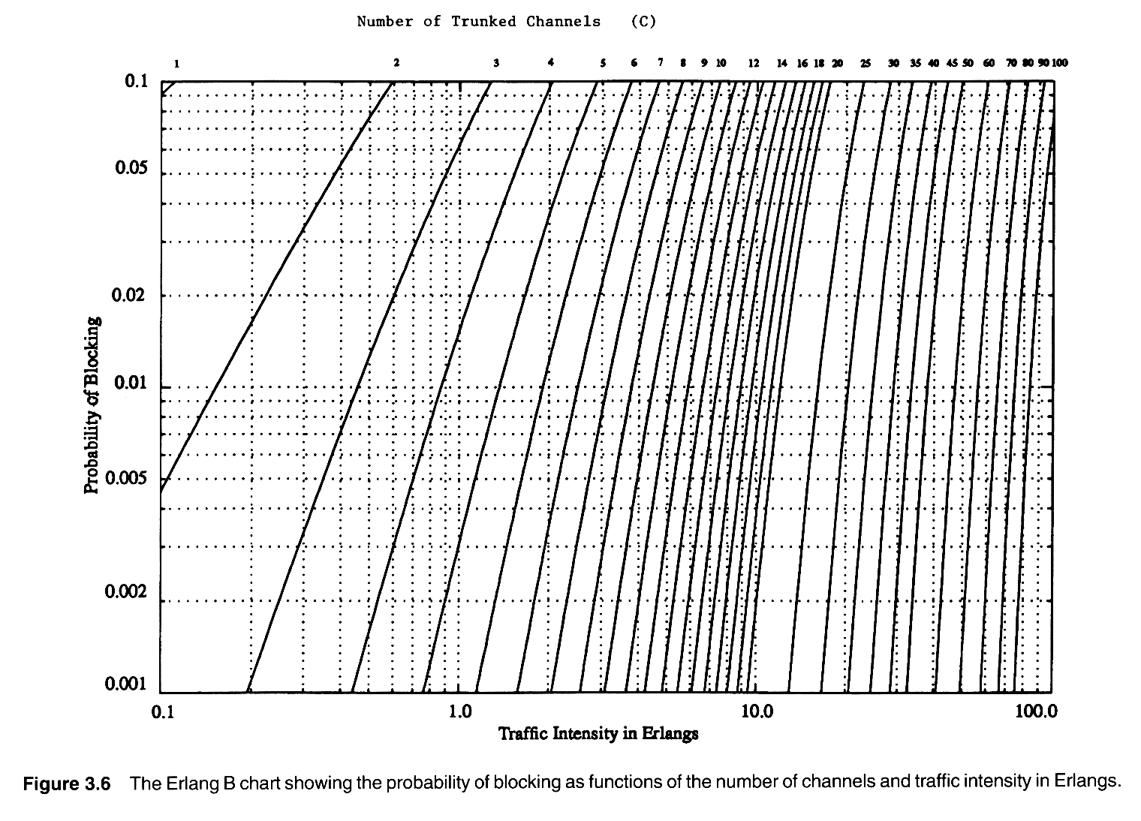
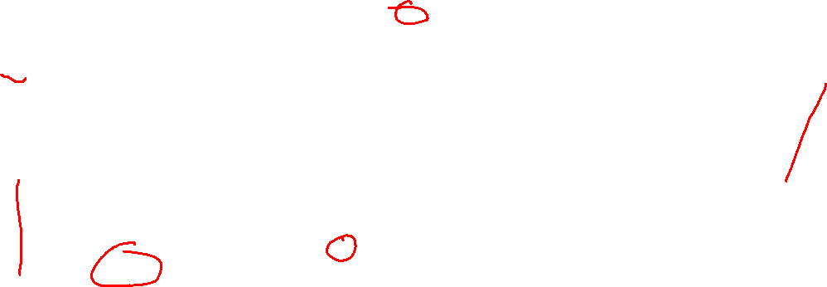
Erlang B
GOS
A
Notes:
Fig. 2.8

Slide 13
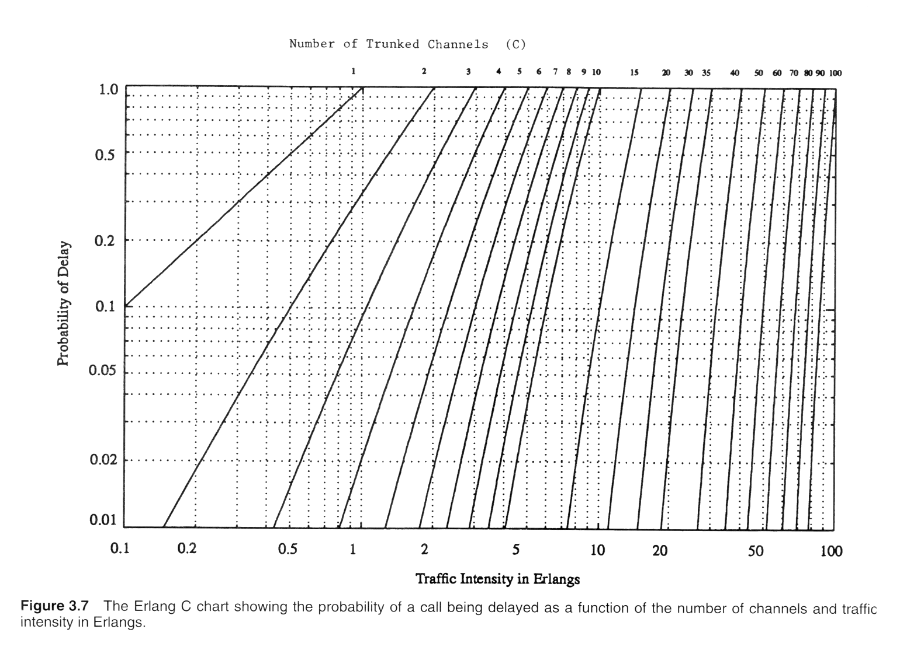
Erlang C
Notes:
Fig. 2.9

Slide 14

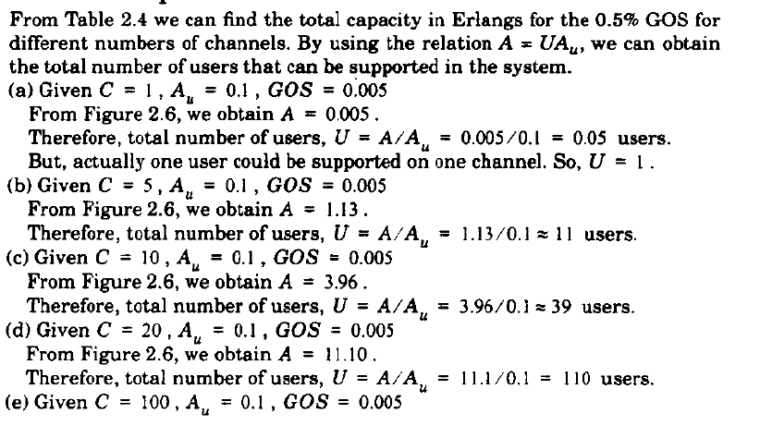

Slide 15

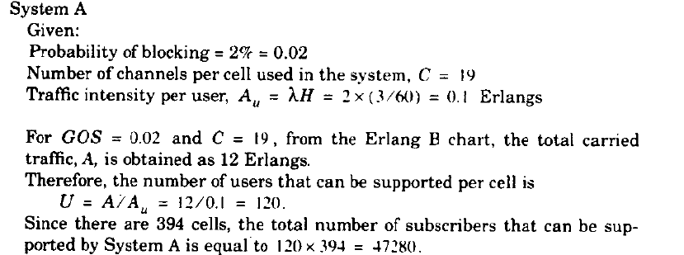

Slide 16
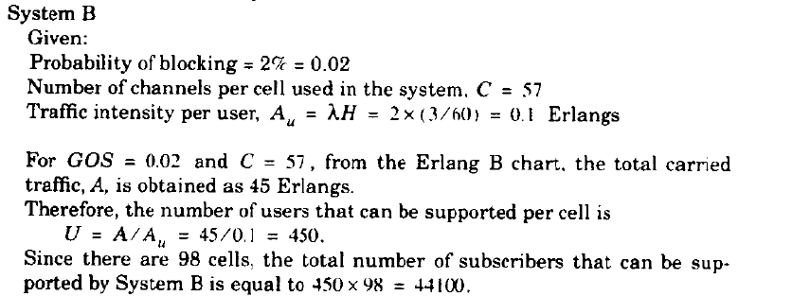

Slide 17



Slide 18


Slide 19


Slide 20




Slide 21


Slide 22



Slide 23




Slide 24


