Slide 1
Data Preprocessing
Why preprocess the data?
Descriptive data summarization
Data cleaning
Data integration and transformation
Data reduction
Discretization and concept hierarchy generation
Summary

Slide 2
Data Objects
Data sets are made up of data objects.
A data object represents an entity.
Examples:
  sales database: customers, store items, sales
  medical database: patients, treatments
  university database: students, professors, courses
Also called samples , examples, instances, data points, objects, tuples.
Data objects are described by attributes.
Database rows -> data objects; columns ->attributes.

Slide 3
Attributes
Attribute (or dimensions, features, variables): a data field, representing a characteristic or feature of a data object.
  E.g., customer _ID, name, address
Types:
  Nominal: represent categories without any inherent order or ranking.
  Binary
  Numeric: quantitative
    Interval-scaled
    Ratio-scaled

Slide 4
Attribute Types
Nominal: categories, states, or “names of things”
  Hair_color = {auburn, black, blond, brown, grey, red, white}
  marital status, occupation
Binary
  Nominal attribute with only 2 states (0 and 1)
  Symmetric binary: both outcomes equally important
    e.g., gender
  Asymmetric binary: outcomes not equally important.
    e.g., medical test (positive vs. negative)
    Convention: assign 1 to most important outcome (e.g., HIV positive)
Ordinal
  Represent qualitative variables with a natural order or ranking, but the intervals between the categories may not be equal or meaningfu
    Rating scales (e.g., 1 star, 2 stars, 3 stars)
    Educational levels (e.g., high school diploma, bachelor's degree, master's degree)
    Likert scales (e.g., strongly disagree, disagree, neutral, agree, strongly agree)

Slide 5
Discrete vs. Continuous Attributes
Discrete Attribute
  Has only a finite or countably infinite set of values
    E.g., zip codes, profession, or the set of words in a collection of documents
  Sometimes, represented as integer variables
  Note: Binary attributes are a special case of discrete attributes
Continuous Attribute
  Has real numbers as attribute values
    E.g., temperature, height, or weight
  Practically, real values can only be measured and represented using a finite number of digits
  Continuous attributes are typically represented as floating-point variables

Slide 6
Why Data Preprocessing?
Data in the real world is dirty
  incomplete: lacking attribute values, lacking certain attributes of interest, or containing only aggregate data
    e.g., occupation=“ ”
  noisy: containing errors or outliers
    e.g., Salary=“-10”
  inconsistent: containing discrepancies in codes or names
    e.g., Age=“42” Birthday=“03/07/1997”
    e.g., Was rating “1,2,3”, now rating “A, B, C”
    e.g., discrepancy between duplicate records

Slide 7
Why Is Data Dirty?
Incomplete data may come from
  “Not applicable” data value when collected
  Different considerations between the time when the data was collected and when it is analyzed.
  Human/hardware/software problems
Noisy data (incorrect values) may come from
  Faulty data collection instruments
  Human or computer error at data entry
  Errors in data transmission
Inconsistent data may come from
  Different data sources
  Functional dependency violation (e.g., modify some linked data)
Duplicate records also need data cleaning

Slide 8
Why Is Data Preprocessing Important?
Data Quality Improvement
  Ensuring that the ML model is trained on reliable and accurate data.
Feature Scaling and Normalization
Dimensionality Reduction
Handling Categorical Data
Addressing Data Imbalance
Feature Engineering
  Creating new features or transforming existing ones to better

Slide 9
Multi-Dimensional Measure of Data Quality
A well-accepted multidimensional view:
  Accuracy
  Completeness
  Consistency
  Timeliness
  Believability
  Value added
  Interpretability
  Accessibility
Broad categories:
  Intrinsic, contextual, representational, and accessibility
Notes:
Accuracy: Refers to the correctness and precision of the data in relation to the real-world phenomenon it represents. Accurate data is free from errors and reflects the true state of affairs.
Completeness: Indicates the extent to which all required data elements are present in the dataset. Complete data contains all necessary information without any missing values or gaps.
Consistency: Involves the coherence and uniformity of data across different sources, systems, or time periods. Consistent data maintains the same meaning and format throughout.
Timeliness: Relates to the currency and relevance of the data in relation to the timeframe of analysis or decision-making. Timely data is available when needed and reflects the most current information.
Believability: Refers to the trustworthiness and credibility of the data. Believable data is perceived as reliable and accurate by users and stakeholders.
Value added: Represents the extent to which the data contributes to achieving organizational goals or fulfilling specific objectives. Valuable data provides actionable insights and enhances decision-making processes.
Interpretability: Indicates the ease with which users can understand and derive meaning from the data. Interpretable data is presented in a clear and understandable manner, facilitating analysis and decision-making.
Accessibility: Relates to the ease of access and availability of data to authorized users. Accessible data is readily obtainable and can be retrieved without significant barriers or restrictions.
These dimensions of data quality can be broadly categorized into four main categories:
Intrinsic: Accuracy, completeness, and consistency pertain to the inherent quality of the data itself.
Contextual: Timeliness and believability are influenced by the context in which the data is collected, stored, and used.
Representational: Value added and interpretability focus on how well the data represents the underlying real-world phenomena and how effectively it can be understood and utilized.
Accessibility: Accessibility refers to the ease with which users can access and retrieve the data, ensuring that it is available when needed.

Slide 10
Major Tasks in Data Preprocessing
Data cleaning
  Fill in missing values, smooth noisy data, identify or remove outliers, and resolve inconsistencies
Data integration
  Integration of multiple databases, data cubes, or files
Data transformation
  Normalization and aggregation
Data reduction
  Obtains reduced representation in volume but produces the same or similar analytical results
Data discretization
  Part of data reduction but with particular importance, especially for numerical data
  partitioning continuous data into discrete intervals or categories

Slide 11

Forms of Data Preprocessing

Slide 12
Data Preprocessing
Why preprocess the data?
Descriptive data summarization
Data cleaning
Data integration and transformation
Data reduction
Discretization and concept hierarchy generation
Summary

Slide 13
Data Descriptive Characteristics
To better understand the data:
Central tendency: Describe the center position of a distribution for a data set
  median, max, min, quantiles, outliers, variance, etc.
Variabiliy measures: Analyses how dispersed the distribution is for a set of data
Numerical dimensions correspond to sorted intervals
  Allows for the analysis of data dispersion at different levels of granularity or precision
  To explore the variability of the dataset across different intervals or categories, providing a more nuanced understanding of the data distribution.
Data dispersion: analyzed with multiple granularities of precision
  Boxplot or quantile analysis on sorted intervals
Notes:
Central tendency measures, such as the median, maximum, minimum, and quantiles, provide insights into the typical or central value of the dataset and its distribution across different intervals or categories. Variation measures, such as variance or standard deviation, quantify the extent of variability or spread of the data points around the central tendency.

Slide 14
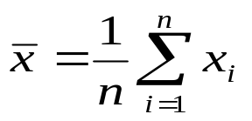

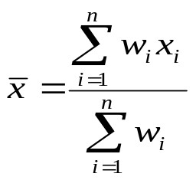
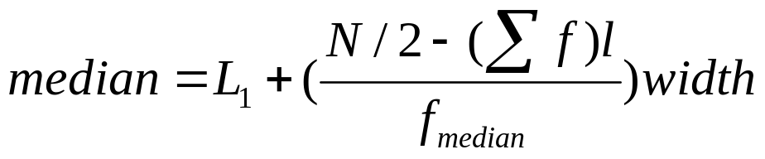
Measuring the Central Tendency
Mean (algebraic measure) (sample vs. population):
  Weighted arithmetic mean:
  Trimmed mean: chopping extreme values
Median: A holistic measure
  Middle value if odd number of values, or average of the middle two values otherwise
  Estimated by interpolation (for grouped data):
Mode
  Value that occurs most frequently in the data
  Unimodal, bimodal, trimodal
  Empirical formula(unimodal):

Slide 15
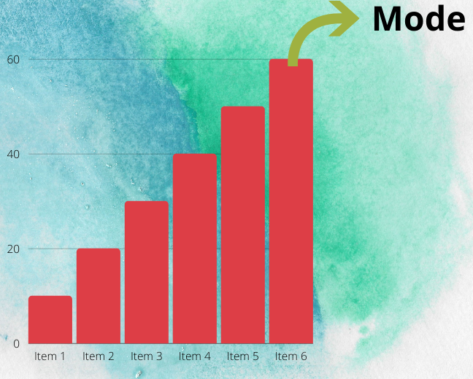
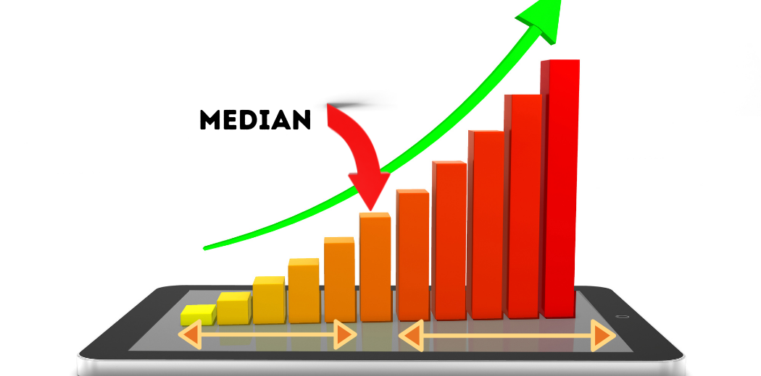

Slide 16
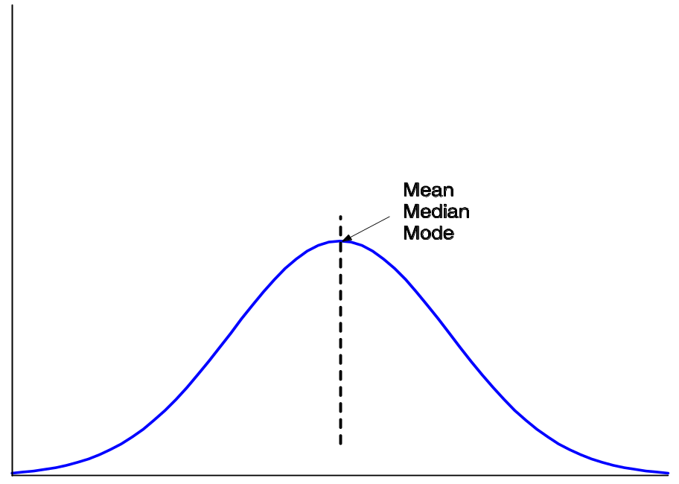


Symmetric vs. Skewed Data
Median, mean and mode of symmetric, positively and negatively skewed data
symmetric
positively skewed
negatively skewed

Slide 17


Measuring the Dispersion of Data
Quartiles, outliers and boxplots
  Quartiles: Q₁ (25th percentile), Q₃ (75th percentile)
  Inter-quartile range: IQR = Q₃ – Q₁
  Five number summary: min, Q₁, M, Q₃, max
  Boxplot: ends of the box are the quartiles, median is marked, whiskers, and plot outlier individually
  Outlier: usually, a value higher/lower than 1.5 x IQR
Variance and standard deviation (sample: s, population: σ)
  Variance: average squared deviation from the mean
  Standard deviation s (or σ) is the square root of variance s² ⁽or σ ²⁾
Data Mining: Concepts and Techniques

Slide 18
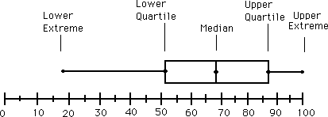
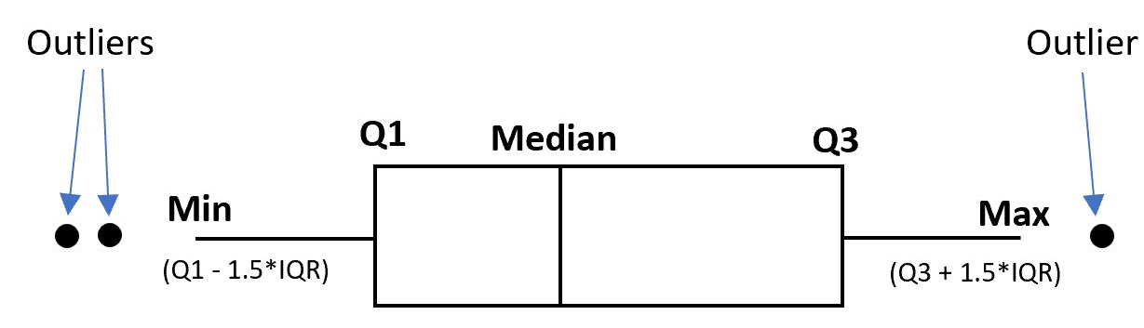
Boxplot Analysis
Boxplot
  Data is represented with a box
  The ends of the box are at the first and third quartiles, i.e., the height of the box is IQR
  The median is marked by a line within the box
  Whiskers: two lines outside the box extended to Minimum and Maximum
  Outliers: points beyond a specified outlier threshold, plotted individually

Slide 19
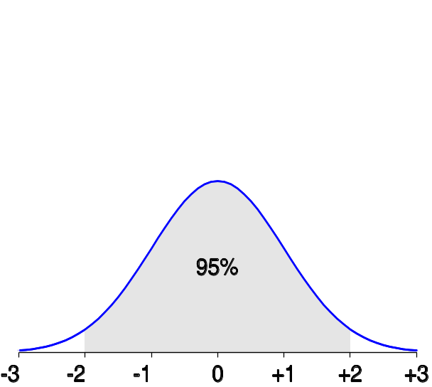
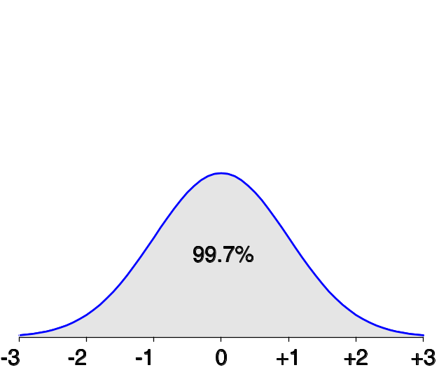
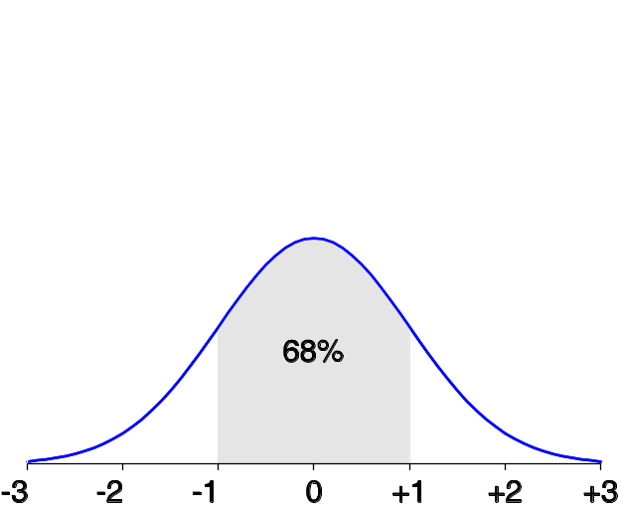
Properties of Normal Distribution Curve/Gaussian distribution/bell curve
A symmetric probability distribution
Symmetry, Unimodality, (Mean, Median, and Mode Equality), Indefinite Tails
The normal (distribution) curve
  68% of the population is within 1 standard deviation of the mean.
  95% of the population is within 2 standard deviation of the mean.
  99.7% of the population is within 3 standard deviation of the mean.

Slide 20
Graphic Displays of Basic Statistical Descriptions
Boxplot: graphic display of five-number summary
Histogram: x-axis are values, y-axis repres. frequencies
Quantile-quantile (q-q) plot: graphs the quantiles of one univariant distribution against the corresponding quantiles of another
Scatter plot: each pair of values is a pair of coordinates and plotted as points in the plane

Slide 21
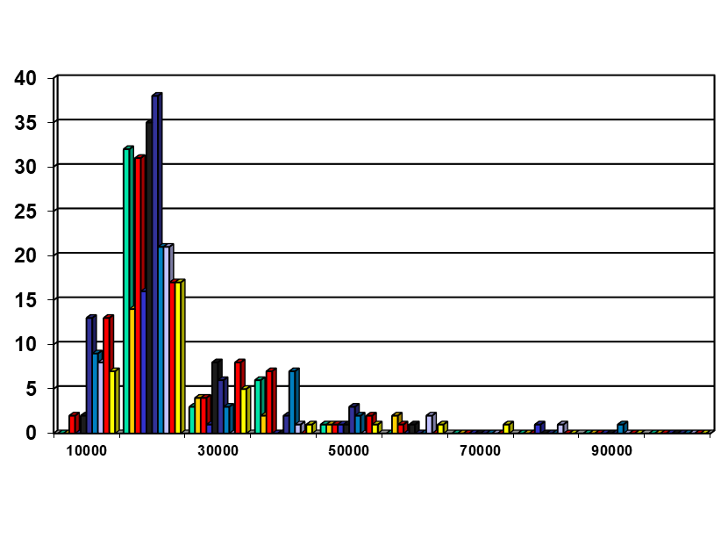
Histogram Analysis
A univariate graphical method
Graph display of tabulated frequencies, shown as bars
It shows what proportion of cases fall into each of several categories
Differs from a bar chart in that it is the area of the bar that denotes the value, not the height as in bar charts, a crucial distinction when the categories are not of uniform width
The categories are usually specified as non-overlapping intervals of some variable.

Slide 22
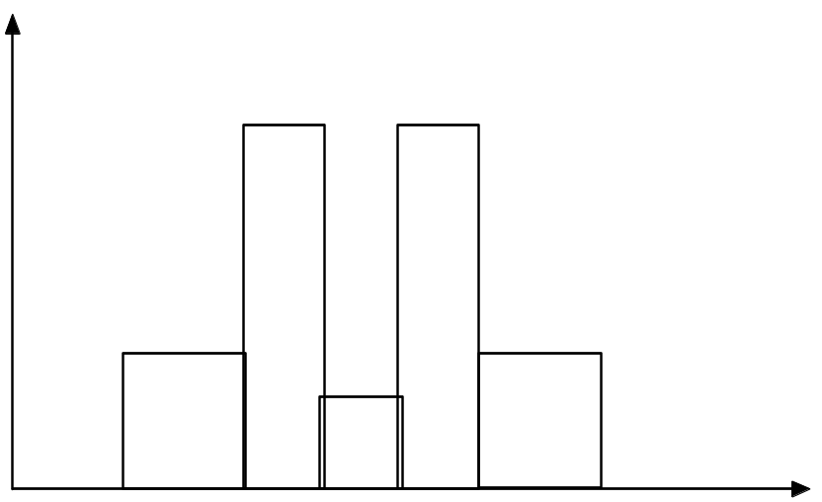
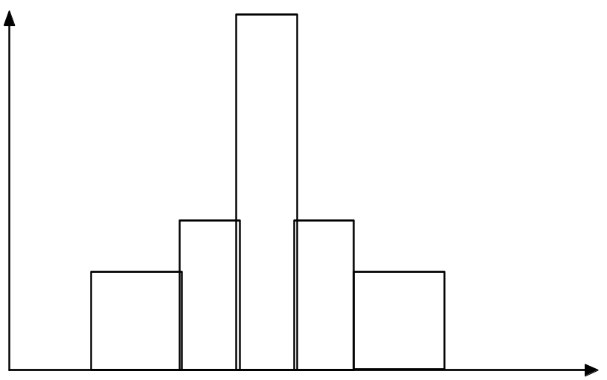
Histograms Often Tell More than Boxplots
While boxplots are useful for summarizing the central tendency and spread of data, histograms provide additional insights into the distribution of the data, such as the shape, skewness, and the presence of multiple modes.
The two histograms shown in the left may have the same boxplot representation
  The same values for: min, Q1, median, Q3, max
But they have rather different data distributions

Slide 23
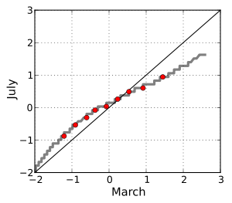
Quantile- Quantile Plot
Compare the quantiles of the dataset with the quantiles of the theoretical distribution.
Sorting the Data
Calculating Quantiles
Chose theoretical distribution: Common choices include normal, exponential, or gamma distributions
Calculating Theoretical Quantiles: by applying the inverse cumulative distribution function (CDF)
Plotting
If the dataset follows the assumed distribution closely, the points on the plot will fall approximately along a straight line.

Slide 24
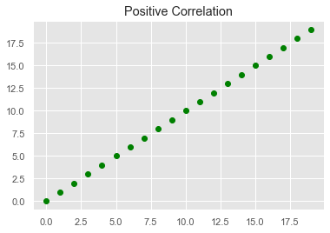
Correlation and Scatter plot
Correlation is the statistical analysis of the relationship or dependency between two variables
Correlation allows us to study both the strength and direction of the relationship between two sets of variables.
To display the relationship between two continuous variables
Particularly useful for identifying patterns, trends, and relationships between variables in a dataset.

Slide 25


Positively and Negatively Correlated Data
The data points tend to form a pattern where an increase in one variable is associated with an increase in the other variable.
Characterized by a general upward trend from left to right.
The degree of correlation can vary, with stronger positive correlation indicated by a tighter clustering of data points around the trend line.

Slide 26


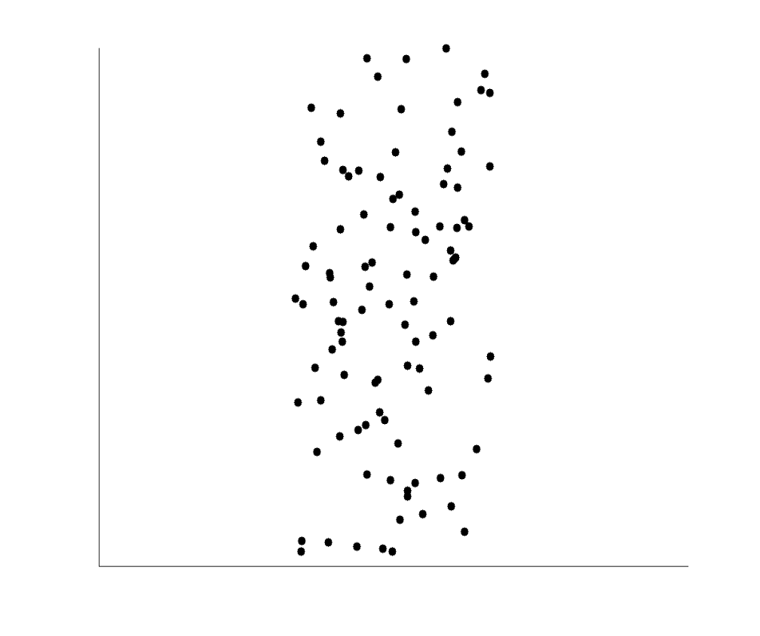
Neutral Correlation

Slide 27
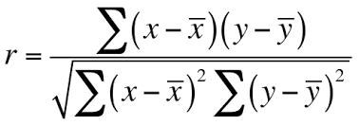
Correlation coefficients
A statistical summary that measures the strength and direction to which two variables are associated with one another.
Measures the linear relationship between two continuous variables.
One of the advantages of correlation coefficients is that they estimate the correlation between two variables in a standardized -1.0 to 1.0
Pearson's correlation coefficient
-1.0 : negative correlation
+1.0 : positive correlation
0.0 : No linear correlation

Slide 28
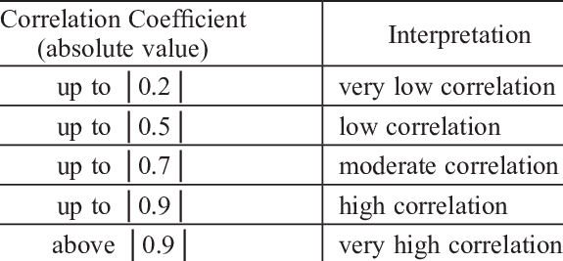
Correlation coefficients

Slide 29
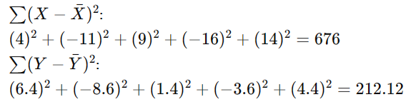

Student | Math Score (X) | English Score (Y)
A | 85 | 90
B | 70 | 75
C | 90 | 85
D | 65 | 80
E | 95 | 88
Xˉ=(85+70+90+65+95)/5=81
Yˉ=(90+75+85+80+88)/5=83.6

Slide 30
Person | Height (X) | Weight (Y)
1 | 65 | 150
2 | 68 | 160
3 | 63 | 145
4 | 70 | 175
5 | 67 | 165
6 | 69 | 170

Slide 31

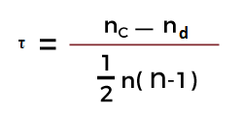
Kendall rank and Spearman rank correlation
Instead of calculating the coefficients using the covariance and standard deviations of the variables
Based on the relative rank of the values of the variables
Measures the ordinal association between two variables.
Makes them robust estimates against extreme values, and suitable to handle certain types of nonlinearities
Spearman rank
Kendall rank
ρ= Spearman rank correlation
d_{i}= the difference between the ranks
n= number of observations
n_{c}= number of concordant
n_{d}= Number of discordant

Slide 32
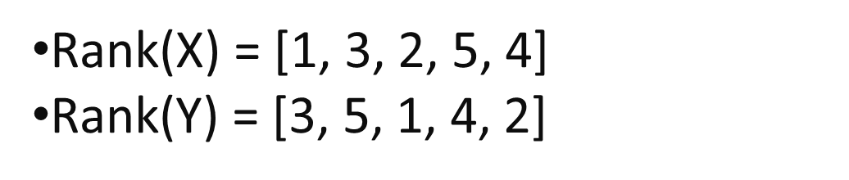
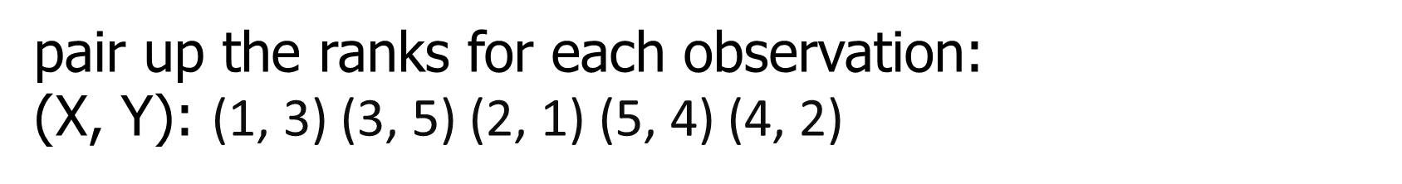
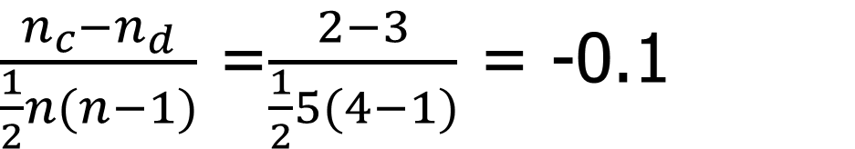
Kendall rank
X: [10, 20, 15, 30, 25]
Y: [20, 30, 10, 25, 15]
Concordant pairs: (1, 3) (3, 5) n_{c}=2
Sensitive to outliers and not robust to non-linear relationships.

Slide 33
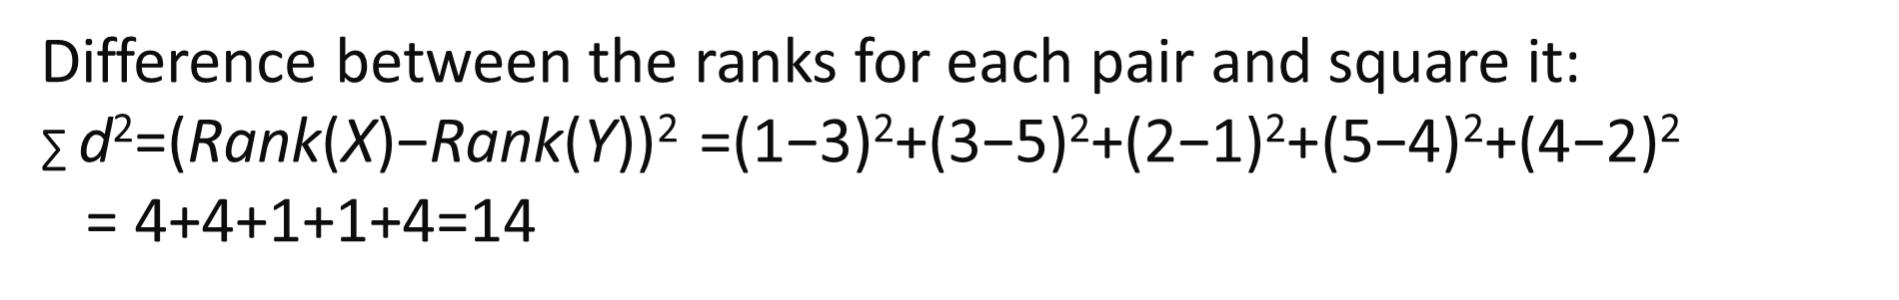
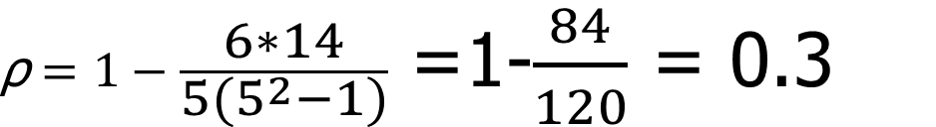
Spearman rank
X: [10, 20, 15, 30, 25]
Y: [20, 30, 10, 25, 15]
More robust to outliers and skewed data than Pearson correlation.

Slide 34
Data Preprocessing
Why preprocess the data?
Descriptive data summarization
Data cleaning
Data integration and transformation
Data reduction
Discretization and concept hierarchy generation
Summary
Data Mining: Concepts and Techniques

Slide 35
Data Cleaning or Cleansing?
It involves identifying and removing any missing, duplicate, or irrelevant data
Goal: Ensure that the data is accurate, consistent, and free of errors, as incorrect or inconsistent data can negatively impact the performance of the ML model
It is essential because raw data is often noisy, incomplete, and inconsistent, which can negatively impact the accuracy and reliability of the insights derived from it.
Plays important role in ensuring the accuracy, reliability, and overall quality of a dataset.

Slide 36
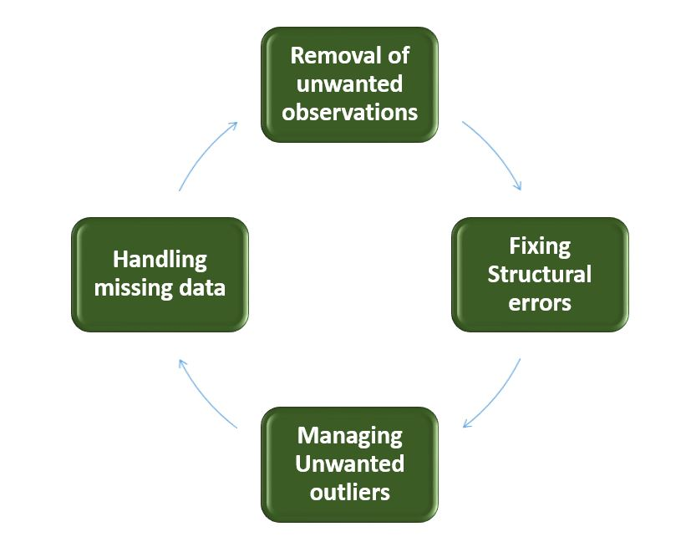
Steps to Perform Data Cleanliness
Scrutinizing data entries for duplicate records, irrelevant information, or data points that do not contribute meaningfully to the analysis.
Address structural issues in the dataset, such as inconsistencies in data formats, naming conventions, or variable types.
Standardize formats, correct naming discrepancies, and ensure uniformity in data representation.
Identify and manage outliers
Devise strategies to handle missing data effectively

Slide 37
Data Cleaning
Importance
  “Data cleaning is one of the three biggest problems in data warehousing”—Ralph Kimball
  “Data cleaning is the number one problem in data warehousing”—DCI survey
Data cleaning tasks
  Fill in missing values
  Identify outliers and smooth out noisy data
  Correct inconsistent data
  Resolve redundancy caused by data integration
Data Mining: Concepts and Techniques

Slide 38
Missing Data
Data is not always available
  E.g., many tuples have no recorded value for several attributes, such as customer income in sales data
Missing data may be due to
  equipment malfunction
  inconsistent with other recorded data and thus deleted
  data not entered due to misunderstanding
  certain data may not be considered important at the time of entry
  not register history or changes of the data
Missing data may need to be inferred.
Data Mining: Concepts and Techniques

Slide 39
How to Handle Missing Data?
Ignore the tuple: usually done when class label is missing (assuming the tasks in classification—not effective when the percentage of missing values per attribute varies considerably.
Fill in the missing value manually: tedious + infeasible?
Fill in it automatically with
  a global constant : e.g., “unknown”, a new class?!
  the attribute mean
  the attribute mean for all samples belonging to the same class: smarter
  the most probable value: inference-based such as Bayesian formula or decision tree
Data Mining: Concepts and Techniques

Slide 40
Noisy Data
Noise: random error or variance in a measured variable
Incorrect attribute values may due to
  faulty data collection instruments
  data entry problems
  data transmission problems
  technology limitation
  inconsistency in naming convention
Other data problems which requires data cleaning
  duplicate records
  incomplete data
  inconsistent data
Data Mining: Concepts and Techniques

Slide 41
How to Handle Noisy Data?
Binning
  first sort data and partition into (equal-frequency) bins
  then one can smooth by bin means, smooth by bin median, smooth by bin boundaries, etc.
Regression
  smooth by fitting the data into regression functions
Clustering
  detect and remove outliers
Combined computer and human inspection
  detect suspicious values and check by human (e.g., deal with possible outliers)
Data Mining: Concepts and Techniques

Slide 42
Simple Discretization Methods: Binning
Equal-width (distance) partitioning
  Divides the range into N intervals of equal size: uniform grid
  if A and B are the lowest and highest values of the attribute, the width of intervals will be: W = (B –A)/N.
  The most straightforward, but outliers may dominate presentation
  Skewed data is not handled well
Equal-depth (frequency) partitioning
  Divides the range into N intervals, each containing approximately same number of samples
  Good data scaling
  Managing categorical attributes can be tricky
Data Mining: Concepts and Techniques

Slide 43
Binning Methods for Data Smoothing
Sorted data for price (in dollars): 4, 8, 9, 15, 21, 21, 24, 25, 26, 28, 29, 34
* Partition into equal-frequency (equi-depth) bins:
- Bin 1: 4, 8, 9, 15
- Bin 2: 21, 21, 24, 25
- Bin 3: 26, 28, 29, 34
* Smoothing by bin means:
- Bin 1: 9, 9, 9, 9
- Bin 2: 23, 23, 23, 23
- Bin 3: 29, 29, 29, 29
* Smoothing by bin boundaries:
- Bin 1: 4, 4, 4, 15
- Bin 2: 21, 21, 25, 25
- Bin 3: 26, 26, 26, 34
Data Mining: Concepts and Techniques

Slide 44
Problem
Suppose that the data for analysis includes the attribute age. The age values for the data tuples are (in increasing order) 13, 15, 16, 16, 19, 20, 20, 21, 22, 22, 25, 25, 25, 25, 30, 33, 33, 35, 35, 35, 35, 36, 40, 45,46, 52, 70.
Use smoothing by bin means to smooth the above data, using a bin depth of 3.
Data Mining: Concepts and Techniques

Slide 45
Regression
y
Y1
Y1’
y = x + 1
X1
x
Data Mining: Concepts and Techniques

Slide 46
Cluster Analysis
Data Mining: Concepts and Techniques

Slide 47
Data Cleaning as a Process
Data discrepancy detection
  Use metadata (e.g., domain, range, dependency, distribution)
  Check field overloading
  Check uniqueness rule, consecutive rule and null rule
  Use commercial tools
    Data scrubbing: use simple domain knowledge (e.g., postal code, spell-check) to detect errors and make corrections
    Data auditing: by analyzing data to discover rules and relationship to detect violators (e.g., correlation and clustering to find outliers)
Data migration and integration
  Data migration tools: allow transformations to be specified
  ETL (Extraction/Transformation/Loading) tools: allow users to specify transformations through a graphical user interface
Data Mining: Concepts and Techniques

Slide 48
Data Preprocessing
Why preprocess the data?
Data cleaning
Data integration and transformation
Data reduction
Discretization and concept hierarchy generation
Summary

Slide 49
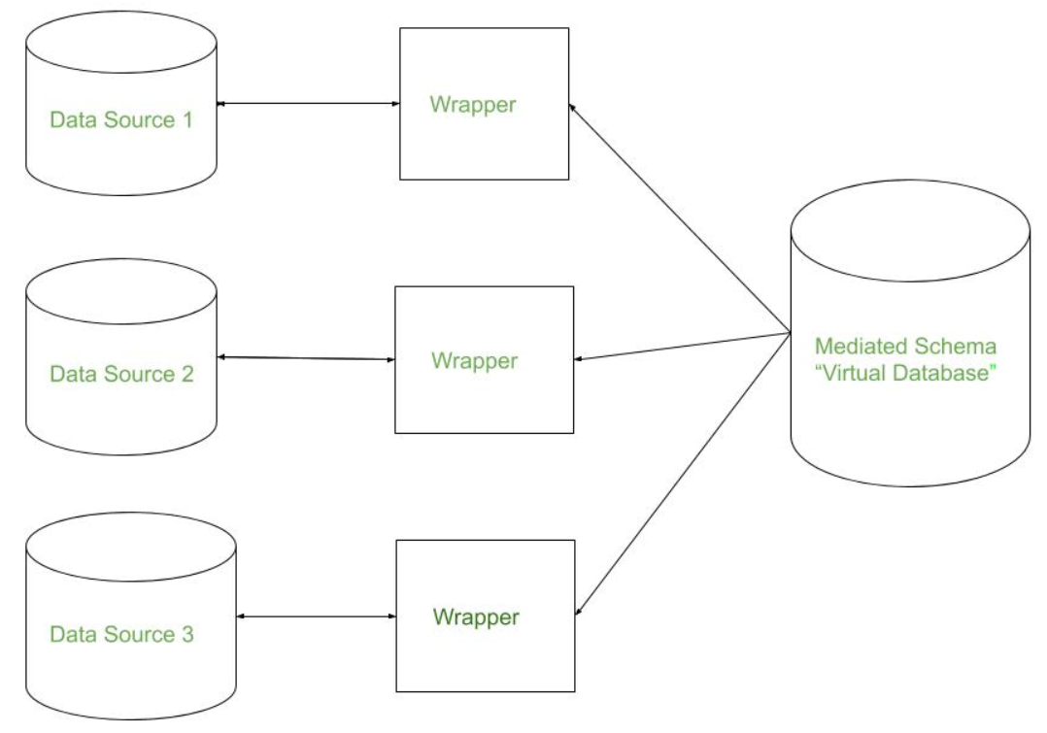
Data Integration
Data integration:
  Combines data from multiple sources into a coherent store
Involves cleaning and transforming the data, as well as resolving any inconsistencies or conflicts that may exist between the different sources.
Goal is to make the data more useful and meaningful for analysis and decision making

Slide 50
Data Integration Steps
Data extraction: Retrieving data from different sources, such as databases, applications, APIs, and files.
Data transformation: Converting and standardizing the extracted data into a common format, resolving discrepancies in data types, formats, and units.
Data loading: Storing the transformed data into a target system or repository, such as a data warehouse, data lake, or centralized database.

Slide 51
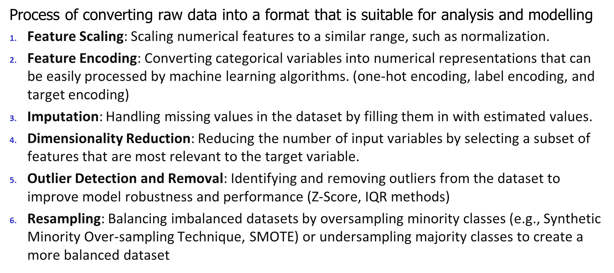
Data Transformation

Slide 52


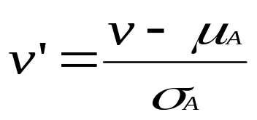
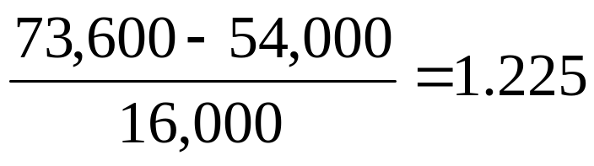

Data Transformation: Normalization
Min-max normalization: to [new_min_{A}, new_max_{A}]
  Ex. Let income range $12,000 to $98,000 normalized to [0.0, 1.0]. Then $73,600 is mapped to
Z-score normalization (μ: mean, σ: standard deviation):
  Ex. Let μ = 54,000, σ = 16,000. Then
Normalization by decimal scaling
Where j is the smallest integer such that Max(|ν’|) < 1

Slide 53
Problem
Use the two methods below to normalize the following group of data:
200; 300; 400; 600; 1000
(a) min-max normalization by setting min = 0 and max = 1
(b) z-score normalization

Slide 54
(a) min-max normalization by setting min = 0 and max = 1
original data 200 300 400 600 1000
[0,1] normalized 0 0.125 0.25 0.5 1
(b) z-score normalization
original data 200 300 400 600 1000
z-score -1.06 -0.7 -0.35 0.35 1.78
2.12. Using

Slide 55
Data Preprocessing
Why preprocess the data?
Data cleaning
Data integration and transformation
Data reduction
Discretization and concept hierarchy generation
Summary

Slide 56
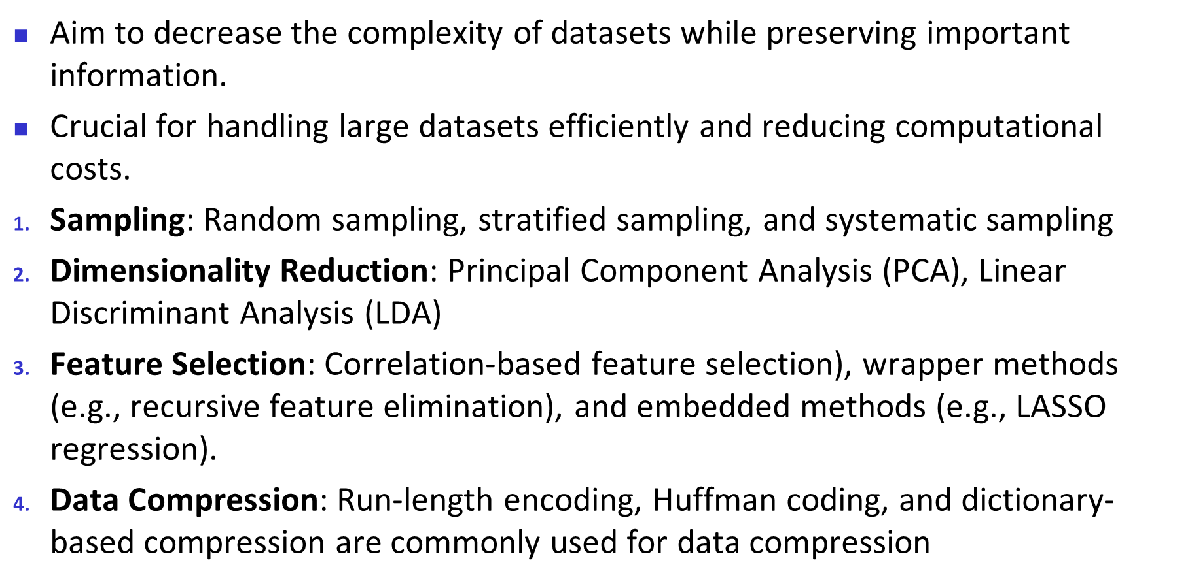
Data Reduction Strategies

Slide 57
Data Preprocessing
Why preprocess the data?
Data cleaning
Data integration and transformation
Data reduction
Discretization and concept hierarchy generation
Summary

Slide 58
Discretization and Concept Hierarchy
Discretization
  Reduce the number of values for a given continuous attribute by dividing the range of the attribute into intervals
  Interval labels can then be used to replace actual data values
  Supervised vs. unsupervised
  Split (top-down) vs. merge (bottom-up)
  Discretization can be performed recursively on an attribute
Concept hierarchy formation
  Recursively reduce the data by collecting and replacing low level concepts (such as numeric values for age) by higher level concepts (such as young, middle-aged, or senior)
Data Mining: Concepts and Techniques

Slide 59
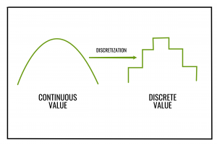
Discretization and Concept Hierarchy Generation for Numeric Data
Typical methods: All the methods can be applied recursively
  Binning
    Top-down split, unsupervised,
  Histogram analysis
    Top-down split, unsupervised
  Clustering analysis
    Either top-down split or bottom-up merge, unsupervised
  Entropy-based discretization: supervised, top-down split
  Segmentation by natural partitioning: top-down split, unsupervised

Slide 60
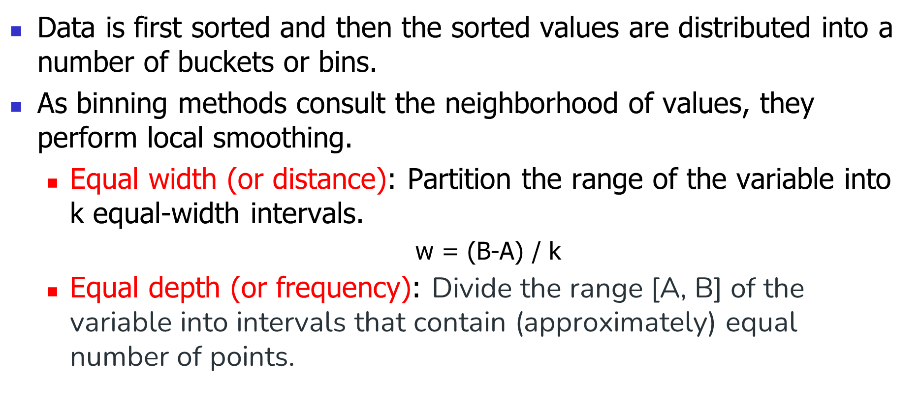
Binning

Slide 61
smoothing on the data
By bin means : Each value in a bin is replaced by the mean value of the bin.
By bin median : Each bin value is replaced by its bin median value.
By bin boundary: The minimum and maximum values in a given bin are identified as the bin boundaries. Each bin value is then replaced by the closest boundary value.

Slide 62
Smoothing by bin median :
Bin 1 : 6, 6, 6
Bin 2 : 13, 13, 13
Bin 3 : 24, 24, 24
Partition using equal frequency:
Bin 1 : 2, 6, 7
Bin 2 : 9, 13, 20
Bin 3 : 21, 24, 30
Smoothing by bin mean :
Bin 1 : 5, 5, 5
Bin 2 : 14, 14, 14
Bin 3 : 25, 25, 25
Smoothing by bin boundary :
Bin 1 : 2, 7, 7
Bin 2 : 9, 9, 20
Bin 3 : 21, 21, 30

Slide 63
Segmentation by Natural Partitioning
A simply 3-4-5 rule can be used to segment numeric data into relatively uniform, “natural” intervals.
  If an interval covers 3, 6, 7 or 9 distinct values at the most significant digit, partition the range into 3 equi-width intervals
  If it covers 2, 4, or 8 distinct values at the most significant digit, partition the range into 4 intervals
  If it covers 1, 5, or 10 distinct values at the most significant digit, partition the range into 5 intervals

