Slide 1
Module 6

Slide 2
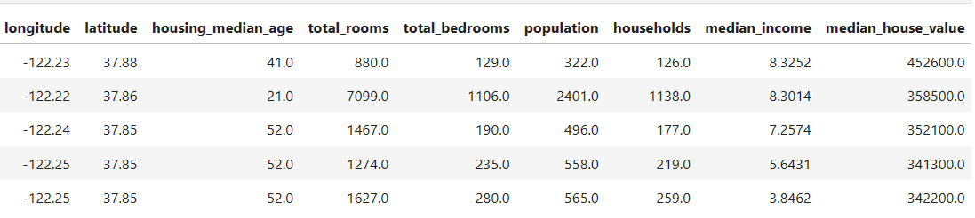
Regression Analysis
A statistical method to model the relationship between a dependent (target) and one or more independent variables.
Predicts continuous/real values such as temperature, age, salary, price, etc.

Slide 3
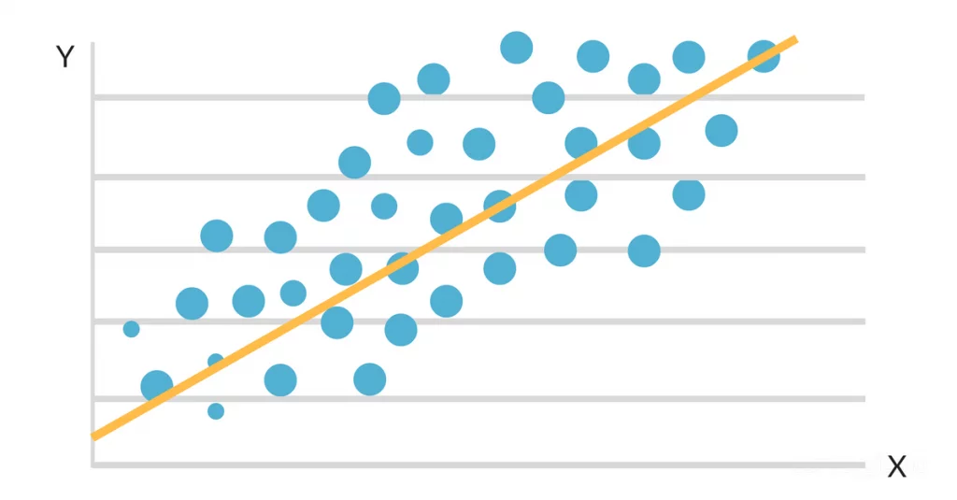
Regression Analysis
Supervised learning technique
Mainly used for prediction, forecasting, time series modeling, and determining the causal-effect relationship between variables.
We plot a graph between the variables which best fits the given datapoints
Using this plot, the machine learning model can make predictions about the data
Regression shows a line or curve that passes through all the datapoints on target-predictor graph in such a way that the vertical distance between the datapoints and the regression line is minimum.

Slide 4
Terminologies Related to the Regression Analysis:
Dependent Variable: Factor which we want to predict, also called target variable.
Independent Variable: The factors which affect the dependent variables, also called as a predictor.
Multicollinearity: If the independent variables are highly correlated with each other than other variables, then such condition is called Multicollinearity. It should not be present in the dataset, because it creates problem while ranking the most affecting variable.
Overfitting: If algorithm works well with the training dataset but not well with test dataset, then such problem is called Overfitting.
Underfitting: If algorithm does not perform well even with training dataset, then such problem is called underfitting.

Slide 5
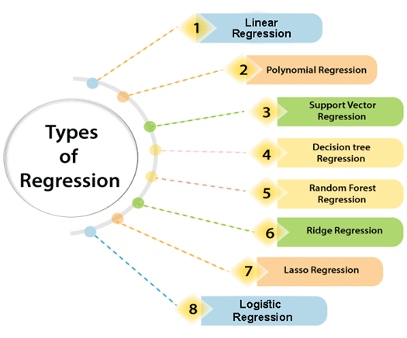

Slide 6
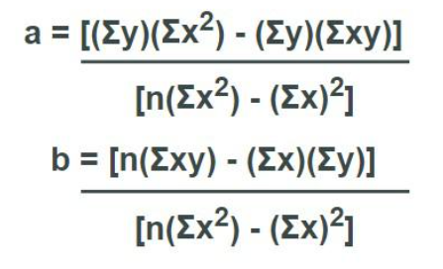
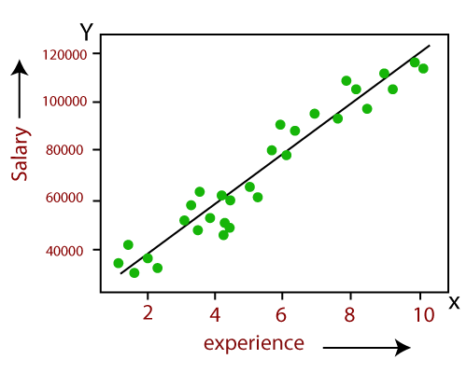
Linear Regression
Y= a+bX
Supervised
Linear regression shows the linear relationship between the independent variable and the dependent variable
If there is only one input variable (x), then such linear regression is called simple linear regression.
If there is more than one input variable, then such linear regression is called multiple linear regression
Popular applications:
Analyzing trends and sales estimates
Salary forecasting
Real estate prediction
Arriving at ETAs in traffic.

Slide 7
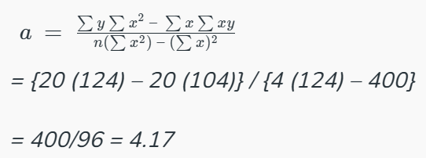
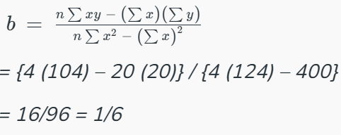
Find the linear regression equation for the given data:
x | y
3 | 8
9 | 6
5 | 4
3 | 2
x | y | x² | xy
3 | 8 | 9 | 24
9 | 6 | 81 | 54
5 | 4 | 25 | 20
3 | 2 | 9 | 6
∑x = 20 | ∑y = 20 | ∑x² = 124 | ∑xy = 104
Linear regression equation is:
Y = 1/6x + 4.17

Slide 8
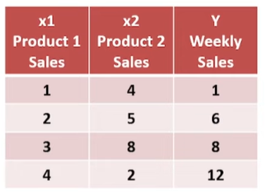
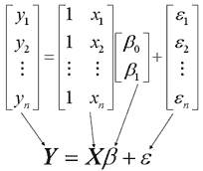
Multiple Linear Regression
β=((X^{T}X)⁻¹X^{T})Y

Slide 9


What Is Cost Function?
Measures the performance of a machine learning model
Quantifies the error between predicted and expected values
Mean absolute error:
Mean squared error:

Slide 10
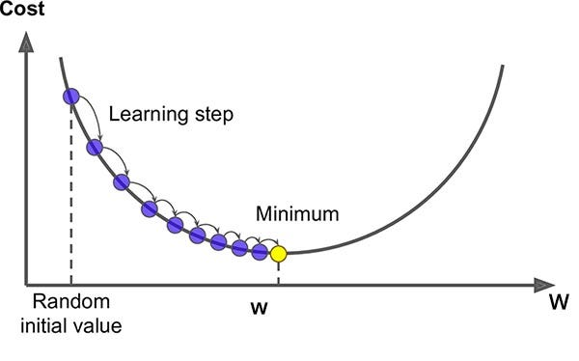
How do you find the line of best fit?
Gradient descent is a tool to arrive at the line of best fit
Start with a random line and then continue adjusting the slope and y-intercept of line little by little until you reach a local minimum, where the sum of squared errors is the smallest and additional tweaks does not produce better result.
The size of each step is determined by parameter α known as Learning Rate.

Slide 11
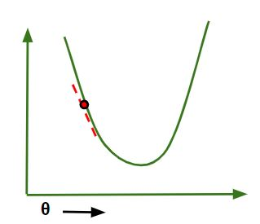
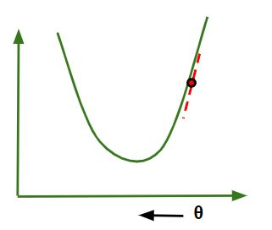
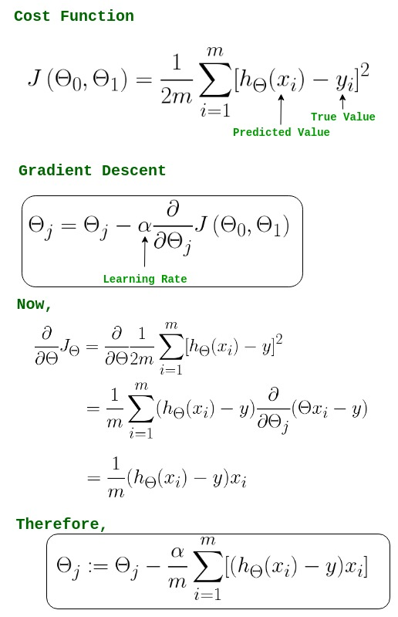
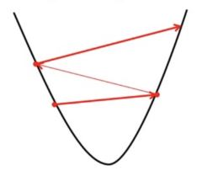
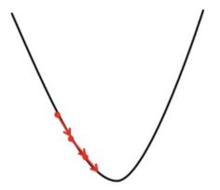
If slope is -ve : θj = θj – (-ve value)
If slope is +ve : θj = θj – (+ve value)
choose α to be very large
choose α to be very small

Slide 12
Subject ID | Diet Score | Male | Age>20 | BMI
A | 4 | 0 | 1 | 27
B | 7 | 1 | 1 | 29
C | 6 | 1 | 0 | 23
D | 2 | 0 | 0 | 20
E | 3 | 0 | 1 | 21

Slide 13
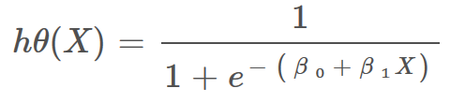
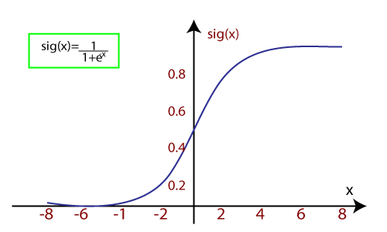
Logistic Regression
Supervised
For Classification problems
Works with the categorical variable such as 0 or 1, Yes or No, True or False, Spam or not spam, etc.
Works on the concept of probability.
Update the parameters b0​ and b1 to better fit the data.
Use gradient descent or other optimization techniques to iteratively update the parameters until convergence.
There are three types of logistic regression:
Binary(0/1, pass/fail)
Multi(cats, dogs, lions)
Ordinal(low, medium, high)
β0 = bias or intercept term
β1 = coefficient for input (x)

Slide 14
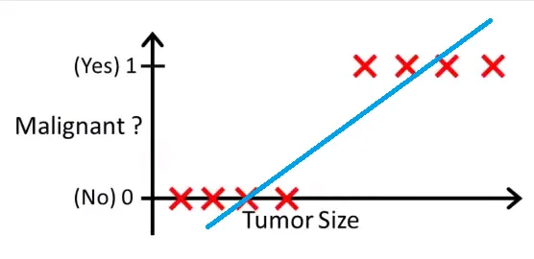
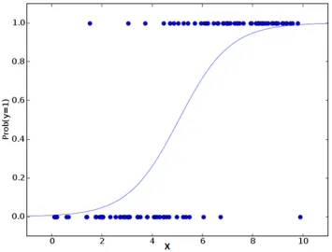
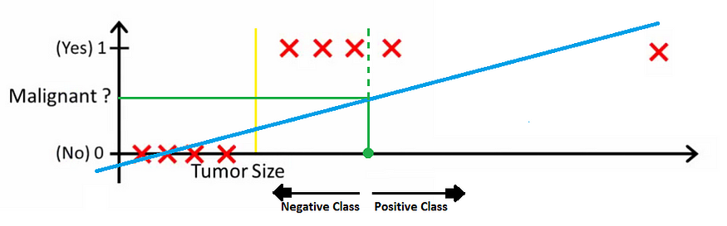
Why not Linear Regression for Classification?

Slide 15
Age (x1) | Income (x2) | Bought Product (y)
25 | 50000 | 0
30 | 60000 | 1
35 | 70000 | 0
40 | 80000 | 1
45 | 90000 | 1

Slide 16

Naïve Bayes
Supervised learning algorithm for solving classification problems.
Most effective Classification algorithms which helps in building the fast machine learning models that can make quick predictions.
It is a probabilistic classifier
Eg: spam filtration, Sentimental analysis, and classifying articles.
P(A|B) is Posterior probability: Probability of hypothesis A on the observed event B.
P(B|A) is Likelihood probability: Probability of the evidence given that the probability of a hypothesis is true.
P(A) is Prior Probability: Probability of hypothesis before observing the evidence.
P(B) is Marginal Probability: Probability of Evidence.

Slide 17
Working of Naïve Bayes' Classifier:
Outlook | Play
Rainy | Yes
Sunny | Yes
Overcast | Yes
Overcast | Yes
Sunny | No
Rainy | Yes
Sunny | Yes
Overcast | Yes
Rainy | No
Sunny | No
Sunny | Yes
Rainy | No
Overcast | Yes
Overcast | Yes
Weather | No | Yes
Overcast | 0 | 5 | 5/14= 0.35
Rainy | 2 | 2 | 4/14 =0.29
Sunny | 2 | 3 | 5/14 =0.35
All | 4/14 =0.29 | 10/14 =0.71
Convert the given dataset into frequency tables.
Generate Likelihood table by finding the probabilities of given features.
And use Bayes theorem to calculate the posterior probability.
P(No|Sunny)=?
P(Yes|Sunny)=?
= P(Sunny|No)*P(No)/P(Sunny)
P(Sunny|NO) = 2/4=0.5
So P(No|Sunny) = 0.5*0.29/0.35
= 0.41
= P(Sunny|Yes)*P(Yes)/P(Sunny)
P(Sunny|Yes) = 3/10= 0.3
So P(Yes|Sunny) = 0.3*0.71/0.35
= 0.60

Slide 18
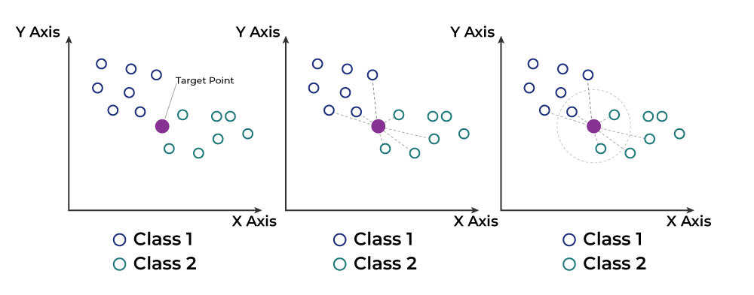
Nearest Neighbor
Supervised machine learning for classification and regression problems
Works by finding the K nearest neighbors to a given data point based on a distance metric, such as Euclidean distance.
The class or value of the data point is then determined by the majority vote or average of the K neighbors.
This approach allows the algorithm to adapt to different patterns and make predictions based on the local structure of the data.

Slide 19
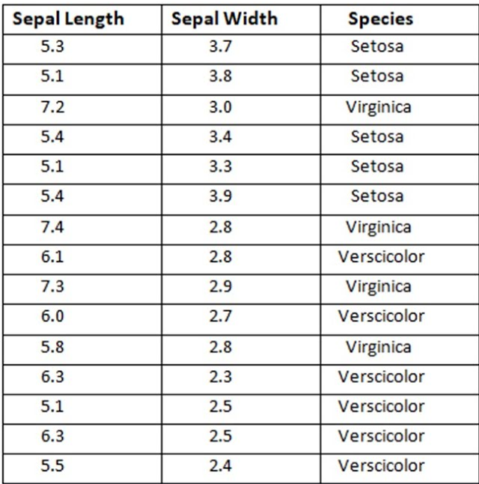
Nearest Neighbor steps
Find the label class for Sepal Length 5.2, and Width 3.1 belongs to for k=2, 3, and 4
Step 1: Selecting the optimal value of K
Step 2: Calculating distance
Step 3: Finding Nearest Neighbors
Step 4: Voting for Classification or Taking Average for Regression

Slide 20
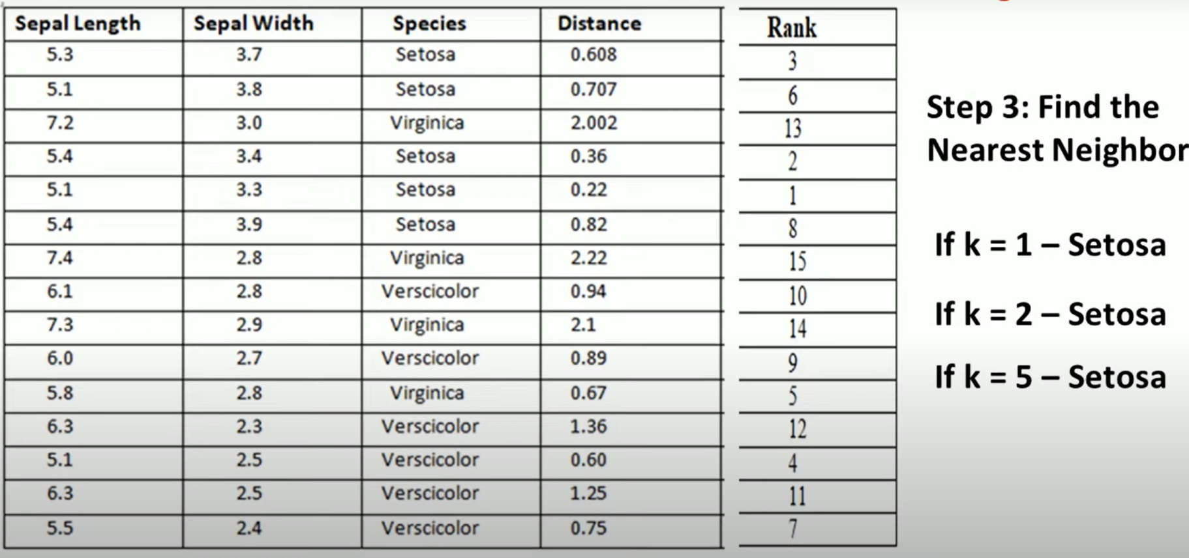

Slide 21
Decision Trees
Supervised learning algorithm for both classification and regression
Each branch represents an outcome of the test, and each leaf node holds a class label
Constructed by recursively splitting the training data into subsets based on the values of the attributes until a stopping criterion is met, such as the maximum depth of the tree or the minimum number of samples required to split a node.
Entropy H(x): A measure of the randomness in the information being processed. The higher the entropy, the harder it is to draw any conclusions from that information.
Information Gain (IG): a measure of the reduction in impurity achieved by splitting a dataset on a particular feature in a decision tree.
Pruning: The process of removing branches from the tree that do not provide any additional information or lead to overfitting.

Slide 22
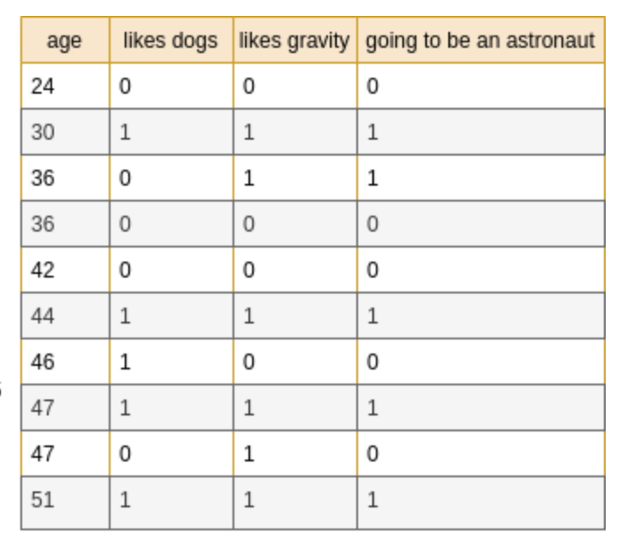
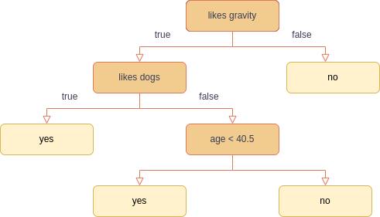
Decision Trees

Slide 23


Create a Decision Tree - Iterative Dichotomiser 3
For each attribute, determine the entropy or information gain resulting from splitting the dataset.
Choose the attribute with the highest information gain as the node for the decision tree.
Divide the dataset into subsets based on the selected attribute's information gain.
Repeat Recursively:
Apply steps 1-3 recursively to the subsets until a stopping condition is met, such as:
All instances in a subset belong to the same class.
No more attributes are available for splitting.
A predefined depth limit is reached.
A predefined number of instances limit is reached.
Build Tree:
Construct the decision tree as recursion progresses.
Each internal node represents an attribute, and each leaf node represents a class label.
Optional: Prune Tree:
After tree construction, prune it to prevent overfitting by removing parts that don't enhance predictive power on the validation set.

Slide 24
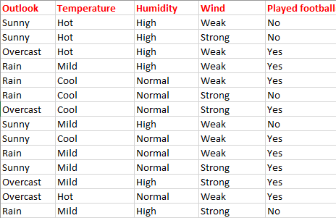
Create a Decision Tree - Iterative Dichotomiser 3

Slide 25
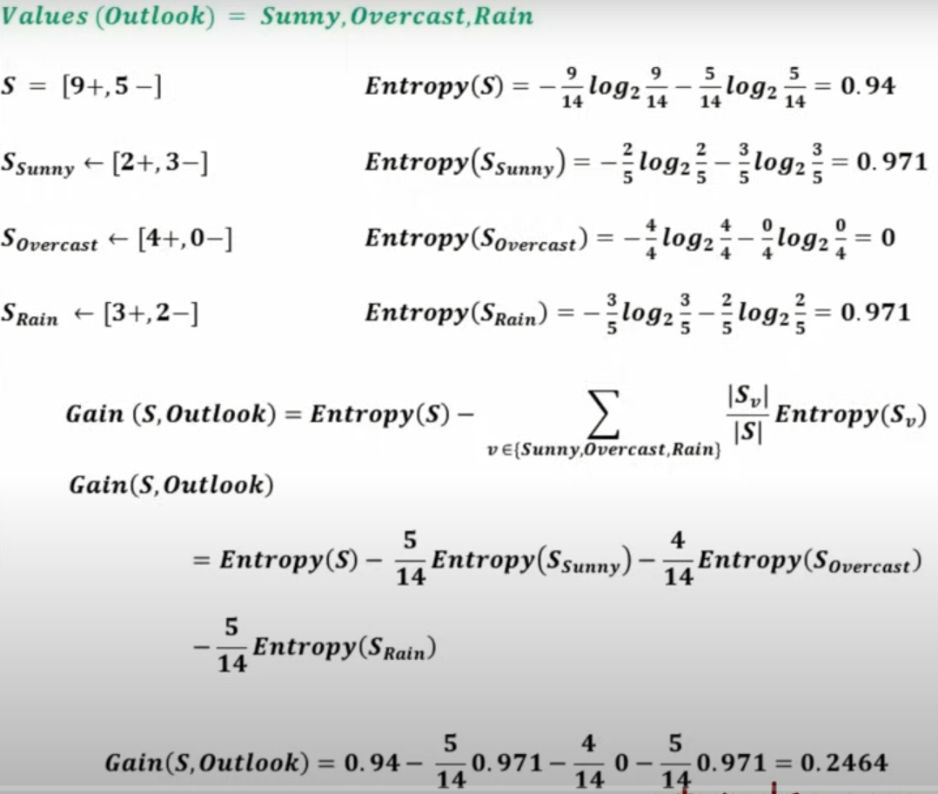
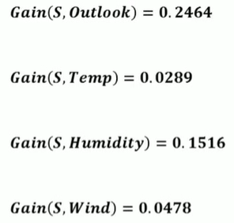
Create a Decision Tree - Iterative Dichotomiser 3

Slide 26
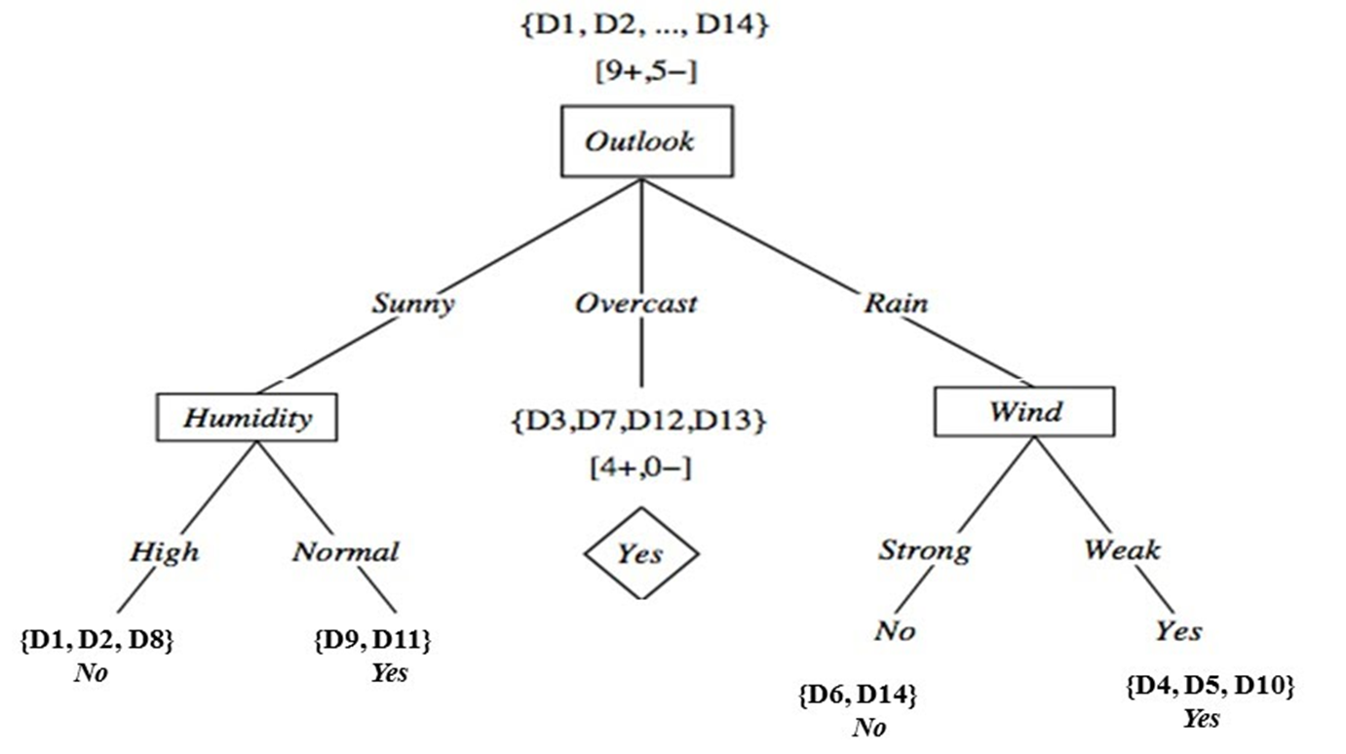
Create a Decision Tree - Iterative Dichotomiser 3

