Slide 1
Data Reduction

Slide 2
Data Reduction
Overview
The Curse of Dimensionality
Data Sampling
Binning and Reduction of Cardinality

Slide 3
Data Reduction
Overview
The Curse of Dimensionality
Data Sampling
Binning and Reduction of Cardinality

Slide 4
Overview
Data reduction techniques can be applied to achieve a reduced representation of the data set.
The goal is to provide the mining process with a mechanism to produce the same (or almost the same) outcome when it is applied over reduced data instead of the original data.

Slide 5
Overview
Data Reduction techniques are usually categorized into three main families:
  Dimensionality Reduction: ensures the reduction of the number of attributes or random variables in the data set.
  Sample Numerosity Reduction: replaces the original data by an alternative smaller data representation
  Cardinality Reduction: transformations applied to obtain a reduced representation of the original data

Slide 6
Data Reduction
Overview
The Curse of Dimensionality
Data Sampling
Binning and Reduction of Cardinality

Slide 7
The Curse of Dimensionality
Dimensionality becomes a serious obstacle for the efficiency of most of the DM algorithms.
It has been estimated that as the number of dimensions increase, the sample size needs to increase exponentially in order to have an effective estimate of multivariate densities.

Slide 8
The Curse of Dimensionality
Several dimension reducers have been developed over the years.
Linear methods:
  Factor analysis
  MultiDimensional Scaling
  Principal Components Analysis
Nonlinear methods:
  Locally Linear Embedding
  ISOMAP

Slide 9
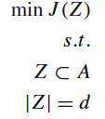
The Curse of Dimensionality
Feature Selection methods are aimed at eliminating irrelevant and redundant features, reducing the number of variables in the model.
To find an optimal subset B that solves the following optimization problem:
J(B) → criterion function
A → Original set of Features
Z → Subset of Features
d → minimum nº features

Slide 10
The Curse of Dimensionality: Principal Components Analysis
Find a set of linear transformations of the original variables which could describe most of the variance using a relatively fewer number of variables.
It is usual to keep only the first few principal components that may contain 95% or more of the variance of the original data set.
PCA is useful when there are too many independent variables and they show high correlation.

Slide 11
The Curse of Dimensionality: Principal Components Analysis
Procedure:
  Normalize input data.
  Compute k orthonormal vectors (principal components).
  Sort the PCs according to their strength, given by their eigenvalues.
  Reduce data by removing weaker components.

Slide 12
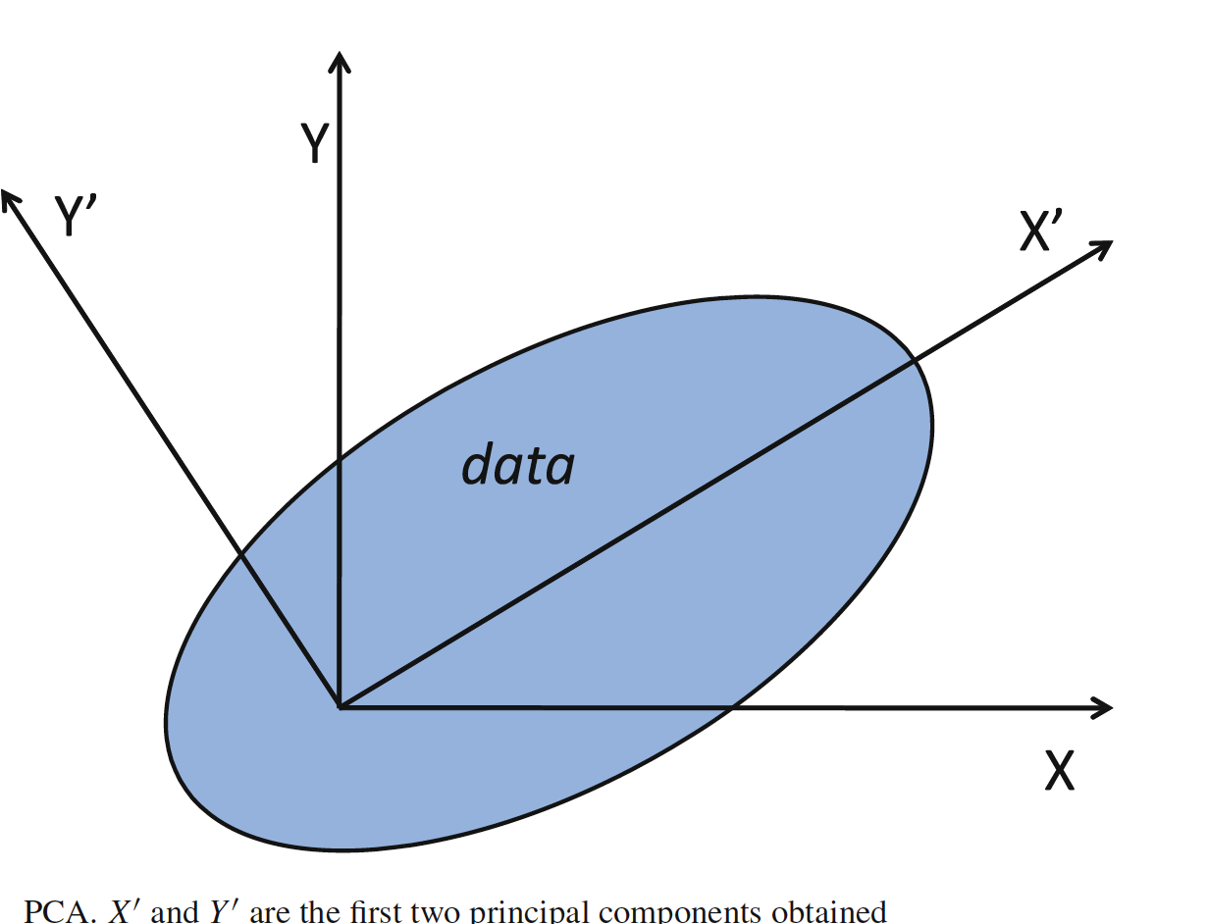
The Curse of Dimensionality: Principal Components Analysis

Slide 13
The Curse of Dimensionality: Factor Analysis
Similar to PCA in the deduction of a semaller set of variables.
Different because it does not seek to find transformations for the given attributes. Instead, its goal is to discover hidden factors in the current variables.

Slide 14
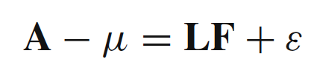
The Curse of Dimensionality: Factor Analysis
The factor analysis problem can be stated as given the attributes A, along with the mean μ, we endeavor to find the set of factors F and the associated loadings L, and therefore the next equation is accurate.

Slide 15
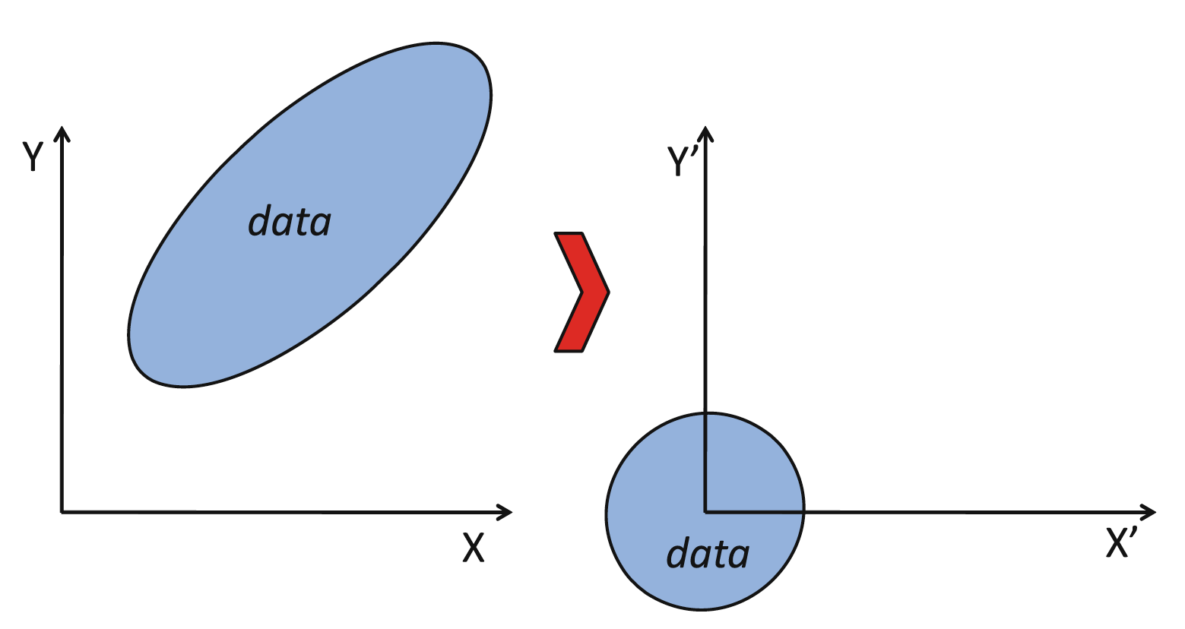
The Curse of Dimensionality: Factor Analysis

Slide 16
The Curse of Dimensionality: MultiDimensional Scaling
Method for situating a set of points in a low space such that a classical distance measure (like Euclidean) between them is as close as possible to each pair of points.
We can compute the distances in a dimensional space of the original data and then to use as input this distance matrix, which then projects it in to a lower-dimensional space so as to preserve these distances.

Slide 17
The Curse of Dimensionality: Locally Linear Embedding
LLE recovers global nonlinear structure from locally linear fits.
Its main idea is that each local patch of the manifold can be approximated linearly and given enough data, each point can be written as a linear, weighted sum of its neighbors.

Slide 18
Data Reduction
Overview
The Curse of Dimensionality
Data Sampling
Binning and Reduction of Cardinality

Slide 19
Data Sampling
To reduce the number of instances submitted to the DM algorithm.
To support the selection of only those cases in which the response is relatively homogeneous.
To assist regarding the balance of data and occurrence of rare events.
To divide a data set into three data sets to carry out the subsequent analysis of DM algorithms.

Slide 20
Data Sampling
Forms of data sampling (T → data set, N → nº examples):
Simple random sample without replacement (SRSWOR) of size s: This is created by drawing s of the N tuples from T (s < N), where the probability of drawing any tuple in T is 1/N.
Simple random sample with replacement (SRSWR) of size s: Similar to SRSWOR, except that each time a tuple is drawn from T , it is recorded and replaced.

Slide 21
Data Sampling
Forms of data sampling (T → data set, N → nº examples):
Balanced sample: The sample is designed according to a target variable and is forced to have a certain composition according to a predefined criterion.
Cluster sample: If the tuples in T are grouped into G mutually disjointed clusters, then an SRS of s clusters can be obtained, where s < G.
Stratified sample: If T is divided into mutually disjointed parts called strata, a stratified sample of T is generated by obtaining an SRS at each stratum

Slide 22
Data Sampling:
Data Condensation
It emerges from the fact that naive sampling methods, such as random sampling or stratified sampling, are not suitable for real-world problems with noisy data since the performance of the algorithms may change unpredictably and significantly.
They attempt to obtain a minimal set which correctly classifies all the original examples.

Slide 23
Data Sampling:
Data Squashing
A data squashing method seeks to compress, or “squash”, the data in such a way that a statistical analysis carried out on the compressed data obtains the same outcome that the one obtained with the original data set.
Schemes:
  Original Data Squashing (DS).
  Likelihood-based Data Squashing (LDS).

Slide 24
Data Sampling:
Data Clustering
Clustering algorithms partition the data examples into groups, or clusters, so that data samples within a cluster are “similar” to one another and different to data examples that belong to other clusters.
Clusters the data could be used instead of the actual data.

Slide 25
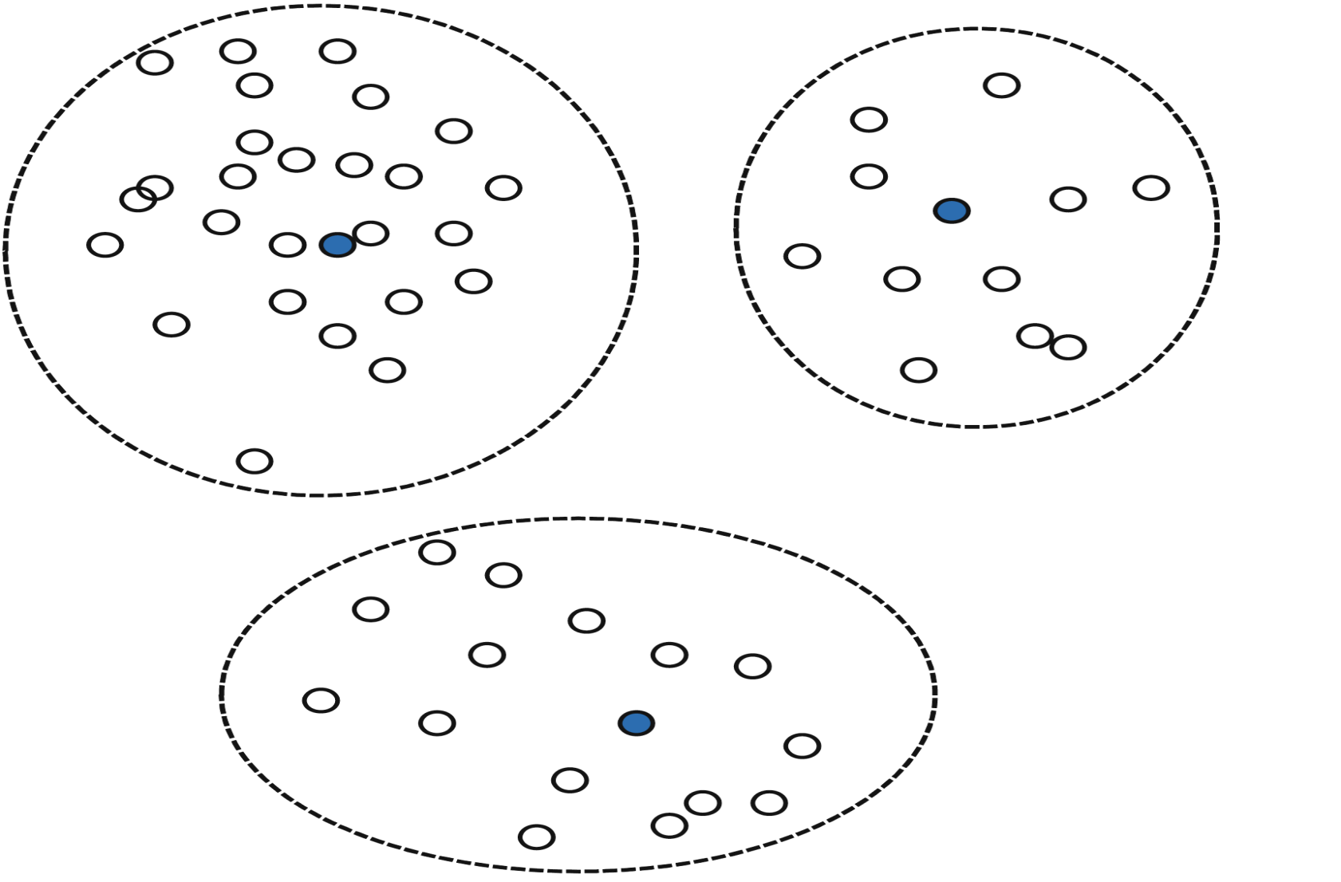
Data Sampling:
Data Clustering

Slide 26
Data Reduction
Overview
The Curse of Dimensionality
Data Sampling
Binning and Reduction of Cardinality

Slide 27
Binning and Reduction of Cardinality
Binning is the process of converting a continuous variable into a set of ranges.
(0–5,000; 5,001–10,000; 10,001–15,000, . . . , etc.)
Cardinality reduction of nominal and ordinal variables is the process of combining two or more categories into one new category.
Binning is the easiest and direct way of discretization.

