Slide 1
Logistic Regression

Slide 2
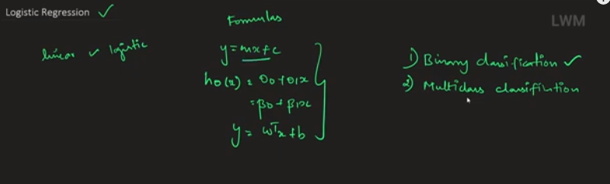

Slide 3
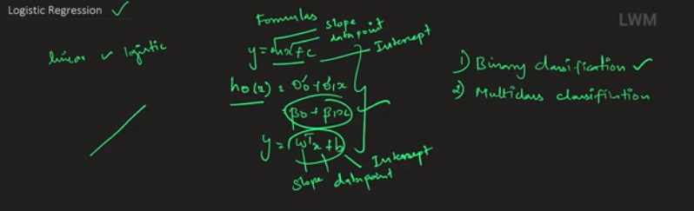

Slide 4
Logistic Regression
The simple and multiple linear regression model apply to the data with a continuous response variable
Normality Assumptions
However, in many situations, we often have a binary (or ordinal) response variable
How to explore this type of relationship?

Slide 5
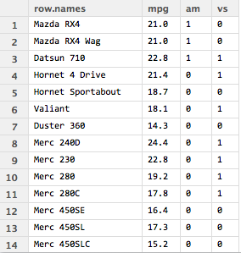
Example — Data
vs: types of the engine, 0: V engine, 1: straight engine
am: transmission, 0: auto, 1: manual
mpg: miles(US)/gallon
What is the relationship between am and mpg ?

Slide 6
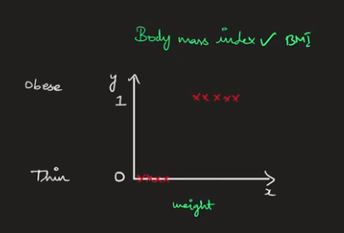

Slide 7
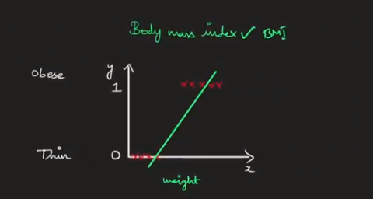

Slide 8
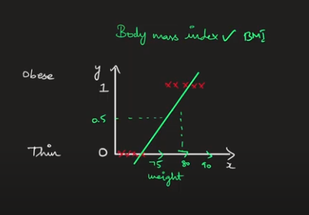

Slide 9
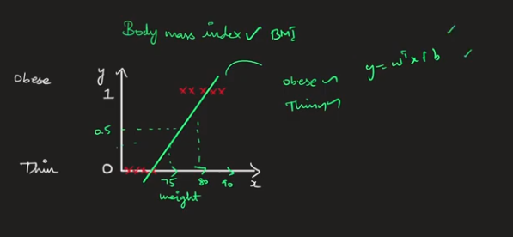

Slide 10
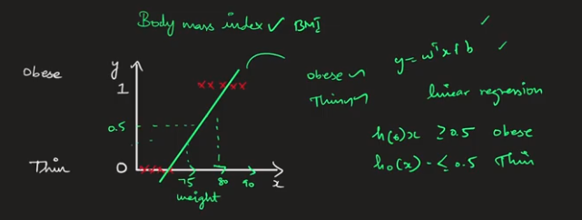

Slide 11
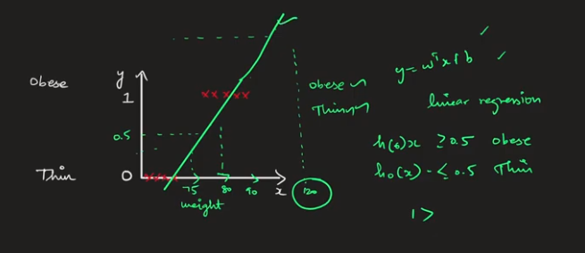

Slide 12
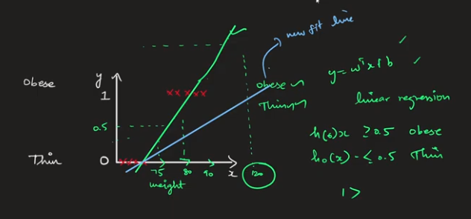

Slide 13
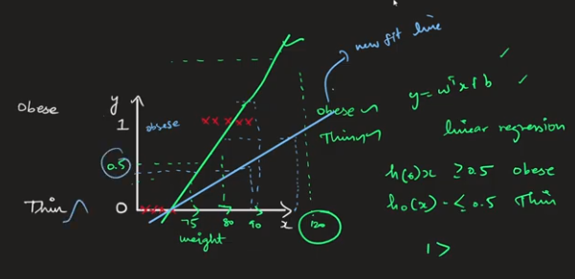

Slide 14
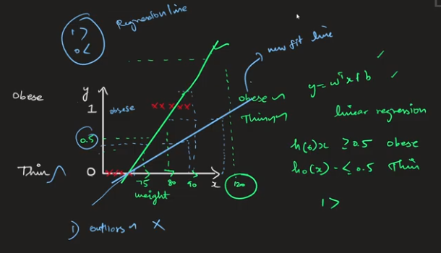
When the outliers are seen by linear regression model, it would give wrong results
Eg.when weight is 120, then according to new blue regression line, it is above 0.5 and below 1
At the same time, when weight is 90, it comes below 0.5, showing not Obese.
Actually speaking, 90 kg is obese.

Slide 15
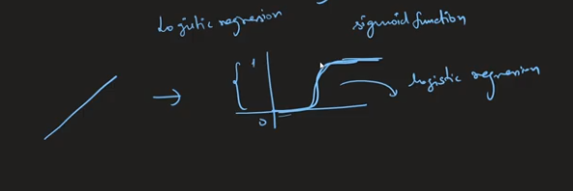
To prevent the outliers, all the data points will be squashed out to become the values in the range (0 to 1)

Slide 16
Summary
Why linear regression is not be used for classification problem
When the outliers are seen by linear regression model, it would give wrong results
To prevent the outliers, all the data points will be squashed out to become the values in the range (0 to 1)

Slide 17
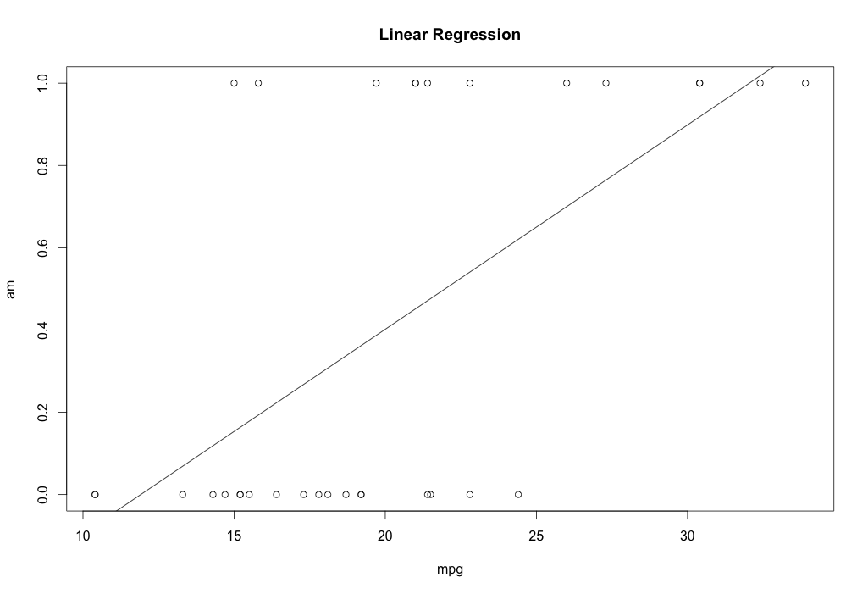
Linear Regression
Not a good fit
Increasing relationship between the am and mpg
But we may want a simpler model, with am predicted as 0 or 1
We need a model for analyzing data with binary response

Slide 18
Outline
Binary response
Link functions
Logistic regression model
Parameter interpretation

Slide 19
Logistic Regression Mathematical Intuition

Slide 20
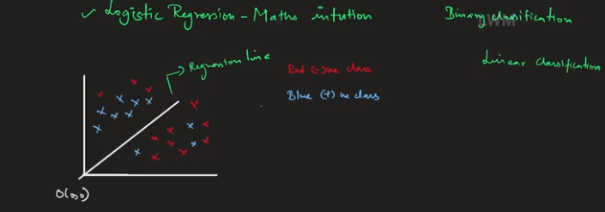
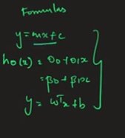


Here, we could not use the linear equation as we used in linear regression
Logistic Regression fits the best line according to coeff W^{T}

Slide 21

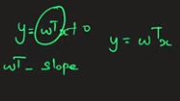
w^{T} is the slope
Since the Regression line passes through the ORIGIN, y_intercept = 0

Slide 22

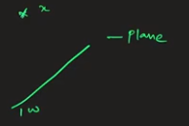
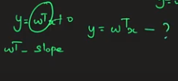
w^{T} is the slope – Angle made by a LINE (Regression line) with respect to AXIS
Let x be a data point, on drawing a normal from x to LINE , then, this distance is said to be w^{T}
How w^{T} ?

Slide 23
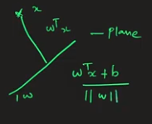
w^{T} is the slope – Angle made by a LINE (Regression line) with respect to AXIS
Let x be a data point, on drawing a normal from x to LINE , then, this distance is said to be w^{T}

Slide 24
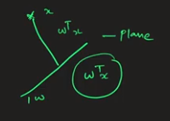
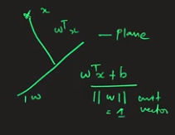
When || w^{T} || is the unit vector, Denominator becomes 1
Since the line passes through the ORIGIN, then, this distance becomes w^{T}

Slide 25
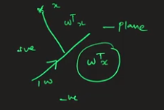
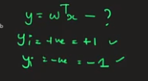
A point lying above slope is +ve and the one which lies below is -ve

Slide 26
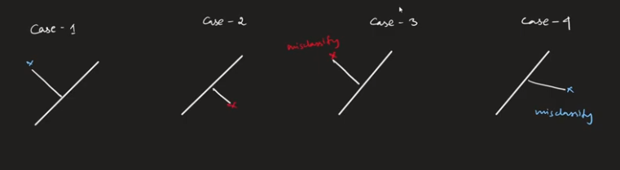
Consider 4 cases

Slide 27
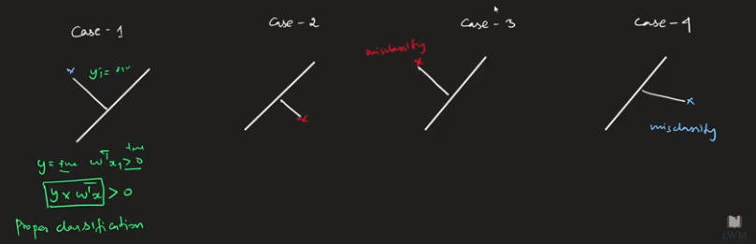

Slide 28
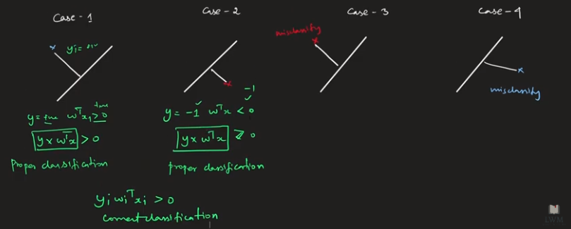

Slide 29
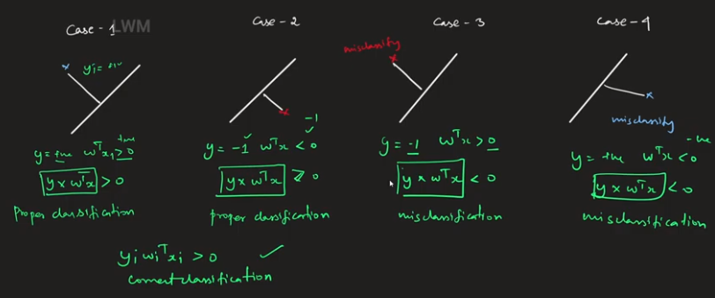

Slide 30


Slide 31

Conclusion: Based on w^{T}, Logistic Regression fits the best line
W_{i}^{T} (slope) keeps on getting updated through iterations, best fit is found when cost function above is MAXIMUM

Slide 32
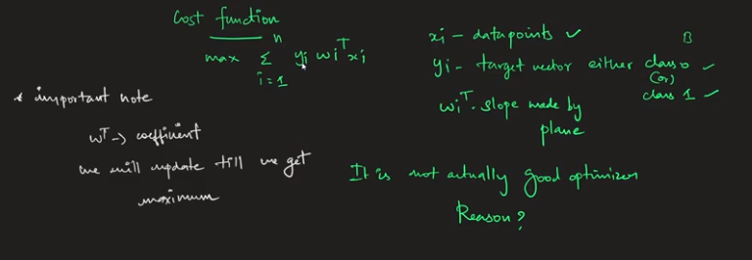
Ans: NO

Slide 33
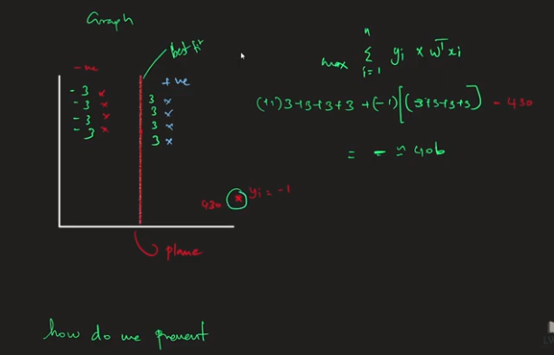

Slide 34
About Binary Response
Odds:
Log-odds:

Slide 35
Logistic Regression
Logistic regression models the log-odds as a linear function of explanatory variables

Slide 36
Binary response & regression models
Often in social science we are interested in relationships between categorical variables.
E.g. absence/presence of a disease, voting intention, Likert-scale…
This session introduces binary logistic regression, which can be used to study the association between:
A binary outcome (dependent) variable; and
Explanatory (independent) variable(s) of any kind

Slide 37
Binary response & regression models
We have a binary (dichotomous) response variable Y defined as
Y = 1 if “success” (“yes”)
0 if “failure” (“no”)
We want to model the probability Π that Y=1

Slide 38
Why not linear regression?
Predicted values may lie outside the interval [0, 1].
Assumption of constant variance is violated as variance depends on x through its influence on п.
var(ε) = п_{i}(x)[1 – п_{i}(x)]
Standard errors not valid, and conclusions from them misleading.

Slide 39
Solution: Link Functions
Good news: we can keep
п_{i} (x) = β₀ +β₁x_{1i} +β₂x_{2i} + … +β_{k}x_{ki}
…if we model a transformation of п_{i}:
η_{i} = g(п_{i}) = β₀ +β₁x_{1i} +β₂x_{2i} + … +β_{k}x_{ki}
where g(.) is the link function.
Notes:
We want to find a transformation of phi (the probability of success) such that we can express it as a linear function of the explanatory variables.
In other words, in the equation of the model, we want to keep the part on the right-hand-side of the equality sign as it is in the linear regression, and we want to find an expression for what is on the left-hand side which allows us to write the model in this way.

Slide 40
What is a ‘link function’?
We require a link transformation that ensures our fitted values vary between 0 and 1
The link function ensures that the expected value of the probability is between 0 and 1
When the linear prediction decreases, the probability goes closer to 0
When the linear prediction increases, the probability goes closer to 1

Slide 41
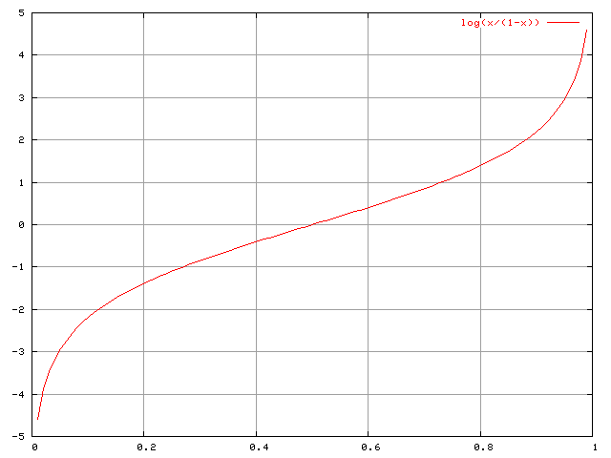
Predictor
Logit link function → logistic regression
Transformation:
log[п/(1-п)]
Fundamental concepts:
probability = п
odds = п/(1-п)
logit(п) = log(odds) = log[п/(1-п)]
Probability
Fig. source: https://commons.wikimedia.org/wiki/File:Logit.png

Slide 42
Characteristics of logits and probabilities
If Π = 0.5
then odds = 0.5/(1-0.5) = 1
and logit = log(1) = 0
If Π > 0.5, then Odds > 1 and logit > 0.
If Π < 0.5, then Odds < 1 and logit < 0.
Logit can take any values but Π is constrained between 0 and 1.
Π can never be exactly 0 or 1.
Notes:
1. Thus when the probability of an event happening is equal to the probability of the event not happening, the odds are one and the logit is zero.
2. Thus the logit is positive when the probability of an event happening is greater than the probability of the event not happening.
3. Thus the logit is negative when the probability of an event happening is smaller than the probability of the event not happening.

Slide 43
Example
# exam1,exam2,admitted
34.62365962451697,78.0246928153624,0
30.28671076822607,43.89499752400101,0
35.84740876993872,72.90219802708364,0
60.18259938620976,86.30855209546826,1
79.0327360507101,75.3443764369103,1
45.08327747668339,56.3163717815305,0
61.10666453684766,96.51142588489624,1
75.02474556738889,46.55401354116538,1
76.09878670226257,87.42056971926803,1
.
.
.
.

Slide 44
import pandas as pd
from sklearn.model_selection import train_test_split
from sklearn.linear_model import LogisticRegression
from sklearn.metrics import accuracy_score
# Import and preprocess data
data = pd.read_csv('2-admissions.csv')
data.dropna(inplace=True)
X = data[['exam1', 'exam2']]
y = data['admitted']
X_train, X_test, y_train, y_test = train_test_split(X, y, test_size=0.2, random_state=42)

Slide 45
# Train logistic regression model
model = LogisticRegression()
model.fit(X_train, y_train)
# Make predictions on testing data
y_pred = model.predict(X_test)
# Evaluate model performance
accuracy = accuracy_score(y_test, y_pred)
print('Accuracy:', accuracy)

Slide 46
Example: Birth Weights
Is the probability of a normal birth weight, associated with gestational age?
Response: Birth weight (BWGHT: 1 = normal, 0 = low).
Explanatory: Gestational age in weeks (GAGE).
Low birthweight has been defined by WHO as weight at birth of less than 2,500 grams (5.5 pounds).

Slide 47
Descriptive statistics: birth weight
 | N | %
Normal birth weight | 17 | 70.8
Low birth weight | 7 | 29.2
Total | 24 | 100.0
Notes:
In this table, the probability (pi) that a given individual in the dataset has Y=1 is equal to their proportion in the dataset. That’s what we want to model in logistic regression. The probability of Y=0 is 1-(p | y=1), bc Y can only be 0 or 1. Suppose we want to model the association between bw and gestational age. What should we do?

Slide 48
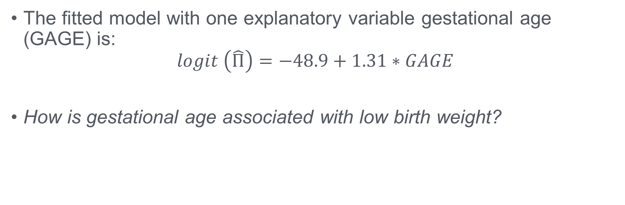
Results: Birth Weights (example)
The fitted model with one explanatory variable gestational age (GAGE) is:
$$logit \left(\hat{Π}\right)=−48.9+1.31∗GAGE$$
How is gestational age associated with low birth weight?

Slide 49
Interpretation on logit scale
A unit increase in x₁ increases the logit (log of the odds) by β₁ units.
For a one week increase in gestational age the log of the odds of a normal birth weight increases by 1.31.
$$logit \left(\hat{Π}\right)=−48.9+1.31∗GAGE$$

Slide 50
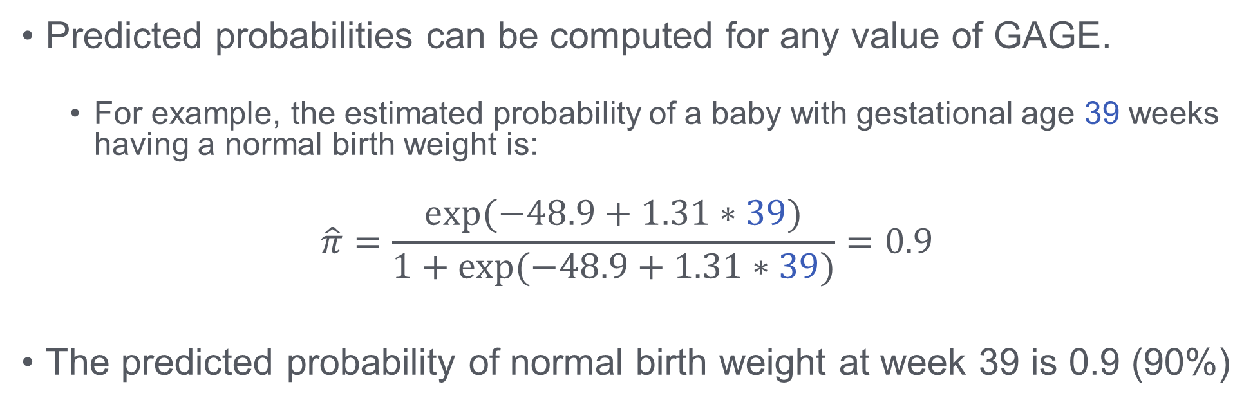
Interpretation on probability scale
Predicted probabilities can be computed for any value of GAGE.
For example, the estimated probability of a baby with gestational age 39 weeks having a normal birth weight is:
$$\hat{π}=\frac{exp⁡(−48.9+1.31∗39)}{1+exp⁡(−48.9+1.31∗39)}=0.9$$
The predicted probability of normal birth weight at week 39 is 0.9 (90%)

Slide 51
Interpretation in the odds scale
The effects of explanatory variables are multiplicative on the odds scale. A unit increase in x₁ multiplies the odds by exp(β₁).
So, a one week increase in gestational age multiplies the odds of a normal birth by 3.71 [i.e. exp(1.31)].
Alternatively, a one week increase in gestational age increases the odds of a normal birth weight by
100 × [3.71 - 1] = 271%

Slide 52
How to report results?
Rarely used (not intuitive)
For a one week increase in gestational age the log of the odds of a normal birth weight increases by 1.31.
The predicted probability of normal birth weight at week 36 was 0.15, whereas at week 39 it is 0.9.
Each additional week of gestation increased the odds of normal birth weight by 271%.
OR: Each additional week of gestation multiplied the odds of normal birth weight by 3.71.
Absolute level of risk /
Example at a specific value of X
Relative level of risk /
Applies to the entire scale of X

Slide 53
Thank you!

