Slide 1
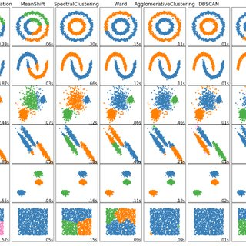
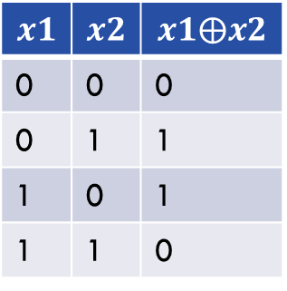

What do (deep) neural networks do?
Learning (highly) non-linear functions.
$$x1$$ | $$x2$$ | $$x1⨁x2$$
0 | 0 | 0
0 | 1 | 1
1 | 0 | 1
1 | 1 | 0
(0, 1)
(1, 1)
(0, 0)
(1, 0)
Logic XOR ($⨁$) operation

Slide 2
Artificial neural network example
A neural network consists of layers of artificial neurons and connections between them.
Each connection is associated with a weight.
Training of a neural network is to get to the right weights (and biases) such that the error across the training data is minimized.
Input
layer
Hidden
layer 1
Hidden
layer 2
Hidden
layer 3
Output
layer

Slide 3
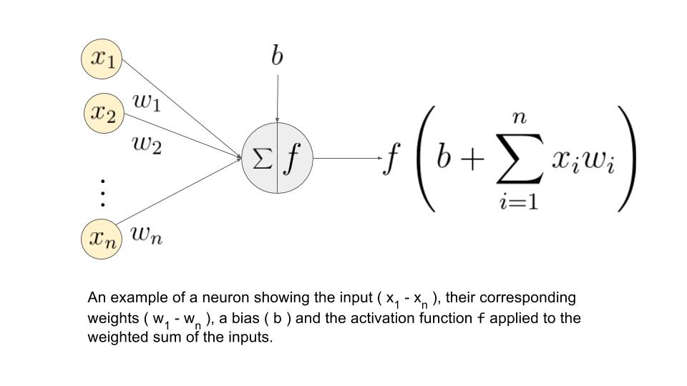
A single neuron
An artificial neuron has two components: (1) weighted sum and activation function.
Many activation functions: Sigmoid, ReLU, etc.

Slide 4
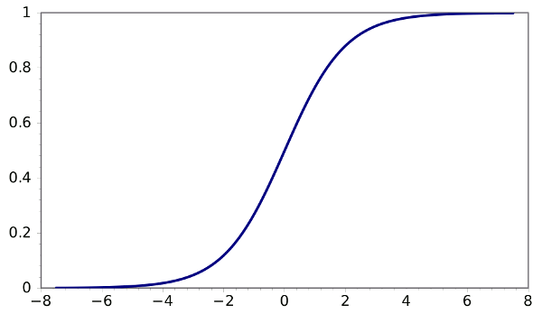
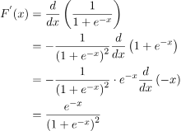
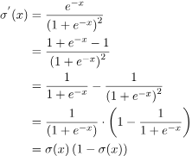

Sigmoid function
$$σ\left(x\right)=sigmoid\left(x\right)= \frac{1}{1+e^{−x}}$$

Slide 5
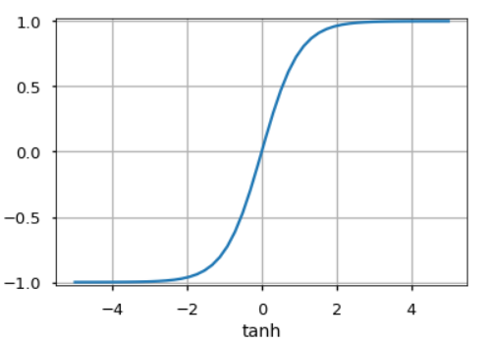
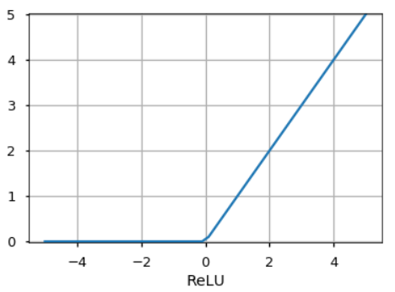
Other Activation Functions
Some other activation functions: Unit Step function, leaky ReLU, Noisy ReLU, Exponential LU

Slide 6
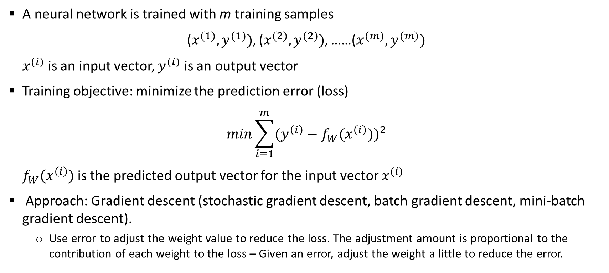
Training a neural network
A neural network is trained with m training samples
($x^{(1)}, y^{(1)}),$($x^{(2)}, y^{(2)}),$……($x^{(m)}, y^{(m)})$
$x^{(i)}$ is an input vector, $y^{(i)}$ is an output vector
Training objective: minimize the prediction error (loss)
$$min\sum_{i=1}^{m}{(y^{\left(i\right)}−f_{W}(x^{\left(i\right)}))^{2}}$$
$f_{W}(x^{\left(i\right)})$ is the predicted output vector for the input vector $x^{(i)}$
Approach: Gradient descent (stochastic gradient descent, batch gradient descent, mini-batch gradient descent).
Use error to adjust the weight value to reduce the loss. The adjustment amount is proportional to the contribution of each weight to the loss – Given an error, adjust the weight a little to reduce the error.
Some of the loss functions
Mean Absolute Error (MAE)
Mean Squared Error (MSE)
Root Mean Squared Error
Binary Crossentropy
Categorical Correntropy
Sparse Categorical Crossentropy

Slide 7
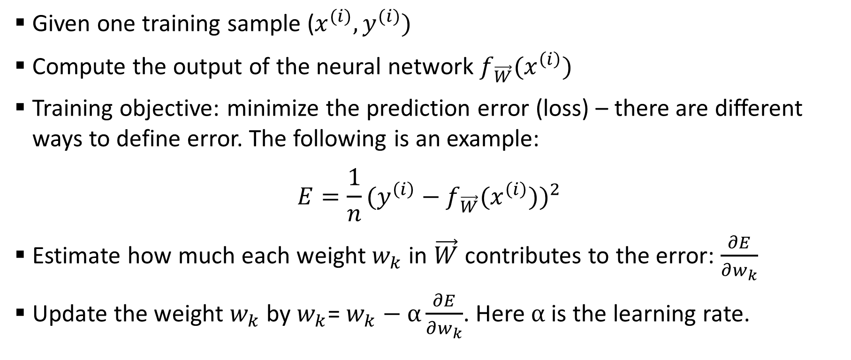
Stochastic gradient descent
Given one training sample ($x^{(i)}, y^{(i)})$
Compute the output of the neural network $f_{\vec{W}}(x^{\left(i\right)})$
Training objective: minimize the prediction error (loss) – there are different ways to define error. The following is an example:
$$E=\frac{1}{n}(y^{\left(i\right)}−f_{\vec{W}}(x^{\left(i\right)}))^{2}$$
Estimate how much each weight $w_{k}$ in $\vec{W}$ contributes to the error: $\frac{∂E}{∂w_{k}}$
Update the weight $w_{k}$ by $w_{k}$=$w_{k}−α\frac{∂E}{∂w_{k}}$. Here $α$ is the learning rate.

Slide 8
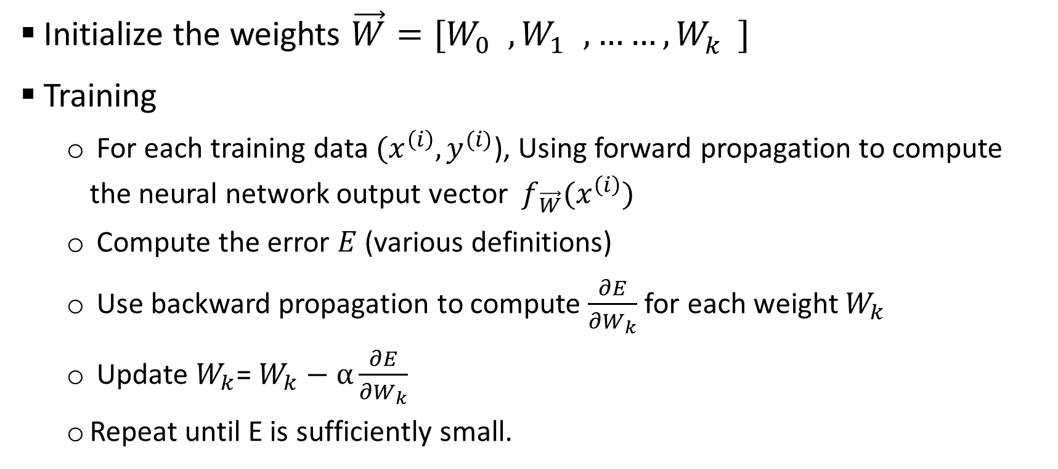
Algorithm for learning artificial neural network
Initialize the weights $\vec{W}=[W_{0}^{}, W_{1}^{}, ……, W_{k}^{}]$
Training
For each training data $(x^{\left(i\right)},y^{(i)}$), Using forward propagation to compute the neural network output vector $f_{\vec{W}}(x^{\left(i\right)})$
Compute the error $E$ (various definitions)
Use backward propagation to compute $\frac{∂E}{∂W_{k}}$ for each weight $W_{k}$
Update $W_{k}$=$W_{k}−α\frac{∂E}{∂W_{k}}$
Repeat until E is sufficiently small.

Slide 9


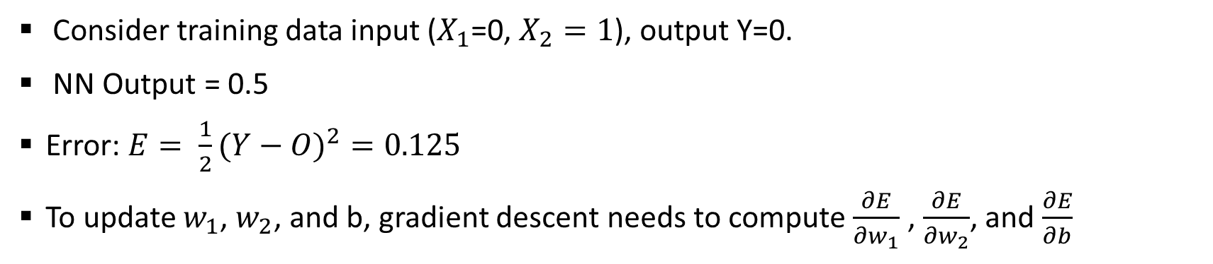



Training for the logic AND with a single neuron
b=0
$X_{1}$=0
$w_{1}$=0
∑
Sigmoid(s)
O=Sigmoid(0)=0.5
$$X_{2}=1$$
$w_{2}$=0
$s=X_{1}w_{1}$+$X_{2}w_{2}+b=0$
Activation function
Consider training data input ($X_{1}$=0, $X_{2}=1$), output Y=0.
NN Output = 0.5
Error: $E= \frac{1}{2}(Y−O)^{2}=0.125$
To update $w_{1}$, $w_{2}$, and b, gradient descent needs to compute $\frac{∂E}{∂w_{1}}$ , $\frac{∂E}{∂w_{2}}$, and $\frac{∂E}{∂b}$

Slide 10

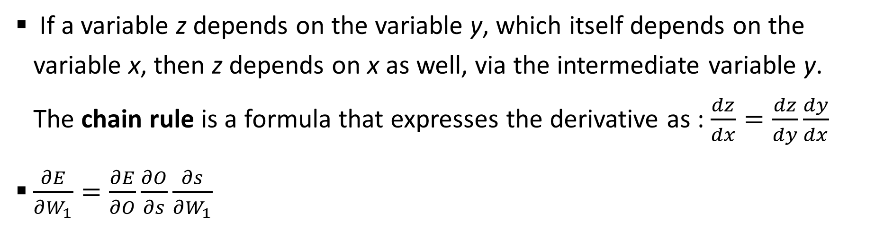





Chain rules for calculating $\frac{∂E}{∂w_{1}}$ , $\frac{∂E}{∂w_{2}}$, and $\frac{∂E}{∂b}$
b=0
$X_{1}$=0
$w_{1}$=0
$s=X_{1}w_{1}$+$X_{2}w_{2}+b=0$
∑
Sigmoid(s)
O=Sigmoid(0)=0.5
$$X_{2}=1$$
$w_{2}$=0
Activation function
If a variable z depends on the variable y, which itself depends on the variable x, then z depends on x as well, via the intermediate variable y. The chain rule is a formula that expresses the derivative as : $\frac{dz}{dx}=\frac{dz}{dy}\frac{dy}{dx}$
$\frac{∂E}{∂W_{1}}=\frac{∂E}{∂O}\frac{∂O}{∂s}\frac{∂s}{∂W_{1}}$

Slide 11
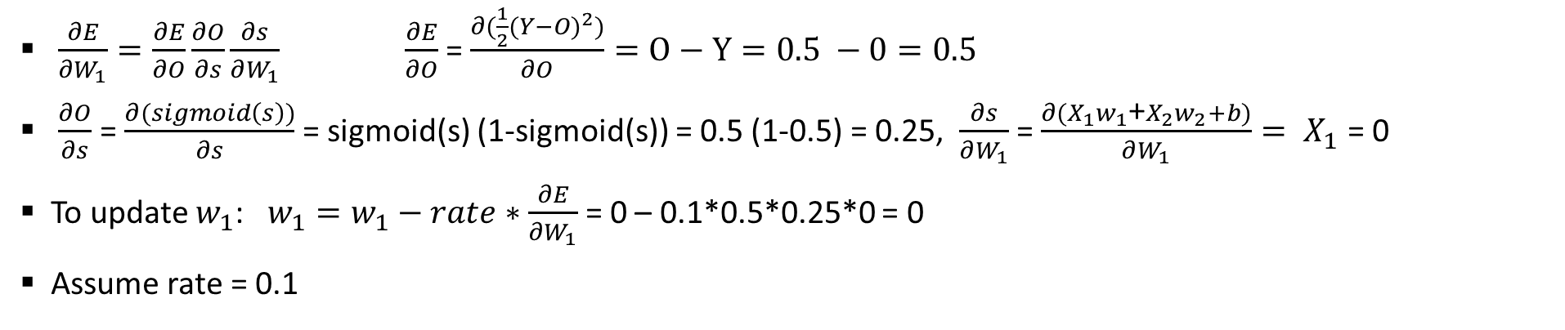
Training for the logic AND with a single neuron
b=0
$X_{1}$=0
$w_{1}$=0
∑
Sigmoid(s)
O=Sigmoid(0)=0.5
$$X_{2}=1$$
$w_{2}$=0
$s=X_{1}w_{1}$+$X_{2}w_{2}+b=0$
Activation function
$\frac{∂E}{∂W_{1}}=\frac{∂E}{∂O}\frac{∂O}{∂s}\frac{∂s}{∂W_{1}} \frac{∂E}{∂O}$ = $\frac{∂(\frac{1}{2}(Y−O)^{2})}{∂O}=O−Y=0.5 −0=0.5$
$\frac{∂O}{∂s}$ = $\frac{∂(sigmoid\left(s\right))}{∂s}$ = sigmoid(s) (1-sigmoid(s)) = 0.5 (1-0.5) = 0.25, $\frac{∂s}{∂W_{1}}$ = $\frac{∂{(X}_{1}w_{1}\text{+}X_{2}w_{2}+b)}{∂W_{1}}= X_{1}$ = 0
To update $w_{1}$: $w_{1}=w_{1}−rate∗\frac{∂E}{∂W_{1}}$ = 0 – 0.1*0.5*0.25*0 = 0
Assume rate = 0.1

Slide 12
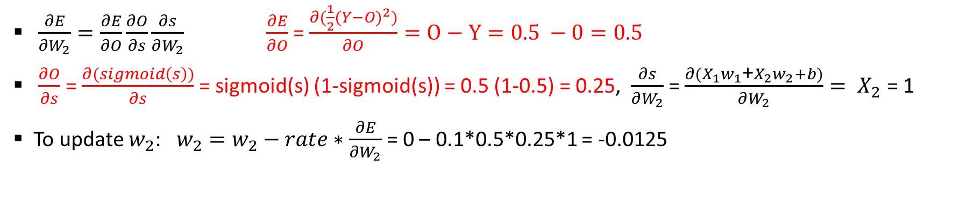
Training for the logic AND with a single neuron
b=0
$X_{1}$=0
$w_{1}$=0
∑
Sigmoid(s)
O=Sigmoid(0)=0.5
$$X_{2}=1$$
$w_{2}$=0
$s=X_{1}w_{1}$+$X_{2}w_{2}+b=0$
Activation function
$\frac{∂E}{∂W_{2}}=\frac{∂E}{∂O}\frac{∂O}{∂s}\frac{∂s}{∂W_{2}} \frac{∂E}{∂O}$ = $\frac{∂(\frac{1}{2}(Y−O)^{2})}{∂O}=O−Y=0.5 −0=0.5$
$\frac{∂O}{∂s}$ = $\frac{∂(sigmoid\left(s\right))}{∂s}$ = sigmoid(s) (1-sigmoid(s)) = 0.5 (1-0.5) = 0.25, $\frac{∂s}{∂W_{2}}$ = $\frac{∂{(X}_{1}w_{1}\text{+}X_{2}w_{2}+b)}{∂W_{2}}= X_{2}$ = 1
To update $w_{2}$: $w_{2}=w_{2}−rate∗\frac{∂E}{∂W_{2}}$ = 0 – 0.1*0.5*0.25*1 = -0.0125

Slide 13
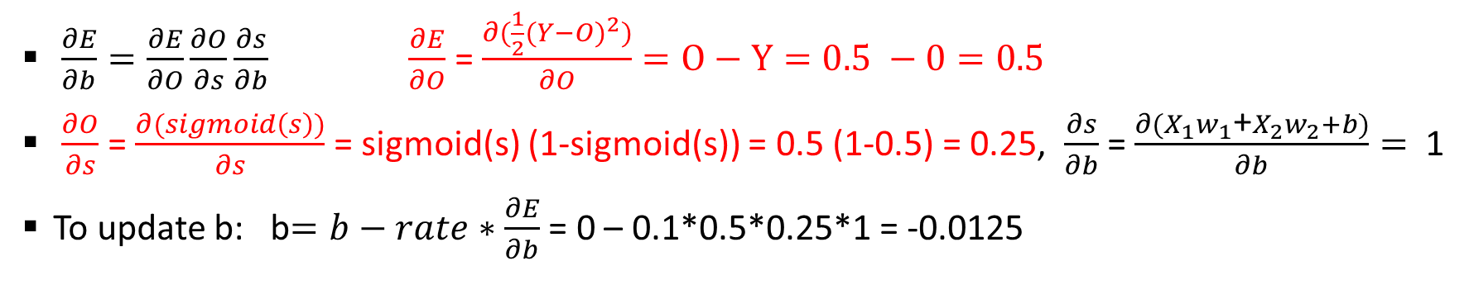
Training for the logic AND with a single neuron
b=0
$X_{1}$=0
$w_{1}$=0
∑
Sigmoid(s)
O=Sigmoid(0)=0.5
$$X_{2}=1$$
$w_{2}$=0
$s=X_{1}w_{1}$+$X_{2}w_{2}+b=0$
Activation function
$\frac{∂E}{∂b}=\frac{∂E}{∂O}\frac{∂O}{∂s}\frac{∂s}{∂b} \frac{∂E}{∂O}$ = $\frac{∂(\frac{1}{2}(Y−O)^{2})}{∂O}=O−Y=0.5 −0=0.5$
$\frac{∂O}{∂s}$ = $\frac{∂(sigmoid\left(s\right))}{∂s}$ = sigmoid(s) (1-sigmoid(s)) = 0.5 (1-0.5) = 0.25, $\frac{∂s}{∂b}$ = $\frac{∂{(X}_{1}w_{1}\text{+}X_{2}w_{2}+b)}{∂b}=$ 1
To update b: b$=b−rate∗\frac{∂E}{∂b}$ = 0 – 0.1*0.5*0.25*1 = -0.0125

Slide 14

Training for the logic AND with a single neuron
b=-0.0125
$X_{1}$=0
$w_{1}$=0
∑
Sigmoid(s)
O=Sigmoid(0)=0.5
$$X_{2}=1$$
$w_{2}$=-0.0125
Activation function
$s=X_{1}w_{1}$+$X_{2}w_{2}+b=0$
This process is repeated until the error is sufficiently small
The initial weight should be randomized. Gradient descent can get stuck in the local optimal.
Note: Logic XOR operation is non-linear and cannot be trained with one neuron.

Slide 15
Multi-level feedforward neural networks
A multi-level feedforward neural network is a neural network that consists of multiple levels of neurons. Each level can have many neurons and connections between neurons in different levels do not form loops.
Information moves in one direction (forward) from input nodes, through hidden nodes, to output nodes.
One artificial neuron can only realize a linear function
Many levels of neurons can combine linear functions can train arbitrarily complex functions.
One hidden layer (with infinite number of neurons) can train for any continuous function.

Slide 16
Multi-level feedforward neural networks examples
A layer of neurons that do not directly connect to outputs is called a hidden layer.
Input
layer
Hidden
layer 1
Hidden
layer 2
Hidden
layer 3
Output
layer

Slide 17
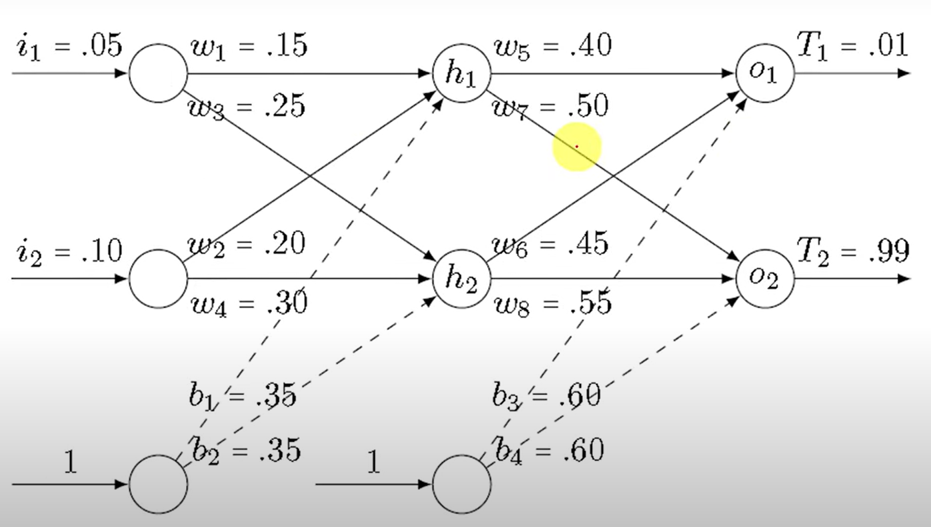

Slide 18
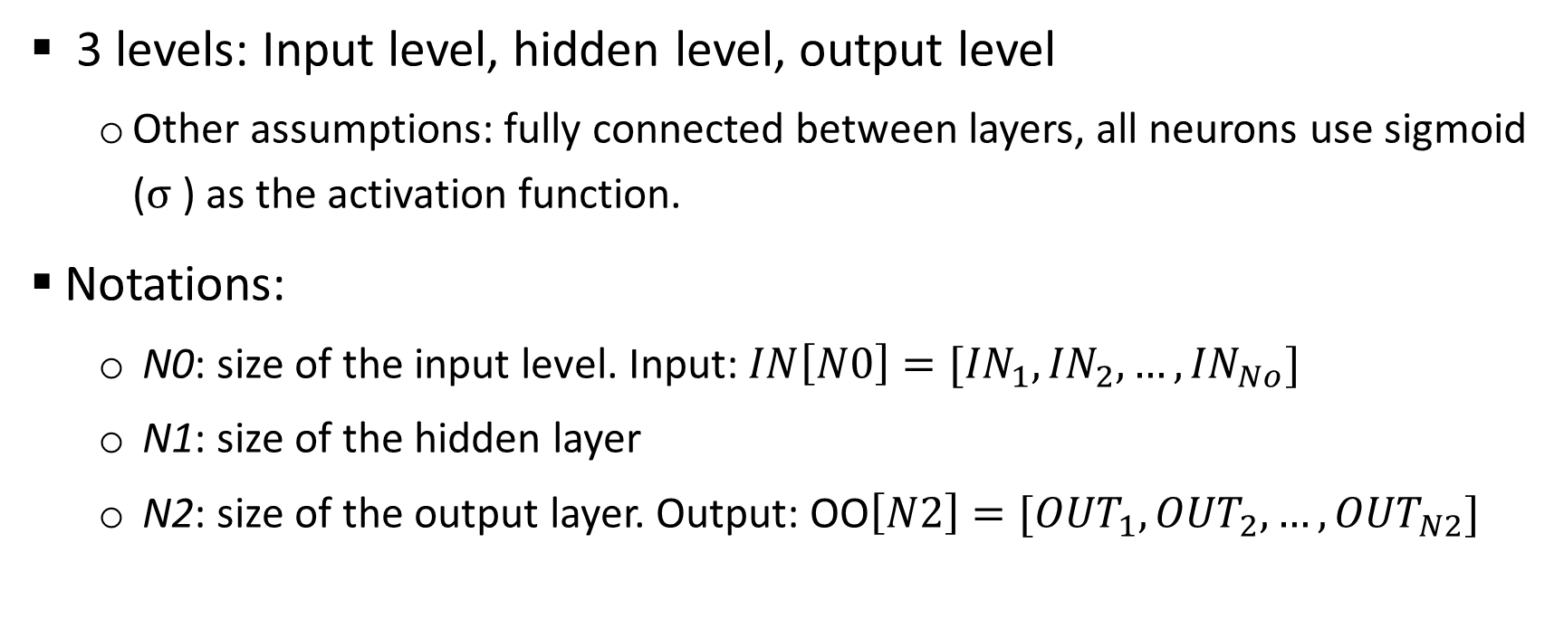
Build a 3-level neural network from scratch
3 levels: Input level, hidden level, output level
Other assumptions: fully connected between layers, all neurons use sigmoid ($σ$) as the activation function.
Notations:
N0: size of the input level. Input: $IN\left[N0\right]=[{IN}_{1},{IN}_{2},…,{IN}_{No}]$
N1: size of the hidden layer
N2: size of the output layer. Output: OO$\left[N2\right]=[{OUT}_{1},{OUT}_{2},…,{OUT}_{N2}]$

Slide 19
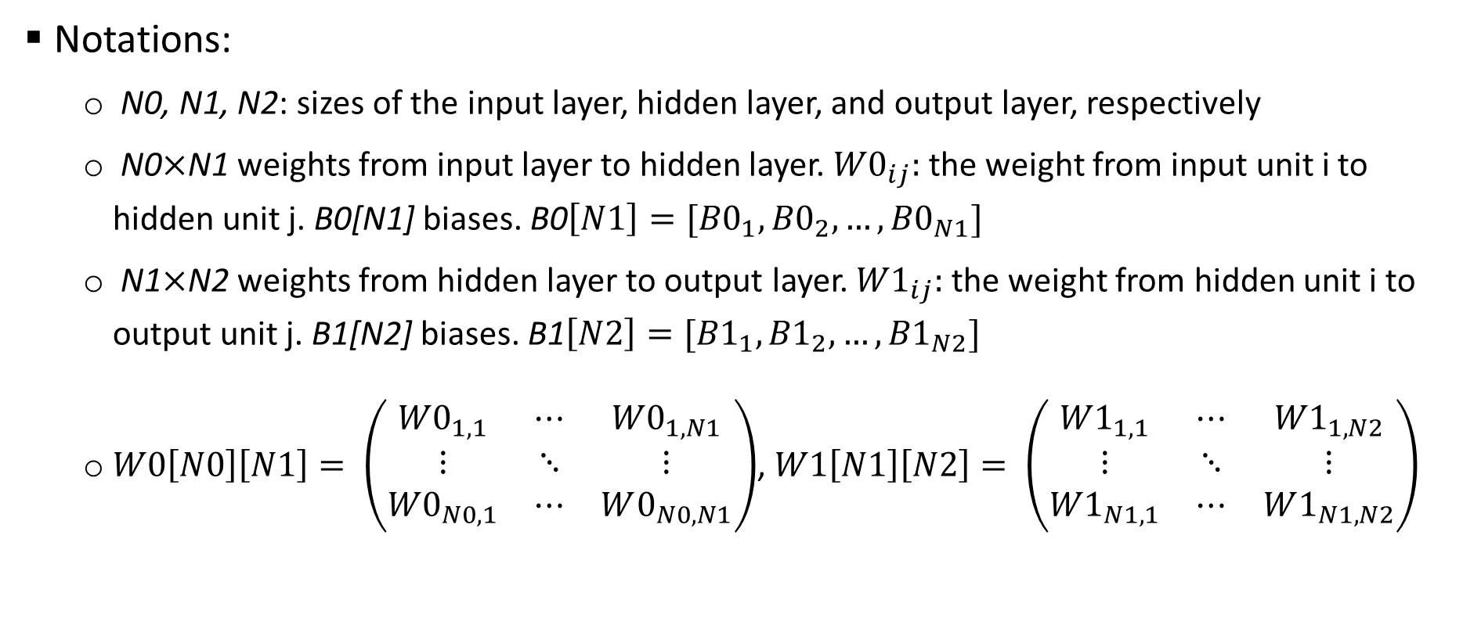
Build a 3-level neural network from scratch
Notations:
N0, N1, N2: sizes of the input layer, hidden layer, and output layer, respectively
N0$×$N1 weights from input layer to hidden layer. ${W0}_{ij}:$ the weight from input unit i to hidden unit j. B0[N1] biases. B0$\left[N1\right]=[{B0}_{1},{B0}_{2},…,{B0}_{N1}]$
N1$×$N2 weights from hidden layer to output layer. ${W1}_{ij}:$ the weight from hidden unit i to output unit j. B1[N2] biases. B1$\left[N2\right]=[{B1}_{1},{B1}_{2},…,{B1}_{N2}]$
$W0\left[N0\right]\left[N1\right]= \left(\begin{matrix}{W0}_{1, 1} & ⋯ & {W0}_{1,N1} \\ ⋮ & ⋱ & ⋮ \\ {W0}_{N0, 1} & ⋯ & W0_{N0, N1}\end{matrix}\right)$, $W1\left[N1\right]\left[N2\right]= \left(\begin{matrix}{W1}_{1, 1} & ⋯ & {W1}_{1,N2} \\ ⋮ & ⋱ & ⋮ \\ {W1}_{N1, 1} & ⋯ & W1_{N1, N2}\end{matrix}\right)$

Slide 20
3-level feedforward neural network
Output: OO[N2]
Output layer
1
2
N2
Hidden layer biases: B2[N2]
Weight: W1[N1][N2]
Hidden layer
Output: HO[N1]
Hidden layer
1
2
N1
Hidden layer biases: B1[N1]
Weight: W0[N0][N1]
Input layer
1
2
N0
Hidden layer weighted sum: HS[N1]
Output layer weighted sum: HS[N2]
Input: IN[N0]

Slide 21
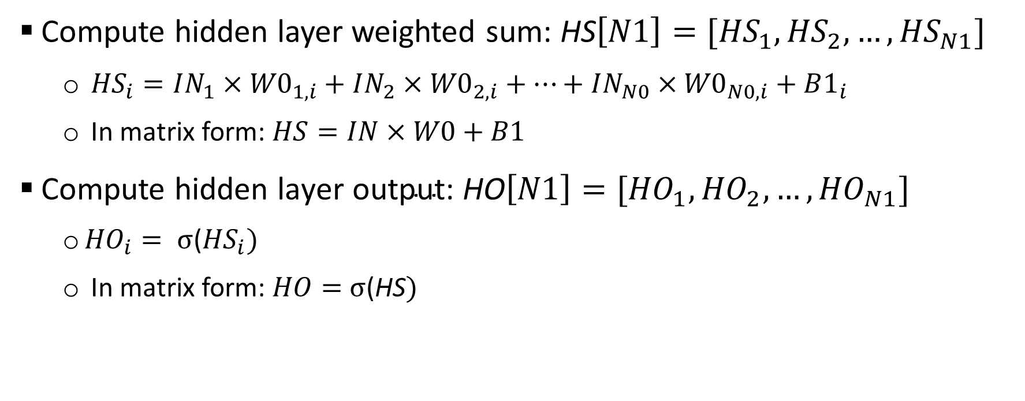
Forward propogation (compute OO and E)
Compute hidden layer weighted sum: HS$\left[N1\right]=[{HS}_{1},{HS}_{2},…,{HS}_{N1}]$
${HS}_{i}=IN_{1}×{W0}_{1, i}+IN_{2}×{W0}_{2, i}+…+IN_{N0}×{W0}_{N0, i}+B1_{i}$
In matrix form: $HS=IN×W0+B1$
Compute hidden ${\text{layer} \text{output}\text{: }\text{HO}\left[N1\right]=[{HO}_{1},{HO}_{2},…,HO}_{N1}]$
${HO}_{i}= σ$(${HS}_{i})$
In matrix form: $HO=$ $σ$(HS$)$

Slide 22
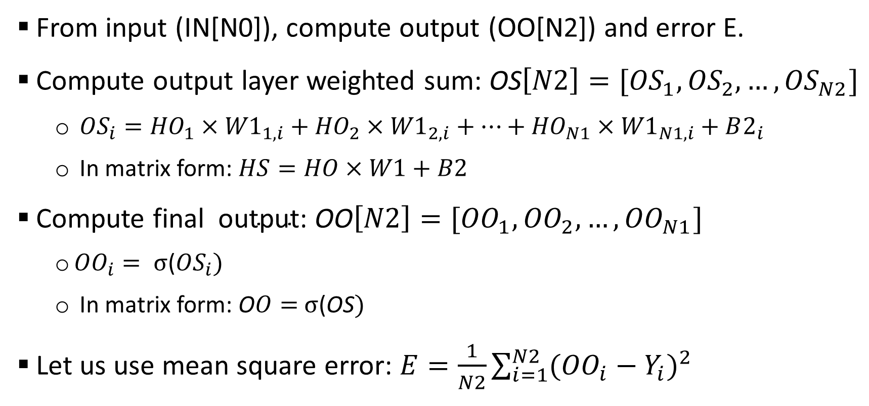
Forward propogation
From input (IN[N0]), compute output (OO[N2]) and error E.
Compute output layer weighted sum: OS$\left[N2\right]=[{OS}_{1},{OS}_{2},…,{OS}_{N2}]$
${OS}_{i}={HO}_{1}×{W1}_{1, i}+{HO}_{2}×{W1}_{2, i}+…+{HO}_{N1}×{W1}_{N1, i}+B2_{i}$
In matrix form: $HS=HO×W1+B2$
Compute final ${ \text{output}\text{: }\text{O}\text{O}\left[N2\right]=[{OO}_{1},{OO}_{2},…,OO}_{N1}]$
${OO}_{i}= σ$(${OS}_{i})$
In matrix form: O$O=$ $σ$(OS$)$
Let us use mean square error: $E=\frac{1}{N2}\sum_{i=1}^{N2}{{({OO}_{i}−Y_{i})}^{2}}$

Slide 23
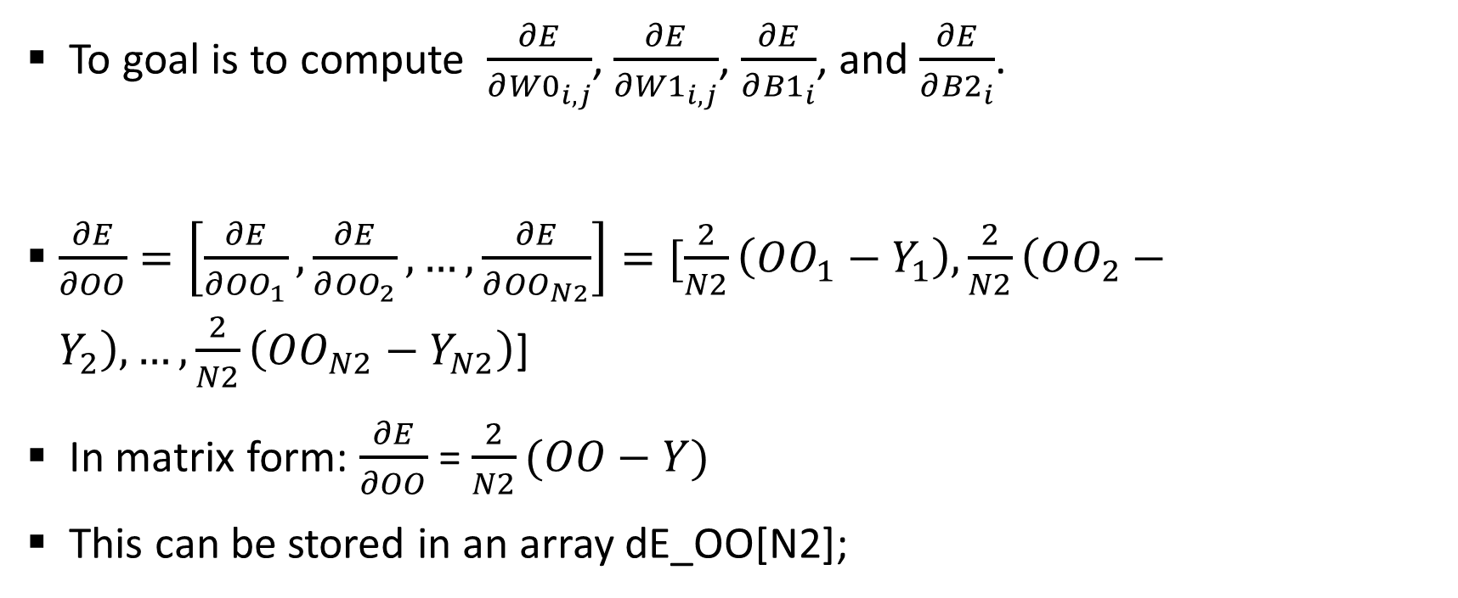
Backward propogation
To goal is to compute $\frac{∂E}{∂{W0}_{i, j}}$, $\frac{∂E}{∂{W1}_{i, j}}$, $\frac{∂E}{∂{B1}_{i}}$, and $\frac{∂E}{∂{B2}_{i}}$.
$\frac{∂E}{∂OO}=\left[\frac{∂E}{∂{OO}_{1}}, \frac{∂E}{∂{OO}_{2}}, …,\frac{∂E}{∂{OO}_{N2}}\right]=[\frac{2}{N2}\left({OO}_{1}−Y_{1}\right), \frac{2}{N2}\left({OO}_{2}−Y_{2}\right), …,\frac{2}{N2}\left({OO}_{N2}−Y_{N2}\right)$]
In matrix form: $\frac{∂E}{∂OO}$ = $\frac{2}{N2}(OO−Y)$
This can be stored in an array dE_OO[N2];

Slide 24
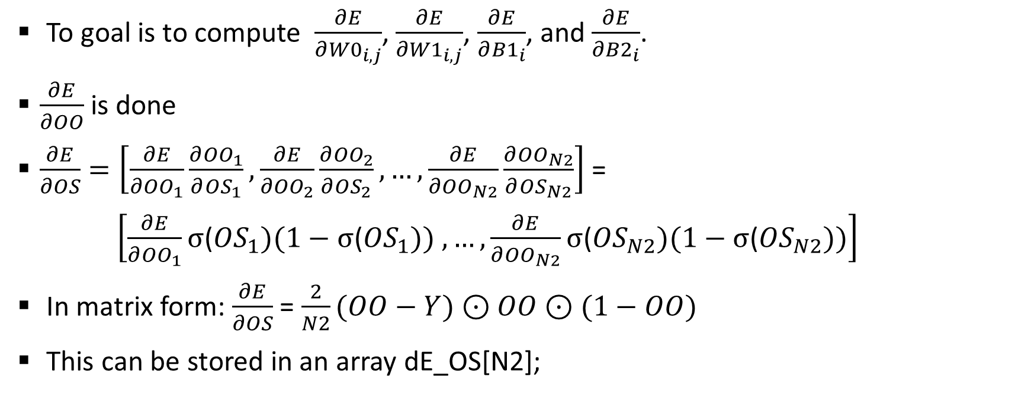
Backward propogation
To goal is to compute $\frac{∂E}{∂{W0}_{i, j}}$, $\frac{∂E}{∂{W1}_{i, j}}$, $\frac{∂E}{∂{B1}_{i}}$, and $\frac{∂E}{∂{B2}_{i}}$.
$\frac{∂E}{∂OO}$ is done
$\frac{∂E}{∂OS}=\left[\frac{∂E}{∂{OO}_{1}}\frac{∂{OO}_{1}}{∂{OS}_{1}}, \frac{∂E}{∂{OO}_{2}}\frac{∂{OO}_{2}}{∂{OS}_{2}}, …,\frac{∂E}{∂{OO}_{N2}}\frac{∂{OO}_{N2}}{∂{OS}_{N2}}\right]$ =
$\left[\frac{∂E}{∂{OO}_{1}}σ\text{(}{OS}_{1})(1−σ\text{(}{OS}_{1})) , …,\frac{∂E}{∂{OO}_{N2}}σ\text{(}{OS}_{N2})(1−σ\text{(}{OS}_{N2}))\right]$
In matrix form: $\frac{∂E}{∂OS}$ = $\frac{2}{N2}(OO−Y)⊙$ $OO$ $⊙$ $(1−OO)$
This can be stored in an array dE_OS[N2];

Slide 25
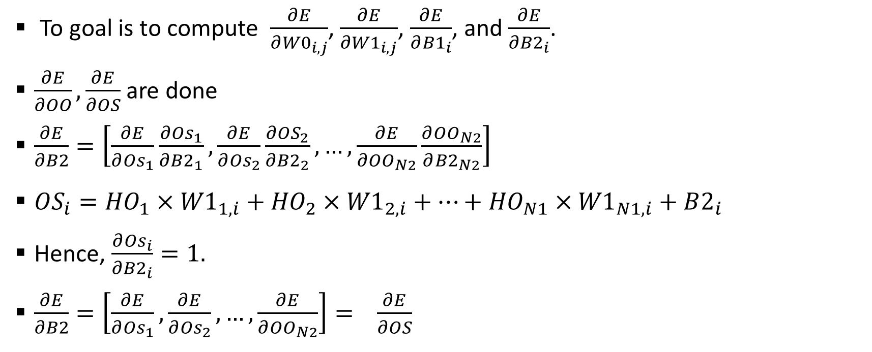
Backward propogation
To goal is to compute $\frac{∂E}{∂{W0}_{i, j}}$, $\frac{∂E}{∂{W1}_{i, j}}$, $\frac{∂E}{∂{B1}_{i}}$, and $\frac{∂E}{∂{B2}_{i}}$.
$\frac{∂E}{∂OO}, \frac{∂E}{∂OS}$ are done
$\frac{∂E}{∂B2}=\left[\frac{∂E}{∂{Os}_{1}}\frac{∂{Os}_{1}}{∂{B2}_{1}}, \frac{∂E}{∂{Os}_{2}}\frac{∂{OS}_{2}}{∂{B2}_{2}}, …,\frac{∂E}{∂{OO}_{N2}}\frac{∂{OO}_{N2}}{∂{B2}_{N2}}\right]$
${OS}_{i}={HO}_{1}×{W1}_{1, i}+{HO}_{2}×{W1}_{2, i}+…+{HO}_{N1}×{W1}_{N1, i}+B2_{i}$
Hence, $\frac{∂{Os}_{i}}{∂{B2}_{i}}=1.$
$\frac{∂E}{∂B2}=\left[\frac{∂E}{∂{Os}_{1}}, \frac{∂E}{∂{Os}_{2}}, …,\frac{∂E}{∂{OO}_{N2}}\right]=$ $\frac{∂E}{∂OS}$

Slide 26

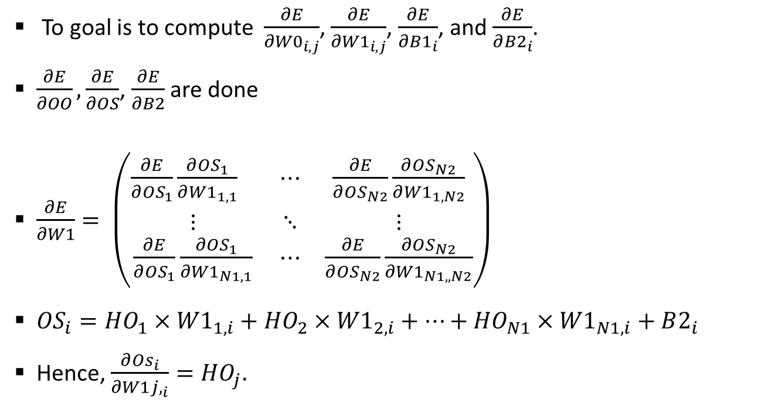


Backward propogation
To goal is to compute $\frac{∂E}{∂{W0}_{i, j}}$, $\frac{∂E}{∂{W1}_{i, j}}$, $\frac{∂E}{∂{B1}_{i}}$, and $\frac{∂E}{∂{B2}_{i}}$.
$\frac{∂E}{∂OO}, \frac{∂E}{∂OS}$, $\frac{∂E}{∂B2}$ are done
$\frac{∂E}{∂W1}= \left(\begin{matrix}{\frac{∂E}{∂{OS}_{1}}\frac{∂{OS}_{1}}{∂{W1}_{1,1}}}_{} & ⋯ & \frac{∂E}{∂{OS}_{N2}}\frac{∂{OS}_{N2}}{∂{W1}_{1,N2}} \\ ⋮ & ⋱ & ⋮ \\ \frac{∂E}{∂{OS}_{1}}\frac{∂{OS}_{1}}{∂{W1}_{N1,1}} & ⋯ & \frac{∂E}{∂{OS}_{N2}}\frac{∂{OS}_{N2}}{∂{W1}_{N1,,N2}}\end{matrix}\right)$
${OS}_{i}={HO}_{1}×{W1}_{1, i}+{HO}_{2}×{W1}_{2, i}+…+{HO}_{N1}×{W1}_{N1, i}+B2_{i}$
Hence, $\frac{∂{Os}_{i}}{∂{W1j,}_{i}}={HO}_{j}.$
$${OS}_{i}$$
i
$${W1}_{1,i}$$
$${W1}_{N2,i}$$

Slide 27
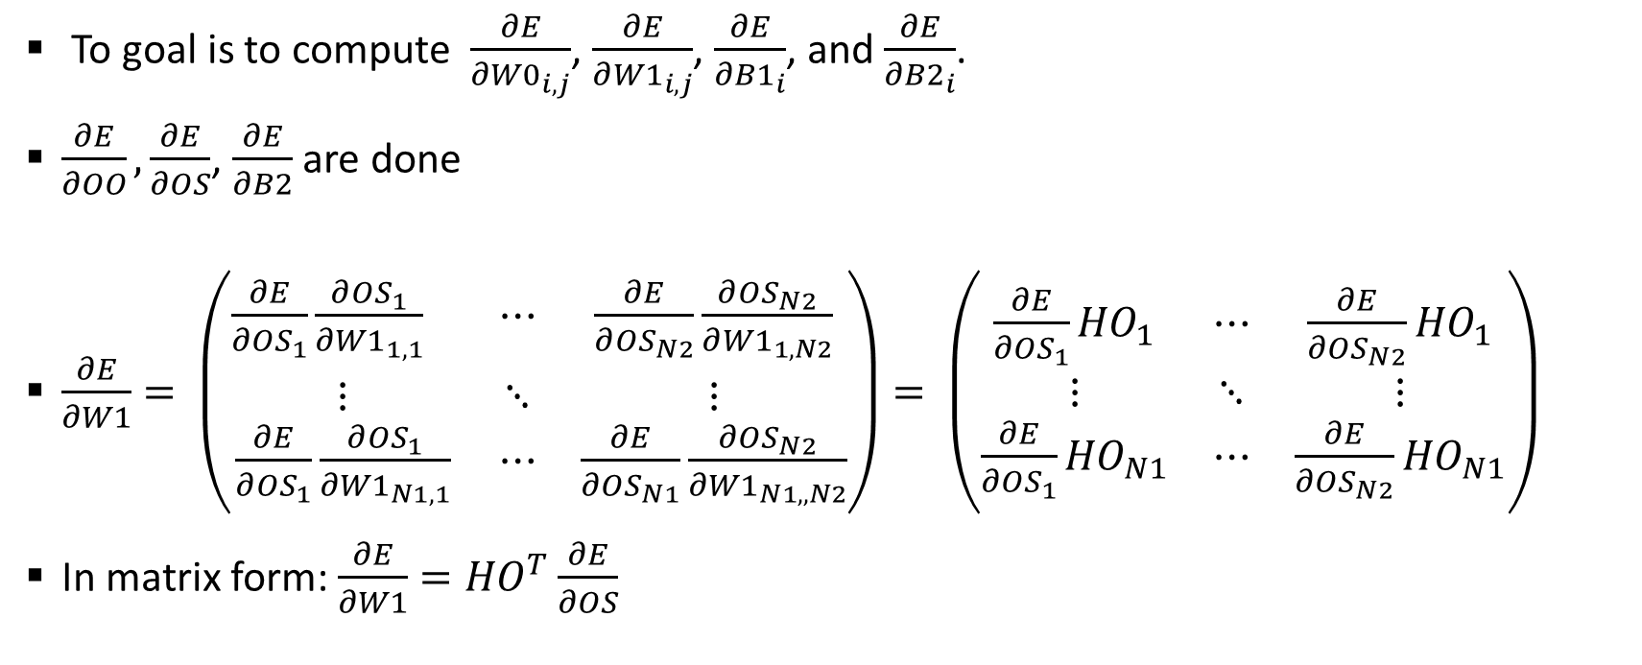
Backward propogation
To goal is to compute $\frac{∂E}{∂{W0}_{i, j}}$, $\frac{∂E}{∂{W1}_{i, j}}$, $\frac{∂E}{∂{B1}_{i}}$, and $\frac{∂E}{∂{B2}_{i}}$.
$\frac{∂E}{∂OO}, \frac{∂E}{∂OS}$, $\frac{∂E}{∂B2}$ are done
$\frac{∂E}{∂W1}= \left(\begin{matrix}{\frac{∂E}{∂{OS}_{1}}\frac{∂{OS}_{1}}{∂{W1}_{1,1}}}_{} & ⋯ & \frac{∂E}{∂{OS}_{N2}}\frac{∂{OS}_{N2}}{∂{W1}_{1,N2}} \\ ⋮ & ⋱ & ⋮ \\ \frac{∂E}{∂{OS}_{1}}\frac{∂{OS}_{1}}{∂{W1}_{N1,1}} & ⋯ & \frac{∂E}{∂{OS}_{N1}}\frac{∂{OS}_{N2}}{∂{W1}_{N1,,N2}}\end{matrix}\right)= \left(\begin{matrix}{\frac{∂E}{∂{OS}_{1}}HO}_{1} & ⋯ & \frac{∂E}{∂{OS}_{N2}}{HO}_{1} \\ ⋮ & ⋱ & ⋮ \\ \frac{∂E}{∂{OS}_{1}}{HO}_{N1} & ⋯ & \frac{∂E}{∂{OS}_{N2}}{HO}_{N1}\end{matrix}\right)$
In matrix form: $\frac{∂E}{∂W1}={HO}^{T}\frac{∂E}{∂OS}$

Slide 28
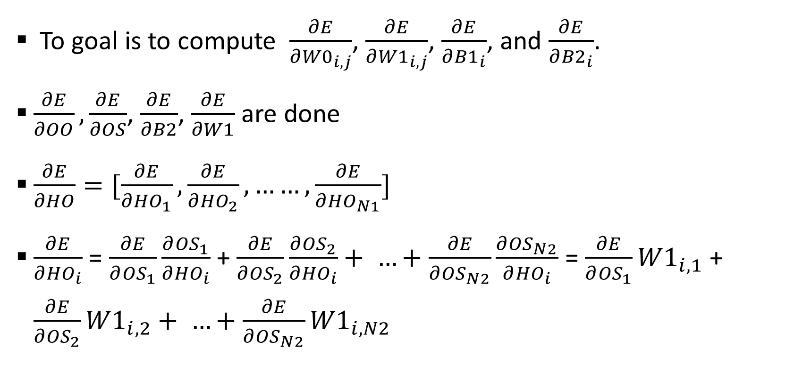
Backward propogation
To goal is to compute $\frac{∂E}{∂{W0}_{i, j}}$, $\frac{∂E}{∂{W1}_{i, j}}$, $\frac{∂E}{∂{B1}_{i}}$, and $\frac{∂E}{∂{B2}_{i}}$.
$\frac{∂E}{∂OO}, \frac{∂E}{∂OS}$, $\frac{∂E}{∂B2}$, $\frac{∂E}{∂W1}$ are done
$\frac{∂E}{∂HO}=[\frac{∂E}{∂{HO}_{1}}, \frac{∂E}{∂{HO}_{2}}, ……,\frac{∂E}{∂{HO}_{N1}}]$
$\frac{∂E}{∂{HO}_{i}}$ = $\frac{∂E}{∂{OS}_{1}}\frac{∂{OS}_{1}}{∂{HO}_{i}}$ + $\frac{∂E}{∂{OS}_{2}}\frac{∂{OS}_{2}}{∂{HO}_{i}}+ …+\frac{∂E}{∂{OS}_{N2}}\frac{∂{OS}_{N2}}{∂{HO}_{i}}$ = $\frac{∂E}{∂{OS}_{1}}{W1}_{i,1}$ + $\frac{∂E}{∂{OS}_{2}}{W1}_{i,2}+ …+\frac{∂E}{∂{OS}_{N2}}{W1}_{i, N2}$

Slide 29
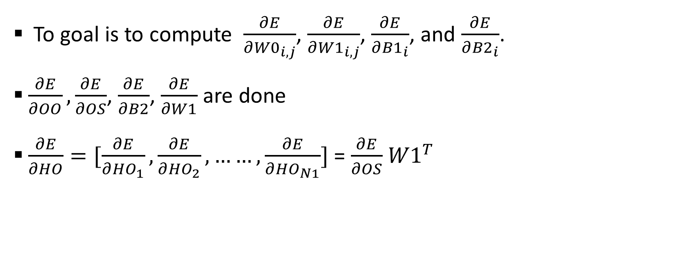
Backward propogation
To goal is to compute $\frac{∂E}{∂{W0}_{i, j}}$, $\frac{∂E}{∂{W1}_{i, j}}$, $\frac{∂E}{∂{B1}_{i}}$, and $\frac{∂E}{∂{B2}_{i}}$.
$\frac{∂E}{∂OO}, \frac{∂E}{∂OS}$, $\frac{∂E}{∂B2}$, $\frac{∂E}{∂W1}$ are done
$\frac{∂E}{∂HO}=[\frac{∂E}{∂{HO}_{1}}, \frac{∂E}{∂{HO}_{2}}, ……,\frac{∂E}{∂{HO}_{N1}}]$ = $\frac{∂E}{∂OS}$ ${W1}^{T}$

Slide 30
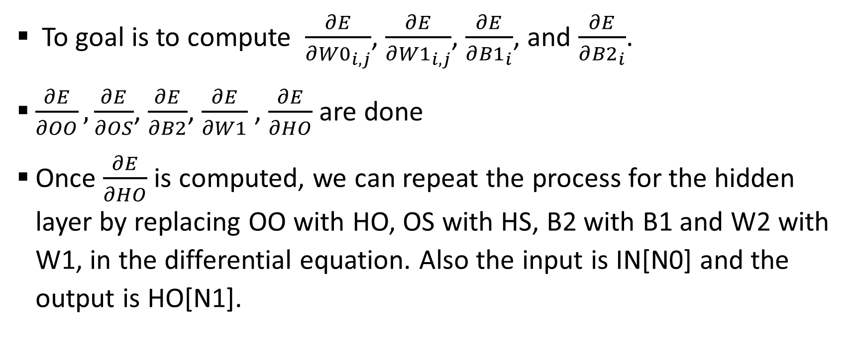
Backward propogation
To goal is to compute $\frac{∂E}{∂{W0}_{i, j}}$, $\frac{∂E}{∂{W1}_{i, j}}$, $\frac{∂E}{∂{B1}_{i}}$, and $\frac{∂E}{∂{B2}_{i}}$.
$\frac{∂E}{∂OO}, \frac{∂E}{∂OS}$, $\frac{∂E}{∂B2}$, $\frac{∂E}{∂W1}$ , $\frac{∂E}{∂HO}$ are done
Once $\frac{∂E}{∂HO}$ is computed, we can repeat the process for the hidden layer by replacing OO with HO, OS with HS, B2 with B1 and W2 with W1, in the differential equation. Also the input is IN[N0] and the output is HO[N1].

Slide 31
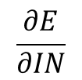
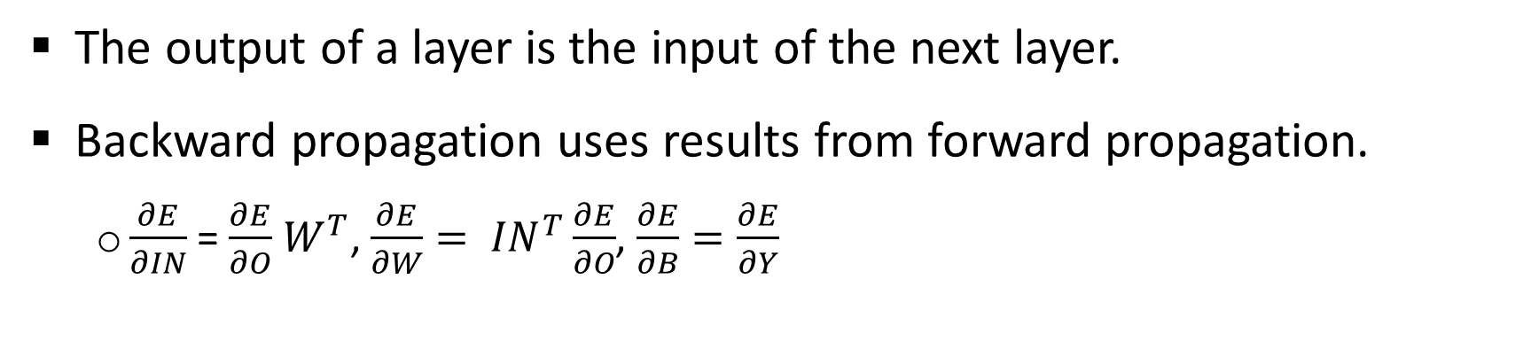

Summary
H1
H2
IN
layer
O
X
Layer 1
Layer 2
Layer 3
Y
$$\frac{∂E}{∂IN}$$
layer
$$\frac{∂E}{∂O}$$
The output of a layer is the input of the next layer.
Backward propagation uses results from forward propagation.
$\frac{∂E}{∂IN}$ = $\frac{∂E}{∂O}$ $W^{T}$, $\frac{∂E}{∂W}= {IN}^{T}\frac{∂E}{∂O}$, $\frac{∂E}{∂B}=\frac{∂E}{∂Y}$

Slide 32
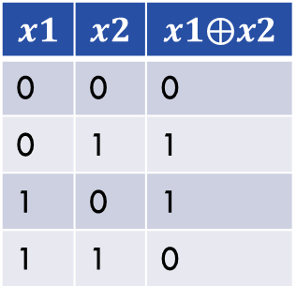

Training for the logic XOR and AND with a 6-unit 2-level nueral network
Logic XOR function is not a linear function (can’t train with lect8/one.cpp). See 3level.cpp
$$x1$$ | $$x2$$ | $$x1⨁x2$$
0 | 0 | 0
0 | 1 | 1
1 | 0 | 1
1 | 1 | 0
(0, 1)
(1, 1)
AND
XOR
(0, 0)
(1, 0)
Logic XOR ($⨁$) operation

