Slide 1
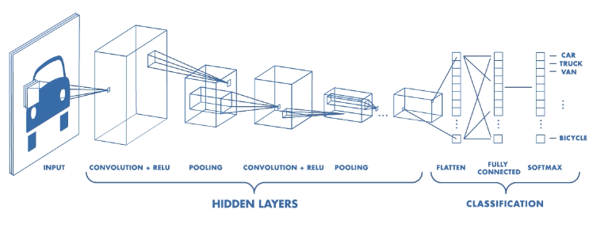
Convolutional Neural Networks (CNN)

Slide 2
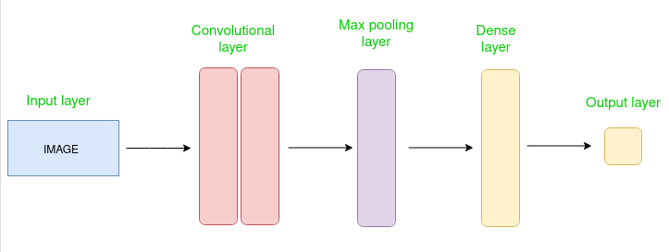
CNN
A type of Deep Learning neural network architecture commonly used in Computer Vision
Different types of Neural Networks are used for different purposes
Recurrent Neural Networks more precisely an LSTM for predicting the sequence of words, and for image classification CNNs
CNN is the extended version of artificial neural networks (ANN) which is predominantly used to extract the feature from the grid-like matrix dataset

Slide 3
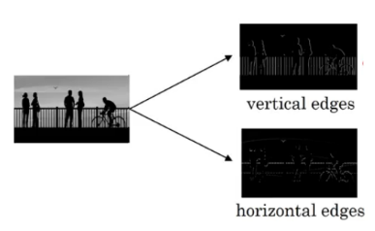
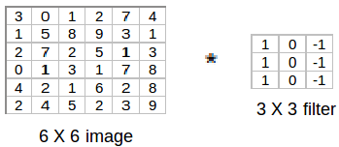

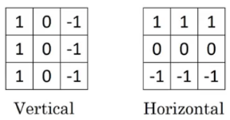
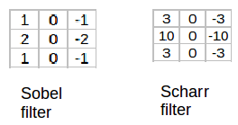
Vertical and Horizontal Edges - Convolve

Slide 4
Convolve

Slide 5
Padding
Pad the image with an additional border, i.e., we add one pixel all around the edges
Input: n X n
Filter size: f X f
Output: (n-f+1) X (n-f+1)
Input: n X n
Padding: p
Filter size: f X f
Output: (n+2p-f+1) X (n+2p-f+1)
Valid: It means no padding: output will be (n-f+1) X (n-f+1)
Same: apply padding so that the output size is the same as the input size, i.e., n+2p-f+1 = n So, p = (f-1)/2

Slide 6
Strided Convolutions
If we choose a stride of 2, while convoluting through the image, will take two steps – both in the horizontal and vertical directions separately.
The dimensions for stride s will be:
Input: n X n
Padding: p
Stride: s
Filter size: f X f
Output: [(n+2p-f)/s+1] X [(n+2p-f)/s+1]

Slide 7
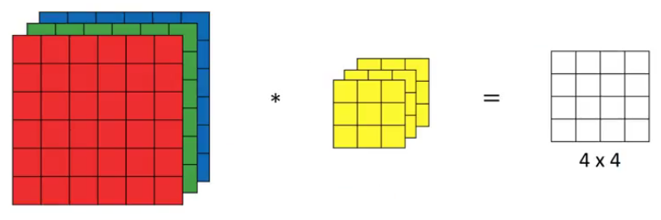
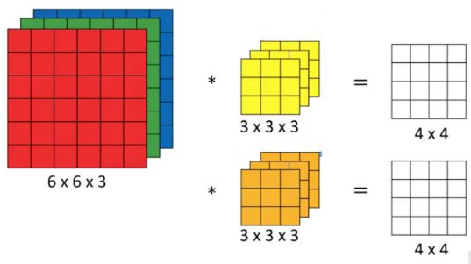
Convolutions Over Volume and multiple filters
Input: n X n X nc
Filter: f X f X nc
Padding: p
Stride: s
Output: [(n+2p-f)/s+1] X [(n+2p-f)/s+1] X nc’
nc is the number of channels in the input and filter, while nc’ is the number of filters.

Slide 8
One Layer of a Convolutional Network
After convolving over the entire image using a filter, add a bias term to those outputs and finally apply an activation function to generate activations. And then apply pooling
z^{[1]} = w^{[1]}*a^{[0]} + b^{[1]} a^{[1]} = g(z^{[1]})
Normalization (mitigate the vanishing gradient problem and stabilize the training) and Regularizations(dropout: control overfitting) are optional
Number of parameters in case of convolutional neural networks is independent of the size of the image. It essentially depends on the filter size and the number of filters
No of parameters: ((m * n * d)+1)* k)
((shape of width of the filter * shape of height of the filter * number of filters in the previous layer+1)*number of filters)

Slide 9
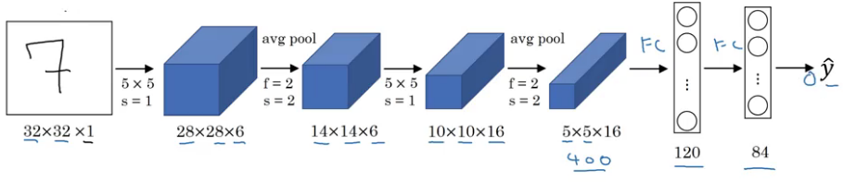
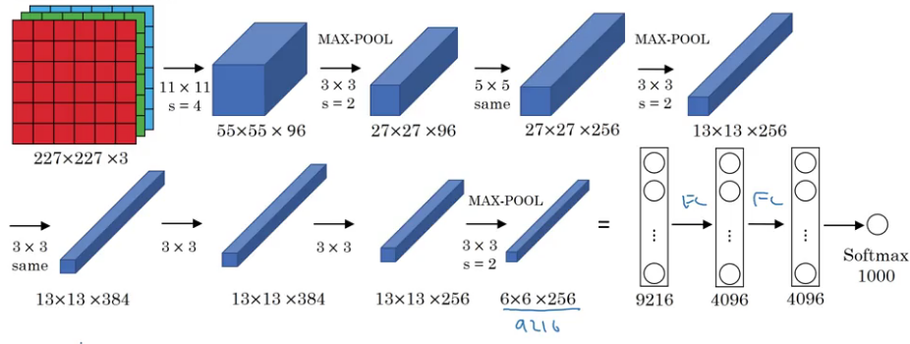
LeNet-5
Activation functions: Sigmoid/tanh and ReLu
Parameters: 60k
AlexNet Parameters: 60 million Activation function: ReLu

Slide 10
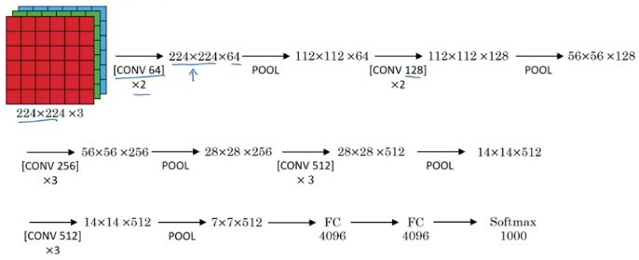
VGG16 Parameters: 138 million

Slide 11
Practical advice for using ConvNets
Building your own model from scratch can be a tedious and cumbersome process.
Also, it is quite a task to reproduce a research paper on your own.
Using Open-Source implementation
Transfer Learning: Extract features from a pretrained model and using those to classify and train our model
Data Augmentation: Deep learning models perform well when we have a large amount of data. Some of the common augmentation methods are: Mirroring, Random Cropping, Rotating, Shearing, Color Shifting

Slide 12
Applications
Object detection: Sophisticated models like R-CNN, Fast R-CNN, and Faster R-CNN are the predominant pipeline for many object detection models deployed in autonomous vehicles, facial detection, and more.
Semantic segmentation
Image captioning: along with recurrent neural networks to write captions for images and videos. This can be used for many applications such as activity recognition or describing videos and images for the visually impaired.

Slide 13
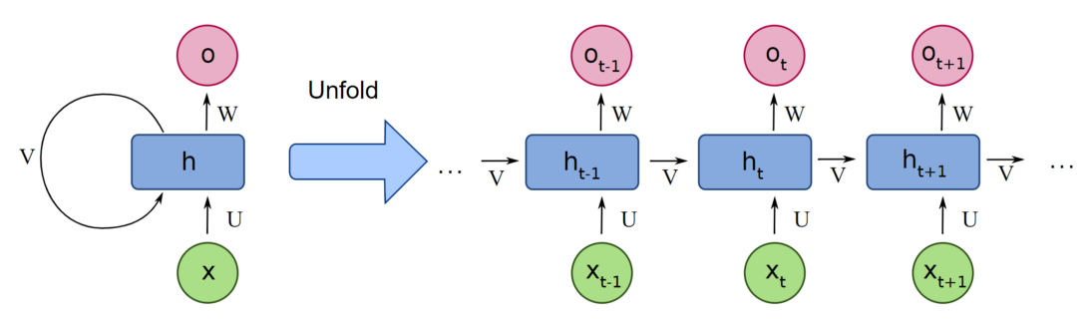
Recurrent Neural Networks (RNN)
RNNs are a type of neural network that can be used to model sequence data
All inputs and outputs in standard NN are independent of one another
In some circumstances, such as when predicting the next word of a phrase, the prior words are necessary, and so the previous words must be remembered.
RNN use Hidden Layer to overcome the problem, which remembers specific information about a sequence.
RNNs have a Memory that stores all information about the calculations.
It employs the same settings for each input since it produces the same outcome by performing the same task on all inputs or hidden layers.
RNNs are a type of neural network that has hidden states and allows past outputs to be used as inputs

Slide 14
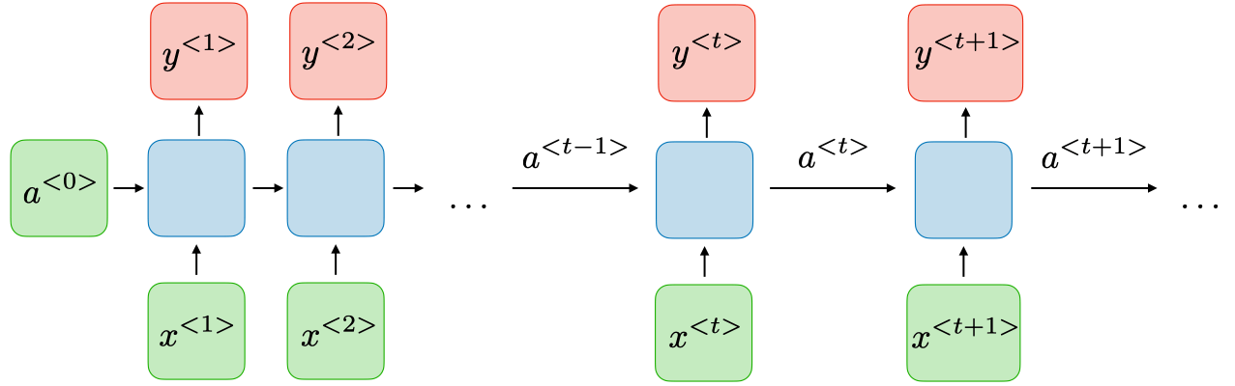
The Architecture of a Traditional RNN

