Slide 1
BECE309L Artificial Intelligence and Machine Learning
Module 1
Introduction – Agents and rationality – Task environment – Agent Architecture Types.

Slide 2
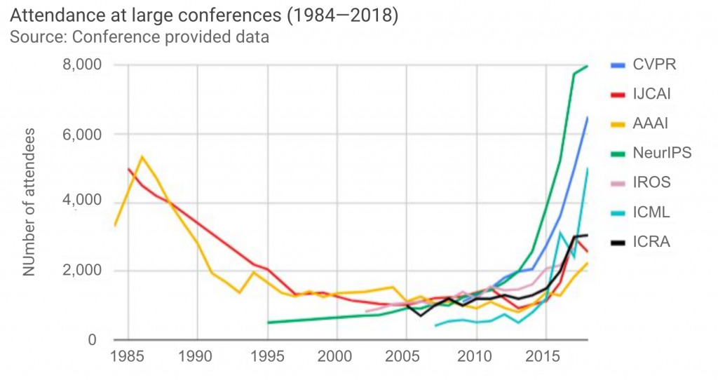
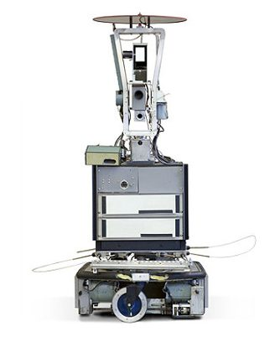
History of AI
1950: Turing Test for Machine Intelligence
1956: AI born at Dartmouth College Workshop
1964: Eliza – the chatbot psychotherapist
1966: Shakey – general purpose mobile robot
AI Winter1 1974-1980:
Failure of machine translation
Negative results in Neural Nets
Poor speech understanding
A boom of AI (1980-1987) : AI came back with "Expert System"
In the Year 1980, the first national conference of the American Association of Artificial Intelligence was held at Stanford University
AI Winter2 1987-1993:
Decline of LISP
Decline of specialized hardware for expert systems

Slide 3
History of AI
1997: IBM Deep Blue beats world chess champion, Gary Kasparov, and became the first computer to beat a world chess champion.
1999: For two days in May, NASA runs an AI program called autonomously ran Deep Space 1
2002: AI entered the home in the form of Roomba, a vacuum cleaner.
2004: AI planner to take decisions on board in Mars rover of NASA with an option to turn of planner when needed
2005: A 2nd DARPA Grand Challenge of 212KM with self driving cars. Stanley car won 1st prize led by Sebastian thrun from Stanford followed by Standstorm and Highlander led by Red Whittaker of Carnegie Mellon University.
2011: IBM's Watson won jeopardy, a quiz show, where it had to solve the complex questions as well as riddles
2014: Chatbot "Eugene Goostman" won a competition in the infamous "Turing test.“
2016: Alpha Go of Deepmind which is acquired by google in 2015 beat Lee Sedol in a game called Go a 19X19 board game
2018: The "Project Debater" from IBM debated on complex topics with two master debaters and also performed extremely well.
2018: Google has demonstrated an AI program "Duplex" which was a virtual assistant, and which had taken hairdresser appointment on call, and lady on other side didn't notice that she was talking with the machine.

Slide 4
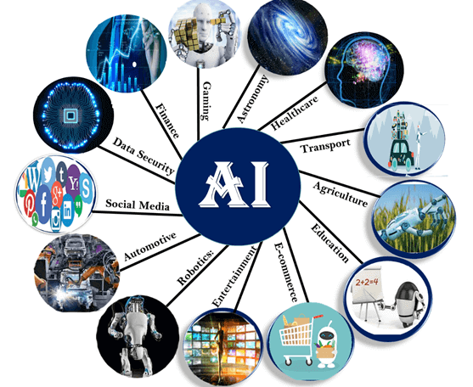
Application of AI

Slide 5
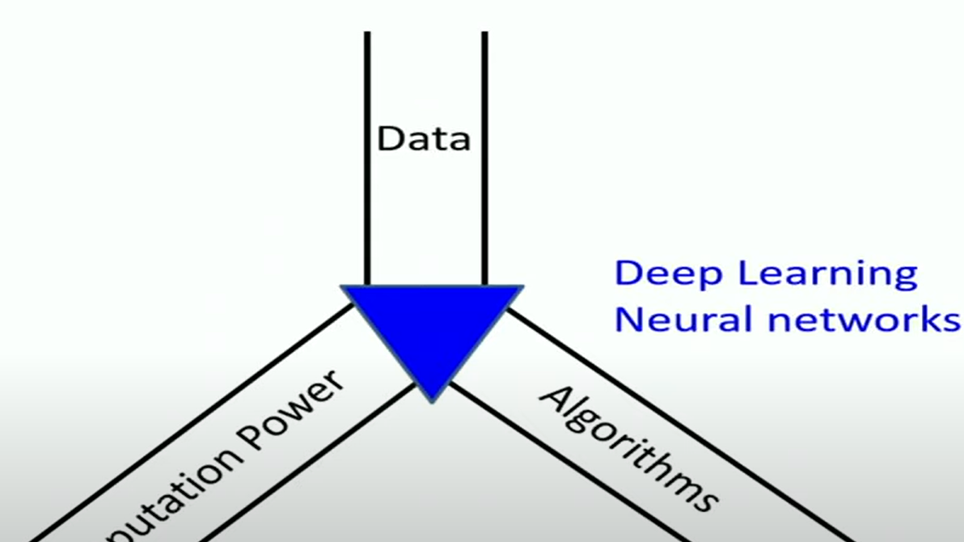
What Changed?

Slide 6
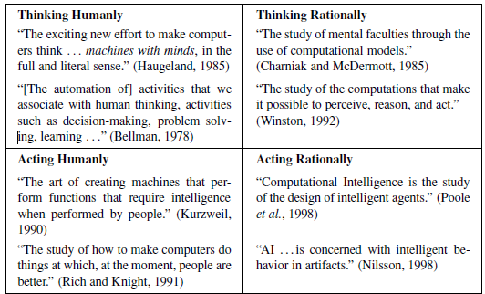
Introduction
Thought processes and reasoning
Humans Like
Rationality
Behavior

Slide 7
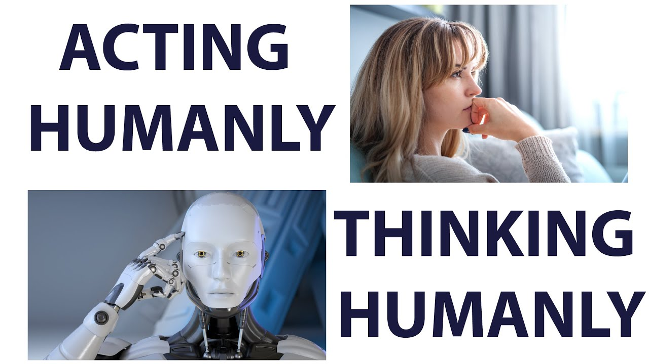
Thinking humanly: The cognitive modeling approach
Where researchers aim to understand and replicate human thought processes.
Cognitive architectures and models inspired by psychology and neuroscience are used to create AI systems that simulate human-like mental processes.
Cognitive modeling typically involves the following steps:
Task Analysis
Develop a representation of the knowledge and information involved in the task.
Design algorithms or mechanisms that simulate the inferential processes humans use to derive conclusions from available information.
Execution and Evaluation
Learning

Slide 8

Thinking rationally: The “laws of thought” approach
What are the correct arguments/thought process?
Making logical inferences and decisions based on explicit rules and reasoning
It involves representing knowledge in a formal, logical manner and using deductive reasoning to derive conclusions.
The Greek philosopher Aristotle was one of the first to attempt to codify “right thinking,” that is, irrefutable reasoning processes
Eg: Expert Systems
There are two main obstacles to this approach.
Not all intelligent behaviour is mediated by logical deliberation (reflexes-hand on heated vessel)
What is the purpose of thinking (looking at the sky from tent)

Slide 9

Acting humanly: The Turing Test approach
Replicating not just cognitive processes but also behavioral aspects such as language use, facial expressions, and social interactions
Programming a computer to pass a rigorously applied test need to possess the following capabilities:
NATURAL LANGUAGE PROCESSING, KNOWLEDGE REPRESENTATION, AUTOMATED REASONING, MACHINE LEARNING
TOTAL TURING TEST: The machine is evaluated not only on its ability to generate human-like text responses but also on its capabilities in areas such as Vision, Hearing, Touch, and other Modalities like taste or smell,
To pass the total Turing Test, the computer will need:
COMPUTER VISION
ROBOTICS
Problems:
Not reproducible, constructive, mathematically analyzable

Slide 10
Acting rationally: The rational agent approach
Rational behaviour : doing the right thing
Making decisions and taking actions that lead to optimal outcomes based on the available information
Doesn't necessarily mimic human thought processes but aims for effective problem-solving and goal achievement.
Game-playing AI, optimization algorithms, and decision-making systems often strive to act rationally by considering all possible actions and selecting the one that maximizes expected utility or achieves specified goals
Notes:
Need not always be deliberative. Need not you need not have logical process at the end, you may have reflexive process, you may have any process that leads to the right action

Slide 11
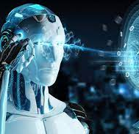
Intelligent Agents
Agents and environments
Rationality
PEAS (Performance measure, Environment, Actuators, Sensors)
Environment types
Agent types

Slide 12
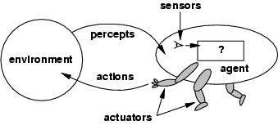
Agents
An agent is anything that can be viewed as perceiving its environment through sensors and acting upon that environment through actuators
Percept Sequence
Human agent:
eyes, ears, and other organs for sensors;
hands, legs, mouth, and other body parts for actuators
Robotic agent:
cameras and infrared range finders for sensors
various motors for actuators
Physically Grounded Agents
Intelligent Buildings, Autonomous aircraft
Softbots
Expert systems
IBM Watson

Slide 13
Agents and environments
The agent function maps from percept histories to actions:
[f: P* → A]
The agent program runs on the physical architecture to produce f
The agent function is an abstract mathematical description
The agent program is a concrete implementation, running within some physical system.
agent = architecture + program

Slide 14
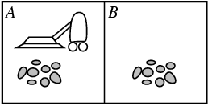

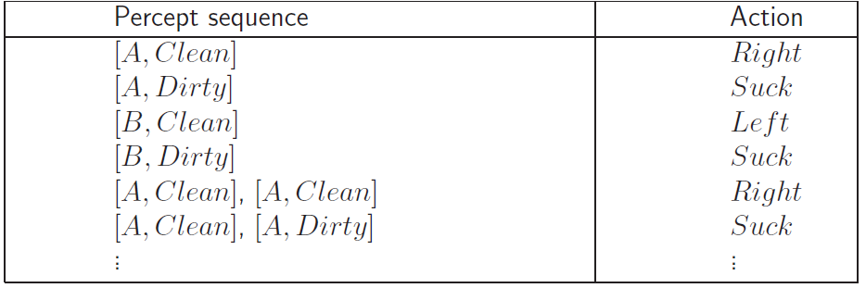
Vacuum-cleaner world
Percepts: location and contents, e.g., [A,Dirty]
Actions: Left, Right, Suck, NoOp
Agent’s function → look-up table
For many agents this is a very large table
Notes:
Only 2 locations

Slide 15
Rational agents
Rationality
The performance measure that defines the criterion of success.
The agent’s prior knowledge of the environment.
The actions that the agent can perform.
The agent’s percept sequence to date.

Slide 16
Ideal Rational agent:
For each possible percept sequence, does whatever action is expected to maximize its performance measure on the basis of evidence so far and built in knowledge
Ideal rational agent need not to be omniscience(need not to know everything about future) but able to learn and exhibits sufficient autonomy
Acting in order to obtain information
Bounded Rationality
Given our state of knowledge
Chose an optimal action
Given limited computational resource

Slide 17
Is vacuum cleaner a rational agent?
Let us assume the following:
The performance measure awards one point for each clean square at each time step, over a “lifetime” of 1000 time steps
The “geography” of the environment is known a priori but not the dirt distribution
The only available actions are Left , Right, and Suck
The agent correctly perceives its location and whether that location contains dirt

Slide 18
PEAS
PEAS: Performance measure, Environment, Actuators, Sensors
Must first specify the setting for intelligent agent design
Consider, e.g., the task of designing an automated taxi driver:
Performance measure: Safe, fast, legal, comfortable trip, maximize profits
Environment: Roads, other traffic, pedestrians, customers
Actuators: Steering wheel, accelerator, brake, signal, horn
Sensors: Cameras, sonar, speedometer, GPS, odometer, engine sensors, keyboard

Slide 19
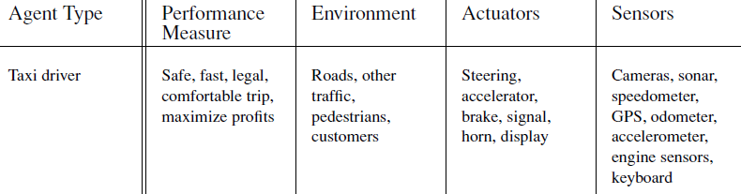
PEAS: Taxi Driver

Slide 20

PEAS : Part Picking Robot
Performance measure: Percentage of parts in correct bins
Environment: Conveyor belt with parts, bins
Actuators: Jointed arm and hand
Sensors: Camera, joint angle sensors

Slide 21

PEAS : Interactive English tutor
Performance measure: Maximize student's score on test
Environment: Set of students
Actuators: Screen display (exercises, suggestions, corrections)
Sensors: Keyboard

Slide 22
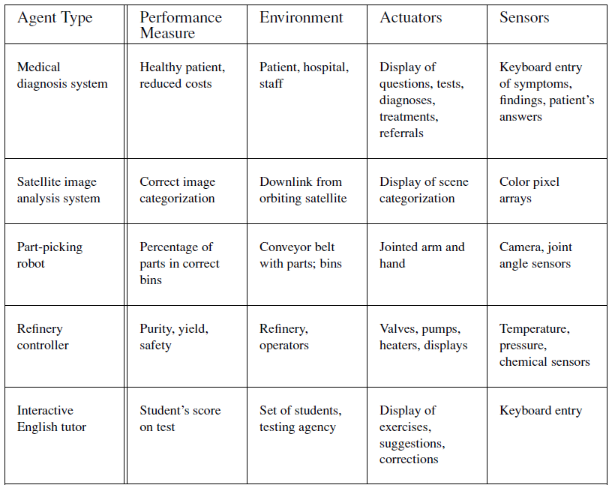
PEAS

Slide 23
Environment types
Fully observable (vs. partially observable)
Deterministic (vs. stochastic)
Episodic (vs. sequential)
Static (vs. dynamic)
Discrete (vs. continuous)
Single agent (vs. multiagent):

Slide 24
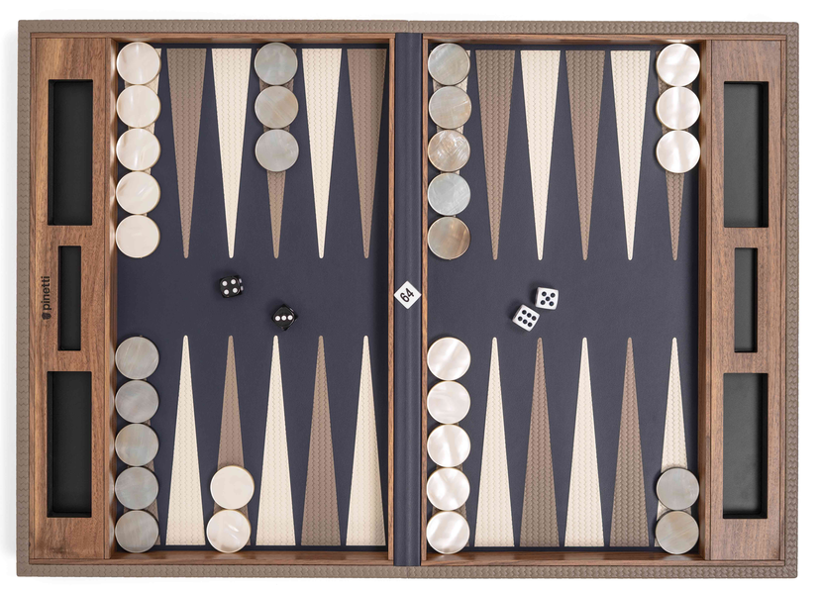
Fully observable (vs. partially observable)
Is everything an agent requires to choose its actions available to it via its sensors? Perfect or Full information.
If so, the environment is fully accessible
If not, parts of the environment are inaccessible
Agent must make informed guesses about world.
Cross Word
Poker
Backgammon
Taxi driver
Part picking robot
Image analysis
Fully
Partially
Fully
Partially
Fully
Fully
Notes:
Satellite image analysis. Some categories depend on definition of task.

Slide 25
Deterministic (vs. stochastic)
If the next state of the environment is completely determined by the current state and the action executed by the agent
Non-deterministic environments
Have aspects beyond the control of the agent
Utility functions have to guess at changes in world
Cross Word
Cross Word
Poker
Poker
Backgammon
Backgammon
Taxi driver
Taxi driver
Part picking robot
Part
Image analysis
Image analysis
Deterministic
Stochastic
Stochastic
Stochastic
Stochastic
Deterministic

Slide 26
Episodic (vs. sequential):
Is the choice of current action
Dependent on previous actions?
If not, then the environment is episodic
In non-episodic environments:
Agent has to plan ahead:
Current choice will affect future actions
Cross Word
Poker
Backgammon
Taxi driver
Part picking robot
Image analysis
Sequential
Sequential
Sequential
Sequential
Episodic
Episodic

Slide 27
Static (vs. dynamic):
Static environments don’t change
While the agent is deliberating over what to do
Dynamic environments do change
So agent should/could consult the world when choosing actions
Alternatively: anticipate the change during deliberation OR make decision very fast
Semidynamic: If the environment itself does not change with the passage of time but the agent's performance score does.
Cross Word
Poker
Backgammon
Taxi driver
Part picking robot
Image analysis
Static
Static
Static
Dynamic
Dynamic
Semi
Another example: off-line route planning vs. on-board navigation system

Slide 28
Discrete (vs. continuous)
Discrete Environments:
State Space: the set of possible states is finite. Each state is distinct and countable.
Action Space: The set of possible actions is also finite and well-defined.
Continuous Environments:
State Space: The set of possible states is infinite, often uncountably so. States are typically represented by real numbers.
Action Space: The set of possible actions is also continuous and may involve real-valued parameters.
Cross Word
Poker
Backgammon
Taxi driver
Part picking robot
Image analysis
Discrete
Discrete
Discrete
Conti
Conti
Conti

Slide 29
Single agent (vs. multiagent):
An agent operating by itself in an environment or there are many agents working together
Cross Word
Poker
Backgammon
Taxi driver
Part picking robot
Image analysis
Single
Multi
Multi
Multi
Single
Single

Slide 30
Summary.
Observable
Deterministic
Episodic
Static
Discrete
Agents
Cross Word
Fully
Deterministic
Sequential
Static
Discrete
Single
Poker
Fully
Stochastic
Sequential
Static
Discrete
Multi
Taxi driver
Partially
Multi
Stochastic
Sequential
Dynamic
Conti
Part picking robot
Partially
Stochastic
Episodic
Dynamic
Conti
Single
Image analysis
Fully
Deterministic
Episodic
Semi
Conti
Single
Notes:
How many environment types are there in total?

Slide 31
Agent types
Types in order of increasing generality:
Simple reflex agents
Reflex agents with state/model
Goal-based agents
Utility-based agents
Learning agents

Slide 32
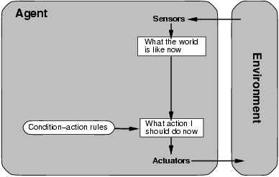
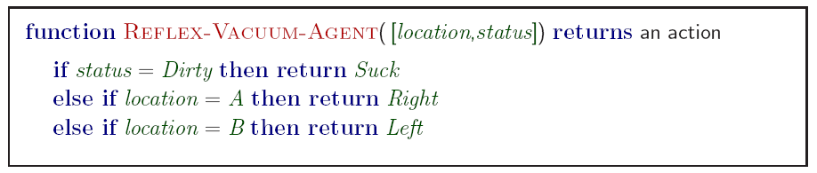
Simple reflex agents
Simple but very limited intelligence.
Action does not depend on percept history, only on current percept.
Environment Should be fully observable
Infinite loops
Suppose vacuum cleaner does not observe location. What do you do given location = clean? Left of A or right on B -> infinite loop.
Fly buzzing around window or light.
Chess – openings, endings
Lookup table (not a good idea in general)
35¹⁰⁰ entries required for the entire game
Notes:
Another example: fly buzzing against window.

Slide 33
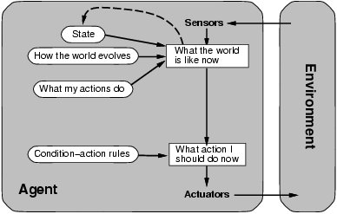
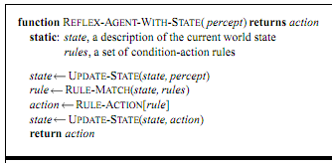
Model-based reflex agents
Maintains an internal model that represents its understanding of the environment
This model can include information about the current state, past states, and possible future states.
Can make more informed decisions and exhibit behavior that is not solely dependent on the immediate percept.
Updates its internal model to reflect the changes in the environment
Adaptability
Handling Partial Information

Slide 34
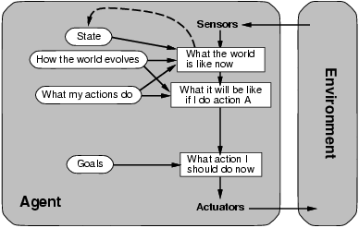
Goal-based agents
Designed to achieve specific objectives or goals within a given environment
More sophisticated in their approach and exhibit a level of planning and reasoning
It evaluates how far the current state is from the desired goal state
Considers possible actions and selects those that are likely to bring it closer to achieving its goals
Mechanisms to assess the success or failure of their actions.
Dynamic Goal Adjustment

Slide 35
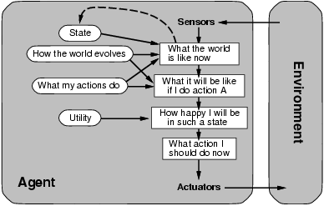
Utility-based agents
Goals are not always enough
Many action sequences get taxi to destination
Consider other things. How fast, how safe…..
A utility function maps a state onto a real number which describes the associated degree of “happiness”, “goodness”, “success”
When there are conflicting goals, only some of which can be achieved (for example, speed and safety), the utility function specifies the appropriate tradeoff.
When there are several goals that the agent can aim for, none of which can be achieved with certainty, utility provides a way in which the likelihood of success can be weighed against the importance of the goals
Notes:
Example: why is it important to get a good grade in this course?

Slide 36
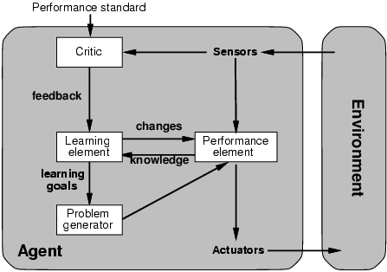
Learning agents
Learning allows the agent to operate in initially unknown environments and to become more competent than its initial knowledge.
Performance element is what was previously the whole agent
Learning element
Modifies performance element.
Critic: how the agent is doing
Problem generator
Tries to solve the problem differently instead of optimizing.
Suggests exploring new actions -> new problems.
Notes:
Problem generator: acts in new ways, explores.

Slide 37
Learning agents(Taxi driver)
Performance element
How it currently drives
Taxi driver Makes quick left turn across 3 lanes
Critics observe shocking language by passenger and other drivers and informs bad action
Learning element tries to modify performance elements for future
Problem generator suggests experiment out something called Brakes on different Road conditions
Exploration vs. Exploitation
Learning experience can be costly in the short run
shocking language from other drivers
Less tip
Fewer passengers

Slide 38
Summary
Agents can be described by their PEAS.
Environments can be described by several key properties: 64 Environment Types.
A rational agent maximizes the performance measure for their PEAS.
The performance measure depends on the agent function.
The agent program implements the agent function.
3 main architectures for agent programs.
In this course we will look at some of the common and useful combinations of environment/agent architecture.

