Slide 1
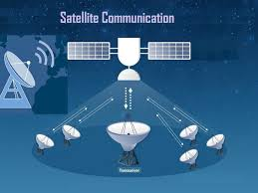
BECE310L- Satellite Communications
J.DIVYA,
AP- SENSE,
VIT-Chennai campus.

Slide 2
Course Objectives
To learn the conceptual knowledge of communication through satellites.
To provide a detailed understanding of navigation - both inertial and by navigation satellites.
To analyze typical challenges of satellite based systems.

Slide 3
Course Outcomes
Analyse the concept of orbits, launch vehicles and satellites
Comprehend the design of satellite subsystems
Imbibe the basics of digital transmission related to satellite communication
Analyse the navigation satellite services.
Analyse the impact of diverse parameters on satellite link design
Apply the satellite systems for various applications

Slide 4
Syllabus
Module:1 Orbital Mechanics
Overview of satellite communication - Orbital mechanics - Equations of the orbit - Kepler’s laws of planetary motion - Orbital elements - Look angle determination - Orbital perturbation and determination
Module:2 Orbital Launchers
Launches and launch vehicles- Launch vehicle selection factors – Satellite positioning into geostationary orbit - Orbital effects in communication systems performance - Doppler shift -Range variations - Solar eclipse and sun transit outage.
Module:3 Elements of Communication Satellite Design
Satellite subsystems - Attitude and orbit control electronics - Telemetry and tracking - Power subsystems - Communication subsystems - Satellite antennas - Reliability
and redundancy- Frequency modulation techniques.

Slide 5
Syllabus
Module:4 Digital Transmission Basics
Modulation and Multiplexing -Multiple access techniques – FDMA, TDMA, CDMA, SDMA, ALOHA and its types – Onboard processing- Satellite switched TDMA – Spread spectrum transmission and reception for satellite networks.
Module:5 Satellite Link Design
Basic transmission theory – System noise temperature and G/T Ratio- Noise figure and noise temperature- Calculation of system noise temperature – G/T ratio for earth stations - Link budgets - Uplink and downlink budget calculations - Error control for digital satellite links - Prediction of rain attenuation and propagation impairment counter measures.
Module:6 VSAT and NGSO System
Overview of VSAT(very small aperture terminal) systems-VSAT Network Architectures, One Way Implementation, Two-Way Implementation, Delay Considerations, VSAT Earth Station Engineering -NGSO Satellite Systems Constellation/ Constellation Design Considerations - Starlink, One Web
Module:7 Direct Broadcast Satellite Television systems and GPS
DBS Satellite Systems: DVB-S2X Standards -System Design for High-Throughput Applications , Antenna Considerations, Modulation Scheme Considerations, Error Coding Considerations, Remote Sensing Application, Navigation Satellite Systems GPS-Position Calculations and Accuracy, Navigation Messages, Receiver Design,- IRNSS

Slide 6
BOOKS
Text Book
1. Pratt, C.W. Boastian and Jeremy Allnutt “Satellite Communication”, 2018, 2nd edition, John Wiley and Sons, Bangalore, India.
Reference Books
1. D.Roddy, “Satellite Communications”, 2011, 4th edition (sixth reprint), Tata McGraw Hill, New York.
2. Anil K. Maini, Varsha Agrawal, “Satellite Communications”, 2018, Wiley IndiaPvt. Ltd, New Delhi, India
3 G. Maral, M. Bousquet, Z. Sun, “Satellite Communications Systems: Systems, Techniques and Technology”, 2020 (6th Edition), John Willy and sons, New York.
4 Teresa M. Braun ,”Satellite Communications Payload and System”, 2021, 2nd edition, John Wiley and Sons, USA

Slide 7
Introduction
What is a satellite?
A satellite is a smaller object or body that revolves around a much larger object in space in a fixed well defined bath.
In general it classified into two types:
Natural satellite
Artificial satellite
Examples:
Earth revolves around sun – it is a satellite, Moon revolves around Earth – it is also a satellite- Natural satellite
Satellites are particularly designed and launched in space for a various applications such as communication applications, monitoring application and research purpose- Artificial satellite.

Slide 8
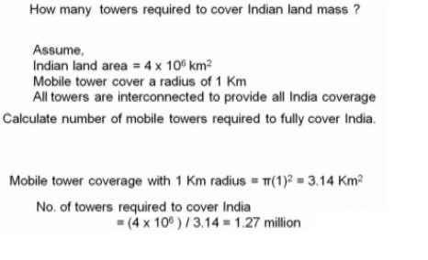
Need for a satellite communication system
Terrestrial microwave links are not suitable to meet a large cover, large geographical area particularly for radio, television networking even cellular telephony.
Microwave communication, it, goes straight line just like light, so only a short distance can be covered Ex: Mobile towers.
want to cover a larger and larger area,
we have to increase the height of the tower.
And on top of the tower we can put a repeater.
Repeater, which receives the microwave
signal and transmits it back.

Slide 9
History
1945- Arthur C. Clarke- microwave repeaters-geosynchronous orbit
October 1957 -Sputnik I- with the launch by the USSR-first artificial earth satellite.
carried only a beacon transmitter and did not have communications capability, but demonstrated that satellites could be placed in orbit by powerful rockets.
January 1958- Explorer I - United States- first satellite successfully launched.
INSAT- Indian national satellite
April 1975- Aryabhata- India.
https://www.isro.gov.in/Satellites.html

Slide 10
Advantages of Satellite communication
Broadcast to a very large area
cost effective, as it can reach to a large number of customers.
communication to/from the unreachable area.
Reliable solution to the last mile problem
do not need to dig the roads
Quick to setup time
Fairness of service as demanded
Used in disaster and defense.
Long life.

Slide 11
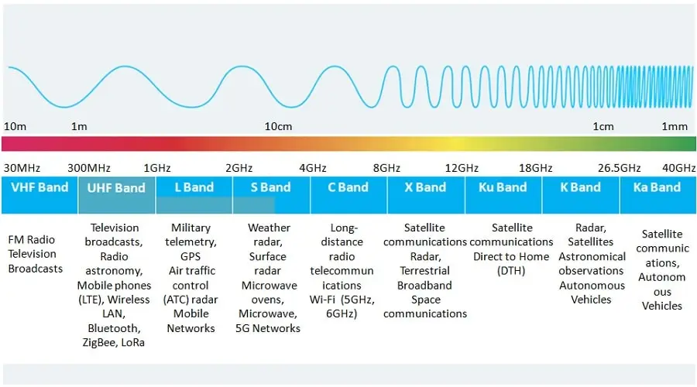

Slide 12
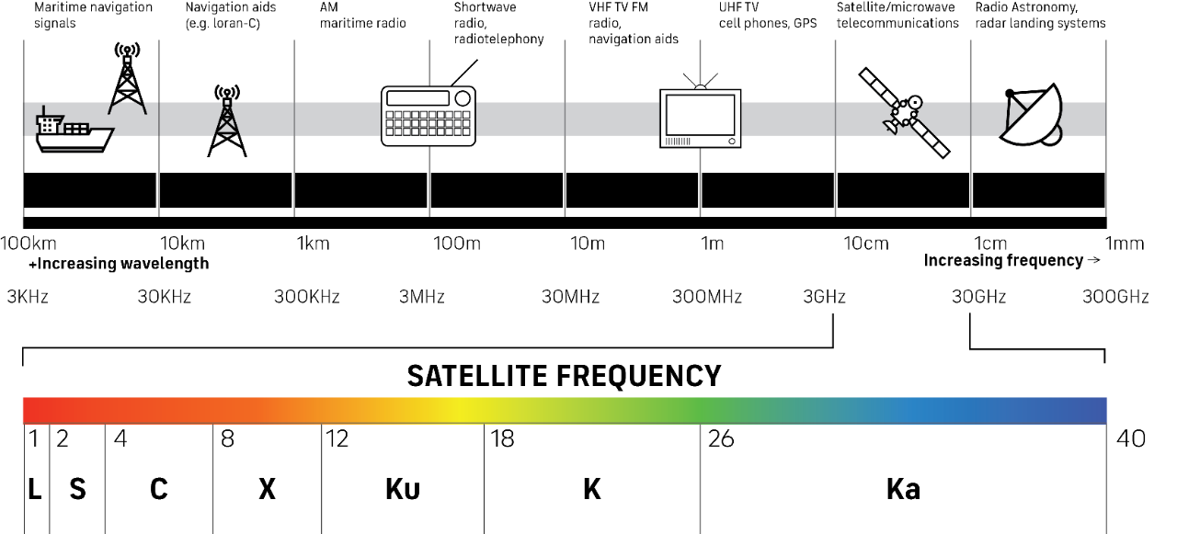

Slide 13
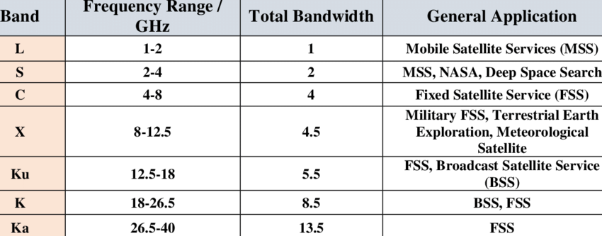

Slide 14
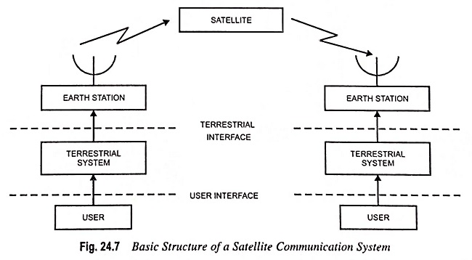
Basic elements of satellite communication system

Slide 15
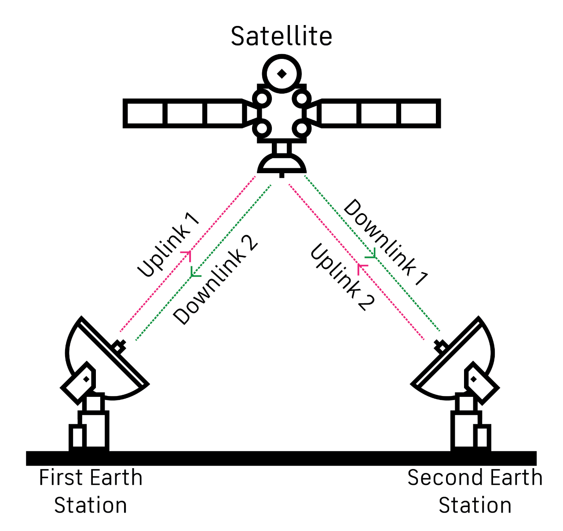
Working principle

Slide 16
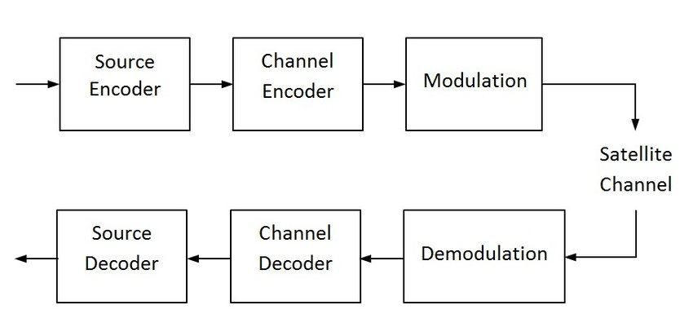
Block diagram

Slide 17
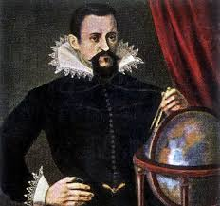
Orbital mechanics-Kepler’s laws of planetary motion
Johannes Kepler
German astronomer (1571 – 1630)
Kepler’s “Laws” are consistent with &
are obtainable from Newton’s Laws
Kepler’s first law – The law of orbits
Kepler’s second law – The law of equal areas
Kepler’s third law – The law of periods
Kepler’s first law: “All the planets revolve around the sun in elliptical orbits having the sun at one of the foci”.- natural law.
Kepler’s second law states, “The radius vector drawn from the sun to the planet sweeps out equal areas in equal intervals of time”.
Kepler’s law of periods (Third law): ”The square of the time period of revolution of a planet around the sun in an elliptical orbit is directly proportional to the cube of its semi-major axis”.

Slide 18
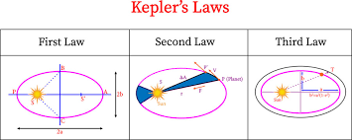
Kepler’s laws of planetary motion

Slide 19
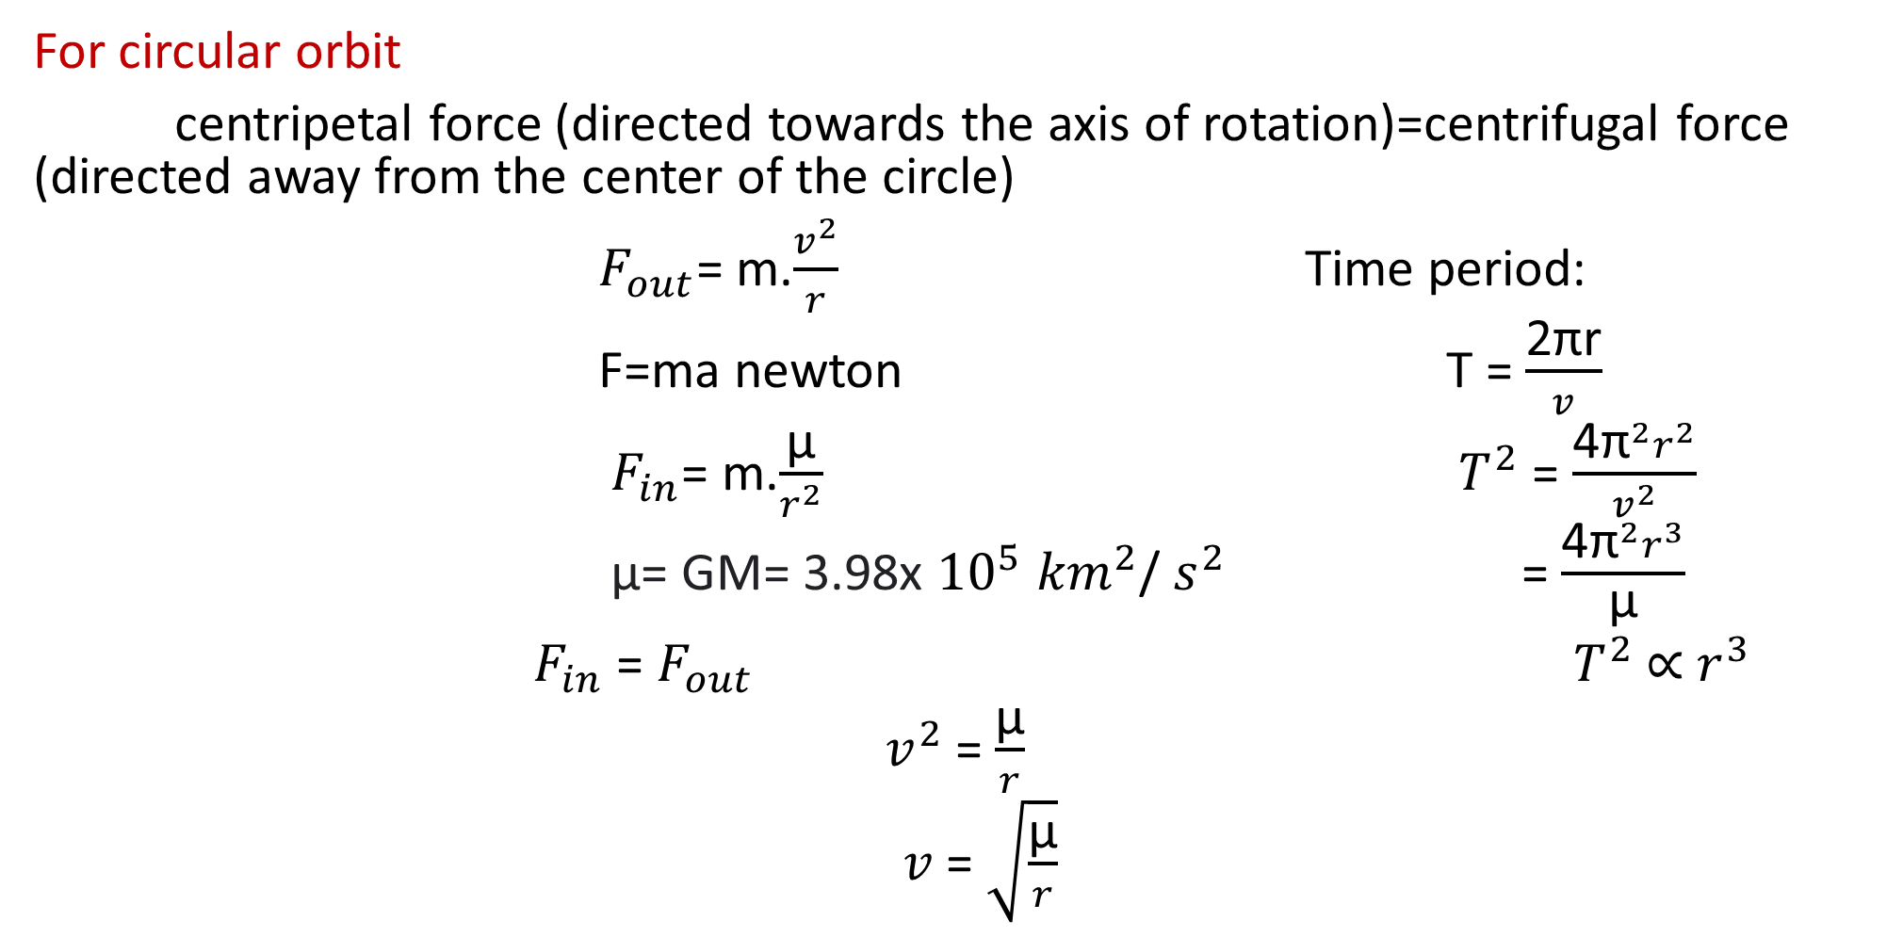
Kepler’s laws of planetary motion
For circular orbit
centripetal force (directed towards the axis of rotation)=centrifugal force (directed away from the center of the circle)
$F_{out}$= m.$\frac{v^{2}}{r}$ Time period:
F=ma newton T = $\frac{\text{2}\text{π}\text{r}}{v}$
$F_{in}$= m.$\frac{\text{µ}}{r^{2}}$ $T^{2}$= $\frac{\text{4}{\text{π}}^{2}r^{2}}{v^{2}}$
µ= GM= 3.98x ${10}^{5}$ ${km}^{2}$/ $s^{2}$ = $\frac{\text{4}{\text{π}}^{2}r^{3}}{\text{µ}}$
$F_{in}$= $F_{out}{ T}^{2}$ ∝ $r^{3}$
$v^{2}$= $\frac{\text{µ}}{r}$
$v$= $\sqrt{\frac{\text{µ}}{r}}$

Slide 20
Orbital Mechanics
The path of satellite revolving around the earth is known as orbit.
Orbital mechanics is the study of the motion of the satellites that are present in orbits.
Orbital Elements: Orbital elements are the parameters, which are helpful for describing the orbital motion of satellites. Following are the orbital elements.
Semi major axis
Eccentricity
Mean anomaly
Argument of perigee
Inclination
Right ascension of ascending node

Slide 21
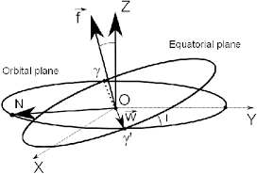
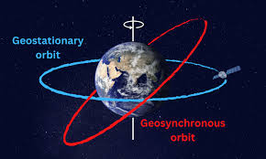
Orbital elements
Orbit:
An orbit is a regular, repeating path that one object in space takes around another one. An object in an orbit is called a satellite.

Slide 22
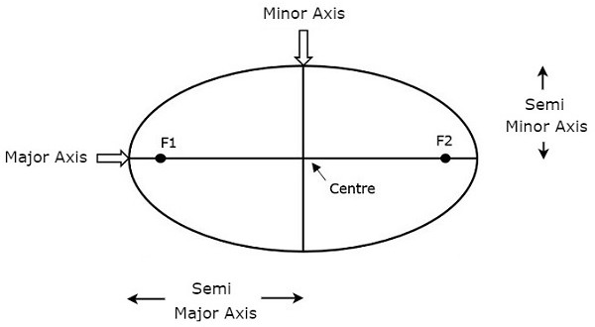
Semi-major and minor axis
The length of Semi-major axis (a) defines the size of satellite’s orbit. It is half of the major axis. This runs from the center through a focus to the edge of the ellipse. So, it is the radius of an orbit at the orbit's two most distant points.
Length of semi major axis (a) not only determines the size of satellite’s orbit, but also the time period of revolution.

Slide 23

Eccentricity
The value of Eccentricity (e) fixes the shape of satellite’s orbit. This parameter indicates the deviation of the orbit’s shape from a perfect circle.
If the lengths of semi major axis and semi minor axis of an elliptical orbit are a & b, then the mathematical expression for eccentricity (e) will be
The value of eccentricity of a circular orbit is zero, since both a & b are equal. Whereas, the value of eccentricity of an elliptical orbit lies between zero and one.

Slide 24
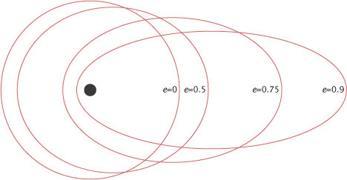
The following figure shows the various satellite orbits for different eccentricity
(e) values
In above figure, the satellite orbit corresponding to eccentricity (e) value of zero is a circular orbit. And, the remaining three satellite orbits are of elliptical corresponding to the eccentricity (e) values 0.5, 0.75 and 0.9.

Slide 25
Mean Anomaly
Mean anomaly (M) gives the average value of the angular position of the satellite with reference to perigee.
If the orbit is circular, then Mean anomaly gives the angular position of the satellite in the orbit.
But, if the orbit is elliptical, then calculation of exact position is very difficult. At that time, Mean anomaly is used as an intermediate step.

Slide 26
Argument of Perigee
Satellite orbit cuts the equatorial plane at two points. First point is called as descending node, where the satellite passes from the northern hemisphere to the southern hemisphere. Second point is called as ascending node, where the satellite passes from the southern hemisphere to the northern hemisphere.
Argument of perigee (ω) is the angle between ascending node and perigee. If both perigee and ascending node are existing at same point, then the argument of perigee will be zero degrees
Argument of perigee is measured in the orbital plane at earth’s center in the direction of satellite motion.

Slide 27
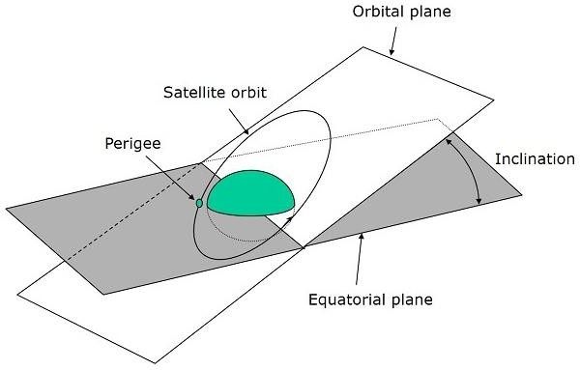
Inclination
The angle between orbital plane and earth’s equatorial plane is known as inclination (i). It is measured at the ascending node with direction being east to north. So, inclination defines the orientation of the orbit by considering the equator of earth as reference.

Slide 28
There are four types of orbits based on the angle of inclination.
Equatorial orbit − Angle of inclination is either zero degrees or 180 degrees.
Polar orbit − Angle of inclination is 90 degrees.
Prograde orbit − Angle of inclination lies between zero and 90 degrees.
Retrograde orbit − Angle of inclination lies between 90 and 180
degrees.

Slide 29
Example:1
The earth rotates once per sidereal day of 23 hours 56 minutes 4.09 seconds. Find the radius of the geostationary earth orbit satellite.
Ans: 42,164.17 km
Example:2
The Space Shuttle is an example of a Low Earth Orbit satellite. Sometimes, it orbits at an altitude of 250 km. The mean earth radius is approximately 6378.14 km.
a. Using a mean earth radius of 6378.14 km, calculate the period of the shuttle orbit.
b. Determine the linear velocity of the shuttle along this orbit.

Slide 30
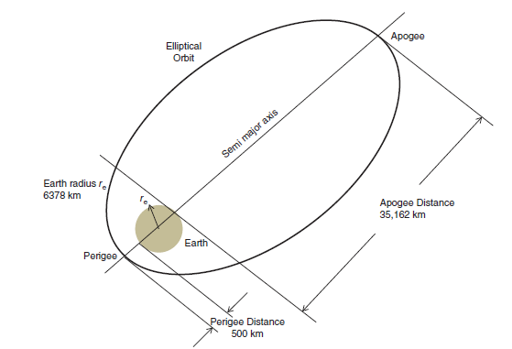
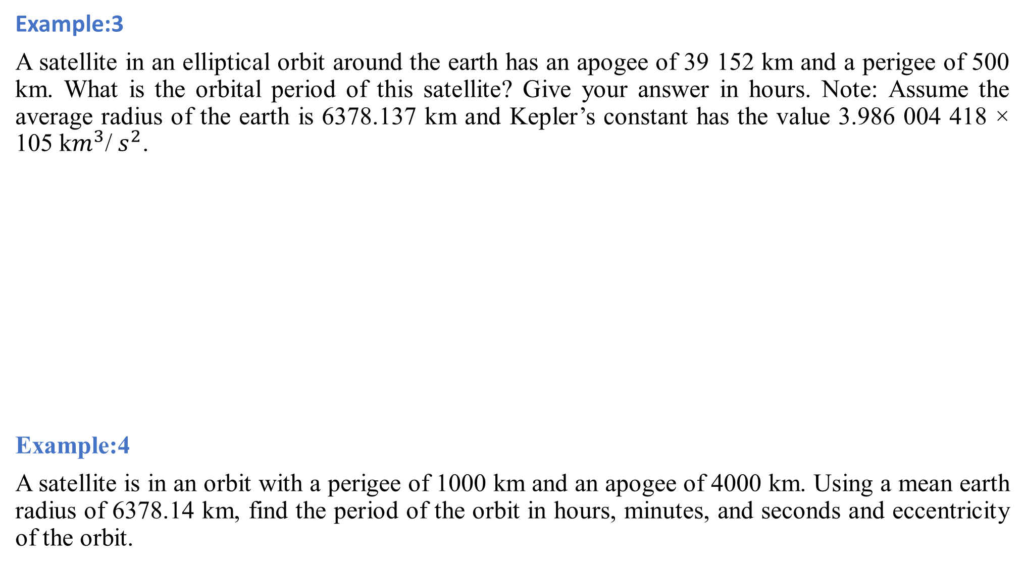
Example:3
A satellite in an elliptical orbit around the earth has an apogee of 39 152 km and a perigee of 500 km. What is the orbital period of this satellite? Give your answer in hours. Note: Assume the average radius of the earth is 6378.137 km and Kepler’s constant has the value 3.986 004 418 × 105 k$m^{3}$/ $s^{2}$.
Example:4
A satellite is in an orbit with a perigee of 1000 km and an apogee of 4000 km. Using a mean earth radius of 6378.14 km, find the period of the orbit in hours, minutes, and seconds and eccentricity of the orbit.

Slide 31
Look angle determination:
The coordinates to which an earth station antenna must be pointed to communicate with a satellite are called look angles.
Latitude and longitude
Latitude measures the distance north or south of the equator. Latitude lines start at the equator (0 degrees latitude) and run east and west, parallel to the equator.
Longitude measures distance east or west of the prime meridian. Lines of longitude, also called meridians, are imaginary lines that divide the Earth.

Slide 32
Look angle determination:
Azimuth and elevation angles
The angle between local horizontal plane and the plane passing through earth station, satellite and center of earth is called as azimuth angle.
It is a crucial parameter used in satellite communication and tracking systems to determine the visibility of a satellite from a specific location on Earth. The elevation angle provides information about how high the satellite appears in the sky when viewed from the observer's position.
Azimuth tells you what direction to face and Elevation tells you how high up in the sky to look.

Slide 33
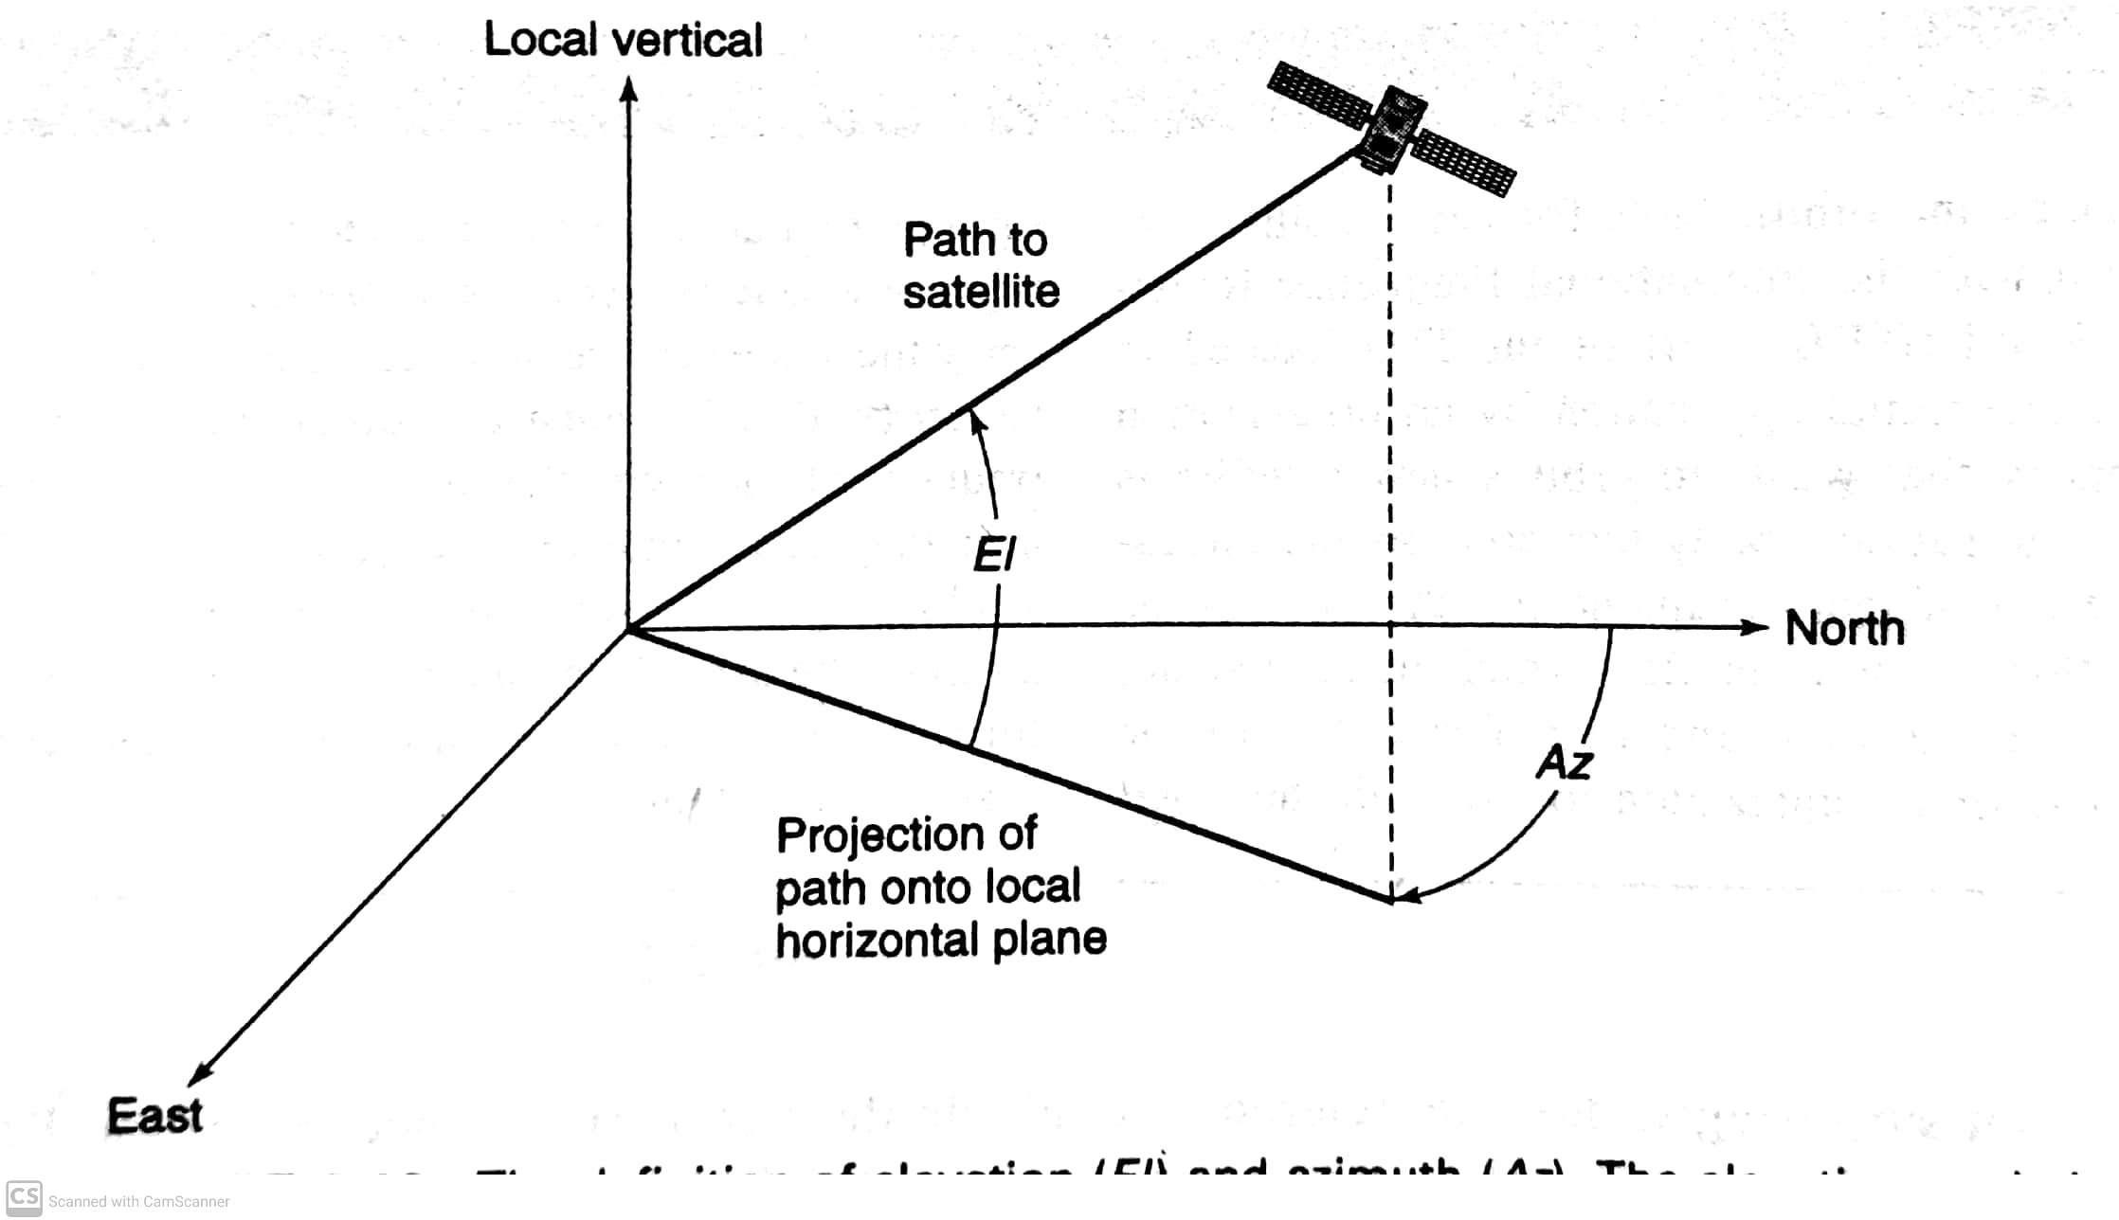
Elevation and azimuth
ECE

Slide 34
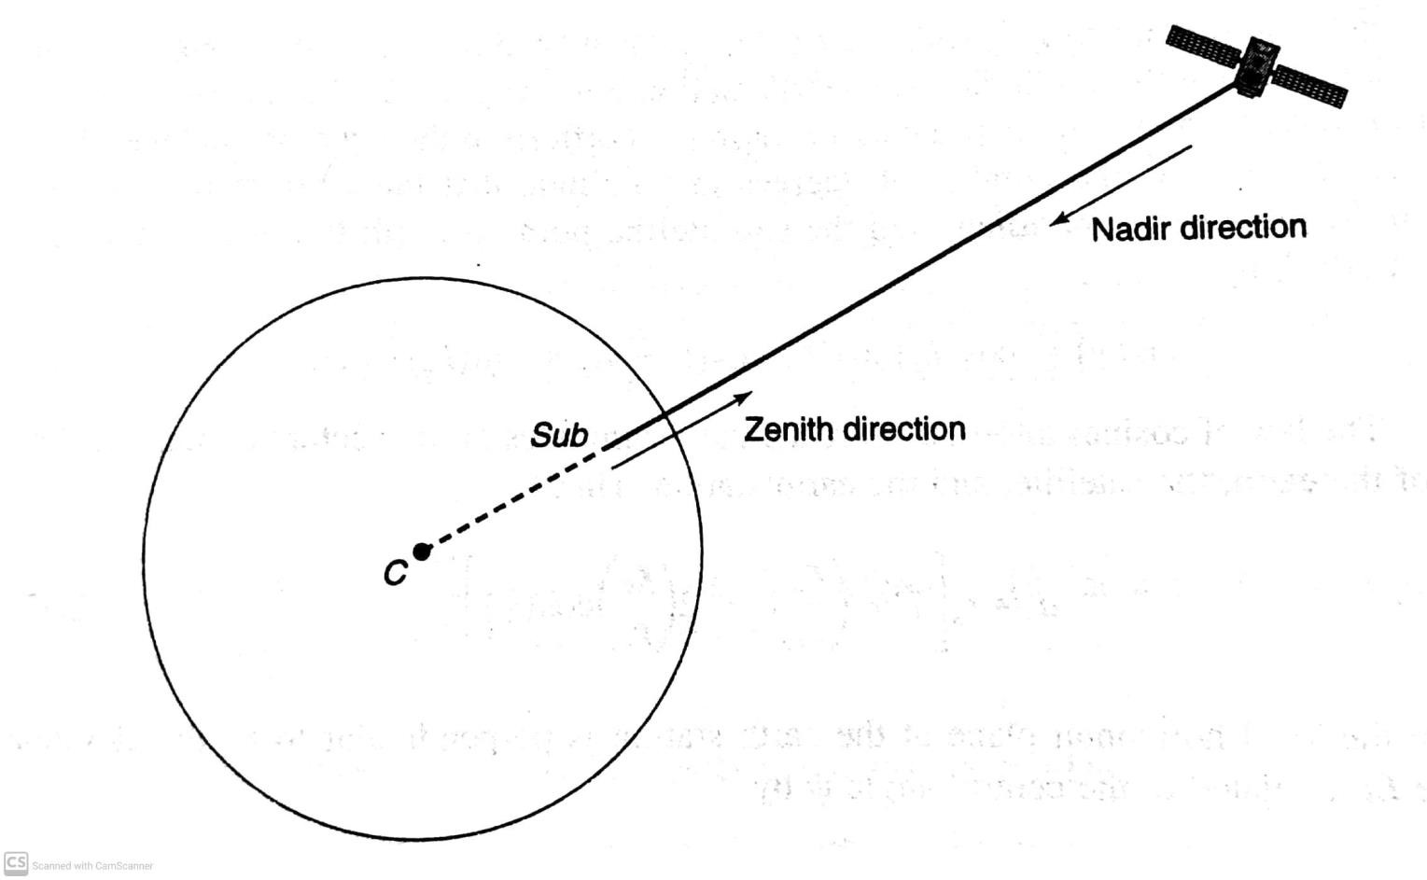
Subsatellite point
The communication coverage region on the earth from a satellite is defined by angles measured from nadir at satellite to the edge of coverage

Slide 35
A geostationary satellite at 87 degree east and Kharagpur is 22 degree north and 87 degree east. The sub satellite point will be Kharagpur.
right on
south of
north of
east of
west of
Hint : sub satellite point is on equator

Slide 36
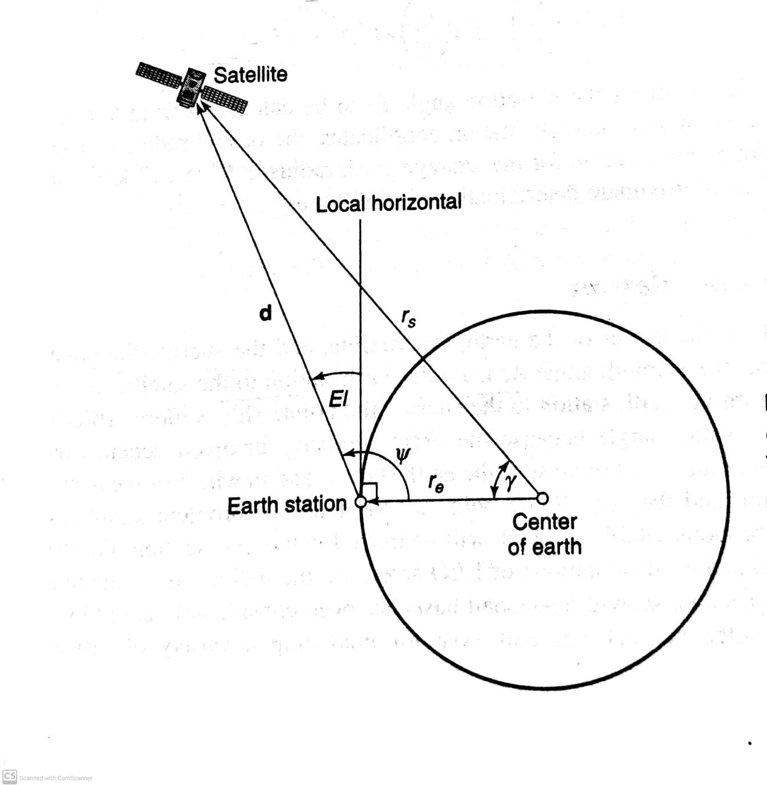

Elevation angle calculation
^{𝛾} is related to the earthstation north latitude L_{e} and west longitude l_{e} and the subsatellite point at the north latitude L_{s} and west longitude l_{s} by
cos 𝛾 = cos 𝐿_{𝑒} cos 𝐿_{𝑠} cos 𝑙_{𝑠} − 𝑙_{𝑒} + sin 𝐿_{𝑒} sin 𝐿_{𝑠}
By law of cosines
𝑟
2
𝑟
1Τ2
𝑑 = 𝑟_{𝑠} 1 +
𝑒
𝑒
− 2 cos 𝛾
𝑟_{𝑠} 𝑟_{𝑠}
El=𝜓 − 90⁰
By law of sines, we have
𝑟_{𝑠}
𝑑
=
sin(𝜓) sin(𝛾 )
Combining above three equations yeilds
𝑟_{𝑠}sin(𝛾 ) sin(𝛾 )
Cos(El)= =
𝑑
2
1Τ2
1+ ^{𝑟𝑒} −2 ^{𝑟𝑒} cos 𝛾
𝑟_{𝑠} 𝑟_{𝑠}
An accurate value of average earth radius is 6378.137km
Approximate value is 6370km.
ECE

Slide 37
Azimuth angle calculation:azimuth angle from the earth station to satellite is same as earth station to subsatellite point
Specialization to Geostationary satellites:
Since L_{s}=0,
cos 𝛾 = cos 𝐿_{𝑒} cos 𝑙_{𝑠} − 𝑙_{𝑒}
With r_{s} =42,164.17km and r_{e} =6,378.137km
𝑑 = 42,164.17 1.02288235 − 0.30253825cos(𝛾) ^{1Τ2}km
Cos(El)=
For a geostationary satellite r_{s} =42,154.17km and r_{e} =6378.137km,(r_{s} /r_{e})=6.6107345,
El=tan⁻¹ [(6.6107345-cos 𝛾 )/sin 𝛾 ]- 𝛾

Slide 38
Azimuth angle:
𝑖𝑛𝑡𝑒𝑟𝑚𝑒𝑑𝑖𝑎𝑡𝑒 𝑎𝑛𝑔𝑙𝑒 𝛼 = 𝑡𝑎𝑛⁻¹
Having found intermediate angle, azimuth angle can be found from:
Case1: earth station in northern hemisphere with
A. satellite to SE of the earth station: Az=180⁰ - 𝛼
B. satellite to SW of the earth station: Az=180⁰ + 𝛼
Case2: earth station in southern hemisphere with
A. satellite to NE of the earth station: Az= 𝛼
B. satellite to NW of the earth station: Az=360⁰ - 𝛼

Slide 39
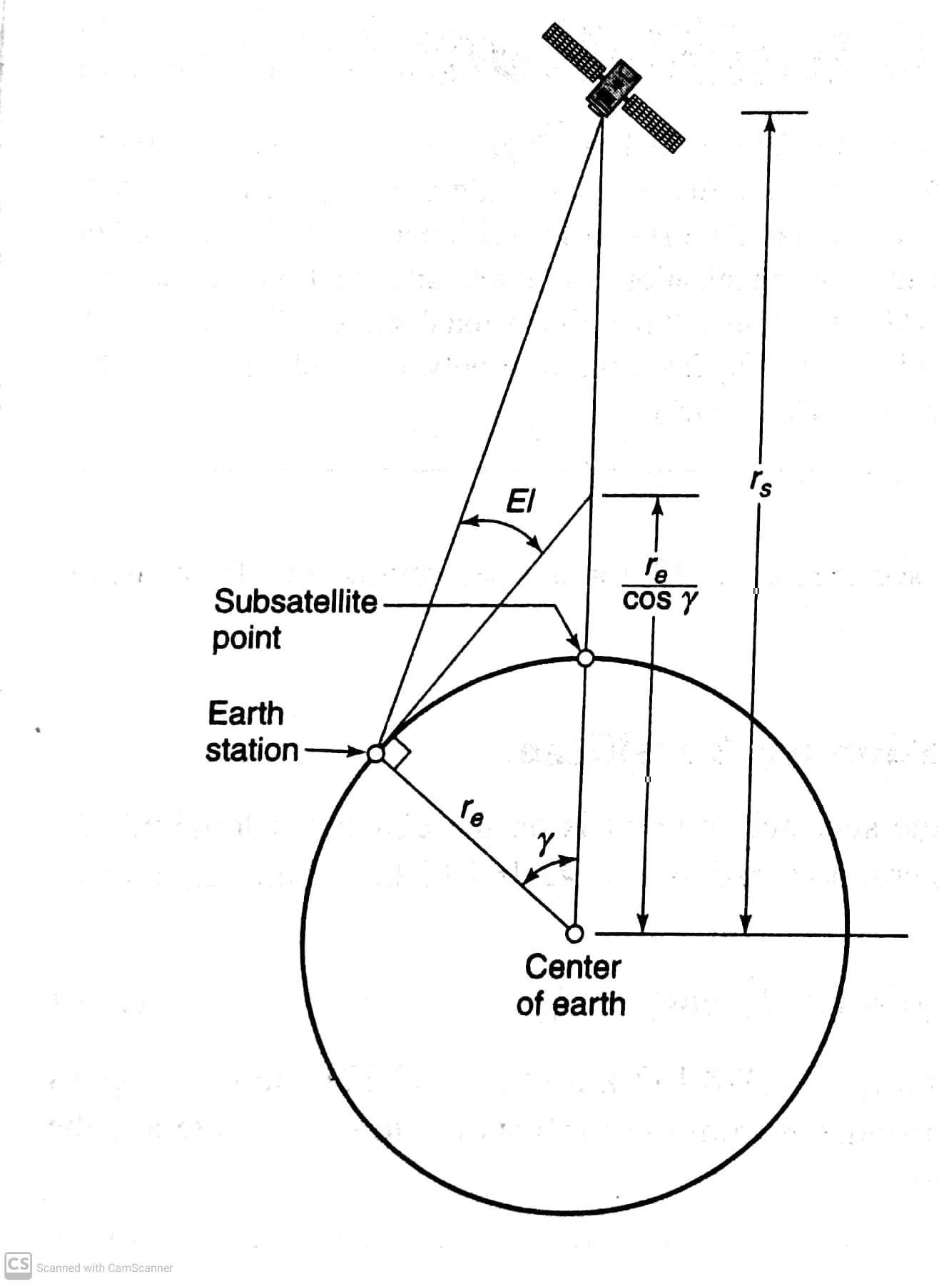
Visibility
for a satellite to be visible from an earth station, its
elevation angle must be at-least 0⁰. this requires that
𝑟_{𝑒}
𝑟 ≥
𝑠
cos 𝛾
this means that maximum central angular separation between the earth station and the sub satellite point is limited by
𝑟_{𝑒}
𝑟_{𝑠}
𝛾 ≤ 𝑐𝑜𝑠⁻¹

Slide 40
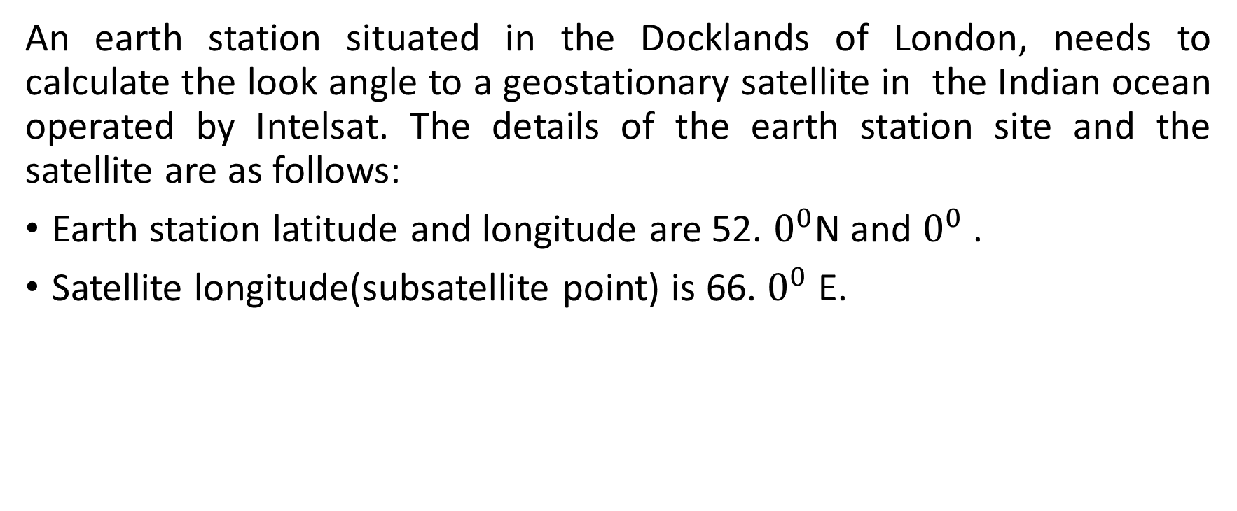
Example:5
An earth station situated in the Docklands of London, needs to calculate the look angle to a geostationary satellite in the Indian ocean operated by Intelsat. The details of the earth station site and the satellite are as follows:
Earth station latitude and longitude are 52. $0^{0}$N and $0^{0}$ .
Satellite longitude(subsatellite point) is 66. $0^{0}$ E.

Slide 41

Example:6

Slide 42
An earth station situated in the Docklands of London, needs to calculate the look angle to a geostationary satellite in the Indian ocean operated by Intelsat. The details of the earth station site and the satellite are as follows:
Earth station latitude and longitude are 52.0⁰N and 0⁰ .
Satellite longitude(subsatellite point) is 66.0⁰ E.
step 1:find the central angle 𝛾:
cos(𝛾)=cos(L_{e} )cos(l_{s} -l_{e} )=cos(52.0)cos(66.0)=0.2504 yielding 𝛾=75.4981⁰
the central angle is less than 81.3⁰ so the satellite is visible from the earth station.
Step 2: find the elevation angle El:
El=tan⁻¹[(6.6107345-cos 𝛾)/sin 𝛾]- 𝛾=tan⁻¹[(6.6107345-0.2504)/sin (75.4981)]-75.4981=5.847⁰
step 3: find the intermediate angle 𝛼
𝛼 = 𝑡𝑎𝑛⁻¹
𝑡𝑎𝑛 𝑙_{𝑠}−𝑙_{𝑒}
=tan⁻¹ [(tan(66.0-0))/sin(52.0)]=70.667
sin(𝐿_{𝑒})
step 4:find the azimuth angle
the earth station is in the northern hemisphere and the satellite is to the southeast of the earth station. This gives
Az=180- 𝛼=180-70.667=109.333(clockwise from true north)

Slide 43
Orbital perturbation
As per the orbital equations ,the earth and the satellite as point masses influenced only by gravitational attraction.
Under these ideal conditions, a Keplerian orbit results, which is an ellipse whose properties are constant with time.
In practice, the satellite and the earth respond to many other influences.

Slide 44
Orbital perturbation
A satellite must remain in GEO once it is placed but practically there are many factors which can influence the satellite orbit over a long period of time.
Orbital perturbations are the results of various forces which are exerted on the satellite other than mutual attraction between the earth and satellite.
Forces pertaining for Orbital perturbations are
Gravitational force of sun and moon
Solar and lunar eclipse
Solar radiation pressure
Atmospheric drag
Asymmetric gravitational field

Slide 45
Effects of the sun and the moon:
It causes the orbital inclination (i) of Geosynchronous satellite which changes with time.
The mass of the sun is significantly larger than that of the moon but the moon is considerably closer to the earth than the sun . For this reason, the acceleration force induced by the moon on a geostationary satellite is about twice as large as that of the sun.
The net effect of the acceleration forces induced by the moon and the sun on a geostationary satellite is to change the plane of the orbit at an initial average rate of change of 0.85°/year from the equatorial plane.
When both the sun and moon are acting on the same side of the satellite’s orbit, the rate of change of the plane of the geostationary satellite’s orbit will be higher than average. When they are on opposite sides of the orbit, the rate of change of the plane of the satellite’s orbit will be less than average.
For example: From an initial zero inclination, the plane of the geostationary orbit will change to a maximum inclination of 14.67° over 26.6 years.

Slide 46
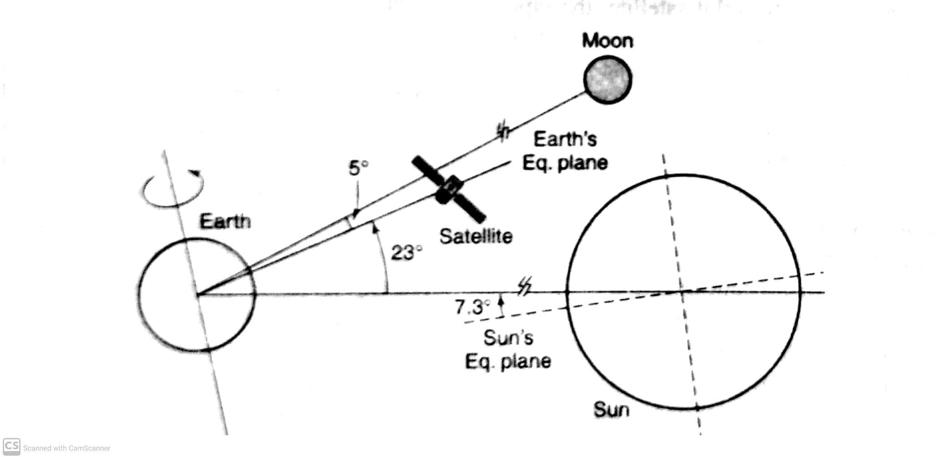
Inclination changes:
Effects of the sun and the moon:
Ecliptic
Satellite orbit inclination
The acceleration force induced by moon on a geostationary satellite is about twice as large as that of the sun.
The net effect of acceleration forces induced by the moon and the sun on a geostationary satellite is to change the plane of the orbit at an initial average rate of 0.85⁰ / year from equatorial plane.
Maximum years: 1988 and 2006(0.94⁰ /year) Minimum years: 1997 and 2015(0.75⁰/year)
Inclination 14.67⁰over 26.6 years

Slide 47
Longitudinal changes:
Effects of earth’s oblateness:
The earth is neither a perfect sphere nor a perfect ellipse; it can be better described as
a triaxial ellipsoid.
In addition to these non-regular features of the earth, there are regions where the average density of the earth appears to be higher. These are referred to as regions of mass concentration.
The nonsphericity of the earth, the noncircularity of the equatorial radius, and the Mascons lead to a non-uniform gravitational field around the earth. The force on an orbiting satellite will therefore vary with position.

Slide 48
Solar radiation pressure:
Sun’s ray perturb the satellite orbit and the satellite experience change in eccentricity of orbit.
The eccentricity built up for 6 months and then shrinks during next 6 months.
Small variations are tolerable.
Doppler effect:
The frequency or wavelength of EM field are affected by relative motion.
It dominates in LEO and negligible in Geosynchronous orbit.
Ft<Fr- Tx moving towards Rx
Ft>Fr- Tx moving away Rx

Slide 49
Example:
A quasi GEO satellite is in a circular equatorial orbit close to geosynchronous altitude. The quasi geo satellite, however, does not have a period of one sidereal day: its orbital period is exactly 24 hours. Calculate:
The radius of the orbit
The rate of drift around the equator of the sub satellite point in degrees per solar day,.
Answer: 1. 𝑇² = (4𝜋²𝑎³)/𝜇
𝑎³ = 𝑇²𝜇/(4𝜋²)
a=42,241.095km

Slide 50
ii)The orbital period of the satellite is longer than a sidereal day by 3min 55.9 s. this will cause the subsatellite point to drift at a rate of 360⁰ x 235.9/86400 per day or 0.983⁰/day.
ECE

