Slide 1
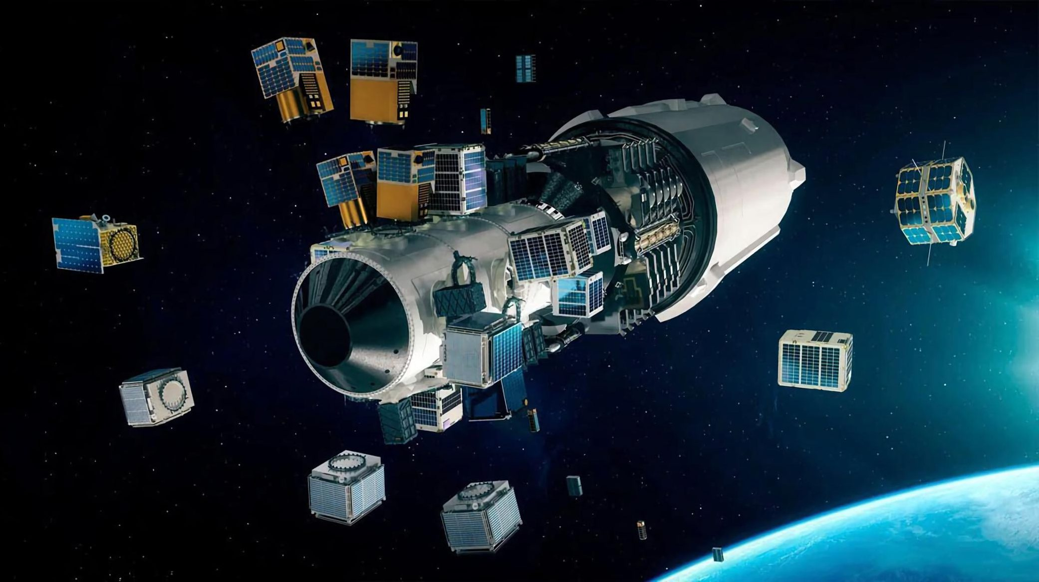
Module:2
Orbital Launchers

Slide 2
Module-2
Launches and launch vehicles
Launch vehicle selection factors
Satellite positioning into geostationary orbit
Orbital effects in communication systems performance
Doppler shift
Range variations
Solar eclipse and sun transit outage.

Slide 3
Introduction
What is launching vehicle?
A launch vehicle is typically a rocket-powered vehicle designed to carry a payload from Earth's surface or lower atmosphere to outer space.
India has three active operational launch vehicles: Polar Satellite Launch Vehicle (PSLV), Geosynchronous Satellite Launch Vehicle (GSLV), Geosynchronous Satellite Launch Vehicle Mk-III (LVM3).

Slide 4
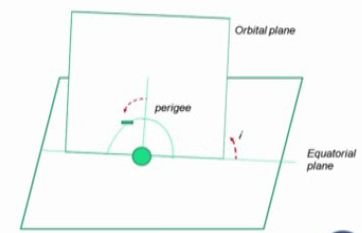
Geosynchronous or Geostationary orbit is quite advantageous near equator.
Elevation angle is quite high the disturbances from the local reflections or multi path are very low.
satellite is orbiting in a different plane than the
equatorial plane and that orbital plane is making
a inclination with the equatorial plane is the
perigee and then may be apogee below.
Example:1
For GEO, inclination i=0, and the eccentricity of the orbit is 0. Calculate orbital height and velocity.

Slide 5
A satellite cannot be placed into a stable orbit unless two parameters are simultaneously correct: the velocity vector and the orbital height.
A geostationary satellite, must be in an orbit at a height of 35 786.03 km above the surface of the earth (42 164.17 km radius from the center of the earth) with an inclination of zero degrees, an ellipticity of zero, and a velocity of 3074.7m/s tangential to the earth in the plane of the orbit, which is the earth’s equatorial plane.

Slide 6
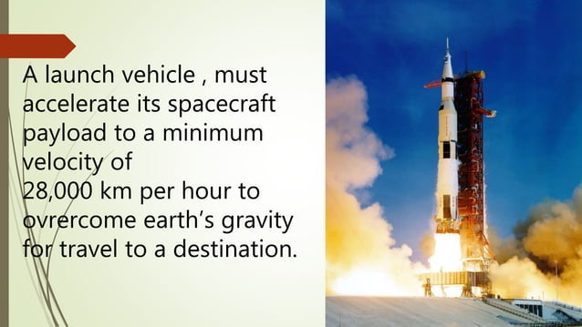

Slide 7
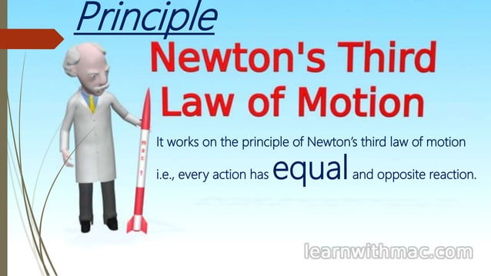

Slide 8
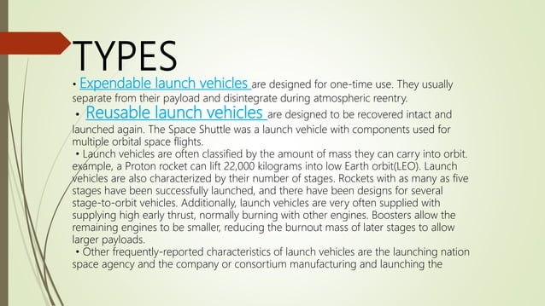

Slide 9
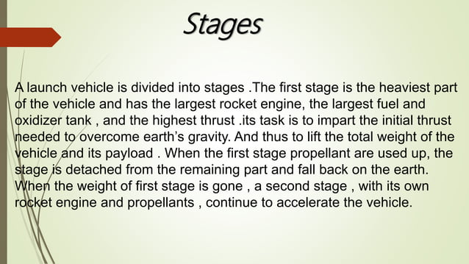

Slide 10
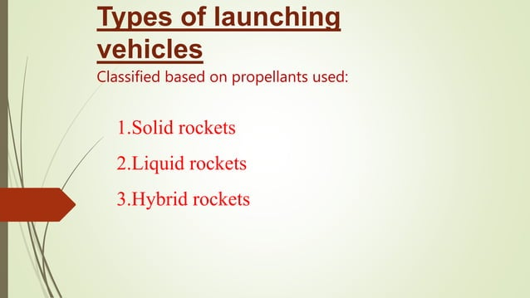

Slide 11
The propellant is the chemical mixture burned to produce thrust in rockets and consists of a fuel and an oxidizer.
Fuel is a substance that burns when combined with oxidizer for propulsion.
The oxidizer is an agent that releases oxygen for combination with a fuel. The ratio of oxidizer to fuel is called the mixture ratio.
Propellants are classified according to their state - liquid, solid, or hybrid.

Slide 12
Liquid Propellants: In a liquid propellant rocket, the fuel and oxidizer are stored in separate tanks and are fed through a system of pipes, valves, and turbopumps to a combustion chamber where they are combined and burned to produce thrust.
Liquid propellants used in rocketry can be classified into three types: petroleum, cryogens, and hypergolic.
The petroleum used as rocket fuel is a type of highly refined kerosene.
Cryogenic propellants are liquefied gases stored at very low temperatures, most frequently liquid hydrogen (LH2) as the fuel and liquid oxygen (LO2 or LOX) as the oxidizer. Hydrogen remains liquid at temperatures of -253 oC (-423 oF) and oxygen remains in a liquid state at temperatures of -183 oC (-297 oF).

Slide 13
Solid propellant: These are the simplest of all rocket designs. They consist of a casing, usually steel, filled with a mixture of solid compounds (fuel and oxidizer) that burn at a rapid rate, expelling hot gases from a nozzle to produce thrust. When ignited, a solid propellant burns from the center out towards the sides of the casing.
There are two families of solids propellants: homogeneous and composite. Both types are dense, stable at ordinary temperatures, and easily storable.
Composites are composed mostly of a mixture of granules of solid oxidizers, such as ammonium nitrate, ammonium dinitramide, ammonium perchlorate, or potassium nitrate in a polymer binding agent.
Single-, double-, or triple-bases (depending on the number of primary ingredients) are homogeneous mixtures of one to three primary ingredients.

Slide 14
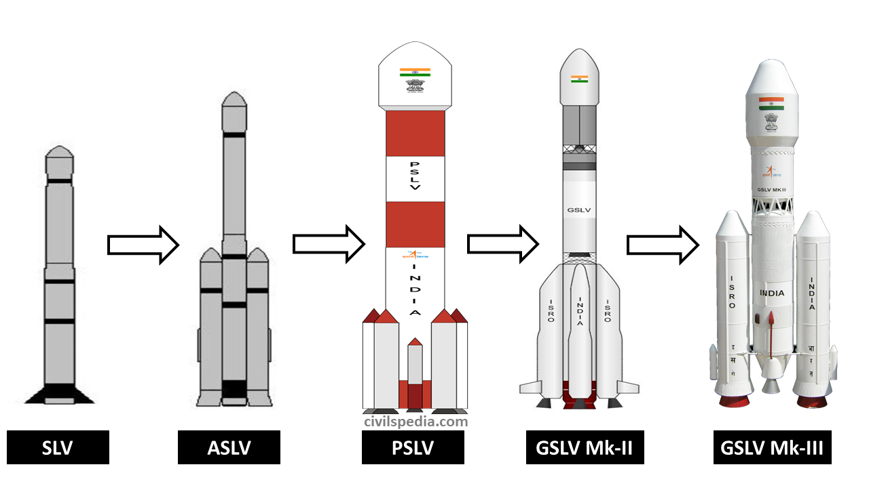

Slide 15
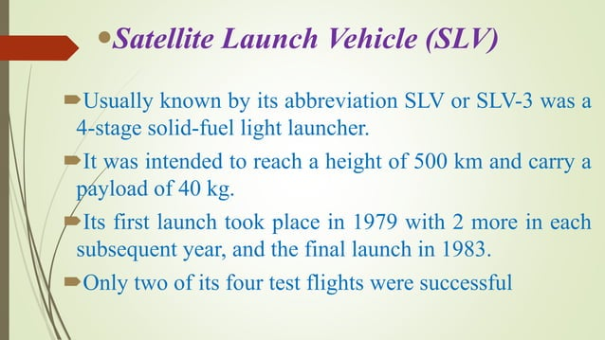

Slide 16
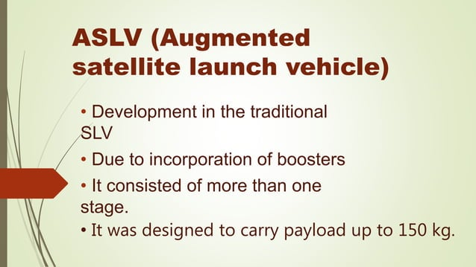

Slide 17
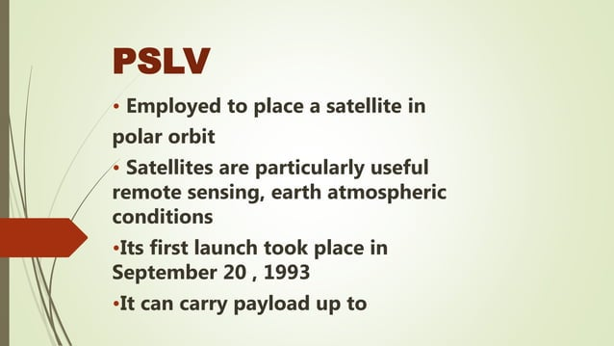
1,750 kg

Slide 18
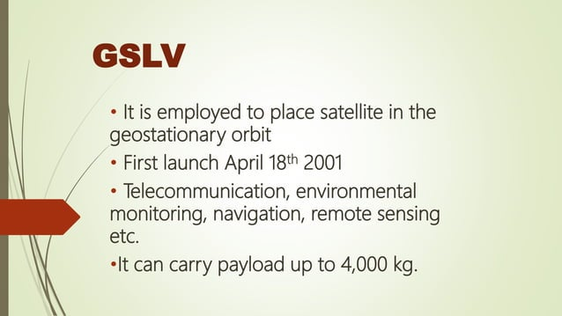

Slide 19
From a location on Earth, a launcher has been used to deploy a satellite. After launch, the launcher ejected the satellite into its designated orbit.
The initial orbit referred to as a Transfer Orbit. This orbit will later be designated as the Geostationary Transfer Orbit (GTO).
So, the satellite will move in this elliptical orbit, where the perigee is close to Earth and the apogee is far away.
There is a rocket on the satellite, known as the Liquid Apogee Motor (LAM), which will fire at the apogee.
So, when the LAM fires using liquid fuel, it provides an incremental velocity. In the Transfer Orbit, the satellite has some velocity at the apogee, and the LAM firing increases this velocity.
Here, it shows that the perigee gradually changes, making the orbit circular. During this process, the satellite begins deploying its peripherals, such as solar panels and antennas. This process is known as orbit raising.

Slide 20
This orbit raising done by the combination of motors and at the launchers and at satellites, it depends on the type and capability of launch vehicle.
Injecting into parking orbit satellite uses perigee to GTO and then apogee maneuver to GSO.

Slide 21
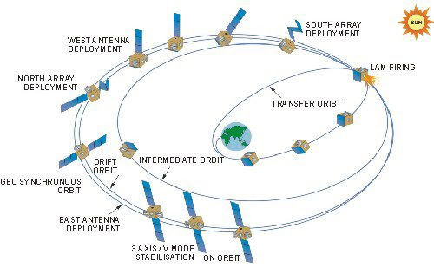

Slide 22
Why multiple stage?
Most launch vehicles have multiple stages and, as each stage completes its burn that portion of the launcher is expended until the final stage places the satellite into the desired trajectory.

Slide 23
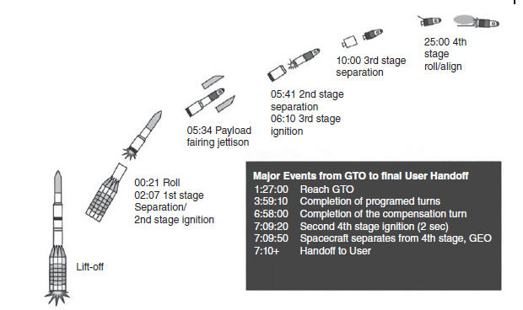

Slide 24
Launch vehicle selection factors
Price/cost
Reliability
Recent launch success/failure history
Dependable launch schedule
Urgency of your launch requirements
Performance
Spacecraft fit to launcher (size, acoustic, and vibration environment)
Flight proven (see recent launch history)
Safety issues
Launch site location
Availability
Market issues

Slide 25
Placing Satellites Into Geostationary Orbit
Example:2
What is the difference, or are the differences, between a geosynchronous satellite and a geostationary satellite orbit? What is the period of a geostationary satellite? What is the name given to this orbital period? What is the velocity of a geostationary satellite in its orbit? Give your answer in km/s.

Slide 26
Example:3
i)A geostationary satellite orbit is one that has zero inclination to the equatorial plane, is perfectly circular (eccentricity is zero), and is at the correct orbital height to remain apparently stationary in orbit as viewed from the surface of the earth.
A geosynchronous satellite orbit has most of the attributes of a geostationary orbit, but is either not exactly circular, not in the equatorial plane, or not at exactly the correct orbital height.
ii)The orbital period of a geostationary satellite is 23 hours, 56 minutes, and 4.1 seconds.
iii) The orbital period of a geostationary satellite is called a sidereal day.
iv) The velocity of a geostationary satellite is 3.0747 km/s.

Slide 27
Example:4
A particular launch from Cape Canaveral released a TDRSS satellite into a circular low orbit, with an orbital height of 270 km. At this point, the TDRSS orbit was inclined to the earth’s equator by approximately 28°. The TDRSS satellite needed to be placed into a GTO once released from the launch adaptor, with the apogee of the GTO a geostationary altitude and the perigee at the height of the original circular orbit.
(i) What was the eccentricity of the GTO?
(ii) What was the period of the GTO?
(iii) What was the difference in velocity of the satellite in GTO between when it was at apogee and when it was at perigee?
Note: Assume the average radius of the earth is 6378.137 km and Kepler’s constant has the value 3.986 004 418 × 105 km3/s2.
Ans:
The GTO will have an apogee of 35 786.03 km (the geostationary altitude) and a
perigee of 270 km (the release altitude of the TDRSS).

Slide 28
Example:5
Find the incremental velocity required to place a satellite in GTO from the parking orbit at 560 km. And incremental velocity required from GTO to GSO. Assume 0 inclination for GTO and GSO.

Slide 29
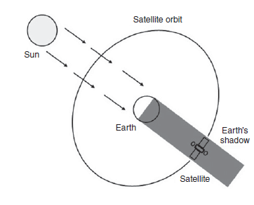
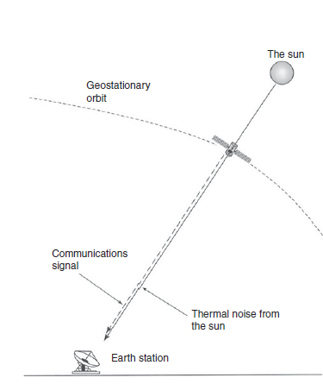
Orbital Effects in Communications Systems Performance
Doppler Shift
Range Variations
Solar Eclipse
Sun Transit Outage

Slide 30
Orbital Effects in Communications Systems
Cause Effect
Range Variations Time
Solar Eclipse Power
Sun Transit Outage Noise
Doppler Shift Frequency
If the battery is discharged below its maximum depth of discharge, the battery may not recover to full operational capacity once recharged- Nickel-hydrogen batteries-70% depth of discharge and recover fully once recharged.
Lithium-ion batteries-75% depth of discharge and do not have a memory effect
The earth station antenna will therefore receive not only the signal from the satellite but also the noise temperature transmitted by the sun

Slide 31
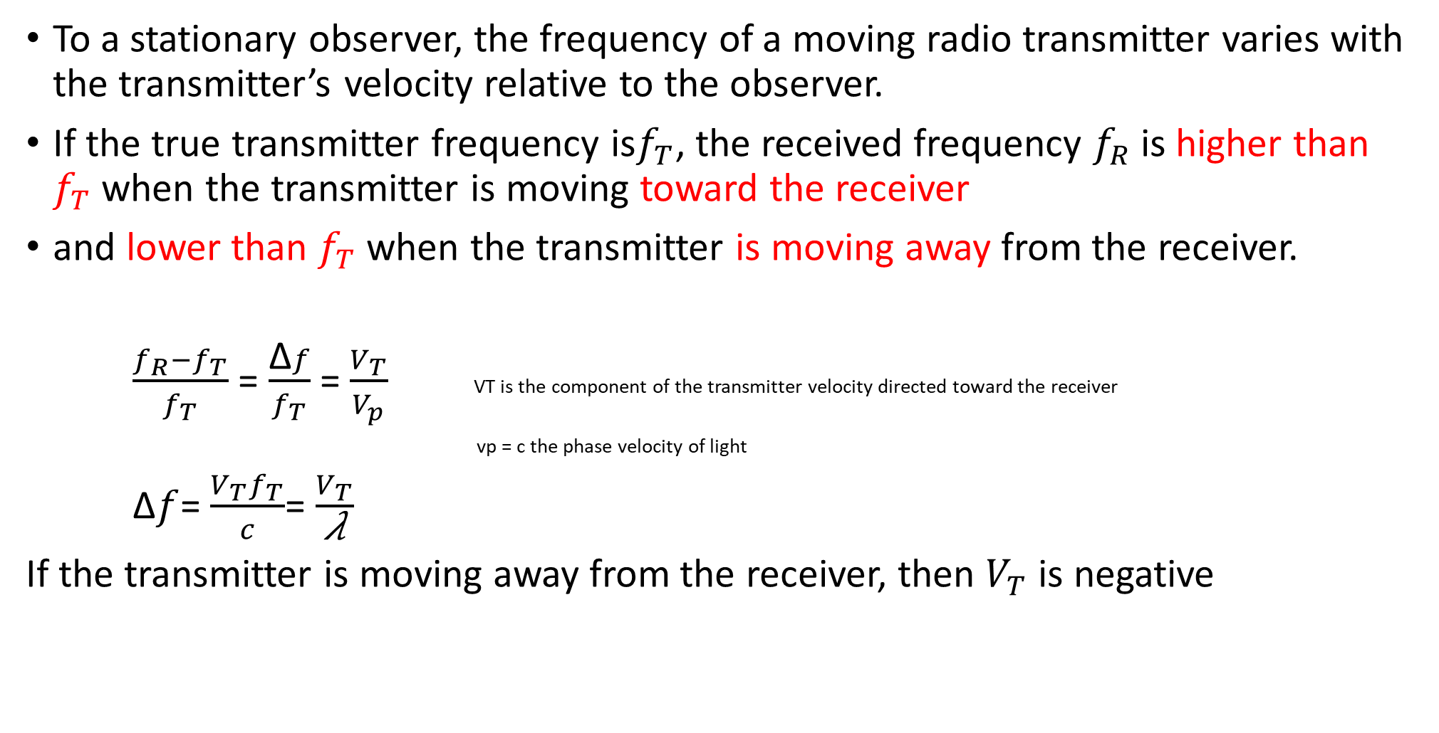
Doppler Shift
To a stationary observer, the frequency of a moving radio transmitter varies with the transmitter’s velocity relative to the observer.
If the true transmitter frequency is$f_{T}$, the received frequency $f_{R}$ is higher than $f_{T}$ when the transmitter is moving toward the receiver
and lower than $f_{T}$ when the transmitter is moving away from the receiver.
$\frac{f_{R}−f_{T}}{f_{T}}$ = $\frac{\text{Δ}f}{f_{T}}$ = $\frac{V_{T}}{V_{p}}$ VT is the component of the transmitter velocity directed toward the receiver
vp = c the phase velocity of light
$\text{Δ}f$= $\frac{V_{T}f_{T}}{c}$= $\frac{V_{T}}{\text{λ}}$
If the transmitter is moving away from the receiver, then $V_{T}$ is negative

Slide 32
Example:6
A LEO satellite is in a circular polar orbit with an altitude, h, of 1000 km. A transmitter on the satellite has a frequency of 2.65 GHz. Find
(i) The velocity of the satellite in orbit
(ii) The component of velocity toward an observer at an earth station as the satellite appears over the horizon, for an observer who is in the plane of the satellite orbit.
(iii) Hence Find the Doppler shift of the received signal at the earth station. Use a mean earth radius value, re, of 6378 km. The satellite also carries a Ka-band transmitter at 20.0 GHz.
Find the Doppler shift for this signal when it is received by the same observer.

Slide 33
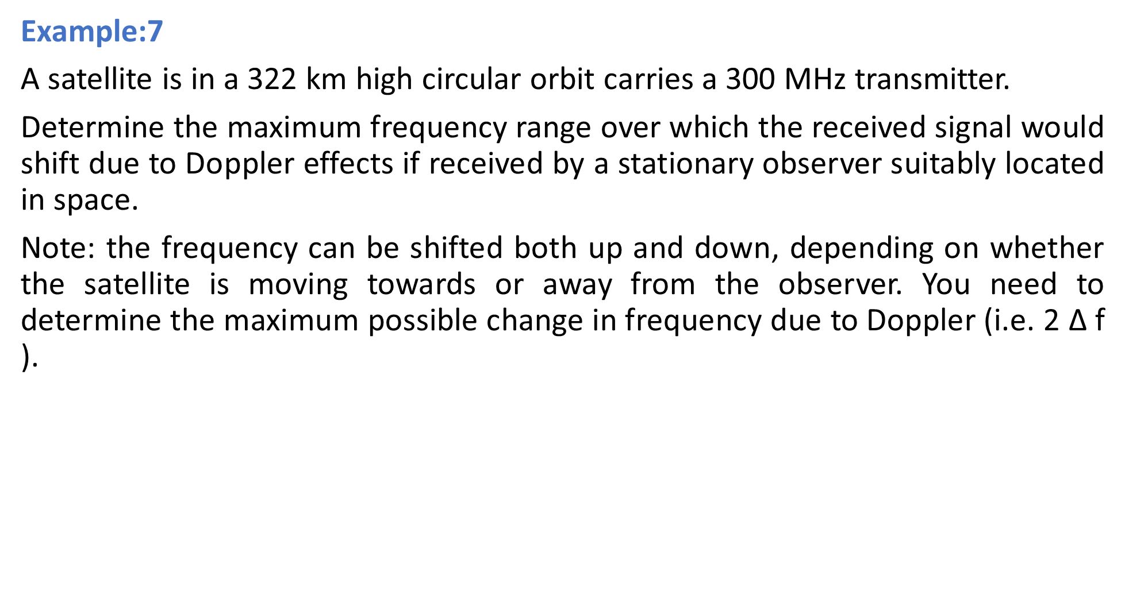
Example:7
A satellite is in a 322 km high circular orbit carries a 300 MHz transmitter.
Determine the maximum frequency range over which the received signal would shift due to Doppler effects if received by a stationary observer suitably located in space.
Note: the frequency can be shifted both up and down, depending on whether the satellite is moving towards or away from the observer. You need to determine the maximum possible change in frequency due to Doppler (i.e. 2 $\text{Δ}$f ).

Slide 34
Practice problems:
A satellite in earth orbit has a semi-major axis of 6,700 km and an eccentricity of 0.01. Calculate the satellite's altitude at both perigee and apogee.
A satellite is in a circular orbit at an altitude of 322 km. Determine
a. The orbital angular velocity in radians per second.
b. The orbital period in minutes.
c. The orbital velocity in meters per second.
Note: Assume the average radius of the earth is 6378.137 km and Kepler’s constant has the value 3.986 004 418 × 105 km3/s2.

Slide 35
Practice problems:
3. A GEO satellite is located at longitude 109° west. The satellite broadcasts television programming to the continental United States.
Calculate the look angles for an earth station located near Blacksburg, Virginia, latitude 37.22°N, longitude 80.42°W.
b. Calculate the look angles for an earth station located near Billings, Montana, latitude 46.00°N, longitude 110.0°W.
c. Calculate the look angles for an earth station located near Los Angles, California, longitude 118.0°W, latitude 34.00°N.
4. A LEO satellite has an apogee altitude of 5000 km and a perigee altitude of 800 km. What is the eccentricity of the orbit?

