Slide 1
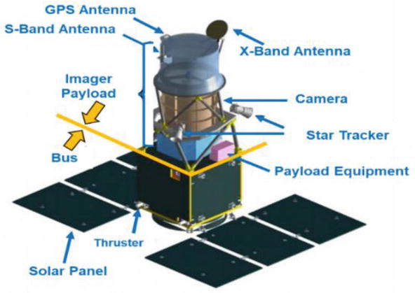
Module:3
Elements of Communication Satellite Design

Slide 2
Module-3
Satellite subsystems
Attitude and orbit control electronics
Telemetry and tracking
Power subsystems
Communication subsystems
Satellite antennas
Reliability and redundancy
Frequency modulation techniques

Slide 3
Introduction
Communications satellites are usually designed to have an operating lifetime of 10–15 years.
In order to support the communications system, the satellite must provide a stable platform on which
To mount the antennas
Be capable of station keeping
Provide the required electrical power for the communication system,
Provide a controlled temperature environment for the communications electronics.

Slide 4
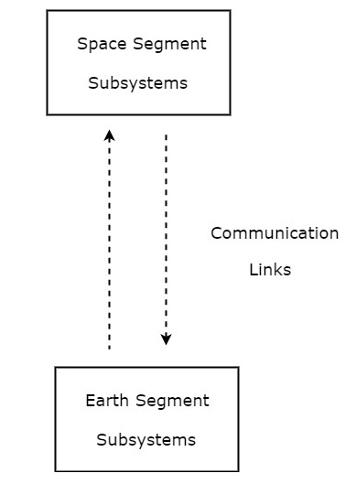
Introduction
In satellite communication system, various operations take place. Among which, the main operations are orbit controlling, altitude of satellite, monitoring and controlling of other subsystems.
A satellite communication consists of mainly two segments
Space segment
Earth segment

Slide 5
Space Segment
The payload and bus are the equipment present in the satellite.
The payload refers to the equipment used to provide the service for which the satellite has been launched.
The bus refers not only to the vehicle which carries the payload but also to the various subsystems which required for service.

Slide 6
Space segment subsystem
The subsystems present in space segment are called as space segment subsystems.
Following are the space segment subsystems.
Attitude and Orbit Control(AOC ) Subsystem
Telemetry, Tracking, Command, and Monitoring (TTC&M) Subsystem
Power and Antenna Subsystems
Transponders

Slide 7
Earth station subsystem
The subsystems present in the ground segment have the ability to access the satellite repeater in order to provide the communication between the users. Earth segment is also called as ground segment.
Earth segment performs mainly two functions. Those are transmission of a signal to the satellite and reception of signal from the satellite. Earth stations are the major subsystems that are present in earth segment.

Slide 8
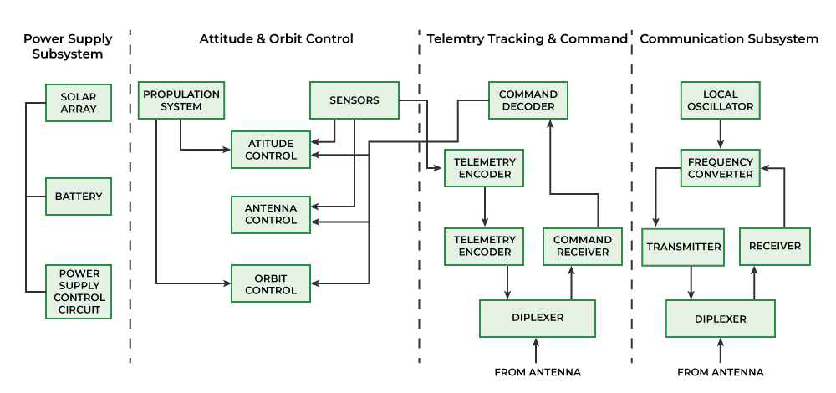

Slide 9
Primary power or Power supply
The primary electrical power for operating the
electronic cells.
Individual
equipment is obtained from solar
cells can generate only small
amounts of power, and therefore, arrays of cells in series-parallel connection are required.

Slide 10
Primary power or Power supply
The earth will eclipse a geostationary satellite twice a year, during the spring and autumnal equinoxes.
Eclipses start approximately 23 days before and end approximately 23 days after the equinox for both the spring and autumnal equinoxes.
Ni-H2 batteries are used in the Hughes HS601 and Intelsat series with INTELSAT VI and INTELSAT VII satellites.

Slide 11
Attitude Control
The attitude of a satellite refers to its orientation in space.
In Satellite, Most of the equipment are used for the purpose of controlling its attitude.
Attitude control is necessary, for example, to ensure that directional antennas point in the proper directions.
In the case of earth environmental satellites, the earth- sensing instruments must cover the required regions of the earth, which also requires attitude control.

Slide 12
Attitude and Orbit Control (AOC) subsystem consists of rocket motors and electric propulsion systems that are used to move the satellite back to the correct orbit when external forces cause it to drift off station, and gas jets or inertial devices that control the attitude of the satellite.
We can make this AOC subsystem into the following two parts.
Attitude Control Subsystem
Orbit Control Subsystem
Communications Subsystems:
It is usually composed of two or more antennas, which receive and transmit over wide bandwidths at microwave frequencies, and a set of receivers and transmitters that amplify and retransmit the incoming signals.
The receiver-transmitter units are known as transponders. There are two types of transponder in use on satellites: the linear or bent pipe transponder that amplifies the received signal and retransmits it at a different frequency, and the baseband processing transponder, used only with digital signals, that converts the received signal to baseband, processes it, and then retransmits a digital signal.

Slide 13
Telemetry, Tracking, Commanding and Monitoring (TTCM) subsystem is present in both satellite and earth station. The telemetry system sends data derived from many sensors on the satellite, which monitor the satellite’s health, via a telemetry link to the controlling earth station.
The tracking system is located at this earth station and provides information on the range and the elevation and azimuth angles of the satellite.
Repeated measurement of these three parameters permits computation of orbital elements, from which changes in the orbit of the satellite can be detected. Based on telemetry data received from the satellite and orbital data obtained from the tracking system, the control system is used to correct the position and attitude of the satellite.
We can make this TTCM subsystem into the following three parts.
Telemetry and Monitoring Subsystem
Tracking Subsystem
Commanding Subsystem

Slide 14
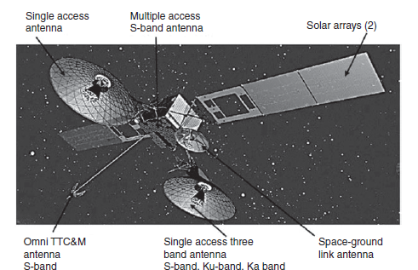
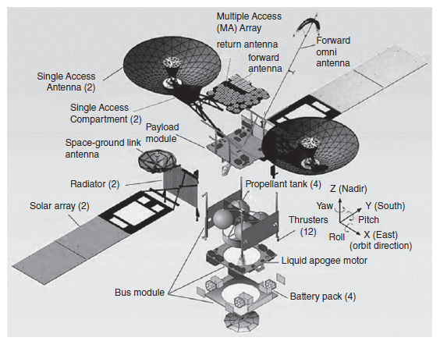
NASA’s Tracking and Data Relay Satellite (TDRS)

Slide 15
Attitude and Orbit Control (AOC) subsystem
Altitude control subsystem takes care of the orientation of satellite in its respective orbit. Following are the two methods to make the satellite that is present in an orbit as stable.
Spinning the satellite- the body of the satellite rotates around its spin axis-spinners
Three axes method

Slide 16
Attitude and Orbit Control (AOC) subsystem
The attitude and orbit of a satellite must be controlled so that the satellite’s antennas point toward earth.
The most important forces for a GEO satellite are the gravitational fields of the sun and the moon, and solar pressure from the sun.
A LEO satellite is less affected by the gravity of the sun and moon,
but variations in the earth’s magnetic field and gravitational constant cause deviations in the orbit.
In early days, the body of most GEO satellites was rotated at a rate between 30 and 100 rpm to create a gyroscopic force that provided stability on the spin axis and kept the satellite pointing in the same direction- Spinners- Boeing 376 GEO satellite- limited power generation capability.
All large GEO communication satellites are now three-axis stabilized designs.

Slide 17
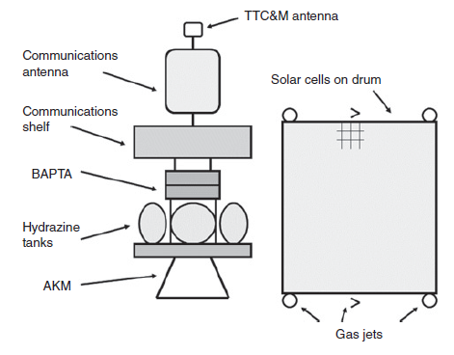
Spinner satellite
Spinner contains a drum, which is of cylindrical shape. This drum is covered with solar cells. Power systems and rockets are present in this drum.
Communication subsystem is placed on top of the drum. An electric motor drives this communication system. The direction of this motor will be opposite to the rotation of satellite body, so that the antennas point towards earth. The satellites, which perform this kind of operation are called as de-spin.
During launching phase, the satellite spins when the small radial gas jets are operated. After this, the de-spin system operates in order to make the TTCM subsystem antennas point towards earth station.

Slide 18
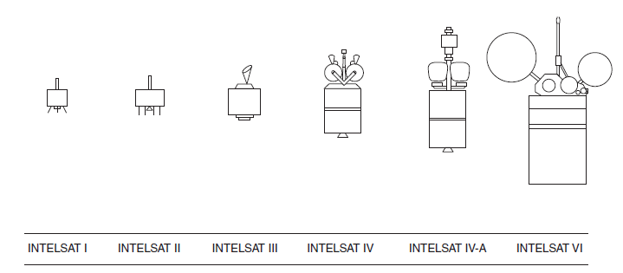
Attitude and Orbit Control (AOC) subsystem
A three-axis stabilized satellite has one or more momentum wheels. The momentum wheel is usually a solid metal disk driven by an electric motor.
Increasing the speed of the momentum wheel causes the satellite to precess in the opposite direction, according to the principle of conservation of angular momentum.
A typical spinner satellite. The entire satellite rotated at roughly one revolution per second.
The communications equipment and antennas were driven by a motor in the opposite direction to the body of the satellite to keep the antennas pointed at earth.

Slide 19
Attitude and Orbit Control (AOC) subsystem
Ina three-axis stabilized satellite, one pair of gas jets or ion thrusters is needed for each axis to provide for rotation in both directions of pitch, roll, and yaw.
When motion is required along a given axis, the appropriate thruster is operated for a specified period of time to achieve the desired velocity.
An opposing thruster must be operated for the same length of time to stop the motion when the satellite reaches its new position.
ZR axis is directed toward the center of the earth and is in the plane of the satellite orbit. It is aligned along the local vertical at the satellite’s subsatellite point.
XR axis is tangent to the orbital plane and lies in the orbital plane. The YR axis is perpendicular to the orbital plane.
For a satellite serving the Northern Hemisphere, the directions of the XR and YR axes are nominally east and south.
roll about the XR axis, pitch about the YR axis, and yaw about the ZR axis, in exactly the same way as for an aircraft or ship traveling in the X direction.

Slide 20
In this method, the following three axes are considered.
Roll axis is considered in the direction in which the satellite moves in orbital plane.
Yaw axis is considered in the direction towards earth.
Pitch axis is considered in the direction, which is perpendicular to orbital plane.
Let XR, YR and ZR are the roll axis, yaw axis and pitch axis respectively. These three axis are defined by considering the satellite’s position as reference. These three axes define the altitude of satellite.
Let X, Y and Z are another set of Cartesian axes. This set of three axis provides the information about orientation of the satellite with respect to reference axes. If there is a change in altitude of the satellite, then the angles between the respective axes will be changed.

Slide 21
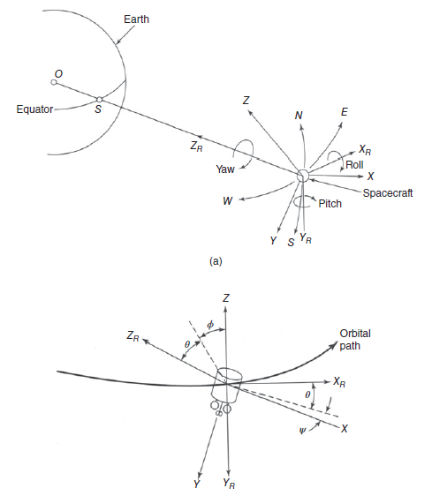

Slide 22
Orbit control system
Gravitation forces of the moon and the sun-i
non-spherical shape of the earth - drift of the subsatellite point
This cannot be done with momentum wheels since linear accelerations are required.
If GEO -it is elliptical - On a three-axis stabilized satellite, there will usually be two pairs of X-axis thrusters acting in opposite directions, one pair of which will be operated for a predetermined length of time to provide the required velocity change.
Circular orbit- does not need frequent velocity corrections to maintain circularity. Altitude corrections are made by operating the Z-axis thrusters.
North–South station keeping maneuver are made every two to four weeks to keep the error small. It has become normal to split the E–W and N–S maneuvers so that at intervals of two weeks the E–W corrections are made first and then after two more weeks, the N–S corrections are made.

Slide 23
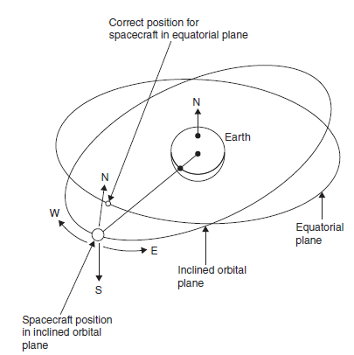
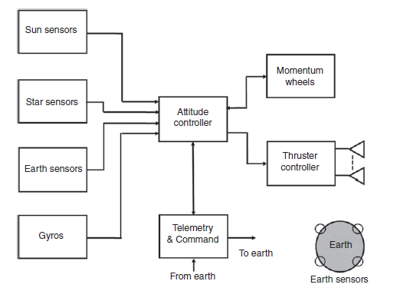
Orbit control system
Geosynchronous satellite in an inclined orbit. Thrusters must be used to give the satellite a velocity in a northerly direction until it reaches the required position.

Slide 24
Attitude and Orbit Control (AOC) subsystem
The attitude of a satellite refers to its orientation in space.
In Satellite, Most of the equipment are used for the purpose of controlling its attitude.
Attitude control is necessary, for example, to ensure that directional antennas point in the proper directions.
In the case of earth environmental satellites, the earth- sensing instruments must cover the required regions of the earth, which also requires attitude control.

Slide 25
Attitude Control
A number of forces, such as the gravitational fields of the earth and the moon, solar radiation, and meteorite impacts are referred to as disturbance torques -can alter the attitude.
Attitude control must not be confused with station keeping-the two are closely related.

Slide 26
Sensors
To find the any deviation or shift in satellite orientation in space, infrared sensors are used, these sensor are referred to as horizon detectors.
With the use of four such sensors, one for each quadrant, the center of the earth is reference point.
Any shift in orientation is detected by one or other of the sensors, and a corresponding control signal is generated which activates a restoring torque.

Slide 27
Attitude Control
Usually, the attitude-control process takes place in the satellite, but it is also possible for control signals to be transmitted from earth, based on attitude data obtained from the satellite.
Controlling torques may number of ways.
Passive attitude control
Active attitude control
be generated in a

Slide 28
Attitude Control
Passive attitude control
The satellite stabilizations is achieved without putting a drain on the satellite’s energy supplies.
Examples of passive attitude control are spin stabilization and gravity gradient stabilization.
The Gravity gradient depends on the gravitational field of the central body.
– Ex.Radio Astronomy Explorer-2 satellite.
For communications satellites, spin stabilization is often used

Slide 29
Attitude Control
Active attitude control
With active attitude control, there is no overall stabilizing torque present to resist the disturbance torques.
Instead, corrective torques are applied as required in response to disturbance torques.
Methods used to generate active control torques, include
momentum wheels, EM coils, and mass expulsion devices.
The electromagnetic coil works on the principle that the earth’s magnetic field exerts a torque on a current-carrying coil and that this torque can be controlled through control of the current.

Slide 30
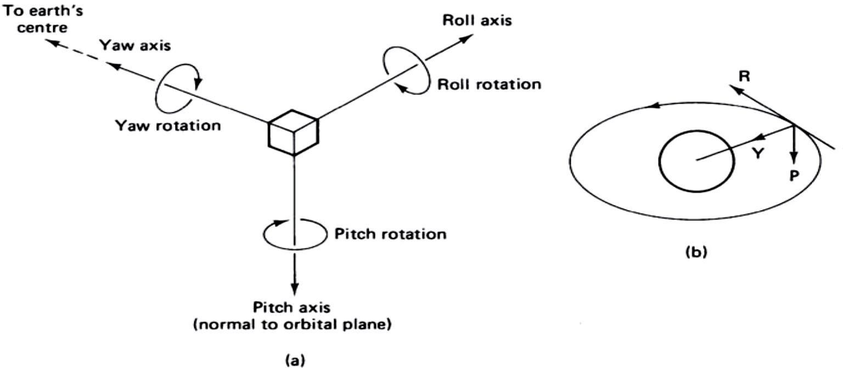
Roll, pitch, and yaw axes. The yaw axis is directed toward the earth’s center, the pitch axis is normal to the orbital plane, and the roll axis is perpendicular to the other two.
RPY axes for the geostationary orbit.

Slide 31
Attitude Control
The three axes which define a satellite’s attitude are its roll, pitch, and yaw (RPY) axes.
For an equatorial orbit,
movement of the satellite about the roll axis moves the antenna footprint north and south;
movement about the pitch axis moves the footprint east and west; and
movement about the yaw axis rotates the antenna footprint.

Slide 32
Attitude Control
Spinning satellite stabilization:
This types of stabilization is applied to the cylindrical type of satellites.
The satellite is mechanically balanced about one particular axis and is then set spinning around this axis.
For geostationary satellites, the spin axis is parallel to the N-S axis of the earth.

Slide 33
Telemetry, Tracking, Command, and Monitoring (TTC&M) system
The TTC&M system is essential to the successful operation of a communications satellite.
It is part of the satellite management task.
Functions of TTC&M:
To monitor the subsystem health and status parameter.
To support detecting the orbital parameter.
To provide the source for the earth station to the track satellite.
To receive and execute commands to perform the required function.
Subsystem Functions
Telemetry Monitor various satellite parameters and Tx the measured data to the satellite control station.
Tracking Monitor the movement of the satellite and correction signals are sent to the satellite
Command Transmit the commands from the satellite control center verify the reception and then execute received command

Slide 34
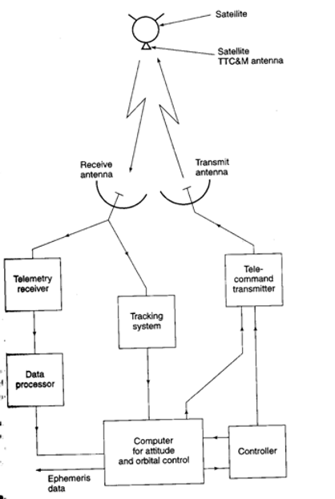
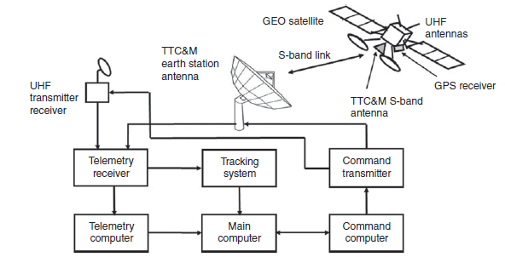

Slide 35
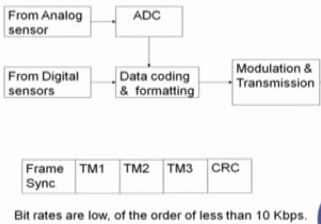
Telemetry
The monitoring system collects data from many sensors within the satellite and sends the data to the controlling earth station.
Coding and formatting is generally done in the form of blocks are frames.
Header which is the beginning of the frame is called frame synchronization bits.
TDM frame
Telemetry data are usually
digitized and transmitted as
phase shift keying (PSK) of a
low-power telemetry carrier using
time division multiplexing (TDM).
A low data rate is normally used
to allow the receiver at the earth station
to have a narrow bandwidth and
thus maintain a high carrier to noise ratio
Alarms can also be sounded if any vital parameter goes outside allowable limits.

Slide 36
Tracking
Continuously monitoring from ground
Velocity and acceleration sensors - change in orbit from the last known position, by integration of the data.
Doppler shift- Earth station- rate of change.
Active determination of range can be achieved by transmitting a pulse, or sequence of pulses, to the satellite and observing the time delay before the pulse is received again.
Tone Range system- Ranging tones are also used for range measurement - phase delay.
Some satellites carry GPS receivers that report the satellite’s position over the telemetry link.

Slide 37
Commands
A secure and effective command structure is important for the successful launch and operation of any communications satellite.
It should be robust to avoid wrong or missed command
Use international std. commands (CCSDS-The Consultative Committee for Space Data Systems)
The command structure must possess safeguards against unauthorized attempts to make changes to the satellite’s operation.
Encryption of commands and responses is used to provide security in the command system
The control code is converted into a command word, which is sent in a TDM frame to the satellite.
In addition to improve error control,
Repeat transmission of command words
Confirmation of command reception through echoing format.

Slide 38
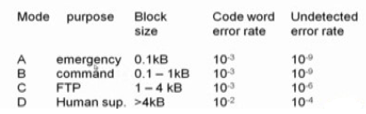
Commands
Execute command transmitted separately
after making sure that command received
Correctly.
Three types of command execution
Direct execution
Validate the command and execution
Time based command execution
Syn word selection
Two properties characterized the code word length
Missed detection probability- Error occur in the code word
False Alarm-Error in data bit

Slide 39
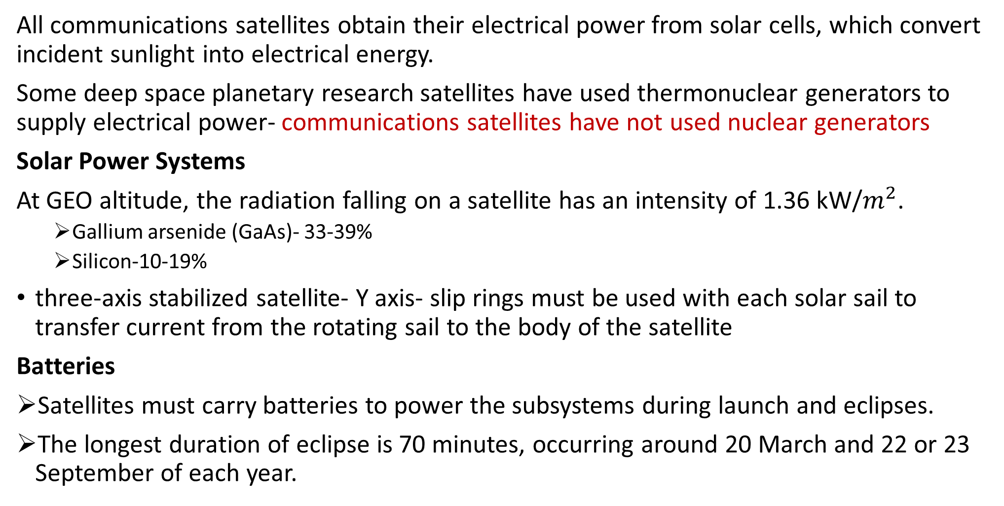
Power system
All communications satellites obtain their electrical power from solar cells, which convert incident sunlight into electrical energy.
Some deep space planetary research satellites have used thermonuclear generators to supply electrical power- communications satellites have not used nuclear generators
Solar Power Systems
At GEO altitude, the radiation falling on a satellite has an intensity of 1.36 kW/$m^{2}$.
Gallium arsenide (GaAs)- 33-39%
Silicon-10-19%
three-axis stabilized satellite- Y axis- slip rings must be used with each solar sail to transfer current from the rotating sail to the body of the satellite
Batteries
Satellites must carry batteries to power the subsystems during launch and eclipses.
The longest duration of eclipse is 70 minutes, occurring around 20 March and 22 or 23 September of each year.

Slide 40
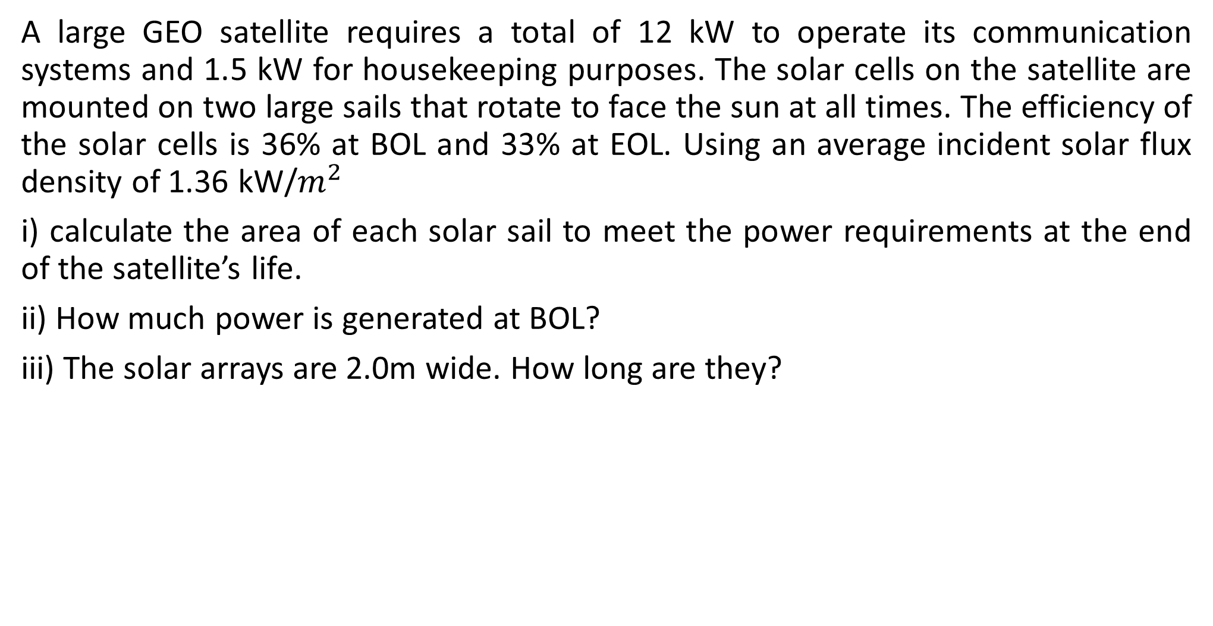
Example:1
A large GEO satellite requires a total of 12 kW to operate its communication systems and 1.5 kW for housekeeping purposes. The solar cells on the satellite are mounted on two large sails that rotate to face the sun at all times. The efficiency of the solar cells is 36% at BOL and 33% at EOL. Using an average incident solar flux density of 1.36 kW/$m^{2}$
i) calculate the area of each solar sail to meet the power requirements at the end of the satellite’s life.
ii) How much power is generated at BOL?
iii) The solar arrays are 2.0m wide. How long are they?

Slide 41
Example:2
The large GEO satellite in Example1 is subject to eclipses that last 70minutes in spring and fall. The satellite is required to maintain full communications capacity during eclipses. Batteries on board the satellite must supply 13.5 kW for 70minutes.The battery voltage is 50V and the batteries must not discharge more than 50% during the eclipse.
Calculate the battery capacity required in ampere hours (AHs).A battery with a capacity of one ampere hour can supply one amp for one hour.
If lithium-ion batteries with a capacity of 200 watt hours per kilogram are used, find the weight of the battery.

Slide 42

Example:3
Calculate the total power radiated by the sun in watts and in dBW.
Hint: The sun is 93million miles (about 150 million kilometers) from the earth. At that distance, the sun produces a flux density of 1.36 kW/$m^{2}$. This power density is present over all of a sphere with a radius of 150 million km.

Slide 43
Communications Subsystems
Communications satellite provides- voice, video, and data communications.
Communications satellites are designed to provide the largest traffic capacity possible.
Transponders
A transponder is a device that receives radio signals and retransmits the identical signal at a different frequency, or a different signal at a different frequency.
Communication satellite transponders receive signals from uplink earth stations and retransmit the same signal at a different frequency.
A transponder that simply amplifies the received signal and changes its frequency for retransmission is known as a linear or bent pipe transponder.
Transponders on GEO satellites typically have bandwidths of 20–200MHz and carry
many signals.
The transmit frequency of the RF signals must be different from the frequency of the received signals. If the same frequency were used, coupling from the transmitting antenna to the receiving antenna on the satellite would cause feedback and oscillation (sometimes called ringing) within the transponder.

Slide 44
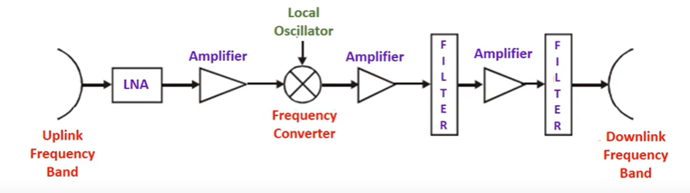
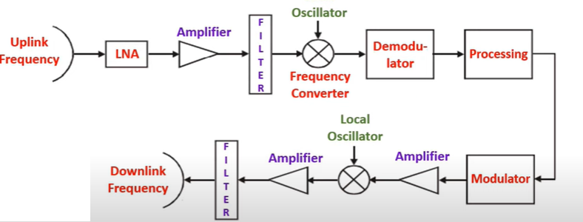
Single conversion transponders
Regenerative transponders

Slide 45
Satellite Antennas
The antennas which are used in satellites are called as satellite antennas.
Four main types of antennas are used on satellites. These are
1. Wire antennas: monopoles and dipoles.
2. Horn antennas.
3. Reflector antennas.
4. Phased array antennas.
It receive the uplink signal and transmit the downlink signal.
Length of the satellite antenna is inversely proportional to frequency. And it operates in GHz

Slide 46
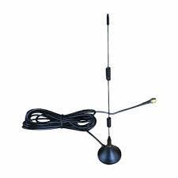
Wire Antennas
Wire antennas are the basic antennas and it categorized into
Monopole antenna
Dipole antenna
Wire antennas are used primarily at VHF and UHF to provide communications for the TTC&M systems.
They are positioned with great care on the body of the satellite in an attempt to provide omnidirectional coverage.

Slide 47
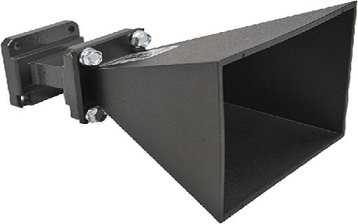
Horn Antennas
A Horn antenna is a type of aperture antenna which is specially designed for microwave frequencies. So, these antennas are frequently called microwave antennas.
The end of the antenna is widened or in the horn shape.
Because of this structure, there is larger directivity so that the emitted signal can be easily transmitted to long distances as well as all direction.
It is used in satellite to cover more area.
The same feed horn antenna can be used for both Tx and Rx.
It is difficult to obtain gains much greater than 23 dB or beamwidths narrower than about 10° with horn antennas.

Slide 48
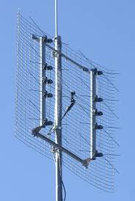
Array Antennas
An antenna is a specialized device that can radiate some amount of energy within a particular direction for better output transmission. For more efficient output, a few more antenna elements are added to it which are known as Antenna arrays.
Array antennas are used in satellite to form multibeam from single aperture. And give high gain and narrow width.

Slide 49
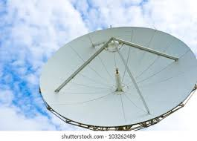
Reflector Antennas
Antennas with high-gain are necessary for long-distance communications, So, the most frequently used high-gain antennas are Reflector antennas because they can easily attain above 30 dB gains for higher & microwave frequencies.
Parabolic reflectors increase the gain of an antenna in satellite communication and it is also used in telecommunication and broadcasting.
For maximum gain, it is necessary to generate a plane wave in the aperture of the reflector. This is achieved by choosing a reflector profile that has equal path lengths from the feed to the aperture, so that all the energy radiated by the feed and reflected by the reflector reaches the aperture with the same phase angle and creates a uniform phase front.

Slide 50
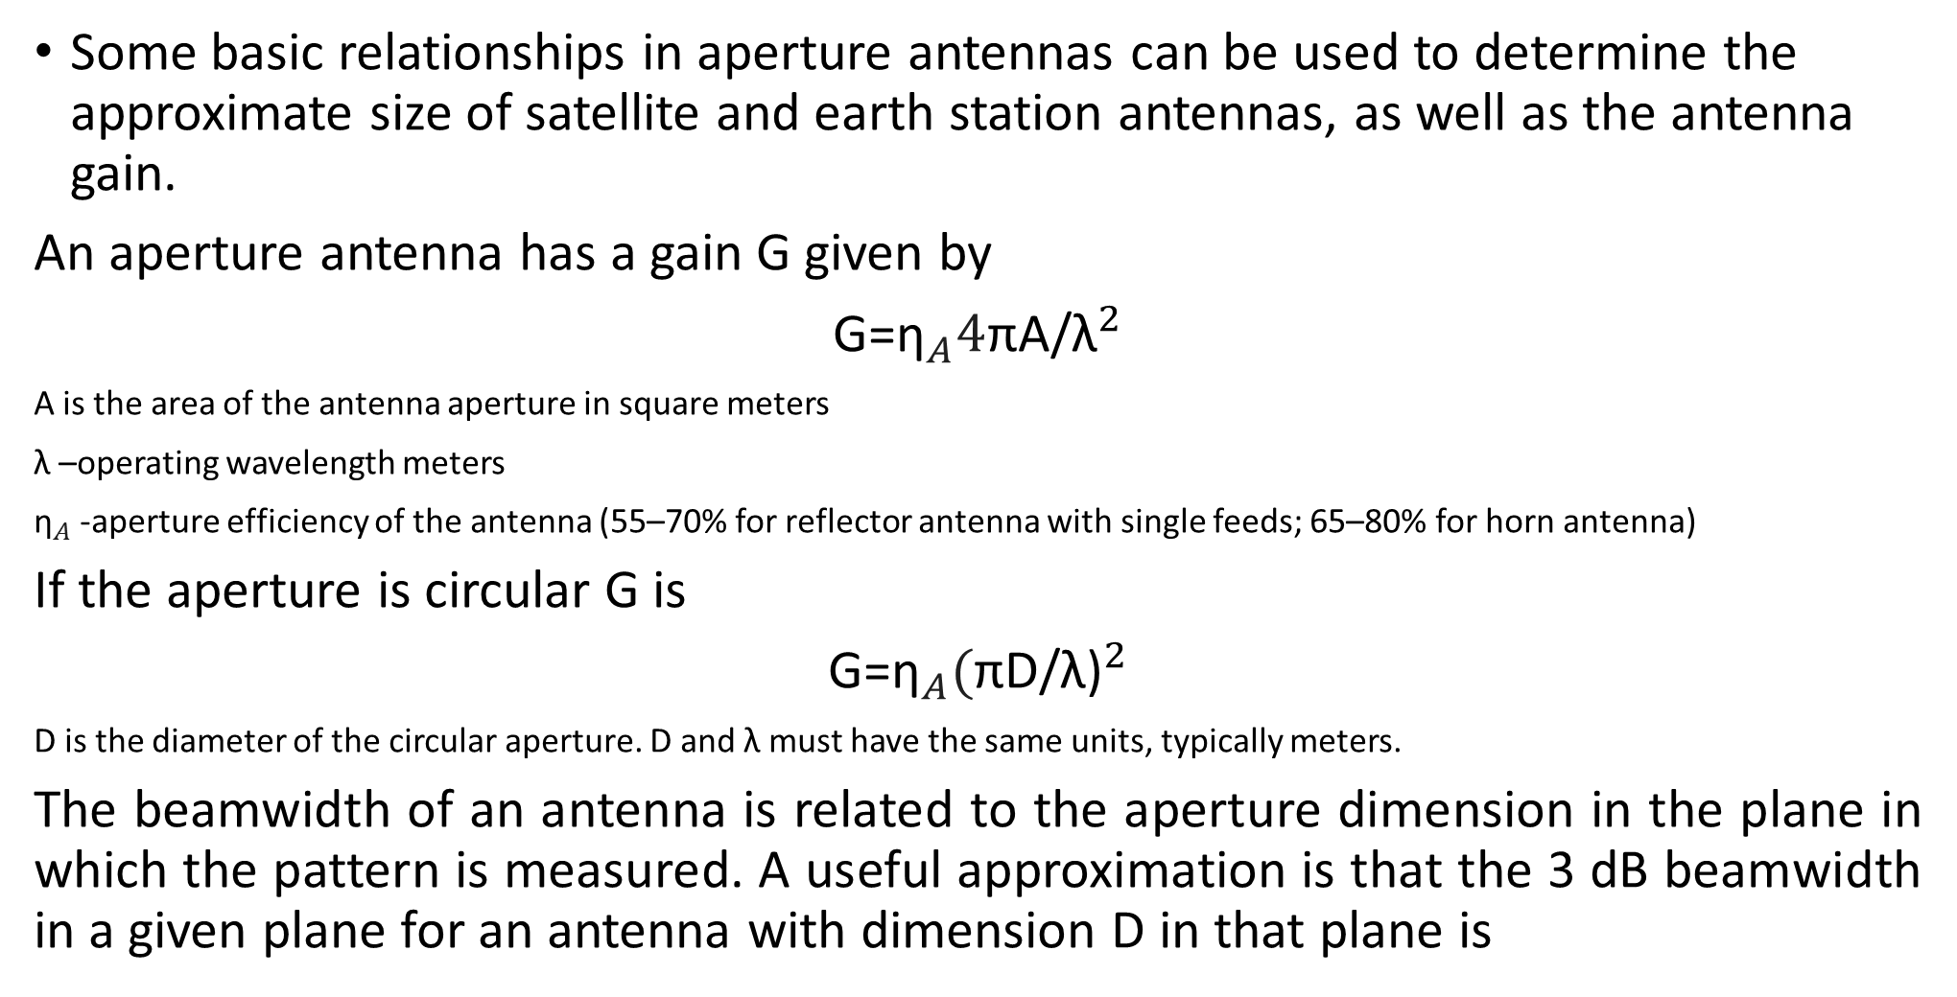
Estimating Gain and Beamwidth
Some basic relationships in aperture antennas can be used to determine the approximate size of satellite and earth station antennas, as well as the antenna gain.
An aperture antenna has a gain G given by
G=${\text{η}}_{A}4$πA/${\text{λ}}^{2}$
A is the area of the antenna aperture in square meters
$\text{λ}$ –operating wavelength meters
${\text{η}}_{A}$-aperture efficiency of the antenna (55–70% for reflector antenna with single feeds; 65–80% for horn antenna)
If the aperture is circular G is
G=${\text{η}}_{A}($πD/${\text{λ}\text{)}}^{2}$
D is the diameter of the circular aperture. D and λ must have the same units, typically meters.
The beamwidth of an antenna is related to the aperture dimension in the plane in which the pattern is measured. A useful approximation is that the 3 dB beamwidth in a given plane for an antenna with dimension D in that plane is

Slide 51
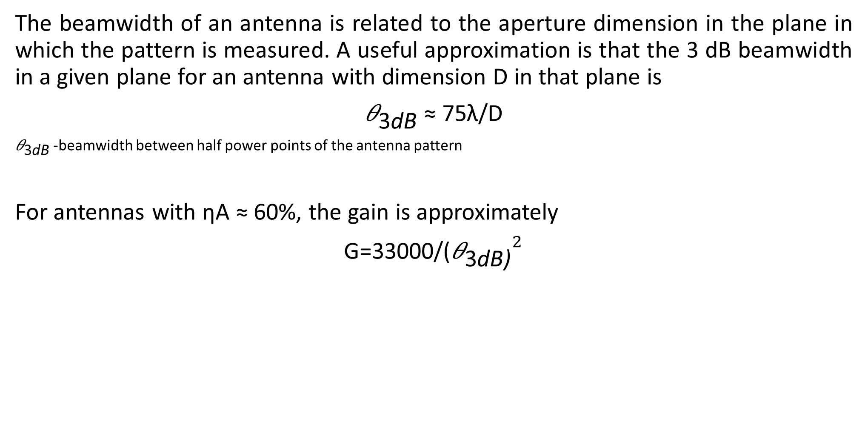
Estimating Gain and Beamwidth
The beamwidth of an antenna is related to the aperture dimension in the plane in which the pattern is measured. A useful approximation is that the 3 dB beamwidth in a given plane for an antenna with dimension D in that plane is
${\text{θ}}_{\text{3}\text{dB}}$ ≈ 75$\text{λ}\text{/}\text{D}$
${\text{θ}}_{\text{3}\text{dB}}$-beamwidth between half power points of the antenna pattern
For antennas with ηA ≈ 60%, the gain is approximately
G=33000/(${{\text{θ}}_{\text{3}\text{dB}\text{)}}}^{2}$

Slide 52
Example:4
The earth subtends an angle of 17° when viewed from geostationary orbit.
What are the dimensions and gain of a horn antenna that will provide global coverage at 4 GHz?
Example:5
The continental United States (48 contiguous states) subtends angles of approximately 6° × 3° in the E–W and N–S directions when viewed from geostationary orbit.
What dimension must a reflector antenna have to illuminate half this area with a circular beam 3° in diameter at 11 GHz?
Can a reflector be used to produce a 6° × 3° beam?
What is the gain of the antenna?

Slide 53
Practice problems
1.An observation satellite is to be placed into a circular equatorial orbit so that it moves in the same direction as the earth’s rotation. Using a synthetic aperture radar system, the satellite stores data on weather related parameters as it flies overhead. These data will be downloaded to a controlling earth station after each trip around the world. The orbit is designed so that the satellite is directly above the controlling earth station, which is located on the equator, once every four hours. Taking the earth’s rotational period is 24hrs, find the following quantities:
a. The satellite’s angular velocity in radians per second.
b. The orbital period in hours, minutes, and seconds.
c. The orbital radius in kilometers.
d. The orbital height in kilometers.
e. The satellite’s linear velocity in meters per second.

Slide 54
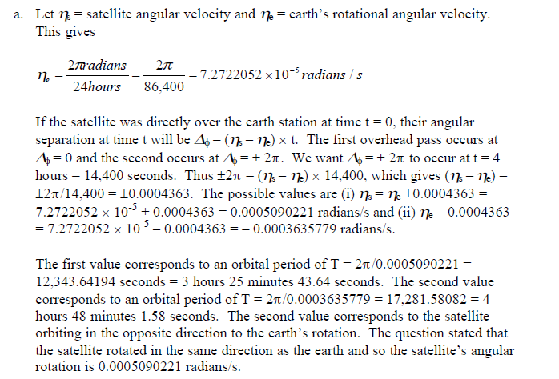
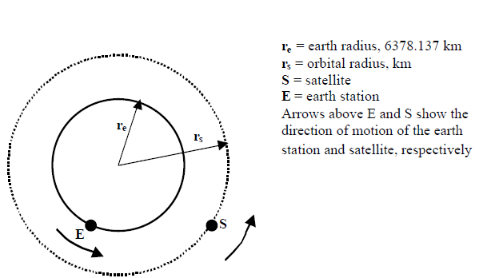
ECE

Slide 55
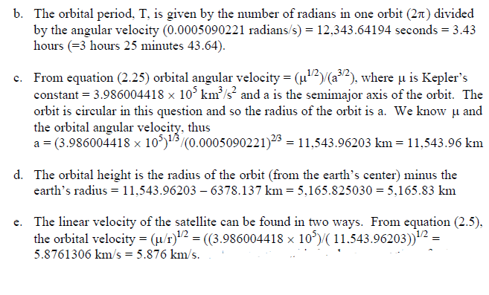
ECE

Slide 56
Practice problems
2. Batteries make up a significant part of the in-orbit weight of a communications satellite but are needed to keep the communications system operating during eclipses. A direct broadcast TV satellite requires 500 W of electrical power to operate the housekeeping functions of the satellite and 5 kW to operate its 16 high power transponders. The longest duration of an eclipse is 70 minutes, during which time the batteries must provide power to keep the satellite operating, but the batteries must not discharge below 70% of their capacity. The satellite bus operates at 48 volts.
What is the current that must be supplied by the power conditioning unit to keep the satellite operating normally?
Battery capacity is rated in ampere hours, the product of the current (in amps) that the battery can supply multiplied by the length of time that this current can be supplied before the battery is fully discharged. The satellite batteries must not discharge beyond 70% of their rated capacity during eclipse. Find the battery capacity required for this DBS-TV satellite.
If batteries weigh 1.25 kg per ampere-hour of capacity, how much weight on this satellite is devoted to batteries?
If half of the transponders are shut down during eclipse, what saving in battery weight is achieved?

Slide 57
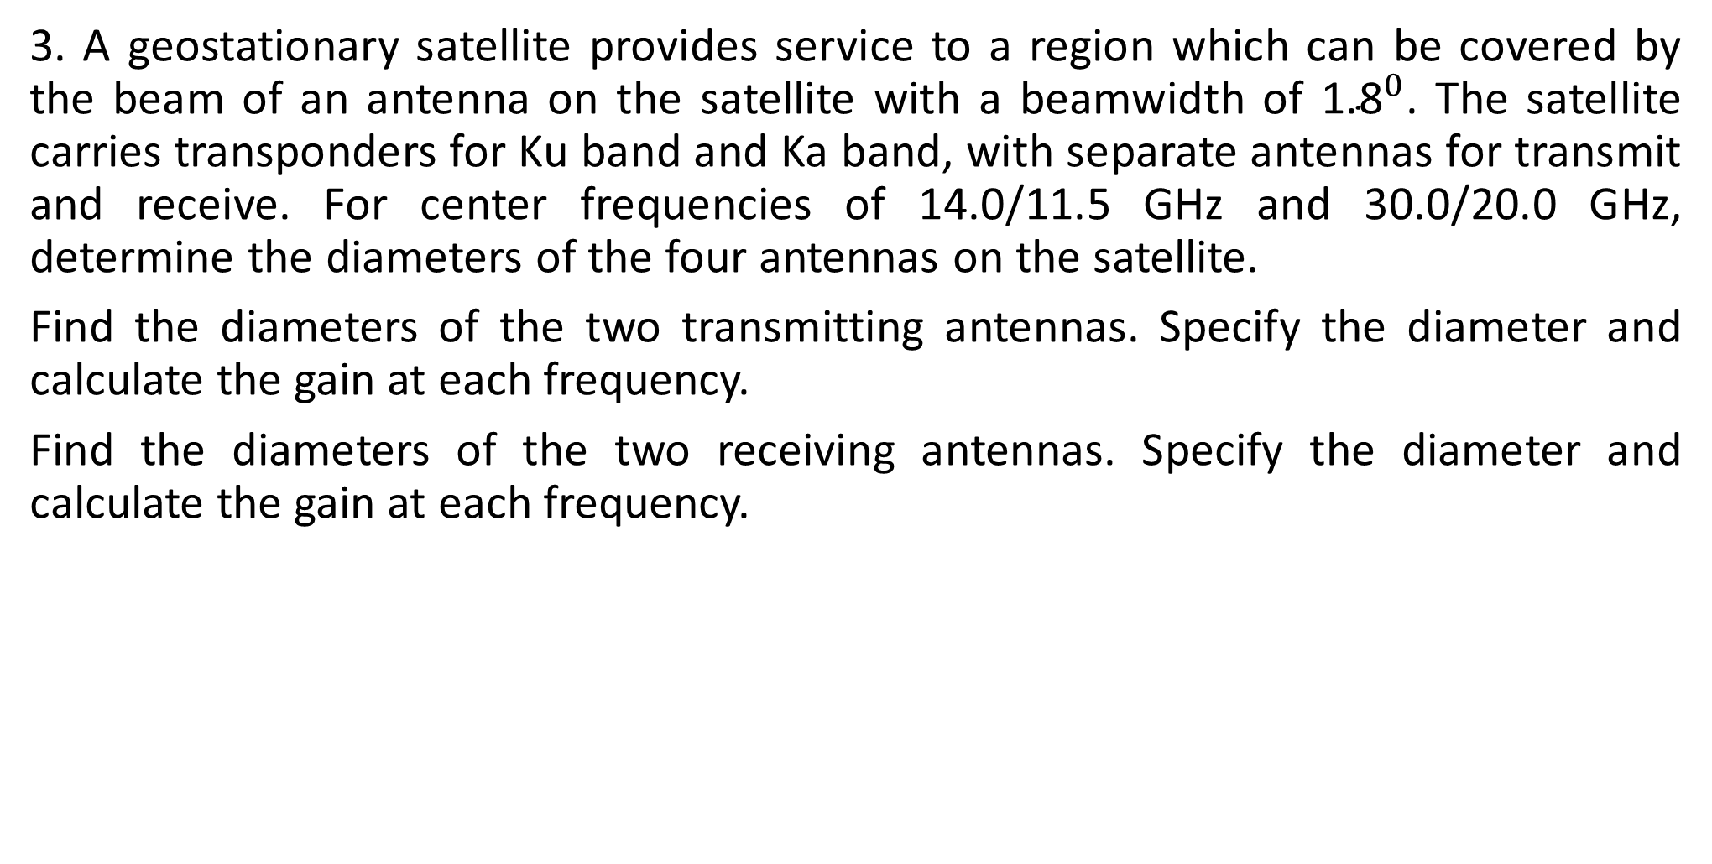
Practice problems
3. A geostationary satellite provides service to a region which can be covered by the beam of an antenna on the satellite with a beamwidth of ${\text{1.8}}^{0}$. The satellite carries transponders for Ku band and Ka band, with separate antennas for transmit and receive. For center frequencies of 14.0/11.5 GHz and 30.0/20.0 GHz, determine the diameters of the four antennas on the satellite.
Find the diameters of the two transmitting antennas. Specify the diameter and calculate the gain at each frequency.
Find the diameters of the two receiving antennas. Specify the diameter and calculate the gain at each frequency.

Slide 58
Reliability and Redundancy
Large GEO communications satellites are designed to provide operational lifetimes of up to 15 years.
Once a satellite is in geostationary orbit, there is little possibility of repairing components
Fail or adding more fuel for station keeping
Very high reliability in the hostile environment of outer space
Two separate approaches are used:
Space qualification of every part of the satellite to ensure that it has a long life expectancy in orbit.
Redundancy of the most critical components to provide continued operation when one component fails.

Slide 59
Space Qualification
In outer space of GEO there is a total vacuum and the sun irradiates the satellite with 1.36 kW of heat and light on each square meter of exposed surface.
Where surfaces are in shadow, heat is lost to the infinite sink of space and surface temperature will fall toward absolute zero - temperature stays within the range 0°–75° C- Thermal control system.
The first stage in ensuring high reliability in a satellite is by selection and screening of every component used.
Past operational and test experience of components indicates which components can be expected to have good reliability.
Each component is then tested individually (or as a subsystem) to ensure that it meets its specification. This process is known as quality control or quality assurance.

Slide 60
Space Qualification
When a satellite is designed, three prototype models are often built and tested
Mechanical model:
All the structural and mechanical parts in the satellite is tested to ensure that all moving parts operate correctly in a vacuum, over a wide temperature range.
It is also subjected to vibration and shock testing to simulate vibration levels and G forces likely to be encountered on launch.
Thermal model:
All the electronics packages and other components that must be maintained at the correct temperature.
The antennas are usually included on the thermal model to check for distortion of reflectors and displacement or bending of support structures.
Electrical model:
All the electronic parts of the satellite and is tested for correct electrical performance under total vacuum and a wide range of temperatures.

Slide 61
Space Qualification
When a satellite is designed, three prototype models are often built and tested
Mechanical model:
All the structural and mechanical parts in the satellite is tested to ensure that all moving parts operate correctly in a vacuum, over a wide temperature range.
It is also subjected to vibration and shock testing to simulate vibration levels and G forces likely to be encountered on launch.
Thermal model:
All the electronics packages and other components that must be maintained at the correct temperature.
The antennas are usually included on the thermal model to check for distortion of reflectors and displacement or bending of support structures.
Electrical model:
All the electronic parts of the satellite and is tested for correct electrical performance under total vacuum and a wide range of temperatures.

Slide 62
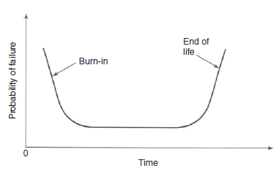
Reliability
Why?
To know what the probability is that the subsystem will still be working after a given time period.
To provide redundant components or subsystems where the probability of a failure is too great to be accepted
Reliability theory: is a mathematical attempt to predict the future.
The application of reliability theory has enabled satellite engineers to build satellites that perform as expected, at acceptable construction costs.
The reliability of a component can be expressed in terms of the probability of failure after time t, PF(t).
For most electronic equipment, probability of failure
is higher at the beginning of life than at some later time.

Slide 63
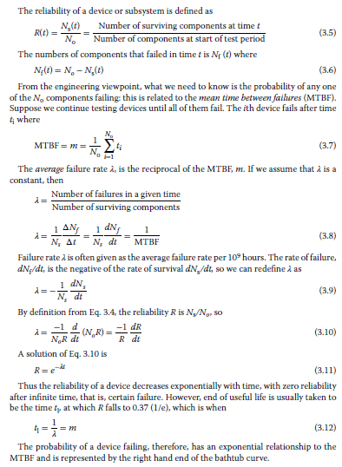
Reliability
Components for satellites are selected only after extensive testing.
reliability, causes of failure, and expected lifetime.

Slide 64
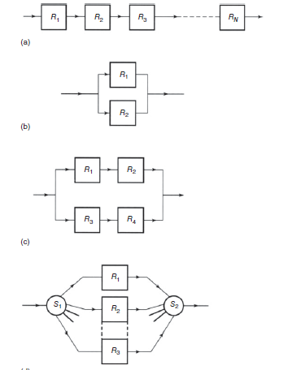
Redundancy
Many of the electronic and mechanical components that are used in satellites are
known to have limited lifetimes. If failure of one of these components will reduce the communication capacity of the satellite, a backup, or redundant, unit will be provided.
The design of the system must be such that
when one unit fails, the backup can automatically
take over into operation by command from the ground.
If we incorporate redundant devices, the subsystem
can continue to function correctly.
series connection, used in solar cells arrays
parallel connection, used to provide redundancy of the
HPAs in satellite transponders,
switched connection, often used to provide parallel
paths with multiple transponders

