Slide 1
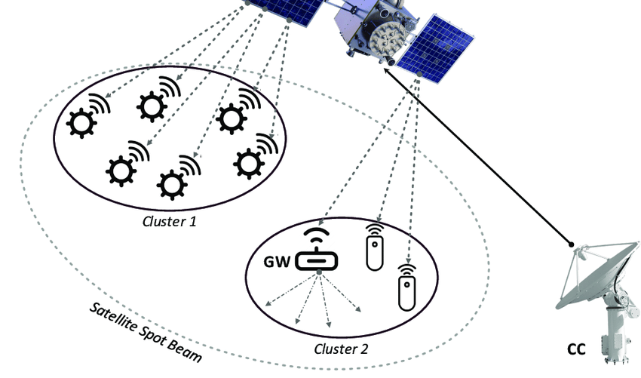
Module:4
Digital Transmission Basics

Slide 2
Module-4
Modulation and Multiplexing
Multiple access techniques – FDMA, TDMA, CDMA, SDMA, ALOHA and its types
Onboard processing
Satellite switched TDMA
Spread spectrum transmission and reception for satellite networks.

Slide 3
Modulation
The information carrying signal is called a baseband signal. Typical baseband signals are audio (voice or music), video (television), or data (bits).
The baseband signals must be modulated onto the radio frequency (RF) carrier to
convey information as a radio signal. An RF carrier has the general form
v(t) = Acos(𝜔t + 𝜑)
Modulate a parameter of the RF carrier in direct proportion to the voltage of the baseband signal- Analog modulation.
If vary a parameter of the RF carrier between two or more discrete states- digital modulation.

Slide 4
Multiple Access
The ability of a satellite to carry many signals at the same time is known as multiple access.
Multiple access allows the communication capacity of the satellite to be shared among a large number of earth stations.
The frequency spectrum used by the satellite is divided into smaller bandwidths, which are allocated to transponders, allowing separate communication links to be established- transponder bandwidths from 20 to 200MHz for GEO satellite.
Multiplexing is the process of combining a number of signals into a single signal, so that it can be processed by a single amplifier or transmitted over a single radio channel.

Slide 5
Multiple Access Technique
The multiple access technique will influence the capacity and flexibility of the satellite communication system, its cost, and its ability to earn revenue.
There are three basic multiple access techniques
Frequency division multiple access (FDMA)-all users share the satellite at the same time, but each uplink earth station transmits at a unique allocated frequency.
Time division multiple access (TDMA)-each user is allocated a unique time slot
at the satellite so that signals pass through the transponder sequentially- causes delays in transmission.
Code division multiple access (CDMA)- all users transmit to the satellite on the same
frequency and at the same time.

Slide 6
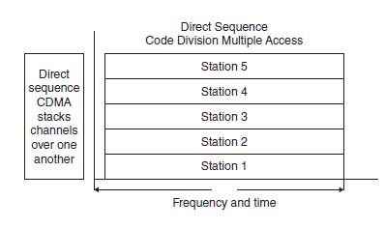
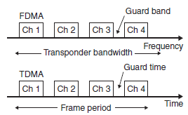
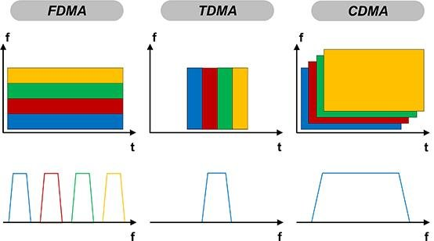
Multiple Access Technique

Slide 7
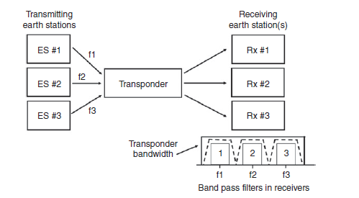
Frequency Division Multiple Access (FDMA)
FDMA was the first multiple access technique used in satellite communication systems.
In Early, all signals were analog, and analog multiplexing was used at earth stations to combine large numbers of telephone channels into a single baseband signal that could be modulated onto a single RF carrier- frequency division multiplexing (FDM).
The main advantage of FDMA is that filters
can be used to separate signals.
Microwave filters were used in
earth stations to separate the FDMA signal
from a given transponder.

Slide 8
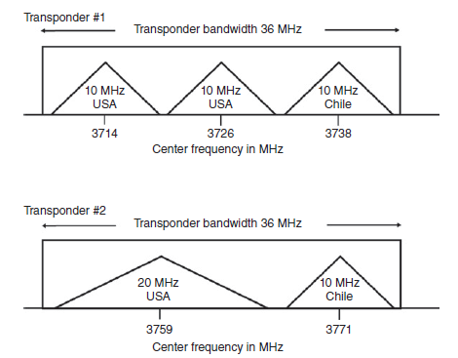
Frequency Division Multiple Access (FDMA)
Implementing FDMA:
Fig. shows a typical fixed assignment FDMA plan for two C-band transponders.
The triangles represent RF carriers with the
transmitting earth station country and RF bandwidth.
The use of microwave filters to separate channels
makes the fixed assignment approach to FDMA
very inflexible.
Changing the frequency assignment or bandwidth
of any one transmitting earth station requires
retuning of the filters at several receiving earth stations.
Fixed assignment systems are rarely used now
with new satellite systems; demand assignment
and single channel per carrier (SCPC) is preferred for higher loading.

Slide 9
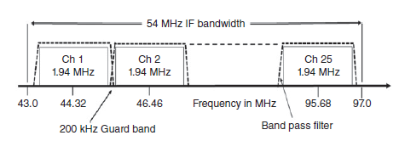
Frequency Division Multiple Access (FDMA)
FDMA Receiver:
Every earth station that operates in a FDMA network must have a separate IF receiver for each of the carriers that it wishes to receive.
Fig. shows how the IF bandwidth of a receiving earth station could be configured
to receive 25 digital data channels, each with an occupied bandwidth of 1.94MHz
from a 54MHz wide Ku-band transponder.
The 200 kHz frequency spaces between
the channels are called guard bands.
Guard bands are essential in FDMA systems to allow the filters in the receiver to select individual channels without excessive interference from adjacent channels.
Wideband transponders- Commercial GEO satellites usually have wide bandwidths, with bandwidths of 24, 36, 54, 72, and up to 200MHzcommonly employed

Slide 10
Frequency Division Multiple Access (FDMA)
FDMA has a disadvantage in satellite communications systems when the satellite
transponder has a non-linear characteristic-HPA
A transponder using a traveling wave tube amplifier (TWTA) is more prone to non-linearity than one with a solid-state high-power amplifier (SSHPA).
Non-linearity of the transponder HPA causes a reduction in the overall (CNR)o at the receiving earth station
Intermodulation:
Intermodulation (IM) products are generated whenever more than one signal is carried by a non-linear device.
Filtering can be used to remove the IM products, but if they are within the bandwidth of the transponder they cannot be filtered out.
The saturation characteristic of a transponder can be modeled by a cubic curve to illustrate the generation of third order intermodulation.
Third order IM is important because third order IM products often have frequencies close to the signals.

Slide 11
Frequency Division Multiple Access (FDMA)
Power Sharing in FDMA:
Intermodulation between multiple carriers in a satellite transponder is minimized when each signal in the transponder has the same power spectral density (PSD).
GEO-power transmitted by each earth station proportional to the bandwidth of the transmitted signal.

Slide 12
Example
Three identical large earth stations with 500W saturated output power transmitters access a 36MHz bandwidth transponder of a GEO satellite using FDMA. The earth stations are all at the same distance from the satellite. The transponder saturated output power is 100W and it is operated with 3 dB output backoff when FDMA is used. The gain of the transponder is 105 dB in its linear range. The bandwidths of the earth station
signals are
Station A: 15MHz
Station B: 10MHz
Station C: 5MHz
Find the power level at the output of the transponder, and at the input to the transponder, in dBW, for each earth station signal, assuming that the transponder is operating in its linear region with 3 dB output backoff. Each earth station must transmit 250W to achieve an output power of 25W from the transponder. Find the transmit power for each earth station when the transponder is operated with FDMA to make the PSD of each signal equal.

Slide 13
Time Division Multiple Access (TDMA)
TDMA is an RF multiple access technique that allows a single transponder to be shared in time between RF carriers from different earth stations.
TDMA systems, the signals are digital and can be divided by time, are easily reconfigured for changing traffic demands, are resistant to noise and interference.
One major advantage of TDMA when using the entire bandwidth of a transponder is that only one signal is present in the transponder at one time- overcome the problems caused by non-linear transponders in FDMA .
Using all of the transponder bandwidth requires every earth station to transmit at a high bit rate, which requires high transmitter power, making the basic form of TDMA not well suited to narrowband signals from small earth stations.

Slide 14
Time Division Multiple Access (TDMA)
TDM- is a baseband technique used at one location to multiplex several digital bit streams into a single higher speed digital signal.
Synchronization bit in the packet or frame must be found to split the high-speed signals into its original low speed signal.
The clock frequency for the bit stream is fixed, and the frame length is usually constant- Direct to home satellite TV systems use TDM to deliver multiple TV channels.
The entire process requires considerable storage of bits.

Slide 15
Time Division Multiple Access (TDMA)
The burst transmission is assembled at a transmitting earth station so that it will correctly fit into the TDMA frame at the satellite.
The frame typically has a length between 125 μs and 20ms, and the burst from the earth station must be transmitted at the correct time to arrive at the satellite in the correct position within the TDMA frame.
Each station must know exactly when to transmit, typically within one or 2 μs, so that the RF bursts arriving at the satellite from different earth stations do not overlap(collision)- it requires synchronization of all the earth stations in a TDMA network

Slide 16
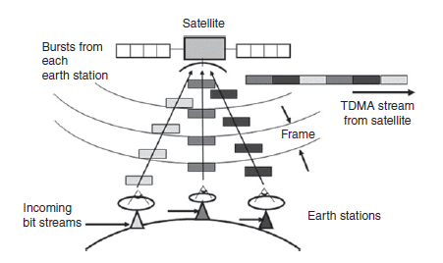
Time Division Multiple Access (TDMA)
A receiving earth station must synchronize its receiver to each of the sequential bursts in the TDMA signal and recover the transmission from each uplink earth station.
uplink earth stations are usually
sent using QPSK or higher order modulator.
Receiving earth station must synchronize
its PSK demodulator.

Slide 17
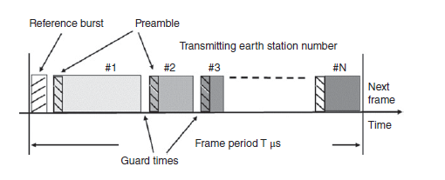
Time Division Multiple Access (TDMA)
TDMA Frame Structure:
A TDMA frame contains the signals transmitted by all of the earth stations in a TDMA network.
A frame typically has a fixed length, and is built up from the burst transmissions of each earth station, with guard times between each burst.
The frame structure can differ
Different satellite communication systems depending on
whether the satellites are GEO or LEO,
Data has a high bit rate or a low bit rate
The system has fixed or mobile earth stations.
In GEO satellite systems, frame lengths of 125 μs up to 20ms have been used, although 2ms has been widely used by stations using Intelsat satellites.
Earth stations must be able to join the network, add their bursts to the TDMA frame in the correct time sequence, and leave the network without disrupting its operation.

Slide 18
Time Division Multiple Access (TDMA)
TDMA Frame Structure:
The transmitted bursts must contain synchronization and identification information that help receiving earth stations to extract the traffic portions of the frame without error.
This can dividing TDMA burst transmissions into two parts:
Preamble or header that contains a synchronization waveform, identification bits, and control bits.
Traffic portion containing data bits.
Synchronization of a TDMA receiver is achieved with the portion of the frame that contains carrier and bit clock synchronization waveforms.
A reference burst may be transmitted by one of the stations, designated as the master station- preamble followed by no traffic bits.

Slide 19
Time Division Multiple Access (TDMA)
TDMA Frame Structure:
CBTR (carrier and bit timing recovery)- is a process that involves recovering the carrier frequency and phase, as well as the timing of symbols in a signal.
Unique word (UW), typically 16–64 bits that are used to identify the transmitting earth station and to determine whether the demodulator locked up correctly.
Control (CNTL): instructions for the receiver, the length of the traffic burst, and warnings of any changes that will occur in the next frame.
Forward error correction (FEC) segment at the end of the preamble that can be used by both the transmitting and receiving stations to determine whether the preamble was received correctly.

Slide 20
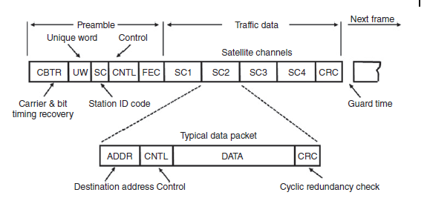
Time Division Multiple Access (TDMA)
TDMA Frame Structure:

Slide 21
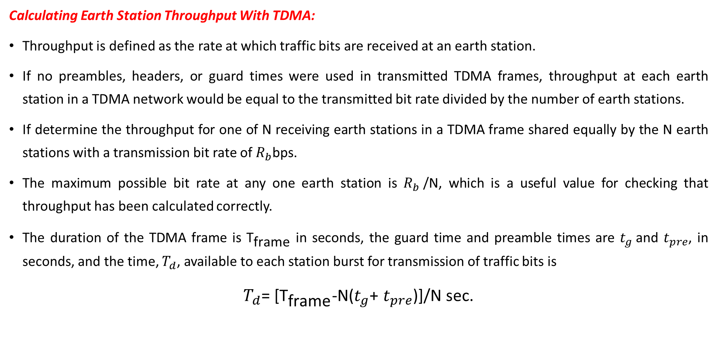
Time Division Multiple Access (TDMA)
Calculating Earth Station Throughput With TDMA:
Throughput is defined as the rate at which traffic bits are received at an earth station.
If no preambles, headers, or guard times were used in transmitted TDMA frames, throughput at each earth station in a TDMA network would be equal to the transmitted bit rate divided by the number of earth stations.
If determine the throughput for one of N receiving earth stations in a TDMA frame shared equally by the N earth stations with a transmission bit rate of $R_{b}$bps.
The maximum possible bit rate at any one earth station is $R_{b}$/N, which is a useful value for checking that throughput has been calculated correctly.
The duration of the TDMA frame is ${\text{T}}_{\text{frame}}$ in seconds, the guard time and preamble times are $t_{g}$and $t_{pre}$, in seconds, and the time, $T_{d}$, available to each station burst for transmission of traffic bits is
$T_{d}$= [${\text{T}}_{\text{frame}}$-N($t_{g}$+ $t_{pre}$)]/N sec.

Slide 22
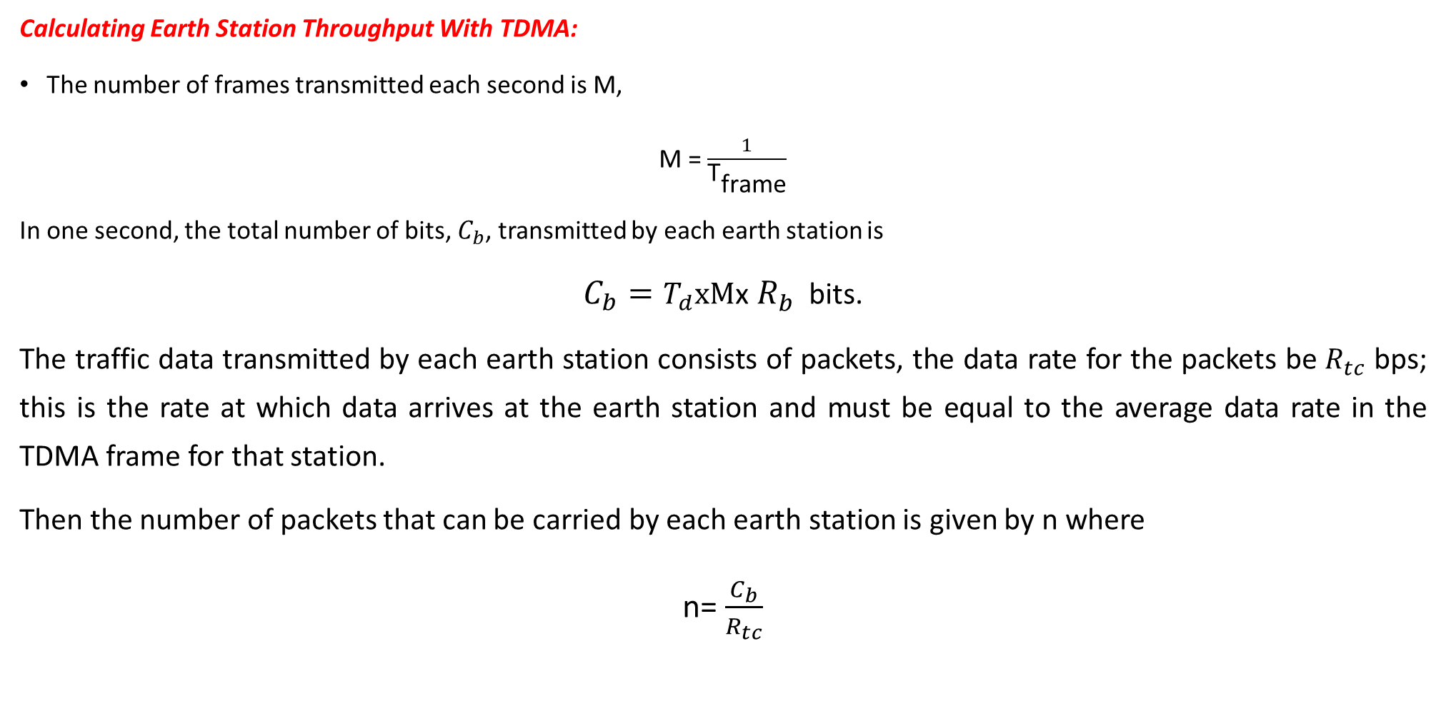
Time Division Multiple Access (TDMA)
Calculating Earth Station Throughput With TDMA:
The number of frames transmitted each second is M,
M = $\frac{1}{{\text{T}}_{\text{frame}}}$
In one second, the total number of bits, $C_{b}$, transmitted by each earth station is
${C_{b}=T}_{d}xM$x $R_{b}$ bits.
The traffic data transmitted by each earth station consists of packets, the data rate for the packets be $R_{tc}$ bps; this is the rate at which data arrives at the earth station and must be equal to the average data rate in the TDMA frame for that station.
Then the number of packets that can be carried by each earth station is given by n where
n= $\frac{C_{b}}{R_{tc}}$

Slide 23
Example-2
A TDMA network of five earth stations shares a single transponder equally. The frame
duration is 2.0 ms, the overhead time per station is 20 μs, and guard bands of 5 μs are
used between bursts. Transmission bursts are QPSK at 30 Mbps.
i) Calculate the number of 256 kbps channels that each TDMA earth station can transmit,
assuming that each channel is encoded with rate ¾ FEC coding. What is the efficiency
of the TDMA system.
ii) If the frame length is increased to 20ms, what is the new TDMA system efficiency?

Slide 24
Code Division Multiple Access (CDMA)
CDMA is a system in which a number of users can occupy all of the transponder bandwidth all of the time.
CDMA signals are encoded such that information from an individual transmitter can be recovered by a receiving station that knows the code being used, in the presence of all the other CDMA signals in the same bandwidth.
Subject to transponder power limitations and the practical constraints of the codes in use, stations with traffic can access a transponder on demand without coordinating their frequency or their time of transmission.
Each transmitting station is allocated a CDMA code; any receiving station that wants to receive data from that earth station must use the correct code.
CDMA codes are typically 16 bits to many thousands of bits in length, and the bits of a CDMA code are called chips to distinguish them from the message bits of a data transmission.
The data bits of the original message modulate the CDMA chip sequence, and the chip rate is always much greater than the data rate.
This greatly increases the speed of the digital transmission, widening its spectrum in proportion to the length of the chip sequence. As a result, CDMA is also known as spread spectrum.

Slide 25
Code Division Multiple Access (CDMA)
Direct sequence spread spectrum (DSSS) is the only type currently used in civilian satellite communication;
Frequency hopping spread spectrum (FH-SS) is used in short range local area wireless networks.
CDMA was originally developed for military communication systems, where its purpose was to spread the energy of a data transmission across a wide bandwidth to make detection of the signal more difficult.
Spreading the energy in a signal across a wide bandwidth can make the noise power spectral density (NPSD) in the receiver larger than the PSD of the received signal.
CDMA has become popular in cellular telephone systems where it is used to enhance cell capacity.
However, it has not been widely adopted by satellite communication systems because it is less efficient, in terms of capacity, than FDMA and TDMA.

Slide 26
Code Division Multiple Access (CDMA)
Spread Spectrum Transmission and Reception:
Direct sequence systems, since that is the only form of spread spectrum that has been used by commercial satellite systems to date.
The spreading codes used in DSSS CDMA systems are designed to have good autocorrelation properties and low cross correlation- Gold and Kasami codes.
DS-SS codes will all be treated as pseudonoise(PN) sequence.
Pseudonoise refers to the spectrum of code, which appears to be a random sequence of bits (or chips) with a flat, noise like spectrum.

Slide 27
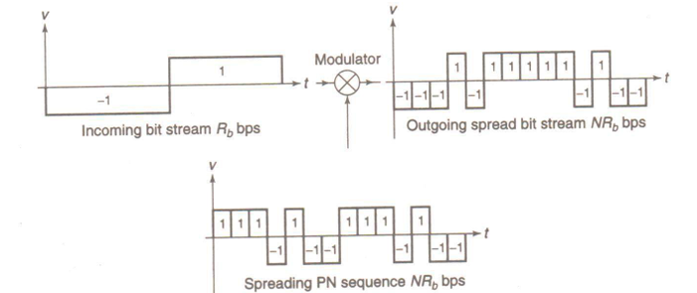
Code Division Multiple Access (CDMA)
Spread Spectrum Transmission and Reception:
The generation of a DS -SS signal is illustrated in Figure.
Assume that the system uses baseband signals most DS -SS systems generate spread spectrum signals using BPSK.
Bit stream containing traffic data
at a rate Rb, converted to have levels of
+1 and — 1 V corresponding to the
logical states 1 and 0, is multiplied by a
PN sequence, also with levels +1 and — 1 V,
at a rate M X Rb Chips per second.

Slide 28
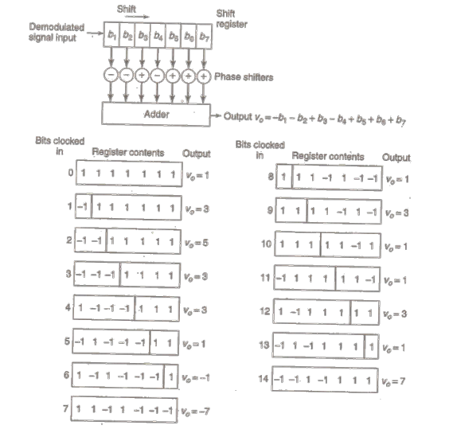
Code Division Multiple Access (CDMA)
Data bit recovery using
an IF correlator
The CDMA chips from the receiver
are clocked into the shift register
serially and the shift register contents
passed through phase shifters
and added.
The phase shifters convert —1 chips to +1 when the correct code is in the shift register such that all the voltages add to a maximum when the received sequence is correct.

Slide 29
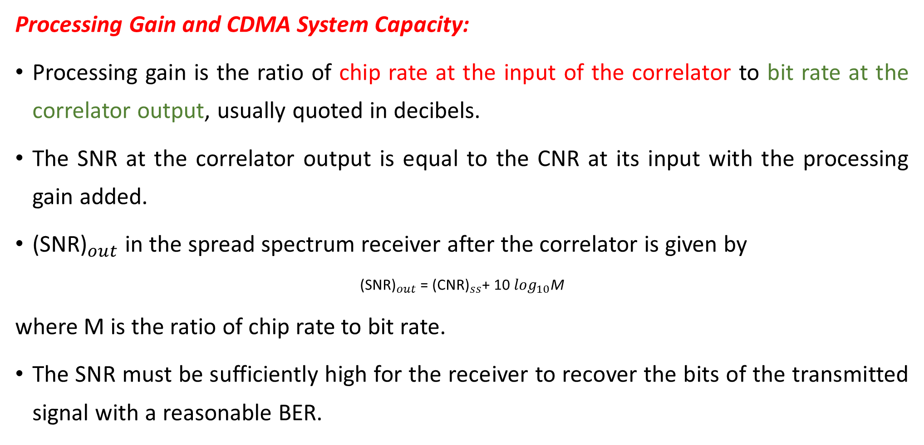
Code Division Multiple Access (CDMA)
Processing Gain and CDMA System Capacity:
Processing gain is the ratio of chip rate at the input of the correlator to bit rate at the correlator output, usually quoted in decibels.
The SNR at the correlator output is equal to the CNR at its input with the processing gain added.
${\text{(}\text{S}\text{NR}\text{)}}_{out}$in the spread spectrum receiver after the correlator is given by
${\text{(}\text{S}\text{NR}\text{)}}_{out}$= ${\text{(}\text{CNR}\text{)}}_{ss}$+ 10 $\log_{10}$M
where M is the ratio of chip rate to bit rate.
The SNR must be sufficiently high for the receiver to recover the bits of the transmitted signal with a reasonable BER.

Slide 30
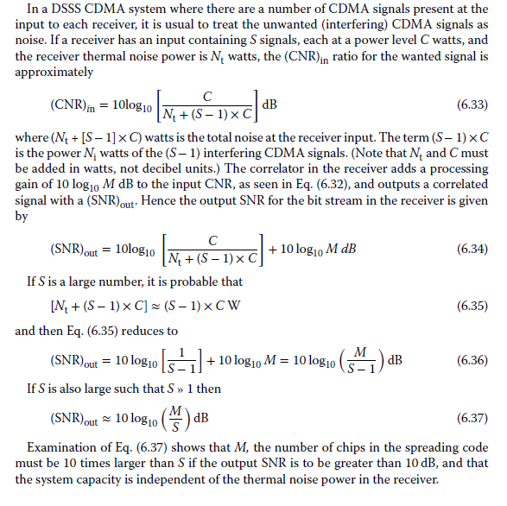
Code Division Multiple Access (CDMA)

Slide 31
Example-3
A DS-SS CDMA system consists of several earth stations sharing a single 54 MHz bandwidth Ka-band transponder. Each station possess a different 1023-bit PN sequence that is used to spread the traffic bits into a bandwidth of 45 MHz. The transmitters and receivers employ RRC filters with α= 0.5 and chip rate 30 Mcps. Calculate the number of earth stations supported by CDMA system if the correlated output S/N= 12 dB

Slide 32
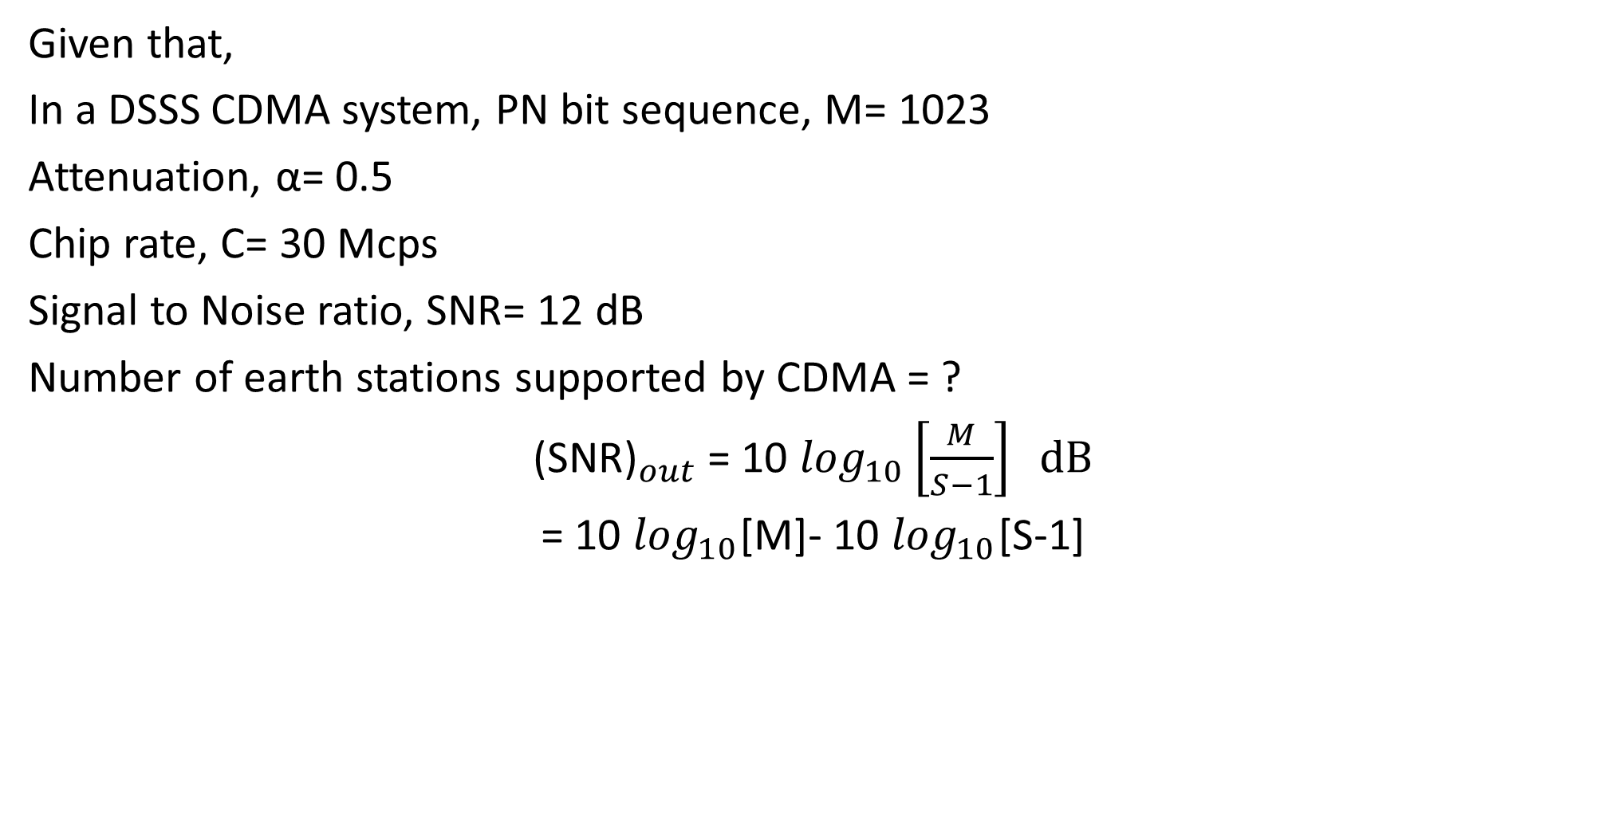
Ans
Given that,
In a DSSS CDMA system, PN bit sequence, M= 1023
Attenuation, α= 0.5
Chip rate, C= 30 Mcps
Signal to Noise ratio, SNR= 12 dB
Number of earth stations supported by CDMA = ?
${\text{(}\text{S}\text{NR}\text{)}}_{out}$= 10 $\log_{10}\left[\frac{M}{S−1}\right] dB$
= 10 $\log_{10}$[M]- 10 $\log_{10}$[S-1]

Slide 33
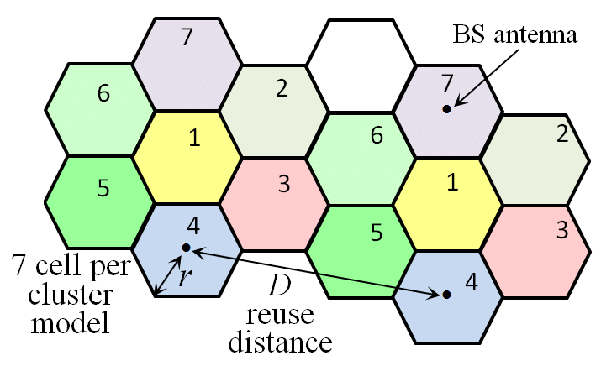
Space Division Multiple Access (SDMA)
Space Division Multiple Access (SDMA) is a technique used in satellite communication to improve the efficient use of satellite resources by dividing spatial domains to serve multiple users.
It enhances capacity and performance by exploiting the spatial separation between users.

Slide 34
Space Division Multiple Access (SDMA)
Satellites often use multiple beams to cover different regions. SDMA allows the satellite to communicate with different users in distinct geographic areas using the same frequency band and time slot, thus reusing resources efficiently.
Advanced antenna systems on satellites-highly directional beams are formed to focus on specific regions or users. This minimizes interference between users.
Practical use:
Iridium satellite constellation with 48 spot beams per satellite.
Uses SDMA and TDMA/CDMA combination.

Slide 35
Demand Assignment Multiple Access (DAMA)
Demand assignment can be used in any satellite communication link where traffic from an earth station is irregular-Ex: LEO satellite system providing links to mobile telephones.
Demand assignment allows a satellite channel to be allocated to a user on demand, rather than continuously, which greatly increases the number of simultaneous users.
In the early days of satellite communication, the equipment required to allocate channels on demand, either in frequency or time, was large and expensive.
The growth of cellular telephone systems has led to the development of low cost, highly integrated controllers and frequency synthesizers that make demand assignment feasible.
Demand assignment systems require two different types of channel: a common signaling channel (CSC) and a communication channel.
A user wishing to enter the communication network first calls the controlling earth station using the CSC, and the controller then allocates a pair of channels to that user.

Slide 36
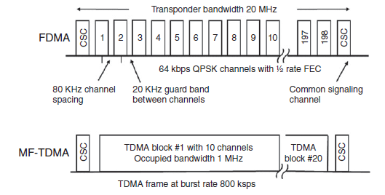
Demand Assignment Multiple Access (DAMA)
CSC is usually operated in random access mode.

Slide 37
Random Access (RA)
Random access is a widely used satellite multiple access technique where the traffic density from individual users is low.
These users can share transponder space without any central control or allocation of time or frequency; a user transmits packets whenever they are available.
The packet has a destination address, and a source address. All stations receive the packet and the station with the correct address stores the data contained in the packet and sends an acknowledgement back to the transmitting station.

Slide 38
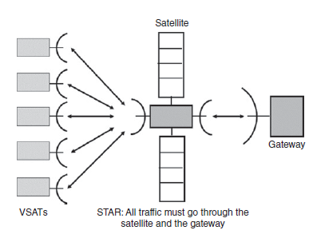
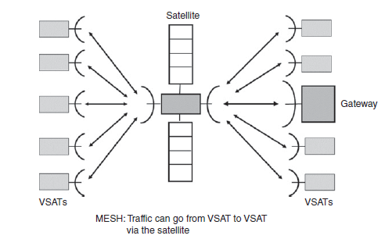
Star and Mesh Networks
The selection of a multiple access technique depends heavily of the way a satellite communication network is organized.
Two basic networks in GEO satellite
Star network
Mesh network

Slide 39
Star and Mesh Networks
Star network:
A Gateway or Hub earth station generates all outbound or forward traffic as one or more high speed TDM bit streams consisting of packets addressed to individual receiving earth stations.
The gateway station sends its uplink signals to one or more transponders on the satellite and the satellite retransmits the bit streams to all the receiving terminals in the network.
The gateway station controls the entire network, and in a TDMA system controls the timing of bursts from the VSAT terminals.
Mesh network:
All terminals have the same status, and control of the network is by mutual agreement between the terminals.
A single frequency slot in FDMA or a single time slot in TDMA is allocated as a request channel.
A station that wants to transmit packets looks for a vacant time slot within the TDMA frame or frequency slot in a SCPC FDMA system and sends a control packet.
All the other terminals make a note of the request and allow the transmitting terminal to transmit packets within set limits
When the transmitting terminal has sent all of its data, a control packet is transmitted releasing the time or frequency slot.

Slide 40
Onboard Processing
Bent pipe transponder, which simply amplifies a signal received from earth and retransmits it back to earth at a different frequency.
Advantage: Flexibility, it can be used for any combination of signals that will fit within its bandwidth.
Example: Link between a small transmitting earth station and a large hub station via a bent pipe GEO satellite transponder. There will usually be a small rain fade margin on the uplink from the transmitting station. CNR-Low; BER-High.
Forward error correction coding- which lowers the data throughput.
Onboard processing or a baseband processing transponder can overcome this problem by separating the uplink and downlink signals and their CNRs.
The baseband processing transponder can also have different modulation schemes on the uplink and downlink to improve spectral efficiency, and can dynamically apply forward error control to only those links affected by rain attenuation.

Slide 41
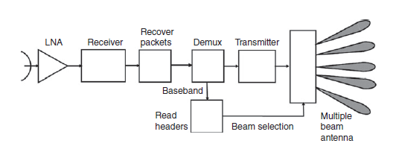
Onboard Processing
Baseband Processing Transponders:
It consist of
Receiver,
Baseband processing unit,
Transmitter.
Received signal converted to an IF demodulated to recover the baseband signal, which is then processed
and reassembled converted to downlink frequency Retransmit.
Baseband processing allows control information to be extracted from the uplink signal so that individual packets or frames can be routed to different downlink beams, and different modulation and coding can be applied on the downlinks.
With onboard processing on the satellite, the CNRs of the uplink and downlink are not tied together through the reciprocal CNR formula.

Slide 42
Onboard Processing
Multiple Beam Satellites:
The combination of multiple satellite beams and TDMA can provide a large increase in satellite capacity when OBP is employed.
If the satellite has a single beam with wide coverage, most of the transmitted energy goes to users who do not need that signal. Ideally, a very narrow beam covering only the location of the intended user would be much more efficient.
A satellite with multiple antenna beams can greatly increase the throughput of its transponders.
A satellite with multiple beam capability can have much narrower beams with higher gain than a satellite with a single fixed beam.

Slide 43
Satellite Switched TDMA
One advantage that TDMA has when used with a baseband processing transponder is Satellite Switched TDMA.
Instead of using a single antenna beam to maintain continuous communication with its entire coverage zone, the satellite has a number of narrow antenna beams that can be used to cover the zone.
A narrow antenna beam has a higher gain than a broad beam, which increases the satellite EIRP and therefore increases the capacity of the downlink.
Uplink signals received by the satellite are demodulated to recover the bit streams, which are structured as a sequence of packets addressed to different receiving earth stations.
The satellite creates TDMA frames of data that contain packets addressed to specific earth stations within each downlink beam- control of the TDMA network timing could now be on board the satellite, rather than at a master earth station.

