Slide 1
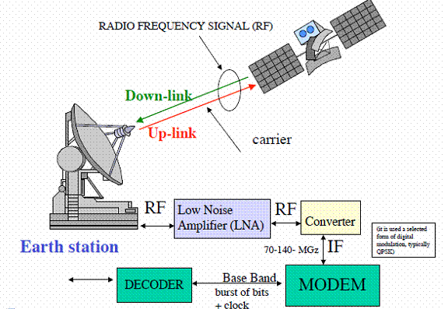
Module:5
Satellite Link Design

Slide 2
Module-5
Basic transmission theory
System noise temperature and G/T Ratio
Noise figure and noise temperature
Calculation of system noise temperature
G/T ratio for earth stations
Link budgets
Uplink and downlink budget calculations
Error control for digital satellite links –
Prediction of rain attenuation and propagation impairment counter measures.

Slide 3
Introduction
Design of a satellite communication system is a complex process requiring compromises between many factors to achieve the best performance at an acceptable cost.
Weight is the most critical factor in design of any satellite, as an increase in weight directly leads to higher costs.
Overall dimension also an important factor because spacecraft must be fit within the launch vehicle.
The weight of a satellite is driven by two factors:
The number and output power of the transponders on the satellite - High power transponders require lots of electrical power, which can only be generated by solar cells.
The weight of station-keeping fuel.
Three other factors influence system design: the choice of frequency band, atmospheric propagation effects, and multiple access technique.

Slide 4
Introduction
Designing a satellite system requires
Knowledge of the required performance of the uplink and downlink,
The propagation characteristics and rain attenuation for the frequency band being used at the earth station locations
The parameters of the satellite and the earth stations.

Slide 5
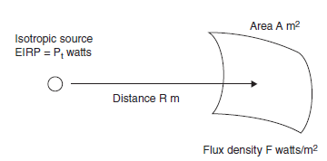
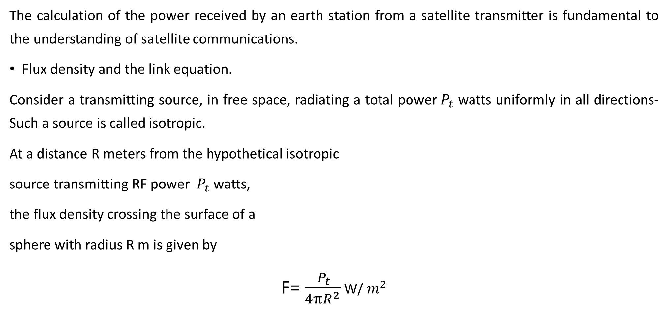
Basic Transmission Theory
The calculation of the power received by an earth station from a satellite transmitter is fundamental to the understanding of satellite communications.
Flux density and the link equation.
Consider a transmitting source, in free space, radiating a total power${ P}_{t}$ watts uniformly in all directions- Such a source is called isotropic.
At a distance R meters from the hypothetical isotropic
source transmitting RF power ${ P}_{t}$ watts,
the flux density crossing the surface of a
sphere with radius R m is given by
F= $\frac{{ P}_{t}}{4{πR}^{2}}$ W/ $m^{2}$

Slide 6
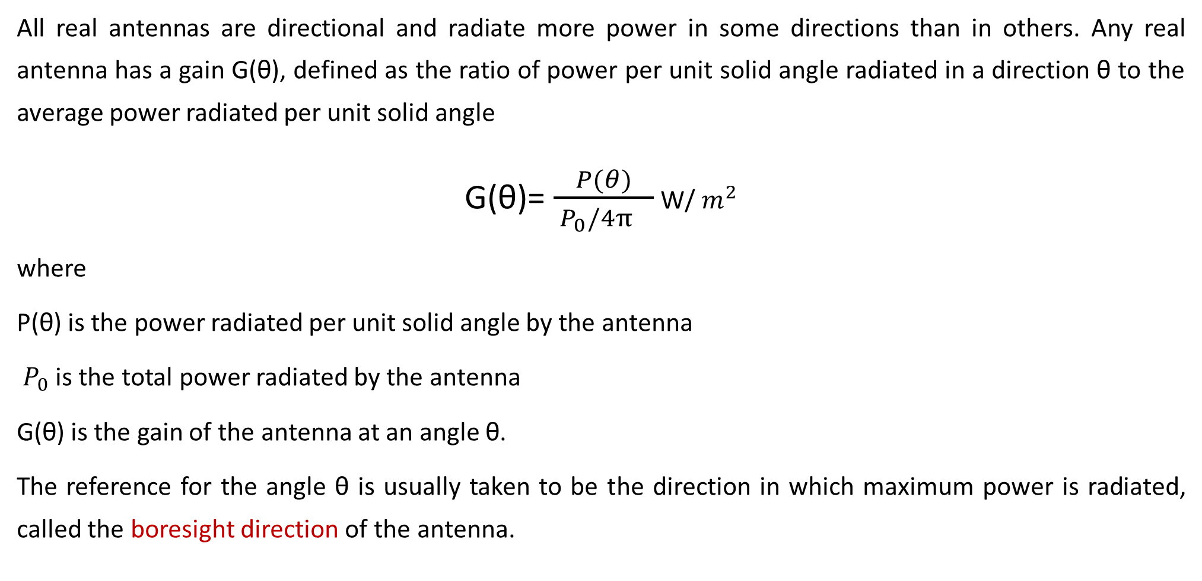
Basic Transmission Theory
All real antennas are directional and radiate more power in some directions than in others. Any real antenna has a gain G(θ), defined as the ratio of power per unit solid angle radiated in a direction θ to the average power radiated per unit solid angle
G(θ)= $\frac{P(θ)}{{ P}_{0}/4π^{}}$ W/ $m^{2}$
where
P(θ) is the power radiated per unit solid angle by the antenna
${ P}_{0}$ is the total power radiated by the antenna
G(θ) is the gain of the antenna at an angle θ.
The reference for the angle θ is usually taken to be the direction in which maximum power is radiated, called the boresight direction of the antenna.

Slide 7
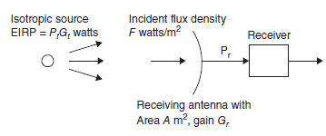
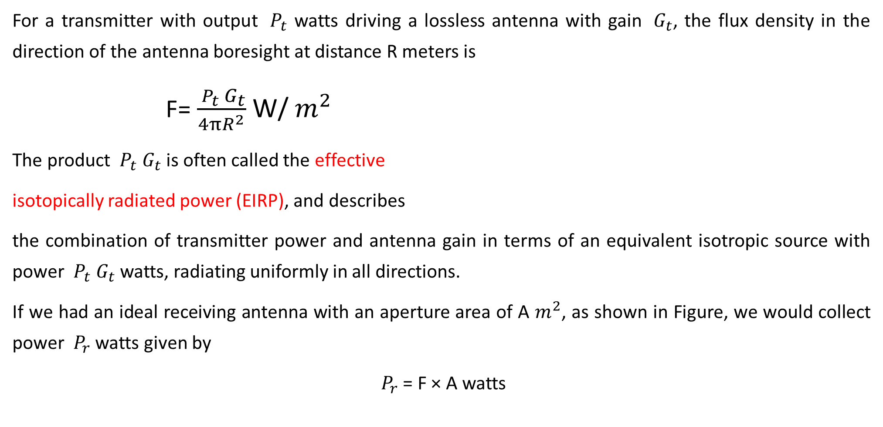
Basic Transmission Theory
For a transmitter with output ${ P}_{t}$ watts driving a lossless antenna with gain ${ G}_{t}$, the flux density in the direction of the antenna boresight at distance R meters is
F= $\frac{{ P}_{t}{ G}_{t}}{4{πR}^{2}}$ W/ $m^{2}$
The product ${ P}_{t}{ G}_{t}$is often called the effective
isotopically radiated power (EIRP), and describes
the combination of transmitter power and antenna gain in terms of an equivalent isotropic source with power ${ P}_{t}{ G}_{t}$watts, radiating uniformly in all directions.
If we had an ideal receiving antenna with an aperture area of A $m^{2}$, as shown in Figure, we would collect power ${ P}_{r}$ watts given by
${ P}_{r}$ = F × A watts

Slide 8
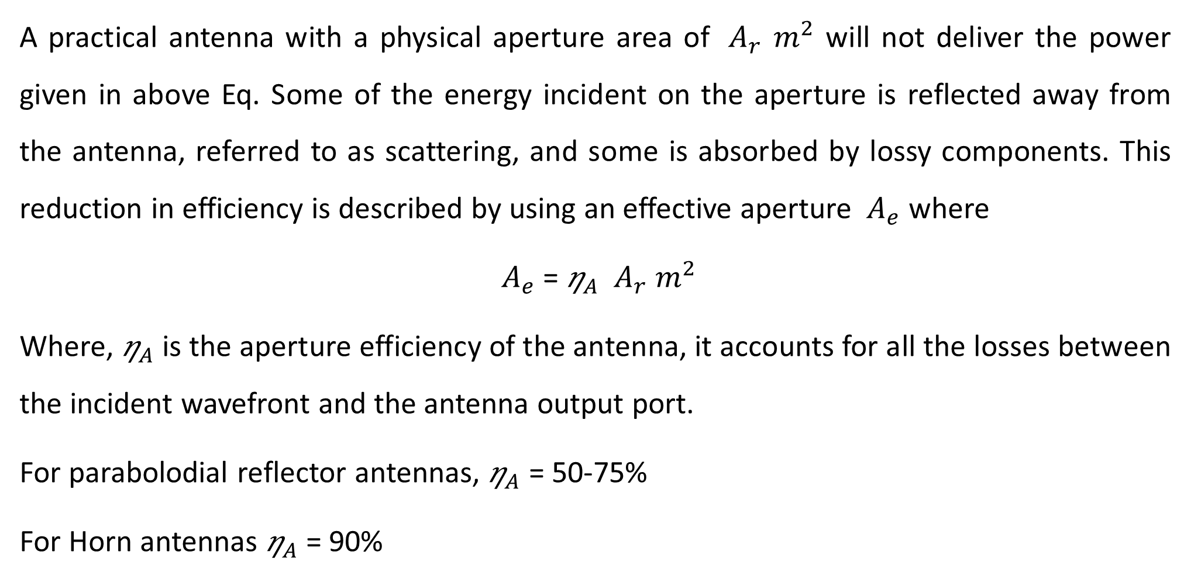
Basic Transmission Theory
A practical antenna with a physical aperture area of ${ A}_{r}$ $m^{2}$ will not deliver the power given in above Eq. Some of the energy incident on the aperture is reflected away from the antenna, referred to as scattering, and some is absorbed by lossy components. This reduction in efficiency is described by using an effective aperture ${ A}_{e}$ where
${ A}_{e}$ = ${\text{η}}_{A}$ ${ A}_{r}$ $m^{2}$
Where, ${\text{η}}_{A}$ is the aperture efficiency of the antenna, it accounts for all the losses between the incident wavefront and the antenna output port.
For parabolodial reflector antennas, ${\text{η}}_{A}$ = 50-75%
For Horn antennas ${\text{η}}_{A}$ = 90%

Slide 9
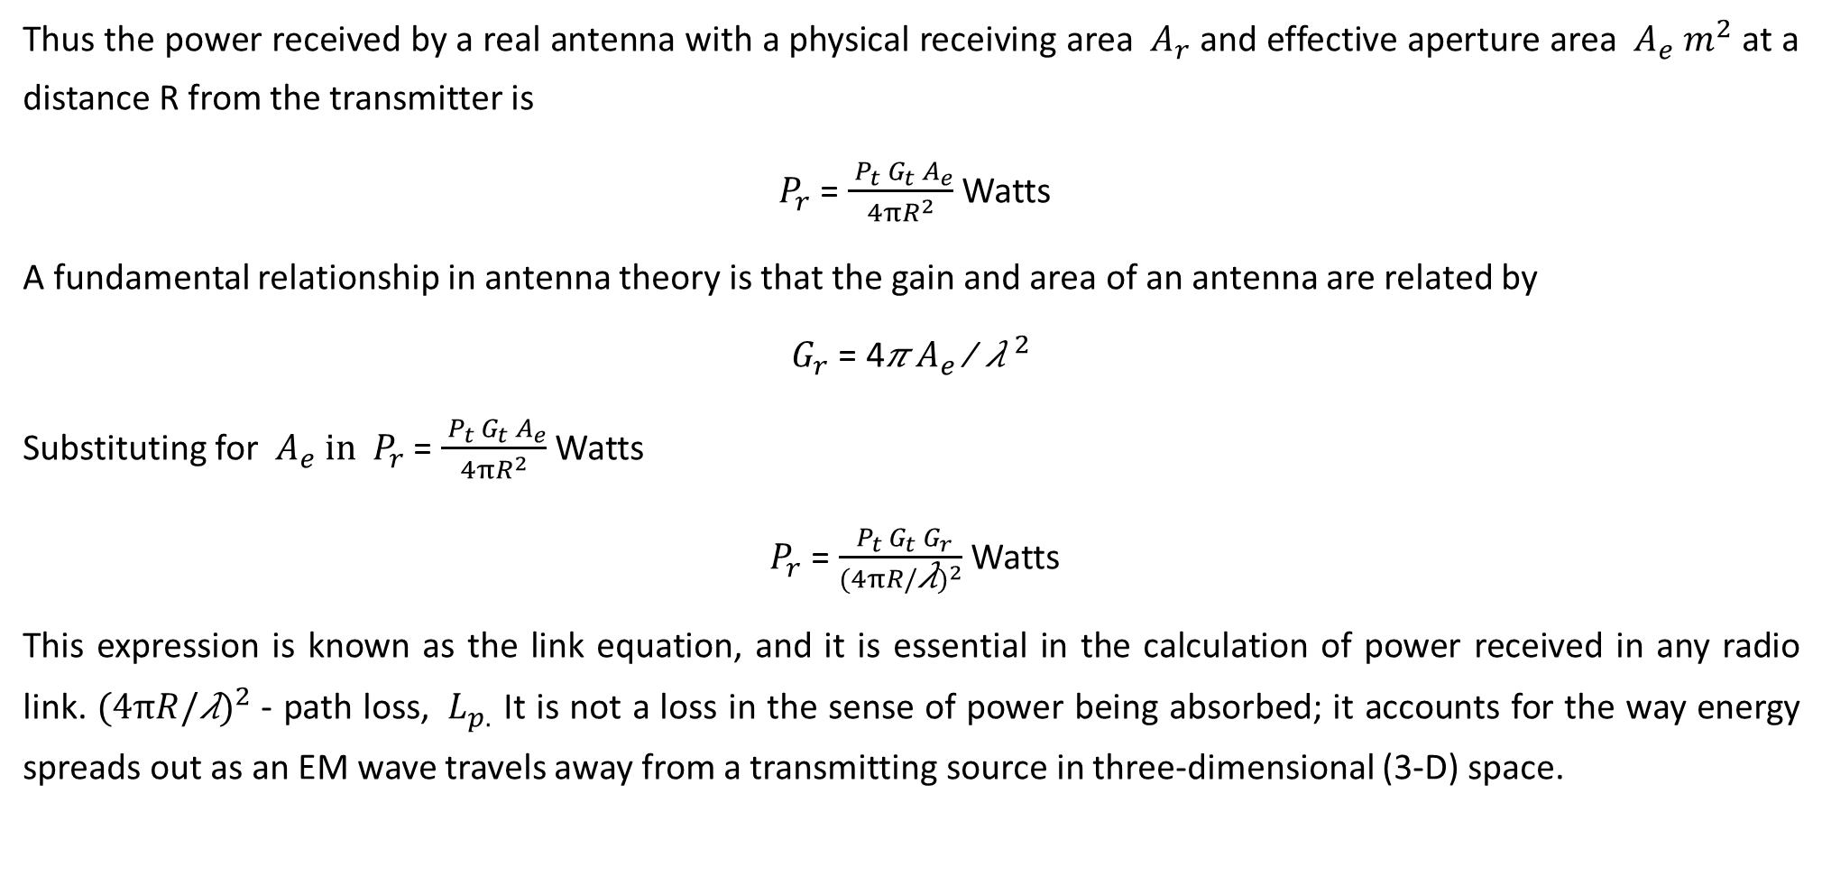
Basic Transmission Theory
Thus the power received by a real antenna with a physical receiving area ${ A}_{r}$ and effective aperture area ${ A}_{e}$ $m^{2}$ at a distance R from the transmitter is
${ P}_{r}$ = $\frac{{ P}_{t}{ G}_{t}{ A}_{e}}{4{πR}^{2}}$ Watts
A fundamental relationship in antenna theory is that the gain and area of an antenna are related by
${ G}_{r}$ = 4𝜋 $A_{e}$∕ ${\text{λ} }^{2}$
Substituting for ${ A}_{e} in$ ${ P}_{r}$ = $\frac{{ P}_{t}{ G}_{t}{ A}_{e}}{4{πR}^{2}}$ Watts
${ P}_{r}$ = $\frac{{ P}_{t}{ G}_{t}{ G}_{r}}{(4{πR/\text{λ})}^{2}}$ Watts
This expression is known as the link equation, and it is essential in the calculation of power received in any radio link. $(4{πR/\text{λ})}^{2}$- path loss, ${ L}_{p.}$ It is not a loss in the sense of power being absorbed; it accounts for the way energy spreads out as an EM wave travels away from a transmitting source in three-dimensional (3-D) space.

Slide 10
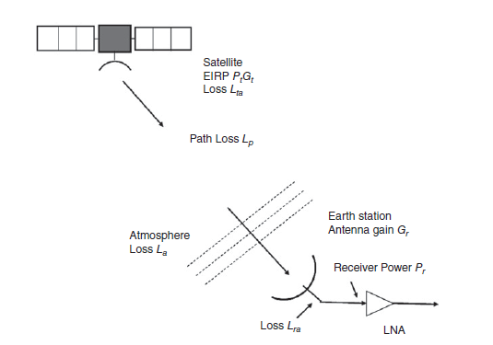
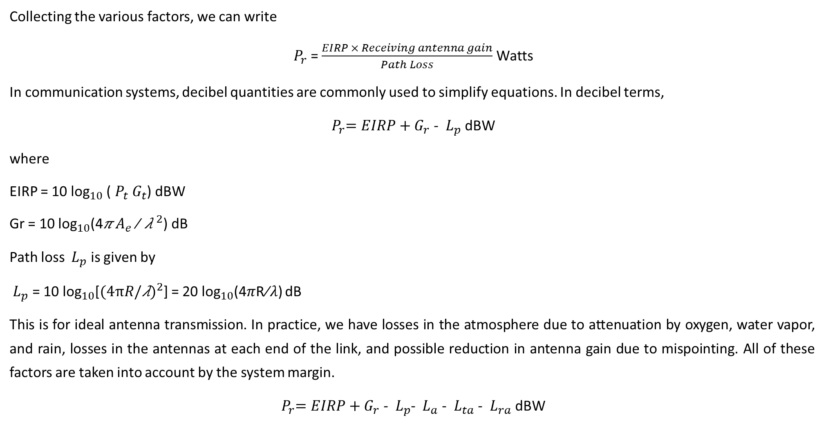
Basic Transmission Theory
Collecting the various factors, we can write
${ P}_{r}$ = $\frac{EIRP × Receiving antenna gain}{Path Loss}$ Watts
In communication systems, decibel quantities are commonly used to simplify equations. In decibel terms,
${{ P}_{r}=EIRP+G}_{r}$ - ${ L}_{p}$ dBW
where
EIRP = 10 ${\text{log}}_{10}$ (${ P}_{t}{ G}_{t}$) dBW
Gr = 10 ${\text{log}}_{10}$(4𝜋 $A_{e}$∕ ${\text{λ} }^{2}$) dB
Path loss ${ L}_{p}$ is given by
${ L}_{p}$ = 10 ${\text{log}}_{10}$[$(4{πR/\text{λ})}^{2}$] = 20 ${\text{log}}_{10}$(4𝜋R∕𝜆) dB
This is for ideal antenna transmission. In practice, we have losses in the atmosphere due to attenuation by oxygen, water vapor, and rain, losses in the antennas at each end of the link, and possible reduction in antenna gain due to mispointing. All of these factors are taken into account by the system margin.
${{ P}_{r}=EIRP+G}_{r}$ - ${ L}_{p}$- ${ L}_{a}$- ${ L}_{ta}$- ${ L}_{ra}$dBW

Slide 11
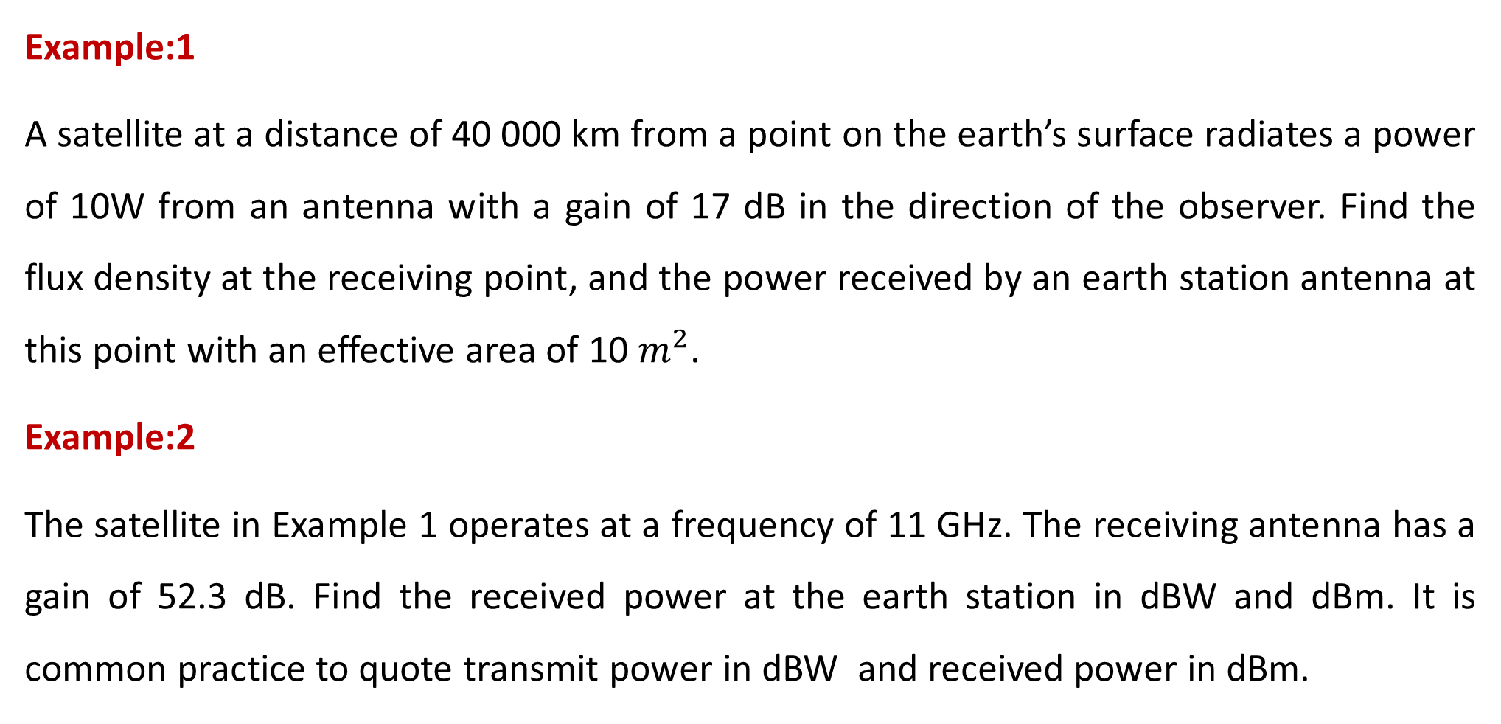
Basic Transmission Theory
Example:1
A satellite at a distance of 40 000 km from a point on the earth’s surface radiates a power of 10W from an antenna with a gain of 17 dB in the direction of the observer. Find the flux density at the receiving point, and the power received by an earth station antenna at this point with an effective area of 10 $m^{2}$.
Example:2
The satellite in Example 1 operates at a frequency of 11 GHz. The receiving antenna has a gain of 52.3 dB. Find the received power at the earth station in dBW and dBm. It is common practice to quote transmit power in dBW and received power in dBm.

Slide 12
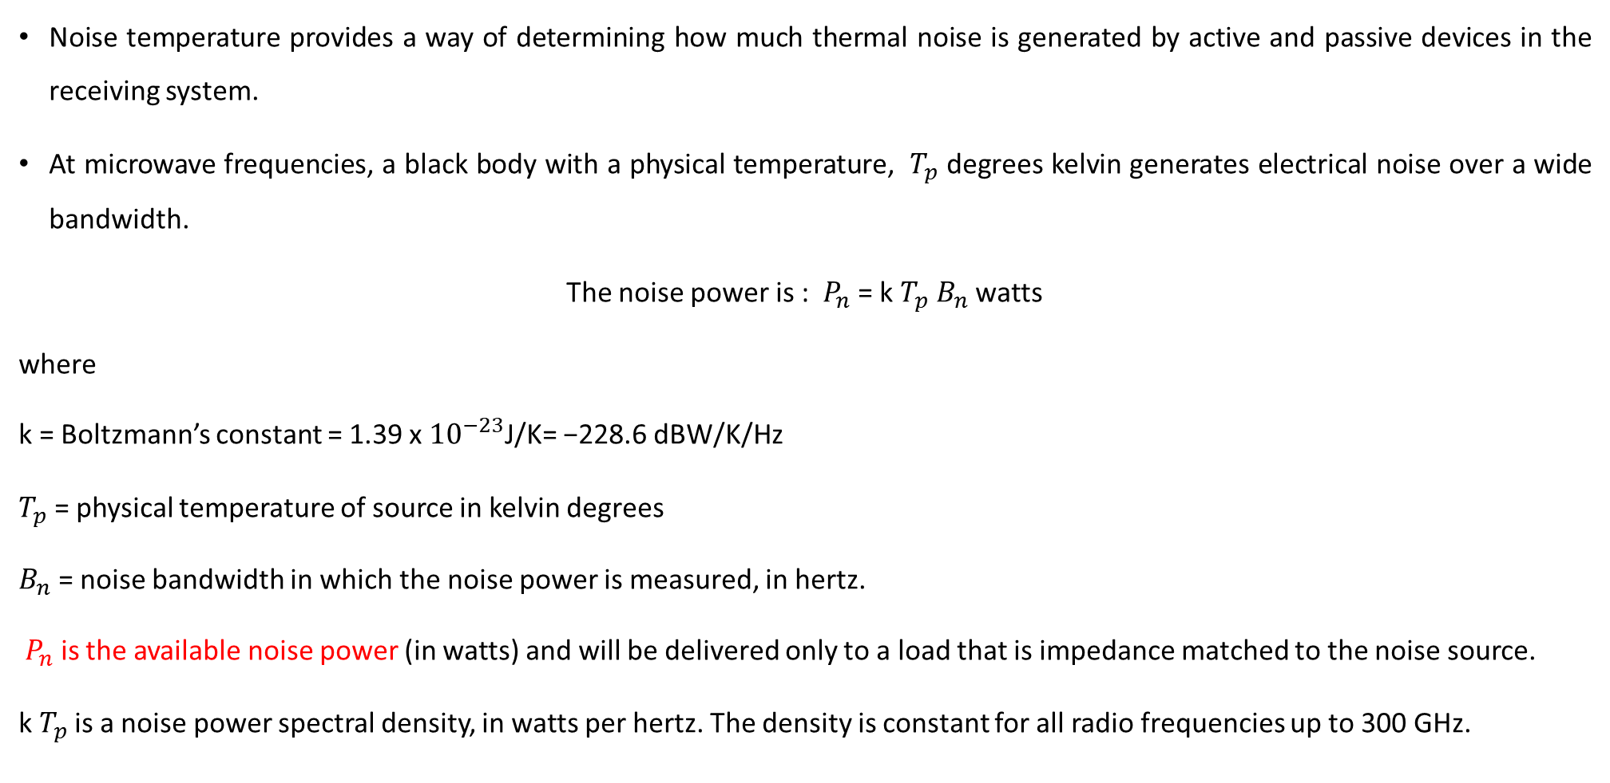
System Noise Temperature and G/T Ratio
Noise temperature provides a way of determining how much thermal noise is generated by active and passive devices in the receiving system.
At microwave frequencies, a black body with a physical temperature, ${ T}_{p}$ degrees kelvin generates electrical noise over a wide bandwidth.
The noise power is : ${ P}_{n}$ = k $T_{p} B_{n}$ watts
where
k = Boltzmann’s constant = 1.39 x ${10}^{−23}$J/K= −228.6 dBW/K/Hz
$T_{p}$ = physical temperature of source in kelvin degrees
$B_{n}$ = noise bandwidth in which the noise power is measured, in hertz.
${ P}_{n}$ is the available noise power (in watts) and will be delivered only to a load that is impedance matched to the noise source.
k $T_{p}$ is a noise power spectral density, in watts per hertz. The density is constant for all radio frequencies up to 300 GHz.

Slide 13
System Noise Temperature and G/T Ratio
In satellite communication systems we are always working with very weak signals and must make the noise level as low as possible to meet the CNR requirements.
This is done by making the bandwidth in the receiver, to be just large enough to allow the signal unrestricted, while keeping the noise power to the lowest value possible.
We do not know the equivalent noise bandwidth and use the 3 dB bandwidth of our receiving system instead.
Amplifier noise temperatures from25 to 250K can be achieved without physical cooling for receivers in the frequency bands up to Ka-band when GaAsFET amplifiers are employed.
Noise temperature simply relates the noise produced by an amplifier to the thermal noise from a matched load at the same physical temperature placed at the input to the amplifier.

Slide 14
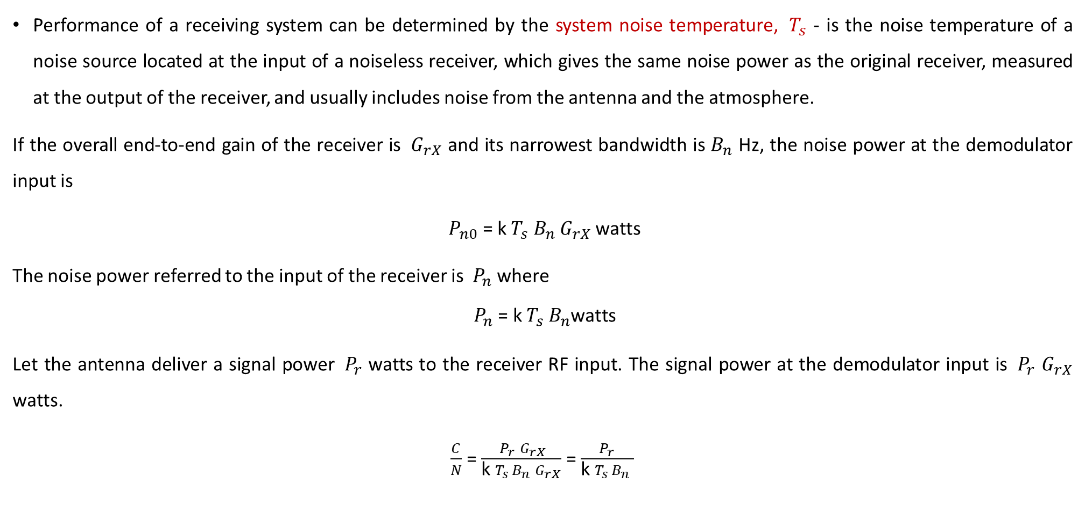
System Noise Temperature and G/T Ratio
Performance of a receiving system can be determined by the system noise temperature, ${ T}_{s}$ - is the noise temperature of a noise source located at the input of a noiseless receiver, which gives the same noise power as the original receiver, measured at the output of the receiver, and usually includes noise from the antenna and the atmosphere.
If the overall end-to-end gain of the receiver is ${ G}_{rX}$ and its narrowest bandwidth is $B_{n}$ Hz, the noise power at the demodulator input is
${ P}_{n0}$ = k $T_{s} B_{n}$ $G_{rX}$watts
The noise power referred to the input of the receiver is ${ P}_{n}$ where
$${ P}_{n}\text{ = }\text{k} T_{s} B_{n}\text{watts}$$
Let the antenna deliver a signal power ${ P}_{r}$ watts to the receiver RF input. The signal power at the demodulator input is ${ P}_{r}$ $G_{rX}$ watts.
$\frac{C}{N}$ = $\frac{{ P}_{r} G_{rX}}{\text{k} T_{s} B_{n} G_{rX}}$ = $\frac{{ P}_{r} }{\text{k} T_{s} B_{n} }$

Slide 15
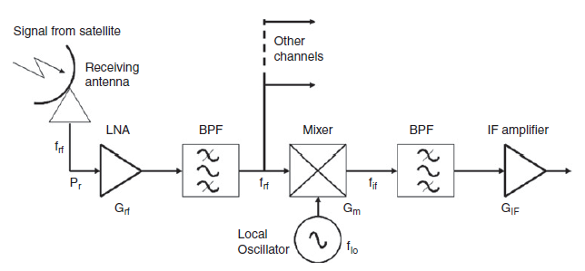
Calculation of System Noise Temperature
Figure shows a simplified communications receiver with an RF amplifier and single frequency conversion, from its RF input to the IF output.
The superhet receiver has three main subsystems: a front end (RF amplifier, mixer and local oscillator [LO]) an IF amplifier (IF amplifiers and filters), a demodulator, and a baseband section.
The RF amplifier is generates a little
noise , So it is called low noise amplifier.
The mixer and LO forms a frequency
conversion stage that down converts – RF to IF.
The IF signal then filtered and amplified accurately.

Slide 16
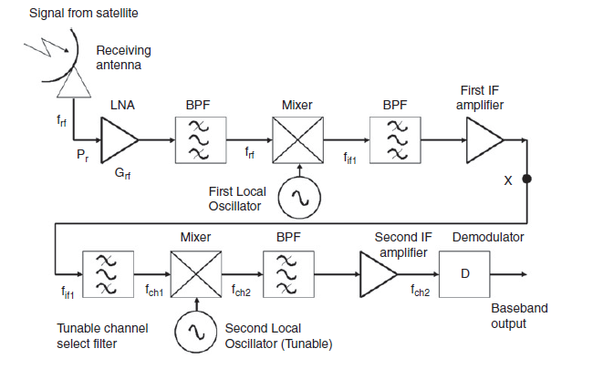
Calculation of System Noise Temperature
Many earth station Rx use the double superhet configuration, which has two stage frequency conversion.
The front end of the receiver- converts
Incoming RF signal to first IF in the range
900-1400MHz.
A unit that combines the LNA and
down converter is known as a low noise block converter (LNB).
IF signal is sent over a coaxial cable to a set-top receiver,
the indoor unit that contains another down converter and a tunable local oscillator. The local oscillator is tuned to convert the incoming signal from a selected transponder to a second IF frequency.
The second IF amplifier has a bandwidth matched to the spectrum of the wanted signal.

Slide 17
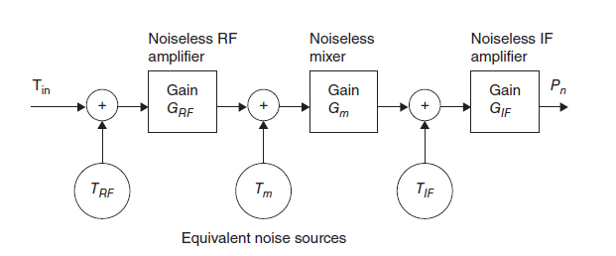

Slide 18
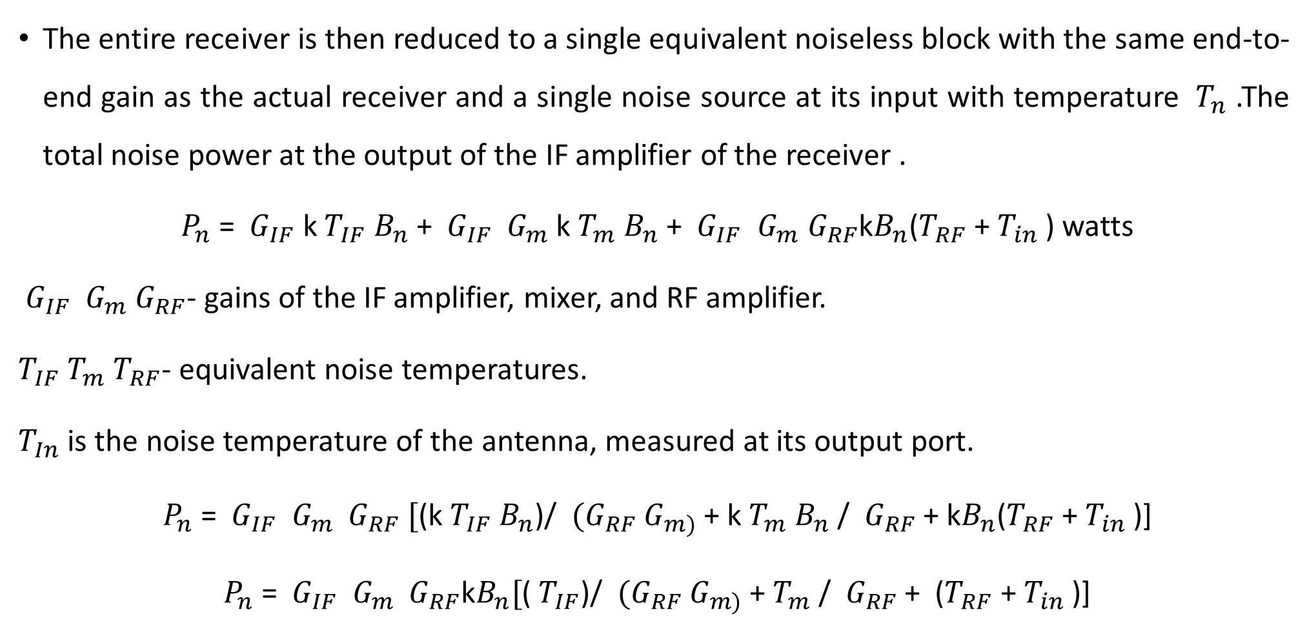
Calculation of System Noise Temperature
The entire receiver is then reduced to a single equivalent noiseless block with the same end-to-end gain as the actual receiver and a single noise source at its input with temperature ${ T}_{n}$ .The total noise power at the output of the IF amplifier of the receiver .
${ P}_{n}$ = ${ G}_{IF}$ k $T_{IF}$ $B_{n}$ + ${ G}_{IF}$ ${ G}_{m}$k $T_{m}$ $B_{n}$+ ${ G}_{IF}$ ${ G}_{m}{ G}_{RF}$k$B_{n}$($T_{RF}$ + $T_{in}$ ) watts
${ G}_{IF}$ ${ G}_{m}{ G}_{RF}$- gains of the IF amplifier, mixer, and RF amplifier.
$T_{IF}$ $T_{m}$ $T_{RF}$- equivalent noise temperatures.
$T_{In}$ is the noise temperature of the antenna, measured at its output port.
${ P}_{n}$ = ${ G}_{IF}$ ${ G}_{m}$ ${ G}_{RF} [$(k $T_{IF}$ $B_{n}$)/ ${ (G}_{RF}$ $G_{m)}$ + k $T_{m}$ $B_{n}$/ ${ G}_{RF}$ + k$B_{n}$($T_{RF}$ + $T_{in}$ )]
${ P}_{n}$ = ${ G}_{IF}$ ${ G}_{m}$ ${ G}_{RF}\text{k}B_{n}[$( $T_{IF}$)/ ${ (G}_{RF}$ $G_{m)}$ + $T_{m}$ / ${ G}_{RF}$ + ($T_{RF}$ + $T_{in}$ )]

Slide 19
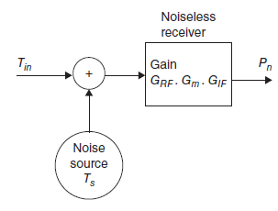
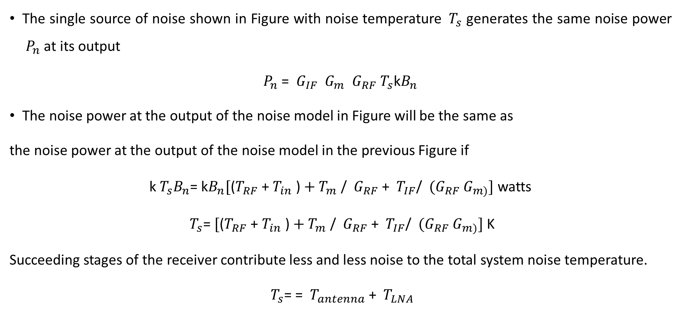
Calculation of System Noise Temperature
The single source of noise shown in Figure with noise temperature ${ T}_{s}$ generates the same noise power ${ P}_{n}$ at its output
$P_{n}$ = ${ G}_{IF}$ ${ G}_{m}$ ${ G}_{RF}{ T}_{s}\text{k}B_{n}$
The noise power at the output of the noise model in Figure will be the same as
the noise power at the output of the noise model in the previous Figure if
$\text{k}{{ T}_{s}B}_{n}$= $\text{k}B_{n}[{\text{(}T_{RF}\text{ + }T_{in}\text{ )}+T}_{m}\text{ / }{ G}_{RF}\text{ + }$ $T_{IF}$/ ${ (G}_{RF}$ $G_{m)}]$ watts
${ T}_{s}$= $[{\text{(}T_{RF}\text{ + }T_{in}\text{ )}+T}_{m}\text{ / }{ G}_{RF}\text{ + }$ $T_{IF}$/ ${ (G}_{RF}$ $G_{m)}]$ K
Succeeding stages of the receiver contribute less and less noise to the total system noise temperature.
${ T}_{s}$= = ${ T}_{antenna}$ + ${ T}_{LNA}$

Slide 20
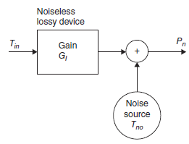
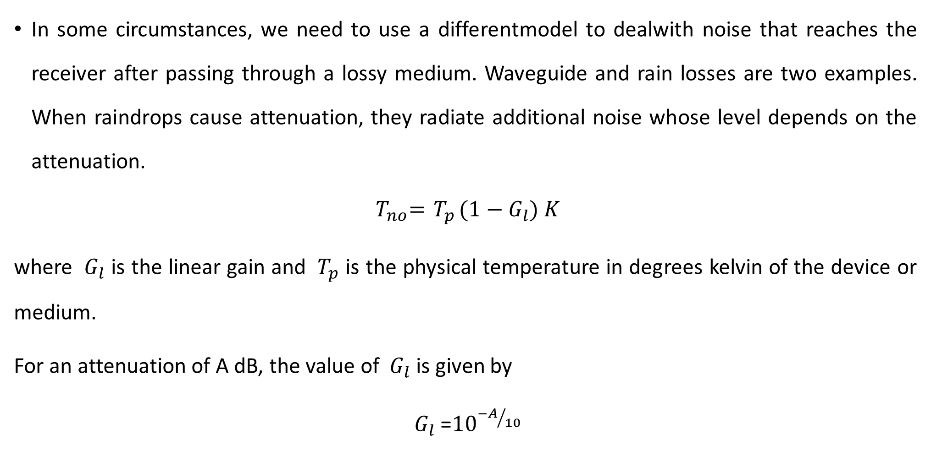
Calculation of System Noise Temperature
In some circumstances, we need to use a differentmodel to dealwith noise that reaches the receiver after passing through a lossy medium. Waveguide and rain losses are two examples. When raindrops cause attenuation, they radiate additional noise whose level depends on the attenuation.
$${ T}_{no}={ T}_{p}(1 −{ G}_{l}) K$$
where ${ G}_{l}$ is the linear gain and ${ T}_{p}$ is the physical temperature in degrees kelvin of the device or medium.
For an attenuation of A dB, the value of ${ G}_{l}$ is given by
${ G}_{l}$ =${10}^{{−A}/{10}}$

Slide 21
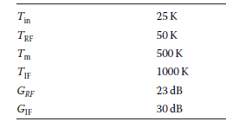
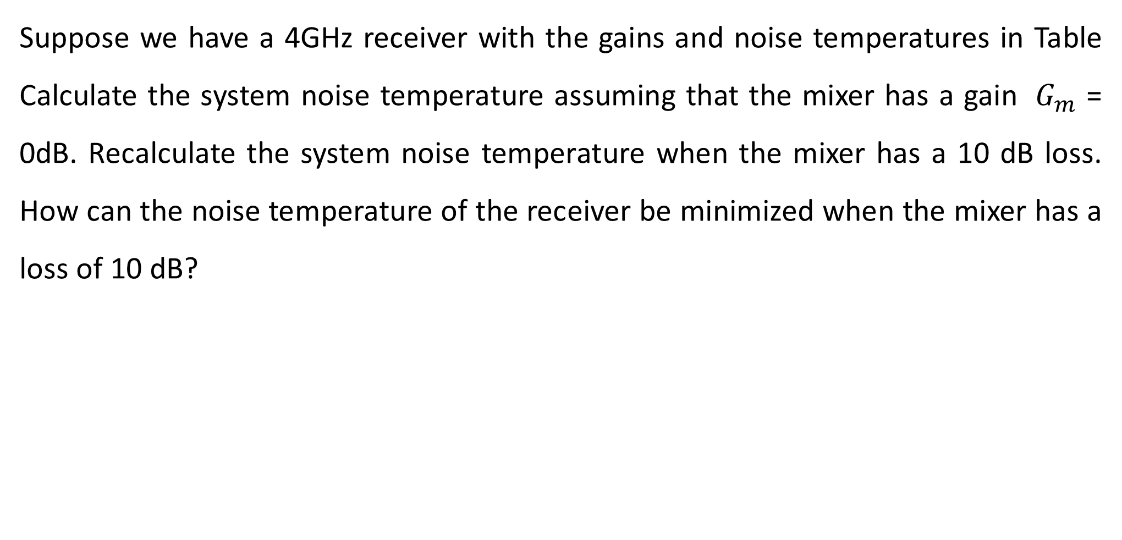
Example:3
Suppose we have a 4GHz receiver with the gains and noise temperatures in Table Calculate the system noise temperature assuming that the mixer has a gain ${ G}_{m}$ = 0dB. Recalculate the system noise temperature when the mixer has a 10 dB loss. How can the noise temperature of the receiver be minimized when the mixer has a loss of 10 dB?

Slide 22
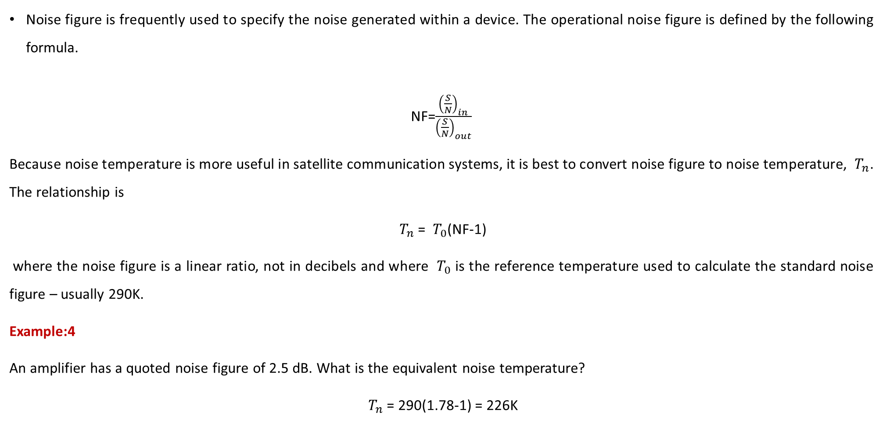
Noise figure and Noise Temperature
Noise figure is frequently used to specify the noise generated within a device. The operational noise figure is defined by the following formula.
NF=$\frac{{\left(\frac{S}{N}\right)}_{in}}{{\left(\frac{S}{N}\right)}_{out}}$
Because noise temperature is more useful in satellite communication systems, it is best to convert noise figure to noise temperature, ${ T}_{n}$. The relationship is
${ T}_{n}$= ${ T}_{0}$(NF-1)
where the noise figure is a linear ratio, not in decibels and where ${ T}_{0}$ is the reference temperature used to calculate the standard noise figure – usually 290K.
Example:4
An amplifier has a quoted noise figure of 2.5 dB. What is the equivalent noise temperature?
${ T}_{n}$= 290(1.78-1) = 226K

Slide 23
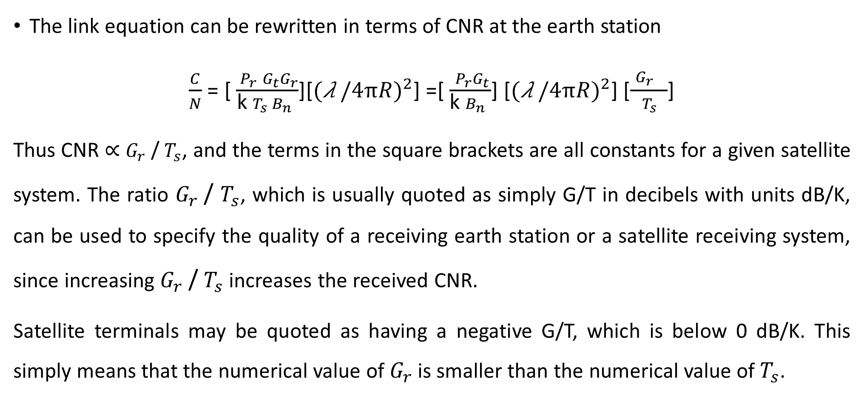
G/T Ratio for Earth Stations
The link equation can be rewritten in terms of CNR at the earth station
$\frac{C}{N}$ = [ $\frac{{ P}_{r} {G_{t}G}_{r}}{\text{k} T_{s} B_{n} }$][$(\text{λ} {/4πR)}^{2}$] =[ $\frac{{ P}_{r}G_{t}}{\text{k} B_{n} }$] [$(\text{λ} {/4πR)}^{2}$] [$\frac{ {G_{r}}_{}}{ T_{s} }$]
Thus CNR ∝ $G_{r}$/ $T_{s}$, and the terms in the square brackets are all constants for a given satellite system. The ratio $G_{r}$/ $T_{s}$, which is usually quoted as simply G/T in decibels with units dB/K, can be used to specify the quality of a receiving earth station or a satellite receiving system, since increasing $G_{r}$/ $T_{s}$increases the received CNR.
Satellite terminals may be quoted as having a negative G/T, which is below 0 dB/K. This simply means that the numerical value of $G_{r}$ is smaller than the numerical value of $T_{s}$.

Slide 24
Example:5
An earth station antenna has a diameter of 30m with an aperture efficiency of 68% and
is used to receive a signal at 4150MHz. At this frequency, the system noise temperature
is 60K when the antenna points at the satellite at an elevation angle of 28°.What is the
earth station G/T ratio under these conditions? If heavy rain causes the sky temperature
to increase so that the system noise temperature rises to 88K,what is the new G/T value?

Slide 25
Link Budgets
The design of any satellite communication is based on two objectives: meeting a minimum CNR for a specified percentage of time, and carrying the maximum revenue earning traffic at minimum cost.
Calculation of CNR in a receiver is simplified by the use of link budgets.
A link budget is a tabular method for evaluating the received power and noise power in a radio link.
Link budgets invariably use decibel units for all quantities so that signal and noise powers can be calculated by addition and subtraction.
The link budget must be calculated for an individual transponder, and must be repeated for each of the individual links.
When a bent pipe transponder is used the uplink and downlink CNRs must be combined to give an overall CNR.

Slide 26
Link Budgets
Link budgets are usually calculated for a worst case, the one in which the link will have the lowest CNR.
Factors that contribute to a worst-case scenario include:
An earth station located at the edge of the satellite coverage zone or spot beam where the received signal is typically 3 dB lower than in the center of the beam;
Maximum path length from the satellite to the earth station;
Low elevation angle at the earth station giving the highest atmospheric path attenuation in clear air;
Maximum rain attenuation on the link causing loss of received signal power and an increase in receiving system noise temperature.
If the antenna is mispointed, a loss factor is included in the link budget to account for the reduction in antenna gain.

Slide 27
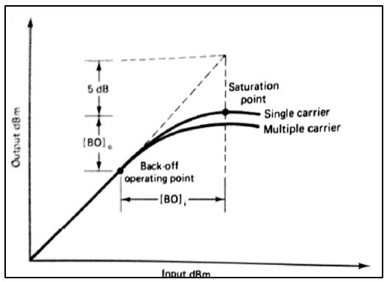
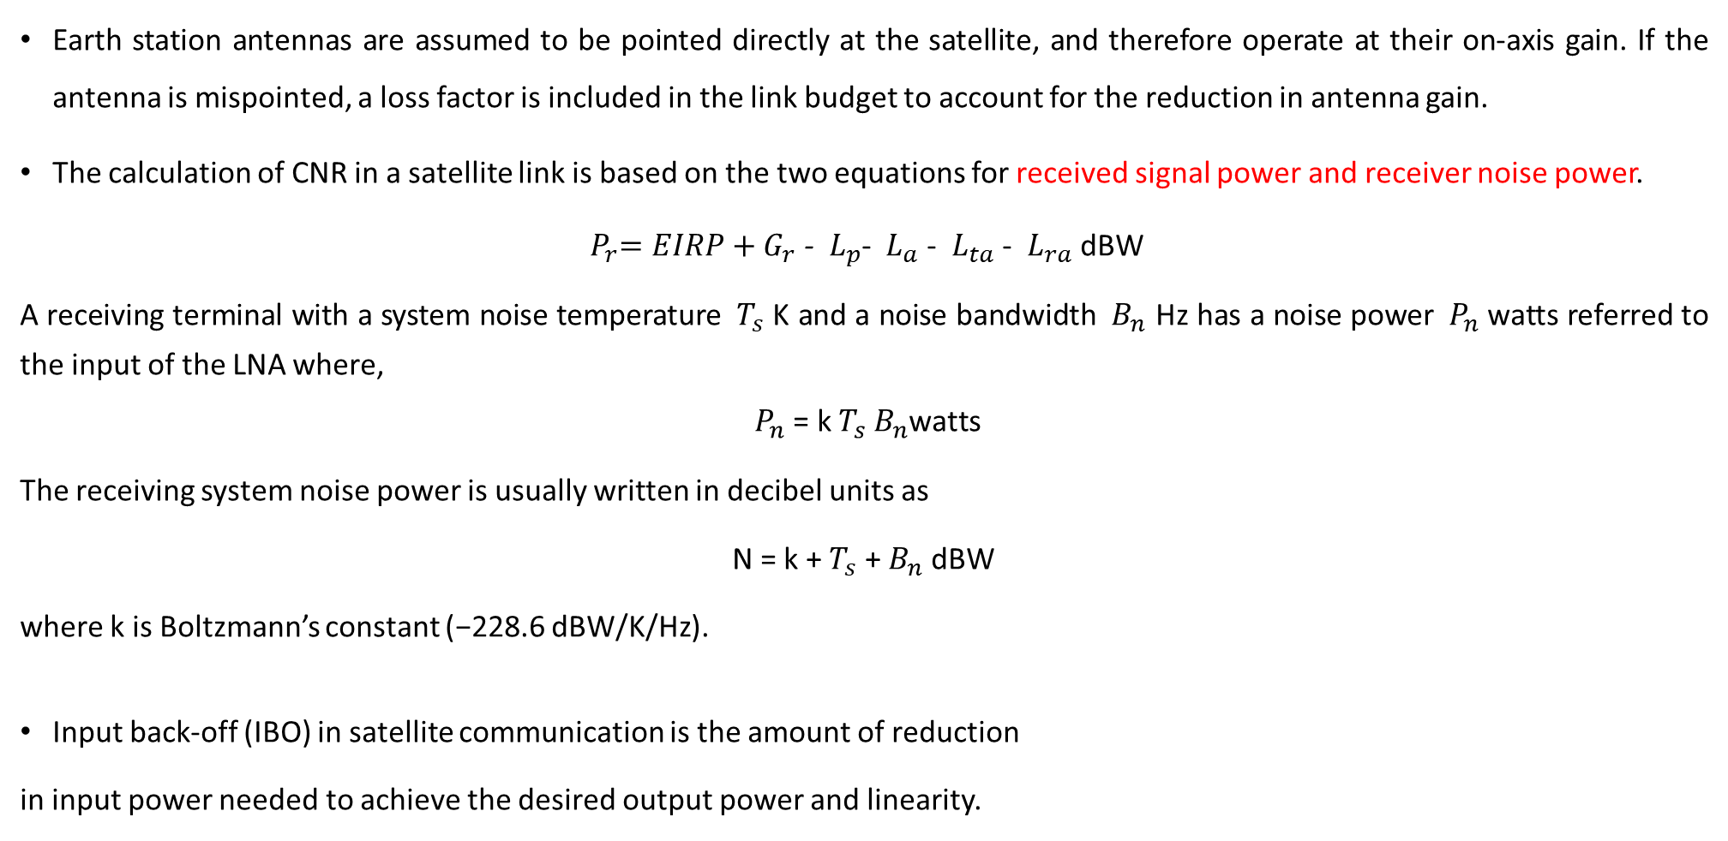
Link Budgets
Earth station antennas are assumed to be pointed directly at the satellite, and therefore operate at their on-axis gain. If the antenna is mispointed, a loss factor is included in the link budget to account for the reduction in antenna gain.
The calculation of CNR in a satellite link is based on the two equations for received signal power and receiver noise power.
${{ P}_{r}=EIRP+G}_{r}$ - ${ L}_{p}$- ${ L}_{a}$- ${ L}_{ta}$- ${ L}_{ra}$dBW
A receiving terminal with a system noise temperature ${ T}_{s}$ K and a noise bandwidth ${ B}_{n}$ Hz has a noise power ${ P}_{n}$ watts referred to the input of the LNA where,
$${ P}_{n}\text{ = }\text{k} T_{s} B_{n}\text{watts}$$
The receiving system noise power is usually written in decibel units as
N = k + $T_{s}$ + $B_{n}$ dBW
where k is Boltzmann’s constant (−228.6 dBW/K/Hz).
Input back-off (IBO) in satellite communication is the amount of reduction
in input power needed to achieve the desired output power and linearity.

Slide 28
Example:6
A LEO satellite has a multi-beam antenna with a gain of 18 dB in each beam. A transponder with transmitter output power of 0.5 watts at 2.5 GHz is connected to one antenna beam. An earth station is located at the edge of the coverage zone of this beam, where the received power is 3 dB below that at the center of the beam, and at a range of 2,000 km from the satellite. Using decibels for all calculations, find:
a) The power received by an antenna with a gain of +1 dB, in dBW.
b) The noise power of the earth station receiver for a noise temperature of 260K and an RF channel bandwidth of 20 kHz.
c) The C/N ratio in dB for the LEO signal at the receiver output.

Slide 29
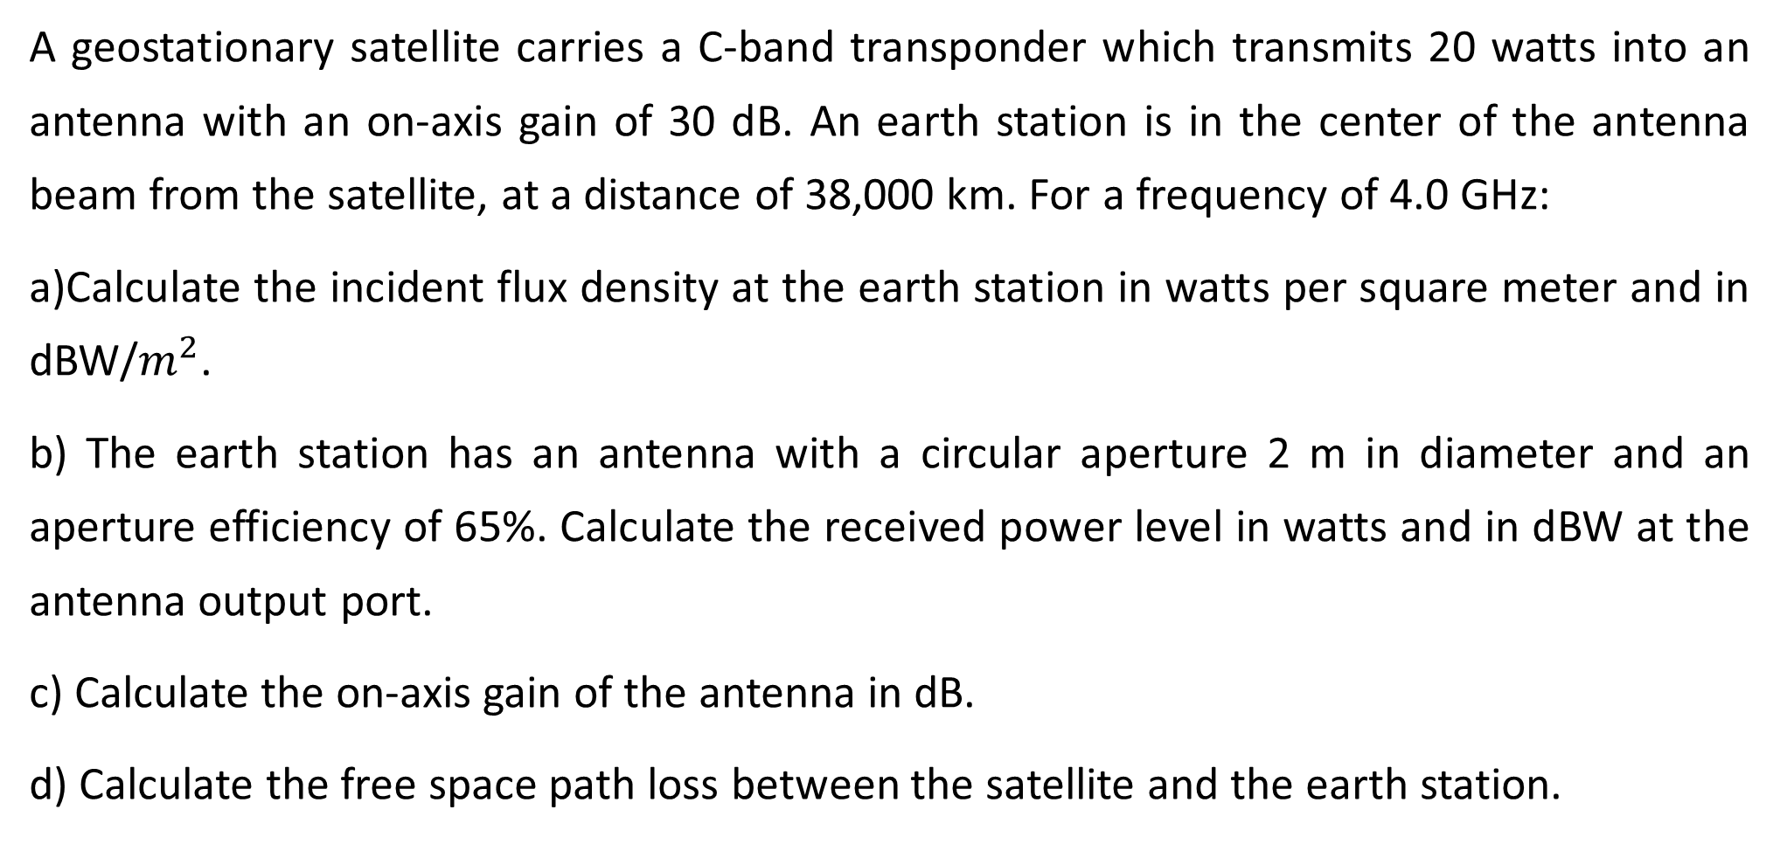
Example:7
A geostationary satellite carries a C-band transponder which transmits 20 watts into an antenna with an on-axis gain of 30 dB. An earth station is in the center of the antenna beam from the satellite, at a distance of 38,000 km. For a frequency of 4.0 GHz:
a)Calculate the incident flux density at the earth station in watts per square meter and in dBW/$m^{2}$.
b) The earth station has an antenna with a circular aperture 2 m in diameter and an aperture efficiency of 65%. Calculate the received power level in watts and in dBW at the antenna output port.
c) Calculate the on-axis gain of the antenna in dB.
d) Calculate the free space path loss between the satellite and the earth station.

Slide 30
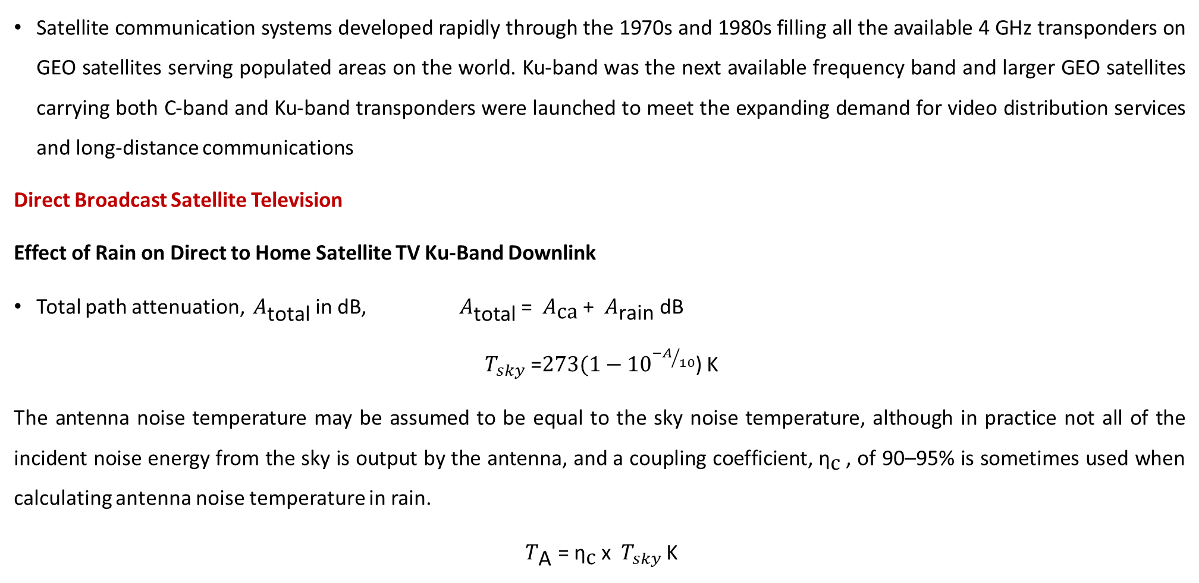
Ku- band geo satellite system
Satellite communication systems developed rapidly through the 1970s and 1980s filling all the available 4 GHz transponders on GEO satellites serving populated areas on the world. Ku-band was the next available frequency band and larger GEO satellites carrying both C-band and Ku-band transponders were launched to meet the expanding demand for video distribution services and long-distance communications
Direct Broadcast Satellite Television
Effect of Rain on Direct to Home Satellite TV Ku-Band Downlink
Total path attenuation, ${ A}_{\text{total}}$in dB, ${ A}_{\text{total}}$ = ${ A}_{\text{ca}}$ + ${ A}_{\text{rain}}$ dB
${ T}_{sky}$ =${273(1−10}^{{−A}/{10}}$) K
The antenna noise temperature may be assumed to be equal to the sky noise temperature, although in practice not all of the incident noise energy from the sky is output by the antenna, and a coupling coefficient, ${\text{η}}_{\text{c}}$, of 90–95% is sometimes used when calculating antenna noise temperature in rain.
${ T}_{\text{A}}$ = ${\text{η}}_{\text{c}}$x ${ T}_{sky}$ K

Slide 31
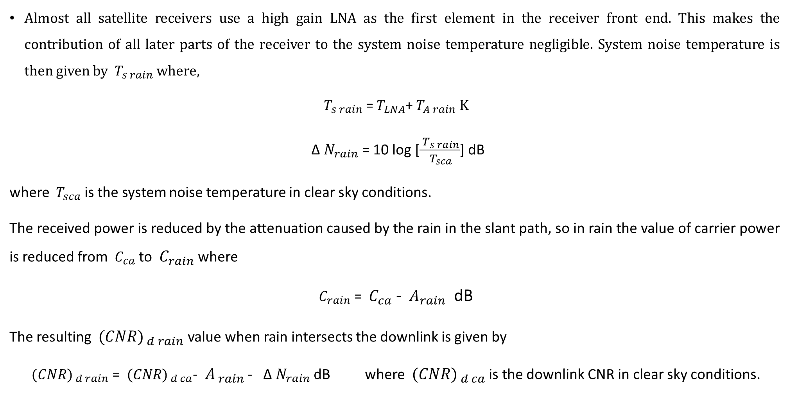
Ku- band geo satellite system
Almost all satellite receivers use a high gain LNA as the first element in the receiver front end. This makes the contribution of all later parts of the receiver to the system noise temperature negligible. System noise temperature is then given by ${ T}_{s rain}$where,
${ T}_{s rain}$=${ T}_{LNA}$+${ T}_{A rain} K$
${ \text{Δ} N}_{rain}$ = 10 log [$\frac{{ T}_{s rain}}{{ T}_{sca}}$] dB
where ${ T}_{sca}$ is the system noise temperature in clear sky conditions.
The received power is reduced by the attenuation caused by the rain in the slant path, so in rain the value of carrier power is reduced from ${ C}_{ca}$ to ${ C}_{rain}$ where
${ C}_{rain}$ = ${ C}_{ca}$ - ${ A}_{rain}$ dB
The resulting ${ (CNR)}_{ d rain}$ value when rain intersects the downlink is given by
${ (CNR)}_{ d rain}$ = ${ (CNR)}_{ d ca}$- ${ A}_{ rain}$ - ${ \text{Δ} N}_{rain}$ dB where ${ (CNR)}_{ d ca}$is the downlink CNR in clear sky conditions.

Slide 32
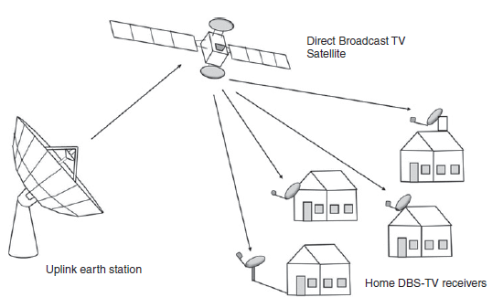
Ku- band geo satellite system

Slide 33
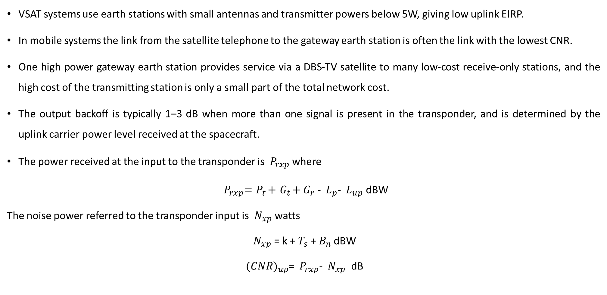
upLink Budgets
VSAT systems use earth stations with small antennas and transmitter powers below 5W, giving low uplink EIRP.
In mobile systems the link from the satellite telephone to the gateway earth station is often the link with the lowest CNR.
One high power gateway earth station provides service via a DBS-TV satellite to many low-cost receive-only stations, and the high cost of the transmitting station is only a small part of the total network cost.
The output backoff is typically 1–3 dB when more than one signal is present in the transponder, and is determined by the uplink carrier power level received at the spacecraft.
The power received at the input to the transponder is ${ P}_{rxp}$ where
${{ P}_{rxp}={ P}_{t}+{ G}_{t}+G}_{r}$ - ${ L}_{p}$- ${ L}_{up}$dBW
The noise power referred to the transponder input is ${ N}_{xp}$ watts
${ N}_{xp}$ = k + $T_{s}$ + $B_{n}$ dBW
${ (CNR)}_{up}$= ${ P}_{rxp}$- ${ N}_{xp}$ dB

Slide 34
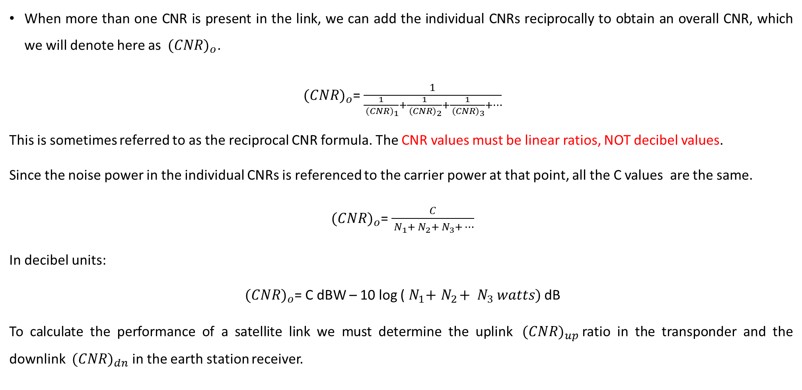
Design for Specified CNR
When more than one CNR is present in the link, we can add the individual CNRs reciprocally to obtain an overall CNR, which we will denote here as ${ (CNR)}_{o}$.
${ (CNR)}_{o}$= $\frac{1}{\frac{1}{{ \left(CNR\right)}_{1}}+\frac{1}{{ \left(CNR\right)}_{2}}+\frac{1}{{ \left(CNR\right)}_{3}}+…}$
This is sometimes referred to as the reciprocal CNR formula. The CNR values must be linear ratios, NOT decibel values.
Since the noise power in the individual CNRs is referenced to the carrier power at that point, all the C values are the same.
${ (CNR)}_{o}$= $\frac{C}{{ N}_{1}+{ N}_{2}+{ N}_{3}+…}$
In decibel units:
${ (CNR)}_{o}$= C dBW – 10 log (${ N}_{1}+{ N}_{2}+{ N}_{3} watts)$ dB
To calculate the performance of a satellite link we must determine the uplink ${ (CNR)}_{up}$ratio in the transponder and the downlink ${ (CNR)}_{dn}$in the earth station receiver.

Slide 35
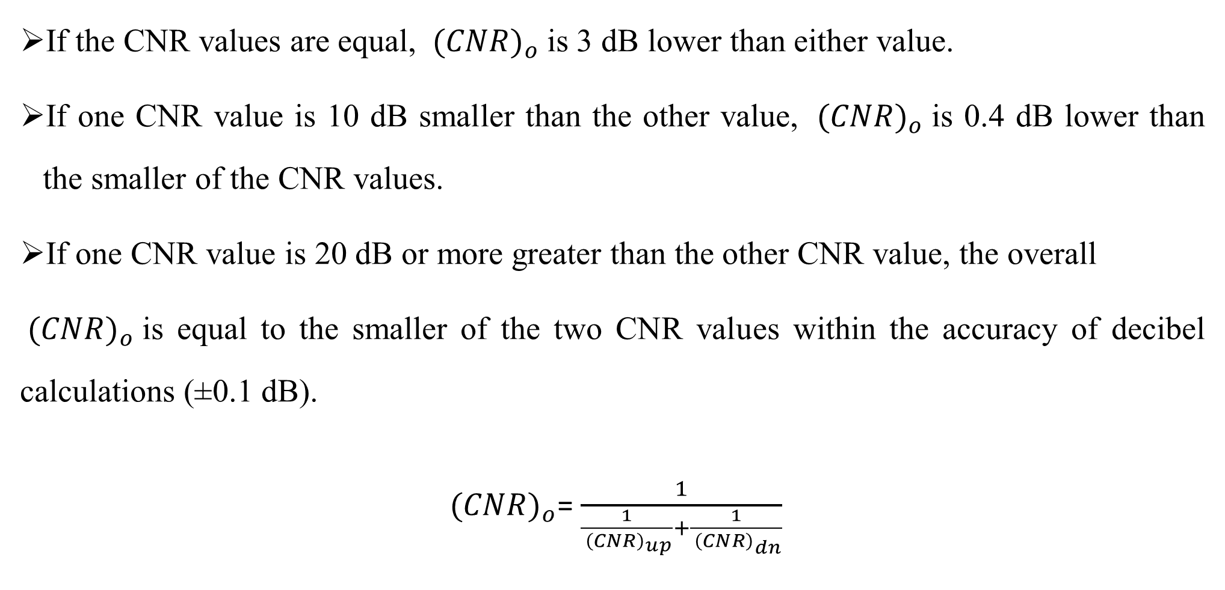
Design for Specified CNR
If the CNR values are equal, ${ (CNR)}_{o}$is 3 dB lower than either value.
If one CNR value is 10 dB smaller than the other value, ${ (CNR)}_{o}$is 0.4 dB lower than the smaller of the CNR values.
If one CNR value is 20 dB or more greater than the other CNR value, the overall
${ (CNR)}_{o}$is equal to the smaller of the two CNR values within the accuracy of decibel calculations (±0.1 dB).
${ (CNR)}_{o}$= $\frac{1}{\frac{1}{{ \left(CNR\right)}_{up}}+\frac{1}{{ \left(CNR\right)}_{dn}}}$

Slide 36
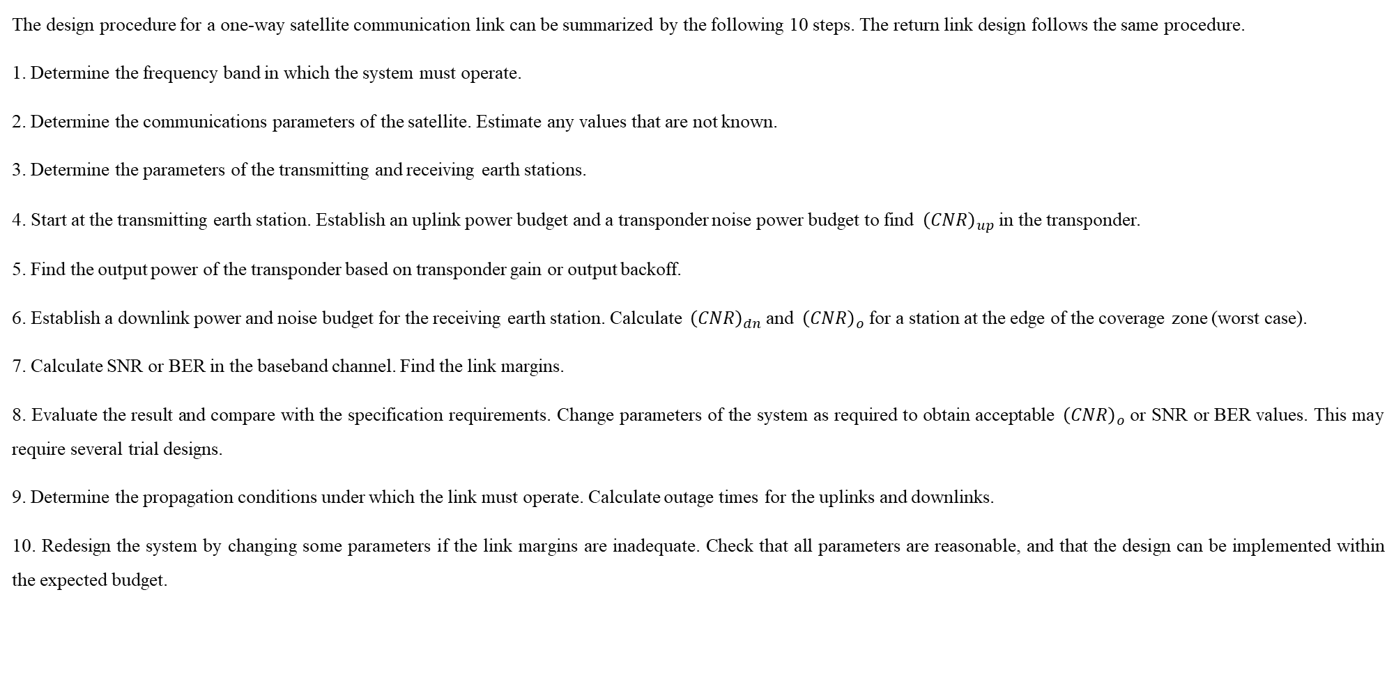
Satellite Communication Link Design Procedure
The design procedure for a one-way satellite communication link can be summarized by the following 10 steps. The return link design follows the same procedure.
1. Determine the frequency band in which the system must operate.
2. Determine the communications parameters of the satellite. Estimate any values that are not known.
3. Determine the parameters of the transmitting and receiving earth stations.
4. Start at the transmitting earth station. Establish an uplink power budget and a transponder noise power budget to find ${ \left(CNR\right)}_{up}$in the transponder.
5. Find the output power of the transponder based on transponder gain or output backoff.
6. Establish a downlink power and noise budget for the receiving earth station. Calculate ${ \left(CNR\right)}_{dn}$and ${ \left(CNR\right)}_{o}$for a station at the edge of the coverage zone (worst case).
7. Calculate SNR or BER in the baseband channel. Find the link margins.
8. Evaluate the result and compare with the specification requirements. Change parameters of the system as required to obtain acceptable ${ \left(CNR\right)}_{o}$or SNR or BER values. This may require several trial designs.
9. Determine the propagation conditions under which the link must operate. Calculate outage times for the uplinks and downlinks.
10. Redesign the system by changing some parameters if the link margins are inadequate. Check that all parameters are reasonable, and that the design can be implemented within the expected budget.

Slide 37
Example:8
This example examines the design of a satellite communication link using a Ku-band geostationary satellite with bent-pipe transponders to distribute digital TV signals from an uplink earth station to many receiving stations throughout the United States. The design requires a clear sky overall CNR of 17.0 dB at the receiving earth station, which will result in no bit errors in the received digital video signal when FEC encoding is applied to the transmitted signal. The minimum allowed overall CNR is 8.0 dB to ensure that the BER in the earth station receiver does not exceed 10^−6.

Slide 38
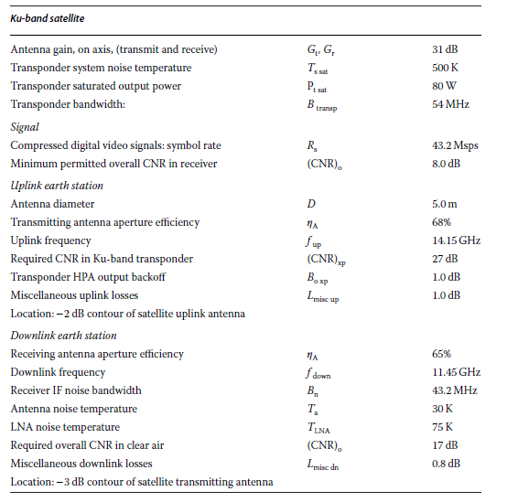
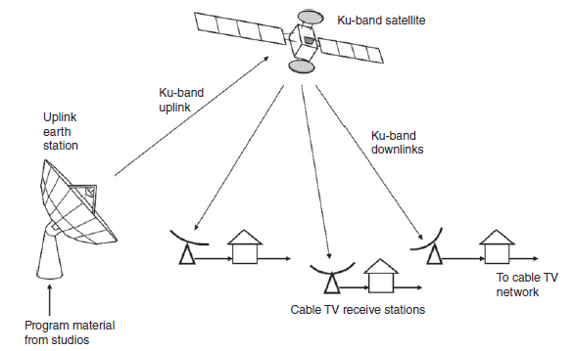
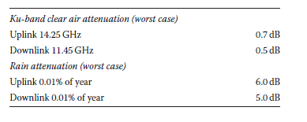
Example:8

Slide 39
Example:8
Ku-Band Uplink Design
We must first calculate uplink antenna gain and path loss. The uplink antenna has a
diameter of 5.0m and an aperture efficiency of 68%. At 14.15 GHz.

Slide 40
Example:9
A C-band earth station has an antenna with a transmit gain of 54 dB. The transmitter output power is set to 100 W at a frequency of 6.100 GHz. The signal is received by a satellite at a distance of 37,500 km by an antenna with a gain of 26 dB. The signal is then routed to a transponder with a noise temperature of 500 K, a bandwidth of 36 MHz, and a gain of 110 dB.
Calculate the path loss.
Calculate the power at the output port of the satellite antenna, in dBW.
Calculate the noise power at the transponder input, in dBW.
Calculate the C/N ratio, in dB, in the transponder.
Calculate the carrier power, in dBW and in watts, at the transponder output

Slide 41
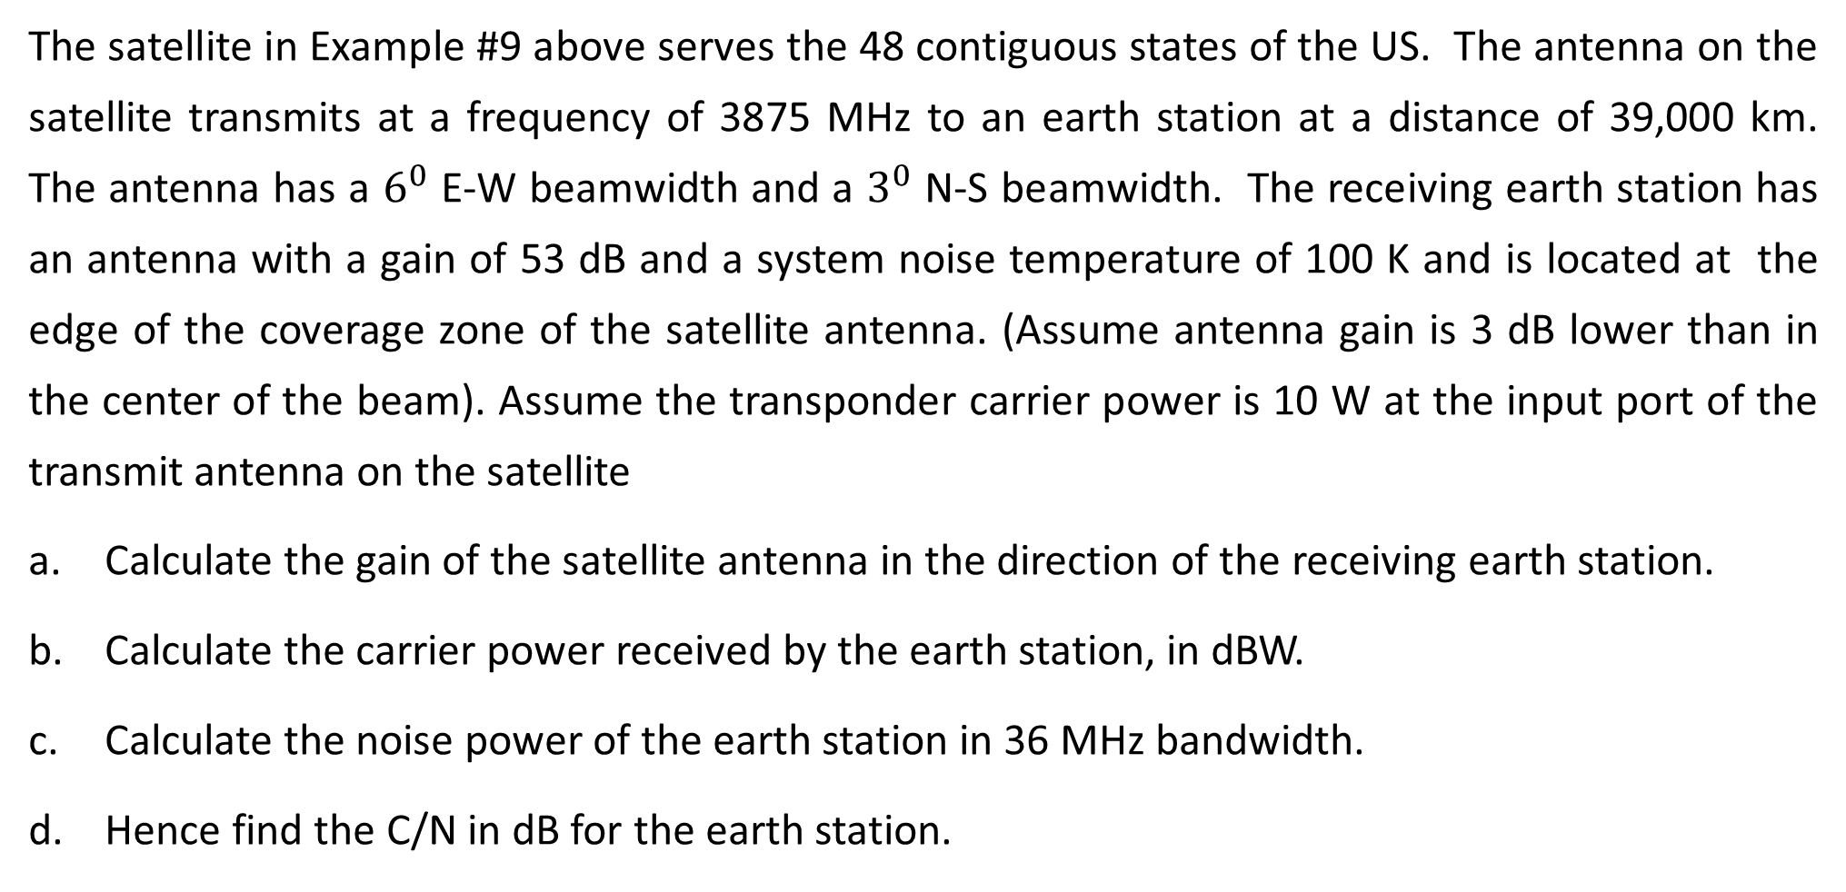
Example:10
The satellite in Example #9 above serves the 48 contiguous states of the US. The antenna on the satellite transmits at a frequency of 3875 MHz to an earth station at a distance of 39,000 km. The antenna has a $6^{0}$ E-W beamwidth and a $3^{0}$ N-S beamwidth. The receiving earth station has an antenna with a gain of 53 dB and a system noise temperature of 100 K and is located at the edge of the coverage zone of the satellite antenna. (Assume antenna gain is 3 dB lower than in the center of the beam). Assume the transponder carrier power is 10 W at the input port of the transmit antenna on the satellite
Calculate the gain of the satellite antenna in the direction of the receiving earth station.
Calculate the carrier power received by the earth station, in dBW.
Calculate the noise power of the earth station in 36 MHz bandwidth.
Hence find the C/N in dB for the earth station.

Slide 42
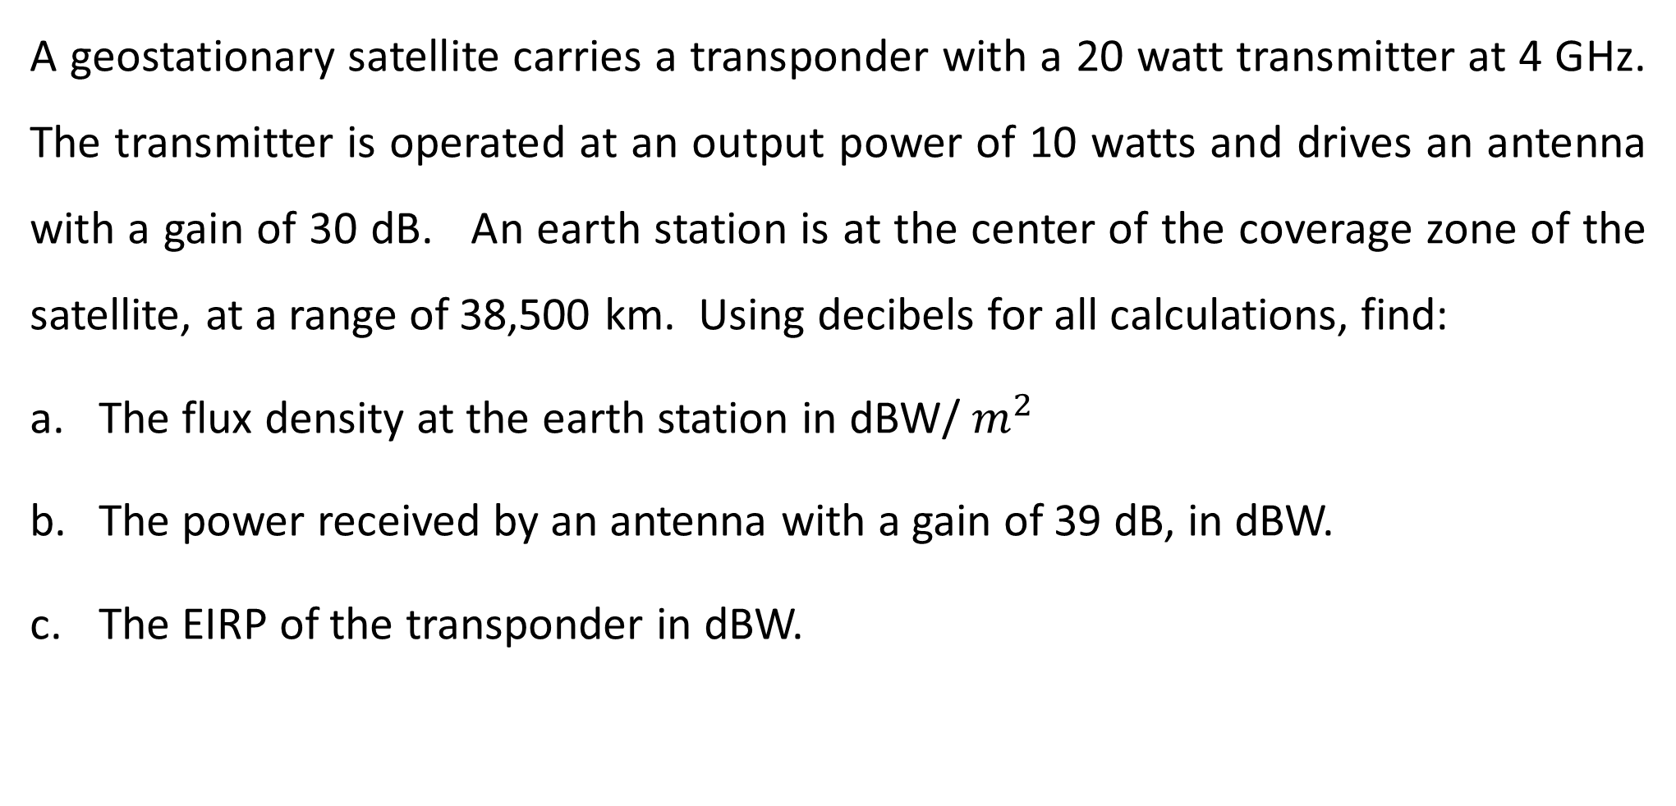
Example:11
A geostationary satellite carries a transponder with a 20 watt transmitter at 4 GHz. The transmitter is operated at an output power of 10 watts and drives an antenna with a gain of 30 dB. An earth station is at the center of the coverage zone of the satellite, at a range of 38,500 km. Using decibels for all calculations, find:
The flux density at the earth station in dBW/ $m^{2}$
The power received by an antenna with a gain of 39 dB, in dBW.
The EIRP of the transponder in dBW.

Slide 43
Example:12
The example below analyzes the links between a user and a gateway station.
(The link between the gateway station and the mobile terminal is defined as the Outbound Link, and the link from the mobile terminal to the gateway is the Inbound Link.). In this example we begin by assuming that 100 active users share the common TDM channel on the outbound link from the gateway station to the mobile terminal.

Slide 44
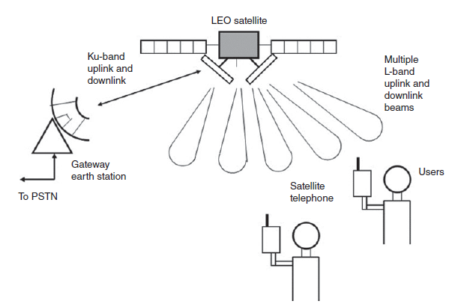
Example:12

Slide 45
