Slide 1
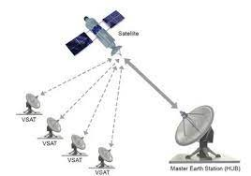
Module:6
VSAT and NGSO System

Slide 2
Module-6
Overview of VSAT systems
VSAT Network Architectures
One Way Implementation,
Two-Way Implementation,
Delay Considerations
VSAT Earth Station Engineering
NGSO Satellite Systems Constellation/ Constellation Design Considerations
Starlink, One Web.

Slide 3
Introduction
VSAT stands for very small aperture terminal.
The first earth station antennas used in commercial satellite communications systems were very large and expensive, with typical aperture diameters of 30 m.
With the rapid expansion of satellite telecommunications worldwide, there was a need to make access to the satellite more affordable.
This came about in two ways: a significant increase in the transmit power capabilities of satellites and the move to frequency bands above C-band.
Both led to a rapid decrease in the size and cost of earth station antennas.

Slide 4
Introduction
Most VSAT systems operate in Ku-band, with earth station antenna diameters of one to two meters and uplink transmitter powers of one or two watts.
VSAT systems operating with GEO satellites are usually organized into two different architectures
Star network – VSATs connect to each other through a central hub station (the gateway earth station) via a GEO satellite.
Mesh network - Each of the VSATs operates directly through the GEO satellites to every other VSAT.
VSAT systems connect businesses and stores to a central computer, enabling faster point-of-sale transactions compared to traditional phone lines and modems, while also allowing centralized data distribution and collection across multiple locations.

Slide 5
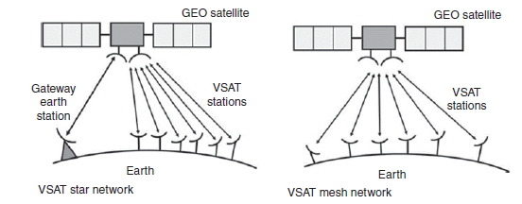
Introduction

Slide 6
Introduction
A Very Small Aperture Terminal (VSAT) is a device known as a small private earth station - that is used to transmit & receive data signal through a satellite.
VSAT network mainly use GEO satellites in Ku and Extended-C band for their application purposes.
VSAT transceivers integrate all necessary functions into a small, highly integrated out door package which provides excellent reliability in a wide range of environments and functions.
VSAT is used for both broadcast & interactive applications of effective data, voice and video transfer.

Slide 7
Why VSAT ?
The dish is small, easily transportable and installation lead-time is much shorter if compared to terrestrial links.
VSAT network allows rapid, low-cost network re- configuration and expansion to meet new or unexpected business requirements.
Cost effective transmission and network operations are made possible by use of the Ex-C band satellite frequency and frequency times division multiple access (FTDMA), Frequency division multiple access (FDMA) or Time division multiple access (TDMA) transmission techniques.

Slide 8
ADVANTAGES
There are many advantages that VSAT offers, some of them are as follows:
Offer flexibility as adding a site is quick and easy.
Service charges depend on the bandwidth, which is allocated to network in line with your requirements.
VSAT terminals prices are falling.
VSAT offers a wide of protocols and features, providing extraordinary flexibility and virtually unlimited expansion capabilities. VSAT network is typically engineered to achieve a minimum of 99.5% end-to-end availability for all locations.
No last mile issues.
As it is mobile, so be used for short term or emergency communications.
Excellent for broadcast transmission.

Slide 9
VSAT Network Architectures
There are three basic implementation services are used in telecommunication services :
One-way
2. Split-two-way
3. Two-way implementation.
Further division of two-way implementation are star and mesh network architectures.

Slide 10
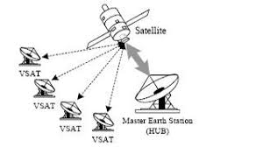
VSAT Network Architectures
One-way implementation:
One-way implementation mode of satellite is used in the BSS(broadcast satellite service).This digital technology allows the user and provider much flexibility in the operation of broadcasting.
By using different software in the user
terminal, different subscriber can access
different parts of the downlink according
to programs offered by supplier.
This channel selection from is called narrowcasting.

Slide 11
VSAT Network Architectures
Split-Two-way implementation:
This implementation is used when there is no normal return channel available.
From the user end terminal uplink capability is not complemented by high-capacity downlink stream relatively. If the BSS downlink is used as the download channel from an ISP(Internet service provider), the only option left for users return link is via another telecommunications channel, such as telephone line.
The internet protocol is therefore split between terrestrial telephone channel and satellite downlink channel.
VSAT terminal does not require a transmit capability due to this approach, which significantly reduce its complexity and cost.
The disadvantage of this approach is that the terrestrial telephone connection must usually be through a modem, with a bit rate generally less than or 56kbps.

Slide 12
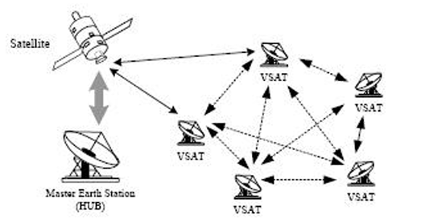
VSAT Network Architectures
Two-way implementation:
A return link is designed in this implementation method so that two-way communication can be set up over the same satellite, from the user to hub and from the hub back to the user. The architecture selected is the key to the economics of two-way connection; it can be either star or mesh.

Slide 13
VSAT Network Architectures
Star Topology:
In star topology, there are three entities
hub station, VSATs and satellite.
All the communication between VSATs happen through Hub station; hence, here if VSAT1 and VSAT2 need to communicate then link is VSAT1-satellite-Hub-Satellite-VSAT2. Hence, two-hop communicate between any two VSATs in the network.
The star-shape network comprise N VSATs and a hub. The most popular of these is star topology.
Generally, the hub antenna is in the range of 6-11 meter in diameter. This hub station controls, monitors and communication with a large number of dispersed VSATs.
Since all VSATs communicate with the central hub station only, this network is more suitable for centralized data applications.
Large organization, like banks, with centralized data processing requirements is a case in point.

Slide 14
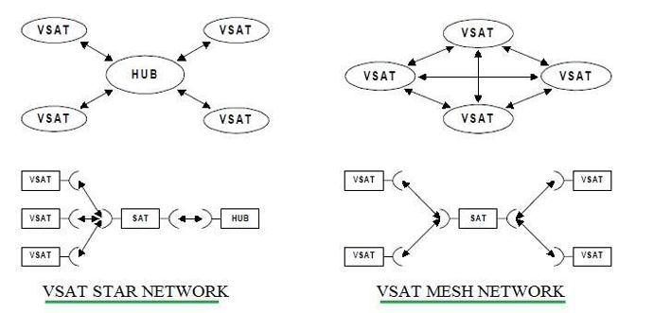
VSAT Network Architectures
Star Topology:

Slide 15
VSAT Network Architectures
Mesh Topology:
In Mesh topology, VSATs can communicate with one another directly and no Hub station is needed. But, each VSAT need to be complex owing to more functionality required similar to the hub station.
Also, antenna specification need to be different than star type of topology. The meshed network comprises N VSATs. Every VSAT should be able to establish a link to any other one across the satellite.
In a mesh topology, a group of VSATs communicate directly with any other VSAT in the network going through a central hub.
A hub station in a mesh network performs only the monitoring and control functions.
These network are more suitable for telephony application.

Slide 16
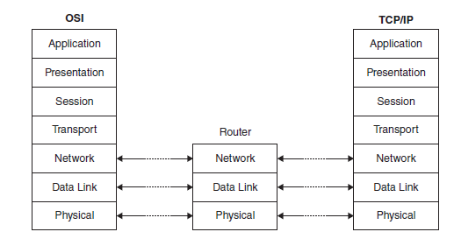
Delay Considerations
A satellite communications link occupies primarily the physical layer of the OSI/ISO model, which is where bits are carried between the terminals.
The network control center typically controls the system and is responsible for the remaining layers.
Most data communication networks use some form of packet transmission, in which blocks of data are tagged with an address, error control parity bits, and other useful information before transmission.

Slide 17

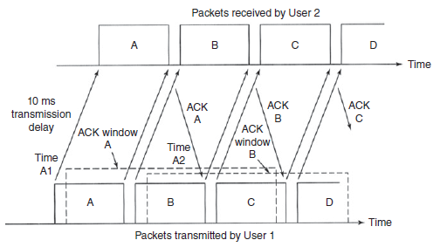
Delay Considerations
The receiving end of a link checks arriving packets for errors, and then sends an acknowledgment signal (ACK) that the packet was received correctly, or a not acknowledge signal (NAK) that tells the transmit end to resend a particular packet because the packet had an error.- automatic repeat request (ARQ).
A typical slant range to a GEO satellite is 39 000 km. The one-way delay of t seconds over such a GEO link is:
To maintain continuous, uninterrupted
communications, it is essential for the
link timing to remain within the protocol window.

Slide 18
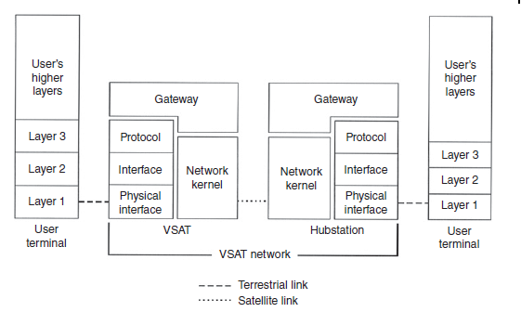
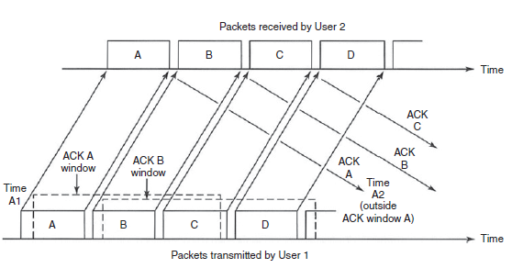
Delay Considerations
There are two ways to make terrestrial protocols work with a long delay satellite link.
First, the protocols can be changed so that the time-out window is well in excess of 260 ms.
Second, the satellite element of the packet network can be configured to exist as a separate sub-network within the global packet network.

Slide 19
Leapfrog
Leapfrogging technology explains the process of the successful adoption of the superior (more advanced) technological solutions.
"Leapfrogging is the notion that areas which have poorly-developed technology or economic bases can move themselves forward rapidly through the adoption of modern systems without going through intermediary steps”.
A frequently cited example is countries which move directly from having no telephones to having cellular phones, skipping the stage of copper wire landline telephones altogether.
GPS devices leapfrogged over maps.

Slide 20
Vsat earth station engineering
Antennas:
The key element in a VSAT system is the earth station antenna used at the VSAT earth stations.
The small size and low transmit power of VSAT station are the factors that keep the price of the earth station at a low level that makes a VSAT network an economic alternative to a terrestrial data network using telephone lines and modems.
Large antennas are usually implemented using a symmetrical configuration, for ease of construction ,the feed on the boresight axis. The feed can either be in front of antenna or behind the antenna, as in a Cassegrain design.
Transmitters and Receivers :
Large earth stations are assembled element.
On the receiver side, the antenna and feed components are connected by waveguide to the front-end side, low noise amplifier (LNA). Behind the LNA, a mixture/down converter changes the signal from radio frequency (RF) to an intermediate frequency(IF). After filtering and amplification, the IF signal is demodulated, demultiplexed, and decoded, and the baseband signal forwarded to the user.

Slide 21
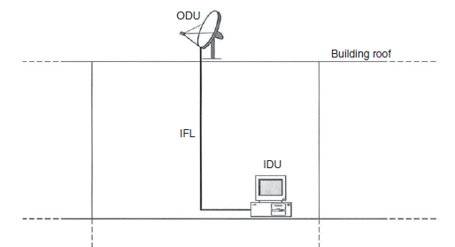
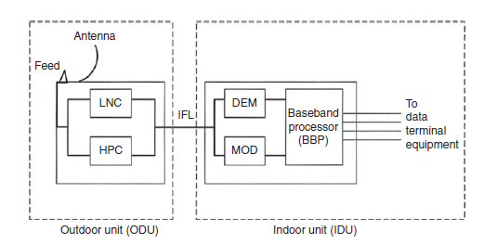
Vsat earth station engineering
The transmit side is the mirror image of the receive side with the signal input at baseband and the output at RF, with the LNA receiver replaced by a high-power amplifier (HPA) transmitter.
Much of this discrete component design has changed with the introduction of digital receiver and the need to develop cheap, mass produced VSAT terminals.
VSAT earth stations have historically consisted of two basic components: an outdoor unit (ODU) and an indoor unit (IDU).

Slide 22
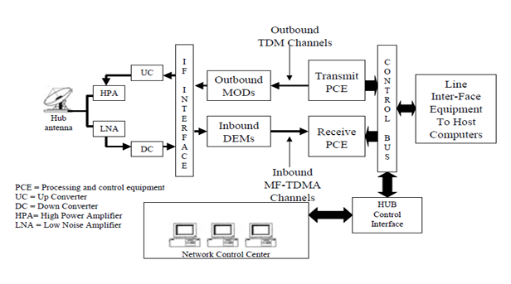
Vsat earth station engineering
The ODU and IDU units are broken down further in fig. It gives a typical configuration of a VSAT that has the modulator/demodulator equipment located in IDU.
In some cases, the low noise block(LNB) or low noise convertor(LNC) and the high-power block (HPB) or high-power converter (HPC) house the complete RF output and input stages of the transmitter and receiver, the up converts and down coverts and in many cases, the modem.
The hub station has more complex design than
the VSAT station since it not only has to handle
all of the inbound and outbound traffic,
rather than just thin route traffic of a single or
a few users, but it also has to manage the
network control functions.

