Slide 1
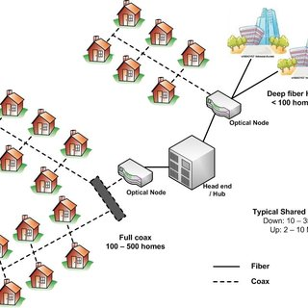
Module:7
Direct Broadcast Satellite Television systems and GPS

Slide 2
Module-7
DBS Satellite Systems:
DVB-S2X Standards
System Design for High-Throughput Applications ,
Antenna Considerations, Modulation Scheme Considerations, Error Coding Considerations, Remote Sensing Application.
Navigation Satellite Systems
GPS-Position Calculations and Accuracy,
Navigation Messages, Receiver Design,
IRNSS

Slide 3
Introduction
The limited bandwidth of undersea cables designed for voice communications prevented their use for video signals, so live television signals could not be transmitted beyond the limits of any continent.
The first time that a geostationary earth orbit (GEO) satellite was used extensively for video transmission was for the Tokyo Olympic Games in 1968, which were broadcast live in the United States using a link through an early Intelsat satellite over the Pacific Ocean.
One transponder on a GEO satellite can send a video signal to thousands of independent cable systems distributed throughout the country. Ex: point to multipoint Tx.

Slide 4
C-Band and Ku-Band Home Satellite TV
In the early 1980s, the development of low noise Gallium Arsenide Field Effect Transistor (GaAsFET) amplifiers for C-band low noise amplifiers (LNAs) and improved threshold extension frequency modulation (FM) demodulators for video signal receivers allowed much smaller diameter antennas to be used to receive C-band FM video signals distributed through GEO satellites.
These were particularly popular in rural areas where terrestrial television broadcasting offered at best three channels from the major networks.

Slide 5
Digital DBS-TV
In the 1990s, digital video transmission became feasible, and several systems were developed in the United States in the 12.2–12.7 GHz band allocated to DBS-TV services.
The development of low-cost Ku-band antennas and receivers, and high speed digital integrated circuits specifically for DBS television that incorporate quadrature phase shift keying (QPSK) demodulation, error control, decryption, and Moving Picture Experts Group (MPEG) compression made DBS-TV practical.

Slide 6
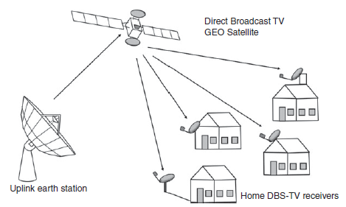
Introduction

Slide 7
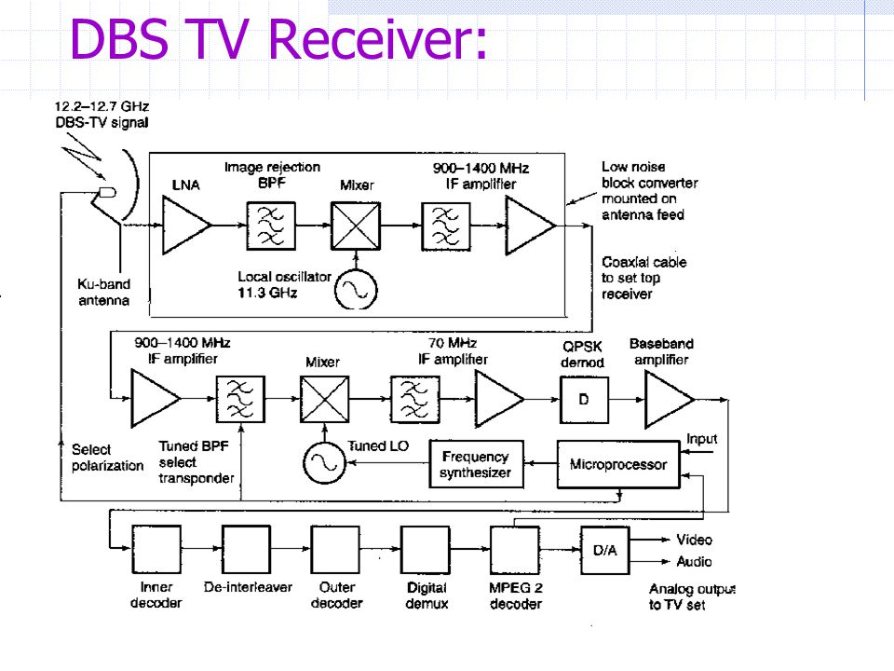
Introduction

Slide 8
Satellite Navigation and the Global Positioning System
The global positioning satellite (GPS) system has revolutionized navigation and position location.
It is now the primary means of navigation for most ships, aircraft, and automobiles, and is widely used in surveying and many other applications.
1973- U.S space force provide a satellite-based radio navigation system- NAVSTAR GPS for guiding missiles, ships, and aircraft.

Slide 9
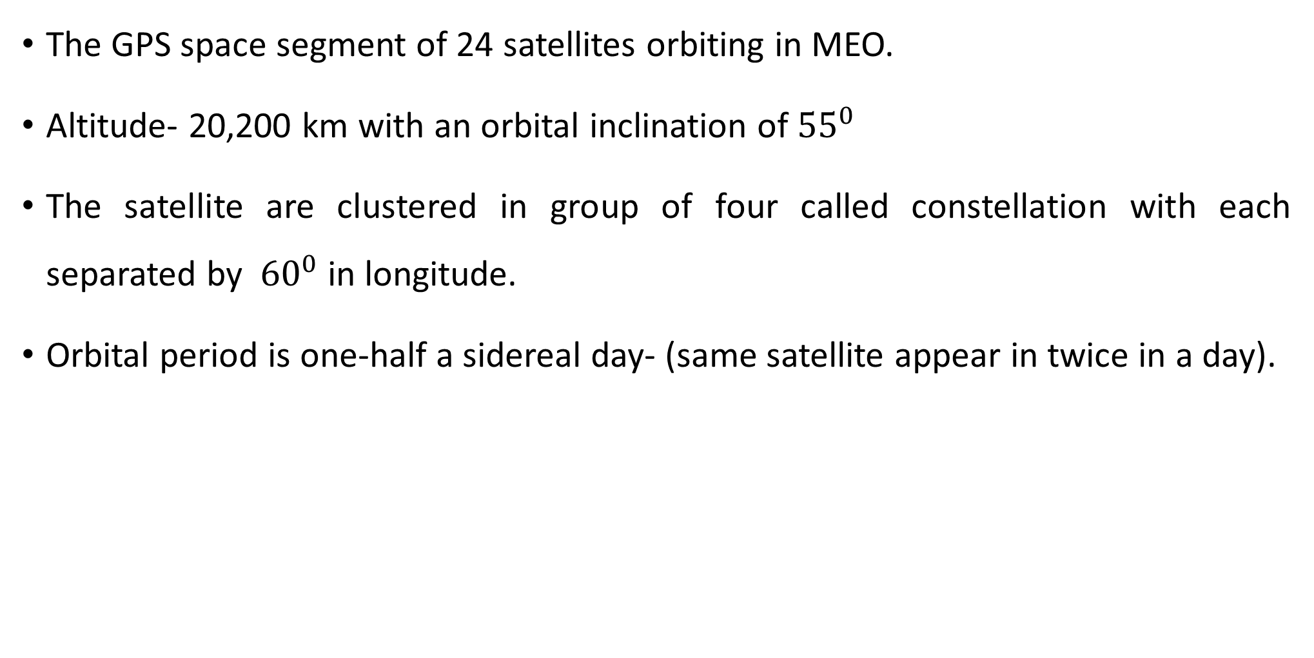
GPS TECHNICAL STRUCTURE
The GPS space segment of 24 satellites orbiting in MEO.
Altitude- 20,200 km with an orbital inclination of${ 55}^{0}$
The satellite are clustered in group of four called constellation with each separated by ${ 60}^{0}$ in longitude.
Orbital period is one-half a sidereal day- (same satellite appear in twice in a day).

Slide 10
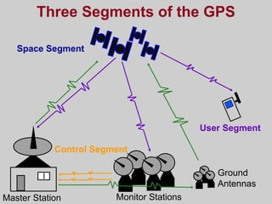
Components of GPS
Space segment
Control segment
User segment

Slide 11
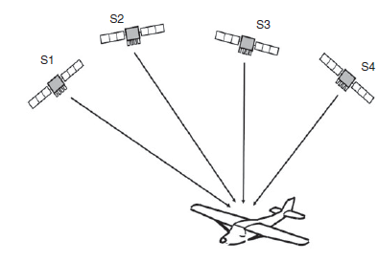
GPS Position Location Principles
Position of GPS receiver is found by trilateration method.
Three satellites are required to provide the three distance measurements, and the fourth is used to remove receiver clock error.
The three satellites provide distance information when the GPS receiver makes three measurements of range, Ri, from the receiver to three known points, that is, GPS satellites.

Slide 12
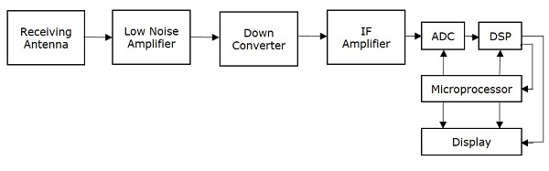
GPS Receiver
The antenna is typically a circularly polarized patch antenna with an LNA mounted on the printed circuit board.

