Slide 1
Numerical Problems

Slide 2
According to Pascal’s Law
F1/A1 = F2/A2 since P1 = P2
Because the volume of fluid pushed down on the left side equals the volume of fluid that is lifted up on the right side, the following formula is also true
V1 = V2
by substitution,
A = cross sectional area
D = the distance moved
A1 D1 = A2 D2
A1/A2= D2/D1
This system can be thought of as a simple machine (lever), since force is multiplied. The mechanical advantage can be found by rearranging terms in the above equation to
Mechanical Advantage(IMA) = D1/D2 = A2/A1

Slide 3
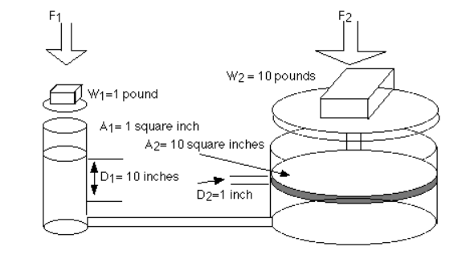
P1.
For this problem, find the IMA

Slide 4
For this problem, the IMA would be 10:1 (10 inches/ 1 inch or 10 square inches / 1 square inch).
Mechanical Advantage (IMA) = D1/D2 = A2/A1

Slide 5
P2. A hydraulic press has an input cylinder 1 inch in diameter and an output cylinder 6 inches in diameter. Assuming 100% efficiency, find the force exerted by the output piston when a force of 10 pounds is applied to the input piston. Also, If the input piston is moved through 4 inches, how far is the output piston moved?

Slide 6
WKT F1/A1 = F2/A2 , so F2=F1xA2 / A1 A1= 0.785 A2= 28.285 F2 = 360
WKT A1/A2= D2/D1 , D1=4, A1= 0.785, A2= 28.285 D2=A1XD1/A2 = 0.111

Slide 7
2. A hydraulic system is said to have a mechanical advantage of 40. Mechanical advantage (MA) is FR (output) / FE (input). If the input piston, with a 12 inch radius, has a force of 65 pounds pushing downward a distance of 20 inches, find the volume of fluid that has been displaced (answer)
the upward force on the output piston (answer)
the radius of the output piston (answer)
the distance the output piston moves (answer)

Slide 8
WKT Mechanical Advantage(IMA) = D1/D2 = A2/A1= 40 = F2/F1
A1=3.14(12)2 = 452.16 F1=65 D1=20
VOLUME = A1xD1 = 9043.2
Upward force F2 = (A2/A1) x F1 = MA x F1 = 40 x 65 = 2600
Output piston radius r2 , A2 = 40 x 452.16 = 18086.4
r2 = 75.89 inches
c. D2= D1 /40 = 20/40 = 0.5

Slide 9
3. What pressure does a 130 pound woman exert on the floor when she balances on one of her heels? Her heels have an average radius of 0.5 inch. (answer)
4. A car has a weight of 2500 pounds and rests on four tires, each having a surface area of contact with the ground of 14 square inches. What is the pressure the ground experiences beneath the tires that is due to the car? (answer) Extension : 5. The input and output pistons of a hydraulic jack are respectively 1 cm and 4 cm in diameter. A lever with a mechanical advantage of 6 is used to apply force to the input piston. How much mass can the jack lift if a force of 180 N is applied to the lever and efficiency is 80%? (answer)

Slide 10
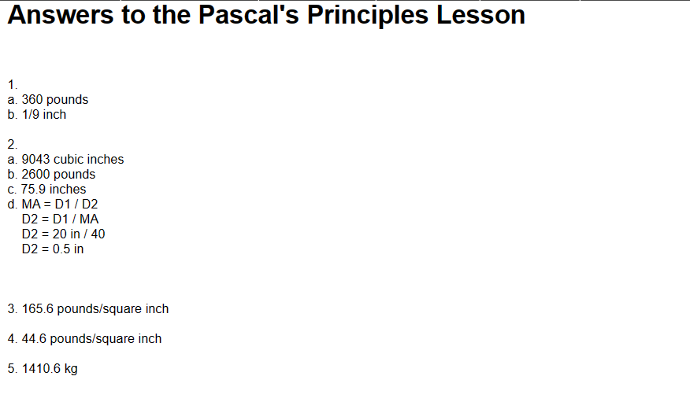

Slide 11
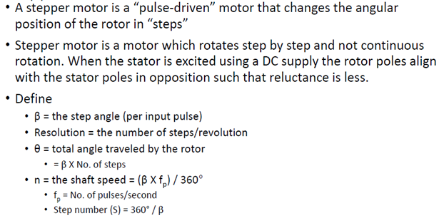
Numericals in Stepper Motor

Slide 12
1. A stepper motor having a resolution of 300 steps/rev and running at 2400 rpm has a pulse rate of _____________ pps. a) 4000 b) 8000 c) 6000 d) 10,000
Answer: c Explanation: Steps per second is mathematically given as SPS = (Rpm/60)*(number of steps per minute) = (2400/60)*300 = 12000 Pulse per second = steps per second /2 = 12000/2 = 6000.
2. What is the step angle of a permanent-magnet stepper motor having 8 stator poles and 4 rotor poles? a) 60º b) 45º c) 30º d) 15º
Answer: b Explanation: Step angle is defined as [(Ns-Nr)/(Ns*Nr)]*360 where Ns is the number of stator poles and Nr is the number of rotor poles. Step angle = [(Ns-Nr)/(Ns*Nr)]*360 = [(8-4)/(8*4)]*360 Step angle = 45º

Slide 13
3. If a hybrid stepper motor has a rotor pitch of 36º and a step angle of 9º, the number of its phases must be a) 4 b) 2 c) 3 d) 6
Answer: a Explanation: Step angle is defined as =(N_{s}-N_{r})/(N_{s}+N_{r})*360. ns=10 nr=40
4. What is the formula to calculate the step angle of a stepper motor? a) (360*ph)/nph b) (ph/nph) c) (nph/ph) d) (360*nph)/ph
Answer: a Explanation: The step angle is given by (360*ph)/nph where ‘nph’ is the number of equivalent poles per phase or number of rotor poles, ‘ ph ‘ is the number of phases and ‘ n ‘ is the total number of poles in all phases.

Slide 14
5. What is the step angle of a hybrid stepper motor? a) 0.9 degree to 3.6 degree b) 0.9 degree to 7.0 degree c) 0.1 degree to 1.0 degree d) 1.0 degree to 0.9 degree
Answer: a Explanation: Typical step angle of a hybrid stepper motor ranges from 0.9 degrees 3.6 degree that is (100 to 400) steps per revolution. The step angle is given by (360*ph)/nph where ‘nph’ is the number of equivalent poles per phase or number of rotor poles, ‘ ph ‘ is the number of phases and ‘ n ‘ is the total number of poles in all phases.

