Slide 1

ROBOTICS
Robot Application in Manufacturing
TEMPUS IV Project: 158644 – JPCR
Development of Regional Interdisciplinary Mechatronic Studies - DRIMS
ROBOTICS

Slide 2
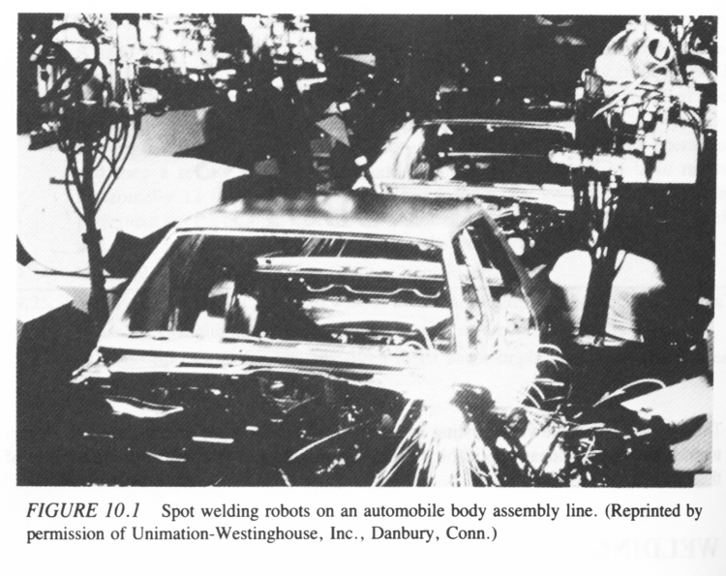
WELDING
TEMPUS IV Project: 158644 – JPCR
Development of Regional Interdisciplinary Mechatronic Studies - DRIMS
ROBOTICS

Slide 3
WHY A ROBOT TO BE USED FOR WELDING?
Welding has two types w.r.t robotic applications
    Spot welding
    Arc welding
Safety hazards
Undesirable job for workers (due to protective equipment that must be worn)
Heavy loads are sometimes involved
To achieve quality and product uniformity
TEMPUS IV Project: 158644 – JPCR
Development of Regional Interdisciplinary Mechatronic Studies - DRIMS
ROBOTICS

Slide 4
BENEFITS OF ROBOTIC WELDING
Automatic line tracking is sometimes required, on assembly lines where welding is to be done
Arc-on-time concept
    Manual welding (arc-on-time percentage is 20-30%)
    Robotic welding (production level of 4 welders
“Weave Patterns” for weld paths
    Weave patterns ….. Zigzag path
    A robot can be programmed for weave patterns
TEMPUS IV Project: 158644 – JPCR
Development of Regional Interdisciplinary Mechatronic Studies - DRIMS
ROBOTICS

Slide 5
MACHINE LOADING
Why robots to be used for machine loading?
    Safety and relief
      Safety and relief from handling heavy equipment
      Risk of amputations while feeding punch press by hand
    To eliminate production slowdowns
    To achieve high operating speed
    Small clearances make manual feeding a tricky job
    Reduction of scrap is a side benefit
Single robot for single machine loading and unloading
Multiple robots for multiple machine loading
Sequential machine loading
Robots in forging and die-casting
TEMPUS IV Project: 158644 – JPCR
Development of Regional Interdisciplinary Mechatronic Studies - DRIMS
ROBOTICS

Slide 6
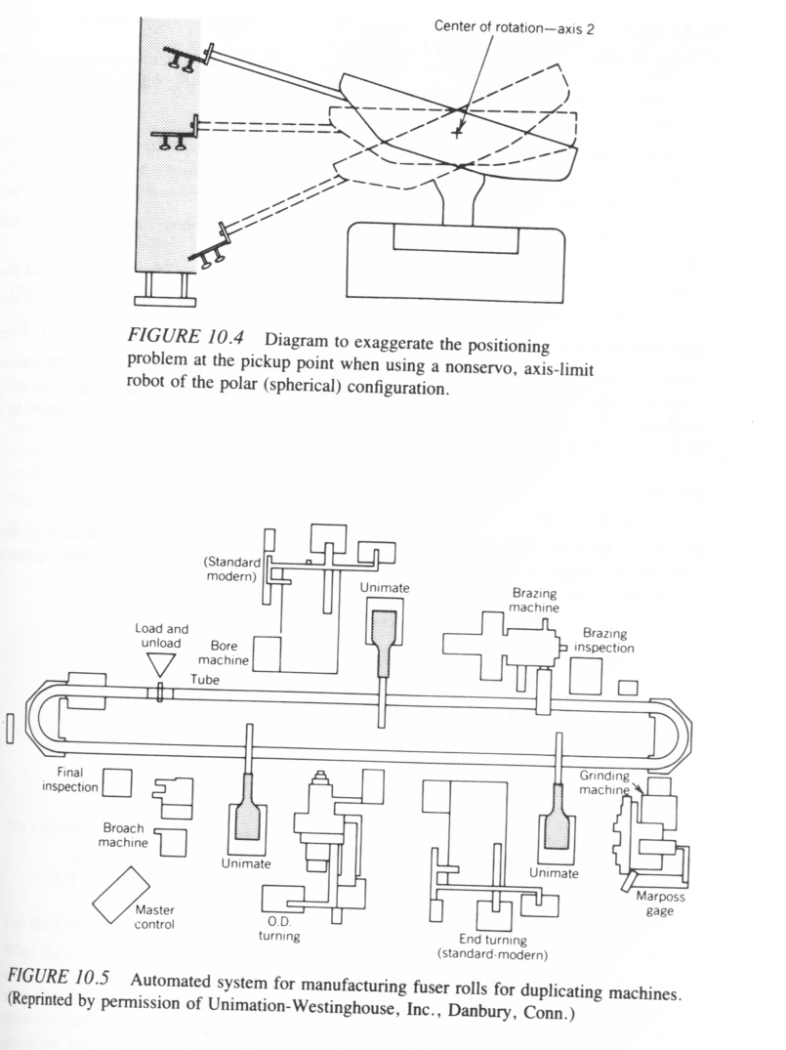
MACHINE LOADING (Contd.)
Positioning problem that may occur (fig 10.4)
A robot has to pick and place on different elevation levels where robot is an axis-limit, polar configuration robot
Remedies
    Work envelop
    Suction cup pickup devices
    Racks design
    End effecter with greater flexibility
Double handed grippers
Figure 10.5
TEMPUS IV Project: 158644 – JPCR
Development of Regional Interdisciplinary Mechatronic Studies - DRIMS
ROBOTICS

Slide 7
PROBLEM
(Robot Machine Loading System Productivity)
The robot machine loading / unloading system diagrammed in figure has an eight seconds cycle time and a daily two shift production level of over 28,000 workpieces. Do the four milling machines perform sequential operations upon each workpieces in series, or do all four milling machines perform the complete machining cycle in parallel with each other – that is, is each part processed completely by only one machine, not all four?
TEMPUS IV Project: 158644 – JPCR
Development of Regional Interdisciplinary Mechatronic Studies - DRIMS
ROBOTICS

Slide 8
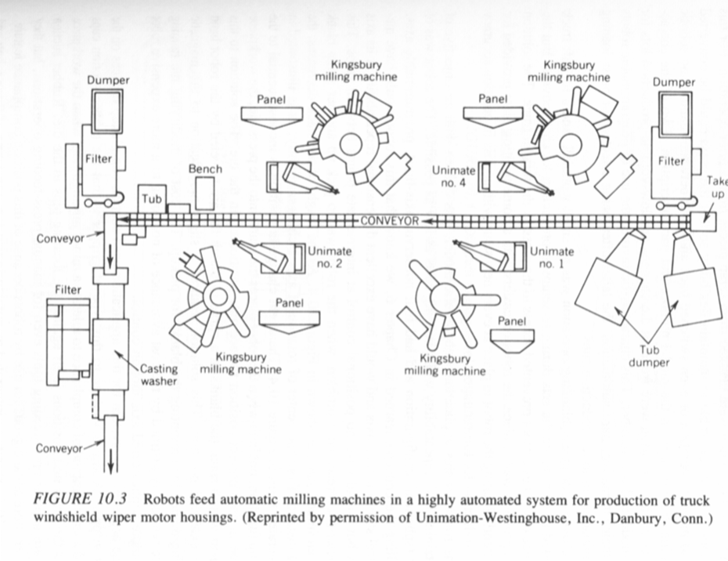
PROBLEM
(Robot Machine Loading System Productivity)
Series operation:
Production rate / day
= 1part / 8sec X 60 sec/min X 60min / hr X 16hr/day
=7200 parts per day (two shifts)
Parallel Operation:
Production rate / day
= 1 part/8sec X 60 sec/min X 60 min/hr X 16hr/day X 4 machines
=28,800 parts per day (two shifts)
=> system runs on parallel basis
Discussion
TEMPUS IV Project: 158644 – JPCR
Development of Regional Interdisciplinary Mechatronic Studies - DRIMS
ROBOTICS

Slide 9
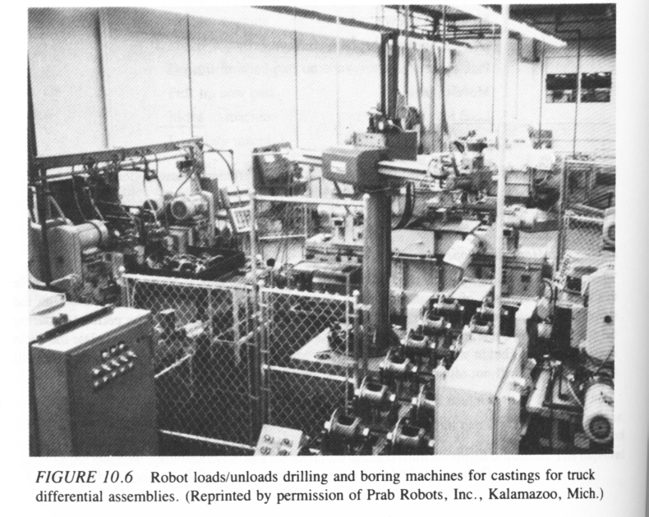
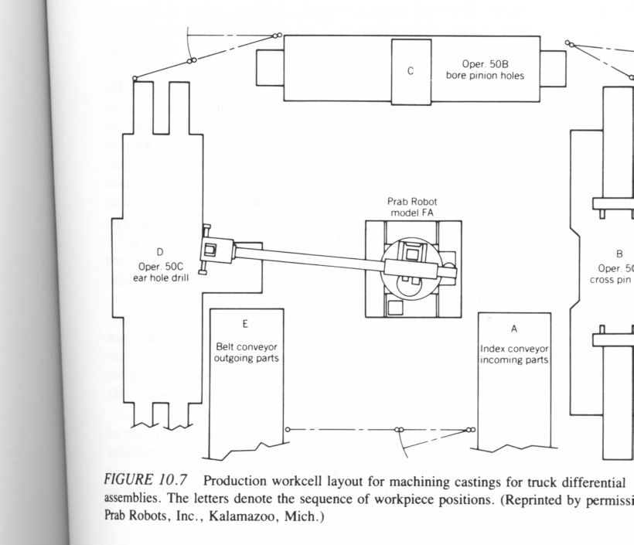
SEQUENTIAL MACHINE LOADING
Single robot to load / unload several machines (figures)
One robot to load and unload three machines with help of two conveyors
60% increase in production level is observed
Double handed grippers are of little value
  We intend to work on single work piece sequentially
  When one job is complete on one machine, the workpiece would be unloaded and loaded to the 2nd machine and so on
  Also because there is no room for semi-finished parts in the workcell
TEMPUS IV Project: 158644 – JPCR
Development of Regional Interdisciplinary Mechatronic Studies - DRIMS
ROBOTICS

Slide 10
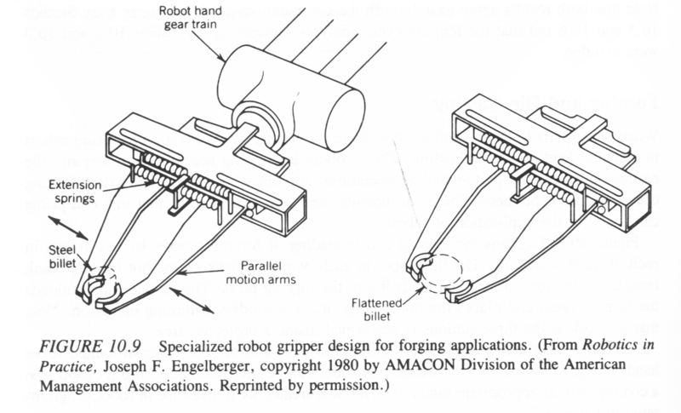
Robots for Forging and Die-casting
Why robots for forging and die-casting?
    Piece parts are hot
    Environmental heat and noise
    Risk of amputation while feeding
Normally a robot for forging is programmed to dip its hand into a cooling bath at appropriate intervals
Gripper must be capable to handle shape changes during forging.
TEMPUS IV Project: 158644 – JPCR
Development of Regional Interdisciplinary Mechatronic Studies - DRIMS
ROBOTICS

Slide 11
SPRAY PAINTING
Environment in spray painting booths is very difficult to maintain according to safety and health standards
A level of consistency is difficult to achieve when human workers are employed
Line tracking capability for continuous feed conveyors
A robot can be taught (only once), by a skilled spray painter
Failures can be expected, so a manual touchup area is sometimes required
Equipment utilization is very important factor to consider
TEMPUS IV Project: 158644 – JPCR
Development of Regional Interdisciplinary Mechatronic Studies - DRIMS
ROBOTICS

Slide 12
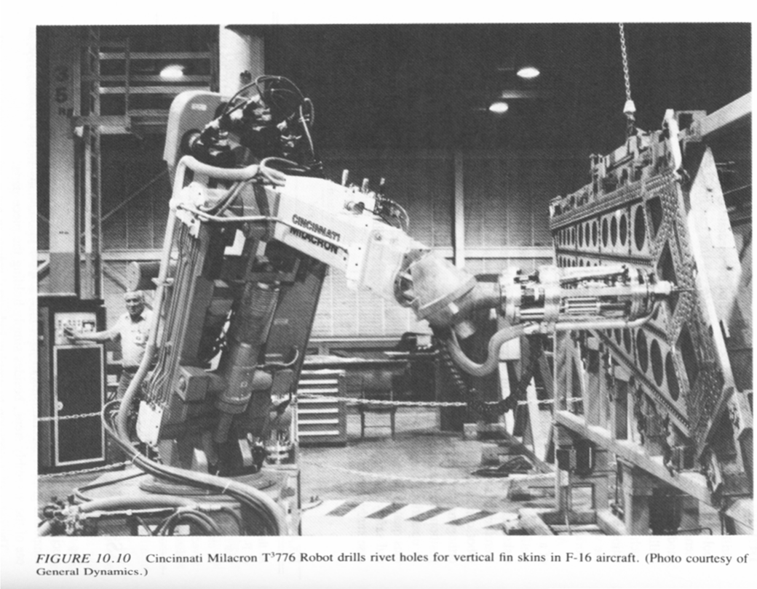
FABRICATION
Welding (already discussed)
Drilling
    For small workpieces (PCB Drilling, fixtured parts)
    For large workpieces (aircraft parts)
      Drill must be oriented perpendicular to the surface
      A human achieves this by visual determination (source of error)
      A robot with deterministic approach can replace a human worker

Slide 13
ASSEMBLY
3D criteria is useless for robotic assembly applications
Assembly requires precision, repeatability, variety of motions, sophisticated gripper devices, and sometimes compound gripper mechanisms.
Basis of decision for assembly robot:
    Save labor costs
    Repetitive job is a boring job
    Fast and efficient work requirement
    Accuracy
    Eliminate omissions or substitutions
    Eliminate intentional omissions
TEMPUS IV Project: 158644 – JPCR
Development of Regional Interdisciplinary Mechatronic Studies - DRIMS
ROBOTICS

Slide 14
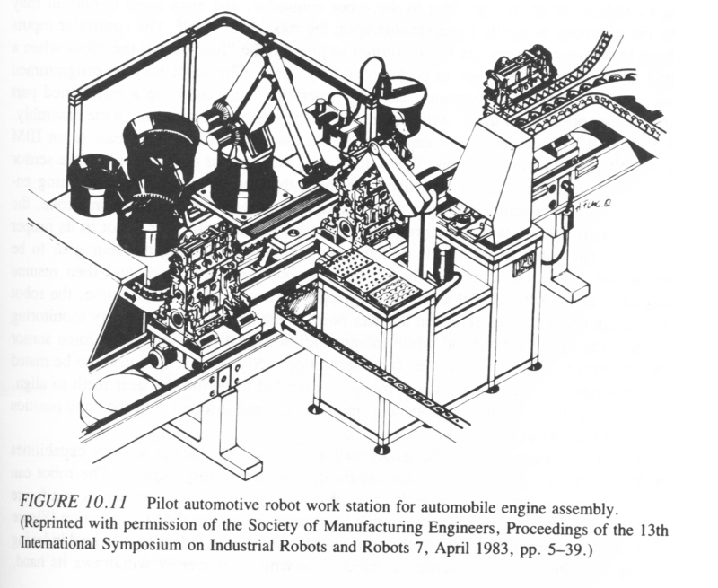
ENGINE ASSEMBLY
Engine blocks travel on a pallet transfer mechanism
Robots facilitated by auxiliary conveyors for subassemblies and vibratory bowls for screws and bolts
Different grippers are provided in a magazine, mainly to do a variety of jobs
TEMPUS IV Project: 158644 – JPCR
Development of Regional Interdisciplinary Mechatronic Studies - DRIMS
ROBOTICS

Slide 15
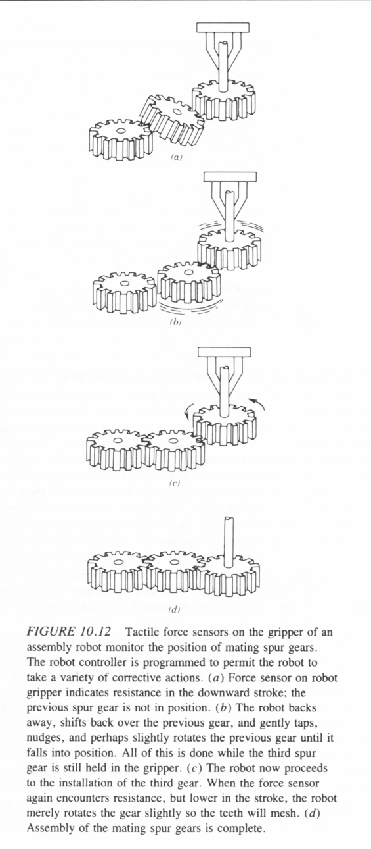
Electrical / Electronic Machine Assembly
Indexed, palletized carrier type transfer mechanisms
Tactile sensing
Visual feedback loops
  Since assembly operations require more “feel” for the objects being handled
  Defects can also be detected
Even more sophisticated / flexible robots are required for flexible manufacturing systems
General Assembly Robots:
  That can sense and assemble virtually any thing of appropriate size
  When combined with judgment, these robots can be used for humanoid robots
TEMPUS IV Project: 158644 – JPCR
Development of Regional Interdisciplinary Mechatronic Studies - DRIMS
ROBOTICS

Slide 16
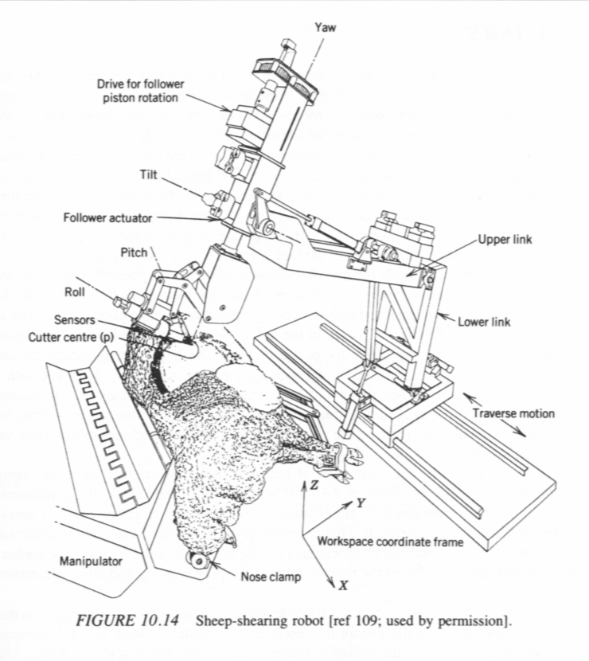
UNUSUAL APPLICATIONS
Sheep shearing robots
Robots in Construction
Robots for Hazardous Material cleaning
Sojourner Rover
Nano-robots
TEMPUS IV Project: 158644 – JPCR
Development of Regional Interdisciplinary Mechatronic Studies - DRIMS
ROBOTICS

Slide 17
Literature:
1. CHAPTER 10: ROBOTICS AND MANUFACTURING AUTOMATION, available on
http://www.pptnetwork.net/lecture-notes-in-manufacturing-automation
2. http://www.seminarpaper.com/2011/12/robotics-and-its-applications.html
TEMPUS IV Project: 158644 – JPCR
Development of Regional Interdisciplinary Mechatronic Studies - DRIMS
ROBOTICS

Slide 18
Robot Application Videos to watch:
Industrial Robotics: http://www.youtube.com/watch?v=DkNVhtOCcrE&feature=endscreen&NR=1
M-10iA Cream Cheese Packing Robots - FANUC Robotics Industrial Automation: http://www.youtube.com/watch?v=Vrxaz0_X3Qs
M-10iA Haas Machine Tool Loading Robot - FANUC Robotics Industrial Automation: http://www.youtube.com/watch?v=TMeh4AQx6_A
ABB Robotics - 10 most popular applications for robots: http://www.youtube.com/watch?v=fH4VwTgfyrQ
ABB Robotics - Cake decorating: http://www.youtube.com/watch?v=57F032tEbE4
TEMPUS IV Project: 158644 – JPCR
Development of Regional Interdisciplinary Mechatronic Studies - DRIMS
ROBOTICS

Slide 19
World Strongest Robot - KUKA KR1000 Titan: http://www.youtube.com/watch?v=ge-UyZG4kjY
KUKA Robot- Foundry Application at Automotive Plant: http://www.youtube.com/watch?v=K5r0POxRcBI&feature=endscreen&NR=1
UNIMATION Robot - Puma 500: http://www.youtube.com/watch?v=04-j_wsuuSM
SCARA robot demonstration: http://www.youtube.com/watch?v=kXXCk_LP8lg
High Speed Pancake stacking with Flexpicker Robots: http://www.youtube.com/watch?v=v9oeOYMRvuQ&feature=endscreen&NR=1
and a lot of more on www.youtube.com
TEMPUS IV Project: 158644 – JPCR
Development of Regional Interdisciplinary Mechatronic Studies - DRIMS
ROBOTICS

Slide 20
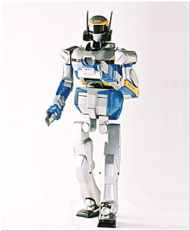
Thank you for attention this semester!
Buy! See you at the exam!
TEMPUS IV Project: 158644 – JPCR
Development of Regional Interdisciplinary Mechatronic Studies - DRIMS
ROBOTICS

