Slide 1
MATLAB SIMULINK FOR ROS2

Slide 2
Introductions
Simulink support for Robot Operating System 2 (ROS 2) enables you to create Simulink models that work with a ROS 2 network. ROS 2 is a communication layer that allows different components of a robot system to exchange information in the form of messages. A component sends a message by publishing it to a particular topic, such as /odometry. Other components receive the message by subscribing to that topic.
Simulink support for ROS 2 includes a library of Simulink blocks for sending and receiving messages for a designated topic. When you simulate the model, Simulink connects to a ROS 2 network, which can be running on the same machine as Simulink or on a remote system. Once this connection is established, Simulink exchanges messages with the ROS 2 network until the simulation is terminated. If Simulink Coder™ is installed, you can also generate C++ code for a standalone ROS 2 node, from the Simulink model.

Slide 3
Create a Publisher
Configure a block to send a geometry_msgs/Point message to a topic
named /location (the "/" is standard ROS syntax).
From the MATLAB Toolstrip, select Home > New > Simulink Model
to open a new Simulink model.
From the Simulink Toolstrip, select Simulation > Library Browser to open the Simulink Library Browser.
Click on the ROS Toolbox tab (you can also type roslib in MATLAB command window).
Select the ROS 2 Library.
Drag a Publish block to the model. Double-click on the block to configure the topic and message type.
Select Specify your own for the Topic source, and enter /location in Topic.
Click Select next to Message type. A pop-up window will appear. Select geometry_msgs/Point
and click OK to close the pop-up window.
You can also specify the ROS 2 Domain ID by clicking Configure ROS 2 Domain ID and ROS
Middleware (RMW) option.

Slide 4
Create a ROS 2 Message
Create a blank ROS 2 message and populate it with the x and y location for the robot path. Then publish the updated ROS 2 message to the ROS 2 network.
A ROS 2 message is represented as a bus signal in Simulink. A bus signal is a bundle of Simulink signals, and can also include other bus signals
(see the Explore Simulink Bus Capabilities (Simulink) example for an overview).
The ROS 2 Blank Message block outputs a Simulink bus signal corresponding to a ROS 2 message.
Click ROS Toolbox tab in the Library Browser, or type roslib at the MATLAB command line.
Select the ROS 2 Library.
Drag a Blank Message block to the model. Double-click on the block to open the block mask.
Click on Select next to the Message type box, and select geometry_msgs/Point from the resulting pop-up window. set Sample time to 0.01. Click OK to close the block mask.
From the Simulink > Signal Routing tab in the Library Browser, drag a Bus Assignment block.
Connect the output port of the Blank Message block to the Bus input port of the Bus Assignment block. Connect the output port of the Bus Assignment block to the input port of Publish block.

Slide 5
Double-click on the Bus Assignment block. You should see x, y and z (the signals comprising a geometry_msgs/Point message) listed on the left. Select ??? signal1 in the right listbox and click Remove.
Select both X and Y signals in the left listbox and click Select. Click OK to apply changes.
You can now populate the bus signal with the robot location.
From the Simulink > Sources tab in the Library Browser, drag two Sine Wave blocks into the model.
Connect the output ports of each Sine Wave block to the assignment input ports x and y of the Bus Assignment block.
Double-click on the Sine Wave block that is connected to input port X. Set the Phase parameter to -pi/2 and click OK. Leave the Sine Wave block connected to input port Y as default.

Slide 6
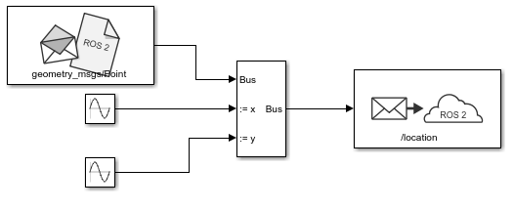
Your publisher should look like this:

Slide 7
At this point, the model is set up to publish messages to the ROS 2 network. You can verify this as follows:
Under the Simulation tab, set the simulation stop time to inf.
Click Run to start simulation. Simulink creates a dedicated ROS 2 node for the model
and a ROS 2 publisher corresponding to the Publish block.
While the simulation is running, type ros2 node list in the MATLAB command window. This lists all the nodes available in the ROS network, and includes a node with a name like /untitled_90580
(the name of the model along with a random number to make it unique).
While the simulation is running, type ros2 topic list in the MATLAB command window. This lists all the topics available in the ROS 2 network, and it includes /location.
If you specified a ROS 2 domain ID in the Publish block, to list all the topics, type ros2 topic list
domainID xx, where xx is the domain ID you specified.

Slide 8
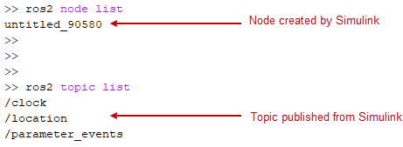

Slide 9
Click Stop to stop the simulation. Simulink deletes the ROS 2 node and publisher. In general, the ROS 2 node for a model and any associated publishers and subscribers are automatically deleted at the end of a simulation; no additional clean-up steps are required.

Slide 10
Create a Subscriber
Use Simulink to receive messages sent to the /location topic. You will extract the x and y
location from the message and plot it in the xy-plane.
From the ROS Toolbox tab in the Library Browser, drag a Subscribe block to
the model. Double-click on the block.
Select Specify your own in the Topic source box, and enter /location in the Topic box.
Click Select next to the Message type box, and select geometry_msgs/Point from the pop-up window.
set Sample time to 0.01. Click OK to close the block mask.

Slide 11
The Subscribe block outputs a Simulink bus signal,
so you need to extract the x and y signals from it.
From the Simulink > Signal Routing tab in the Library Browser, drag a Bus Selector block to the model.
Connect the Msg output of the Subscribe block to the input port of the Bus Selector block.
From the Modeling tab, select Update Model to ensure that the bus information is propagated.
You may get errors and they will be resolved by the next step.
Double-click on the Bus Selector block. Select signal1 and signal2 in the right listbox
and click delete to remove them. Select both x and y signals in the left listbox and click
delete to select the signals. Click OK.

Slide 12
The Subscribe block will output the most-recently received message for the topic on every time step.
The IsNew output indicates whether the message has been received during the prior time step. For the current task,
the IsNew output is not needed, so do the following:
From the Simulink > Sinks tab in the Library Browser, drag a Terminator block to the model.
Connect the IsNew output of the Subscribe block to the input of the Terminator block.
The remaining steps configure the display of the extracted X and Y signals.
From the Simulink > Sinks tab in the Library Browser, drag an XY Graph block to the model.
Connect the output ports of the Bus Selector block to the input ports of the XY Graph block.
From the Simulink > Sinks tab in the Library Browser, drag two Display blocks to the model.
Connect each output of the Bus Selector block to each Display block.
Save your model.

Slide 13
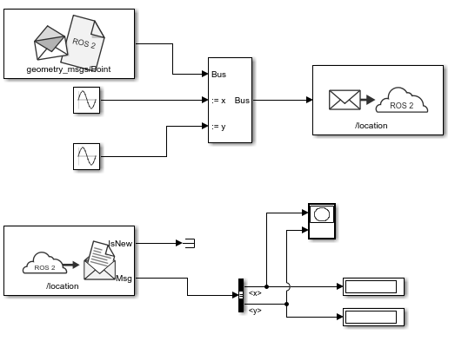
The entire model should look like this:

Slide 14
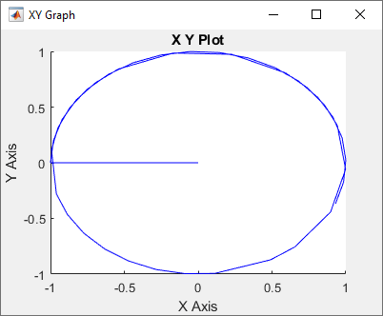
Configure and Run the Model
From the Modeling tab, select Model Settings. In the Solver pane, set Type to
Fixed-step and Fixed-step size to 0.01.
Set simulation stop time to 10.0.
Click Run to start simulation. An XY plot will appear.
Note:
The first time you run the model in Simulink, the XY plot may look
more jittery than the one above due to delays caused by loading ROS libraries.
Once you rerun the simulation a few times, the plot should look smoother.
Note that the simulation does not work in actual or "real" time.
The blocks in the model are evaluated in a loop
that only simulates the progression of time, and is not intended to track
actual clock time (for details, see Simulation Loop Phase (Simulink)).

Slide 15
Modify the Model to React Only to New Messages
In the above model, the Subscribe block outputs a message (bus signal) on every time step;
if no messages have been received at all, it outputs a blank message (i.e., a message with zero values).
Consequently, the XY coordinates are initially plotted at (0,0).
In this task, you will modify the model to use an Enabled Subsystem, so that it plots the location only
when a new message is received (for more information, see Using Enabled Subsystems (Simulink)).
A pre-configured model is included for your convenience.
In the model, click and drag to select the Bus Selector block and XY Graph blocks. Right-click on the
selection and select Create Subsystem from Selection.
From the Simulink > Ports & Subsystems tab in the Library Browser, drag an Enable block into the
newly-created subsystem.
Connect the IsNew output of the Subscribe block to the enabled input of the subsystem as shown in the picture below.
Delete the Terminator block. Note that the IsNew output is true only if a new message was received during the
previous time step.

Slide 16
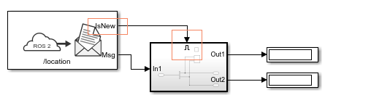

Slide 17
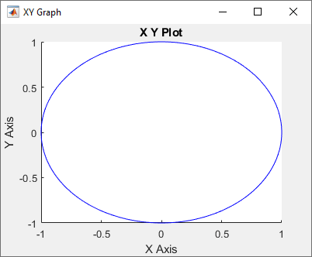
Save your model.
Click Run to start simulation. You should see the following XY plot.
The blocks in the enabled subsystem are
only executed when a new ROS 2 message
is received by the Subscribe block.
Hence, the initial (0,0) value will not be displayed in the XY plot.

