Slide 1
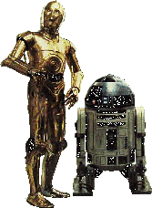
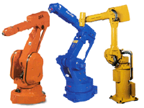
Introduction to Robotics amd Automation
We will be studying Industrial manipulator type Robots.

Slide 2
Module 1
Introduction to Robotics
Classification of Robots
Mobility
Do F
Components classification, performance characteristics
Industrial Robots, HRI
Automatic assembly system.

Slide 3
What is a Robot ?
Random House Dictionary A machine that resembles a human being and does mechanical routine tasks on command.
Robotics Association of America An industrial robot is a re-programmable, multifunctional manipulator designed to move materials, parts, tools, or specialized devices through variable programmed motions for the performance of a variety of tasks.

Slide 4
What is a Robot ?
A manipulator (or an industrial robot) is composed of a series of links connected to each other via joints. Each joint usually has an actuator (a motor) connected to it.
These actuators are used to cause relative motion between successive links. One end of the manipulator is usually connected to a stable base and the other end is used to deploy a tool.

Slide 5
Evolution of Robots
1922 Czech author Karel Capek wrote a story called Rossum’s Universal Robots and introduced the word “Rabota”(meaning forced labourer)
1954 George Devol developed the first programmable Robot.
1955 Denavit and Hartenberg developed the homogenous transformation matrices
1962 Unimation was formed, first industrial Robots appeared. George Charles Devol Jr.
1967: Mark II (Unimation Inc.)
1973 Cincinnati Milacron introduced the T3 model robot, which became very popular in industry.
1990 Cincinnati Milacron was acquired by ABB
21C: Walking Robots, Mobile Robots, Humanoid Robots
Notes:
Homogeneous transform is actually a matrix that describes the translation and rotation of one coordinate system with respect to another one.

Slide 6
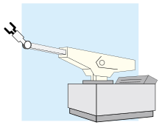
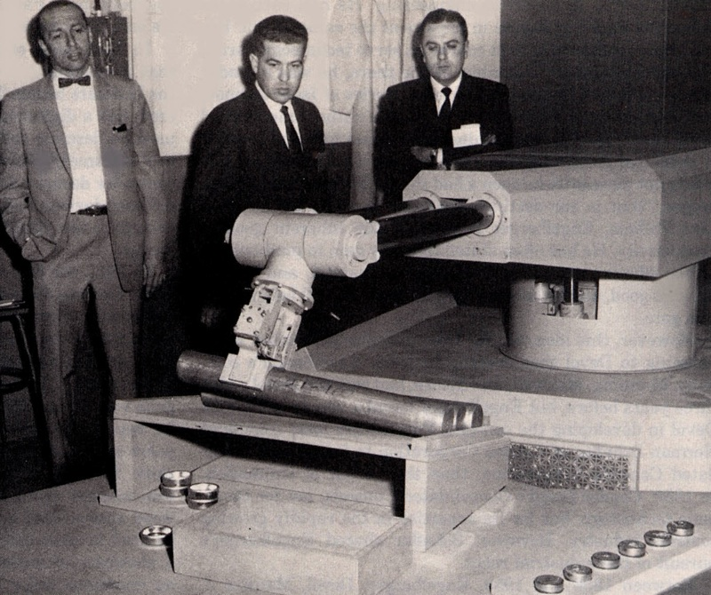
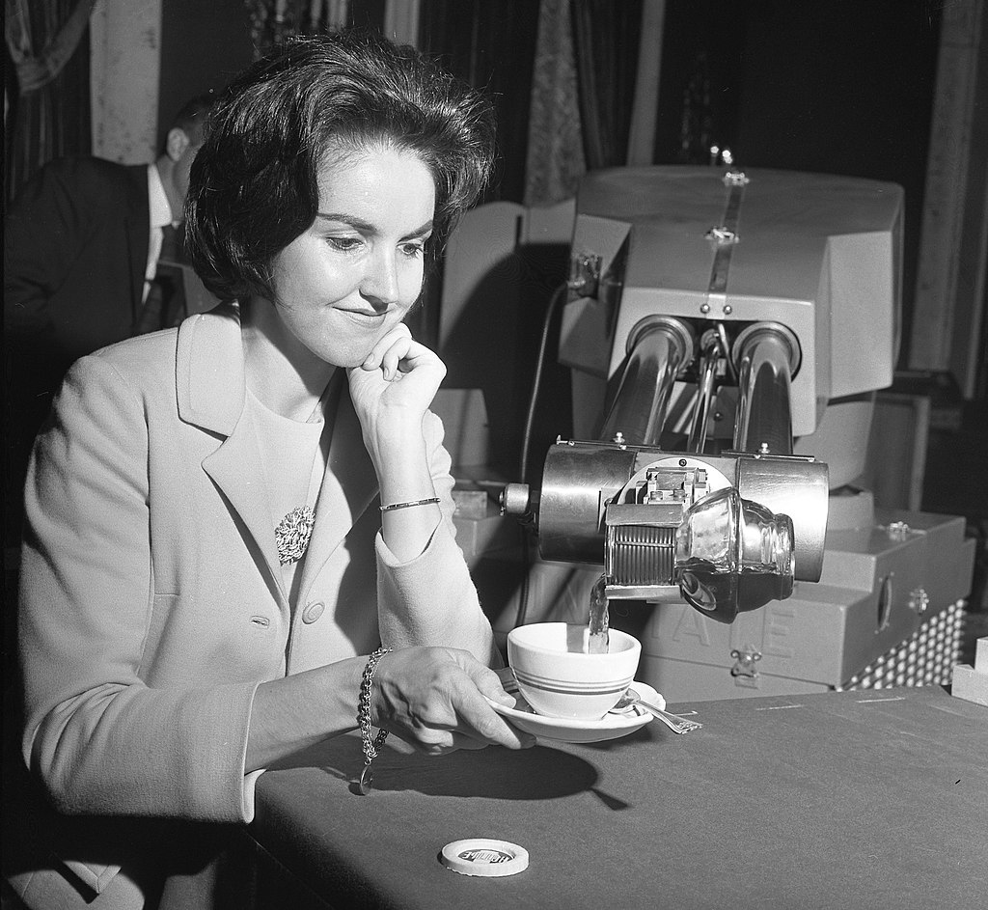
Unimate

Slide 7
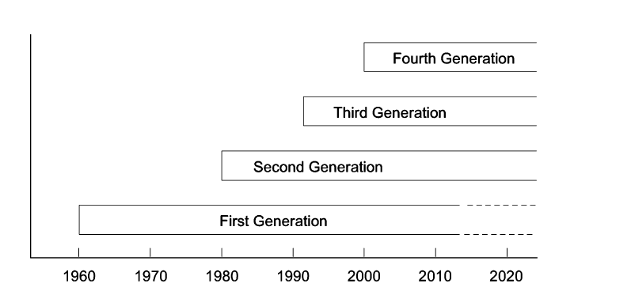
Generation of Robots

Slide 8
First generation
  Repeating, non-servo based, pick and place, point to point type.
  80% of these are used in industries.
  Second
Second generation
  Has sensing devices, moves according to feedback
  Path control capabilities

Slide 9
Third generation
  Intelligence, high speed information processing, self learning, drawing conclusion from previous experiences.
  Online computation, artificial vision, active force / torque interaction are significant features.
Fourth generation
  Artificial biological robot, humanoid capable of producing its clones.

Slide 10
Classification of Robots
- JIRA (Japanese Industrial Robot Association)
Class1: Manual-Handling Device
Class2: Fixed Sequence Robot
Class3: Variable Sequence Robot
Class4: Playback Robot
Class5: Numerical Control Robot
Class6: Intelligent Robot
Notes:
Manual handling means transporting or supporting a load by hand or bodily force. It includes lifting, putting down, pushing, pulling, carrying or moving loads.
A fixed-sequence robot is a robot that performs a single, pre-programmed task or set of tasks, making exactly the same movements each time.
Variable-Sequence Robot : A device that performs the successive stages of a task according to a predetermined method easy to modify.
Playback robot: This type of robot is first guided through a sequence of actions by an operator, then repeats the same actions automatically.
Numerical control robot: This type of robot moves through a sequence of actions, which it receives in the form of numerical data.
Intelligent Robot: are autonomous and advanced versions are capable of thinking

Slide 11
Classification of Robots
- RIA (Robotics Institute of America)
Variable Sequence Robot(Class3)
Playback Robot(Class4)
Numerical Control Robot(Class5)
Intelligent Robot(Class6)

Slide 12
Robot Classification
The following is the classification of Robots according to the Robotics Institute of America
Variable-Sequence Robot : A device that performs the successive stages of a task according to a predetermined method easy to modify
Playback Robot :A human operator performs the task manually by leading the Robot
Numerical Control Robot : The operator supplies the movement program rather than teaching it the task manually.
Intelligent Robot : A robot with the means to understand its environment and the ability to successfully complete a task despite changes to the environment.

Slide 13
Classification of Robots
- AFR (Association FranÇaise de Robotique)
Type A: Manual Handling Devices/ telerobotics
Type B: Automatic Handling Devices/ predetermined cycles
Type C: Programmable, Servo controlled robot,
continuous point-to-point trajectories
Type D: Same type with C, but it can acquire information.

Slide 14
What is Robotics?
Robotics is the art, knowledge base, and the know-how of designing, applying, and using robots in human endeavors.
Robotics is an interdisciplinary subject that benefits from mechanical engineering, electrical and electronic engineering, computer science, biology, and many other disciplines.

Slide 15
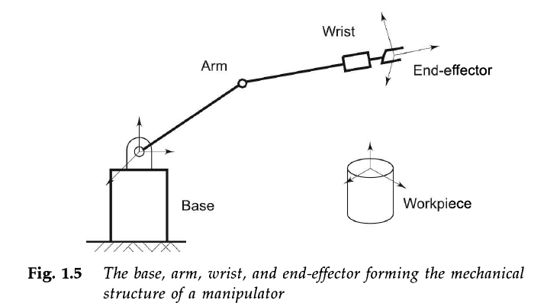
Robot Anatomy

Slide 16
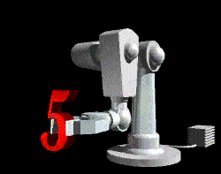
What are the parts of a robot (Robot Anatomy – skeletal parts) ?
Manipulator
Pedestal
Controller
End Effectors
Power Source

Slide 17
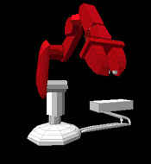
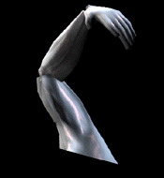
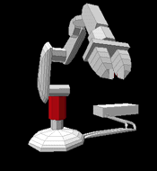
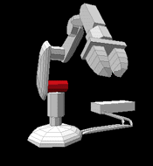
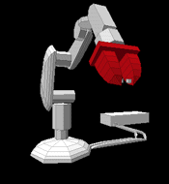
Manipulator
  Base
  Appendages
    Shoulder
    Arm
    Grippers

Slide 18
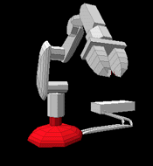
Pedestal
(Human waist)
Supports the manipulator.
Acts as a counterbalance.

Slide 19
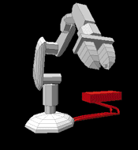
Controller
(The brain)
Issues instructions to the robot.
Controls peripheral devices.
Interfaces with robot.
Interfaces with humans.

Slide 20
End Effectors
(The hand)
Spray paint attachments
Welding attachments
Vacuum heads
Hands
Grippers

Slide 21
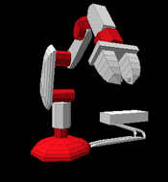
Power Source
(The food)
Electric
Pneumatic
Hydraulic

Slide 22
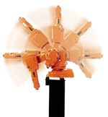
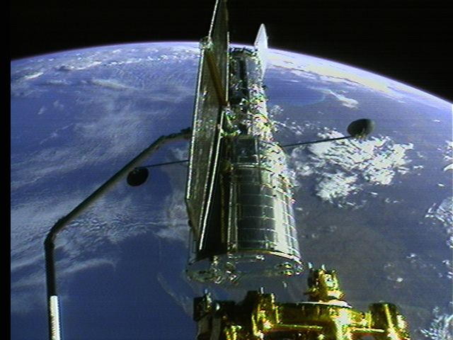
Robot Accessories
A Robot is a system, consists of the following elements, which are integrated to form a whole:
Manipulator / Rover : This is the main body of the Robot and consists of links, joints and structural elements of the Robot.
End Effector : This is the part that generally handles objects, makes connection to other machines, or performs the required tasks.
It can vary in size and complexity from a
end effector on the space shuttle to a
small gripper

Slide 23
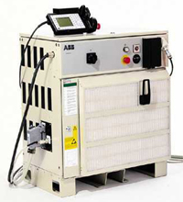
Accessories
Acutators : Actuators are the muscles of the manipulators. Common types of actuators are servomotors, stepper motors, pneumatic cylinders etc.
Sensors : Sensors are used to collect information about the internal state of the robot or to communicate with the outside environment. Robots are often equipped with external sensory devices such as a vision system, touch and tactile sensors etc which help to communicate with the environment
Controller : The controller receives data from the computer, controls the motions of the actuator and coordinates these motions with the sensory feedback information.

Slide 24
Robots degrees of freedom
Degrees of Freedom: Number of independent position variables which has to be specified to locate all parts of a mechanism.
In most manipulators this is usually the number of joints.

Slide 25
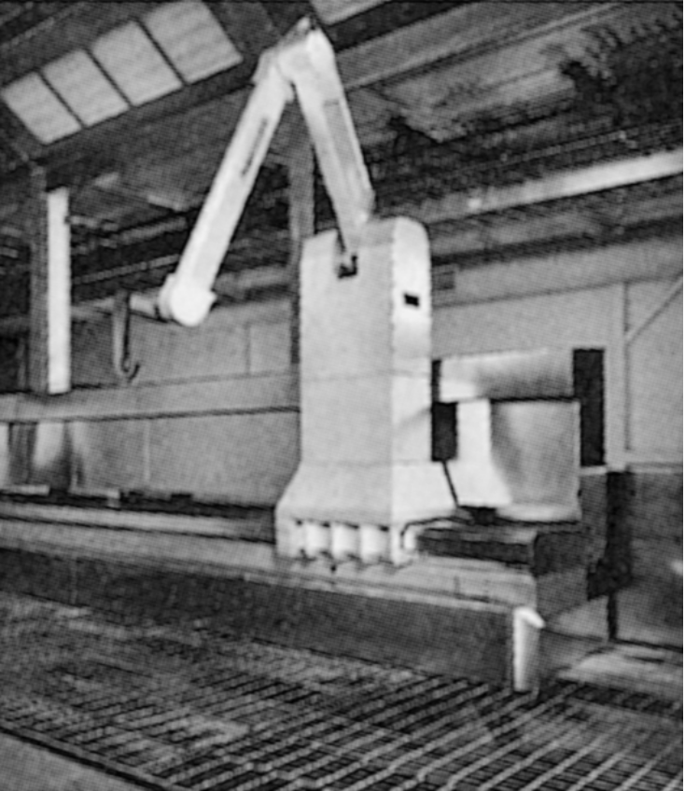
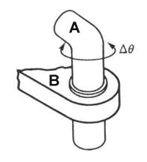
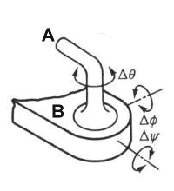
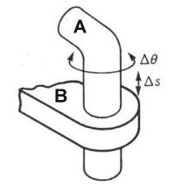
Robots degrees of freedom
Consider what is the degree of Fig. 3
1 D.O.F.
2 D.O.F.
3 D.O.F.
Fig. 1.3 A Fanuc P-15 robot.
Reprinted with permission from Fanuc Robotics, North America, Inc.

Slide 26
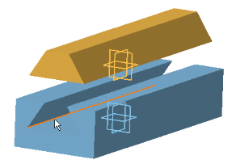
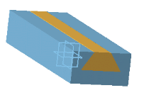
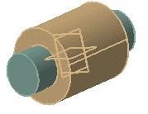
Robot Joints
Prismatic Joint: Linear, No rotation involved.
(Hydraulic or pneumatic cylinder)
Revolute Joint: Rotary, (electrically driven with stepper motor, servo motor)

Slide 27
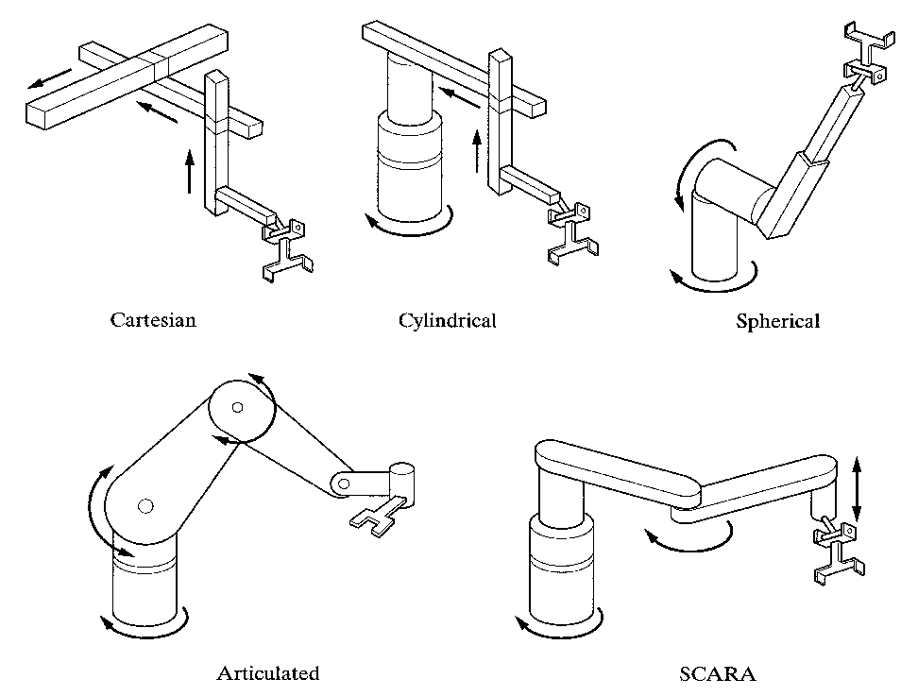
Robot Coordinates
Fig. 1.4
• Cartesian/rectangular/gantry (3P) : 3 Prismatic joint
• Cylindrical (R2P) : 2 Prismatic joint and 1 revolute joint
• Spherical (2RP) : 1 Prismatic joint and 2 revolute joint
• Articulated/anthropomorphic (3R) : All revolute(Human arm)
• Selective Compliance Assembly Robot Arm (SCARA):
2 paralleled revolute joint and 1 additional prismatic joint

Slide 28
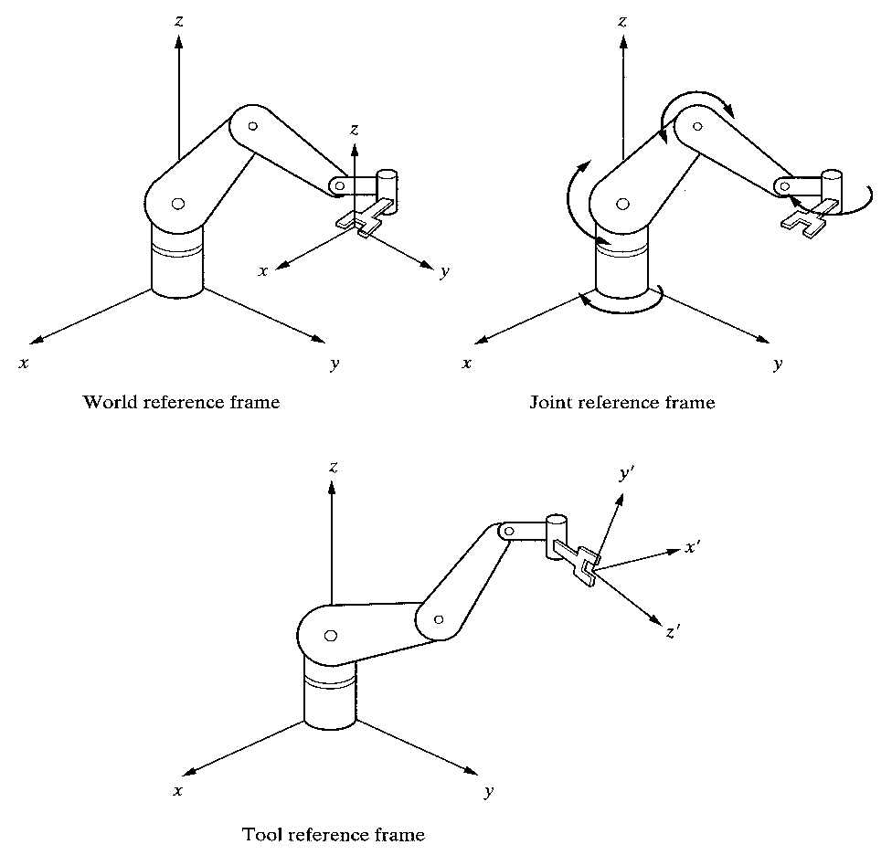
Robot Reference Frames
Fig. 1.6 A robot’s World, Joint, and Tool reference frames.
Most robots may be programmed to move relative to either of these reference frames.
Notes:
Tool Reference Frame: Tool frame specifies movements of the robot hand relative to a frame attached to the hand. All motions are relative to this local frame denoted by n,o,a axes. This frame will move with a robot as the robot changes its position similarly this frame reference will change.
The joint reference frame is used to specify the movements of individual joints of the robot. In this case, each joint is accessed and moved individually so one joint will be moved at a time. Depending on the prismatic, revolute, and spherical joints used the motion of the robot hand will be different.

Slide 29
Reference Frames
World Reference Frame which is a universal coordinate frame, as defined by the x-y-z axes. In this case the joints of the robot move simultaneously so as to create motions along the three major axes.
Joint Reference Frame which is used to specify movements of each individual joint of the Robot. In this case each joint may be accessed individually and thus only one joint moves at a time.
Tool Reference Frame which specifies the movements of the Robots hand relative to the frame attached to the hand. The x’,y’and z’ axes attached to the hand define the motions of the hand relative to this local frame. All joints of the Robot move simultaneously to create coordinated motions about the Tool frame.

Slide 30
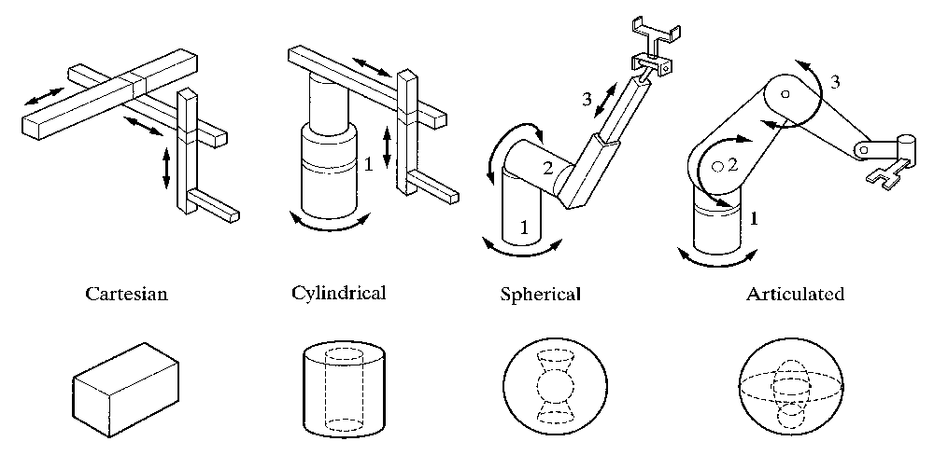
Robot Workspace
Fig. 1.7 Typical workspaces for common robot configurations

Slide 31
ROBOT CHARACTERISTICS
Payload
  Payload is the weight a robot can carry
Reach
Reach is the maximum distance a robot can reach within its work envelope.
Precision
  Precision is defined as how accurately a specified point can be reached
Repeatability
  Repeatability is how accurately the same position can be reached if the motion is repeated many times.
  http://www.directindustry.com/prod/yamaha-motor-industrial-robots/product-25092-56426.html#video

Slide 32
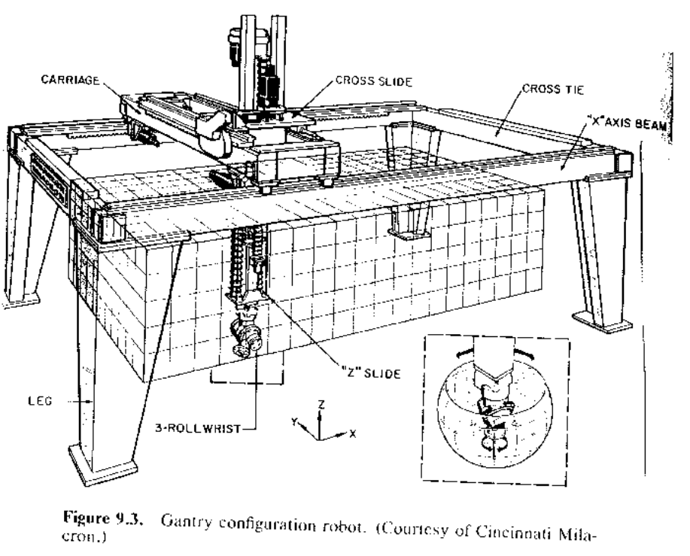
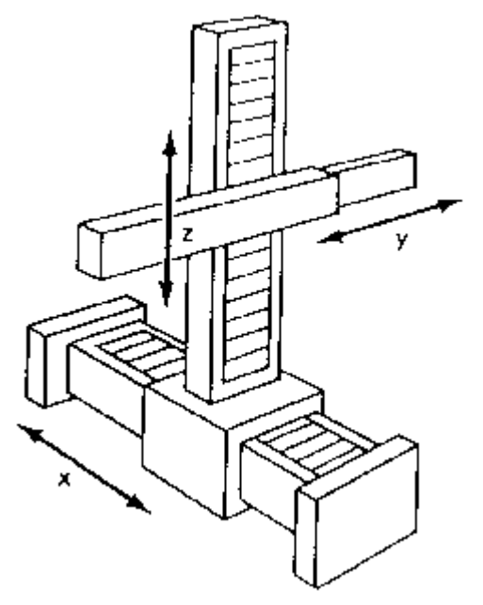
Robot Configurations
Some of the commonly used configurations in Robotics are
Cartesian/Rectangular Gantry(3P) : These Robots are made of 3 Linear joints that orient the end effector, which are usually followed by additional revolute joints.

Slide 33
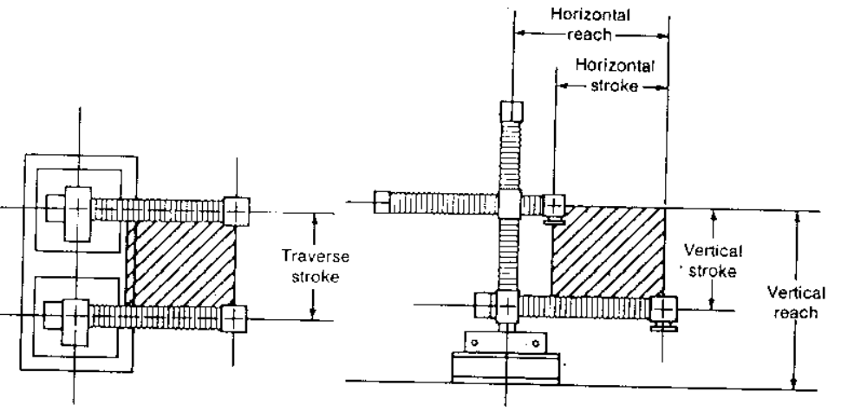
Cartesian Robot - Work Envelope

Slide 34
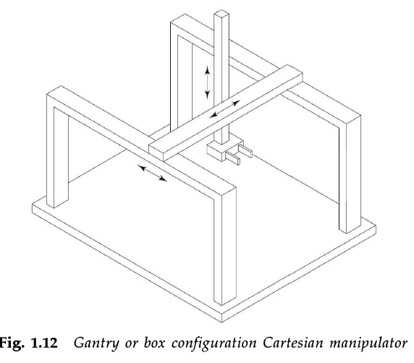
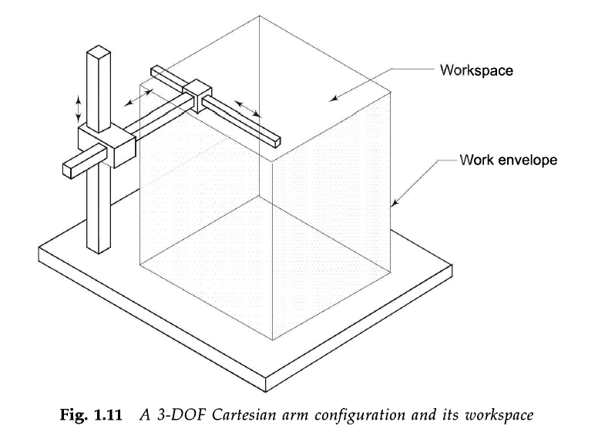

Slide 35
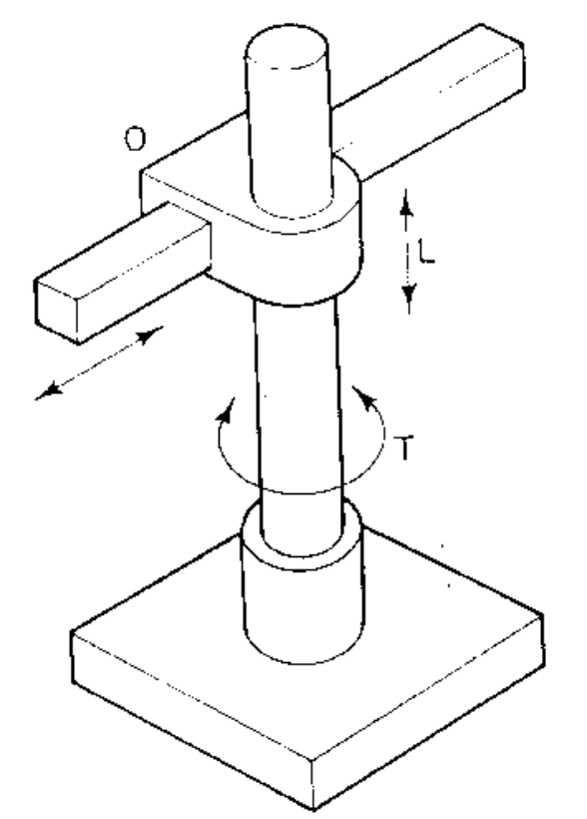
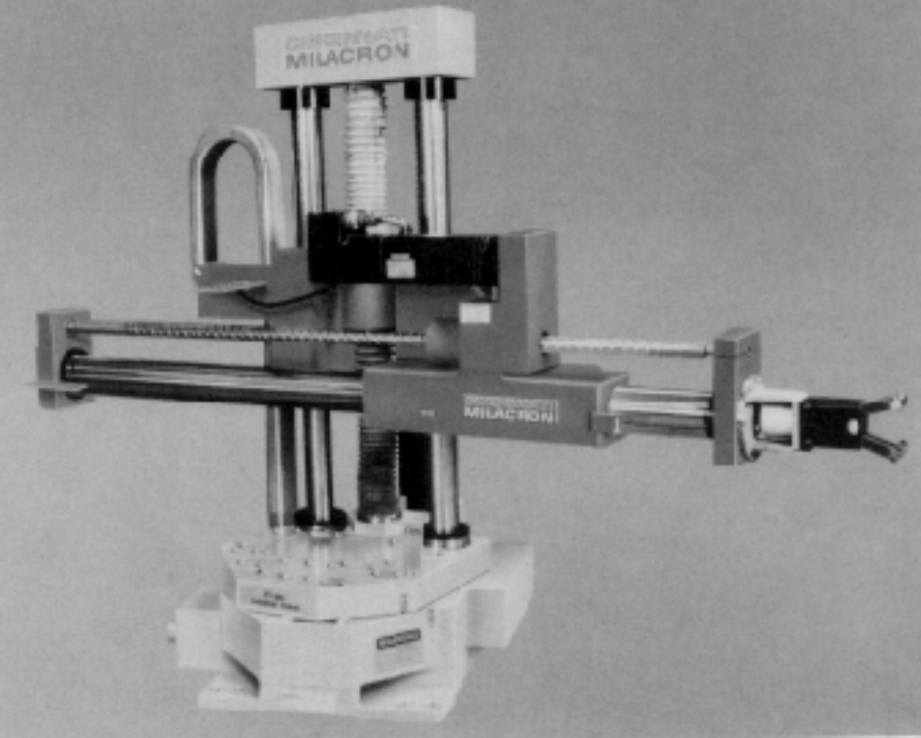
Robot Configurations (cont’d)
Cylindrical (R2P): Cylindrical coordinate Robots have 2 prismatic joints and one revolute joint.

Slide 36
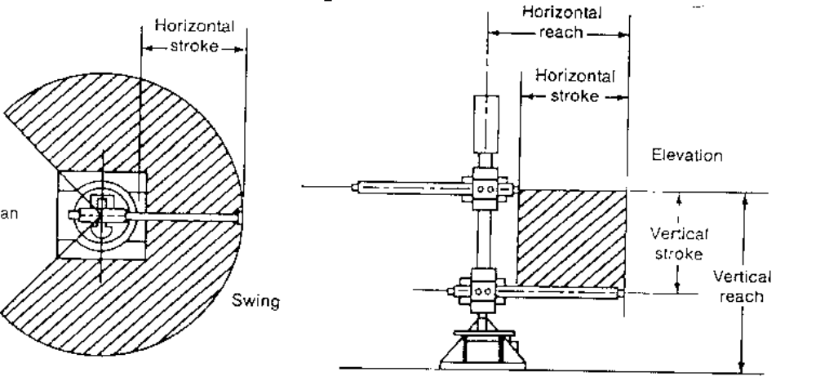
Cylindrical Robot - Work Envelope

Slide 37
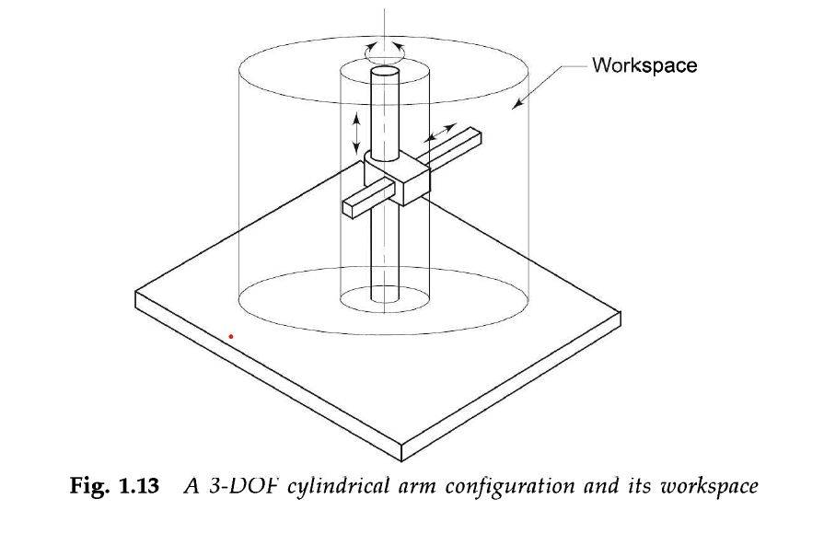

Slide 38
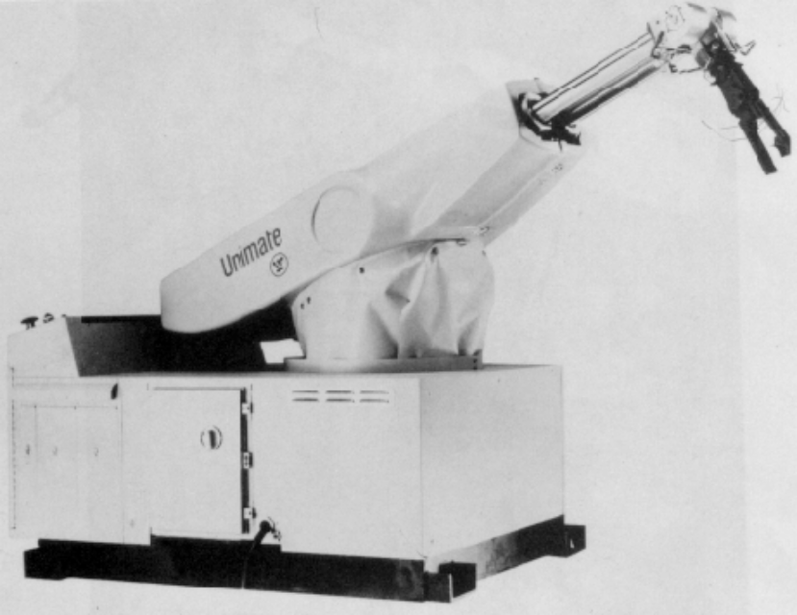
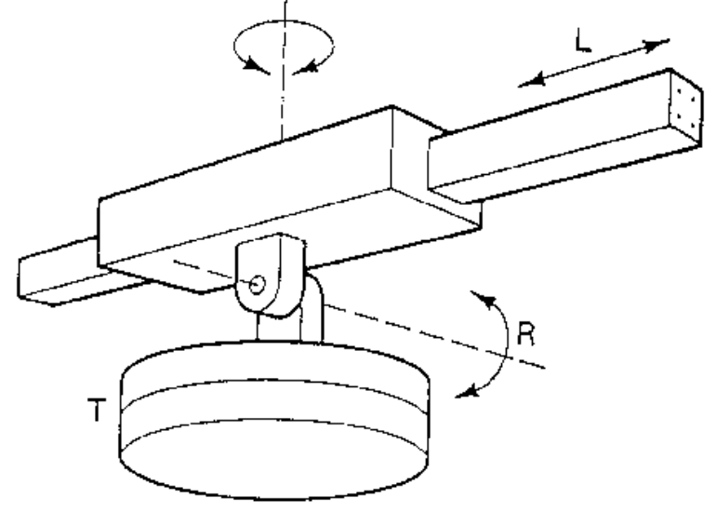
Robot Configurations (cont’d)
Spherical joint (2RP): They follow a spherical coordinate system, which has one

Slide 39
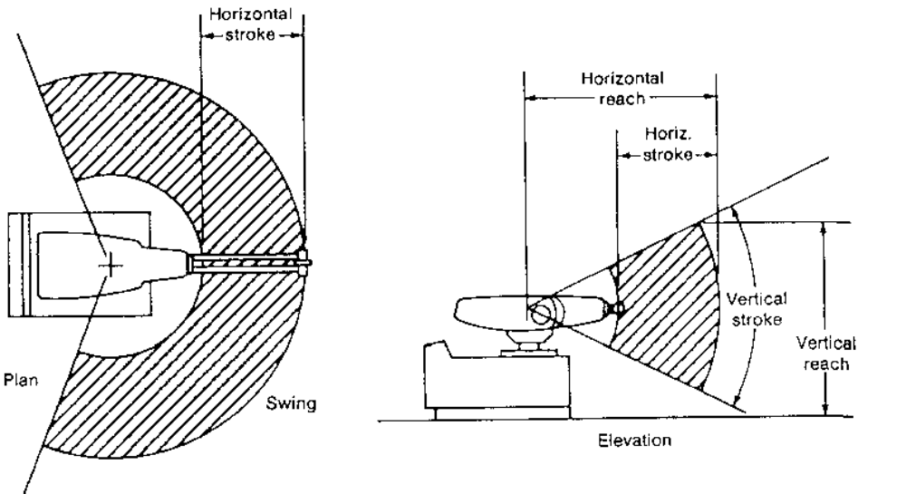
Spherical Robot - Work Envelope

Slide 40
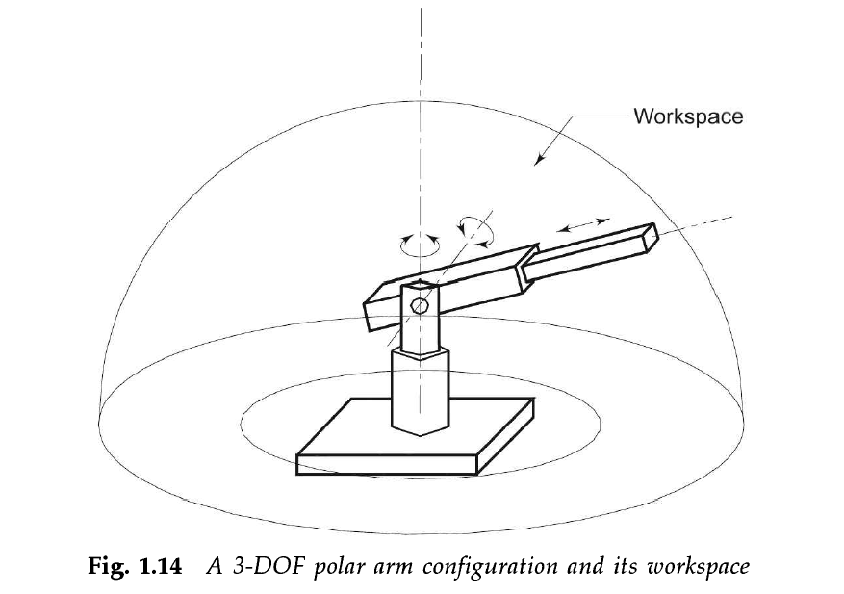

Slide 41
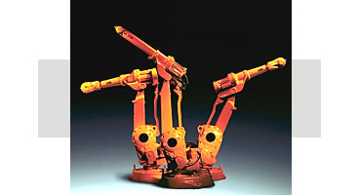
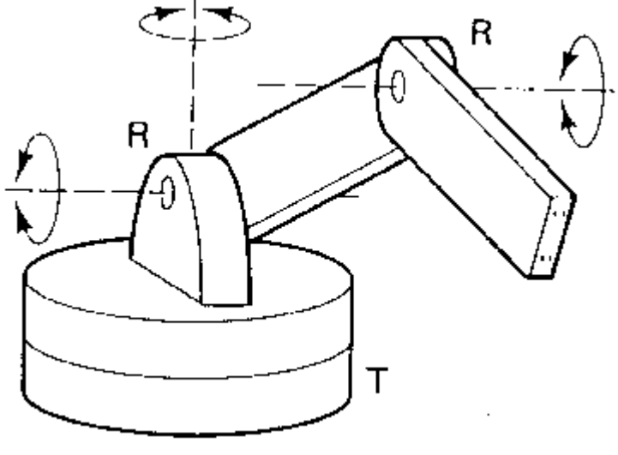
Robot Configurations (cont’d)
Articulated/anthropomorphic(3R) :An articulated robot’s joints are all revolute, similar to a human’s arm.

Slide 42
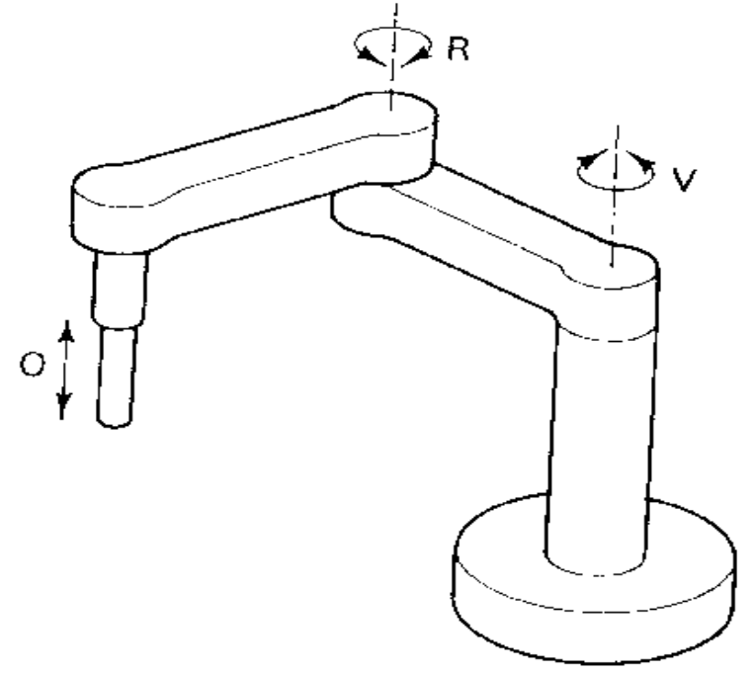
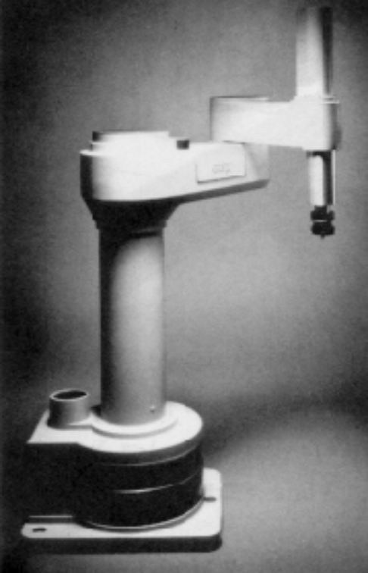
Robot Configurations (cont’d)
Selective Compliance Assembly Robot Arm (SCARA) (2R1P): They have two revolute joints that are parallel and allow the Robot to move in a horizontal plane, plus an additional prismatic joint that moves vertically

Slide 43
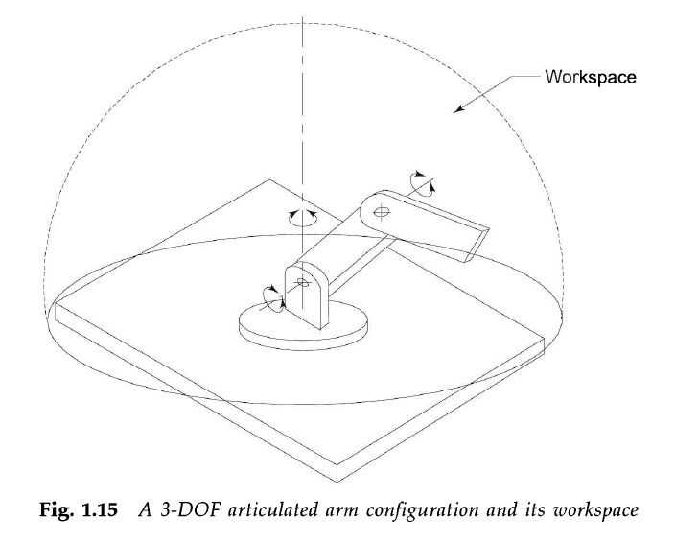

Slide 44
Work Envelope concept
Depending on the configuration and size of the links and wrist joints, robots can reach a collection of points called a Workspace.
Alternately Workspace may be found empirically, by moving each joint through its range of motions and combining all space it can reach and subtracting what space it cannot reach

Slide 45
WRIST
typically has 3 degrees of freedom
  Roll involves rotating the wrist about the arm axis
  Pitch up-down rotation of the wrist
  Yaw left-right rotation of the wrist
End effector is mounted on the wrist

Slide 46
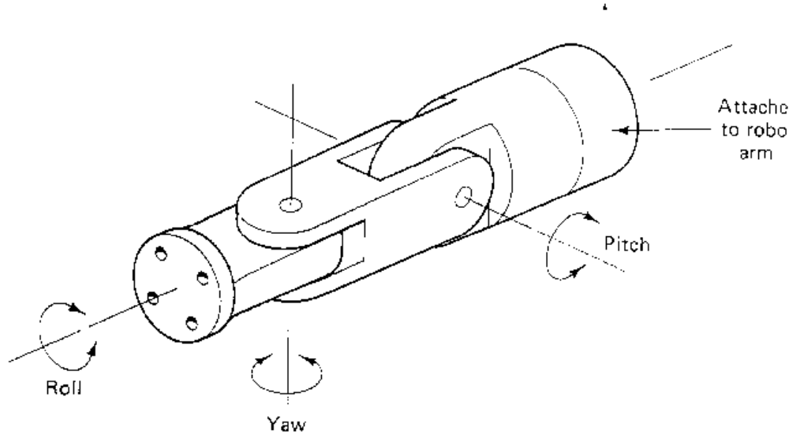
WRIST MOTIONS

Slide 47
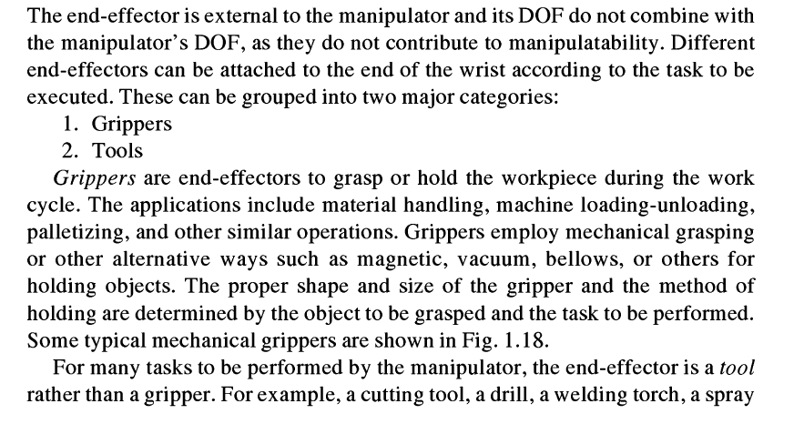
The End Effector

Slide 48
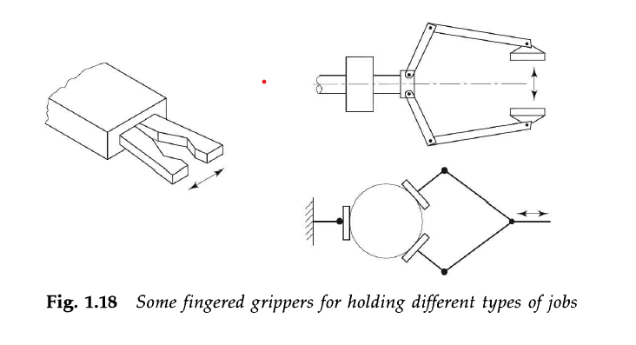

Slide 49

Manipulation and Control

Slide 50


Slide 51
Point-to-Point Control
Only the end points are programmed, the path used to connect the end points are computed by the controller
user can control velocity, and may permit linear or piece wise linear motion
Feedback control is used during motion to ascertain that individual joints have achieved desired location

Slide 52
Often used hydraulic drives, recent trend towards servomotors
loads up to 500lb and large reach
Applications
  pick and place type operations
  palletizing
  machine loading

Slide 53
Continuous Path Controlled
in addition to the control over the endpoints, the path taken by the end effector can be controlled
Path is controlled by manipulating the joints throughout the entire motion, via closed loop control
Applications:
  spray painting, polishing, grinding, arc welding

