Slide 1
Human Robot Interaction

Slide 2
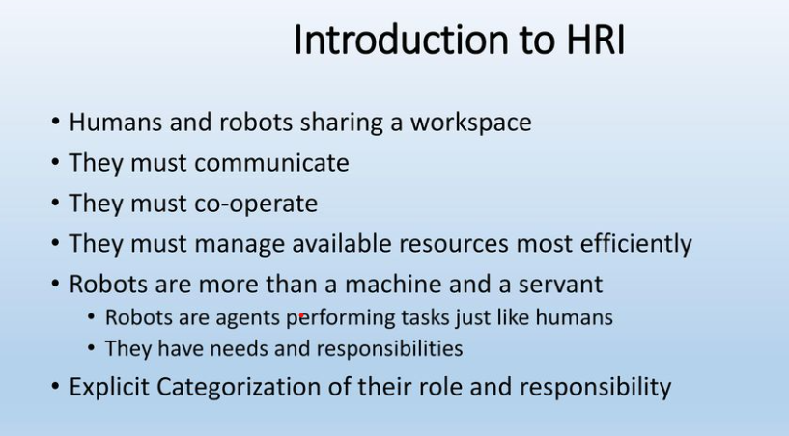

Slide 3
Importance of HRI - Efficiency of work environment
Harmony between two species
Best robot design strategies
Best adaption strategies in multiple roles and multiple scenarios
Awareness of unseen issues
Humans and robots learn to live cohesively

Slide 4
Three Scenarios for HRI
Programming (coding) and training (machine learning and artificial intelligence) robots to understand and cooperate with human needs.
Psychological training of humans to understand and cooperate with robot as a resource and companion.
Training both humans (psychological) and robots (computational) to work in cohesion based on a common understanding to implement a task.

Slide 5
Training Robots Asimov’s three laws state that:
A robot may not injure a human being or, through inaction, allow a human being to come to harm.
A robot must obey the orders given to it by human beings except where such orders would conflict with the first Law.
A robot must protect its own existence as long as such protection does not conflict with the first or second laws

Slide 6
Problems with Asimov’s laws
Racism/Speciesism
Trust deficit
Ambiguity
Complex fear of man encroaching God’s realm and being unable to control the things he/she creates.
Fear of AI (Artificial Intelligence) Doomsday
Utilitarian morality
Robot should fulfill its utilitarian obligation(s) while maintaining minimum moral standards (as defined by master)
Our desire to imagine everything as Human-like

Slide 7
Controlling Robots possessing lethal force
Human-in-loop
Strict identification and confirmation routes to be hard coded
A sequence of commands instead of one
Final verification by human
Intent sensing
Technologically challenging
Too many variables
Functions not known
Too complex to solve mathematically in short time
Low-power high-performance computing

Slide 8
Robot Ethics EURON robot-ethics roadmap Forgettable memories:
Taking fresh independent decisions
Giving different levels of access
Never giving root access to important codes and documentation
Human-in-loop

Slide 9
Training both humans and robots
Task oriented training
Medical missions
Outer Space activity
Disaster management
Search and rescue operations
Hazardous environments
Non-verbal communication is also important
Training is focused for task
Limited multi-functionality

Slide 10
Teamwork, Clear definition of roles and responsibilities
Mutual respect and trust
Inculcating empathy (Artificial emotions)
Decision making
Decentralized
Hierarchical (Chain of command)
Managing Peer pressure
Partnership
Comradeship
Fast response to urgency

Slide 11
Artificial emotions: Human-like emotions, Cognition, Physiological
Human emotions is baseline
Cognitive, physiological, behavioral components
Perception, interpretation, understanding and generating a conclusion
Physiological
Hormonal
Behavioral
Expressions and actions facial expressions, gestures, gait, body postures, movement of eyes
Computationally challenging with present state-of-the-art robotics knowledge

