Slide 1
Automated Assembly Systems
Sections:
Fundamentals of Automated Assembly Systems
Quantitative Analysis of Assembly Systems

Slide 2
Automated Assembly - Defined
The use of mechanized and automated devices to perform the various assembly tasks in an assembly line or cell
Fixed automation usually
  Most automated assembly systems are designed to perform a fixed sequence of assembly steps on a specific product that is produced in very large quantities

Slide 3
Automated Assembly -
Application Characteristics
Where is automated assembly appropriate:
  High product demand
  Stable product design
  The assembly consists of no more than a limited number of components
  The product is designed for automated assembly

Slide 4
Assembly Processes in
Automated Assembly
Adhesive bonding Snap fitting
Insertion of components Soldering
Placement of components Spot welding
Riveting Stapling
Screw fastening Stitching

Slide 5
System Configurations
In-line assembly machine
Dial indexing machine
Carousel assembly system
Single-station assembly cell

Slide 6
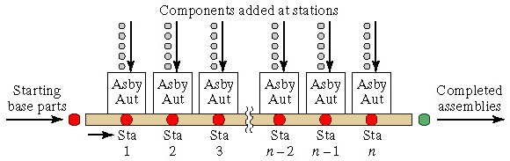
In-Line Assembly Machine
A series of automatic workstations located along and in-line transfer system
Either synchronous or asynchronous work transfer used

Slide 7
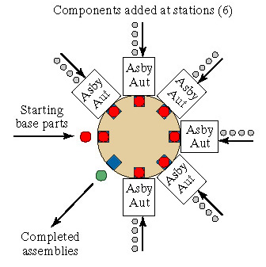
Dial Indexing Machine
Base parts are loaded onto fixtures or nests attached to a circular dial table, and components are added at workstations located around the periphery of the dial as it indexes from station to station

Slide 8
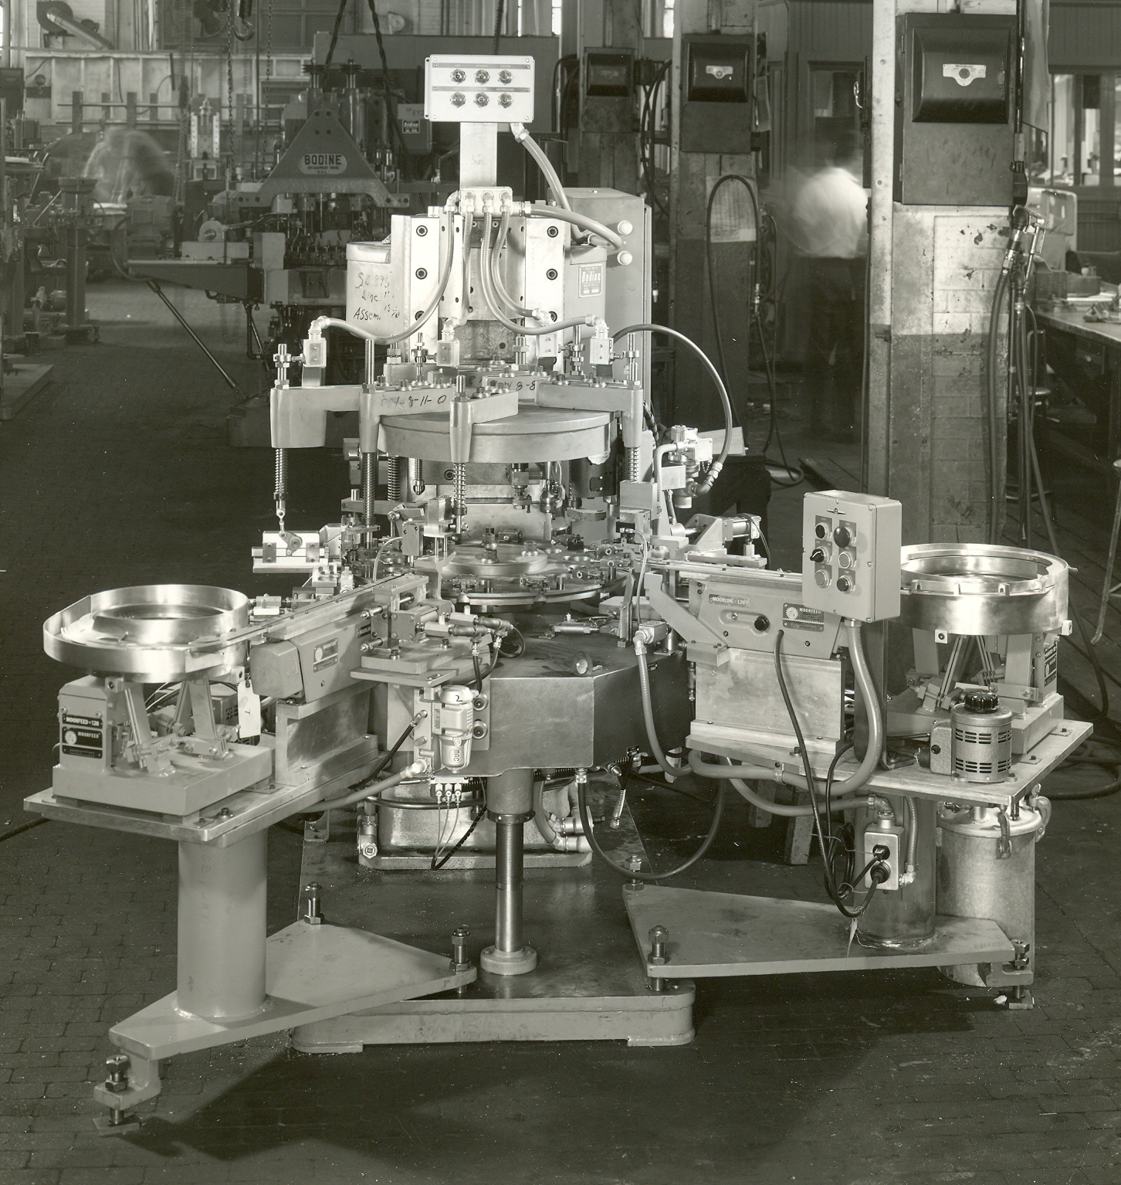
Dial indexing assembly machine (Bodine Corp.)

Slide 9
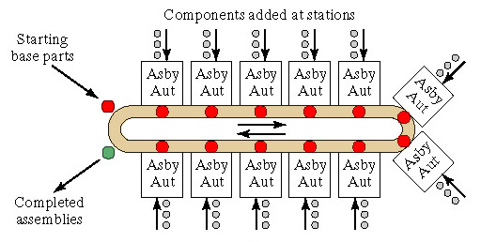
Carousel Assembly System
A hybrid between circular work flow of dial indexing machine and straight work flow of in-line system

Slide 10
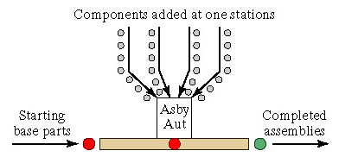
Single-Station Assembly Cell
Assembly operations are performed on a base part at a single location
A robot is sometimes used as the assembly machine

Slide 11
Multi-Station vs. Single-Station
Multi-station assembly machine or line
  Faster cycle rate
  High production quantities
  More operations possible
  More components per assembly
Single-station assembly cell
  Suited to robotic assembly
  Intended for lower production quantities

Slide 12
Parts Delivery at Workstations
Typical parts delivery system at a workstation consists of the following hardware components:
  Hopper - container for parts
  Parts feeder - removes parts from hopper
  Selector and/or orientor - to assure part is in proper orientation for assembly at workhead
  Feed track - moves parts to assembly workhead
  Escapement and placement device - removes parts from feed track and places them at station

Slide 13
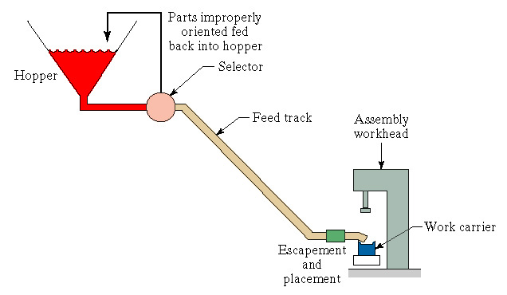
Parts Delivery System at Station

Slide 14
Vibratory Bowl Feeder
Most versatile of hopper feeders for small parts
Consists of bowl and helical track
  Parts are poured into bowl
  Helical track moves part from bottom of bowl to outlet
Vibration applied by electromagnetic base
  Oscillation of bowl is constrained so that parts climb upward along helical track

Slide 15
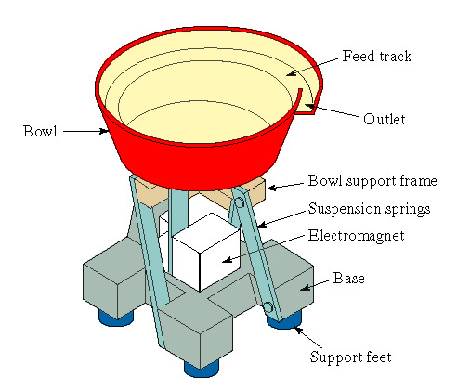
Vibratory Bowl Feeder

Slide 16
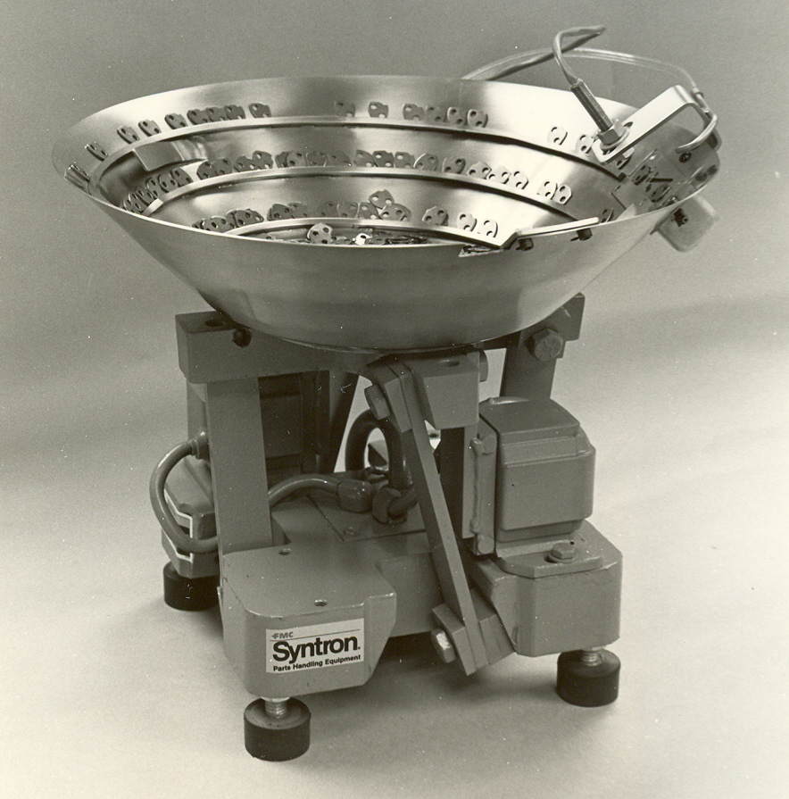
Vibratory Bowl Feeder
Photo courtesy Syntron Inc.

Slide 17
Selector and/or Orientor
Purpose - to establish the proper orientation of the components for the assembly workhead
Selector
  Acts as a filter
  Only parts in proper orientation are allowed to pass through to feed track
Orientor
  Allows properly oriented parts to pass
  Reorients parts that are not properly oriented

Slide 18
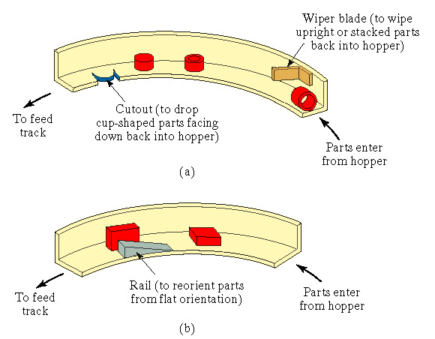
Parts Selection and Orientation
(a) Selector
(b) Orientor

Slide 19
Feed Track
Moves parts from hopper to assembly workhead
Categories:
  Gravity - hopper and feeder are located at higher elevation than workhead
  Powered - uses air or vibration to move parts toward workhead

Slide 20
Escapement and Placement Devices
Escapement device
  Removes parts from feed track at time intervals that are consistent with the cycle time of the assembly workhead
Placement device
  Physically places the parts in the correct location at the assembly workstation
Escapement and placement devices are sometimes the same device, sometimes different devices

Slide 21
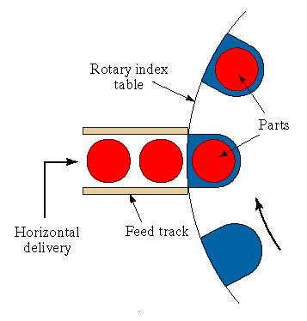
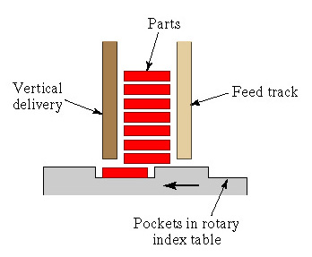
Escapement and Placement Devices
(a) Horizontal and (b) vertical devices for placement of parts onto dial-indexing table

Slide 22
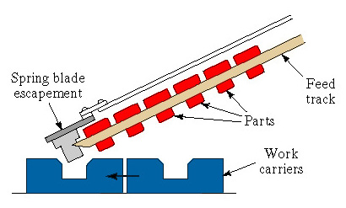
Escapement and Placement Devices
Escapement of rivet-shaped parts actuated by work carriers

Slide 23
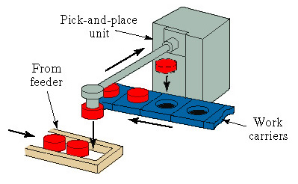
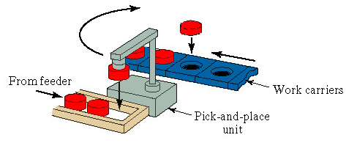
Escapement and Placement Devices
Two types of pick-and-place mechanisms for transferring base parts from feeders to work carriers

Slide 24
Quantitative Analysis of
Assembly Systems
Parts delivery system at workstations
Multi-station assembly machines
Single-station assembly cells
Partial automation

Slide 25
What the Equations Tell Us
The parts delivery system at each station must deliver components to the assembly operation at a net rate that is greater than or equal to the cycle rate of the assembly workhead
  Otherwise, assembly system performance is limited by the parts delivery system rather than the assembly process technology
Component quality has an important effect on system performance - poor quality means
  Jams at stations that stop the entire assembly system
  Assembly of defective components in the product

Slide 26
What the Equations Tell Us
As the number of stations increases, uptime efficiency and production rate are adversely affected due to parts quality and station reliability effects
The cycle time of a multi-station assembly system is determined by its slowest station
By comparison with a multi-station assembly system, a single-station assembly cell with the same number of assembly tasks has a lower production rate but a higher uptime efficiency

Slide 27
What the Equations Tell Us
Multi-station assembly systems are appropriate for high production applications and long production runs
By comparison, single-station assembly cells have a longer cycle time and are more appropriate for mid-range quantities
Storage buffers should be used on partially automated production lines to isolate the manual stations from breakdowns at the automated stations
An automated station should be substituted for a manual station only if it has the effect of reducing cycle time sufficiently to offset negative effects of lower reliability

