Slide 1
Robot Languages
Microcomputer Machine Language Level: the most basic and
very efficient but difficult to understand to follow.
Point-to-Point Level: Funky® Cincinnati Milacron’s T3©
It lacks branching, sensory information.
Primitive Motion Level: VAL by Unimation™
Interpreter based language.
Structured Programming Level: This is compiler based
but more difficult to learn.
Task-Oriented Level: Recent programming

Slide 2
♦ Robot Application
Machine loading
Pick and place operations
Welding
Painting
Sampling
Assembly operation
Manufacturing
Surveillance
Medical applications
Assisting disabled individuals
Hazardous environments
Underwater, space, and remote locations

Slide 3
Robot Application
Fig. 1.9 Staubli robot placing dishwasher tubs
Fig. 1.8 A Staubli robot loading and unloading
Fig. 1.10 An AM120 Fanuc robot
Fig. 1.11 A P200 Fanuc painting automobile bodies

Slide 4
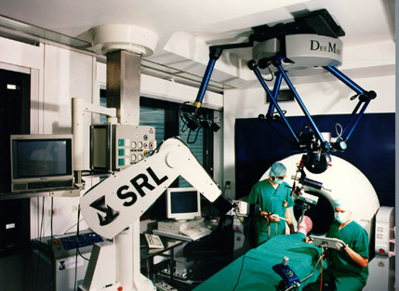
Robot Application
Fig. 1.13 A Fanuc LR Mate 200i robot removal operation
Fig. 1.12 Staubli RX FRAMS robot in a BMW
Fig. 1.13 The Arm, a 6 DOF bilateral force-feedback manipulator
Medical Robot of German

Slide 5
Advantages VS. Disadvantages of Robots
♦ Robots increase productivity, safety, efficiency, quality, and consistency of products.
♦ Robots can work in hazardous environments without the need.
♦ Robots need no environmental comfort.
♦ Robots work continuously without experiencing fatigue of problem.
♦ Robots have repeatable precision at all times.
♦ Robots can be much more accurate than human.
♦ Robots can process multiple stimuli or tasks simultaneously.
♦ Robots lack capability to respond in emergencies.
♦ Robots, although superior in certain senses, have limited capabilities in Degree of freedom, Dexterity, Sensors, Vision system, real time response.
♦ Robots are costly, due to Initial cost of equipment, Installation costs, Need for Peripherals, Need for training, Need for programming.
♦ Robots replace human workers creating economic problems

