Slide 1
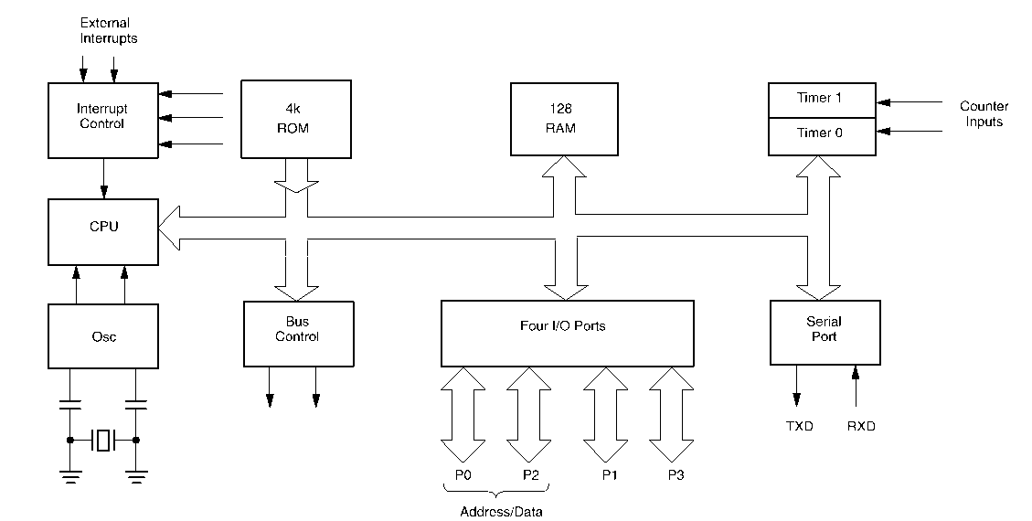
80C51 Block Diagram

Slide 2
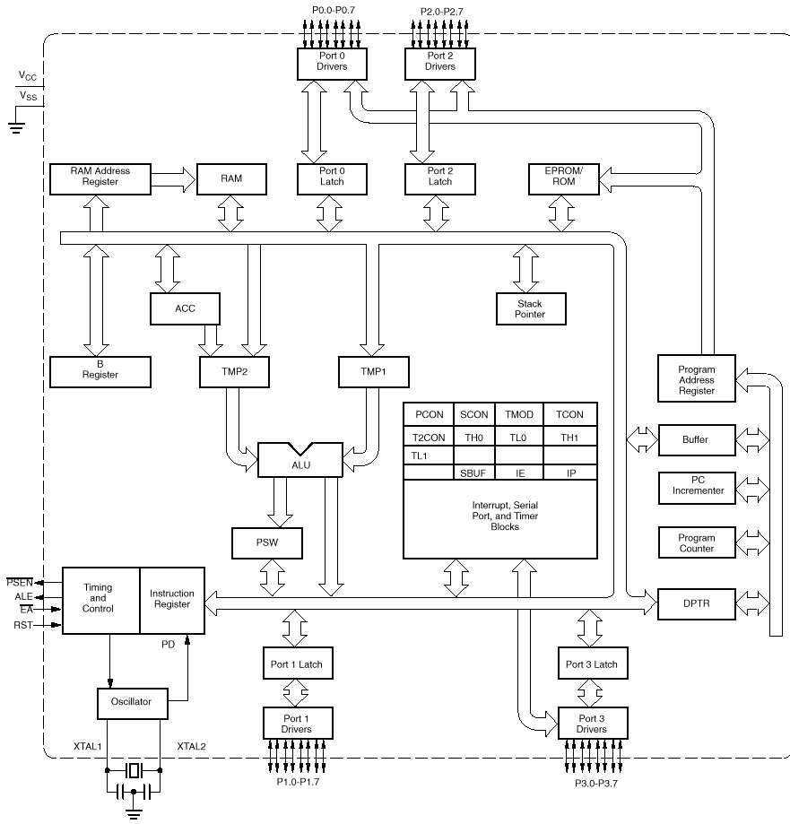

Slide 3
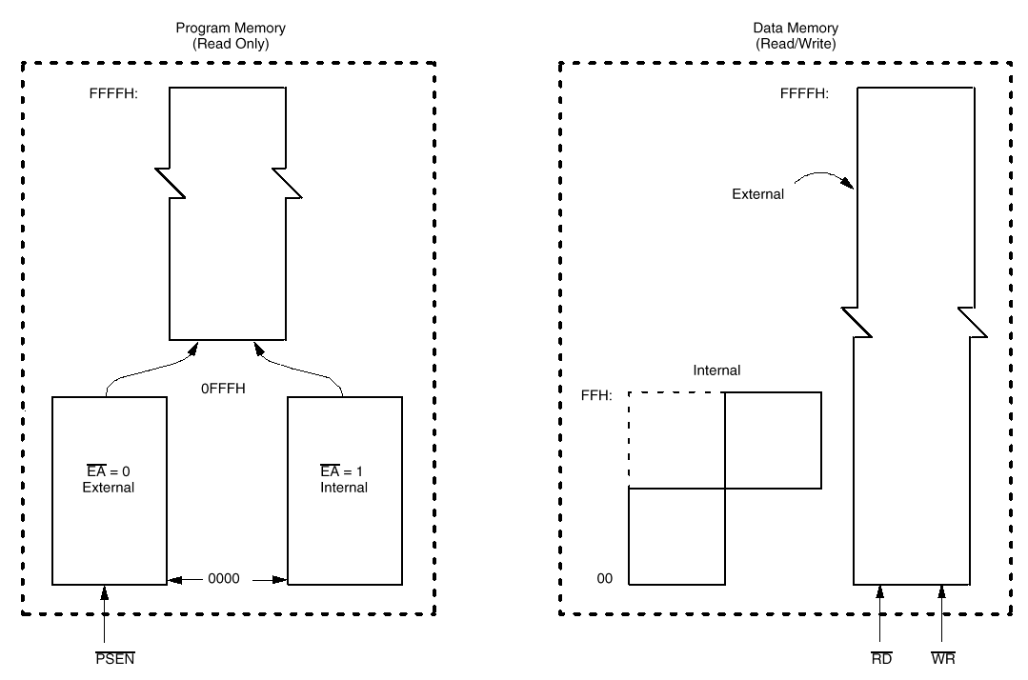
80C51 Memory

Slide 4
8051 Memory
The data width is 8 bits
Registers are 8 bits
Addresses are 8 bits
  i.e. addresses for only 256 bytes!
  PC is 16 bits (up to 64K program memory)
  DPTR is 16 bits (for external data - up to 64K)
C types
  char - 8 bits <-- use this if at all possible!
  short - 16 bits
  int - 16 bits
  long - 32 bits
  float - 32 bits
C standard signed/unsigned

Slide 5
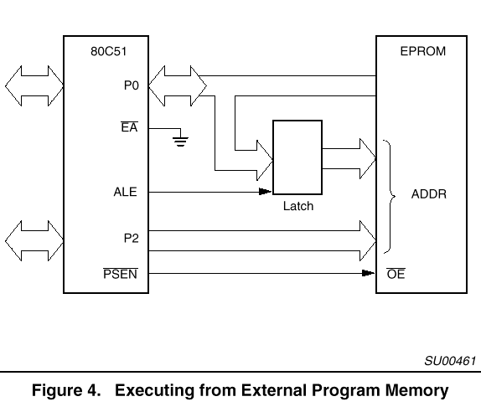
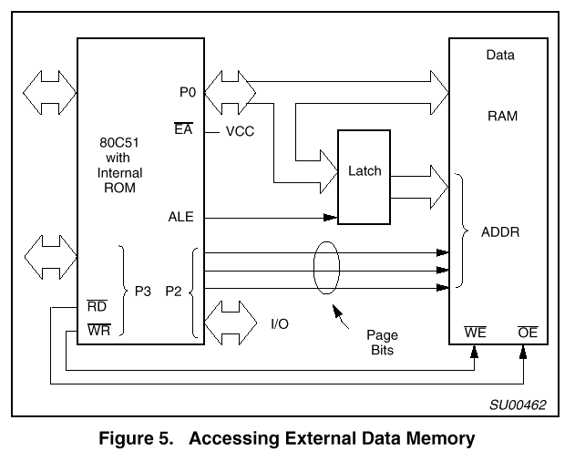
Accessing External Memory

Slide 6
Program Memory
Program and Data memory are separate
Can be internal and/or external
  20K internal flash for the Atmel controller
Read-only
  Instructions
  Constant data
  char code table[5] = {‘1’,‘2’,‘3’,‘4’,‘5’} ;
  Compiler uses instructions for moving “immediate” data

Slide 7
External Data Memory
External Data - xdata
  Resides off-chip
  Accessed using the DPTR and MOVX instruction
  We will not use xdata
  We will use the SMALL memory model
    all data is on-chip
    limited to only ~128 bytes of data!

Slide 8
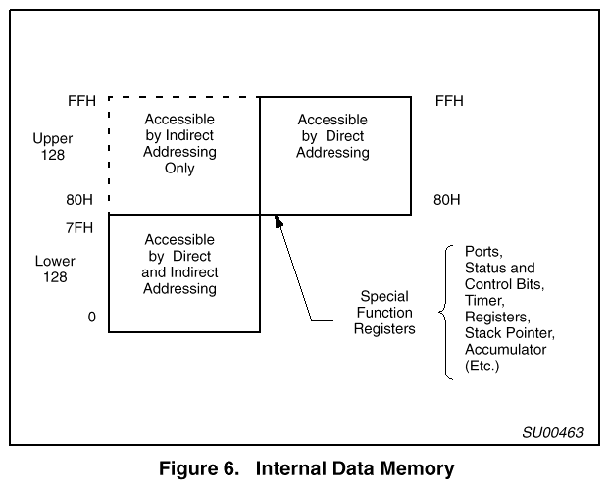
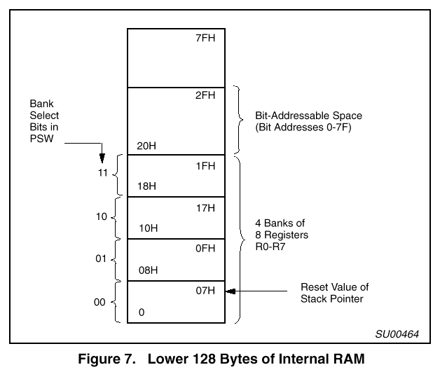
Internal Data Memory
Internal data memory contains all the processor state
  Lower 128 bytes: registers, general data
  Upper 128 bytes:
    indirectly addressed: 128 bytes, used for the stack (small!)
    directly addressed: 128 bytes for “special” functions

Slide 9
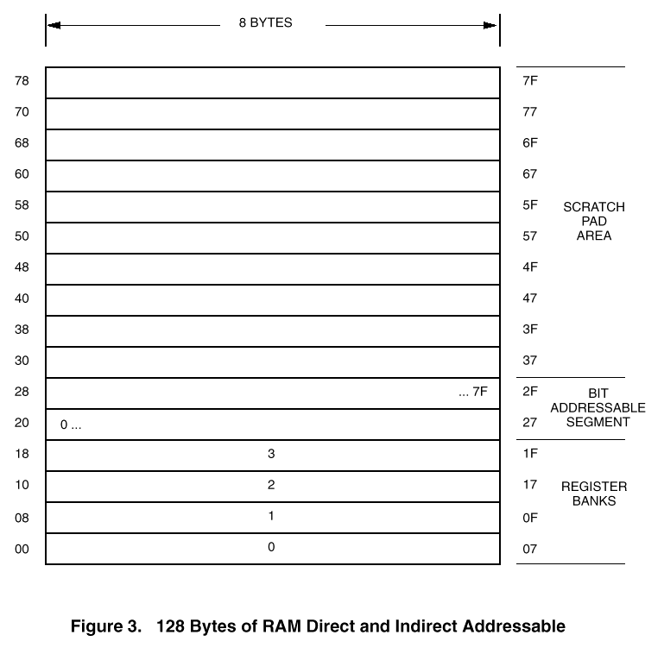
Lower 128 bytes
Register banks, bit addressable data, general data
  you can address any register!
  let the C compiler deal with details (for now)

Slide 10
Data Memory Specifiers
“data” - first 128 bytes, directly addressed
  the default
“idata” - all 256 bytes, indirectly addressed (slower)
“bdata” - bit-addressable memory
  16 bytes from addresses 0x20 to 0x2F
  128 bit variables max
  bit flag1, flag2;
  flag1 = (a == b);
  can access as bytes or bits
  char bdata flags;
  sbit flag0 = flags ^ 0; /* use sbit to “overlay” */
  sbit flag7 = flags ^ 7; /* ^ specifies bit */
  flags = 0; /* Clear all flags */
  flag7 = 1; /* Set one flag */

Slide 11
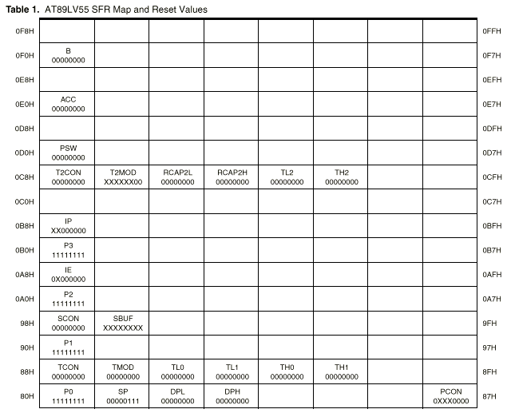
Upper 128 bytes: SFR area

Slide 12
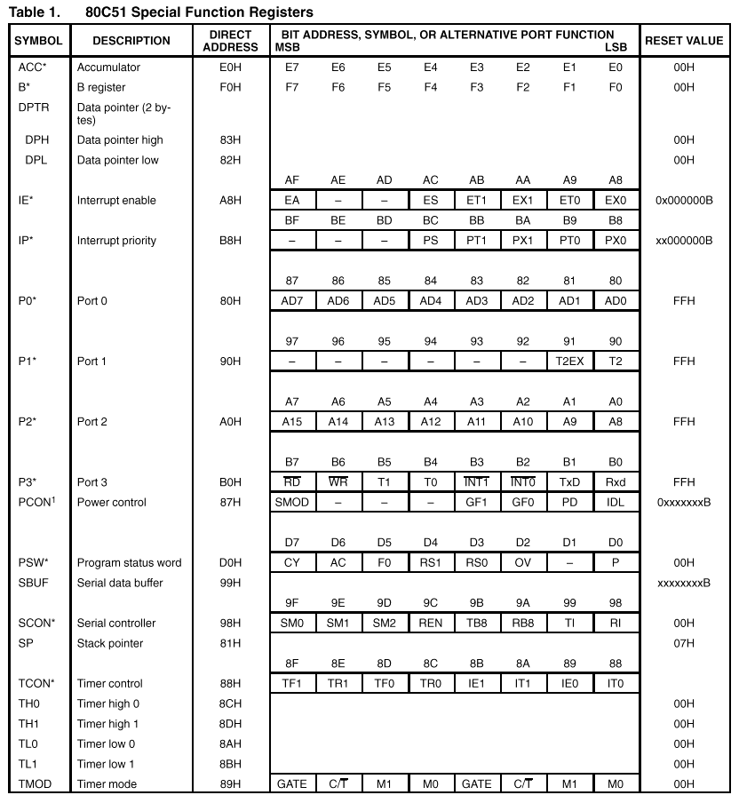

Slide 13
Accessing SFRs
The interesting SFRs are bit-addressable
  addresses 0x80, 0x88, 0x90, . . . , 0xF8
SFRs can be addressed by bit, char or int
sbit EA = 0xAF; /* one of the interrupt enables
sfr Port0 = 0x80; /* Port 0 */
sfr16 Timer2 = 0xCC; /* Timer 2 */
sbit LED0 = Port1 ^ 2; /* Define a port bit */
EA = 1; /* Enable interrupts */
Port0 = 0xff; /* Set all bits in Port 0 to 1
if (Timer2 > 100) . . .
LED0 = 1; /* Turn on one bit in Port 2 */

Slide 14
Ports
Port 0 - external memory access
  low address byte/data
Port 2 - external memory access
  high address byte
Port 1 - general purpose I/O
  pins 0, 1 for timer/counter 2
Port 3 - Special features
  0 - RxD: serial input
  1 - TxD: serial output
  2 - INT0: external interrupt
  3 - INT1: external interrupt
  4 - T0: timer/counter 0 external input
  5 - T1: timer/counter 1 external input
  6 - WR: external data memory write strobe
  7 - RD: external data memory read strobe

Slide 15
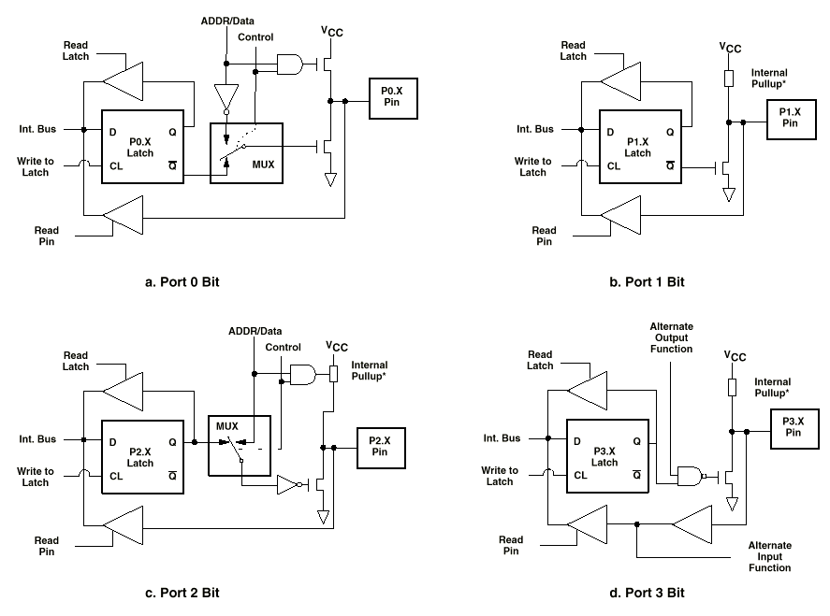
Ports

Slide 16
Ports
Port 0 - true bi-directional
Port 1-3 - have internal pullups that will source current
Output pins:
  Just write 0/1 to the bit/byte
Input pins:
  Output latch must have a 1 (reset state)
    Turns off the pulldown
    pullup must be pulled down by external driver
  Just read the bit/byte

Slide 17
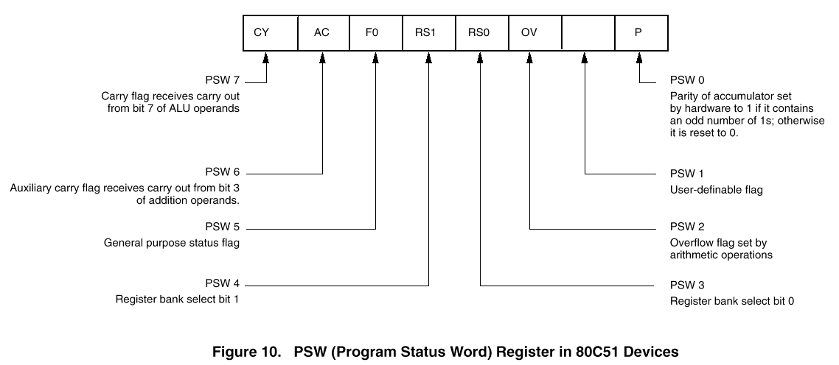
Program Status Word
Register set select
Status bits

Slide 18
Instruction Timing
One “machine cycle” = 6 states (S1 - S6)
One state = 2 clock cycles
  One “machine cycle” = 12 clock cycles
Instructions take 1 - 4 cycles
  e.g. 1 cycle instructions: ADD, MOV, SETB, NOP
  e.g. 2 cycle instructions: JMP, JZ
  4 cycle instructions: MUL, DIV

Slide 19
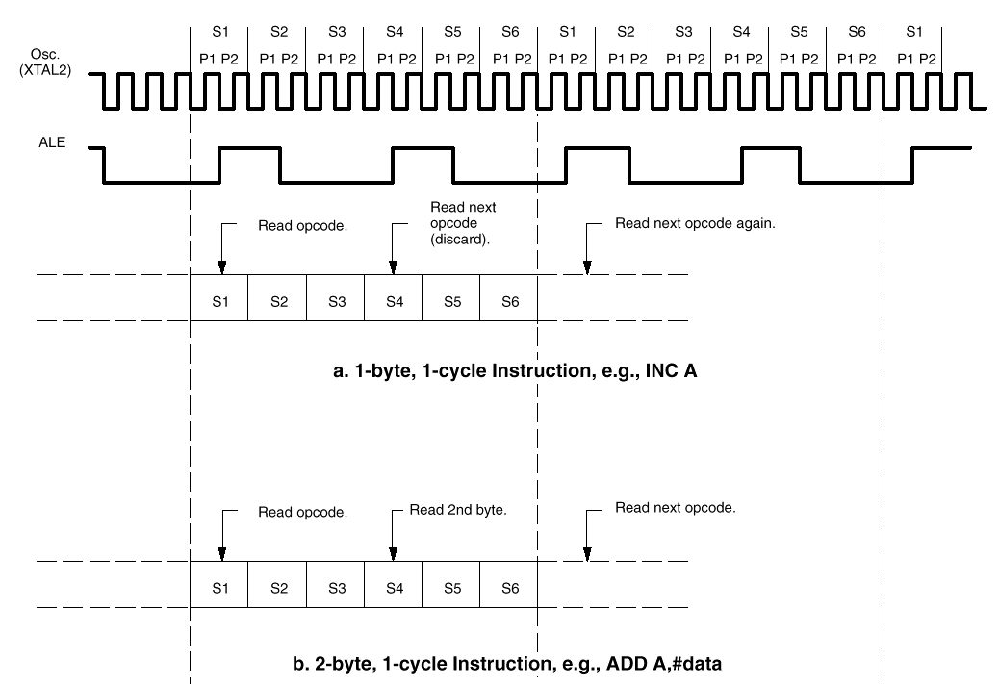
Instruction Timing

Slide 20
Timers
Base 8051 has 2 timers
  we have 3 in the Atmel 89C55
Timer mode
  Increments every machine cycle (12 clock cycles)
Counter mode
  Increments when T0/T1 go from 1 - 0 (external signal)
Access timer value directly
Timer can cause an interrupt
Timer 1 can be used to provide programmable baud rate for serial communications
Timer/Counter operation
  Mode control register (TMOD)
  Control register (TCON)

Slide 21
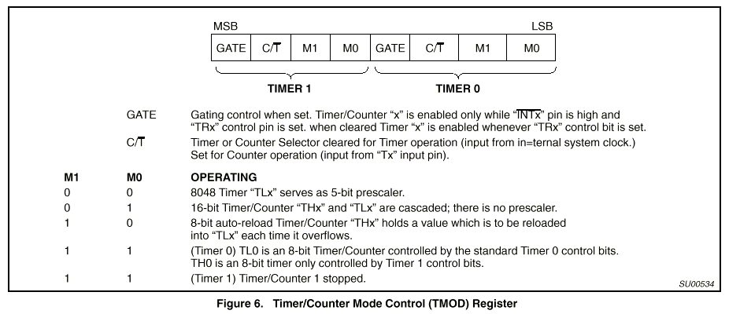
Mode Control Register (TMOD)
Modes 0-3
GATE - allows external pin to enable timer (e.g. external pulse)
  0: INT pin not used
  1: counter enabled by INT pin (port 3.2, 3.3)
C/T - indicates timer or counter mode

Slide 22
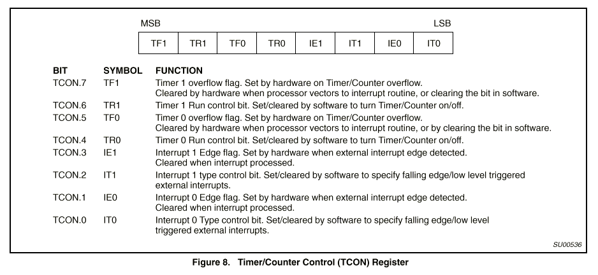
Timer/Counter Control Register (TCON)
TR - enable timer/counter
TF - overflow flag: can cause interrupt
IE/IT - external interrupts and type control
  not related to the timer/counter

Slide 23
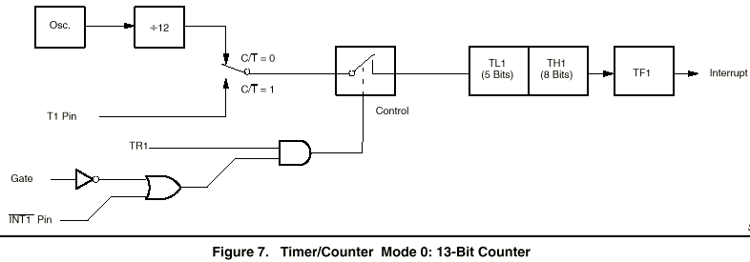
Timer/Counter Mode 0
Mode 1 same as Mode 0, but uses all 16 bits

Slide 24
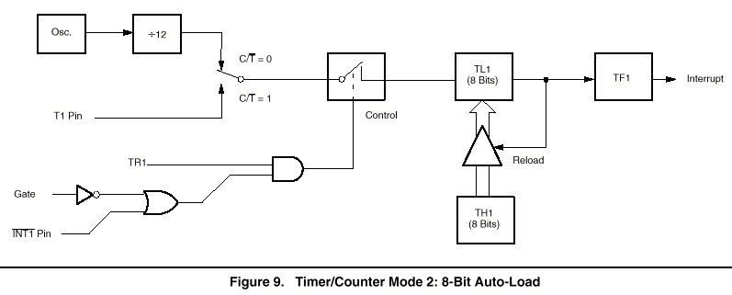
Timer/Counter Mode 2
8-bit counter, auto-reload on overflow

Slide 25
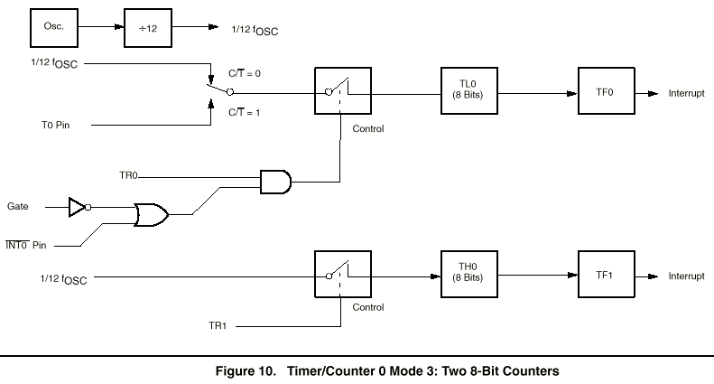
Timer/Counter Mode 3
Applies to Timer/Counter 0
Gives an extra timer

Slide 26
Interrupts
Allow parallel tasking
  Interrupt routine runs in “background”
Allow fast, low-overhead interaction with environment
  Don’t have to poll
  Immediate reaction
An automatic function call
  Easy to program
8051 Interrupts
  Serial port - wake up when data arrives/data has left
  Timer 0 overflow
  Timer 1 overflow
  External interrupt 0
  External interrupt 1

Slide 27
Interrupt Vector
For each interrupt, which interrupt function to call
In low program addresses
  Hardware generates an LCALL to address in interrupt vector
  Pushes PC (but nothing else) onto the stack
  RETI instruction to return from interrupt
0x00 - Reset PC address
0: 0x03 - External interrupt 0
1: 0x0B - Timer 0
2: 0x13 - External interrupt 1
3: 0x1B - Timer 1
4: 0x23 - Serial line interrupt

Slide 28
Writing Interrupts in C
The C compiler takes care of everything
  Pushing/popping the right registers (PSW, ACC, etc.)
  Generating the RTI instruction
  No arguments/no return values
  unsigned int count;
  unsigned char second;
  void timer0 (void) interrupt 1 using 2 {
  if (++count == 4000) {
  second++;
  count = 0;
  }
  }
  Timer mode 2
  Reload value = 6

Slide 29
Timer Interrupts
Wakeup after N clock cycles, i.e. at a specified time
Wakeup every N clock cycles (auto reload)
  Allows simple task scheduling
  Clients queue function calls for time i
  Interrupt routine calls functions at the right time
Wakeup after N events have occurred on an input

Slide 30
Design Problem 1 - frequency counter
Measure the frequency of an external signal
Display as a number using the 7-segment display
  e.g. number represents exponent of 2 or 10

Slide 31
Example Timer Setup
What does this setup do?
TMOD = 0x62; // 01100010;
TCON = 0x50; // 01010000;
TH1 = 246;
TH0 = 6;
IE = 0x8A; // 10001010;

Slide 32
Using the timers
void counterInterrupt ( void ) interrupt 3 using 1 {
timeLow = TL0;
TL0 = 0;
timeHigh = count;
count = 0;
if (timeHigh == 0 && timeLow < 10) *ledaddress = 0x6f;
else if (timeHigh == 0 && timeLow < 100) *ledaddress = 0x6b;
else if (timeHigh < 4) *ledaddress = 0x02;
else if (timeHigh < 40) *ledaddress = 0x04;
else if (timeHigh < 400) *ledaddress = 0x08;
else if (timeHigh < 4000) *ledaddress = 0x10;
else if (timeHigh < 40000) *ledaddress = 0x20;
else *ledaddress = 0xf0; // default
}
void timerInterrupt ( void ) interrupt 1 using 1 {
count++;
}

Slide 33
Design Problem 2 - Measure the pulse width
Problem: send several bits of data with one wire
  Serial data
    precise, but complicated protocol
  Pulse width
    precise enough for many sensors
    simple measurement

Slide 34
Design Problem 3 - Accelerometer Interface
Accelerometer
  Two signals, one for each dimension
  Acceleration coded as the duty cycle
    pulse-width/cycle-length
    cycle time = 1ms - 10ms (controlled by resistor)
      1ms gives faster sampling
      10ms gives more accurate data

Slide 35
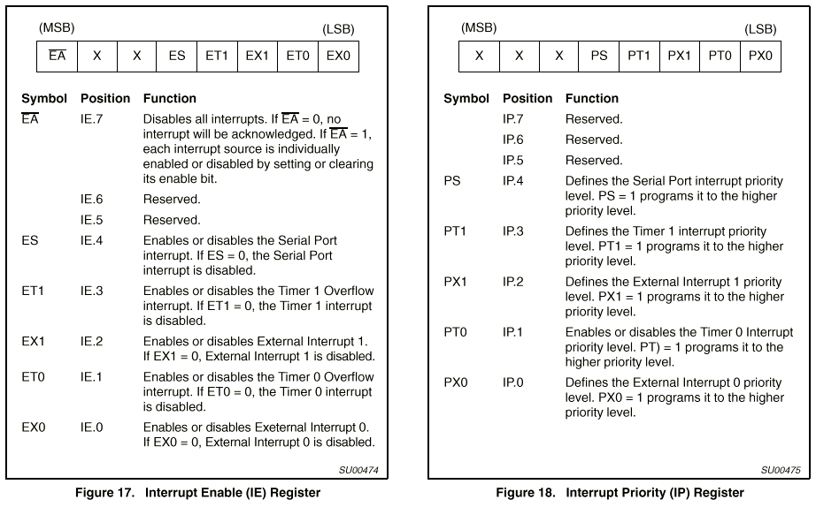
Controlling Interrupts: Enables and Priority

Slide 36
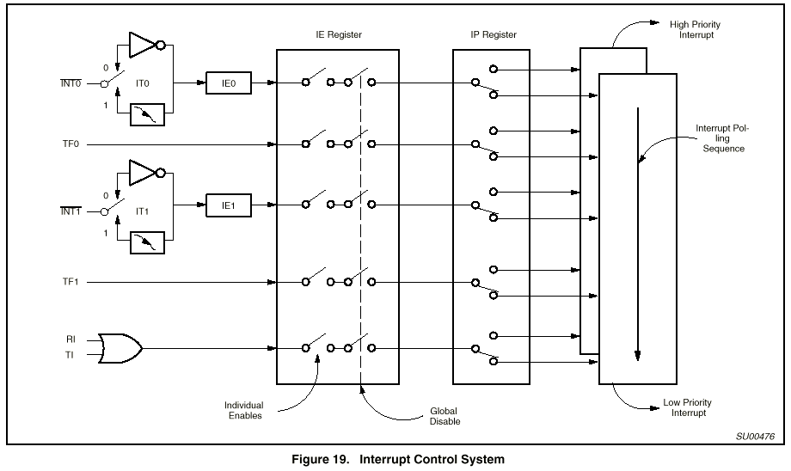
Interrupt Controls

Slide 37
Interrupt Priorities
Two levels of priority
  Set an interrupt priority using the interrupt priority register
  A high-priority interrupt can interrupt an low-priority interrupt routine
  In no other case is an interrupt allowed
  An interrupt routine can always disable interrupts explicitly
    But you don’t want to do this
Priority chain within priority levels
  Choose a winner if two interrupts happen simultaneously
  Order shown on previous page

Slide 38
Re-entrant Functions
A function can be called simultaneously be different processes
Recursive functions must be re-entrant
Functions called by interrupt code and non-interrupt code must be re-entrant
Keil C functions by default are not re-entrant
  Does not use the stack for everything
  Use the reentrant specifier to make a function re-entrant
  int calc (char i, int b) reentrant {
  int x;
  x = table[i];
  return (x * b);
  }

Slide 39
External Interrupts
Can interrupt using the INT0 or INT1 pins (port 3: pin 2,3)
  Interrupt on level or falling edge of signal (TCON specifies which)
  Pin is sampled once every 12 clock cycles
    for interrupt on edge, signal must be high 12 cycles, low 12 cycles
  Response time takes at least 3 instuctions cycles
    1 to sample
    2 for call to interrupt routine
    more if a long instruction is in progress (up to 6 more)

