Slide 1
Module - 4
8051 ARCHITECTURE

Slide 2
INTRODUCTION TO
INTEL MCS 51 µC
1

Slide 3
INTEL MCS 51 MICROCONTROLLER
The Intel MCS-51 (commonly termed 8051) is a Harvard architecture, complex instruction set computing (CISC) Architecture, single chip microcontroller (µC) series developed by Intel in 1980 for use in embedded systems
In a CISC processor, each instruction performs so many actions that it takes several clock cycles to complete.
RISC-based machines execute one instruction per clock cycle
MODULE - 2
2

Slide 4
INTEL MCS 51 MICROCONTROLLER
FEATURES
8-bit CPU
64K bytes on-chip program memory (ROM)
128 bytes on-chip data memory (RAM)
32 I/O pins arranged as four 8-bit ports (P0 - P3)
32 general purpose registers each of 8-bit
Special Function Registers (SFRs) of 128 bytes
16-bit Program Counter
8-bit Processor Status Word (PSW) & Stack Pointer
Two 16-bit timer/counters : T0 and T1
Two external and three internal vectored interrupts
One full duplex serial I/O (UART)
MODULE - 2
3

Slide 5
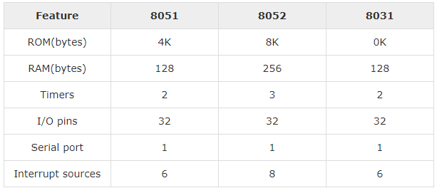
INTEL MCS 51 MICROCONTROLLER
8051 FAMILY SERIES
MODULE - 2
4

Slide 6
INTEL MCS 51 MICROCONTROLLER
8051 FAMILY SERIES
Although the 8051 is the most popular member of the 8051 family, you will not see “8051″ in the part number.
This is because the 8051 is available in different memory types, such as UV-EPROM, flash, and NV-RAM, all of which have different part numbers.
The UV-EPROM version of the 8051 is the 8751. The flash ROM version is marketed by many companies including Atmel Corp. and Dallas Semiconductor.
MODULE - 2
5
Notes:
Intel was liberal in giving away license to whoever asked
Ultra-Violet Erasable Programmable Read Only Memory (UV-EPROM)
electrically erased and reprogrammed.
non-volatile random-access memory

Slide 7
INTEL MCS 51 MICROCONTROLLER
8051 FAMILY SERIES
The Atmel Flash 8051 is called AT89C51, while Dallas Semiconductor calls theirs DS89C4xO (DS89C420/430/440).
The NV-RAM version of the 8051 made by Dallas Semiconductor is called DS5000.
There is also an OTP (one-time programmable) version of the 8051 made by various manufacturers.
MODULE - 2
6
Notes:
can be programmed only once and it cannot be changed or reused after its initial programming.

Slide 8
INTEL MCS 51 MICROCONTROLLER
8051 MAJOR MANUFACTURERS
ATMEL
ANALOG DEVICES
ST MICROELECTRONICS
DALLAS
MAXIM
SILICON LABS
TEXAS INSTRUMENTS
MICROCHIP
ZILOG
MODULE - 2
7

Slide 9
INTEL MCS 51 MICROCONTROLLER
8051 ATMEL SERIES
Part Number | ROM | RAM | I/O pins | Timer | Interrupt | Vcc | Packaging
AT89C51 | 4K | 128 | 32 | 2 | 6 | 5V | 40
AT89C52 | 8K | 256 | 32 | 3 | 8 | 5V | 40
AT89C1051 | 1K | 64 | 15 | 1 | 3 | 3V | 20
AT89C2051 | 2K | 128 | 32 | 3 | 8 | 3V | 20
AT89LV51 | 4K | 128 | 32 | 2 | 6 | 3V | 40
AT89LV52 | 8K | 128 | 32 | 3 | 8 | 3V | 40
MODULE - 2
8
Notes:
low-voltage, high-performance CMOS 8-bit microcomputer

Slide 10
8051 MICROCONTROLLER
PIN DETAILS

Slide 11
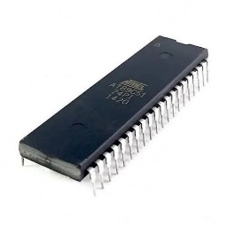
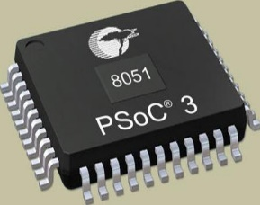
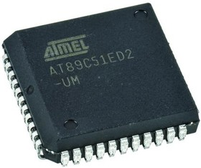
8051 MICROCONTROLLER PIN DETAILS
8051 PIN DETAILS
Although 8051 family members (e.g., 8751, 89C51, 89C52, DS89C4xO) come in different packages, such as DIP (dual in-line package), QFP (quad flat package), and LLC (leadless chip carrier)
They all have 40 pins that are dedicated to various functions such as I/O, RD, WR, address, data, and interrupts.
Some companies provide a 20-pin version of the 8051 with a reduced number of I/O ports for less demanding applications.
DIP
QFP
LLC
MODULE - 2
9

Slide 12
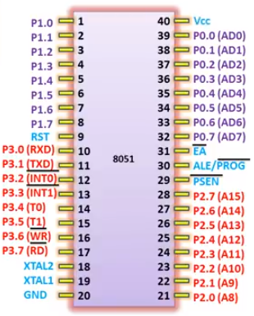
8051 MICROCONTROLLER PIN DETAILS
8051 PIN DETAILS
However, since the vast majority of developers use the 40-pin chip, we will concentrate on that.
In 40 pin package, a total of 32 pins are set aside for the four ports PO, P1, P2, and P3, where each port takes 8 pins.
The rest of the pins are designated as Vcc, GND, XTAL1, XTAL2, RST, EA, PSEN, and ALE.
MODULE - 2
10

Slide 13
8051 MICROCONTROLLER PIN DETAILS
8051 PIN DETAILS
Of these pins, six (Vcc, GND, XTAL1, XTAL2, RST, and EA) are used by all members of the 8051 and 8031 families.
In other words, they must be connected in order for the system to work, regardless of whether the microcontroller is of the 8051 or 8031 family.
The other two pins, PSEN and ALE, are used mainly in 8031-based systems.
MODULE - 2
11

Slide 14
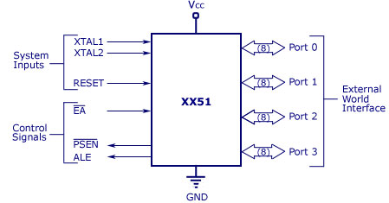
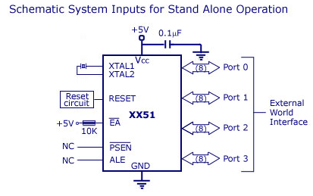
8051 MICROCONTROLLER PIN DETAILS
8051 SCHEMATICS
MODULE - 2
12

Slide 15
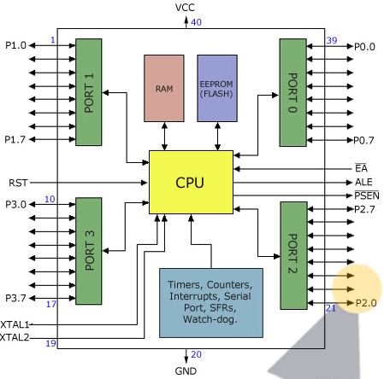
8051 MICROCONTROLLER PIN DETAILS
8051 PIN DIAGRAM
MODULE - 2
13

Slide 16
8051 MICROCONTROLLER PIN DETAILS
8051 PIN DESCRIPTION
Pin-40 : Vcc is the main power source. Usually its +5V DC.
Pins 32-39: Port 0 (P0.0 to P0.7) – In addition to serving as I/O port, lower order address and data bus signals are multiplexed with this port (to serve the purpose of external memory interfacing). This is a bi directional I/O port (the only one in 8051) and external pull up resistors are required to function this port as I/O.
MODULE - 2
14

Slide 17
8051 MICROCONTROLLER PIN DETAILS
Pin-31:- ALE - Address Latch Enable. It is especially used for 8031 IC to connect it to the external memory. It can be used while deciding whether P0 pins will be used as Address bus or Data bus. When ALE = 1, then the P0 pins work as Data bus and when ALE = 0, then the P0 pins act as Address bus.
Pin-30:- EA - External Access input is used to enable or disallow external memory interfacing. If there is no external memory requirement, this pin is pulled high by connecting it to Vcc.
MODULE - 2
15

Slide 18
8051 MICROCONTROLLER PIN DETAILS
Pin- 29:- PSEN or Program Store Enable. This is an active low pin, i.e., it gets activated after applying a low pulse. It is an output pin and used along with the EA pin in 8031 based (i.e. ROMLESS) Systems to allow storage of program code in external ROM.
Pins- 21-28: Port 2 (P 2.0 to P 2.7) – in addition to serving as I/O port, higher order address bus signals are multiplexed with this quasi bi directional port.
Pin 20:- Vss – it represents ground (0 V) connection.
MODULE - 2
16

Slide 19
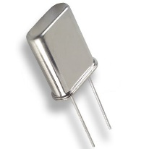
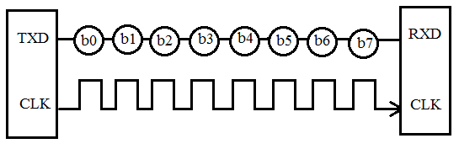
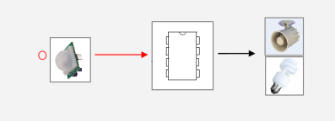
8051 MICROCONTROLLER PIN DETAILS
Pins 18 and 19:- XTAL1 & XTAL2 Used for interfacing an external crystal to provide system clock.
Pins 10 – 17:- Port 3 (P 3.0 to P 3.7) It is also of 8 bits and can be used as Input/Output. This port provides some extremely important signals.
P3.0 and P3.1 are RxD (Receiver) and TxD (Transmitter) respectively and are collectively used for Serial Communication.
P3.2 and P3.3 pins are used for external interrupts. P3.4 and P3.5 are used for timers T0 and T1 respectively.
P3.6 and P3.7 are Write (WR) and Read (RD) pins.
crystal
Serial Communication.
MODULE - 2
17

Slide 20
8051 MICROCONTROLLER PIN DETAILS
Pin 9:- RESET pin is used to set the 8051 microcontroller to its initial values, while the microcontroller is working or at the initial start of application. The RESET pin must be set high for 2 machine cycles.
Pins 1 – 8:- Port 1 (P 1.0 to P 1.7). It is an 8-bit port (pin 1 through 8) and can be used either as input or output. Unlike other ports, this port does not serve any other functions. Port 1 is an internally pulled up, quasi bi directional I/O port.
MODULE - 2
18

Slide 21
8051 MICROCONTROLLER ARCHITECTURE

Slide 22
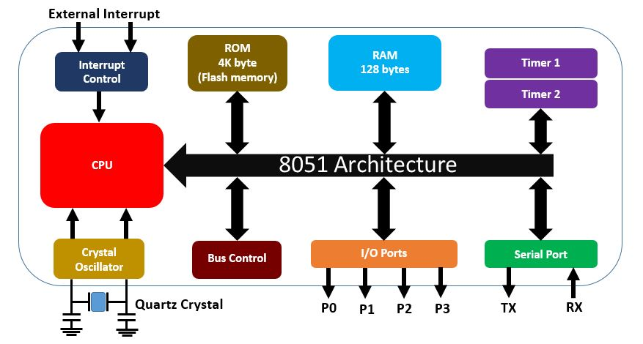
8051 MICROCONTROLLER ARCHITECTURE
8051 ARCHITECTURE (Simplified)
MODULE - 2
19

Slide 23
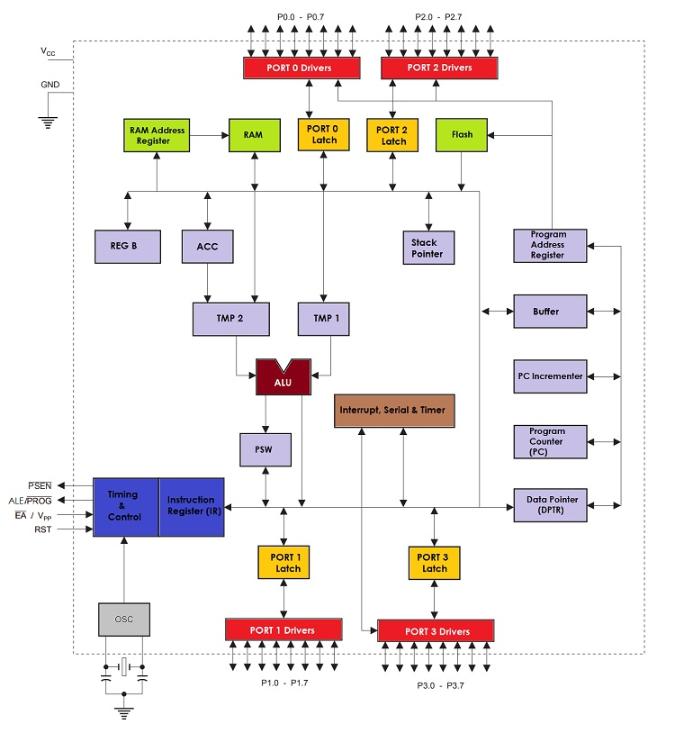
8051 MICROCONTROLLER ARCHITECTURE
8051 ARCHITECTURE (Detailed)
MODULE - 2
20

Slide 24
8051 MICROCONTROLLER ARCHITECTURE
CENTRAL PROCESSING UNIT (CPU)
Central Processor Unit (CPU) is the brain of any processing device of the microcontroller.
It monitors and controls all operations that are performed on the Microcontroller units.
The User has no control over the work of the CPU directly.
It reads program written in ROM memory and executes them and do the expected task of that application.
MODULE - 2
21

Slide 25
8051 MICROCONTROLLER ARCHITECTURE
INTERRUPT CONTROL
There are five interrupt sources in 8051 Microcontroller and interrupt control section control all these interrupts.
Two external interrupts (INT0 & INT1), two timer (TF0 & TF1) interrupts and one serial port (RI / TI) interrupt.
The Microcontroller 8051 can be configured in such a way that it temporarily terminates or pause the main program at the occurrence of interrupt. When subroutine is completed then the execution of main program starts as usual.
MODULE - 2
22

Slide 26
8051 MICROCONTROLLER ARCHITECTURE
RAM & ROM
Microcontroller 8051 has 4K of Code Memory or Program memory that is it has 4KB ROM and RAM of 128 bytes.
The memory which is used to store the program of Microcontroller, is known as code memory or Program memory . It is known as 'ROM'(Read Only Memory).
Microcontroller also requires a memory to store data or operands temporarily. This memory is known as Data Memory and we use 'RAM'(Random Access Memory) for this purpose.
MODULE - 2
23

Slide 27
8051 MICROCONTROLLER ARCHITECTURE
BUS CONTROL
Bus control section of 8051 is responsible for controlling the operation of address and data bus.
Bus: Basically Bus is a collection of wires which work as a communication channel or medium for transfer of Data.
Buses are of two types:
Address Bus: Microcontroller 8051 has a 16 bit address bus. It used to address memory locations.
Data Bus: Microcontroller 8051 has 8 bits data bus. It is used to carry data.
MODULE - 2
24

Slide 28
8051 MICROCONTROLLER ARCHITECTURE
CRYSTAL OSCILLATOR
Crystal Oscillator: Since Microcontroller is a digital circuit device, therefore it requires clock for its operation.
For this purpose, Microcontroller 8051 has oscillator circuitry section which works as a clock source for Central Processing Unit.
As the output pulses of oscillator are stable therefore it enables synchronized work of all parts of 8051 Microcontroller.
MODULE - 2
25

Slide 29
8051 MICROCONTROLLER ARCHITECTURE
I/O PORTS
I/O Ports: To connect any external devices or peripherals we require I/O interfacing ports in the microcontroller.
All 8051 microcontrollers have 4 I/O ports each comprising 8 bits which can be configured as input (1) or an output (0), depends on its logic state.
Accordingly, in total of 32 input/output pins enabling the microcontroller to be connected to peripheral devices are available for use.
MODULE - 2
26

Slide 30
8051 MICROCONTROLLER ARCHITECTURE
TIMERS/COUNTERS
Timers/Counters: 8051 Microcontroller 8051 two 16-bit timers and counters: Timer 0 and Timer 1.
They can be used either as timers to generate a time delay or as counters to count events happening outside the microcontroller.
Since the 8051 has an 8-bit architecture, each 16-bit is accessed as two separate registers of low byte and high byte.
MODULE - 2
27

Slide 31
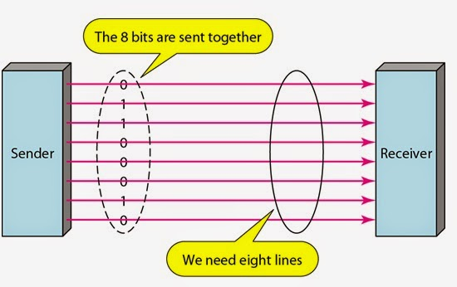
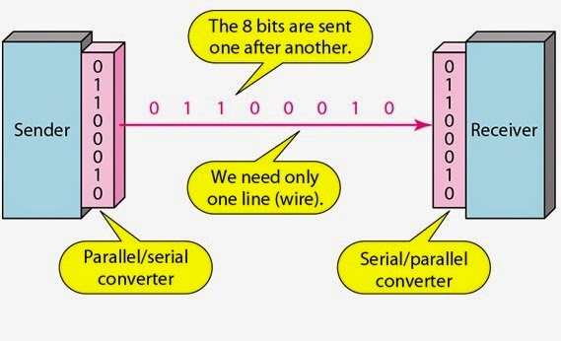
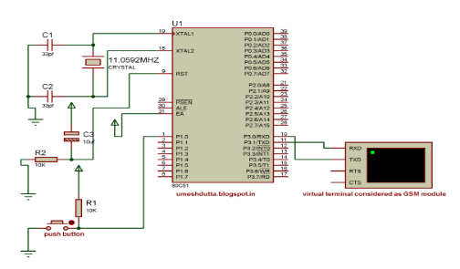
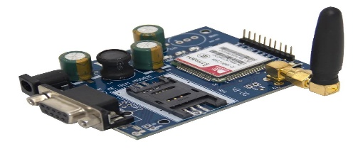
8051 MICROCONTROLLER ARCHITECTURE
SERIAL PORT
Serial port: The 8051 contains one Serial port or UART (Universal Asynchronous Receiver Transmitter)
The serial port is full-duplex so, it can transmit and receive simultaneously
Two port pins are used to provide the serial interface P3.0 is the receive pin (RXD) P3.1 is the transmit pin (TXD)
This serial port that can be programmed to operate in one of four different modes and at a range of frequencies.
MODULE - 2
28

Slide 32
8051 MEMORY ORGANIZATION
(RAM-ROM ORGANIZATION)

Slide 33
8051 MEMORY ORGANIZATION
The 8051 has two types of memory and these are Program Memory and Data Memory.
Program Memory (ROM) is used to permanently save the program being executed, while Data Memory (RAM) is used for temporarily storing data and intermediate results created and used during the operation of the microcontroller.
Depending on the model in use (8051 microcontroller family in general) at most a few Kb of ROM and 128 or 256 bytes of RAM is used.
MODULE - 2
29

Slide 34
8051 MEMORY ORGANIZATION
PROGRAM MEMORY (ROM)
The 8051 has 4K (4096 locations) of internal or on-chip ROM. And it can be expanded up to 64K.
This is used for storing the system program. 2¹² = 4096, therefore the internal ROM locations go from 0000H to 0FFFH.
Even though such an amount of memory is sufficient for writing most of the programs, there are situations when it is necessary to use additional memory as well.
MODULE - 2
30

Slide 35
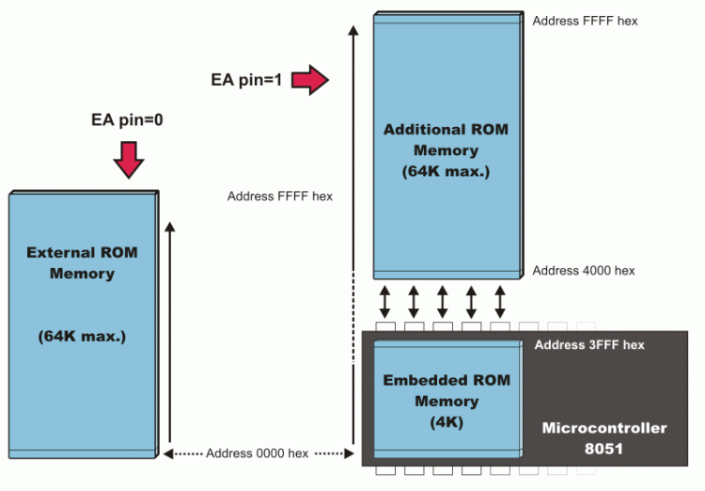
8051 MEMORY ORGANIZATION
PROGRAM MEMORY (ROM)
EA=0 In this case, the microcontroller completely ignores internal program memory and executes only the program stored in external memory.
EA=1 In this case, the microcontroller executes first the program from built-in ROM, then the program stored in external memory
MODULE - 2
31

Slide 36
8051 MEMORY ORGANIZATION
DATA MEMORY (RAM)
In the MCS-51 family, 8051 has 128 bytes of internal data memory and it allows interfacing external data memory of maximum size up to 64K.
So the total size of data memory in 8051 can be upto 64K (external) + 128 bytes (internal).
So there are 3 separations/divisions of the data memory:-
1) Register banks
2) Bit addressable area
3) Scratch pad area
MODULE - 2
32

Slide 37
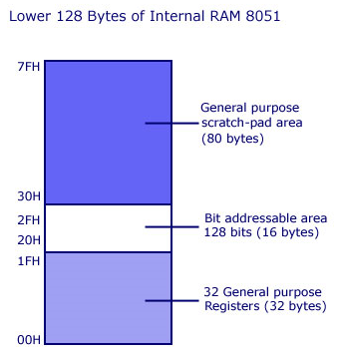
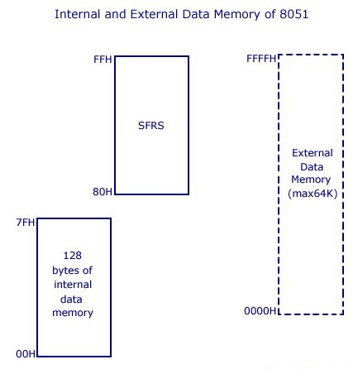
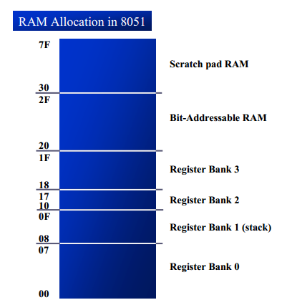
8051 MEMORY ORGANIZATION
DATA MEMORY (RAM)
MODULE - 2
33

Slide 38
8051 MEMORY ORGANIZATION
DATA MEMORY (RAM)
MODULE - 2
34

Slide 39
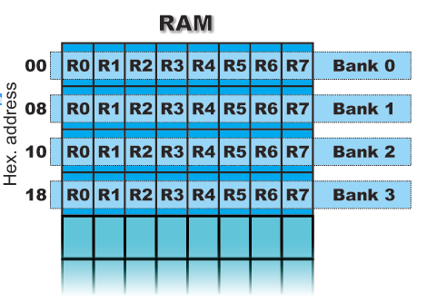
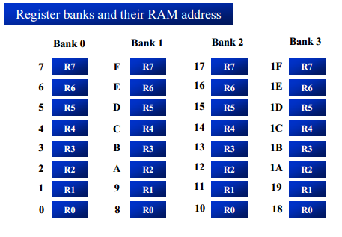
8051 MEMORY ORGANIZATION
DATA MEMORY – REGISTER BANKS
Registers are used to store data or operands during executions. Register banks form the lowest 32 bytes on internal RAM memory.
There are 4 register banks designated bank #0,#1, #2 and #3. Each bank has 8 registers which are designated as R0,R1…R7.
At a time only one register bank is selected (using RS1 & RS0 bits in PSW register) for operations and the registers inside the selected bank are accessed using mnemonics R0..R1.. etc.
By default register bank #0 is selected (after a system reset).
MODULE - 2
35

Slide 40
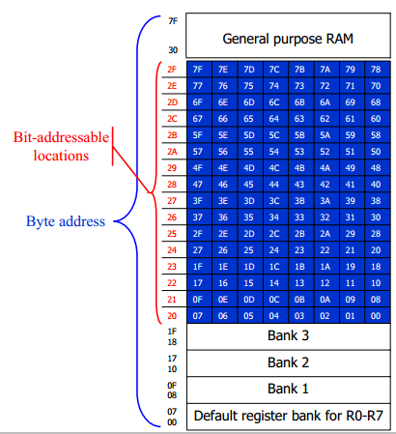
8051 MEMORY ORGANIZATION
DATA MEMORY – BIT ADDRESSABLE AREA
The 8051 supports a special feature which allows access to bit variables. This is where individual memory bits in Internal RAM can be set or cleared.
The Bit Addressable area of the RAM is 16 bytes (128 bits) next to register banks of Internal RAM located between 20h and 2Fh. In all there are 128 bits numbered 00h to 7Fh.
Being bit variables any one variable can have a value 0 or 1. A bit variable can be set with a command such as SETB and cleared with a command such as CLR.
MODULE - 2
37

Slide 41
8051 MEMORY ORGANIZATION
DATA MEMORY – BIT ADDRESSABLE AREA
Example instructions are
SETB 25h ; sets the bit 25h (becomes 1)
CLR 25h ; clears bit 25h (becomes 0)
Bit addressable area is mainly used to store bit variables from application program, like status of an output device like LED or Motor (ON/OFF) etc.
We need only a bit to store this status and using a complete byte addressable area for storing this is really bad programming practice, since it results in wastage of memory.
MODULE - 2
39

Slide 42
8051 MEMORY ORGANIZATION
DATA MEMORY – SCRATCH PAD RAM
These 80 bytes of Internal RAM memory scratch pad RAM are available for general-purpose data storage.
Scratch pad RAM is from 30H to 7FH and this includes stack too.
However, these 80 bytes are used by the system stack and in practice little space is left for general storage.
Access to this area of memory is fast compared to access to the main memory and special instructions with single byte operands are used.
MODULE - 2
40

Slide 43
8051 MEMORY ORGANIZATION
DATA MEMORY – SCRATCH PAD RAM
The scratch pad RAM can be accessed using direct or indirect addressing modes.
Examples of direct addressing:
MOV A, 6Ah ;reads contents of address 6Ah to accumulator
Examples for indirect addressing (use registers R0 or R1):
MOV R1, #6Ah ; move immediate 6Ah to R1
MOV A, @R1 ; move indirect: R1 contains address of Internal RAM which contains data that is moved to A.
MODULE - 2
41

Slide 44
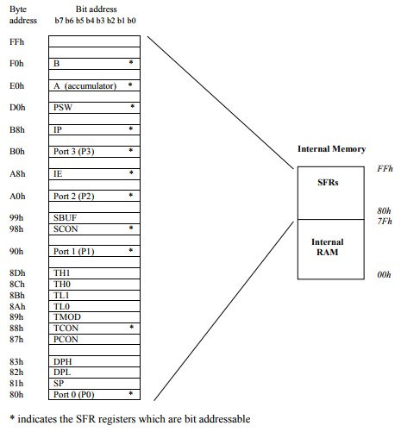
8051 MEMORY ORGANIZATION
DATA MEMORY – SFRs (Special Function Registers)
SFRs are accessed just like normal Internal RAM locations.
The SFR registers are located within the Internal Memory in the address range 80h to FFh.
Each SFR has a very specific function. Note some of the SFR registers are bit addressable.
MODULE - 2
42

Slide 45
8051 MEMORY ORGANIZATION
DATA MEMORY – SFRs
Although 128 byes of the SFR address space is defined only 21 SFR registers are defined in the standard 8051.
Rest of locations are intentionally left unoccupied in order to enable the manufacturers to further develop microcontrollers keeping them compatible with the previous versions.
Main function of SFR is to control timers, counters, serial I/O, port I/O, and peripherals that are present in 8051 microcontroller.
MODULE - 2
43

Slide 46
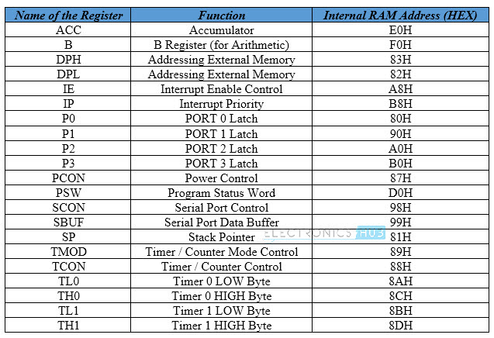
8051 MEMORY ORGANIZATION
DATA MEMORY – SFRs
MODULE - 2
45

Slide 47
8051 MEMORY ORGANIZATION
SFRs A- Register
The 21 Special Function Registers of 8051 Microcontroller are categorized in to seven groups.
Math or CPU Registers: A and B
Status Register: PSW (Program Status Word)
I/O Port Latches: P0 (Port 0), P1 (Port 1), P2 (Port 2) and P3 (Port 3)
Pointer Registers: DPTR (Data Pointer – DPL,DPH), SP (Stack Pointer)
Peripheral Control Registers: PCON, SCON, TCON, TMOD, IE and IP
Peripheral Data Registers: TL0, TH0, TL1, TH1 and SBUF
MODULE - 2
46
Notes:
PCON, SCON, TCON, TMOD, IE and IP
Peripheral control, serial control, timer control , Timer mode selection and Interrupt enable

Slide 48
8051 MEMORY ORGANIZATION
SFRs A- Register
The most important of all special function register is Accumulator which is also known as ACC or A.
The Accumulator holds the result of most of arithmetic and logic operations. It is also used to store 8 bit data and to hold one of operand of ALU units during arithmetical and logical operations.
More than half instructions used by the 8051 microcontroller use somehow use the accumulator.
ACC is usually accessed by direct addressing and its physical address is E0H.
MODULE - 2
47

Slide 49

8051 MEMORY ORGANIZATION
SFRs A- Register
Accumulator is an 8-bit register and it is both byte and bit addressable.
To access the individual bits of accumulator, use the format ACC.X in the instruction where “X” denotes bit to be accessed.
MODULE - 2
48

Slide 50

8051 MEMORY ORGANIZATION
SFRs B- Register
It is special 8-bit math register and it is bit and byte accessible.
It is used in conjunction with A register as an input operand for ALU to perform multiplication and division operation.
It can also be used as general purpose register to store 8-bit data.
MODULE - 2
49

Slide 51
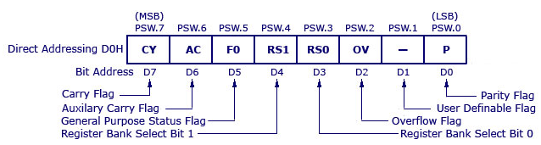
8051 MEMORY ORGANIZATION
SFRs - PSW REGISTER
It is 8 bit register and it is bit and byte accessible.
It contains several status bits that reflects the status of the operation that is being carried out in the processor.
It has 4 conditional flags or math flags (CY, AC, OV, P)which sets or resets according to condition of result.
It has 3 control flags (F0, RS0, RS1) by setting or resetting bit required operation or function can be achieved.
MODULE - 2
50

Slide 52
8051 MEMORY ORGANIZATION
SFRs - PSW REGISTER
CY, the carry flag: This flag is set whenever there is a carry out from the D7 bit. This flag bit is affected after an 8-bit addition or subtraction.
AC, the auxiliary carry flag: If there is a carry from D3 to D4 during an ADD or SUB operation, this bit is set; otherwise, it is cleared. This flag is used by instructions that perform BCD (binary coded decimal) arithmetic.
F0, the Flag 0 : The PSW.5 and PSW.1 bits are general-purpose status flag bits and can be used by the programmer for any purpose. In other words, they are user definable.
MODULE - 2
52

Slide 53
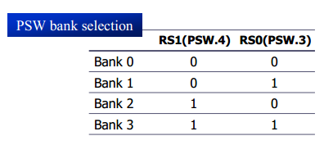
8051 MEMORY ORGANIZATION
SFRs - PSW REGISTER
RS0, RS1 - Register bank select bits. These two bits are used to select one of four register banks of RAM. By setting and clearing these bits, registers R0-R7 are stored in one of four banks of RAM.
MODULE - 2
53

Slide 54
8051 MEMORY ORGANIZATION
SFRs - PSW REGISTER
OV, overflow flag:
This flag is set whenever the result of a signed number operation is too large, causing the high-order bit to overflow into sign bit.
In general, the carry flag is used to detect errors in unsigned arithmetic operations.
The overflow flag is only used to detect errors in signed arithmetic operations
P, the parity flag: The parity flag reflects the number of 1 s in the A (accumulator) register only. If the A register contains an odd number of 1’s, then P = 1. Therefore, P = 0 if A has an even number of 1s.
MODULE - 2
54

Slide 55
8051 MEMORY ORGANIZATION
SFRs - P0, P1, P2, P3 - Input/Output Registers
There are 4 ports with in total of 32 input/output pins are available for connection to peripheral environment.
So 4 Input/Output ports named P0, P1, P2 and P3 has got four corresponding port registers P0, P1, P2 and P3. All 4 port registers are bit as well as byte addressable.
Data must be written into port registers first to send it out to any other external device through ports.
Similarly any data received through ports must be read from port registers for performing any operation.
MODULE - 2
55

Slide 56
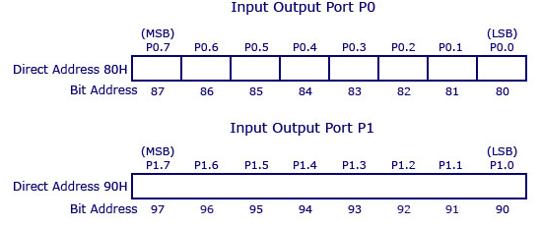
8051 MEMORY ORGANIZATION
SFRs - P0, P1, P2, P3 - Input/Output Registers
MODULE - 2
56

Slide 57
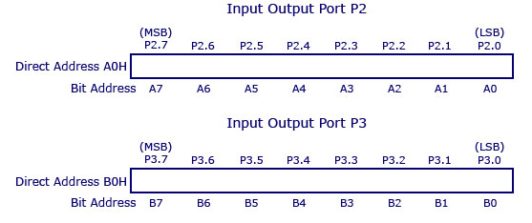
8051 MEMORY ORGANIZATION
SFRs - P0, P1, P2, P3 - Input/Output Registers
MODULE - 2
57

Slide 58

8051 MEMORY ORGANIZATION
SFRs - P0, P1, P2, P3 - Input/Output Registers
If a bit is cleared (0), the appropriate pin will be configured as an output, while if it is set (1), the appropriate pin will be configured as an input.
Upon reset and power-on, all port bits are set (1), which means that all appropriate pins will be configured as inputs.
MODULE - 2
58

Slide 59
8051 MEMORY ORGANIZATION
SFRs - DPTR REGISTER
It is a 16 bit register used to hold address of external or internal RAM where data is stored or result is to be stored.
It can be divided into two 8-bit registers, DPH-data pointer higher order and DPL-data pointer lower order.
Each register can be used as general purpose register to store 8 bit data and can also be used to store memory location.
It functions as Base register in base relative addressing mode and indirect jump.
MODULE - 2
59

Slide 60
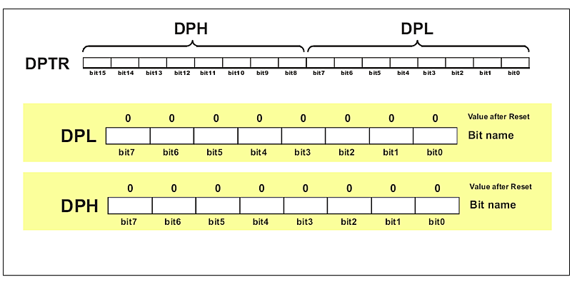
8051 MEMORY ORGANIZATION
SFRs - DPTR REGISTER
MODULE - 2
60

Slide 61
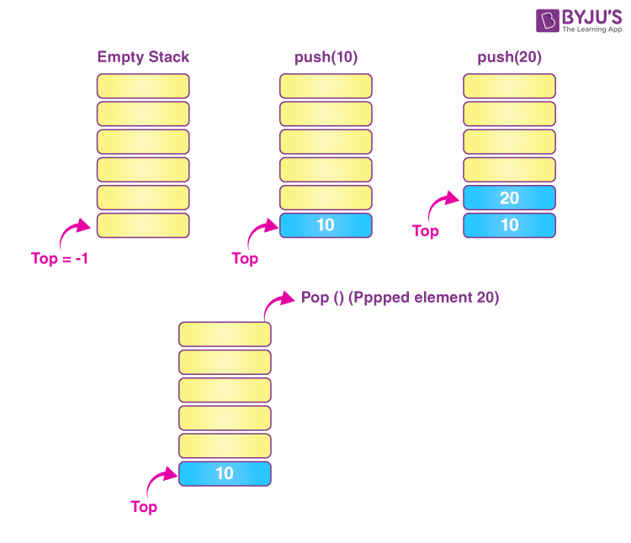
8051 MEMORY ORGANIZATION
SFRs - STACK POINTER
It is 8-bit register. It is byte addressable.
It is used to hold the internal RAM memory location addresses which are used as stack memory.
When the data is to be placed on stack by push instruction, the content of stack pointer is incremented by 1.
When data is retrieved from stack, content of stack of stack pointer is decremented by 1.
MODULE - 2
61

Slide 62

8051 MEMORY ORGANIZATION
SFRs - STACK POINTER
A value stored in the Stack Pointer points to the first free stack address and permits stack availability.
Upon any reset and power-on, the value 7 is stored in the Stack Pointer, which means that the space of RAM reserved for the stack starts at this location.
MODULE - 2
62

Slide 63
8051 MEMORY ORGANIZATION
PC - PROGRAM COUNTER (not a part of SFRs)
It is used to hold 16 bit address of internal program memory, or external ROM locations.
The Program Counter (PC) is a 2-byte address which tells the 8051 where the next instruction to be executed from memory.
When the 8051 is initialized PC always starts at 0000h and is incremented each time an instruction is executed.
MODULE - 2
63

Slide 64
8051 MACHINE CYCLE

Slide 65
8051 MACHINE CYCLES
MACHINE CYCLES
The CPU takes a certain number of clock cycles to execute an instruction.
In the 8051 family, these clock cycles are referred to as machine cycles.
A single machine cycle is the minimum amount of time in which a single 8051 instruction can be executed, although many instructions take multiple machine cycles.
MODULE - 2
64

Slide 66
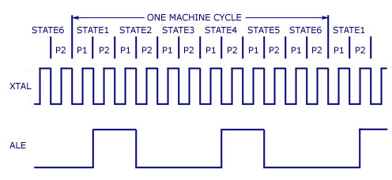
8051 MACHINE CYCLES
MACHINE CYCLES
Pulse - One complete oscillation of the clock source; State - Two pulses;
1 machine cycle 8051 = six states or 12 clock pulses
MODULE - 2
65
Notes:
t-state is measured from the falling edge of one clock pulse to the falling edge of the next clock pulse.

Slide 67
8051 MACHINE CYCLES
MACHINE CYCLES
If an instruction takes one machine cycle to execute, it will take 12 pulses of the crystal to execute.
8051 is designed to operate between 4MHz to 40MHz and generally operates with a crystal frequency 11.0592 MHz.
Since we know the crystal is pulsing 11,059,000 times per second and that one machine cycle is 12 pulses. we can calculate how many instruction cycles the 8051 can execute per second:
11,059,000 / 12 = 921,583 and 1/ 921,583=1.085µs
MODULE - 2
66
Notes:
One Crore Ten Lakh Fifty Nine Thousand
Nine Lakh Twenty One Thousand Five Hundred And Eighty Three

Slide 68
8051 MACHINE CYCLES
MACHINE CYCLES
This means that the 8051 can execute 921,583 single-cycle instructions per second.
For example, if you are using exclusively 2-cycle instructions you would find that the 8051 would execute 460,791 instructions per second.
The 8051 also has two really slow instructions that require a full 4 cycles to execute-those instructions you’d find performance to be about 230,395 instructions per second.
MODULE - 2
67

Slide 69
8051 MACHINE CYCLES
EXAMPLE - 1
Lets find the time period of the machine cycle in each case for the following crystal frequency of different 8051 based systems: 11.0592 MHz, 16 MHz, 20 MHz.
Answer:
11.0592 MHz:
11.0592/12 = 921.6 KHz
Machine cycle = 1/921.6 KHz = 1.085us [us=microsecond]
16 MHz:
16MHz/12 = 1.333 MHz
Machine cycle = 1/1.333 MHz = 0.75us [us=microsecond]
20MHz:
20MHz/12 = 1.66 MHz
Machine Cycle = 1/1.66 MHz = 0.60us [us=microsecond]
MODULE - 2
68

