Slide 1
Module 2 (Loop statements)
Loops: do-while, while, for loops and nested loops.
Break, continue, goto and exit statements

Slide 2
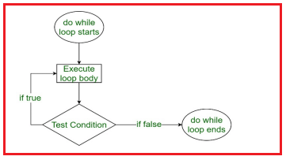
do while loop

Slide 3
C program to input a 4-digit number and find the sum of its digits using do while loop.

Slide 4
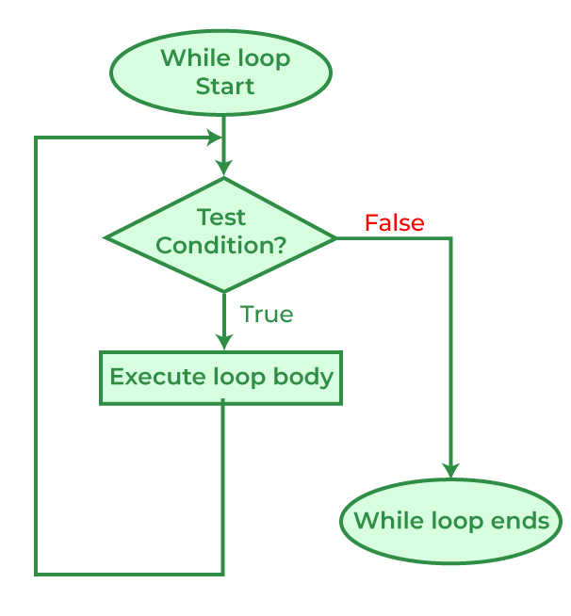
While loop

Slide 5
While vs do-while
Condition Checking:
In a while loop, the condition is checked before entering the loop.
In a do-while loop, the condition is checked after executing the loop body.
do-while guarantees that the loop body will execute at least once, regardless of the condition. This is not necessarily the case with a while loop.
Use a while loop when you want to execute the loop body zero or more times based on a condition.
Use a do-while loop when you want to ensure that the loop body is executed at least once and then continue based on a condition.

Slide 6
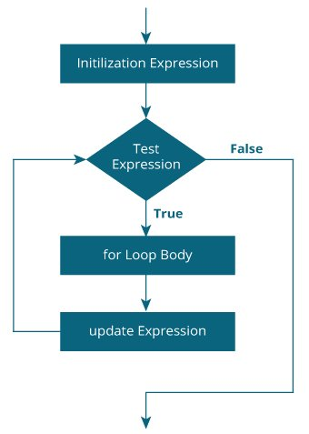
For loop For loop is used when the number of iterations is known, whereas execution is done in the while loop until the statement in the program is proved wrong.
Example program:
#include <stdio.h>
int main() {
int i, start, end;
start = 1;
end = 10;
//reverse counting, we'll interchange loop variables
for(i = end; i >= start; i--)
printf("%2d\n", i);
return 0;
}

Slide 7
What is the output of the following program?
#include <stdio.h>
int main(void)
{
int i = -99;
// declare i within for
for(int i=0; i < 10; i++)
printf(''%d ", i);
printf("\n");
printf("Value of i is: %d", i); // displays-99
return 0;
}

Slide 8
Continue statement
The continue statement is used to skip the current iteration of any loop and bring the control to the beginning of the iteration.
The statements following the continue statement are skipped and the iteration starts again.

Slide 9
#include<stdio.h>
int main()
{
int m = 0 ;
do
{
if (m > 10 )
continue ;
m = m + 10 ;
}
while ( m < 50 ) ;
printf("%d", m);
}
What is the output of the above program?

Slide 10
goto statement:
The goto statement in C is used to jump from one block to another block during execution, and transfer the flow of execution of the code.
Disadvantages :
The use of the goto statement is highly discouraged as it makes the program logic very complex.
The use of goto makes tracing the flow of the program very difficult.
The use of goto makes the task of analyzing and verifying the correctness of programs (particularly those involving loops) very difficult.
The use of goto can be simply avoided by using break and continue statements.

Slide 11
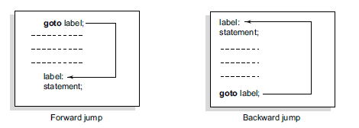

Slide 12
Exit function in C
When exit() is called, it immediately terminates the program without executing any further statements.
It's a standard library function defined in stdlib.h.
It takes an optional integer argument as the exit status:
0 typically indicates successful termination.
Non-zero values often indicate errors or abnormal termination.
It can be used for premature termination based on conditions, errors, or user input.
It can be used within loops or functions to control program flow.

Slide 13
General form: void exit(int code);
Specific exit status values can vary from one program to another, and it's often a part of the program's documentation or specification.
The choice of exit status values depends on the conventions and requirements of the specific program or system.

