Slide 1
Module:2
Control and loop statements

Slide 2
Contents
Control statements:
if, if-else, if-else ladder, elseif ladder.
switch.
Loops:
do-while, while.
for loops and nested loops.
Break, continue, goto and exit statements.
Programs on if, switch and loops.

Slide 3
Decision-making constructs
The if statement
The switch statement
The conditional operator

Slide 4
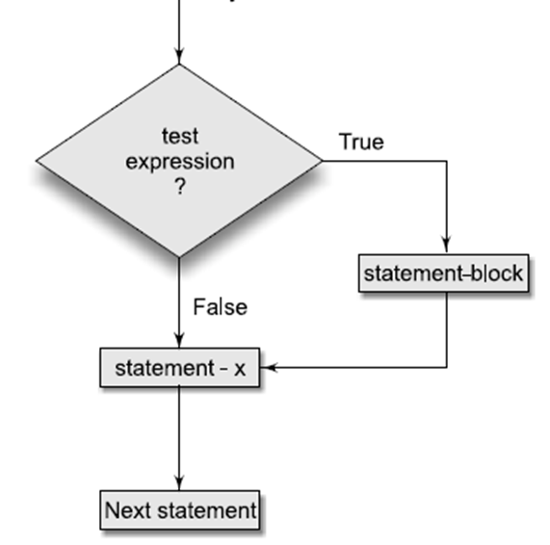
The if Statement
The general format of this statement is as follows:
if ( expression )
program statement
In the program statement
if ( count > COUNT_LIMIT )
printf ("Count limit exceeded\n");
the printf statement is executed only if the value of count is greater than the value of COUNT_LIMIT; otherwise, it is ignored.

Slide 5
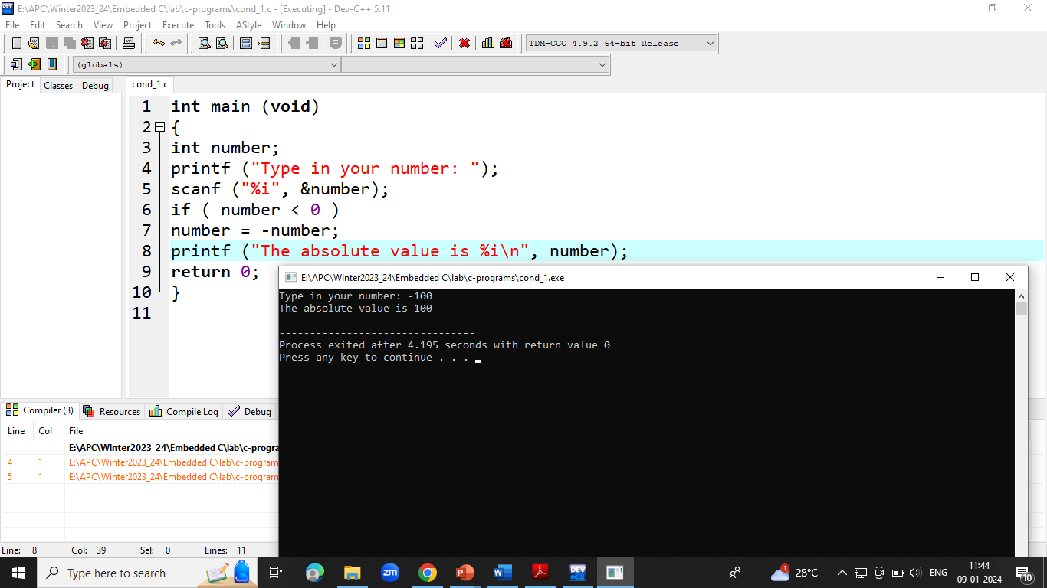
// Program to calculate the absolute value of an integer
int main (void)
{
int number;
printf ("Type in your number: ");
scanf ("%i", &number);
if ( number < 0 )
number = -number;
printf ("The absolute value is %i\n", number);
return 0;
}

Slide 6
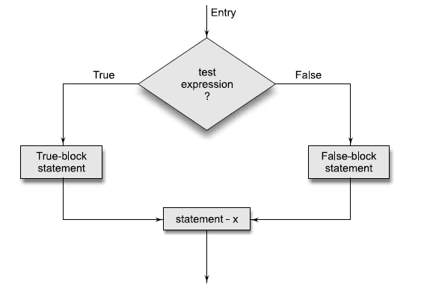
if-else construct
if ( expression )
program statement 1
else
program statement 2
The if-else is actually just an extension of the general format of the if statement.
If the result of the evaluation of expression is TRUE, program statement 1, which immediately follows, is executed; otherwise, program statement 2 is executed.
In either case, either program statement 1 or program statement 2 is executed, but not both.

Slide 7
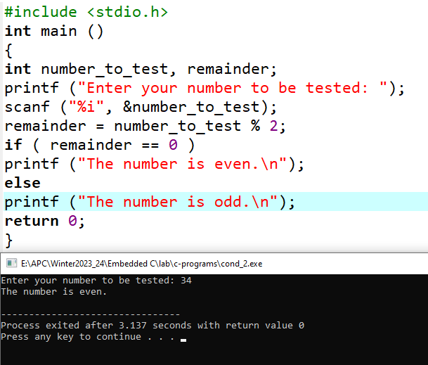
Program to Determine if a Number Is Even or Odd
#include <stdio.h>
int main ()
{
int number_to_test, remainder;
printf ("Enter your number to be tested: ");
scanf ("%i", &number_to_test);
remainder = number_to_test % 2;
if ( remainder == 0 )
printf ("The number is even.\n");
else
printf ("The number is odd.\n");
return 0;
}

Slide 8
Determining if a Year Is a Leap Year
// Program to determines if a year is a leap year
#include <stdio.h>
int main (void)
{
int year, rem_4, rem_100, rem_400;
printf ("Enter the year to be tested: ");
scanf ("%i", &year);
rem_4 = year % 4;
rem_100 = year % 100;
rem_400 = year % 400;
if ( (rem_4 == 0 && rem_100 != 0) || rem_400 == 0 ) //Compound Relational Tests
printf ("It's a leap year.\n");
else
printf ("Nope, it's not a leap year.\n");
return 0;
}

Slide 9
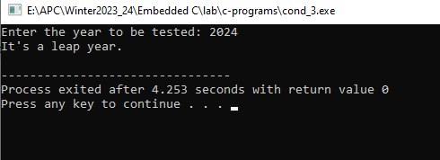
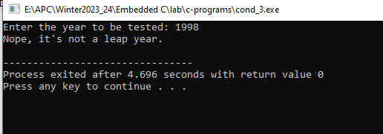

Slide 10
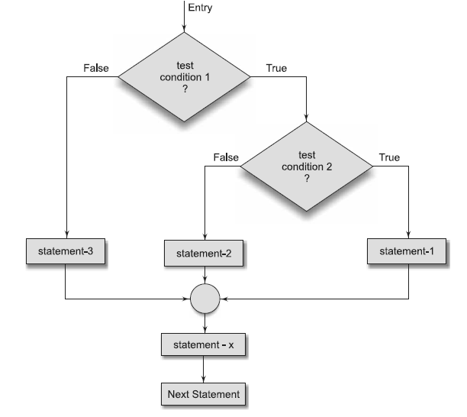
Nested if Statements (if-else Ladder Statement)
Syntax:
if (test condition 1)
{
if (test condition 2)
{
statement 1;
}
else
{
statement 2;
}
}
else
{
statement 3;
}
statement x;

Slide 11
Example program for nested-if
main()
{
float A, B, C;
printf(“Enter three values\n”);
scanf(“%f %f %f”, &A, &B, &C);
printf(“\nLargest value is “);
if (A>B)
{
if (A>C)
printf(“%f\n”, A);
else
printf(“%f\n”, C);
}
else
{
if (C>B)
printf(“%f\n”, C);
else
printf(“%f\n”, B);
}
}

Slide 12
The else if Construct

Slide 13
What is the output of the following program?
main ( )
{
int m = 5 ;
if (m < 3) printf(“%d” , m+1) ;
else if(m < 5) printf(“%d”, m+2);
else if(m < 7) printf(“%d”, m+3);
else printf(“%d”, m+4);
}

Slide 14
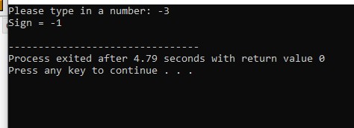
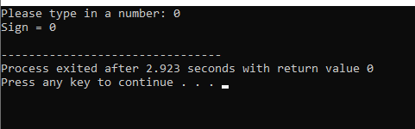
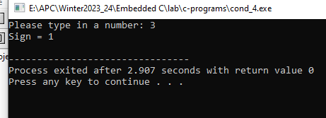
// Program to implement the sign function
#include <stdio.h>
int main (void)
{
int number, sign;
printf ("Please type in a number: ");
scanf ("%i", &number);
if ( number < 0 )
sign = -1;
else if ( number == 0 )
sign = 0;
else // Must be positive
sign = 1;
printf ("Sign = %i\n", sign);
return 0;
}

Slide 15
Conditional Expression -or- The Ternary Operator
The conditional expression can be used as a shorthand for some if-else statements.
The general syntax of the conditional operator is:
<expression1> ? <expression2> : <expression3>
This is an expression, not a statement, so it represents a value.
The operator works by evaluating expression1. If it is true (non-zero), it evaluates and returns expression2 . Otherwise, it evaluates and returns expression3.
The classic example of the ternary operator is to return the smaller of two variables.
Every once in a while, the following form is just what you needed.
Instead of...
if (x < y) {
min = x; }
else {
min = y; }
You just say...
min = (x < y) ? x : y;

Slide 16
/* Program to evaluate simple expressions of the form
value operator value */
#include <stdio.h>
int main (void)
{
float value1, value2;
char operator;
printf ("Type in your expression.\n");
scanf ("%f %c %f", &value1, &operator, &value2);
if ( operator == '+' )
printf ("%.2f\n", value1 + value2);
else if ( operator == '-' )
printf ("%.2f\n", value1 - value2);
else if ( operator == '*' )
printf ("%.2f\n", value1 * value2);
else if ( operator == '/' )
if ( value2 == 0 )
printf ("Division by zero.\n");
else
printf ("%.2f\n", value1 / value2);
else
printf ("Unknown operator.\n");
return 0;
}
Note: in this example, value of a variable is successively compared against different values

Slide 17
The switch Statement
General format:
switch ( expression )
{
case value1:
program statement
program statement
...
break;
case value2:
program statement
program statement
...
break;
...
case valuen:
program statement
program statement
...
break;
default:
program statement
break;
}
The expression enclosed within parentheses is successively compared against the values value1, value2, ..., valuen, which must be simple constants or constant expressions.
If a case is found whose value is equal to the value of expression, the program statements that follow the case are executed.
Note that when more than one such program statement is included, they do not have to be enclosed within braces.
The break statement signals the end of a particular case and causes execution of the switch statement to be terminated.
Remember to include the break statement at the end of every case.
Forgetting to do so for a particular case causes program execution to continue into the next case whenever that case gets executed.
The special optional case called default is executed if the value of expression does not match any of the case values.

Slide 18
#include <stdio.h>
int main (void)
{
float value1, value2;
char operator;
printf ("Type in your expression.\n");
scanf ("%f %c %f", &value1, &operator, &value2);
switch (operator)
{
case '+':
printf ("%.2f\n", value1 + value2);
break;
case '-':
printf ("%.2f\n", value1 - value2);
break;
case '*':
printf ("%.2f\n", value1 * value2);
break;
case '/':
if ( value2 == 0 )
printf ("Division by zero.\n");
else
printf ("%.2f\n", value1 / value2);
break;
default:
printf ("Unknown operator.\n");
break;
}
return 0;
}
cond_switch.c

Slide 19
Find errors, if any, in the following switch related statements.
Assume that the variables x and y are of int type and x = 1 and y = 2.
switch (y);
case 10;
switch (x + y)
switch (x) {case 2: y = x + y; break};

Slide 20
Assuming that x = 2, y = 1 and z = 0 initially, what will be their values after executing the following
code segments?
(a)
switch (x)
{
case 2:
x = 1;
y = x + 1;
case 1:
x = 0;
break;
default:
x = 1;
y = 0;
}
Ans: x = 0, y = 2
(b)
switch (y)
{
case 0:
x = 0;
y = 0;
case 2:
x = 2;
z = 2;
default:
x = 1;
y = 2;
}
Ans: x= 1, y = 2, z=0

