Slide 1
BECE320E Embedded C Programming
Introduction to Embedded C, difference between C and Embedded C. Introduction to C programming, comments, identifiers, variables, headers

Slide 2
Embedded systems
An embedded system refers to the combination of hardware and software to carry out a specific task inside a device or bigger computer system.
The elements that are combined here correspond to microprocessors or microcontrollers, I/O peripheral devices, sensors, computer memories, among others.
Examples of Embedded systems
Calculators, Microwave oven, refrigerators, ATM, Washing machine, induction stove
Drone, Robots, Industrial control, Digital cameras, Video game consoles
Smart wearables, Mobile phones
Medical devices

Slide 3
Introduction to Embedded C
Embedded C is a generic term given to a programming language written in C, which is associated with a particular hardware architecture.
Embedded C is an extension to the C language with some additional header files. These header files may change from controller to controller.
For the microcontroller 8051, #include<reg51.h> is used.

Slide 4
Difference between C and Embedded C
Another difference between C and Embedded C is their syntax. Embedded C includes additional keywords and syntax that are specific to embedded systems, such as interrupt service routines and memory-mapped I/O.
C language, on the other hand, does not include these keywords and syntax.

Slide 5
C Language | Embedded C Language
Generally, this language is used to develop desktop-based applications | Embedded C language is used to develop microcontroller-based applications.
C language is not an extension to any programming language, but a general-purpose programming language | Embedded C is an extension to the C programming language including different features such as addressing I/O, fixed-point arithmetic, multiple-memory addressing, etc.
It processes native development in nature | It processes cross development in nature
It is independent for hardware architecture | It depends on the hardware architecture of the microcontroller & other devices
The compilers of C language depends on the operating system | Embedded C compilers are OS independent
In C language, the standard compilers are used for executing a program | In embedded C language, specific compilers are used.
The popular compilers used in this language are GCC, Borland turbo C, Intel C++, etc | The popular compilers used in this language are Keil, BiPOM Electronics & green hill
The format of C language is free-format | Its format mainly depends on the kind of microprocessor used.
Optimization of this language is normal | Optimization of this language is a high level
It is very easy to modify & read | It is not easy to modify & read
Bug fixing is easy | Bug fixing of this language is complicated

Slide 6
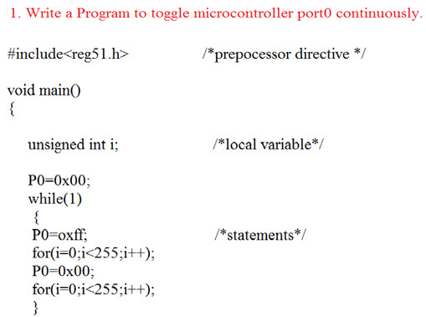
Sample program

Slide 7
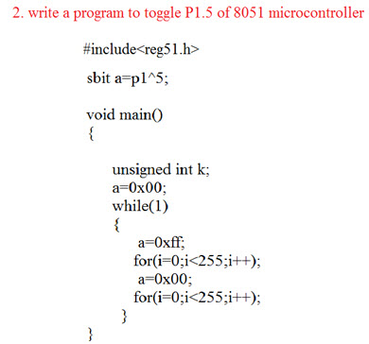

Slide 8
Limitations of Embedded C programming language
Following are the disadvantages of embedded C programming language.
It executes one task at a time, it does not support multiple task executions.
When we make any changes in the program then the appropriate changes are to be made in the hardware as well.
Only hardware systems are supported.
It cannot be scaled efficiently, there are still some issues faced while doing it.
There are also memory related restrictions or sometimes it has compatibility issues with certain computers.

Slide 9
Limitations of Embedded C:
One of the major disadvantages of Embedded C is its lack of portability.
Embedded C code is often written specifically for a particular hardware platform, which can make it difficult to port to other platforms.
Another disadvantage of Embedded C is its complexity.
Embedded C requires a deep understanding of computer hardware and memory management, which can make it difficult for beginners to learn.

Slide 10
Introduction to C programming
Language | Year | Developed By
Algol | 1960 | International Group
BCPL | 1967 | Martin Richard
B | 1970 | Ken Thompson
Traditional C | 1972 | Dennis Ritchie
K & R C | 1978 | Kernighan & Dennis Ritchie
ANSI C | 1989 | ANSI Committee
ANSI/ISO C | 1990 | ISO Committee
C99 | 1999 | Standardization Committee

Slide 11
Comments
Single line comment:
#include <stdio.h>
int main() {
// print Hello World to the screen
printf("Hello World");
return 0;
}

Slide 12
Example program
#include <stdio.h>
int main() {
// create integer variable
int age = 25;
// print the age variable
printf("Age: %d", age);
return 0;
}

Slide 13
Multi-line comments
/* This program takes age input from the user
It stores it in the age variable
And, print the value using printf() */
#include <stdio.h>
int main() {
int age;
printf("Enter the age: ");
scanf("%d", &age);
printf("Age = %d", age);
return 0;
}

Slide 14
Identifiers
The first character of an identifier should be either an alphabet or an underscore, and then it can be followed by any of the character, digit, or underscore.
It should not begin with any numerical digit.
In identifiers, both uppercase and lowercase letters are distinct. Therefore, we can say that identifiers are case sensitive.
Commas or blank spaces cannot be specified within an identifier.
Keywords cannot be represented as an identifier.
The length of the identifiers should not be more than 31 characters.
Identifiers should be written in such a way that it is meaningful, short, and easy to read.

Slide 15
Keywords
C Keywords
auto | double | int | struct
break | else | long | switch
case | enum | register | typedef
char | extern | return | union
continue | for | signed | void
do | if | static | while
default | goto | sizeof | volatile
const | float | short | unsigned

Slide 16
Variables
A variable can have alphabets, digits, and underscore.
A variable name can start with the alphabet, and underscore only. It can't start with a digit.
No whitespace is allowed within the variable name.
A variable name must not be any reserved word or keyword, e.g. int, float, etc.

Slide 17
Types of variables
local variable
global variable
A variable that is declared outside the function or block is called a global variable. Any function can change the value of the global variable. It is available to all the functions.
static variable
A variable that is declared with the static keyword is called static variable.
It retains its value between multiple function calls.
automatic variable
Any variable declared as a parameter to a function or inside the body of the function is automatic by default. An automatic variable is created on the stack when the function is called, and it is destroyed when exiting from the function. Therefore, any value they may be assigned during the execution of the function will be lost when returning from the function call
external variable
We can share a variable in multiple C source files by using an external variable. To declare an external variable, you need to use extern keyword.

Slide 18
Headers
A header file is a source file that has the .h extension. Header files contain the function prototypes or function declaration, whereas the source code contains the constants, macros, system-wide global variables. Whenever we require the definition of a function, then we simply include that header file in which function is declared.
There are two types of header files defined in a program:

Slide 19
System defined header file: The header file which is predefined is known as a system defined header file.
User-defined header file: The header file which is defined by the user is known as a user-defined header file.
Both the user-defined and system-defined header file can be included in a program with the help of using preprocessing directive (#). These preprocessor directives are used to instruct the compiler to process these files before compilation. There are two forms of including header file:
#include<file>
#include "file"
There is a difference between the header files given above. If the header file is defined within the predefined source path, we can specify the header within the angular brackets. If the header file is not defined within the predefined source path then we can specify the full path of the header file within the double-quotes.

Slide 20
#include<stdio.h>: It is used for performing input and output operations with the help of using printf() and scanf() function.
#include<string.h>: It is used for performing string related functionalities like strlen(), strcmp(), etc.
#include<conio.h>: It is a header file with several built-in functions that are commonly used to execute input/output on the console, or to receive input from the user's keyboard and show results on the screen. Several of the conio.h routines, such getch(), are used to retain the screen until the user presses a key
#include<iostream>: It is used to perform input and output operations with the help of using cin and cout objects.

Slide 21
#include<math.h>: This header file contains some predefined math functions that perform mathematical operations, such as sqrt(), log2(), pow(), etc.
#include<iomanip.h>: It contains the definition of set() and setprecision() function to limit the decimal places in variables.
#include<signal.h>: It contains the definitions of functions that perform the signal handling functions such as signal(), raise().
#include<errno.h>: It performs the error handling related operations like errno(), strerror(), perror(), etc.

Slide 22
stdio.h | Mainly used to perform input and output operations like print(), scanf().
string.h | Mainly used to perform string handling operations like strlen(), strcmp() etc.
conio.h | With this header file, you can execute console input and output operations.
stdlib.h | Mainly used to perform standard utility functions like malloc(), calloc() etc.
math.h | Mainly used to perform mathematical operations like sqrt(), pow() etc.
ctype.h | Used to perform character type functions like isdigit(), isalpha() etc.
time.h | Used to perform operations related to date and time.
assert.h | Used to verify assumptions made by a program and print a message if the assumption is false using functions like assert() etc.
locale.h | Mainly used to perform localization like functions such as setlocale() etc.
signal.h | Mainly used to perform signal handling functions such as signal(), raise() etc.
setjmp.h | Used to perform jump functions.
stdarg.h | Used to perform standard argument functions like va_start() etc.
errno.h | For performing error handling operations such as errno() to indicate the errors.

Slide 23
// C program to understand the usage of header file.
#include <stdio.h>
#include <string.h>
#include <math.h>
int main()
{
char str1[10] = "hello";
char str2[10] = "javatpoint";
// function defined in math.h header file
long int a = pow(3, 3);
printf("The value of a is %d", a);
// function defined in string.h to calculate the length of the string
int length = strlen(str2);
printf("\nThe length of the string str2 is : %d", length);
return 0;
}

Slide 24
References
https://www.youtube.com/watch?v=KQBBWvY-s0o
https://www.youtube.com/watch?v=e8I4Ah2wwFA

