Slide 1
BECE320E - Embedded C Programming Module 1 - Introduction to C (data types, operators, order of operations, format specifies, escape sequence characters, input and output statements, programs on sequential statements)
-prepared by Srinivasan R, AP(C), SENSE

Slide 2
Data types in C
All high-level programming languages support the concept of data types.
A data type defines a set of values that a variable can store along with a set of operations that can be performed on that variable. Common data types are integer, character, and floating-point.
C language is rich in its data types.
The variety of data types available allow the programmer to select the type appropriate to the needs of the application as well as the machine.
All C compilers support five basic data types, namely integer (int), character (char), floating point (float), double-precision floating point (double) and void.
Many of them also offer extended data types such as long int and long double.

Slide 3
Data types in C
Types | Data Types
Basic Data Type | int, char, float, double
Derived Data Type | array, pointer, structure, union
Enumeration Data Type | enum
Void Data Type | void
Derived types:
They include (a) Pointer types, (b) Array types, (c) Structure types, (d) Union types, and (e) Function types.
Enumerated types:
They are again arithmetic types and they are used to define variables that can only assign certain discrete integer values throughout the program.
Void type:
The type specifier void indicates that no value is available.

Slide 4
Integer data type
The integer datatype in C is used to store the integer numbers(any number including positive, negative and zero without decimal part). Octal values, hexadecimal values, and decimal values can be stored in int data type in C.
We use int keyword to declare an integer variable
int var_name;
unsigned int: Unsigned int data type in C is used to store the data values from zero to positive numbers but it can’t store negative values like signed int.
short int: It is lesser in size than the int by 2 bytes so can only store values from -32,768 to 32,767.
long int: Larger version of the int datatype so can store values greater than int.
unsigned short int: Similar in relationship with short int as unsigned int with int

Slide 5
Character Data Type
Character data type allows its variable to store only a single character. The size of the character is 1 byte. It is the most basic data type in C. It stores a single character and requires a single byte of memory in almost all compilers.
Range: (-128 to 127) or (0 to 255)
Size: 1 byte
Format Specifier: %c
The char keyword is used to declare the variable of character type.

Slide 6
Float Data Type
In C programming float data type is used to store floating-point values. Float in C is used to store decimal and exponential values. It is used to store decimal numbers (numbers with floating point values) with single precision.
Range: 1.175494351 E – 38 to 3.402823466 E + 38 Size: 4 bytes
Format Specifier: %f
The float keyword is used to declare the variable as a floating point.

Slide 7
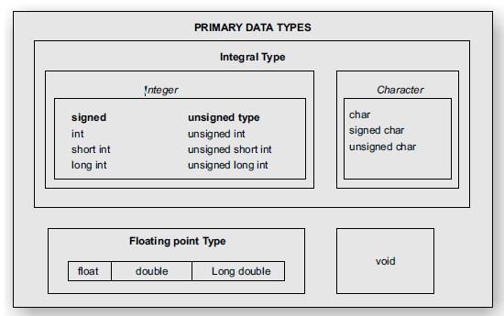

Slide 8
Ref: https://www.shiksha.com/online-courses/articles/data-types-in-c-programming-with-examples/
Range of values supported by different data types
Data Type | Format Specifier | Minimal Range | Size in bytes
unsigned char | %c | 0 to 255 | 1
char | %c | -127 to 127 | 1
signed char | %c | -127 to 127 | 1
int | %d, %i | -32,767 to 32,767 | 2 or 4
unsigned int | %u | 0 to 65,535 | 2 or 4
signed int | %d, %i | -32,767 to 32,767 (same as int) | 2 or 4
short int | %hd | -32,767 to 32,767 | 2
unsigned short int | %hu | 0 to 65,535 | 2
signed short int | %hd | Same as short int | 2
long int | %ld, %li | -2,147,483,647 to 2,147,483,647 | 4
long long int | %lld, %lli | -(2^63) to (2^63)-1 | 8
signed long int | %ld, %li | Same as long int | 4
unsigned long int | %lu | 0 to 4,294,967,295 | 4
unsigned longlong int | %llu | (2^63)-1 | 8
float | %f | 1.175494351 E–38 to 3.402823466 E+38 | 4
double | %lf | 1.7E-308 to 1.7E+308 | 8
long double | %Lf | 3.4E-4932 to 1.1E+4932 (varies with implementation) | 10

Slide 9
Data types (example program)
#include <stdio.h>
void main()
{
// Create variables of different types
int items = 50;
float cost_per_item =9.99;
float total_cost = items * cost_per_item;
char currency ='$';
// Print variables
printf("Number of items: %d\n",items);
printf("Cost per item: %.2f %c\n", cost_per_item, currency);
printf("Total cost = %.2f %c\n", total_cost, currency);
}

Slide 10
Float type data
#include<stdio.h>
void main(){
float myFloatNum =3.5;
double myDoubleNum =19.99;
printf("%f \n", myFloatNum);// Default will show 6 digits after the decimal point
printf("%lf \n", myDoubleNum); // Outputs 19.990000
printf("%.1f \n",myFloatNum); // Only show 1 digit
printf("%.2f \n", myFloatNum); // Only show 2 digits
printf("%.4f", myFloatNum); // Only show 4 digits
}

Slide 11
Void type
The void type specifies that no value is available. It is used in three kinds of situations:
1. Function returns as void
There are various functions in C which do not return any value or you can say they return void. A function with no return value has the return type as void. For example, void exit (int status);
2. Function arguments as void
There are various functions in C which do not accept any parameter. A function with no parameter can accept a void.
For example,
int rand(void);
3. Pointers to void
A pointer of type void * represents the address of an object, but not its type.
For example, a memory allocation function void *malloc(size_t size); returns a pointer to void which can be casted to any data type.
size_t is an unsigned integer type used for sizes of objects. The parameter size represents the number of bytes to allocate.

Slide 12
Operators in C
Assignment operators
Arithmetic operators
Relational operators
Logical operators (AND, OR, NOT)
Bitwise operators (AND, OR, XOR, COMPLEMENT, Right shift, Left shift)
Other operators (miscellaneous)
The ? operator (ternary operator)
The & and * Pointer Operators
The Compile-Time Operator sizeof
The Comma Operator
The Dot (.) and Arrow (–>) Operators
The [ ] and ( ) Operators

Slide 13
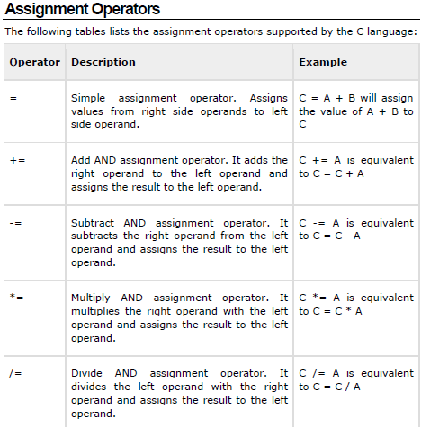

Slide 14
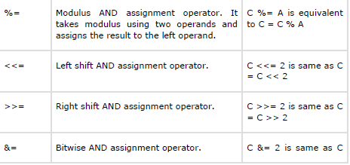
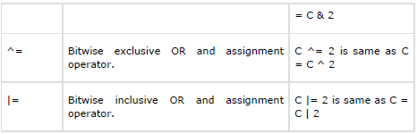

Slide 15
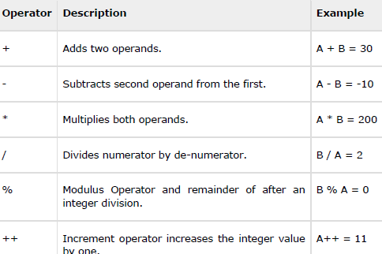

Arithmetic operators
Assume variable A holds 10 and variable B holds 20, then

Slide 16
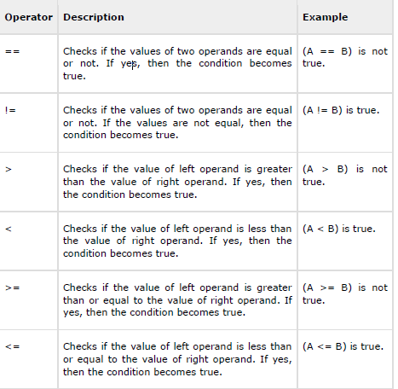
Relational operators Assume A = 10 and B = 20

Slide 17
Code to demonstrate relational operators
Output:
Line 1 - a is not equal to b
Line 2 - a is not less than b
Line 3 - a is greater than b
Line 4 - a is either less than or equal to b
Line 5 - b is either greater than or equal to b

Slide 18
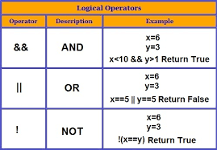
Logical Operators (AND, OR and NOT)

Slide 19
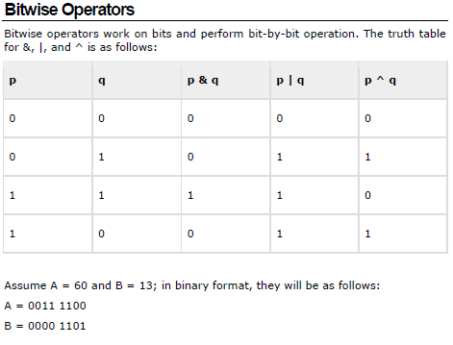

Slide 20
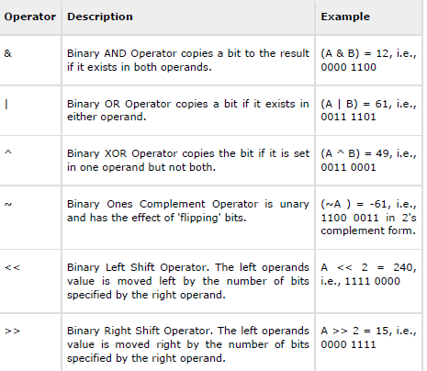
A = 0011 1100, B =0000 1101 A&B = 0000 1100 A|B = 0011 1101 A^B = 0011 0001 ~A = 1100 0011

Slide 21
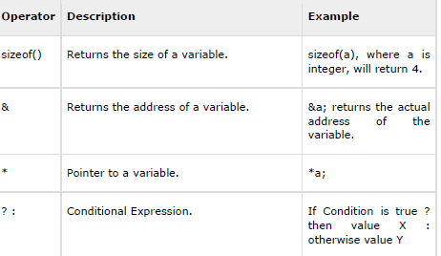
Other operators

Slide 22
Conditional operator
It sometimes called as ternary operator. Since it required three expressions as operand and it is represented as (? , :).
SYNTAX
exp1 ? exp2 :exp3
Here exp1 is first evaluated. It is true then value return will be exp2 . If false then exp3.
EXAMPLE
void main()
{
int a=10, b=2;
int s= (a>b) ? a:b;
printf(“value is:%d”);
}
Output:
Value is:10

Slide 23
Find the output of the code
# include <stdio.h>
int main( )
{
int x = 0, y = 5, z ;
float a = 1.5, b = 2.2, c ;
z = x || b ;
c = a && b ;
printf ( "%d %f", z, c ) ;
return 0 ;
}
Output: 1 1.000000

Slide 24
Find the output of the following code
# include <stdio.h>
int main( )
{
int a, b, c, d ;
a = 2 % 5 ;
b = -2 % 5 ;
c = 2 % -5 ;
d = -2 % -5 ;
printf ( "a = %d b = %d c = %d d = %d\n", a, b, c, d ) ;
return 0;
}
Output: 2, -2, 2, -2 (the sign of dividend will be retained)

Slide 25
3.12 What is printed by the following program?
main ()
{
int x = 5, y = 10, z = 10 ;
x = y == z;
printf(“%d”,x ) ;
}
Output: 1
3.13 What is the output of the following program?
main ( )
{
int x = 100, y = 200;
printf (“%d”, (x > y)? x : y);
}
Output: 200

Slide 26
Order of operations
Operator precedence determines the grouping of terms in an expression and decides how an expression is evaluated. Certain operators have higher precedence than others; for example, the multiplication operator has a higher precedence than the addition operator.
Here are the two main types of associativity:
Left-to-right: Operators are grouped from left to right. In mathematical expressions, this is the most common type. For example, in 2 + 3 * 4, the multiplication is performed first (3 * 4 = 12) and then added to 2 (2 + 12 = 14).
Right-to-left: Operators are grouped from right to left. This is less common but used in some specific cases, like exponentiation (2 ^ 3 ^ 2 = 2 ^ (3 ^ 2) = 2 ^ 9 = 512).

Slide 27
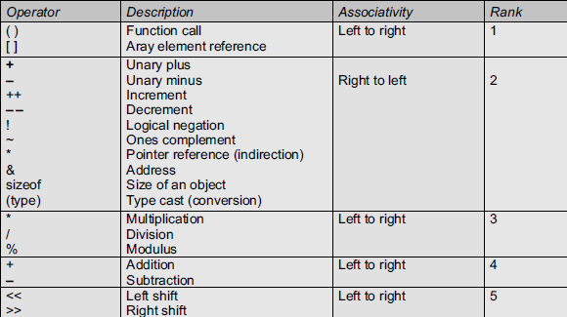
Order of operations in C

Slide 28
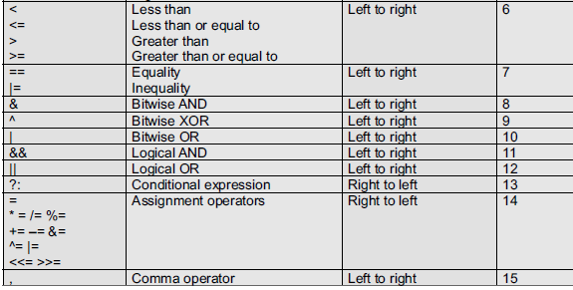
Order of operations (contd..)

Slide 29
Example
Output:
Value of (a + b) * c / d is : 90
Value of ((a + b) * c) / d is : 90
Value of (a + b) * (c / d) is : 90
Value of a + (b * c) / d is : 50

Slide 30
What will be the output?
# include <stdio.h>
int main( )
{
int i = 2, j = 3, k, l ;
float a, b ;
k = i / j * j ;
l = j / i * i ;
a = i / j * j ;
b = j / i * i ;
printf ( "%d %d %f %f\n", k, l, a, b ) ;
return 0 ;
}
Output: 0 2 0.000000 2.000000

Slide 31
Format specifiers in C
SPECIFIER | USED FOR
%c | a single character
%s | a string
%hi | short (signed)
%hu | short (unsigned)
%Lf | long double
%n | prints nothing
%d | a decimal integer (assumes base 10)
%i | a decimal integer (detects the base automatically)
%o | an octal (base 8) integer
%x | a hexadecimal (base 16) integer
%p | an address (or pointer)
%f | a floating point number for floats
%u | int unsigned decimal
%e | a floating point number in scientific notation
%E | a floating point number in scientific notation
%% | the % symbol

Slide 32
%d or %i - Signed integer
%lf - Double floating-point number
%x or %X - Lowercase or uppercase hexadecimal integer
%e or %E - Lowercase or uppercase scientific notation
%g or %G - Lowercase or uppercase concise representation of %f and %e
%g – formats the number in either %f or %e notation, whichever is shorter
%G – similar to %g, but uses uppercase ‘E’ in the exponential part

Slide 33
Escape sequence characters
\n - Newline
Moves the cursor to the beginning of the next line.
\t - Tab
Moves the cursor to the next tab stop.
\b - Backspace
Moves the cursor one position back.
\r - Carriage Return
Moves the cursor to the beginning of the current line.
\\ - Backslash
Represents a single backslash character.
\' - Single Quote
Represents a single quote character.
\" - Double Quote
Represents a double quote character.
\a - Alert (Bell)
Produces an audible or visible alert.
\f - Form Feed
Moves the cursor to the next logical page.
\v - Vertical Tab
Moves the cursor to the next vertical tab stop.
\? - Question Mark
Represents a question mark character.
\0 - Null
Represents the null character (binary 0).

Slide 34
Code for demo
#include<stdio.h>
int main () {
printf("\a Hello!\nHow are you?\n"); //alert sound
printf("I am learning C.\n"); // new line
printf("\tAm I physically fit?"); //tab
printf("\nAm\tI physically" " fit?\n"); // tab
printf("I am feeling\r good\n"); // carriage return
printf("I am feeling\b good\n"); // backspace
printf("\vThis gives vertical space\n"); // vertical space
printf("\f Printing in next page\n"); // form feed
printf("I am feeling \0 good\n"); // null (end of string)
printf("\nI am feeling \\\'good\'\n"); // backslash and single quote
printf("\"I am feeling good\"\n"); // double quote
printf("\?\n"); // question mark
return 0;
}

Slide 35
Input and output statements in C
The int getchar(void) function reads the next available character from the screen and returns it as an integer. This function reads only single character at a time. You can use this method in the loop in case you want to read more than one character from the screen.
The int putchar(int c) function puts the passed character on the screen and returns the same character. This function puts only single character at a time.
e.g.
int main( )
{
int c;
printf( "Enter a value :");
c = getchar( );
printf( "\nYou entered: ");
putchar( c );
return 0;
}

Slide 36
Input and output statements in C
The char *gets(char *s) function reads a line from stdin into the buffer pointed to by s until either a terminating newline or EOF (End of File).
The int puts(const char *s) function writes the string ‘s’ and ‘a’ trailing newline to stdout.
#include <stdio.h>
int main( )
{
char str[100];
printf( "Enter a value :");
gets( str );
printf( "\nYou entered: ");
puts( str );
return 0;
}

Slide 37
The int scanf(const char *format, ...) function reads the input from the standard input stream stdin and scans that input according to the format provided.
The int printf(const char *format, ...) function writes the output to the standard output stream stdout and produces the output according to the format provided.
The format can be a simple constant string, but you can specify %s, %d, %c, %f, etc., to print or read strings, integer, character, or float, respectively. There are many other formatting options available which can be used based on requirements.
#include <stdio.h>
int main( )
{
char str[100];
int i;
printf( "Enter a value :");
scanf("%s %d", str, &i);
printf( "\nYou entered: %s %d ", str, i);
return 0;
}
While reading a string, scanf() stops reading as soon as it encounters a space, so "this is test" are three strings for scanf().

Slide 38
Example programs on sequential statements
Print ASCII value of a character
Area and circumference of a Circle (Area= pi*r*r, Circumference = 2*pi*r)
Area of a triangle (0.5*b*h)
Perimeter of a rectangle (2*l*b)
Volume of a cylinder (pi*r*r*h)
Simple interest (p*n*i/100)
Converting temperature Celsius into Fahrenheit (F = (9/5)*C+32)
Display the size of the different data types
Gross salary of an employee

Slide 39
C program for average of 3 numbers
#include <stdio.h>
int main() {
int num1, num2, num3;
float average;
printf("Enter three numbers: ");
scanf("%d %d %d", &num1, &num2, &num3);
// Calculate the average
average = (num1 + num2 + num3) / 3.0; // Use 3.0 for floating-point division
printf("The average of %d, %d, and %d is: %.2f\n", num1, num2, num3, average);
return 0;
}

Slide 40
Display the size of different data types
#include <stdio.h>
int main() {
printf("Size of char: %lu bytes\n", sizeof(char));
printf("Size of int: %lu bytes\n", sizeof(int));
printf("Size of short: %lu bytes\n", sizeof(short));
printf("Size of long: %lu bytes\n", sizeof(long));
printf("Size of long long: %lu bytes\n", sizeof(long long));
printf("Size of float: %lu bytes\n", sizeof(float));
printf("Size of double: %lu bytes\n", sizeof(double));
printf("Size of long double: %lu bytes\n", sizeof(long double));
return 0;
}

Slide 41
Area of a triangle
#include <stdio.h>
int main() {
float base, height, area;
// Input the base and height of the triangle
printf("Enter the base of the triangle: ");
scanf("%f", &base);
printf("Enter the height of the triangle: ");
scanf("%f", &height);
// Calculate the area of the triangle
area = 0.5 * base * height;
// Display the result
printf("The area of the triangle is: %.2f\n", area);
return 0;
}

Slide 42
Additional problems to solve
(from Balagurusamy and Kanetkar books)

Slide 43
2.2 Identify syntax errors in the following program. After corrections, what output would you expect when you execute it?
#define PI 3.14159
main()
{
int R,C; /* R-Radius of circle
float perimeter; /* Circumference of circle */
float area; /* Area of circle */
C = PI
R = 5;
Perimeter = 2.0 * C *R;
Area = C*R*R;
printf(“%f”, “%d”,&perimeter,&area)
}

Slide 44
2.8 Write a program to read two floating point numbers using a scanf statement, assign their sum to an integer variable and then output the values of all the three variables.
Answer:
#include <stdio.h>
int main() {
float num1, num2;
int sum;
// Input
printf("Enter the first floating-point number: ");
scanf("%f", &num1);
printf("Enter the second floating-point number: ");
scanf("%f", &num2);
// Calculate sum and assign it to an integer variable
sum = (int)(num1 + num2);
// Output
printf("\nValues entered:\n");
printf("First number: %.2f\n", num1);
printf("Second number: %.2f\n", num2);
printf("Sum (rounded to nearest integer): %d\n", sum);
return 0;
}

Slide 45
3.5 Which of the following expressions are true?
(a) !(5 + 5 >=10) - false
(b) 5 + 5 = = 10 || 1 + 3 = = 5 - true
(c) 5 > 10 || 10 < 20 && 3 < 5 - true
(d) 10 ! = 15 && !(10<20) || 15 > 30 - false

Slide 46
3.6 Which of the following arithmetic expressions are valid? If valid, give the value of the expression; otherwise give reason.
(a) 25/3 % 2 (e) –14 % 3
(b) +9/4 + 5 (f) 15.25 + – 5.0
(c) 7.5 % 3 (g) (5/3) * 3 + 5 % 3
(d) 14 % 3 + 7 % 2 (h) 21 % (int)4.5

Slide 47
3.9 Determine the value of each of the following logical expressions if
a = 5, b = 10 and c = –6
(a) a > b && a < c
(b) a < b && a > c
(c) a == c || b > a
(d) b > 15 && c < 0 || a > 0
(e) (a/2.0 == 0.0 && b/2.0 != 0.0) || c < 0.0

Slide 48
3.10 What is the output of the following program?
#include<stdio.h>
void main ( )
{
char x;
int y;
x = 100;
y = 125;
printf("%c\n", x);
printf("%c\n", y);
printf("%d\n", x);
}
Ans:
d
}
100
3.11 Find the output of the following program
#include<stdio.h>
void main ( )
{
int x = 100;
printf("%d\n", 10 + x++);
printf("%d\n", 10 + ++x);
}
Ans:
110
112

Slide 49
4.7 Write a program that prints the value 10.45678 in exponential format with the following specifications:
(a) correct to two decimal places;
(b) correct to four decimal places; and
(c) correct to eight decimal places.
Answer:
#include <stdio.h>
int main() {
double value = 10.45678;
// (a) Correct to two decimal places
printf("(a) Correct to two decimal places: %.2e\n", value);
// (b) Correct to four decimal places
printf("(b) Correct to four decimal places: %.4e\n", value);
// (c) Correct to eight decimal places
printf("(c) Correct to eight decimal places: %.8e\n", value);
return 0;
}

Slide 50
4.8 Write a program to print the value 345.6789 in fixed-point format with the following specifications:
(a) correct to two decimal places;
(b) correct to five decimal places; and
(c) correct to zero decimal places.
Answer:
#include <stdio.h>
int main() {
double value = 345.6789;
// (a) Correct to two decimal places
printf("(a) Correct to two decimal places: %.2f\n", value);
// (b) Correct to five decimal places
printf("(b) Correct to five decimal places: %.5f\n", value);
// (c) Correct to zero decimal places
printf("(c) Correct to zero decimal places: %.0f\n", value);
return 0;
}

Slide 51
References
PROGRAMMING IN ANSI C, E Balagurusamy
Let us C, Yashwant Kanetkar
C, The complete reference, Herbert Schildt
https://www.geeksforgeeks.org/
https://www.programiz.com/
https://www.shiksha.com/online-courses/articles/operators-in-c-programming-a-complete-tutorial/
https://w3schools.com/
https://tutorialspoint.com/

