Slide 1
Different input statements
getch() is often used to read a character without waiting for the user to press Enter. It doesn't buffer the input, meaning the character is immediately read without the need to press Enter.
getchar() reads a character and waits for the user to press Enter. It buffers the input, meaning the character is stored in a buffer until Enter is pressed.
gets() reads a line from stdin and stores it into the string pointed to by str. It stops when either the newline character is read or when the end-of-file is reached, whichever comes first.

Slide 2
The Basic I/O Functions
getchar( ) Reads a character from the keyboard; usually waits for carriage return.
getche( ) Reads a character with echo; does not wait for carriage return; not defined by Standard C, but a common extension.
getch( ) Reads a character without echo; does not wait for carriage return; not defined by Standard C, but a common extension.
putchar( ) Writes a character to the screen.
gets( ) Reads a string from the keyboard.
puts( ) Writes a string to the screen.

Slide 3
getchar can take input from a single standard input stream.
int main()
{
int character;
printf("Enter any random character between a-z: ");
character = getchar();
printf("The entered character is : ");
putchar(character);
return 0;
}

Slide 4
Schaum’s series
4.50 A C program contains the following statements:
#include <stdio.h>
char a, b, c;
(a) Write appropriate getchar statements that will allow values for a, b and c to be entered into the computer.
(b) Write appropriate putchar statements that will allow the current values of a, b and c to be written out of the computer

Slide 5
Answer
#include <stdio.h>
int main() {
char a, b, c;
// Getting values for a, b, and c
printf("Enter value for a: ");
a = getchar();
// You may want to clear the input buffer before reading the next character
while (getchar() != '\n');
printf("Enter value for b: ");
b = getchar();
while (getchar() != '\n');
printf("Enter value for c: ");
c = getchar();
while (getchar() != '\n');
// Displaying the current values of a, b, and c
printf("Current values: a=%c, b=%c, c=%c\n", a, b, c);
// Writing out the current values using putchar
putchar(a);
putchar(b);
putchar(c);
return 0;
}

Slide 6
A C program contains the following statements:
#include <stdio. h>
int i,j,k;
Write an appropriate scanf function to enter numerical values for i, j and k into the computer, assuming
(a) The values for i, j and k will be decimal integers not exceeding six characters each.
Ans: scanf("%6d %6d %6d", &i, &j, &k);
(b) The value for i will be a decimal integer, j an octal integer and k a hexadecimal integer, with each quantity not exceeding 8 characters.
Ans: scanf("%8d %8o %8x", &i, &j, &k);
(c) The values for i and j will be hexadecimal integers and k will be an octal integer. Each quantity will be 7 or fewer characters.
Ans: scanf("%7x %7x %7o", &i, &j, &k);

Slide 7
4.57
(a) scanf("%12ld %5hd %15lf %15le”, &a, &b, &c, &d);
(12ld – 12 digit long int, 5hd – 5 digit short int, 15lf – 15 digit double, 15le- 15 digit double in scientific notation)
(b) scanf ("%10lx %6ho %5hu %14lu”, &a, &b, &c, &d);
(10lx – 10 digit long hexadecimal, 6 ho – 6 digit short octal, 5hu- 5 digit short unsigned int, 14 lu – 14 digit long unsigned int)
(c) scanf(“%12D %hd %15f %15e”, &a, &b, &c, &d);
(12D – undefined, %hd - short int, 15f -15 digit float, 15e -15 digit scientific notation)
(d) scanf(”%8d %*d %12lf %12lf”, &a, &b, &c, &d);
(The asterisk before the format specifier indicates that the read value will be discarded.)

Slide 8
4.64
A C program contains the following statements.
#include <stdio.h>
char a, b, c;
Suppose that $ is to be entered into the computer and assigned to a, * assigned to b and @ assigned to c.
Show how the input data must be entered for each of the following scanf functions.
(a) scanf ( "%c%c%c", &a, &b, &c) ;
(b) scanf("%c %c %c", &a, &b, &c);
(c) scanf("%s%s%s", &a, &b, &c);
(undefined when used to read a single character)
(d) scanf("%s %s %s", &a, &b, &c);
(undefined when used to read a single character)
(e) scanf ("%ls%ls%ls", &a, &b, &c);
(undefined when used to read a single character)

Slide 9
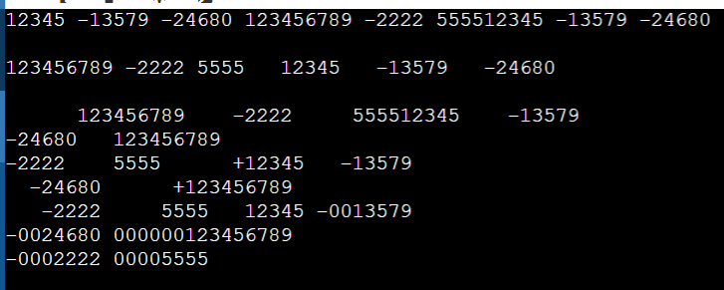
A C program contains the following variable declarations.
int i = 12345, j = -13579, k = -24680;
long ix = 123456789;
short sx = -2222;
unsigned ux = 5555;
Show the output resulting from each of the following printf statements.
(a) printf("%d %d %d %ld %d %U”, i, j, k, ix, sx, ux); //%U – error. %u will work
(b) printf(“%3d %3d %3d\n\n%3ld %3d %3u", i, j, k, ix, sx, ux); //(min. 3 digits width.)
(c) printf ("%8d %8d %8d\n\n%15ld %8d %8u” , i, j , k, ix, sx, ux);
(d) printf("%-8d %-8d\n%-8d %-15ld\n%-8d %-8u", i, j, k, ix, sx, ux); //(- for left alignment)
(e) printf ("%+8d %+8d\n%+8d %+15ld\n%+8d %8u" , i, j , k, ix, sx, ux); //(+ to indicate sign of the number)
(f) printf("%8d %08d\n%08d %015ld\n%08d %08u”, i, j, k, ix, sx, ux); //(08d means padded with leading zeros)

Slide 10
A C program contains the following variable declarations.
int i = 12345, j = 0xabcd9, k = 077777;
Show the output resulting from each of the following printf statements.
(a) printf("%d %x %o", i, j, k ) ;
(b) printf("%3d %3x %3o", i, j, k ) ;
(c) printf ("%8d %8x %8o" , i, j , k ) ;
(d) printf('%-8d %-8x %-8o", i, j, k ) ;
(e) printf ("%+8d %+8x %+8o", i, j, k);
(f) printf("%08d %#8x %#8o", i,j,k); (# will add prefix 0x for hexa and 0 for octal)

