Slide 1
Global variable is defined outside of all the functions
They are initialized to zero by default.
Variable is available till the end of the program.
If a local variable has the same name as the global variable, then the local variable will be used.
If we declare a global variable with the extern keyword, we say that we’re defining this variable elsewhere

Slide 2
Static variable
A static variable is by default a global variable, but 'static' keyword confines it to the scope of its function.
It prevents the reinitialization of the variable on multiple function calls.
A global variable can be accessed from anywhere inside the program while a static variable only has a block scope.

Slide 3
#include <stdio.h>
int function1()
{
static int count1 = 0; // does not intialize the value of count1 to 0 at every function call
count1++;
printf("count of function 1 is %d\n", count1);
}
int function2()
{
static int count2 = 0; // does not intialize the value of count2 to 0 at every function call
count2++;
printf("count of function 2 is %d\n", count2);
}
int main() {
function1(); // print "count of function 1 is 1"
function1(); // print "count of function 1 is 2"
function2(); // print "count of function 2 is 1"
function2(); // print "count of function 2 is 2"
function2(); // print "count of function 2 is 3"
}

Slide 4
Volatile variable
When a variable is declared as volatile, it indicates to the compiler that the variable’s value may change at any time
This is particularly useful in scenarios where the variable can be modified externally, such as by hardware, an interrupt service routine, or concurrently running threads.
Using the volatile keyword ensures that the program reads the current value of the variable every time it is accessed, rather than using any cached or optimized value.

Slide 5
The typedef is a keyword that is used to provide existing data types with a new name.
typedef unsigned long ulong;
ulong myVar = 1000000;
The register keyword implies that the compiler should store the variable in a CPU register to enable quicker access as opposed to memory.

Slide 6
Order of operations in C

Slide 7
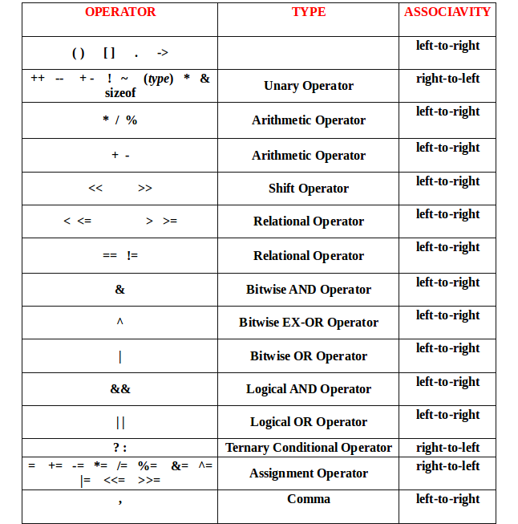

Slide 8
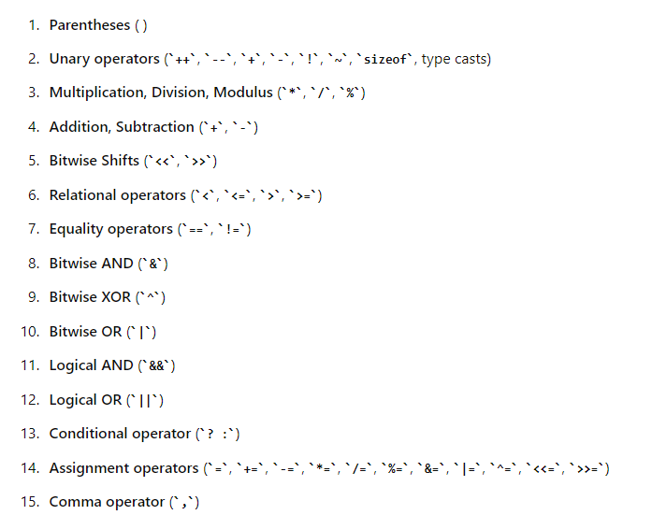

Slide 9
int a = 5;
int b = 10;
int c = 15;
int result = - ++ a * -- b + ! c;

Slide 10
#include <stdio.h>
int main ()
{
int x, y, a, b; // declare local variable
a = 10;
x = --a; // It shows pre decrement operator
printf (" Pre Decrement Operator");
// Here the value of x is decreased by 1.
printf (" \n The value of x is %d.", x);
printf (" \n The value of a is %d.", a);
b = 20;
y = b--; // It shows the post decrement operator
printf (" \n\n Post Decrement Operator");
printf (" \n The value of y is %d.", y);
// get updated value of b
printf (" \n The value of b is %d.", b);
return 0;
}
Pre Decrement Operator
The value of x is 9.
The value of a is 9.
Post Decrement Operator
The value of y is 20.
The value of b is 19.

Slide 11
#include <stdio.h>
int main ()
{
// declaration of different types of data variables
int x;
float y;
char ch;
double z;
// use sizeof() operator and pass the different data type variable to get their size.
printf (" The size of the int (x) variable is: %d", sizeof(x));
printf (" \n The size of the float (y) variable is: %d", sizeof(y));
printf (" \n The size of the char (ch) variable is: %d", sizeof(ch));
printf (" \n The size of the double (z) variable is: %d", sizeof(z));
return 0;
}
sizeof operator
The size of the int (x) variable is: 4
The size of the float (y) variable is: 4
The size of the char (ch) variable is: 1
The size of the double (z) variable is: 8

Slide 12
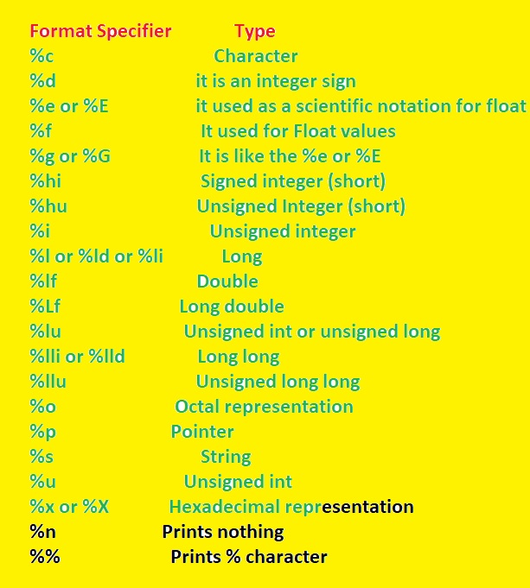

Slide 13
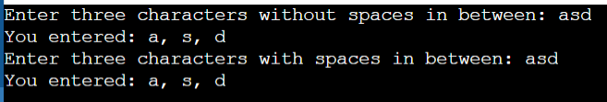
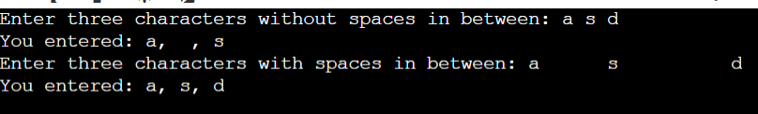
#include <stdio.h>
int main() {
char a, b, c;
printf("Enter three characters without spaces in beween: ");
scanf("%c%c%c", &a, &b, &c);
printf("You entered: %c, %c, %c\n", a, b, c);
// Clear the input buffer
while (getchar() != '\n');
printf("Enter three characters with spaces in between: ");
scanf("%c %c %c", &a, &b, &c);
printf("You entered: %c, %c, %c\n", a, b, c);
return 0;
}

Slide 14
\r - Carriage Return
Moves the cursor to the beginning of the current line.
\\ - Backslash
Represents a single backslash character.
\f - Form Feed
Moves the cursor to the next logical page.
\? - Question Mark
Represents a question mark character.
\0 - Null
Represents the null character (binary 0).
The statement after \0 will be omitted.

Slide 15
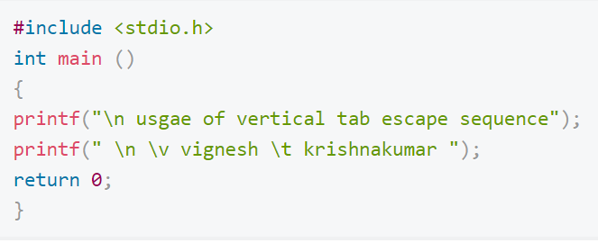
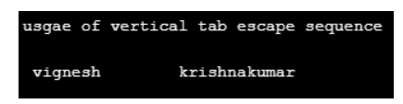
Vertical tab

Slide 16
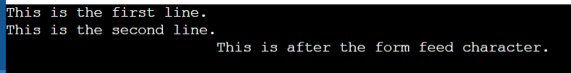
#include <stdio.h>
int main()
{
printf("This is the first line.\n");
printf("This is the second line.\f");
printf("This is after the form feed character.\n");
return 0;
}

Slide 17
Thanks

