Slide 1
Arrays & Strings

Slide 2
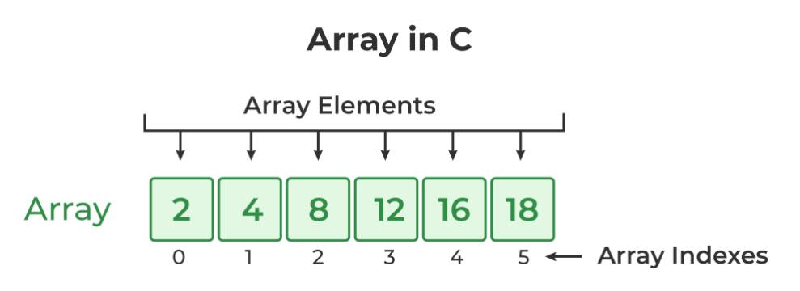
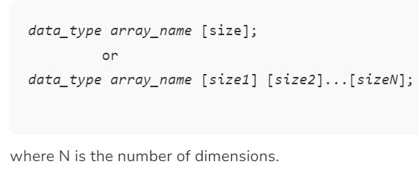
One-dimensional array

Slide 3
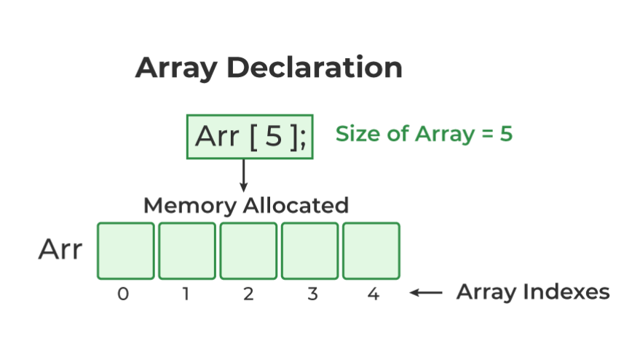
// declaring array of integers
int arr_int[5];
// declaring array of characters
char arr_char[5];

Slide 4
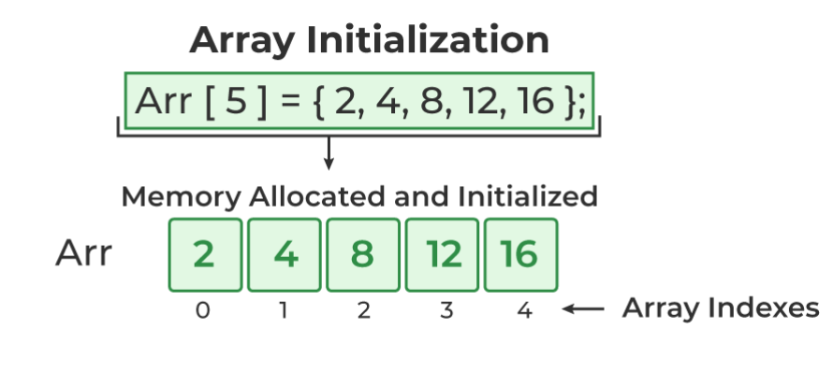
data_type array_name [size] = {value1, value2, ... valueN};
data_type array_name[] = {1,2,3,4,5};
for (i = 0; i < N; i++) {
array_name[i] = valuei;
}

Slide 5
Update Array Element
array_name[i] = new_value;

Slide 6
// C Program to demonstrate array initialization
#include <stdio.h>
int main()
{
int i;
// array initialization using initializer list
int arr[5] = { 10, 20, 30, 40, 50 };
// array initialization using initializer list without
// specifying size
int arr1[] = { 3, 4, 2, 7, 5 };
// array initialization using for loop
float arr2[5];
for ( i = 0; i < 5; i++)
{
arr2[i] = (arr[i]/arr1[i])* 2.1;
printf("array_2 of %d is %f\n",i,arr2[i]);
printf("array2 addrs of %d is %u\n", i,&arr2[i]);
}
return 0;
}

Slide 7
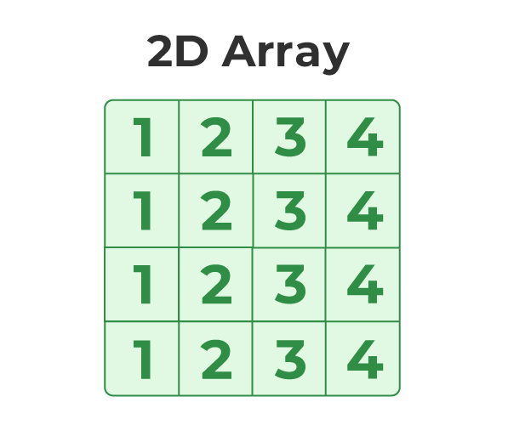
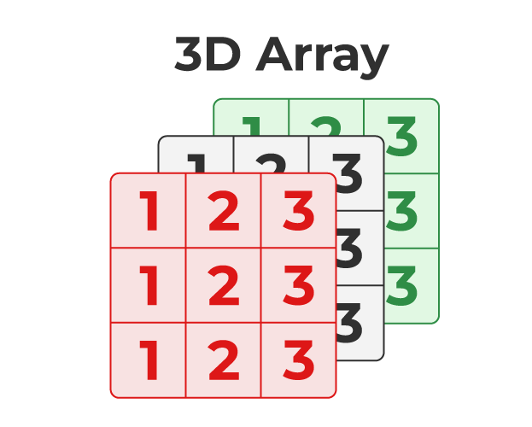
Syntax of 2D Array in C
Syntax of 3D Array in C
array_name[size1] [size2];
array_name [size1] [size2] [size3];

Slide 8
// C Program to illustrate 2d array
#include <stdio.h>
int main()
{
int i,j;
// declaring and initializing 2d array
int arr[2][3] = { 10, 20, 30, 40, 50, 60 };
printf("2D Array:\n");
// printing 2d array
for ( i = 0; i < 2; i++) {
for ( j = 0; j < 3; j++) {
printf("%d ",arr[i][j]);
}
printf("\n");
}
return 0;
}
0,0
0,1
0,2
1,0
1,1
1,2
int arr[2][3] = {{10,20,30},{40,50,60}};

Slide 9
// C Program to illustrate the 3d array
#include <stdio.h>
int main()
{
int i,j,k;
// 3D array declaration
int arr[2][2][2] = { 10, 20, 30, 40, 50, 60 };
// printing elements
for ( i = 0; i < 2; i++) {
for ( j = 0; j < 2; j++) {
for ( k = 0; k < 2; k++) {
printf("%d ", arr[i][j][k]);
}
printf("\n");
}
printf("\n");
}
return 0;
}
Array index for 3d
0,0,0
0,0,1
0,1,0
0,1,1
1,0,0
1,0,1
1,1,0
1,1,1

Slide 10
// C Program to illustrate the 3d array
#include <stdio.h>
int main()
{
int i,j,k;
// 3D array declaration
int arr[2][2][3] = { 10, 20, 30, 40, 50, 60,70,80,90,100,110,120};
// printing elements
for ( i = 0; i < 2; i++) {
for ( j = 0; j < 2; j++) {
for ( k = 0; k < 3; k++) {
printf("%d ", arr[i][j][k]);
}
printf("\n");
}
printf("\n");
}
return 0;
}
int arr[2][2][3] = {
{{10,20,30},{40,50,60}},
{{70,80,90},{100,110,120} }
}; //method 2 to initialize array

Slide 11
// C Program to perform input and output on array
#include <stdio.h>
int main()
{
int i;
// declaring an integer array
int arr[5];
// taking input to array elements one by one
for ( i = 0; i < 5; i++) {
scanf("%d", &arr[i]);
}
// printing array elements
printf("Array Elements: ");
for ( i = 0; i < 5; i++) {
printf("%d ", arr[i]);
}
return 0;
}

Slide 12
Largest Element of an Array in C using Loops
Take the size of the array as input from the user. 2. Then, initialize an array of size given by the user. 3. Using for loop, take array element as input from users and insert them into the array. 4. After inserting all the elements of the array, consider the very first element of array to be the largest. 5. Run a for loop, from 1 to arraySize-1, extracting array element one by one and comparing it to the largest element. 6. If the largest element is smaller than the element being compared, then the largest element is updated with the value of the current element of the array. 7. In the end, the largest element will hold the actual largest value present in the array.

Slide 13
*
* C Program to find the largest number in an array using loops
*/
#include <stdio.h>
int main()
{
int size, i, largest;
printf("\n Enter the size of the array: ");
scanf("%d", &size);
int array[size]; //Declaring array
//Input array elements
printf("\n Enter %d elements of the array: \n", size);
for (i = 0; i < size; i++)
{
scanf(" %d", &array[i]);
}
//Declaring Largest element as the first element
largest = array[0];
for (i = 1; i < size; i++)
{
if (largest < array[i])
largest = array[i];
}
printf("\n largest element present in the given array is : %d", largest);
return 0;
}

Slide 14
Write a C Program to insert an element in an Array.
1. Declare a one-dimensional array of some fixed capacity. 2. Take size of the array as input from users 3. Define array elements, taking each element as input from users. 4. Get the number to be inserted. 5. Get the position where element needs to be inserted. 6. From that position shift all elements to one position forward. 7. Insert the element in that position. 8. Exit.

Slide 15
/*
* C program to insert an element in a specified position in a given array
*/
#include <stdio.h>
void main()
{
int array[100];
int i, n, x, pos;
printf("Enter the number of elements in the array \n");
scanf("%d", &n);
printf("Enter the elements \n");
for (i = 0; i < n; i++)
{
scanf("%d", &array[i]);
}
printf("Input array elements are: \n");

Slide 16
for (i = 0; i < n; i++)
{
printf("%d ", array[i]);
}
printf("\nEnter the new element to be inserted: ");
scanf("%d", &x);
printf("Enter the position where element is to be inserted: ");
scanf("%d", &pos);
//shift all elements 1 position forward from the place
//where element needs to be inserted
n=n+1;
for(i = n-1; i >= pos; i--)
array[i]=array[i-1];
array[pos-1]=x; //Insert the element x on the specified position
//print the new array
for (i = 0; i < n; i++)
{
printf("%d ", array[i]);
}
}

Slide 17
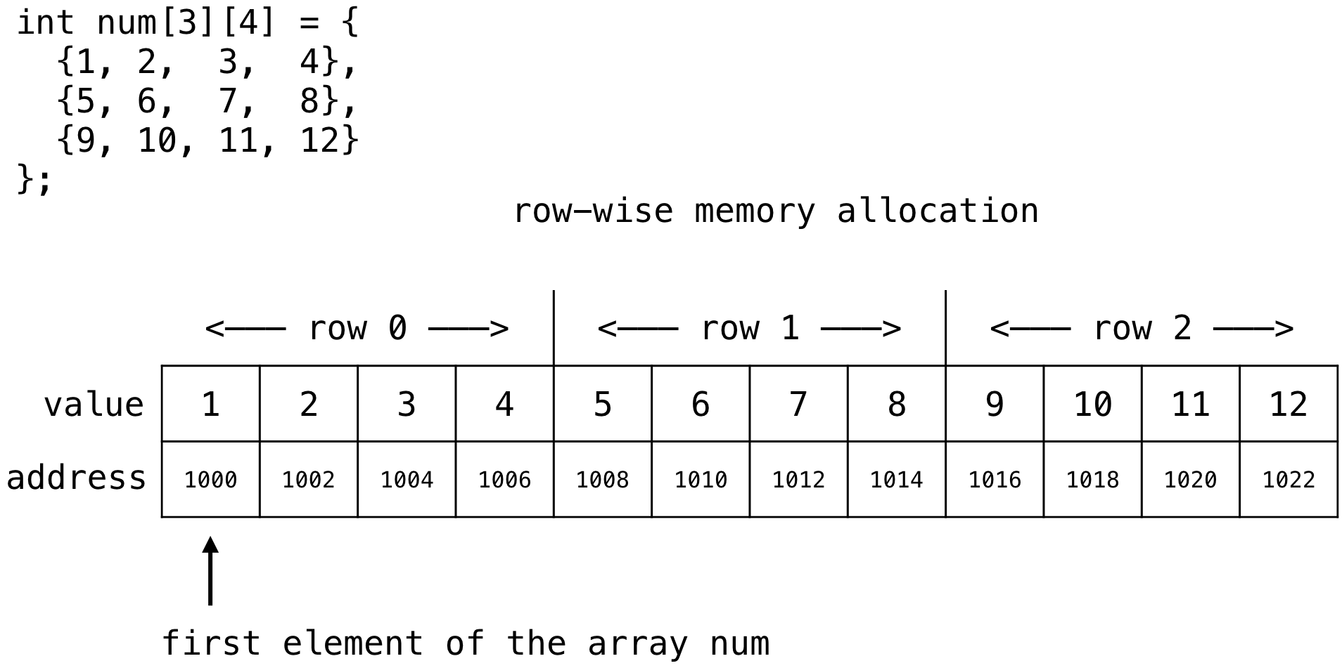
Arrays in Memory: How C Stores Arrays

Slide 18
Example: Searching an Array
Implementing a Search Algorithm
A linear search algorithm iterates over an array to find a value.
This is a straightforward example of how to traverse an array with a loop.
int linearSearch(int arr[], int size, int value) { for (int i = 0; i < size; i++) {
if (arr[i] == value) return i;
}
return -1; // Value not found
}
Standard C Code for Linear Search
Embedded C Scenario
Searching through a data array to find a sensor reading that exceeds a threshold could trigger an event or alert.

Slide 19
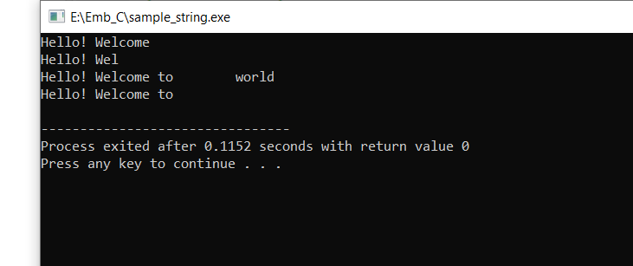

Strings
#include<stdio.h>
#include<string.h>
int main()
{
char str[]="Hello! Welcome";
printf("%s\n",str);
char str1[10]="Hello! Welcome";
printf("%s\n",str1);
char str2[]="Hello! Welcome to world";
printf("%s\n",str2);
char str3[20]="Hello! Welcome to world";
printf("%s\n",str3);
return 0;
}

Slide 20
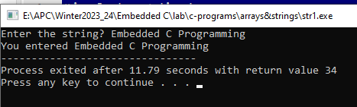
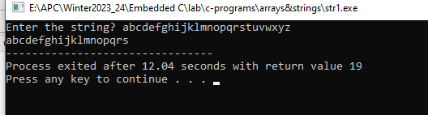

Programs on Strings ----- gets()
#include<stdio.h>
void main ()
{
char s[30];
printf("Enter the string? ");
gets(s);
printf("You entered %s",s);
}
#include<stdio.h>
void main()
{
char str[20];
printf("Enter the string? ");
fgets(str, 20, stdin);
printf("%s", str);
}

Slide 21
String Functions
No. | Function | Description
1) | strlen(string_name) | returns the length of string name.
2) | strcpy(destination, source) | copies the contents of source string to destination string.
3) | strcat(first_string, second_string) | concats or joins first string with second string. The result of the string is stored in first string.
4) | strcmp(first_string, second_string) | compares the first string with second string. If both strings are same, it returns 0.

Slide 22
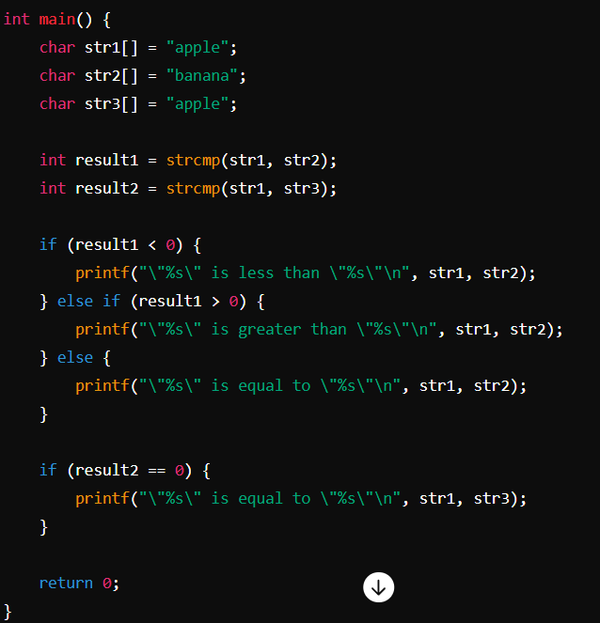
4. Compare String: strcmp()
3. String Concatenation: strcat()
#include<stdio.h>
#include <string.h>
int main(){
char ch[10]={'h', 'e', 'l', 'l', 'o', '\0'};
char ch2[10]={'c', '\0'};
strcat(ch,ch2);
printf("Value of first string is: %s",ch);
return 0;
}

Slide 23
String Palindrome
int main() { char string1[20]; // Prompt the user for input printf("Enter a string: "); scanf("%s", string1); // Start from first and // last character of str int l = 0; int h = strlen(string1) - 1; | // Keep comparing characters // while they are same while (h > l) { if (string1[l++] != string1[h--]) { printf("%s is not a palindrome\n", string1); return 0; // will return from here } } printf("%s is a palindrome\n", string1); return 0; }

Slide 24
Reverse String: strrev()
#include<stdio.h>
#include <string.h>
int main(){
char str[20];
printf("Enter string: ");
gets(str);//reads string from console
printf("String is: %s",str);
printf("\nReverse String is: %s",strrev(str));
return 0;
}

Slide 25
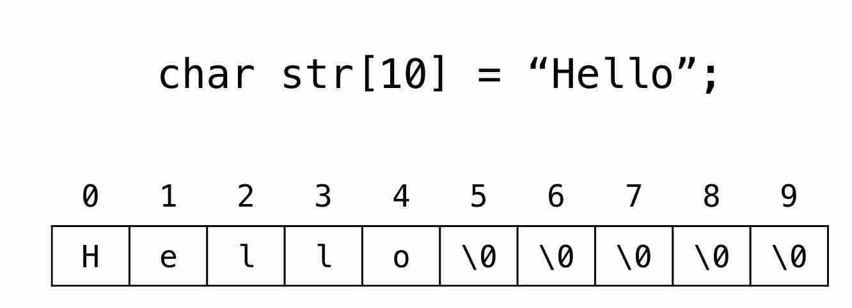
Strings in C: A Special Kind of Array
What Are Strings in C?
In C, strings are arrays of characters terminated by a null character \0.
Usage in Embedded Systems
Strings are often used for storing data read from or to be written to peripherals, like displays in embedded systems.
25/103

Slide 26
Reading and Writing Strings
scanf("%s", &str);
printf("%s", str);
In embedded systems, functions like ‘sprintf‘ and ‘sscanf‘ are used for formatting strings to interact with hardware or protocol messages.
Using Standard I/O Functions
Embedded C Considerations
26/103

Slide 27
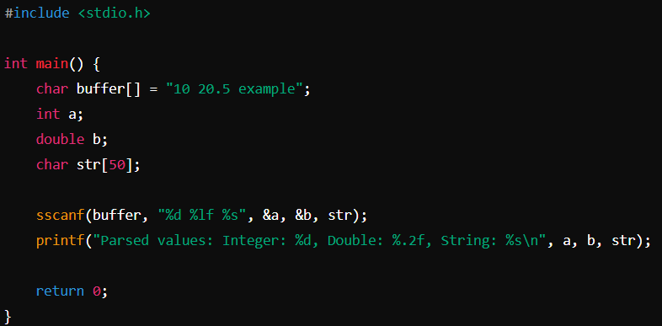

Parsed values: Integer: 10, Double: 20.50, String: example

Slide 28
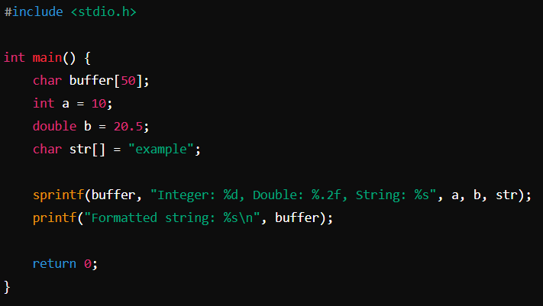

Formatted string: Integer: 10, Double: 20.50, String: example

Slide 29
Programs on Strings ----- gets()
#include<stdio.h>
void main ()
{
char s[30];
printf("Enter the string? ");
gets(s);
printf("You entered %s",s);
}
#include<stdio.h>
void main()
{
char str[20];
printf("Enter the string? ");
fgets(str, 20, stdin);
printf("%s", str);
}

Slide 30
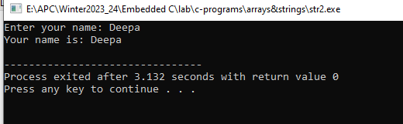
Programs on Strings ----- puts()
#include<stdio.h>
#include <string.h>
int main(){
char name[50];
printf("Enter your name: ");
gets(name); //reads string from user
printf("Your name is: ");
puts(name); //displays string
return 0;
}

Slide 31
1. String Length: strlen() function
#include<stdio.h>
#include <string.h>
int main(){
char ch[20]={'j', 'a', 'v', 'a', 't', 'p', 'o', 'i', 'n', 't', '\0'};
printf("Length of string is: %d",strlen(ch));
return 0;
}
2. Copy String: strcpy()
#include<stdio.h>
#include <string.h>
int main(){
char ch[20]={'j', 'a', 'v', 'a', 't', 'p', 'o', 'i', 'n', 't', '\0'};
char ch2[20];
strcpy(ch2,ch);
printf("Value of second string is: %s",ch2);
return 0;
}

Slide 32
3. String Concatenation: strcat()
#include <stdio.h>
#include <string.h>
int main()
{
char string_1[25]; // char array is declared
char string_2[25]; // char array is declared
printf("Enter value for string_1 : ");
// first string is taken as input
scanf("%s", string_1);
printf("\nEnter value for string_2 : ");
// second string is taken as input
scanf("%s",string_2);
strcat(string_1,string_2);
// concatenation is done here
printf("Concatenated String: %s",string_1);
return 0;
}
#include<stdio.h>
#include <string.h>
int main(){
char ch[10]={'h', 'e', 'l', 'l', 'o', '\0'};
char ch2[10]={'c', '\0'};
strcat(ch,ch2);
printf("Value of first string is: %s",ch);
return 0;
}

