Slide 1
Advantages of functions
Modularity: Functions allow you to break down a program into smaller, manageable pieces called modules. Each function can perform a specific task, making the code more modular and easier to understand.
Reusability: Once a function is defined, it can be called multiple times from different parts of the program. This promotes code reuse and helps avoid duplicating code, making the program more efficient and easier to maintain.
Readability: Functions enhance the readability of code by encapsulating specific functionality. When you give meaningful names to functions, it becomes easier for other programmers (or even yourself) to understand the purpose of different parts of the code.
Abstraction: Functions provide a level of abstraction by hiding the details of the implementation. A function's interface (parameters and return type) describes what it does, without revealing how it achieves its task. This allows changes to the implementation without affecting the rest of the program.
Testing and Debugging: Functions make it easier to test and debug code. Since each function performs a specific task, it is easier to isolate and test that functionality. Additionally, if an error occurs, functions help narrow down the search for the bug to a specific module.
Scoping: C uses block-level scoping, and functions define their own scope. This means that variables declared inside a function are local to that function and do not interfere with variables outside of it. This helps prevent naming conflicts and unintended variable modifications.
Parameter Passing: Functions allow you to pass parameters, enabling the transfer of data between different parts of the program. This facilitates communication and allows functions to operate on different data sets.
Encapsulation: Functions provide a form of encapsulation by bundling related code into a single unit. This helps in managing complexity, as the internal details of a function can be hidden from the rest of the program.
Code Organization: Functions contribute to a more organized code structure. By grouping related tasks into functions, the overall codebase becomes more structured and easier to navigate.

Slide 2
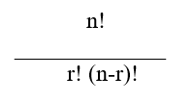
Functions
What if we want to find the result of the expression
#include<stdio.h>
int main()
{
int n=5,r=3,i;
float nfact=1, rfact=1, nrfact=1;
for(i=1;i<=n;i++)
nfact*=i;
for(i=1;i<=r;i++)
rfact*=i;
for(i=1;i<=n-r;i++)
nrfact*=i;
printf("%f\n",nfact/(rfact*nrfact));
return 0;
}

Slide 3
Functions
To write programs using functions, we must know about the following three:
Function definition
Function call
Function Prototype or declaration
A) Function Definition:
Has 2 parts
Function header
Function body
Syntax
[ReturnType] FunctionName([type arg1,type arg2, … , type argN])
{
[ local declarations; ]
function body;
[ return (expression); ]
}

Slide 4
Functions
B) Function call:
i) Syntax for a function which does not return any value:
functionName(arg1, arg2, …, argn); where arg1, arg2,…. are optional
ii) Syntax for a function which returns a value:
functionName(arg1, arg2, …, argn);
(Or)
X = functionName(arg1, arg2, …, argn);
(Or)
printf("%d",functionName(arg1, arg2, …, argn));

Slide 5
Functions
C) Function Prototype or declaration:
returntype functionName(datatype arg1, datatype arg2, …, datatype argn);
Or
returntype functionName(datatype1, datatype2, …, datatype n);

Slide 6
Call by value, Call by reference
void swap(int *x, int *y)
{
int temp;
temp = *x; /* save the value at address x */
*x = *y; /* put y into x */
*y = temp; /* put x into y */
}
#include <stdio.h>
void swap(int *x, int *y);
int main (void)
{
int i, j;
i = 10;
j = 20;
printf("i and j before swapping: %d %d\n", i, j);
swap(&i, &j); /* pass the addresses of i and j */
printf("i and j after swapping: %d %d\n", i, j);
return 0;
}
#include <stdio.h>
int sqr(int x);
int main(void)
{
int t=10;
printf("%d %d", sqr(t), t);
return 0;
}
int sqr(int x)
{
x = x*x;
return(x);
}

Slide 7
Type I (No arguments, no return value) #include <stdio.h> #include <math.h> void power() { int x,n,z; printf("Enter the values of x and n:"); scanf("%d%d",&x,&n); z=pow(x,n); printf("The result is:%d",z); return; } int main() { power(); } | Type II (no arguments but return value) #include <stdio.h> #include <math.h> int power() { int x,n,z; printf("Enter the values of x and n:"); scanf("%d%d",&x,&n); z=pow(x,n); return z; } int main() { int a; a=power(); printf("The result is:%d",a); }
Type III (takes arguments but no return value) #include <stdio.h> #include <math.h> void power(int x, int n) { int z; z=pow(x,n); printf("The result is:%d",z); return; } int main() { int x,n; printf("Enter the values of x and n:"); scanf("%d%d",&x,&n); power(x,n); } | Type IV (takes arguments and returns value) #include <stdio.h> #include <math.h> int power(int x, int n) { int z; z=pow(x,n); return z; } int main() { int x,n,a; printf("Enter the values of x and n:"); scanf("%d%d",&x,&n); a=power(x,n); printf("The result is:%d",a); }

Slide 8
Functions
#include<stdio.h>
float factorial(int x)
{
int i;
float fact=1;
for(i=1;i<=x;i++)
fact*=i;
return fact;
}
int main()
{
int n=5,r=3,i;
printf("%f\n",factorial(n)/(factorial(n-r)*factorial(r)));
return 0;
}

Slide 9
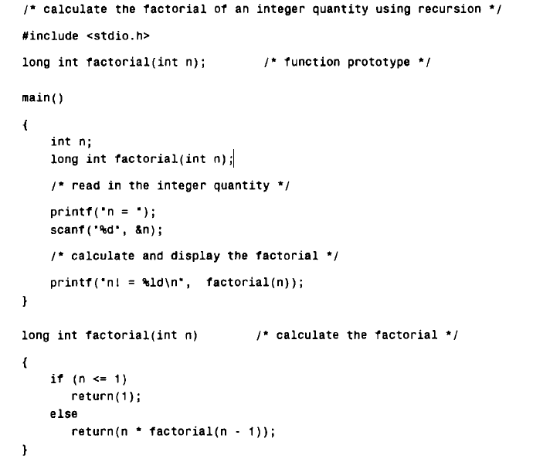
Recursive function

Slide 10
Exercise
Write the first line of the function definition, including the formal argument declarations, for each of the situations described below.
(a) A function called sample generates and returns an integer quantity.
(b) A function called root accepts two integer arguments and returns a floating-point result.
(c) A function called convert accepts a character and returns another character.
(d) A function called transfer accepts a long integer and returns a character.
(e) A function called inverse accepts a character and returns a long integer.
(f) A function called process accepts an integer and two floating-point quantities (in that order), and returns a double-precision quantity.
(g) A function called value accepts two double-precision quantities and a short-integer quantity (in that
order). The input quantities are processed to yield a double-precision value which is displayed as a final
resu1t.

Slide 11
Pointers
Pointers allow to use dynamic memory allocation
Allows sharing without copying, i.e., pass by reference
Execution time with pointers is faster because data are manipulated with the address, that is, direct access to memory location.
By using pointers to functions, functions can be passed as arguments to other functions

Slide 12
Pointers
Declaring a Pointer variable
datatype *pointer variable ;
Storing address in a pointer variable
pointervariable=&datavariable;
Accessing the value of the data variable using pointer (Dereferencing)
*pointervariable

Slide 13
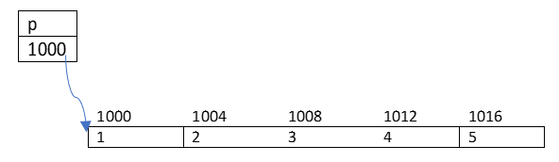
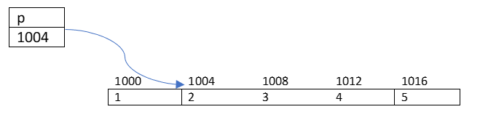
Pointers
int arr[]={1,2,3,4,5};
int *p=arr;
when we increment pointer, its value
is increased by the length of the data type that it points to. This length is called scale factor.
Let p=1000;
p+1 will be 1004

Slide 14
Example program
main()
{
char a;
int x;
fl oat p, q;
a = ‘A’;
x = 125;
p = 10.25, q = 18.76;
printf(“%c is stored at addr %u.\n”, a, &a);
printf(“%d is stored at addr %u.\n”, x, &x);
printf(“%f is stored at addr %u.\n”, p, &p);
printf(“%f is stored at addr %u.\n”, q, &q);
}

Slide 15
void * pointer
In C, it is permissible to assign a void * pointer to any other type of pointer.
It is also permissible to assign any other type of pointer to a void * pointer. A void * pointer is called a generic pointer.
The void * pointer is used to specify a pointer whose base type is unknown.
The void * type allows a function to specify a parameter that is capable of receiving any type of pointer argument without reporting a type mismatch.

Slide 16
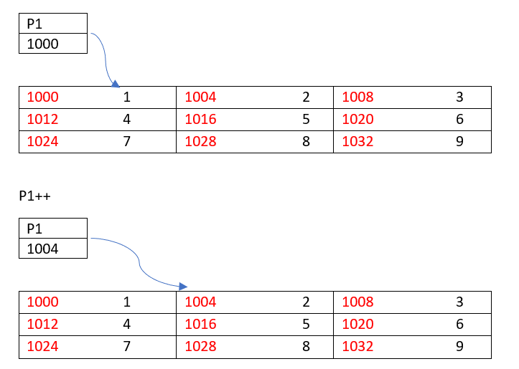
Pointers
Pointer to a 2-D array
int arr[2][3]={{1,2,3},{4,5,6}};
int *p1=arr;
To access the i^{th} row and
j^{th} column element
*(p1+i*3+j)

Slide 17
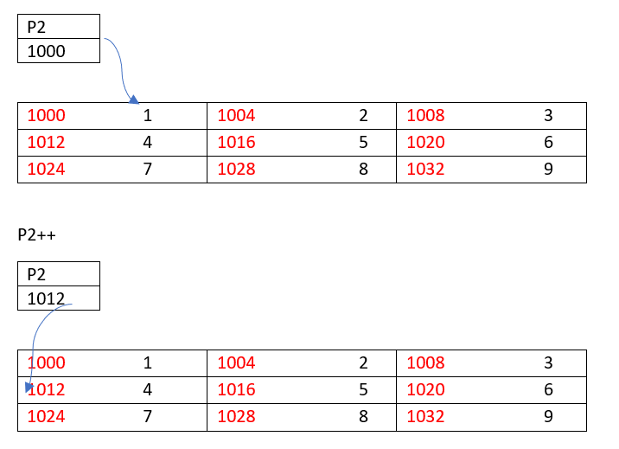
Pointers
(ii) int (*p2)[3]=arr;
To access the i^{th} row and
j^{th} column element
*(*(p2+i)+j)

Slide 18
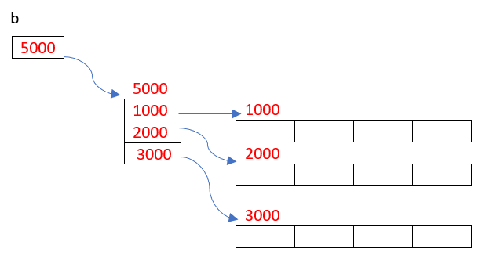
Pointers
1-Dimensional Dynamic Array Creation
int *b=(int*) malloc(sizeof(int) *n);
2-Dimensional Dynamic Array Creation
int **b=(int**) malloc(sizeof(int*)*r);
for(i=0;i<r;i++)
b[i]=(int*) malloc(sizeof(int)*c);

Slide 19
Handling 2D arrays using pointers
#include <stdio.h>
int main() {
int rows = 3, cols = 4;
// Declare a 2D array using pointer notation
int (*arr)[cols] = (int (*)[cols])malloc(rows * cols * sizeof(int));
// Initialize the array elements
for (int i = 0; i < rows; i++) {
for (int j = 0; j < cols; j++) {
arr[i][j] = i * cols + j + 1; // Assign sequential values
}
}
// Print the array elements using pointer arithmetic
printf("2D Array:\n");
for (int i = 0; i < rows; i++) {
for (int j = 0; j < cols; j++) {
printf("%d ", *(arr + i)[j]); // Access elements using pointer expression
}
printf("\n");
}
// Free the dynamically allocated memory
free(arr);
return 0;
}

