Slide 1
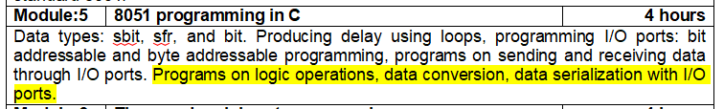
8051 Programming in C

Slide 2
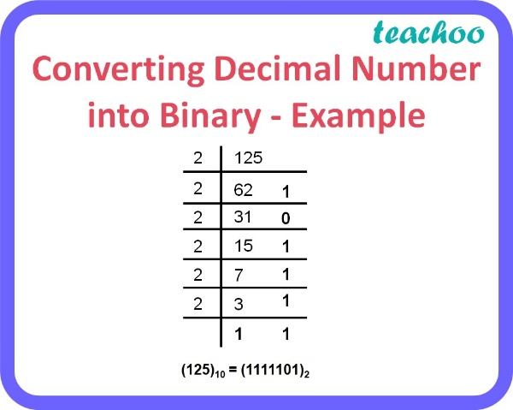
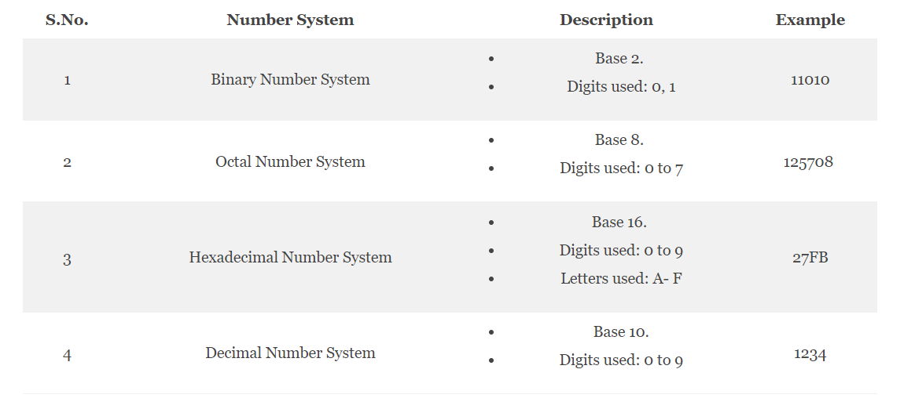
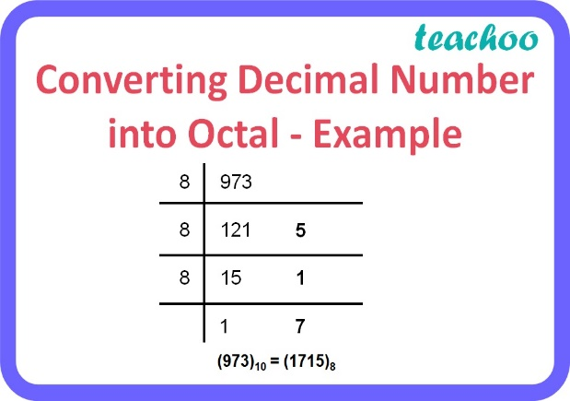
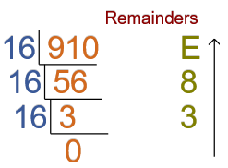
Number System

Slide 3
Exercise - I
Number system Decimal | 10 | 16 | 32 | 127 | 255 | 512 | 1023
Binary Base 2 | 1010 | ? | ? | ? | ? | ? | ?
Octal (Base 8) | 12 | ? | ? | ? | ? | ? | ?
Hexadecimal (Base 16) | A | ? | ? | ? | ? | ? | ?

Slide 4
Answer
Number system Decimal | 10 | 16 | 32 | 127 | 255 | 512 | 1023
Binary Base 2 | 1010 | 10000 | 100000 | 1111111 | 11111111 | 1000000000 | 1111111111
Octal (Base 8) | 12 | 20 | 40 | 177 | 377 | 1000 | 1777
Hexadecimal (Base 16) | A | 10 | 20 | 7F | FF | 200 | 3FF

Slide 5
sbit, sfr, and bit
#include<reg51.h>
sbit inbit = P1^0;
//sbit datatype and inbit variable
sbit outbit = P2^7;
bit membit =27H;
//bit addresable memory for store the single bit
void main(void){
while(1){
membit= inbit;
// read the single bit data from port
outbit = membit;
// out the single bit data to port
}
}

Slide 6
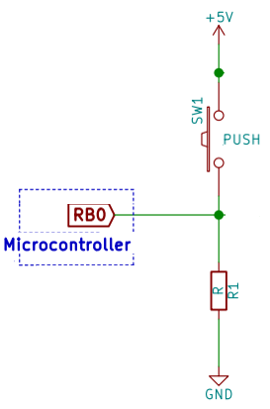
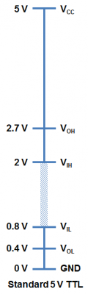
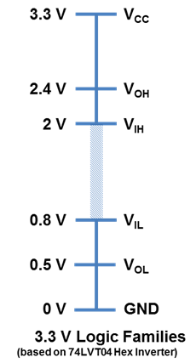
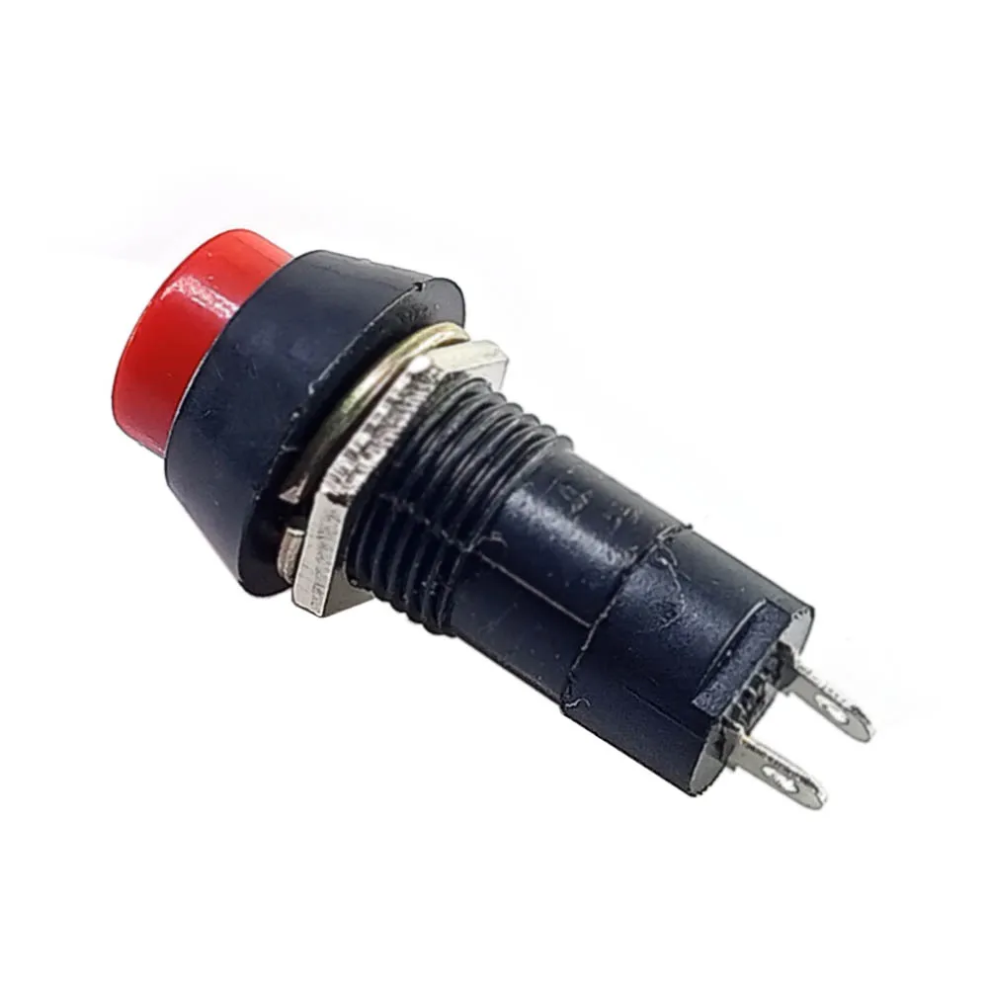
sbit, sfr, and bit.
#include<reg51.h>
sbit sw = P1^7
void main(void)
{
while(1){
if(sw == 1)
{
P0 = 0x55; }
else
{
P2 = 0XAA;
}}}
1
/* Switch variable corresponds to PORT 1 Pin7. It is
used as an input. We put 0x55 on P0 if the P1.7 status
is 1 else we put 0xAA on P2*/
Notes:
https://ebooks.inflibnet.ac.in/csp13/chapter/212/

Slide 7
Producing delay using loops
#include <reg51.h>
void main(void)
{
unsigned int x;
for (;;) //repeat forever
{
p1=0x55;
for (x=0;x<40000;x++);
p1=0xAA;
for (x=0;x<40000;x++);
}
}

Slide 8
Programs on logic operations

Slide 9
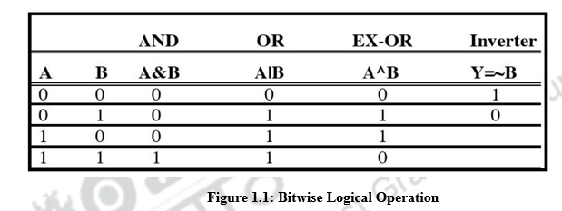
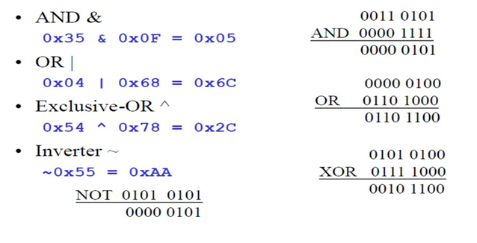
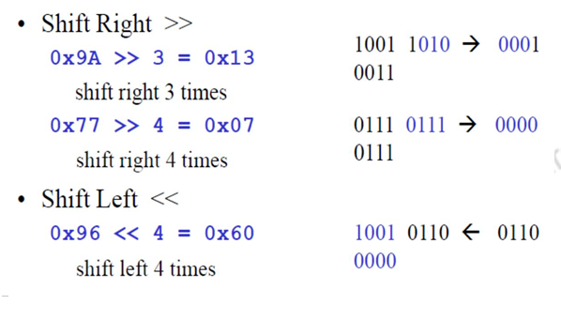
Bitwise Operations
There are two bit-wise shift operators in C:
shift right ( »), and shift left («)

Slide 10
Logical operations example code
#include <reg51.h>
void main(void)
{
P0=0x35 & 0x0F; //ANDing
P1=0x04 | 0x68; //ORing
P2=0x54 ^ 0x78; //XORing
P0=~0x55; //inverting
P1=0x9A >> 3; //shifting right 3 0001 1101
P2=0x77 >> 4; //shifting right 4
P0=0x6 << 4; //shifting left 4
}

Slide 11
Write an 8051 C program to get bit P1.0 and send it to P2.7 after inverting it.
#include <reg51.h>
sbit inbit=P1^0;
sbit outbit=P2^7;
bit membit;
void main(void)
{
while (1)
{
membit=inbit; //get a bit from P1.0
outbit=~membit; //invert it and send it to P2.7
}
}

Slide 12
Data conversion

Slide 13
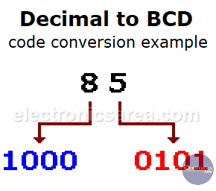
BCD
0 | 0000
1 | 0001
2 | 0010
3 | 0011
4 | 0100
5 | 0101
6 | 0110
7 | 0111
8 | 1000
9 | 1001
BCD is a form of binary encoding method
Each digit in a decimal number is represented in the form of binary bits.
Encoding can be done in either 4-bit or 8-bit (usually 4-bit is preferred).
Generally used in digital displays, calculators do all their calculations in BCD
RTC provides the time of day
Saves storage space compared to binary representations
Ease of use in coding, fewer computations and less computational errors.

Slide 14
ASCII
ASCII code is an alphanumeric code used for data communication in digital computers.
it uses eight bits to represent a letter or a punctuation mark.
keyboard, printers, and monitors all use ASCII
On ASCII keyboards, when press the key “0″ - 30H (011 0000) is forward to CPU, Similarly, 31H (011 0001) is provided for the key “1″

Slide 15
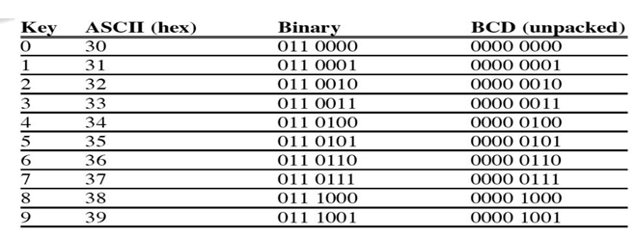
Data conversion
Decimal number into BCD
Packed BCD to ASCII conversion
ASCII to packed BCD conversion
Binary to decimal and ASCII conversion in C
Checksum byte in ROM

Slide 16
Write a C program to convert 8 bit BCD number (29) into ASCII Code

Slide 17
Convert 29 into ASCII character 32 and 39 for display in LCD
#include <reg51.h>
void main(void)
{
unsigned char x,y,z;
unsigned char mybyte=0x29;
x=mybyte&0x0F; → X=09
P1=x|0x30; → P=39
y=mybyte&0xF0; → X=20
y=y>>4; → Y=02 shift right
P1=y|0x30; → P1 = 32
}

Slide 18
Write an 8051 C program to convert ASCII digits of ‘4’ and ‘7’ to packed BCD and display them on P1.
#include <reg51.h>
void main(void)
{
unsigned char bcdbyte;
unsigned char w=‘4’; → 34
unsigned char z=‘7’; → 37
w=w&0x0F; → 04
w=w<<4; →40
z=z&0x0F; → 07
bcdbyte=w|z; → 47
P1=bcdbyte;
}

Slide 19
Write an 8051 C program to convert 11111101 (FD hex) to decimal and display the digits on P0, P1 and P2.
#include <reg51.h>
void main(void) {
unsigned char number = 0xFD; // Hexadecimal FD (253 in decimal)
unsigned char hundreds, tens, ones;
unsigned char decimal_value = number; // 253 in decimal
// Calculate the hundreds, tens, and ones digits
hundreds = decimal_value / 100; // Get the hundreds digit
decimal_value = decimal_value % 100; // Remainder after removing hundreds
tens = decimal_value / 10; // Get the tens digit
ones = decimal_value % 10; // Get the ones digit
// Display the digits on P0, P1, and P2
P0 = hundreds; // Display the hundreds digit on P0
P1 = tens; // Display the tens digit on P1
P2 = ones; // Display the ones digit on P2
while (1); // Infinite loop to keep the program running
}

Slide 20
Write an 8051 C program to convert hexadecimal value FF into decimal, BCD and ASCII format

Slide 21
Write an 8051 C program to calculate the checksum byte for the data 25H, 62H, 3FH, and 52H.
Steps to calculate Checksum byte in ROM are:
1. Add the bytes together and drop carries.
2. Take the 2’s complement (invert and then add 1) of the total sum. This is the Checksum byte, which becomes the last byte of the series.

Slide 22
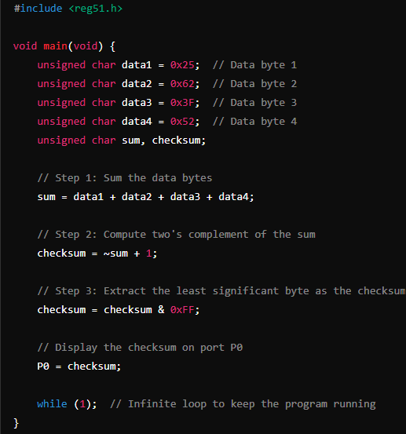

Slide 23
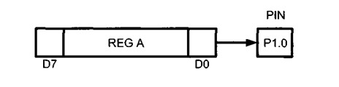
Data serialization with I/O ports.
Serializing data is a way of sending a byte of data one bit at a time through a single pin of microcontroller.
There are two ways to transfer a byte of data serially:
Serializing data and transfer data the one bit a time through bit wise data transfer method
Using the serial port

Slide 24
Write A C Program To Send Out The Value 44H Serially One Bit At A Time Via P1.0. The LSB Should Go Out First.
#include <reg51.h>
sbit P1b0 = P1^0;
sbit regALSB = ACC^0;
void main(void) {
unsigned char conbyte = 0x44;
unsigned char x;
ACC = conbyte;
for (x=0; x<8; x++) {
P1b0 = regALSB;
ACC = ACC >> 1; }
}

