Slide 1
Interrupts Programming

Slide 2
Introduction
An interrupt is an external or internal event that interrupts the microcontroller to inform it that a device needs its service.
Whenever any device needs its service, the device notifies the microcontroller by sending it an interrupt signal
Upon receiving an interrupt signal, the microcontroller interrupts whatever it is doing and serves the device.
The program which is associated with the interrupt is called the interrupt service routine (ISR) or interrupt handler.
When an interrupt is invoked, the microcontroller runs the ISR. For every interruption,
- there is a fixed location in memory that contains the address of its ISR
- The group of memory locations set aside to hold the addresses of ISRs is called interrupt vector table

Slide 3
Steps in Executing Interrupts
Step 1: Upon activation of an interrupt, the microcontroller completes the instruction it is executing and saves the address of the next instruction on the stack.
Step 2: The current status of all the interrupts are saved internally.
Step 3: The microcontroller gets the address of the ISR from the interrupt vector table and jumps to it
It starts to execute the interrupt service subroutine until it reaches the last instruction of the subroutine which is RETI (return from interrupt)
Step 4: Upon executing the RETI instruction, the microcontroller returns to the place where it was interrupted
It gets the program counter (PC) address from the stack
Then it starts to execute from that address

Slide 4
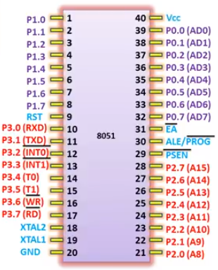
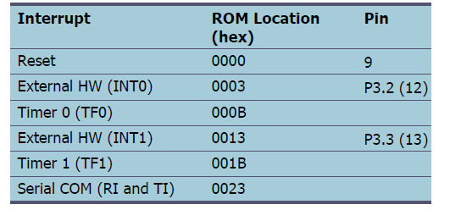
Interrupts

Slide 5
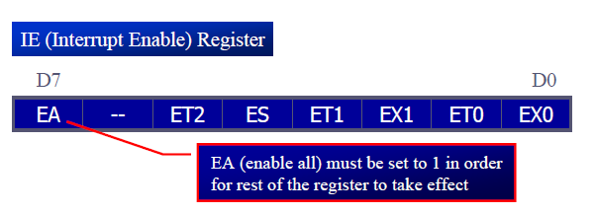
Enabling and Disabling an Interrupt
Upon reset, all interrupts are disabled.
The interrupts must be enabled by software in order for the microcontroller to respond to them
IE (interrupt enable) register is responsible for enabling and disabling the interrupts.

Slide 6
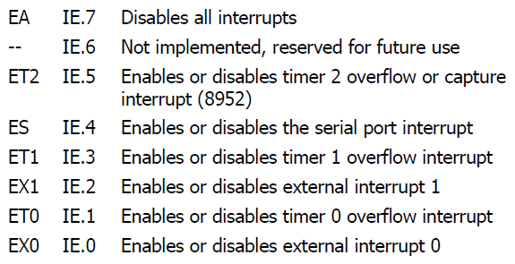

Slide 7
To enable an interrupt, :
Bit D7 of the IE register (EA) must be set to high to allow the rest of register to take effect
If EA = 1, interrupts are enabled and will be responded to if their corresponding bits in IE are high
If EA = 0, no interrupt will be responded to, even if the associated bit in the IE register is high

Slide 8
Timer Interrupts
If the timer interrupt in the IE register is enabled, whenever the timer rolls over, TF is raised, and the microcontroller is interrupted in whatever it is doing, and jumps to the interrupt vector table to service the ISR.

Slide 9
External Hardware Interrupts
Pin 12 (P3.2) and pin 13 (P3.3) of the 8051, designated as INT0 and INT1, are used as external hardware interrupts.
There are two activation levels for the external hardware interrupts
Level triggered
Edge triggered

Slide 10
Level – Triggered Interrupt
In the level-triggered mode, INT0 and INT1 pins are normally high
If a low-level signal is applied to them, it triggers the interrupt.
Then the microcontroller stops whatever it is doing and jumps to the interrupt vector table to service that interrupt.
The signal at the INT pin must be removed before the execution of the last instruction of the ISR, RETI; otherwise, another interrupt will be generated

Slide 11

Edge - Triggered Interrupt
To make INT0 and INT1 edge-triggered interrupts, we must program the bits of the TCON register.
The TCON register holds the IT0 and IT1 flag bits that determine level- or edge-triggered mode of the hardware interrupt.
They are also referred to as TCON.0 and TCON.2 since the TCON register is bit addressable

Slide 12
Sampling Edge – Triggered Interrupt
In edge-triggered interrupts the external source must be held high for at least one machine cycle, and then held low for at least one machine cycle.
The falling edge of pins INT0 and INT1 are latched by the 8051 and are held by the TCON.1 and TCON.3 bits of TCON register
Function as interrupt-in-service flags
It indicates that the interrupt is being serviced now and on this INTn pin, and no new interrupt will be responded to until this service is finished.
When the ISRs are finished, TCON.1 and TCON.3 are cleared, indicating that the interrupt is finished and the 8051 is ready to respond to another interrupt on that pin

Slide 13
Serial Communication Interrupts
TI (transfer interrupt) is raised when the last bit of the framed data, the stop bit, is transferred, indicating that the SBUF register is ready to transfer the next byte
RI (received interrupt) is raised when the entire frame of data, including the stop bit, is received
In the 8051 there is only one interrupt set aside for serial communication
This interrupt is used to both send and receive data
If the interrupt bit in the IE register (IE.4) is enabled, when RI or TI is raised the 8051 gets interrupted and jumps to memory location 0023H to execute the ISR

Slide 14

The TCON register holds four of the interrupt flags
The SCON register has the RI and TI flags

Slide 15
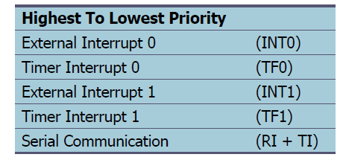
Interrupt Priority

Slide 16
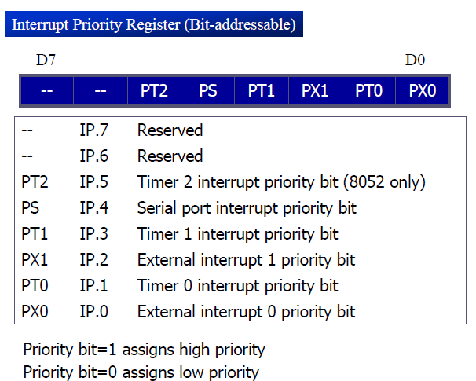
We can alter the sequence of interrupt priority by assigning a higher priority to any one of the interrupts by programming a register called IP (interrupt priority).

