Slide 1
THE 8051 MICROCONTROLLER AND EMBEDDED SYSTEMS
8051 TIMER PROGRAMMING IN ASSEMBLY

Slide 2
OBJECTIVES
List the timers of the 8051 and their associated registers
Describe the various modes of the 8051 timers
Program the 8051 timers in Assembly to generate time delay

Slide 3
PROGRAMMING 8051 TIMERS
Basic registers of the timer
  Timer 0 and Timer 1 are 16 bits wide
  each 16-bit timer is accessed as two separate registers of low byte and high byte.

Slide 4
PROGRAMMING 8051 TIMERS
Timer 0 registers
  low byte register is called TL0 (Timer 0 low byte) and the high byte register is referred to as TH0 (Timer 0 high byte)
  can be accessed like any other register, such as A, B, R0, R1, R2, etc.
  "MOV TL0, #4 FH" moves the value 4FH into TL0
  "MOV R5, TH0" saves TH0 (high byte of Timer 0) in R5

Slide 5
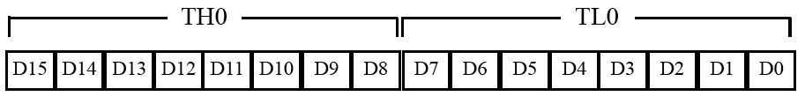
PROGRAMMING 8051 TIMERS
Figure 9–1 Timer 0 Registers

Slide 6
PROGRAMMING 8051 TIMERS
Timer 1 registers
  also 16 bits
  split into two bytes TL1 (Timer 1 low byte) and TH1 (Timer 1 high byte)
  accessible in the same way as the registers of Timer 0.

Slide 7
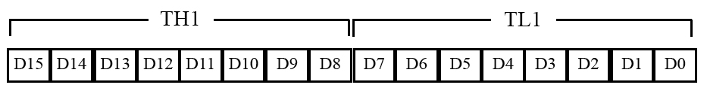
PROGRAMMING 8051 TIMERS
Figure 9–2 Timer 1 Registers

Slide 8
PROGRAMMING 8051 TIMERS
TMOD (timer mode) register
  timers 0 and 1 use TMOD register to set operation modes
  8-bit register
  lower 4 bits are for Timer 0
  upper 4 bits are for Timer 1
  lower 2 bits are used to set the timer mode
  upper 2 bits to specify the operation

Slide 9
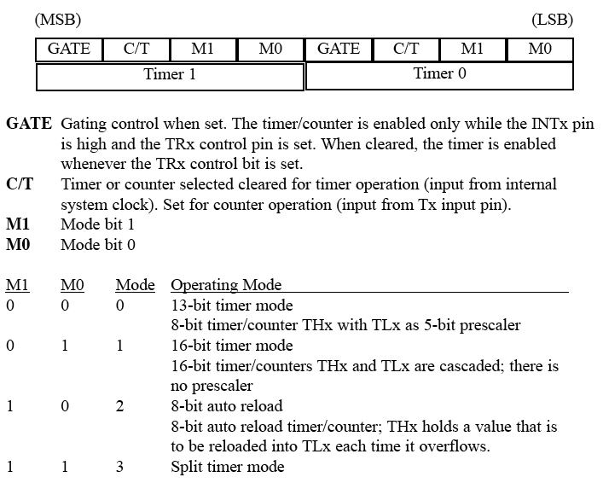
PROGRAMMING 8051 TIMERS
Figure 9–3 TMOD Register

Slide 10
PROGRAMMING 8051 TIMERS
Clock source for timer
  timer needs a clock pulse to tick
  if C/T = 0, the crystal frequency attached to the 8051 is the source of the clock for the timer
  frequency for the timer is always 1/12th the frequency of the crystal attached to the 8051
  XTAL = 11.0592 MHz allows the 8051 system to communicate with the PC with no errors

Slide 11
PROGRAMMING 8051 TIMERS
Mode 1 programming
  16-bit timer, values of 0000 to FFFFH
  TH and TL are loaded with a 16-bit initial value
  timer started by "SETB TR0" for Timer 0 and "SETB TR1" for Timer l
  timer count ups until it reaches its limit of FFFFH
  rolls over from FFFFH to 0000H
  sets TF (timer flag)
  when this timer flag is raised, can stop the timer with "CLR TR0" or "CLR TR1“
  after the timer reaches its limit and rolls over, the registers TH and TL must be reloaded with the original value and TF must be reset to 0

Slide 12
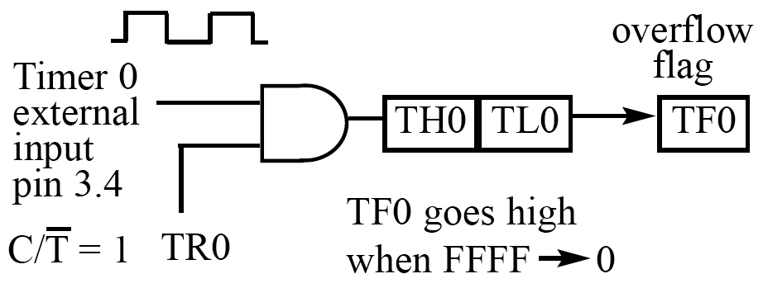
PROGRAMMING 8051 TIMERS
Figure 9–5a Timer 0 with External Input (Mode 1)

Slide 13
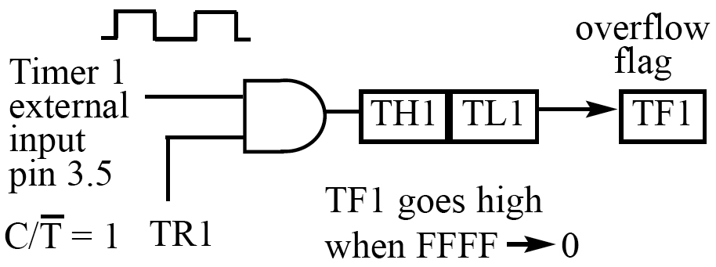
PROGRAMMING 8051 TIMERS (for information only)
Figure 9–5b Timer 1 with External Input (Mode 1)

Slide 14
PROGRAMMING 8051 TIMERS
Steps to program in mode 1
  Set timer mode 1 or 2
  Set TL0 and TH0 (for mode 1 16 bit mode)
  Set TH0 only (for mode 2 8 bit auto reload mode)
  Run the timer
  Monitor the timer flag bit

Slide 15
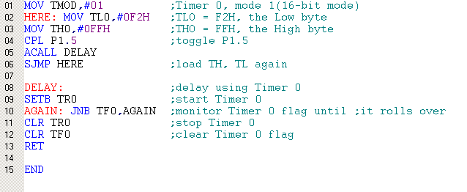
Example
In the following program, we are creating a square wave of 50% duty cycle (with equal portions high and low) on the P1.5 bit.
Timer 0 is used to generate the time delay

Slide 16
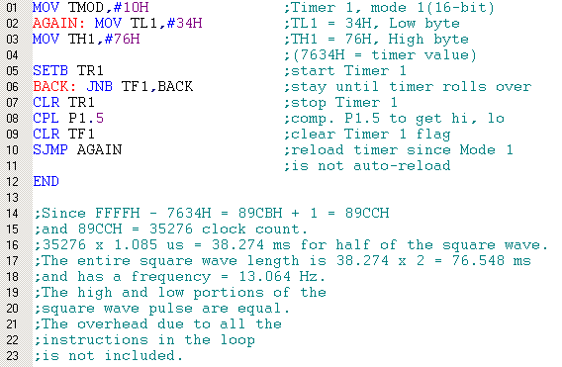
Example
The following program generates a square wave on pin P 1.5 continuously using Timer 1 for a time delay. Find the frequency of the square wave if XTAL = 11.0592 MHz. In your calculation do not include the overhead due to the timer setup instructions in the loop.

Slide 17
SECTION 9.1: PROGRAMMING 8051 TIMERS
Finding values to be loaded into the timer
  XTAL = 11.0592 MHz (12MHz)
  divide the desired time delay by 1.085μs (1μs) to get n
  65536 – n = N
  convert N to hex yyxx
  set TL = xx and TH = yy

Slide 18
Example
Assuming XTAL = 11.0592 MHz, write a program to generate a square wave of 50 Hz frequency on pin P2.3.
T = 1/50 Hz = 20 ms
1/2 of it for the high and low portions of the pulse = 10 ms
10 ms / 1.085 us = 9216
65536 - 9216 = 56320 in decimal = DC00H
TL = 00 and TH = DCH
The calculation for 12MHz crystal uses the same steps

Slide 19
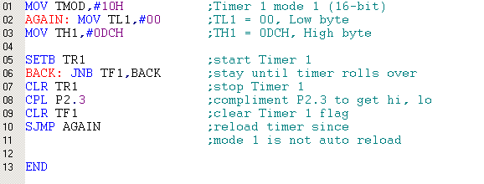
Example (cont)
Assuming XTAL = 11.0592 MHz, write a program to generate a square wave of 50 Hz frequency on pin P2.3.

Slide 20
PROGRAMMING 8051 TIMERS
Generating a large time delay
  size of the time delay depends
    crystal frequency
    timer's 16-bit register in mode 1
  largest time delay is achieved by making both TH and TL zero
  what if that is not enough?

Slide 21
PROGRAMMING 8051 TIMERS
Using Windows calculator to find TH, TL
  Windows scientific calculator can be use to find the TH, TL values
  Lets say we would like to find the TH, TL values for a time delay that uses 35,000 clocks of 1.085μs
    open scientific calculator and select decimal
    enter 35,000
    select hex - converts 35,000 to hex 88B8H
    select +/- to give -35000 decimal (7748H)
    the lowest two digits (48) of this hex value are for TL and the next two (77) are for TH

Slide 22
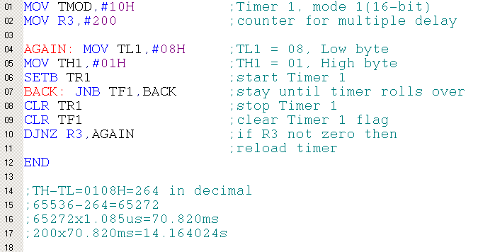
Example
Examine the following program and find the time delay in seconds. Exclude the time delay due to the instructions in the loop.

Slide 23
PROGRAMMING 8051 TIMERS (for information only)
Mode 0
  works like mode 1
  13-bit timer instead of 16­bit
  13-bit counter hold values 0000 to 1FFFH
  when the timer reaches its maximum of 1FFFH, it rolls over to 0000, and TF is set

Slide 24
PROGRAMMING 8051 TIMERS
Mode 2 programming
  8-bit timer, allows values of 00 to FFH
  TH is loaded with the 8-bit value
  a copy is given to TL
  timer is started by ,"SETB TR0" or "SETB TR1“
  starts to count up by incrementing the TL register
  counts up until it reaches its limit of FFH
  when it rolls over from FFH to 00, it sets high TF
  TL is reloaded automatically with the value in TH
  To repeat, clear TF
  mode 2 is an auto-reload mode

Slide 25
PROGRAMMING 8051 TIMERS
Steps to program in mode 2
  load TMOD, select mode 2
  load the TH
  start timer
  monitor the timer flag (TF) with "JNB”
  get out of the loop when TF=1
  clear TF
  go back to Step 4 since mode 2 is auto-reload

Slide 26
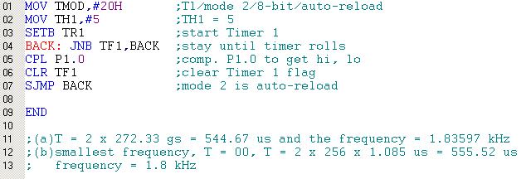
Example
Assuming that XTAL = 11.0592 MHz, find (a) the frequency of the square wave generated on pin P1.0 and (b) the smallest frequency achievable in this program, and the TH value to do that.

Slide 27
PROGRAMMING 8051 TIMERS
Assemblers and negative values
  can let the assembler calculate the value for TH and TL which makes the job easier
  "MOV TH1, # -100", the assembler will calculate the -100 = 9CH
  "MOV TH1,#high(-10000) "
  "MOV TL1,#low(-10000) "

Slide 28
COUNTER PROGRAMMING (for information only)
C/T bit in TMOD register
  used as a timer, the 8051's crystal is used as the source of the fre­quency
  used as a counter, pulse outside the 8051 increments the TH, TL registers
  counter mode, TMOD and TH, TL registers are the same as for the timer
  timer modes are the same as well

Slide 29
COUNTER PROGRAMMING (for information only)
C/T bit in TMOD register
  C/T bit in the TMOD register decides the source of the clock for the timer
  C/T = 0, timer gets pulses from crystal
  C/T = 1, the timer used as counter and gets pulses from outside the 8051
  C/T = 1, the counter counts up as pulses are fed from pins 14 and 15
  pins are called T0 (Timer 0 input) and T1 (Timer 1 input)
  these two pins belong to port 3
  Timer 0, when C/T = 1, pin P3.4 provides the clock pulse and the counter counts up for each clock pulse coming from that pin
  Timer 1, when C/T = 1 each clock pulse coming in from pin P3.5 makes the counter count up

Slide 30
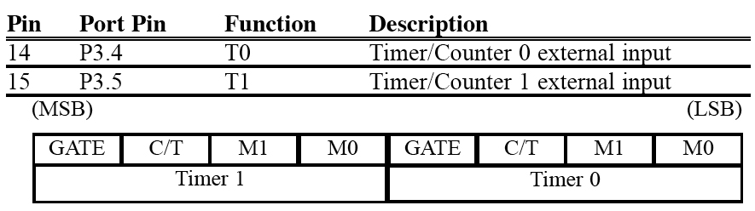
COUNTER PROGRAMMING
Table 9–1 Port 3 Pins Used For Timers 0 and 1

Slide 31
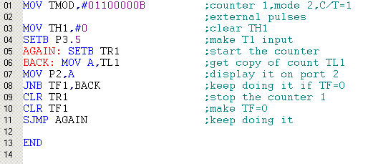
Example 18
Assuming that clock pulses are fed into pin T1, write a program for counter 1 in mode 2 to count the pulses and display the state of the TL1 count on P2. (for information only)
to LEDs
P2 is connected to 8 LEDs and input T1 to pulse.

Slide 32
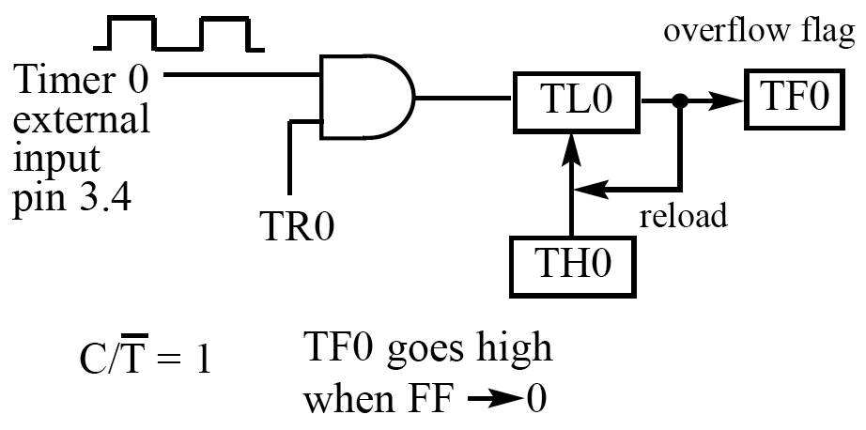
COUNTER PROGRAMMING
Figure 9–6 Timer 0 with External Input (Mode 2)

Slide 33
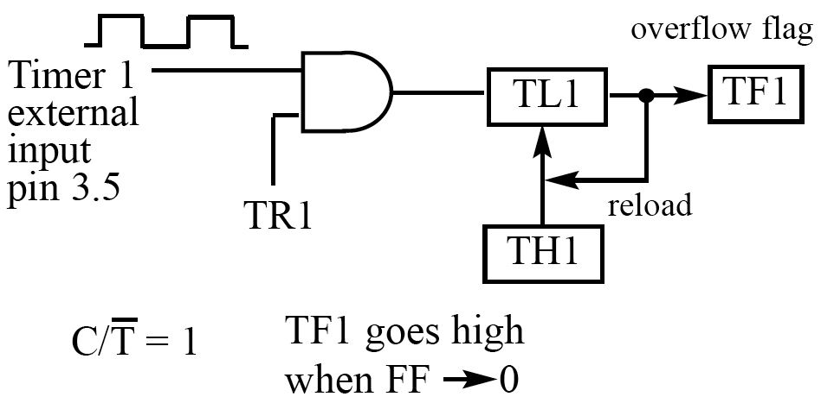
COUNTER PROGRAMMING
Figure 9–7 Timer 1 with External Input (Mode 2)

Slide 34
COUNTER PROGRAMMING

Slide 35
COUNTER PROGRAMMING

Slide 36
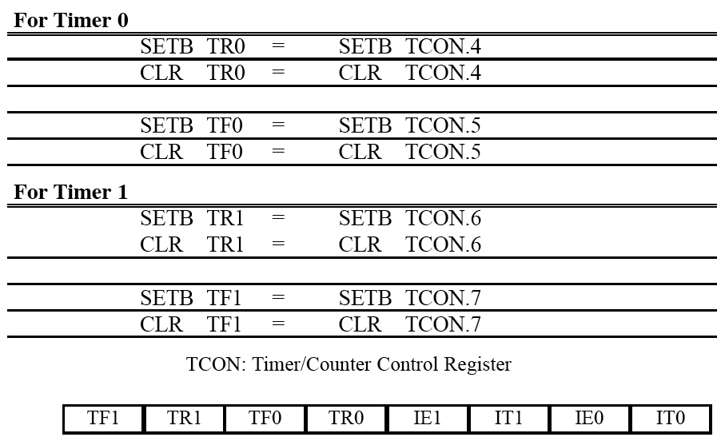
COUNTER PROGRAMMING
Table 9–1 Port 3 Pins Used For Timers 0 and 1

Slide 37
COUNTER PROGRAMMING
TCON register
  TR0 and TR1 flags turn on or off the timers
  bits are part of a register called TCON (timer control)
  upper four bits are used to store the TF and TR bits of both Timer 0 and Timer 1
  lower four bits are set aside for controlling the interrupt bits
  "SETB TRl" and "CLR TRl“
  "SETB TCON. 6" and "CLR TCON. 6“

Slide 38
COUNTER PROGRAMMING
Table 9–2 Equivalent Instructions for the Timer Control Register (TCON)

Slide 39
COUNTER PROGRAMMING
The case of GATE = 1 in TMOD
  GATE = 0, the timer is started with instructions "SETB TR0" and "SETB TR1“
  GATE = 1, the start and stop of the timers are done externally through pins P3.2 and P3.3
  allows us to start or stop the timer externally at any time via a simple switch

Slide 40
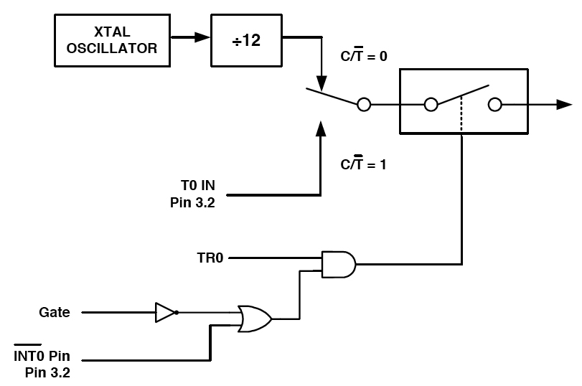
COUNTER PROGRAMMING
Figure 9–8 Timer/Counter 0

Slide 41
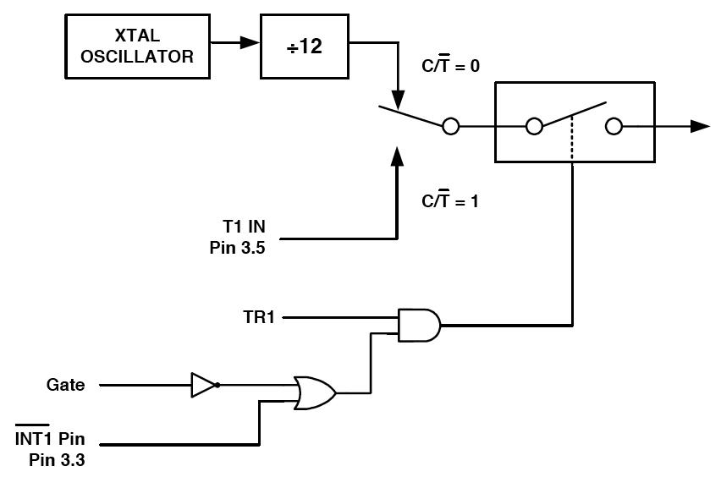
COUNTER PROGRAMMING
Figure 9–9 Timer/Counter 1

Slide 42


