Slide 1

Microprocessor & Microcontrollers
Chapter 11 Interrupts Programming
Engr. Rashid Farid Chishti
Faculty of Engineering & Technology
International Islamic University Islamabad
Mobile: +92 321 5300 497
e-mail: chishti@iiu.edu.pk

Slide 2
Interrupts VS. Polling
An interrupt is an external or internal event that interrupts the microcontroller to inform it that a device needs its service.
A microcontroller can serve other devices by two ways
Interrupts
Whenever any device needs its service, the device notifies the microcontroller by sending it an interrupt signal
Upon receiving an interrupt signal, the microcontroller interrupts whatever it is doing and serves the device
The program which is associated with the interrupt is called the interrupt service routine (ISR) or interrupt handler

Slide 3
Interrupts VS. Polling
Polling
The microcontroller continuously monitors the status of a given device.
When the conditions met, it performs the service
After that, it moves on to monitor the next device until every one is serviced.
Polling can monitor the status of several devices and serve each of them as certain conditions are met.
The polling method is not efficient, since it wastes much of the microcontroller’s time by polling devices that do not need service.
e.g. while(TI == 0);

Slide 4
Interrupts VS. Polling
The advantage of interrupts is that the microcontroller can serve many devices (not all at the same time)
Each devices can get the attention of the micro-controller based on the assigned priority
For the polling method, it is not possible to assign priority since it checks all devices in a round-robin fashion.
The microcontroller can also ignore (mask) a device request for service
This is not possible for the polling method

Slide 5
Interrupt Service Routine
For every interrupt, there must be an interrupt service routine (ISR), or interrupt handler
When an interrupt is invoked, the microcontroller runs the interrupt service routine
For every interrupt, there is a fixed location in memory that holds the address of its ISR
The group of memory locations set aside to hold the addresses of ISRs is called interrupt vector table
Upon activation of an interrupt, the microcontroller goes through the following steps

Slide 6
Steps in Executing an Interrupt
Upon activation of an interrupt, the microcontroller goes through the following steps
It finishes the instruction it is executing and saves the address of the next instruction (PC) on the stack
It also saves the current status of all the interrupts internally (i.e: not on the stack)
It jumps to a fixed location in memory, called the interrupt vector table, that holds the address of the ISR

Slide 7
Steps in Executing an Interrupt
The microcontroller gets the address of the ISR from the interrupt vector table and jumps to it
It starts to execute the interrupt service subroutine until it reaches the last instruction of the subroutine which is RETI (return from interrupt)
Upon executing the RETI instruction, the microcontroller returns to the place where it was interrupted
First, it gets the program counter (PC) address from the stack by popping the top two bytes of the stack into the PC
Then it starts to execute from that address

Slide 8
Six Interrupts in 8051
Six interrupts are allocated as follows
Reset – power-up reset
Two interrupts are set aside for the timers: one for timer 0 and one for timer 1
Two interrupts are set aside for hardware external interrupts
P3.2 and P3.3 are for the external hardware interrupts INT0 (or EX1), and INT1 (or EX2)
Serial communication has a single interrupt that belongs to both receive and Transfer

Slide 9
Six Interrupts in 8051
Interrupt | ROM Location (Hex) | Pin
Reset | 0000 | 9
External Hardware (INT0) | 0003 | P3.2(12)
Timer 0 (TF0) | 000B
External Hardware (INT1) | 0013 | P3.3(13)
Timer 1 (TF1) | 001B
Serial Comm. (RI and TI) | 0023
Interrupt Vector Table

Slide 10
Enabling and Disabling an Interrupt
Upon reset, all interrupts are disabled (masked), meaning that none will be responded to by the microcontroller if they are activated
The interrupts must be enabled by software in order for the microcontroller to respond to them
There is a register called IE (interrupt enable) that is responsible for enabling (unmasking) and disabling (masking) the Interrupts.

Slide 11
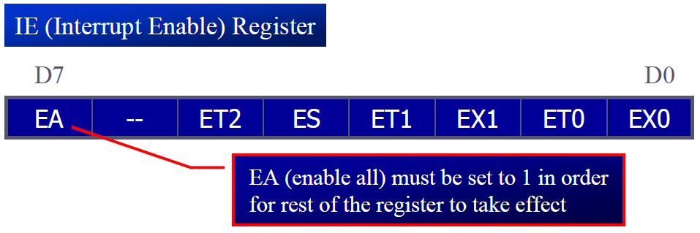
Enabling and Disabling an Interrupt
EA | IE.7 | Disables all interrupts
--- | IE.6 | Not implemented, reserved for future use
ET2 | IE.5 | Enables or disables timer 2 overflow or capture interrupt (8952)
ES | IE.4 | Enables or disables the serial port interrupt
ET1 | IE.3 | Enables or disables timer 1 overflow interrupt
EX1 | IE.2 | Enables or disables external interrupt 1
ET0 | IE.1 | Enables or disables timer 0 overflow interrupt
EX0 | IE.0 | Enables or disables external interrupt 0

Slide 12
Enabling and Disabling an Interrupt
To enable an interrupt, we take the following steps:
Bit D7 of the IE register (EA) must be set to high to allow the rest of register to take effect
The value of EA
If EA = 1, interrupts are enabled and will be responded to if their corresponding bits in IE are high
If EA = 0, no interrupt will be responded to, even if the associated bit in the IE register is high

Slide 13
Timer Interrupts
The timer flag (TF) is raised when the timer rolls over
In polling TF, we have to wait until the TF is raised
The problem with this method is that the microcontroller is tied down while waiting for TF to be raised, and can not do anything else
Using interrupts solves this problem and, avoids tying down the controller
If the timer interrupt in the IE register is enabled, whenever the timer rolls over, TF is raised, and the microcontroller is interrupted in whatever it is doing, and jumps to the interrupt vector table to service the ISR
In this way, the microcontroller can do other until it is notified that the timer has rolled over

Slide 14
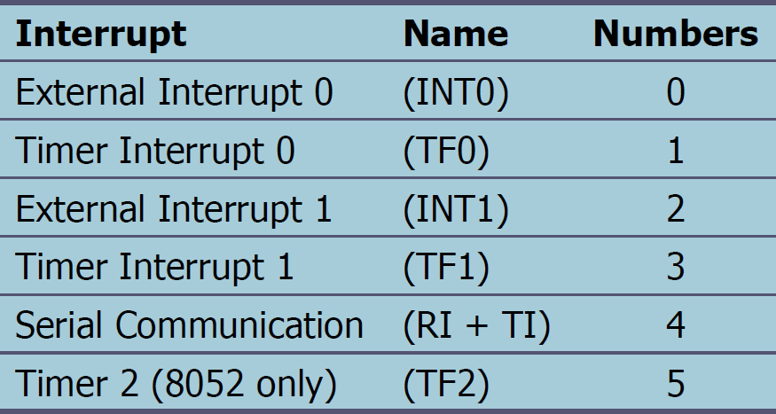
Interrupts Programming in C
The 8051 compiler have extensive support for the interrupts
They assign a unique number to each of the 8051 interrupts
It can assign a register bank to an ISR
This avoids code overhead due to the pushes and pops of the R0 – R7 registers

Slide 15
Serial Port Programming in C
Example 11-14: Write a C program that continuously gets a single bit of data from P1.7 and sends it to P1.0, while simultaneously creating a square wave of 200 μs period on pin P2.5. Use Timer 0 to create the square wave. Assume that XTAL = 11.0592 MHz.
// We will use timer 0 mode 2 (auto-reload). One half of the
// period is 100 μs. 100/1.085 μs = 92, and TH0=256-92=164=A4H
#include <reg51.h>
sbit SW = P1^7;
sbit IND = P1^0;
sbit WAVE = P2^5;
void timer0(void) interrupt 1 {
WAVE = ~WAVE; // toggle pin
}
void main() {
SW=1; // make switch input
TMOD=0x02;
TH0=0xA4; // TH0=-92
IE=0x82; // enable interrupt for timer 0
TR0 = 1;
while (1)
IND = SW; // send switch to LED
}

Slide 16
Serial Port Programming in C
Example 11-16: Write a C program using interrupts to do the following:
(a) Receive data serially and send it to P0
(b) Read port P1, transmit data serially, and give a copy to P2
(c) Make timer 0 generate a square wave of 5 kHz frequency on P0.1
Assume that XTAL = 11.0592 MHz. Set the baud rate at 4800.
#include <reg51.h>
sbit WAVE = P0^1;
void timer0() interrupt 1 {
WAVE = ~WAVE; // toggle pin
}
void serial() interrupt 4 {
if (TI==1)
TI = 0; // clear interrupt
else
{
P0 = SBUF; // put value on pins
RI = 0; // clear interrupt
}
}

Slide 17
void main()
{
unsigned char x;
P1 = 0xFF; // make P1 an input
TMOD = 0x22; // use timer 1 mode 2 for serial comm.
// and timer 0 mode 2 for frequency gen.
TH1 = 0xF6; // 4800 baud rate
SCON = 0x50; // serial mode 1, 1 start bit, 8 data bits
// 1 stop bit,
TH0 = 0xA4; // 5 kHz has T=200us
IE = 0x92; // enable global interrupts, serial and
// timer 0 interrupts.
TR1 = 1; // start timer 1
TR0 = 1; // start timer 0
while (1)
{
x = P1; // read Port 1
P2 = x; // Give copy to Port 2
}
}

Slide 18
External Hardware Interrupts
The 8051 has two external hardware interrupts
Pin 12 (P3.2) and pin 13 (P3.3) of the 8051, designated as INT0 and INT1, are used as external hardware interrupts
The interrupt vector table locations 0003H and 0013H are set aside for INT0 and INT1
There are two activation levels for the external hardware interrupts
Level trigged
Edge trigged

Slide 19
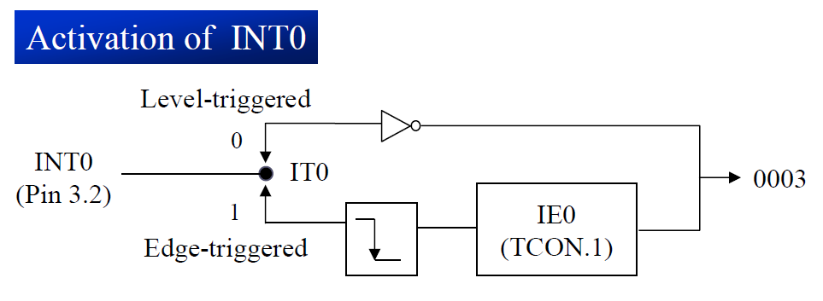
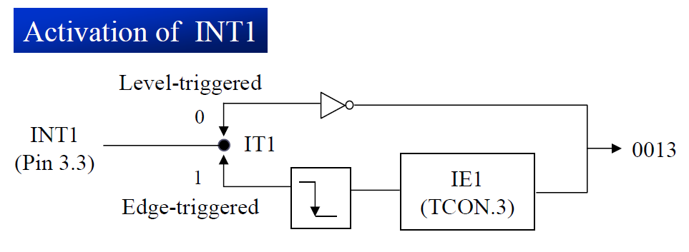
External Hardware Interrupts

Slide 20
Level Triggered Interrupt
In the level-triggered mode, INT0 and INT1 pins are normally high
If a low-level signal is applied to them, it triggers the interrupt
Then the microcontroller stops whatever it is doing and jumps to the interrupt vector table to service that interrupt
The low-level signal at the INT pin must be removed before the execution of the last instruction of the ISR, RETI; otherwise, another interrupt will be generated
This is called a level-triggered or level-activated interrupt and is the default mode upon reset of the 8051

Slide 21
Sampling Low Level-Triggered Interrupt
Pins P3.2 and P3.3 are used for normal I/O unless the INT0 and INT1 bits in the IE register are enabled
After the hardware interrupts in the IE register are enabled, the controller keeps sampling the INTn pin for a low-level signal once each machine cycle
According to one manufacturer’s data sheet,
The pin must be held in a low state until the start of the execution of ISR
If the INTn pin is brought back to a logic high before the start of the execution of ISR there will be no interrupt
If INTn pin is left at a logic low after the RETI instruction of the ISR, another interrupt will be activated after one instruction is executed

Slide 22
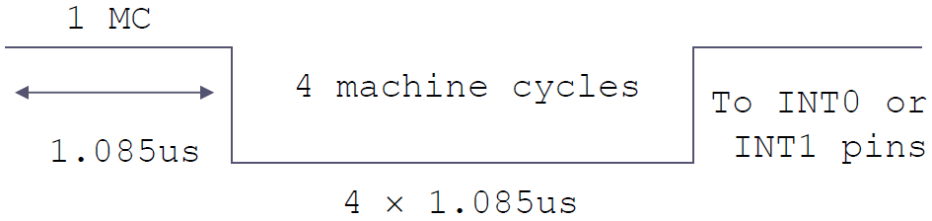
Sampling Low Level-Triggered Interrupt
To ensure the activation of the hardware interrupt at the INTn pin, make sure that the duration of the low-level signal is around 4 machine cycles, but no more
This is due to the fact that the level-triggered interrupt is not latched
Thus the pin must be held in a low state until the start of the ISR execution
note: On reset, IT0 (TCON.0) and IT1 (TCON.2) are both low, making external interrupt level-triggered

Slide 23
Serial Port Programming in C`
Example : Assume that the INT1 pin is connected to a switch that is normally high. Whenever it goes low, it should toggle an LED. The LED is
connected to P1.3 . When it is turned on it should stay on for a fraction of a second. As long as the switch is pressed low, the LED should toggle continuously.
#include <reg51.h>
sbit LED =P1^3;
unsigned char cnt;
void ext1() interrupt 1 {
unsigned int i;
LED = ~ LED;
for(i=0 ; i<0xFFFF ; i++);
}
void main() {
// IT1 = 1; // make external INT1 as falling edge triggered
IE=0x84; // enable external INT1 interrupts
while (1); // wait until interrupted
}

Slide 24
Edge-Triggered Interrupt
To make INT0 and INT1 edge-triggered interrupts, we must program the bits of the TCON register
The TCON register holds, among other bits, the IT0 and IT1 flag bits that determine level- or edge-triggered mode of the hardware interrupt
IT0 and IT1 are bits D0 and D2 of the TCON register
They are also referred to as TCON.0 and TCON.2 since the TCON register is bit-addressable

Slide 25
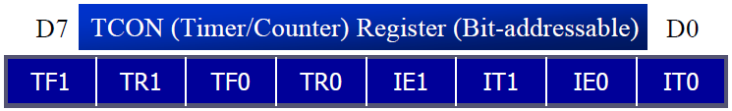
TF1 | TCON.7 | Timer 1 overflow flag. Set by hardware when timer/counter 1 overflows. Cleared by hardware as the processor vectors to the interrupt service routine
TR1 | TCON.6 | Timer 1 run control bit. Set/cleared by software to turn timer/counter 1 on/off
TF0 | TCON.5 | Timer 0 overflow flag. Set by hardware when timer/counter 0 overflows. Cleared by hardware as the processor vectors to the interrupt service routine
TR0 | TCON.4 | Timer 0 run control bit. Set/cleared by software to turn timer/counter 0 on/off
IE1 | TCON.3 | External interrupt 1 edge flag. Set by CPU when the external interrupt edge (H-to-L transition) is detected. Cleared by CPU when the interrupt is processed
IT1 | TCON.2 | Interrupt 1 type control bit. Set/cleared by software to specify falling edge/lowlevel triggered external interrupt
IE0 | TCON.1 | External interrupt 0 edge flag. Set by CPU when the external interrupt edge (H-to-L transition) is detected. Cleared by CPU when the interrupt is processed
IT0 | TCON.0 | Interrupt 0 type control bit. Set/cleared by software to specify falling edge/lowlevel triggered external interrupt

Slide 26
Serial Port Programming in C`
Example 11-17: Write a C program using interrupts to do the following:
(a) Generate a 10 KHz frequency on P2.1 using T0 8-bit auto-reload
(b) Use timer 1 as an event counter to count up a 1-Hz pulse and display it on P0. The pulse is connected to EX1.
Assume that XTAL = 11.0592 MHz. Set the baud rate at 9600.
#include <reg51.h>
sbit WAVE = P2^1;
void timer0() interrupt 1 {
WAVE = ~WAVE; } // toggle pin
void main(){
TH1 = 0;
TL1 = 0;
TMOD = 0x52;
TH0 = -46; // 10 KHz
IE = 0x82; // enable interrupts
TR0 = 1; // start timer 0
TR1 = 1; // start timer 1
while (1) // stay here
P0 = TL1;
}

Slide 27
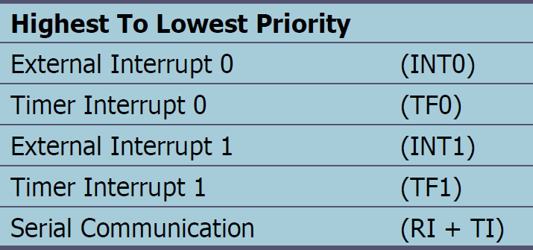
Interrupt Priority
When the 8051 is powered up, the priorities are assigned according to the following
In reality, the priority scheme is nothing but an internal polling sequence in which the 8051 polls the interrupts in the sequence listed and responds accordingly.

Slide 28
Interrupt Priority
Example 11-11: Discuss what happens if interrupts INT0, TF0, and INT1 are activated at the same time. Assume priority levels were set by the power-up reset and the external hardware interrupts are edge-triggered.
Solution: If these three interrupts are activated at the same time, they are latched and kept internally. Then the 8051 checks all five interrupts according to the sequence listed in Table 11-3. If any is activated, it services it in sequence. Therefore, when the above three interrupts are activated, IE0 (external interrupt 0) is serviced first, then timer 0 (TF0), and finally IE1 (external interrupt 1).

Slide 29
Interrupt Priority
We can alter the sequence of interrupt priority by assigning a higher priority to any one of the interrupts by programming a register called IP (interrupt priority)
To give a higher priority to any of the interrupts, we make the corresponding bit in the IP register high
When two or more interrupt bits in the IP register are set to high
While these interrupts have a higher priority than others, they are serviced according to the sequence of Table in slide 27

Slide 30
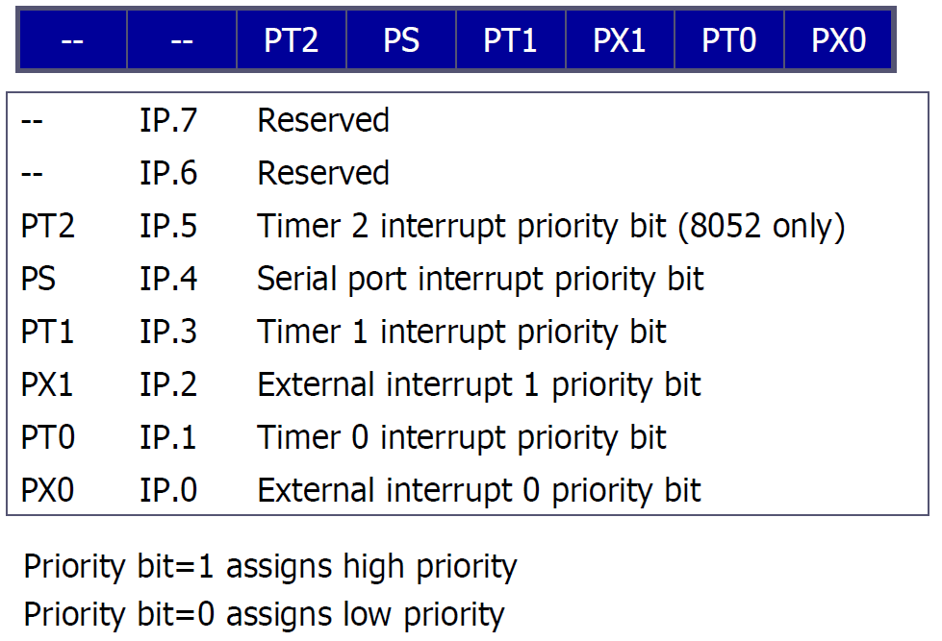
Interrupt Priority (IP) Register

Slide 31
THE End of Chapter 11

