Slide 1
MODULE 7
Interfacing with displays and sensors

Slide 2
Contents
Programming of keyboard interfacing
Programming of LEDs interfacing
Programming of seven-segment display interfacing
Interfacing circuit description and programming of
16 x 2 LCD
ADC
DAC
Temperature sensor interfacing

Slide 3
16 x 2 LCD interfacing with 8051 8-bit, 4-bit mode
LCD is short for Liquid Crystal Display.
Each LCD screen contains a matrix of pixels that together form an image on the screen.
The LCD is a flat panel display technology commonly used in consumer electronics.
The main advantage of using a character LCD instead of a seven-segment display and other multi-segment LEDs is that there is no limitation in displaying special & custom character animations.
Notes:
LCD is short for Liquid Crystal Display. Each LCD screen contains a matrix of pixels that together form an image on the screen. The LCD is a flat panel display technology commonly used in consumer electronics.

Slide 4
Off the 16 pins, eight are data pins through which data or commands are passed into the LCD registers.
16x2 LCD is one of the most used display unit.
The 16×2 LCD module consists of 2 rows, each with 16 columns, which can, in turn, each display 16 characters.
It supports all the ASCII chars and is basically used for displaying the alpha numeric characters.
Here each character is displayed in a matrix of 5x7 pixels.
Apart from alpha numeric chars it also provides the provision to display the custom characters by creating the pattern.

Slide 5
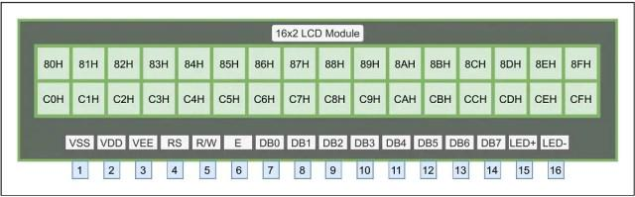
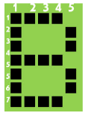
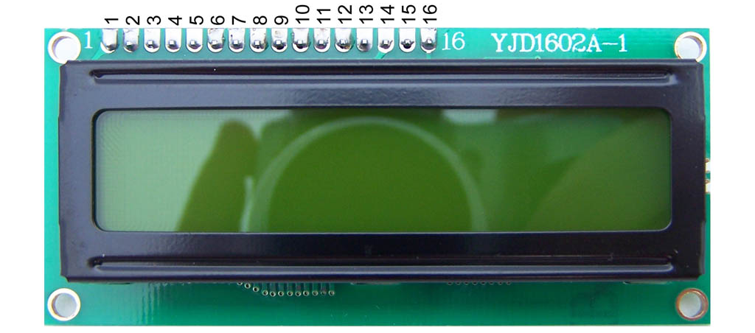
Pin diagram of an LCD module

Slide 6
Pin1 (VSS): Ground pin of the LCD module. (0V is given to this pin.)
Pin2 (VDD): Power to LCD module (+5V supply is given to this pin.)
Pin3 (VEE): Contrast adjustment pin. This is done by connecting the ends of a 10K potentiometer to +5V and ground and then connecting the slider pin to the VEE pin. The normal setting is between 0.4V and 0.9V.
Pin4 (RS): Register select pin.
The LCD module has two registers, namely, command register and data register.
RS = 1 implies that the data register is selected. RS = 0 implies that the command register is selected.
Pin5 (R/W): Read/Write modes.
Logic HIGH at this pin = read mode.
Logic LOW at this pin = write mode.
Pin6(E): Enables the LCD module.
A HIGH to LOW pulse at this pin will enable the module.
Pin7 (DB0) to Pin14 (DB7): The data pins.
The commands and data are fed to the LCD module through these pins.
They are 8-bit wide and called as the 8-bit data bus.
Pin15(LED+): Anode of the back-light LED.
Pin16(LED-): Cathode of the back-light LED.

Slide 7
The 16X2 LCD has two built in registers namely data register and command register.
Command Register - stores the command instructions given to the LCD. A command is an instruction given to LCD to do a predefined task like initializing, clearing the screen, setting the cursor position, controlling display etc.
Data Register - stores the data to be displayed on the LCD. The data is the ASCII value of the character to be displayed on the LCD.
For programming LCD follow these steps:
STEP1: Initialization of LCD.
STEP2: Sending command to LCD.
STEP3: Writing the data to LCD.

Slide 8
STEP1: Initialization of LCD.
38H or 00111000B:
It is used to interface LCD in an 8-bit mode (use eight pins to communicate).
It selects LCD of two rows and each character of a 5×7 matrix display.
28H or 00101000B:
Used to interface LCD in 4-bit mode (only four pins are used to communicate.)
0EH or 00001110B:
This command is used for Display ON and cursor ON function.
01H or 00000001B:
This command is used for the Clear Display function.
80H or 10000000B:
Each row consists of 16 characters, and each character has a unique address depending on the manufacturer.
To display any character in the LCD’s display, the first ASCII value is sent to the address of the first character into the command register.
After this, the cursor automatically increments by one and moves to the next character position.
SStep1: LCD initialization tep1: LCD initialization

Slide 9
Code (Hex) | Command to LCD
0x01 | Clear the display screen
0x06 | Shift the cursor right
0x0C | Display on, cursor off
0x0E | Display on, cursor blinking
0x80 | Force the cursor to the beginning of the 1st line
0xC0 | Force the cursor to the beginning of the 2nd line
0x10 | Shift cursor position to the left
0x14 | Shift cursor position to the right
0x18 | Shift entire display to the left
0x1C | Shift entire display to the right
0x38 | 2 lines, 5×8 matrix, 8-bit mode
0x28 | 2 lines, 5×8 matrix, 4-bit mode
0x30 | 1 line, 8-bit mode
0x20 | 1 line, 4-bit mode

Slide 10
Step2: Sending command to LCD
Send the command data to command register
Make R/W low.
Make RS=0 if data byte is a command
Pulse EN from high to low with some delay.
Repeat above steps for sending another data.
void LCD_CMD(unsigned char CMD)
{
P2=CMD;
RS=0;
RW=0;
EN=1;
DELAY_ms(5);
EN=0;
}

Slide 11
Step3: Writing the data to LCD
Place data byte on the data register.
Make R/W low.
make RS=1 if the data byte is a data to be displayed.
Pulse EN from high to low with some delay.
Repeat above steps for sending another data.
void LCD_DATA(unsigned char DATA)
{
P2=DATA;
RS=1;
RW=0;
EN=1;
DELAY_ms(5);
EN=0;
}

Slide 12
Lab Tasks
Write an 8051 C program to display “SENSE” in the 16*2 LCD display interfaced to the 8051.
Write an 8051 C program to display “VIT - CHENNAI” in the first line and “SENSE” in the second line of 16*2 LCD display interfaced to the 8051. (8-bit mode of operation)
Repeat the above code with 4-bit mode of operation.

Slide 13
KEYBOARD INTERFACING
Keys are organized in a matrix of rows and columns
The CPU accesses both rows and columns through ports.
The CPU accesses both rows and columns through ports; therefore, with two 8-bit ports, an 8 x 8 matrix of keys can be connected to a microprocessor.
When a key is pressed, a row and a column make a contact.

Slide 14
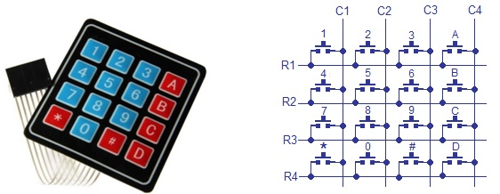
A 4x4 matrix connected to two ports
The rows are connected to an output port and the columns are connected to an input port

Slide 15
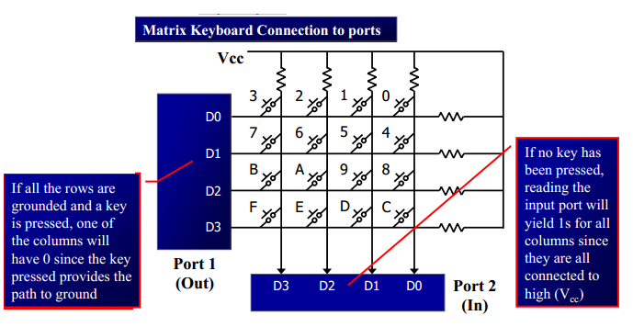

Slide 16
It is the function of the microcontroller to scan the keyboard continuously to detect and identify the key pressed
To detect a pressed key, the microcontroller grounds all rows by providing 0 to the output latch, then it reads the columns
If the data read from columns is D3 –D0 = 1111, no key has been pressed and the process continues till key press is detected
If one of the column bits has a zero, this means that a key press has occurred
It grounds a row, reads the columns, and checks for any zero, this process continues for the next row.
After identification of the row in which the key has been pressed it find out which column the pressed key belongs to.
It grounds the next row, reads the columns, and checks for any zero, this process continues until the row is identified
After identification of the row in which the key has been pressed it find out which column the pressed key belongs to.

Slide 17
Identify the row and column of the pressed key for
(a) D3 – D0 = 1110 for the row, D3 – D0 = 1011 for the column
(b) D3 – D0 = 1101 for the row, D3 – D0 = 0111 for the column
Answer : (a) 2 (b) 7

Slide 18
Steps for key press identification
Initially all switches are assumed to be released. So there is no connection between the rows and columns.
When any one of the switches are pressed, the corresponding row and column are connected (short circuited). This will drive that column pin (initially high) low.
Using this logic, the button press can be detected. The colors red and black is for logic high and low respectively.

Slide 19
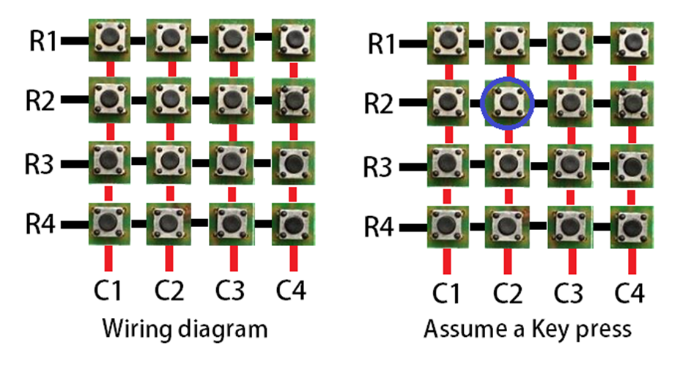
Step 1: The first step involved in interfacing the matrix keypad is to write all logic 0’s to the rows and all logic 1’s to the columns. In the image, black line symbolizes logic 0 and red line symbolizes logic 1.

Slide 20
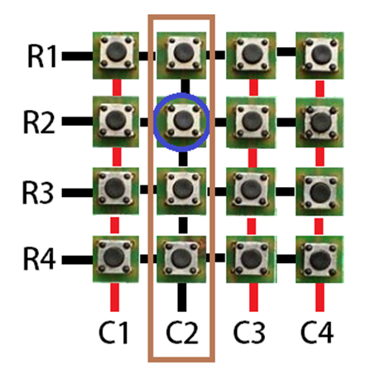
Step 2: Now the program has to scan the pins connected to columns of the keypad. If it detects a logic 0 in any one of the columns, then a key press was made in that column. This is because the event of the switch press shorts the C2 line with R2. Hence C2 is driven low.

Slide 21
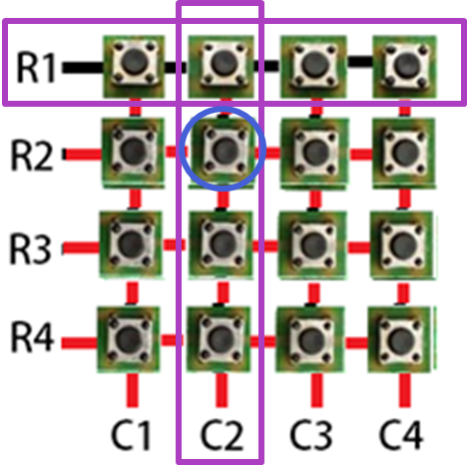
Step 3: Once the column corresponding to the key pressed is located, start writing logic 0’s to the rows sequentially (one after the other) and check if C2 becomes low.

Slide 22
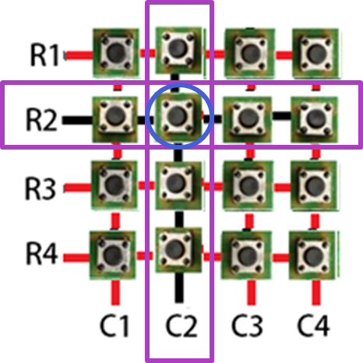
Step 4: The procedure is followed till C2 goes low when logic low is written to a row. In this case, a logic low to the second row will be reflected in the second column.
We already know that the key press happened at column 2. Now we have detected that the key is in row 2. So, the position of the key in the matrix is (2,2).
Once this is detected, its up to us to name it or provide it with a task on the event of the key press.

Slide 23
Keypad interface code
Note:
R1 – P1.0
R2 – P1.1
R3 – P1.2
R4 – P1.3
C1 – P0.0
C2 – P0.1
C3 – P0.2
C4 – P0.3
Steps for keypad interfacing:
Note: the key pressed is displayed on the LCD. Hence the LCD commands are also incorporated in keyboard interfacing.
Step 1: Define all the required pins for LCD and Keypad
Step 2: Write the delay code
Step 3: LCD interface commands
a. subroutine for LCD command
b. subroutine for LCD data
c. subroutine for loading string to LCD to request the key press
d. Subroutine for LCD initialization
RS= P3^7;
RW= P3^6;
EN= P3^5;

Slide 24
Step 4: Keypad interfacing
a. Write the subroutine to detect a key press for every row.
b. In the main code , detect the key press corresponding to the correct row for every column.
Note :
1. when no key is pressed, the default values for both rows and columns are usually set to a high logic level
2. When a key is pressed, it connects a specific row to a specific column, creating a path for current flow. This connection changes the voltage levels on the corresponding row and column lines.

Slide 25
Keypad interface code
#include<reg51.h>
#define display_port P2 //Data pins are connected to port 2 on the microcontroller
sbit RS= P3^7;
sbit RW= P3^6;
sbit EN= P3^5;
sbit C4 = P0^3; // Connecting keypad to Port 1
sbit C3 = P0^2;
sbit C2 = P0^1;
sbit C1 = P0^0;
sbit R4 = P1^3;
sbit R3 = P1^2;
sbit R2 = P1^1;
sbit R1 = P1^0;
Note:
R1 – P1.0
R2 – P1.1
R3 – P1.2
R4 – P1.3
C1 – P0.0
C2 – P0.1
C3 – P0.2
C4 – P0.3
RS= P3^7;
RW= P3^6;
EN= P3^5;

Slide 26
// Function for creating delay in milliseconds.
void msdelay(unsigned int time)
{
unsigned i,j ;
for(i=0;i<time;i++)
for(j=0;j<1275;j++);
}

Slide 27
//Function to send command instruction to LCD
void lcd_cmd(unsigned char command) {
display_port = command;
rs= 0;
rw=0;
e=1;
msdelay(1);
e=0;
}

Slide 28
//Function to send display data to LCD
void lcd_data(unsigned char disp_data)
{
display_port = disp_data;
rs= 1;
rw=0;
e=1;
msdelay(1);
e=0;
}

Slide 29
// loading the string value
void lcdstring(char *str)
{
while(*str)
{
lcd_data(*str);
str++;
}
}

Slide 30
//Function to prepare the LCD and get it ready
void lcd_init()
{
lcd_cmd(0x38); // for using 2 lines and 5X7 matrix of LCD
msdelay(10);
lcd_cmd(0x0F); // turn display ON, cursor blinking
msdelay(10);
lcd_cmd(0x01); //clear screen
msdelay(10);
lcd_cmd(0x80); // bring cursor to position 1 of line 1
msdelay(10);
}

Slide 31
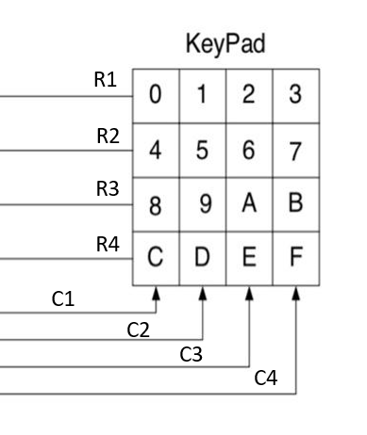
//Function for finding the row for column 1
void row_finder1() {
R1=R2=R3=R4=1;
C1=C2=C3=C4=0;
if(R1==0)
lcd_data('0');
if(R2==0)
lcd_data('4');
if(R3==0)
lcd_data('8');
if(R4==0)
lcd_data('C');
}

Slide 32
//Function for finding the row for column 2 void row_finder2() {
R1=R2=R3=R4=1;
C1=C2=C3=C4=0;
if(R1==0)
lcd_data('1');
if(R2==0)
lcd_data('5');
if(R3==0)
lcd_data('9');
if(R4==0)
lcd_data('D’); }

Slide 33
//Function for finding the row for column 3
void row_finder3() {
R1=R2=R3=R4=1;
C1=C2=C3=C4=0;
if(R1==0)
lcd_data('2');
if(R2==0)
lcd_data('6');
if(R3==0)
lcd_data('A');
if(R4==0)
lcd_data('E’); }

Slide 34
//Function for finding the row for column 4
void row_finder4() {
R1=R2=R3=R4=1;
C1=C2=C3=C4=0;
if(R1==0)
lcd_data('3');
if(R2==0)
lcd_data('7');
if(R3==0)
lcd_data('B');
if(R4==0)
lcd_data('F’); }

Slide 35
void main() {
lcd_init();
lcdstring("Please press key");
lcd_cmd(0xC0);
while(1)
{
msdelay(30);
C1=C2=C3=C4=1;
R1=R2=R3=R4=0;
if(C1==0)
row_finder1();
else if(C2==0)
row_finder2();
else if(C3==0)
row_finder3();
else if(C4==0)
row_finder4();
}
}

Slide 36
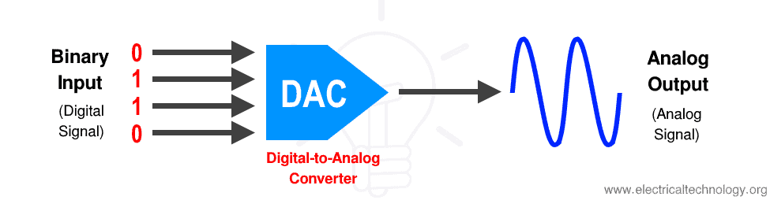
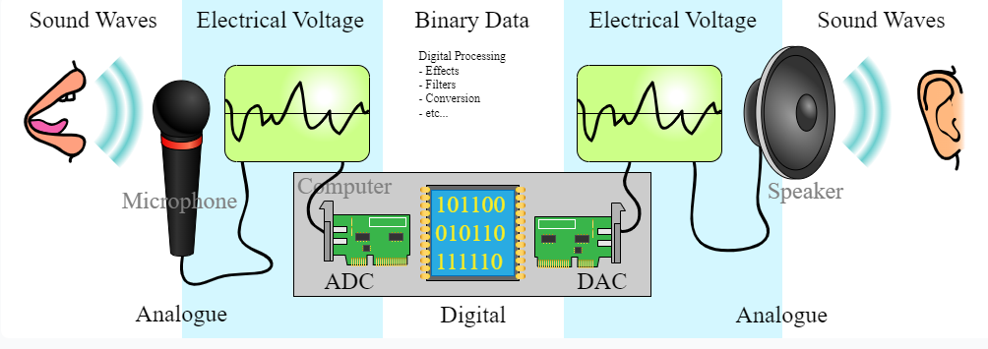
DAC INTERFACE
The digital-to-analog converter (DAC) is a device used to converts digital data into equivalent analog voltage/current.
DAC converting digital data into analog current
Most commonly used DAC is R/2R method due to high precision.
DAC resolutions (in bits): 8, 10, and 12 bits
21

Slide 37

The DAC0808 accepts an 8-bit digital input and converts it into a proportional analog current output.
current output range of 0 to 255 times the reference current (Iref)
I_{out} is the output current
D is the 8-bit digital input (0 to 255),
I _{ref} is the reference current.

Slide 38
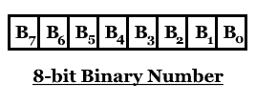
1->The bit weight is multiplied by the bit value. Since the bit could be either 0 or 1, it means;
Bit value of 1 x bit weight = 1 x 2^{n} = 2^{n}
Bit value of 0 x bit weight = 0 x 2^{(n-1)} = 0
2-> Now adding the weights of all the bits with its value in a binary number 10011;
1 0011₂ = (1 x 2⁴) + (0 x 2³) + (0 x 2²) + (1 x 2¹) + (1 x 2⁰)
10011₂ = 16 + 0 + 0 + 2 + 1
10011₂ = 19

Slide 39

DAC INTERFACE
The 8-bit DAC 0808 converts digital data into equivalent analog Current.
The total current provided by the I_{out} pin is as follows:
The I_{ref} current is generally set to 2.0 mA.
Hence we require an I to V converter to convert this current into equivalent voltage.
21

Slide 40
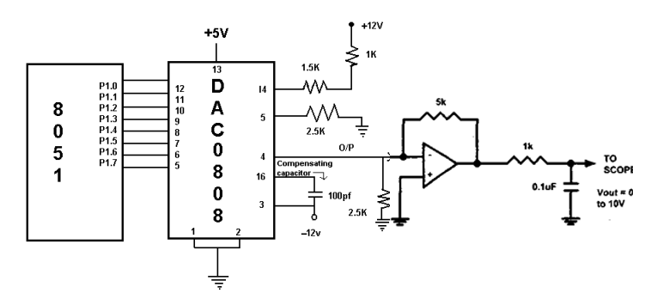
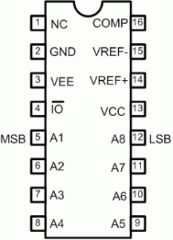
DAC INTERFACE
25

Slide 41
DIGITAL-TO-ANALOG (DAC) CONVERTER
The DAC is a device widely used to convert digital pulses to analog signals.
The two method of creating a DAC is binary weighted and R/2R ladder.
The Binary Weighted DAC, which contains one resistor or current source for each bit of the DAC connected to a summing point.
These precise voltages or currents sum to the correct output value.
This is one of the fastest conversion methods but suffers from poor accuracy because of the high precision required for each individual voltage or current.
Such high-precision resistors and current-sources are expensive, so this type of converter is usually limited to 8-bit resolution or less.
The R-2R ladder DAC, which is a binary weighted DAC that uses a repeating cascaded structure of resistor values R and 2R.

Slide 42
This improves the precision due to the relative ease of producing equal valued matched resistors (or current sources).
However, wide converters perform slowly due to increasingly large RC-constants for each added R-2R link.
The first criterion for judging a DAC is its resolution, which is a function of the number of binary inputs.
The common ones are 8, 10, and 12 bits.
The number of data bit inputs decides the resolution of the DAC since the number of analog output levels is equal to 2n , where n is the number of data bit inputs.
Therefore, an 8-input DAC such as the DAC0808 provides 256 discrete voltage (or current) levels of output.
Similarly, the 12-bit DAC provides 4096 discrete voltage levels.
There also 16-bit DACs, but they are more expensive.

Slide 43
DAC0808
The digital inputs are converter to current (Iout), and by connecting a resistor to the Iout pin, we can convert the result to voltage.
The total current provided by the Iout pin is a function of the binary numbers at the D0-D7 inputs of the DAC0808 and the reference current (Iref), and is as follows:
Usually reference current is 2mA.
Ideally we connect the output pin to a resistor, convert this current to voltage, and monitor the output on the scope.
But this can cause inaccuracy; hence an opamp is used to convert the output current to voltage.
Now assuming that Iref = 2mA, if all the inputs to the DAC are high, the maximum output current is 1.99mA.

Slide 45
Generating a sine wave with an 8051 microcontroller
Lookup Table: A sine wave can be represented as a series of discrete values stored in a lookup table. Each value in the table corresponds to the magnitude of the sine wave at a specific point in its cycle
DAC (Digital-to-Analog Converter): The 8051 microcontroller communicates with a DAC to convert the digital values from the lookup table into analog voltages. The DAC's output voltage varies based on the digital input it receives from the microcontroller.
Timing and Sampling: To generate a continuous sine wave, the microcontroller samples values from the lookup table at regular intervals. The frequency of sampling determines the frequency of the sine wave.
Scaling: The values in the lookup table need to be scaled to match the input range of the DAC. For example, if the DAC accepts values from 0 to 255 to represent 0V to a maximum voltage (e.g., 5V or 10V), the values in the lookup table must be scaled accordingly.

Slide 46
Sine Wave generation
Generate a lookup table that contains the magnitude of the sine values for angles between 0° to 360°.
The sine function varies from -1 to +1.
Since the DAC requires integer values, you can scale the sine values to fit within the DAC's input range
Consider 30° increments and calculate the values from degree to DAC input
Assuming full-scale voltage of 10V for DAC output.
V_{out} = 5V + (5 × sinθ)

Slide 47
Angle(in θ ) | sinθ | V_{out} (Voltage Magnitude) | Values sent to DAC = Vout * 25.6 [Note: 25.6=256/10 (Max volts)]
0 | 0 | 5 | 128
30 | 0.5 | 7.5 | 192
60 | 0.866 | 9.33 | 238
90 | 1.0 | 10 | 255
120 | 0.866 | 9.33 | 238
150 | 0.5 | 7.5 | 192
180 | 0 | 5 | 128
210 | -0.5 | 2.5 | 64
240 | -0.866 | 0.669 | 17
270 | -1.0 | 0 | 0
300 | -0.866 | 0.669 | 17
330 | -0.5 | 2.5 | 64
360 | 0 | 5 | 128
V_{out} = 5V + (5 × sinθ)

Slide 48
Generating Sinewave using DAC and 8051
#include<reg51.h>
sfr DAC = 0x80; //Port P0 address
void main(){
int sin_value[12] = {128,192,238,255,238,192,128,64,17,0,17,64};
int i;
while(1){
//infinite loop for sine wave
for(i = 0; i<12; i++){
DAC = sin_value[i];
}
}
}

Slide 49
Sine Wave generation for every 10 degree
#include<reg51.h>
int main()
{
int j;
int c[37]={128,150,172,192,210,226,239,248,254,255,254,248,239,226,210,192,172,150,128,106,84,64,46,30,17,8,2,0,2,8,17,30,46,64,84,106,128};
while(1)
{
for(j=0;j<37;j++)
{
P1=c[j];
}
P1=128;
}}

Slide 50
Triangle wave generation 8051 microcontroller
Create a counter variable use the counter function or for loop based counter
This counter value is then used to set the state (high or low) of a chosen output pin on the microcontroller.
Output Pin Manipulation: An output pin on the microcontroller is used to represent the voltage level of the triangle wave.
Counter and Ramp Up: At each , a counter variable is incremented. This increasing counter value is used to set the output pin to a higher voltage level, creating the rising edge of the triangle wave.
Peak and Ramp Down: Once the counter reaches a maximum value, a loop begins. Here, the counter is decremented at each step, causing the output voltage to decrease. This loop continues until the counter reaches zero.
Reset and Repeat: When the counter reaches zero, it's reset back to the maximum value. This triggers the loop again, creating the descending ramp of the triangle wave.

Slide 51
Triangular wave
#include<reg51.h>
void main()
{ int j;
while(1)
{
for(j=0;j<256;j++)
{
P0=j;
}
for(j=255;j>0;j=j--)
{
P0=j;
}
}
}

Slide 52
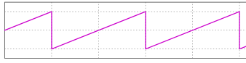
Saw-tooth Wave
Create a counter variable
This counter value is then used to set the state (high or low) of a chosen output pin on the microcontroller to generate the output voltage.
Rising Sawtooth: The counter is incremented at each step. When it reaches a pre-defined maximum value, it resets back to zero. This reset causes the output voltage to drop back down abruptly, creating the characteristic sharp rise and sudden drop of a rising sawtooth wave.
Falling Sawtooth: In this approach, the counter is decremented at each step. When it reaches zero, it's reset to a maximum value. This reset results in the output voltage jumping back up to a higher level, forming the falling edge of a falling sawtooth wave.
Loop: Repeat the process to continuously generate the sawtooth waveform.
Notes:
https://www.youtube.com/watch?v=5lz5e3YKN-Y&ab_channel=HarshaBK
https://www.youtube.com/watch?v=d4-8Q7MzkGw&ab_channel=Dr.ArtiParab

Slide 53
Saw tooth or Ramp Waveform
#include<reg51.h>
void main()
{
int j;
while(1)
{
for(j=0;j<256;j++)
{
P1=j;
}}}

Slide 54
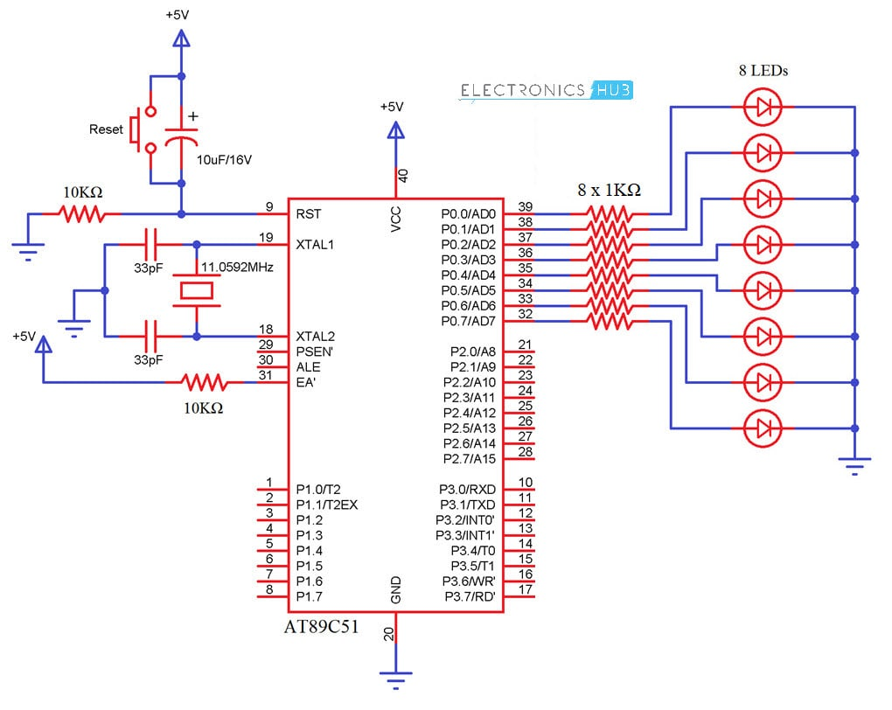
LED Interfacing

Slide 55

LED is connected to the AT89C51 microcontroller with the help of a current limiting resistor. The value of this resistor is calculated using the following formula.
R= (V-1.7)/10mA, where V is the input voltage.
Generally, microcontrollers output a maximum voltage of 5V. Thus, the value of the resistor calculated for this is 330 Ohms. This resistor can be connected to either the cathode or the anode of the LED.

Slide 56
LED interfacing code for toggling all the 8-bits and display binary number
#include<reg51.h>
#define led P0
unsigned char i=0;
void delay (int);
void delay (int d)
{
unsigned char i=0;
for(;d>0;d--)
{
for(i=250;i>0;i--);
for(i=248;i>0;i--);
}
}

Slide 57
void main()
{
while(1) //// led blink
{
led=0xff;
delay(1000);
led=0x00;
delay(1000);
++i;
if(i==7) // seven times toggling happens
{
i=0;
break;
}
}

Slide 58
while(1) //// binary equivalent representation of 1byte data
{
led=i++;
if(i==256)
{
i=0;
break;
}
delay(500);
}
while(1);
}

Slide 59
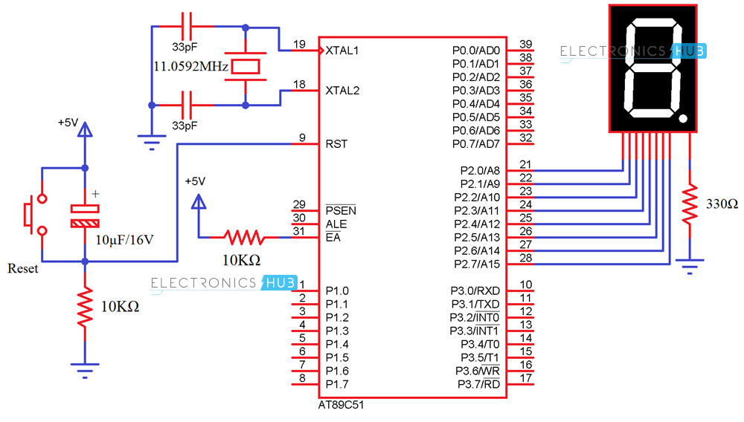
Interfacing 7 Segment Display to 8051 (Single Digit)

Slide 60
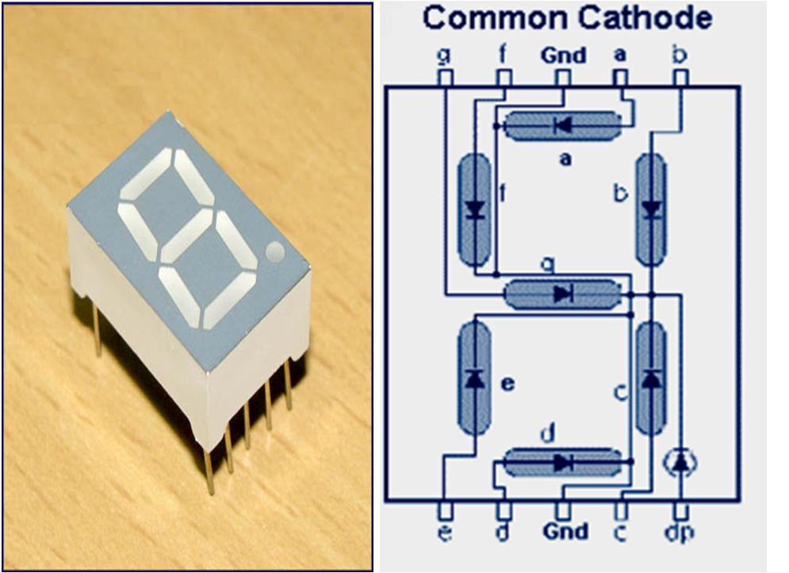

Slide 61
The below table show you the Hex decimal values what we need to send from PORT2 to Display the digits from 0 to 9.
DIGIT | DP | G | F | E | D | C | B | A | HEX VALUE
0 | 0 | 0 | 1 | 1 | 1 | 1 | 1 | 1 | 0x3f
1 | 0 | 0 | 0 | 0 | 0 | 1 | 1 | 0 | 0x06
2 | 0 | 1 | 0 | 1 | 1 | 0 | 1 | 1 | 0x5b
3 | 0 | 1 | 0 | 0 | 1 | 1 | 1 | 1 | 0x4f
4 | 0 | 1 | 1 | 0 | 0 | 1 | 1 | 0 | 0x66
5 | 0 | 1 | 1 | 0 | 1 | 1 | 0 | 1 | 0x6d
6 | 0 | 1 | 1 | 1 | 1 | 1 | 0 | 1 | 0x7d
7 | 0 | 0 | 0 | 0 | 0 | 1 | 1 | 1 | 0x07
8 | 0 | 1 | 1 | 1 | 1 | 1 | 1 | 1 | 0x7f
9 | 0 | 1 | 1 | 0 | 0 | 1 | 1 | 1 | 0x67

Slide 62
First initialize all the segment hex values of the digits in an array.
unsigned char arr[10]={0x3f,0x06,0x5b,0x4f,0x66,0x6d,0x7d,0x07,0x7f,0x67};
Now take for loop and assign array values to the PORT2 with some time delay.
for (i=0;i<10;i++)
{
P2=arr[i];
delay_ms(500);
}
Task: Interfacing 7 Segment Display to 8051 (4-Digit)

